Slide 1
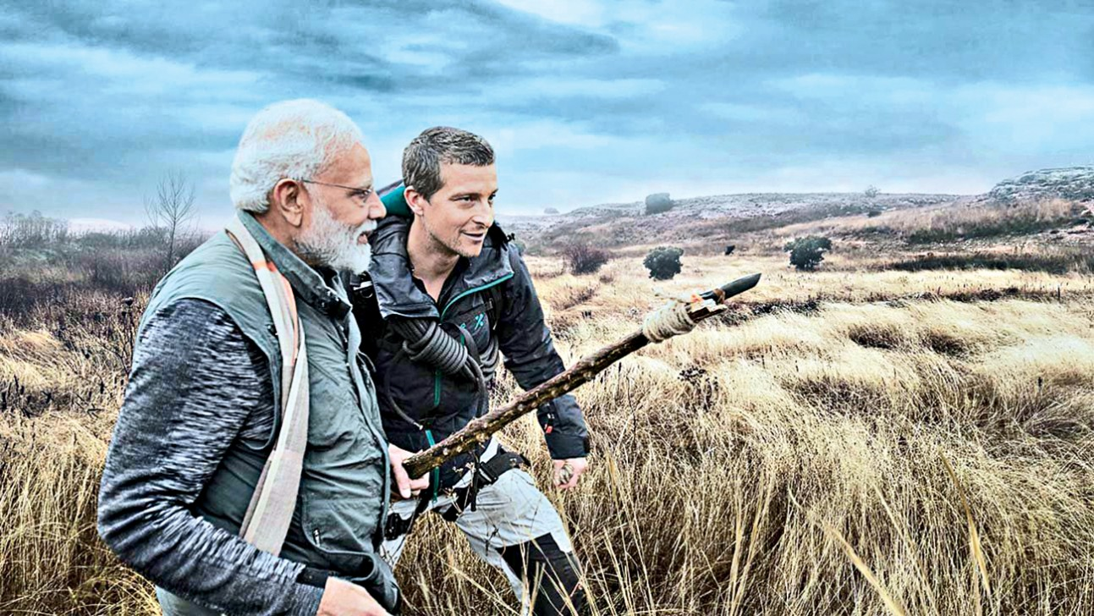
Surviving Serpentine Sufferings A Case Series
Dr.ARJUN.H.M.
JR 2
EMERGENCY MEDICINE

Slide 2
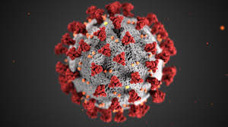
COVID-19
Notes:
1.We all know that YCM Hospital closed for non covid cases since April.
2.we are presenting 16 cases of snake envenomation who were
Succesfully managed in Emegrency Department during the period of april to july

Slide 3
Agenda
Introduction
Indian Guidelines
Investigations
Therapies
Our Case series
Take home
Notes:
1. We will first start with a brief introduction of the topic along with the indian guidelines ,investigations and therapies.
2.Then we will discuss our case series and will conclude with a take home message

Slide 4
INTRODUCTION
In India , 2.8 million people are bitten by snakes, and 46 900 people die from snakebite every year
About 94% of snakebite deaths occurred in rural areas, and 77% occurred out of hospital
Russell’s viper-43%
unknown species- 21%
krait-18%
cobra-12%
Suraweera W, Warrell D, et al. Trends in snakebite deaths in India from 2000 to 2019 in a nationally representative mortality study. Elife. 2020 Jul 7;9:e54076. doi: 10.7554/eLife.54076.
Notes:
1. In India 2.8 million people are bitten by snakes and almost fifty thousand patients die every year from snake bites.
2-its is a predominantly rural condition with 94% cases occuring in rural areas and most of the victims die before reaching the hospital
3-Viper bite is most common and many patients cannot identify the snake

Slide 5
- “CARRY NO R.I.G.H.T.”
CARRY = Just carry the victim don’t let him walk or run
No = Tourniquet ; No-electrotherapy ;
No-cutting; No-pressure immobilization;
No-sucking of venom
R = Reassure the patient
I = Immobilize the limb as for a fracture.
G.H. = Get to the hospital immediately.
T = Tell the doctor about any systemic symptoms that may have been observed.
Mohan G, Singh A, Singh T. Guidelines for the Management of Snakebites. Curr Trends Diagn Treat 2018;2(2):102-108.
Notes:
We suggest a simple mnemonic as CARRY NO right which includes that we should first
CARRY = Do not allow victim to walk even for a short distance; just carry him in any form, especially when bite is at leg.
No = Tourniquet5 ; No-electrotherapy7 ; No-cutting; No-pressure immobilization; No-sucking of venom
● Approximately 65-70% of total snakebite cases are due to non-venomous snakes.
● Only 50% of venomous snakebites actually cause envenomation.
● Approximately 85-90% of venomous bites do not develop any signs and symptoms of envenoming.
● Use cloth to hold the splints in place.
● Don’t apply too much pressure, as this can block the blood supply.
● Don’t apply any compression in the form of tight ligatures, as these are ineffective and can be dangerous.

Slide 6
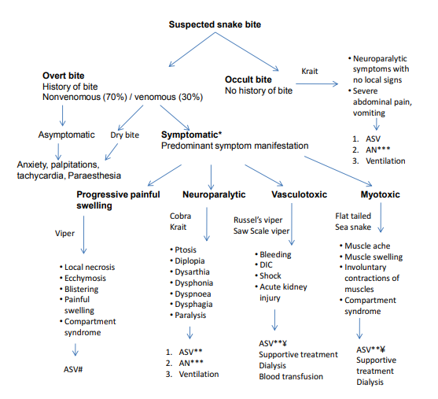
Indian Guidelines

Slide 7
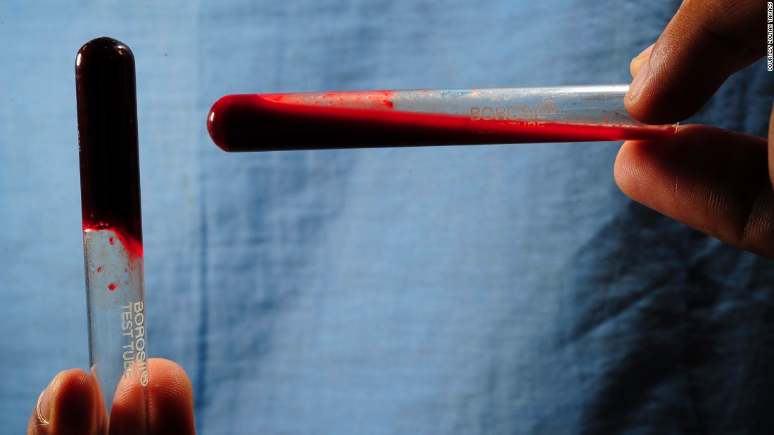
Investigations
Neuroparalytic : single breath count,neck holding
Vasculotoxic : Coagulation profile and hemolysis profile
20minWBCT
Cardiotoxicity: Cardiac enzymes
Myotoxic : Muscle enzymes
Notes:
1. For coagulopathy- BT, CT, PT, APTT, Platelet, Serum Fibrinogen, FDP D- Dimer assay, LDH, peripheral blood smear
2. Urine for myoglobin, Urine haemoglobinUrine microscopy for RBC, casts, RFT, urinary proteins Hepatic
3. CPK-MB, 2D Echo, BNP
4. CPK, SGOT, Urine myoglobin, compartment pressure
wbct
Take 2 ml blood of patient in plain test tube.
Wait 20 min
If clotting then normal
If no clotting test is positive for hemotoxicity
Repeat 6 hour after administration of loading dose of ASV.
If clotted, repeat every hour for first 3 hours and every 6 hours for remaining 24 hours.

Slide 8
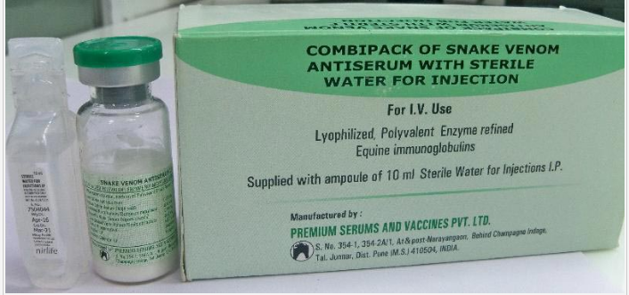
Anti Snake Venom(ASV)
Polyvalent equine antivenom against 4 common species found in India
1 vial Neutralises : 0.6 mg of dried Indian cobra and Russell’s viper venom whereas 0.45 mg of saw-scaled viper and common krait venom
15 mg of Russell’s venom is fatal
One bite delivers 63 mg (approx)
So 0.6 mg per vial x 10 = 60 mg the initial dose
Notes:
one bite of russels viper delivers around 50mg of venom
ASV Regimen
Two regimens
Low Dose infusion therapy – 10 vials Stat and 2 vials 6 hourly till clotting time normalizes or for 3 days whichever is earlier.
OR
High dose intermittent bolus therapy - 10 vials followed by 6 vials 6 hourly as till clotting time normalizes and/or local swelling subsides.

Slide 9
ASV Reaction
Early anaphylactic reactions
Pyrogenic reactions
Late (serum sickness–type) reactions
Management is same as any other anaphylactic reaction followed by restarting the ASV infusion
Notes:
Early anaphylactic reactions: occurs within 10–180 min. Characterized by itching, urticaria, dry cough, nausea and vomiting, abdominal colic, diarrhoea, tachycardia, and fever.
A minority of these patients may develop severe life-threatening anaphylaxis, hypotension, bronchospasm and angio-oedema.
Pyrogenic reactions: usually develop 1–2 h after treatment. Symptoms include chills and rigors, fever, and hypotension. These reactions are caused by contamination of the ASV with pyrogens during the manufacturing process.
Late (serum sickness–type) reactions: develop 1–12 (mean 7) days after treatment. Clinical features include fever, nausea, vomiting, diarrhoea, itching, recurrent urticaria, arthralgia, myalgia, lymphadenopathy, immune complex nephritis and, rarely, encephalopathy.

Slide 10
DESENSITIZATION
1 | Dilute 1 ml of ASV in 10 ml NS | 10ml | A
2 | 1ml of solution A + 9ml NS | 10ml | B | 1:10
3 | 1ml of solution B + 9ml NS | 10ml | C | 1:100
4 | 1ml of solution C + 9ml NS | 10ml | D | 1:1000
5 | 1ml of solution D + 9ml NS | 10ml | E | 1:10000

Slide 12
Important points for ASV
No absolute contraindications
NO TEST DOSE
Only to be given IV.
No local infiltration to be done.
Children and Pregnant women have the same dosage.
ASV in patient requiring lifesaving surgeries can go up to 30 vials.

Slide 13
Other therapies
Forced Alkaline Diuresis(FAD)
Give a trial of FAD within first 24 hours of the bite to avoid pigment nephropathy, which leads to ATN.
Local Treatment
Magnesium suphate compress
Limb elevation
Broad spectrum antibiotic
Fasciotomy
Notes:
Inj. Frusemide 40 mg IV stat
Inj. Normal saline 500 ml + 20 ml of NaHCO3 over 20 minutes
Inj. Ringer’s lactate 500 ml + 20 ml of NaHCO3 over 20 minutes
Inj. 5% dextrose 500 ml + 10 ml of Potassium Chloride over 90 minutes
Inj. Mannitol 150 ml over 20 min
Whole cycle completes in 2 h 30 min and urine output of 3 ml/min is expected.
If patient responds to first cycle continue for 3 cycles. FAD converts oliguria into polyuria and avoid ATN and acute kidney injury needing dialysis in more than 75% patients.
– If there is no response to furosemide discontinue FAD and refer patient immediately to a higher center for dialysis.

Slide 14
Our Study
16 cases from April to july
Succefully managed at our department

Slide 15
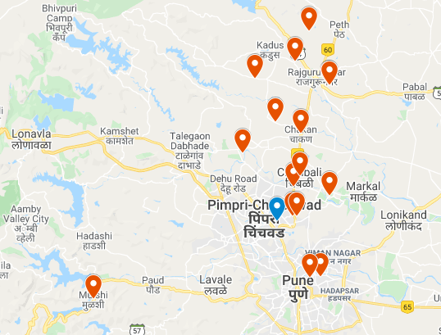
Location of encounter with snake
Notes:
Most of the cases were from the khed district but we also got cases from the posh areas of pune like koregaon park

Slide 16
Pain Swelling Bleeding Neurologic None
Notes:
Most common symptoms were pain and swelling but six patients had no symptoms
Most had normal GCS but 3 had GCS 8 and below at presentation
5 patients had deranged initial WBCT and one patient required repeat dose of ASV before to normalize his WBCT
1 patient presented with compartment syndrome

Slide 17
Yes No
Yes No
Yes No
Yes No
Notes:
We had to intubate 5 patients due to features of neurotoxicity
We considered dry bite in 5 patients and ASV was not given although some of them initially got incomplete doses of ASV from the referring centre. Seems like the local centers are not aware of the guidelines. 2 patients directly reported to us and were not given ASV as had no symptoms. We gave initial full dose of ASV to 9 patients and one patient required repeat dose
All the 5 patients with neurotoxicity were given atropine-neostigmine
2 received FFP and 1 was given FAD

Slide 18
Special cases to mention
A 42 year old male with Snake bite
WBCT>20 minutes
No neurological signs
Responded to ASV
The snake he brought with him was ..............

Slide 19
COBRA

Slide 20
Special cases to mention
45 year old female
C/O progressive weakness,aphasia,ptosis
Intubated in EM- two complete doses of ASV and 5 doses of AN
Extubated in EM-Discharged
Suspect Occult bite in sudden onset generalised weakness with ptosis !!!!

Slide 21
Special cases to mention
25 year old female
C/O drowsiness,heaviness of all 4 limbs,diplopia,aphasia
Intubated inEM two complete doses of ASV and 3 doses of AN but there was no improvement
INJ Calcium Gluconate10ml IV given and GCS improved
Transferred to MICU-Extubated-Discharged
Neurotoxic manifestations in Krait bite are due to presynaptic inhibition, where calcium acts as a neurotransmitter
Notes:
Give Inj. Calcium gluconate 10ml IV (in children 1-2 ml/kg (1:1 dilution) slowly over 5-10 min every 6 hourly and continue till neuroparalysis recovers which may last for 5-7 days.
2. Neurotoxic manifestations in Krait bite are due to presynaptic inhibition, where calcium acts as a neurotransmitter; as a result, neurotoxic manifestations doesn't respond to Atropine neostigmine therapy but can respond to Injection Calcium gluconate therapy

Slide 22
Special cases to mention
22 year old male
H/O snake bite at 3:00AM,C/O one episode of vomiting,diplopia,difficulty in speech and breathing
Intubated in EM 2 complete doses of ASV and AN,Calcium Gluconate-no response
Transfered To MICU –Patient improving
Variant of Krait-‘Sind Krait’ (Bungarus cf. sindanus)

Slide 23
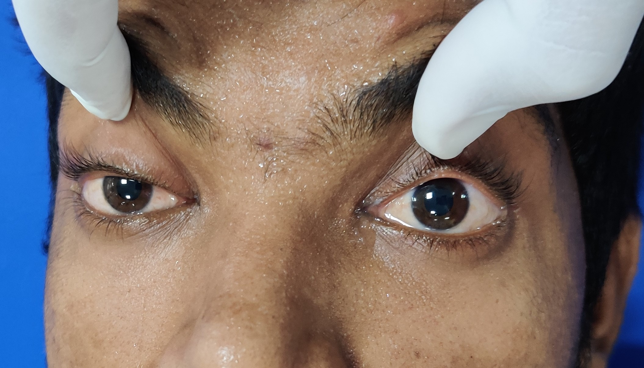

Slide 24
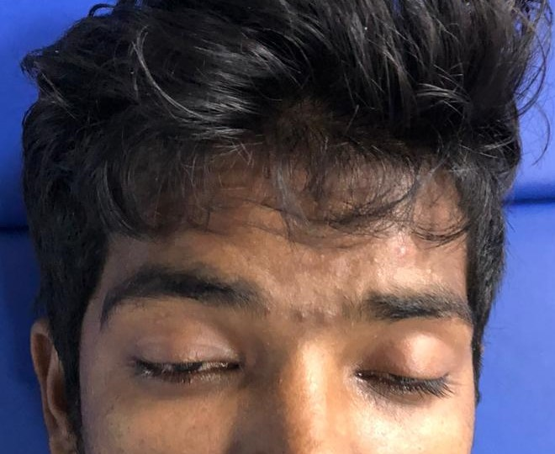
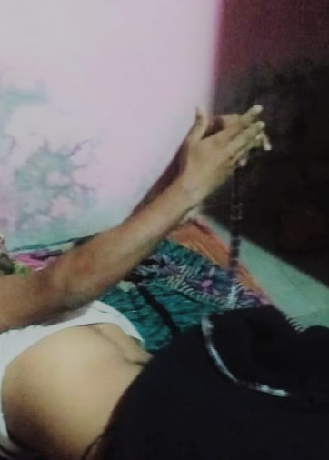
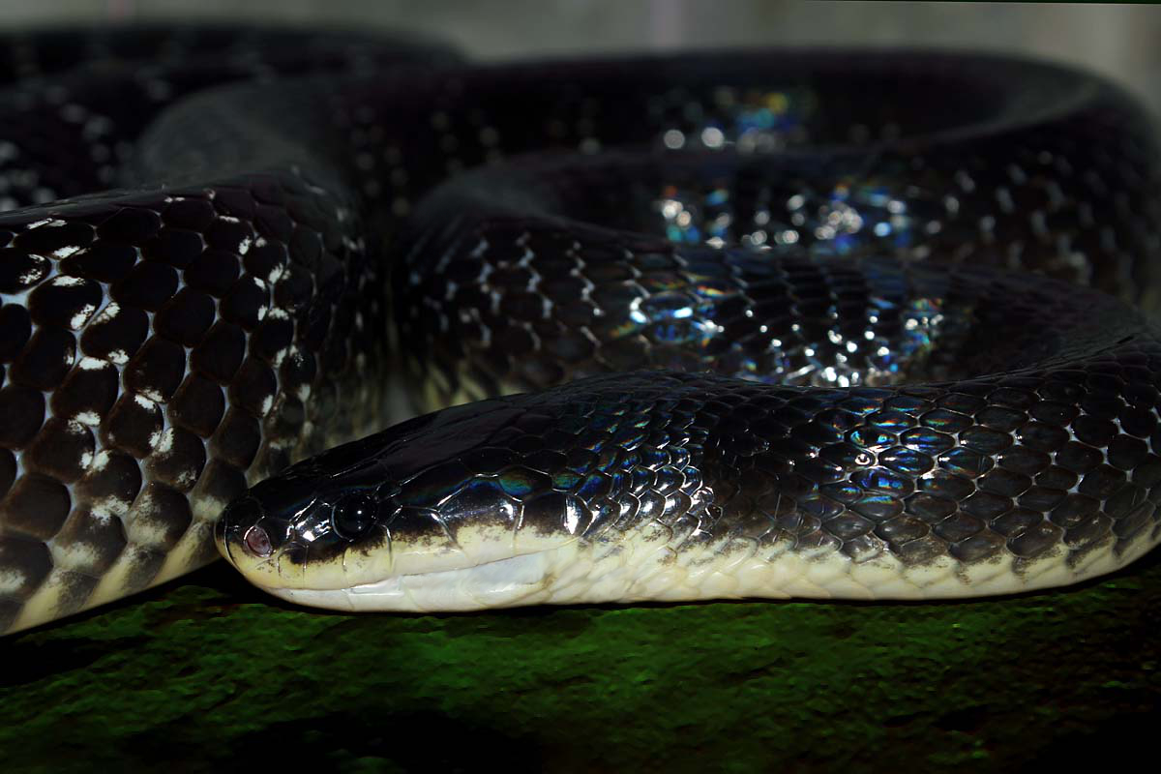
Notes:
Case report Severe Neurotoxic Envenoming and Cardi TMH ac Complications after the Bite of a ‘Sind Krait’ (Bungarus cf. sindanus) in Maharashtra, India

Slide 25
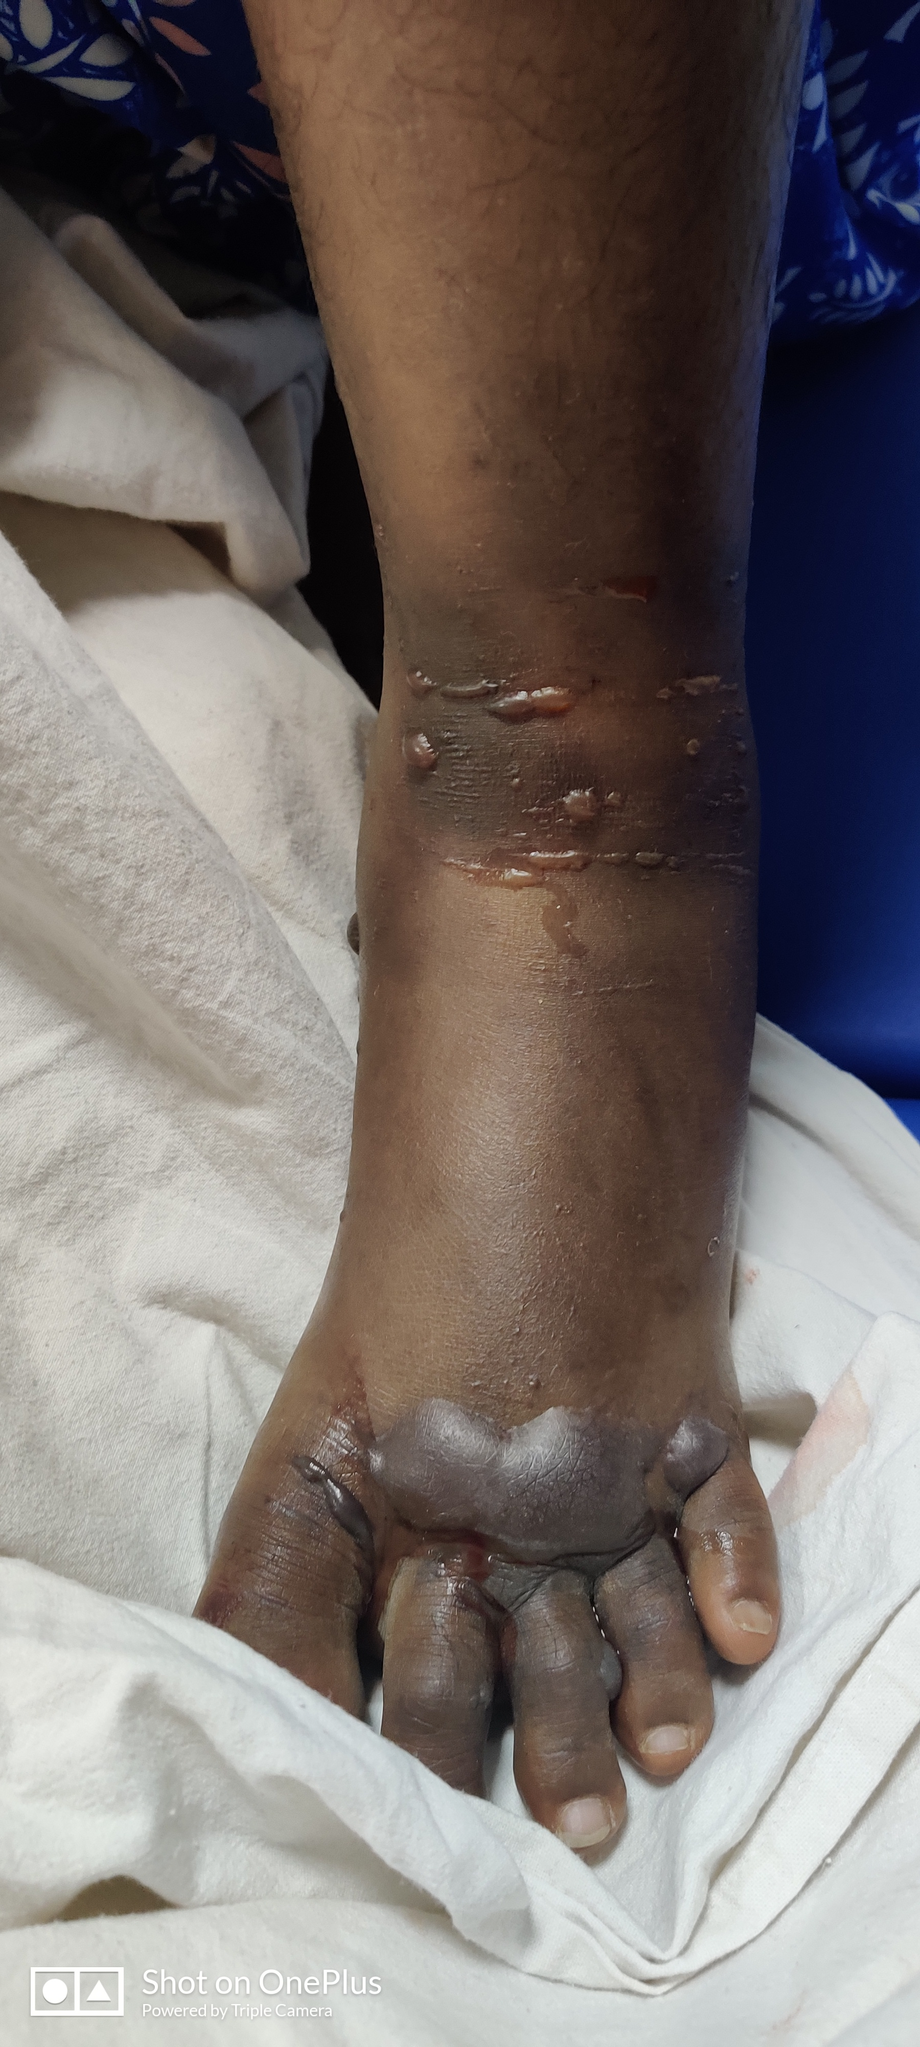
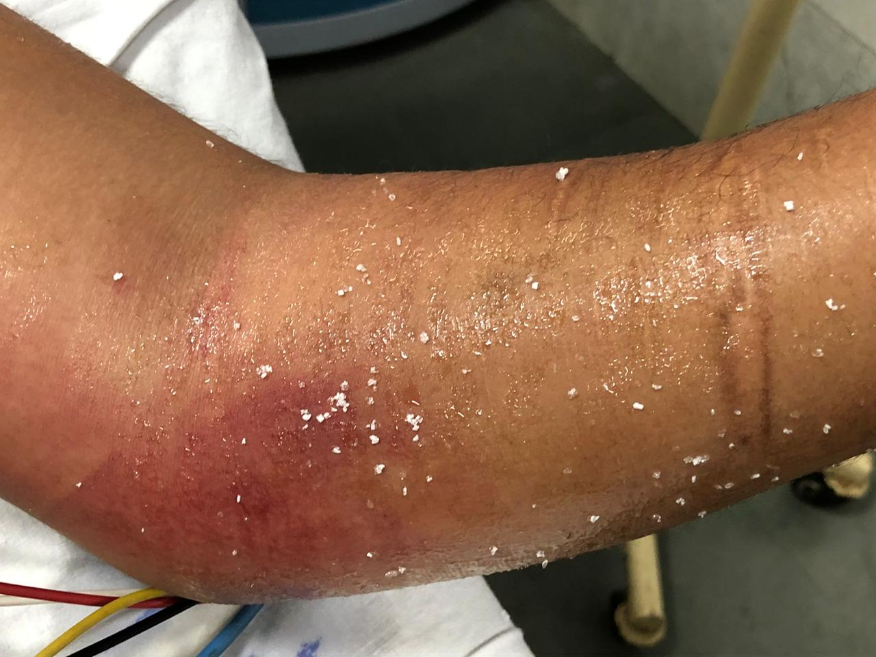
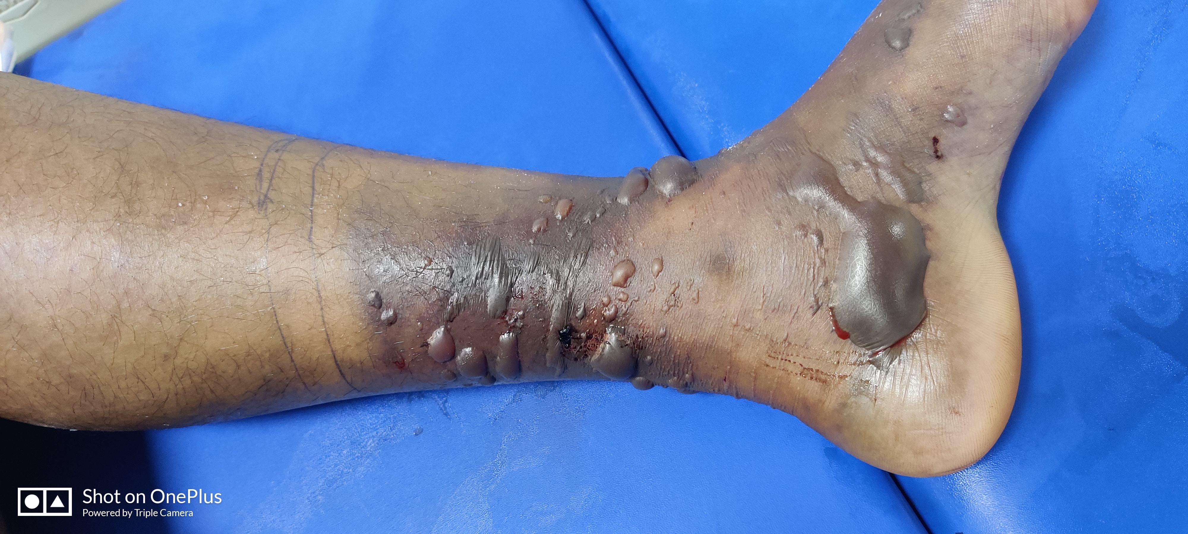

Slide 26
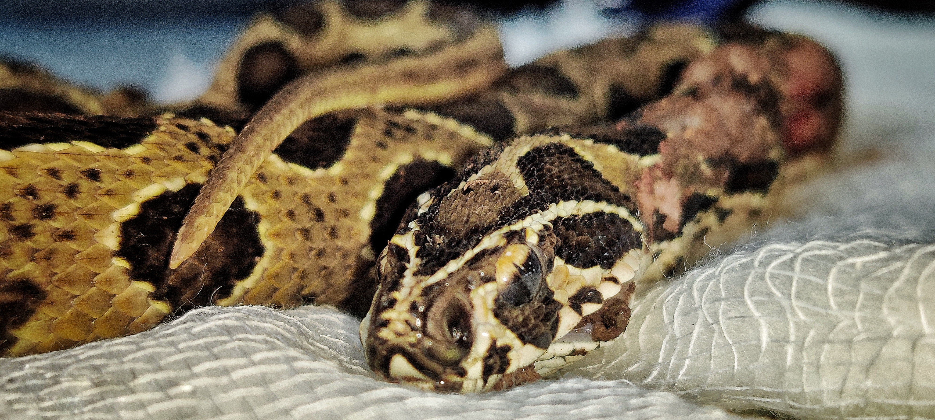
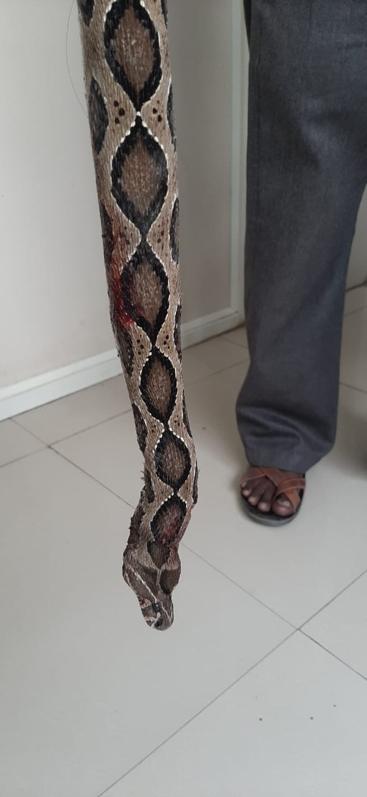
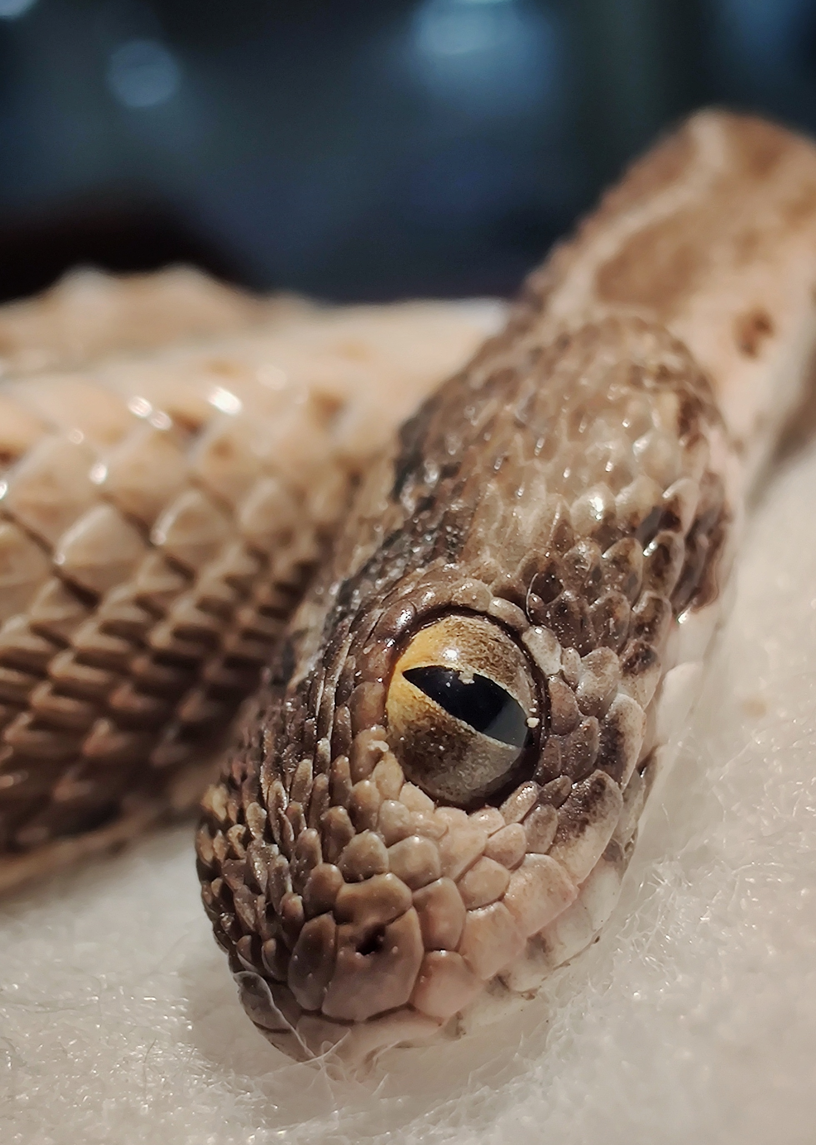
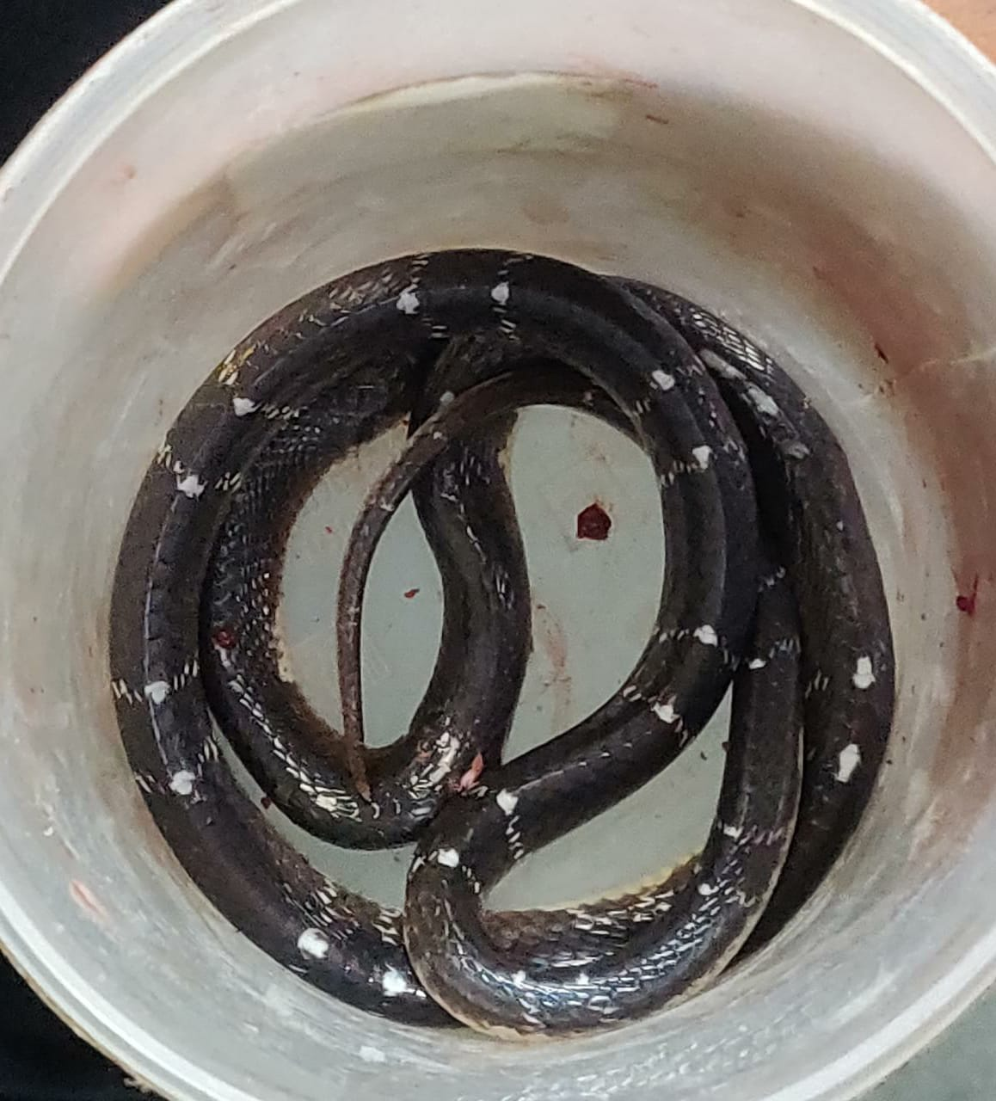
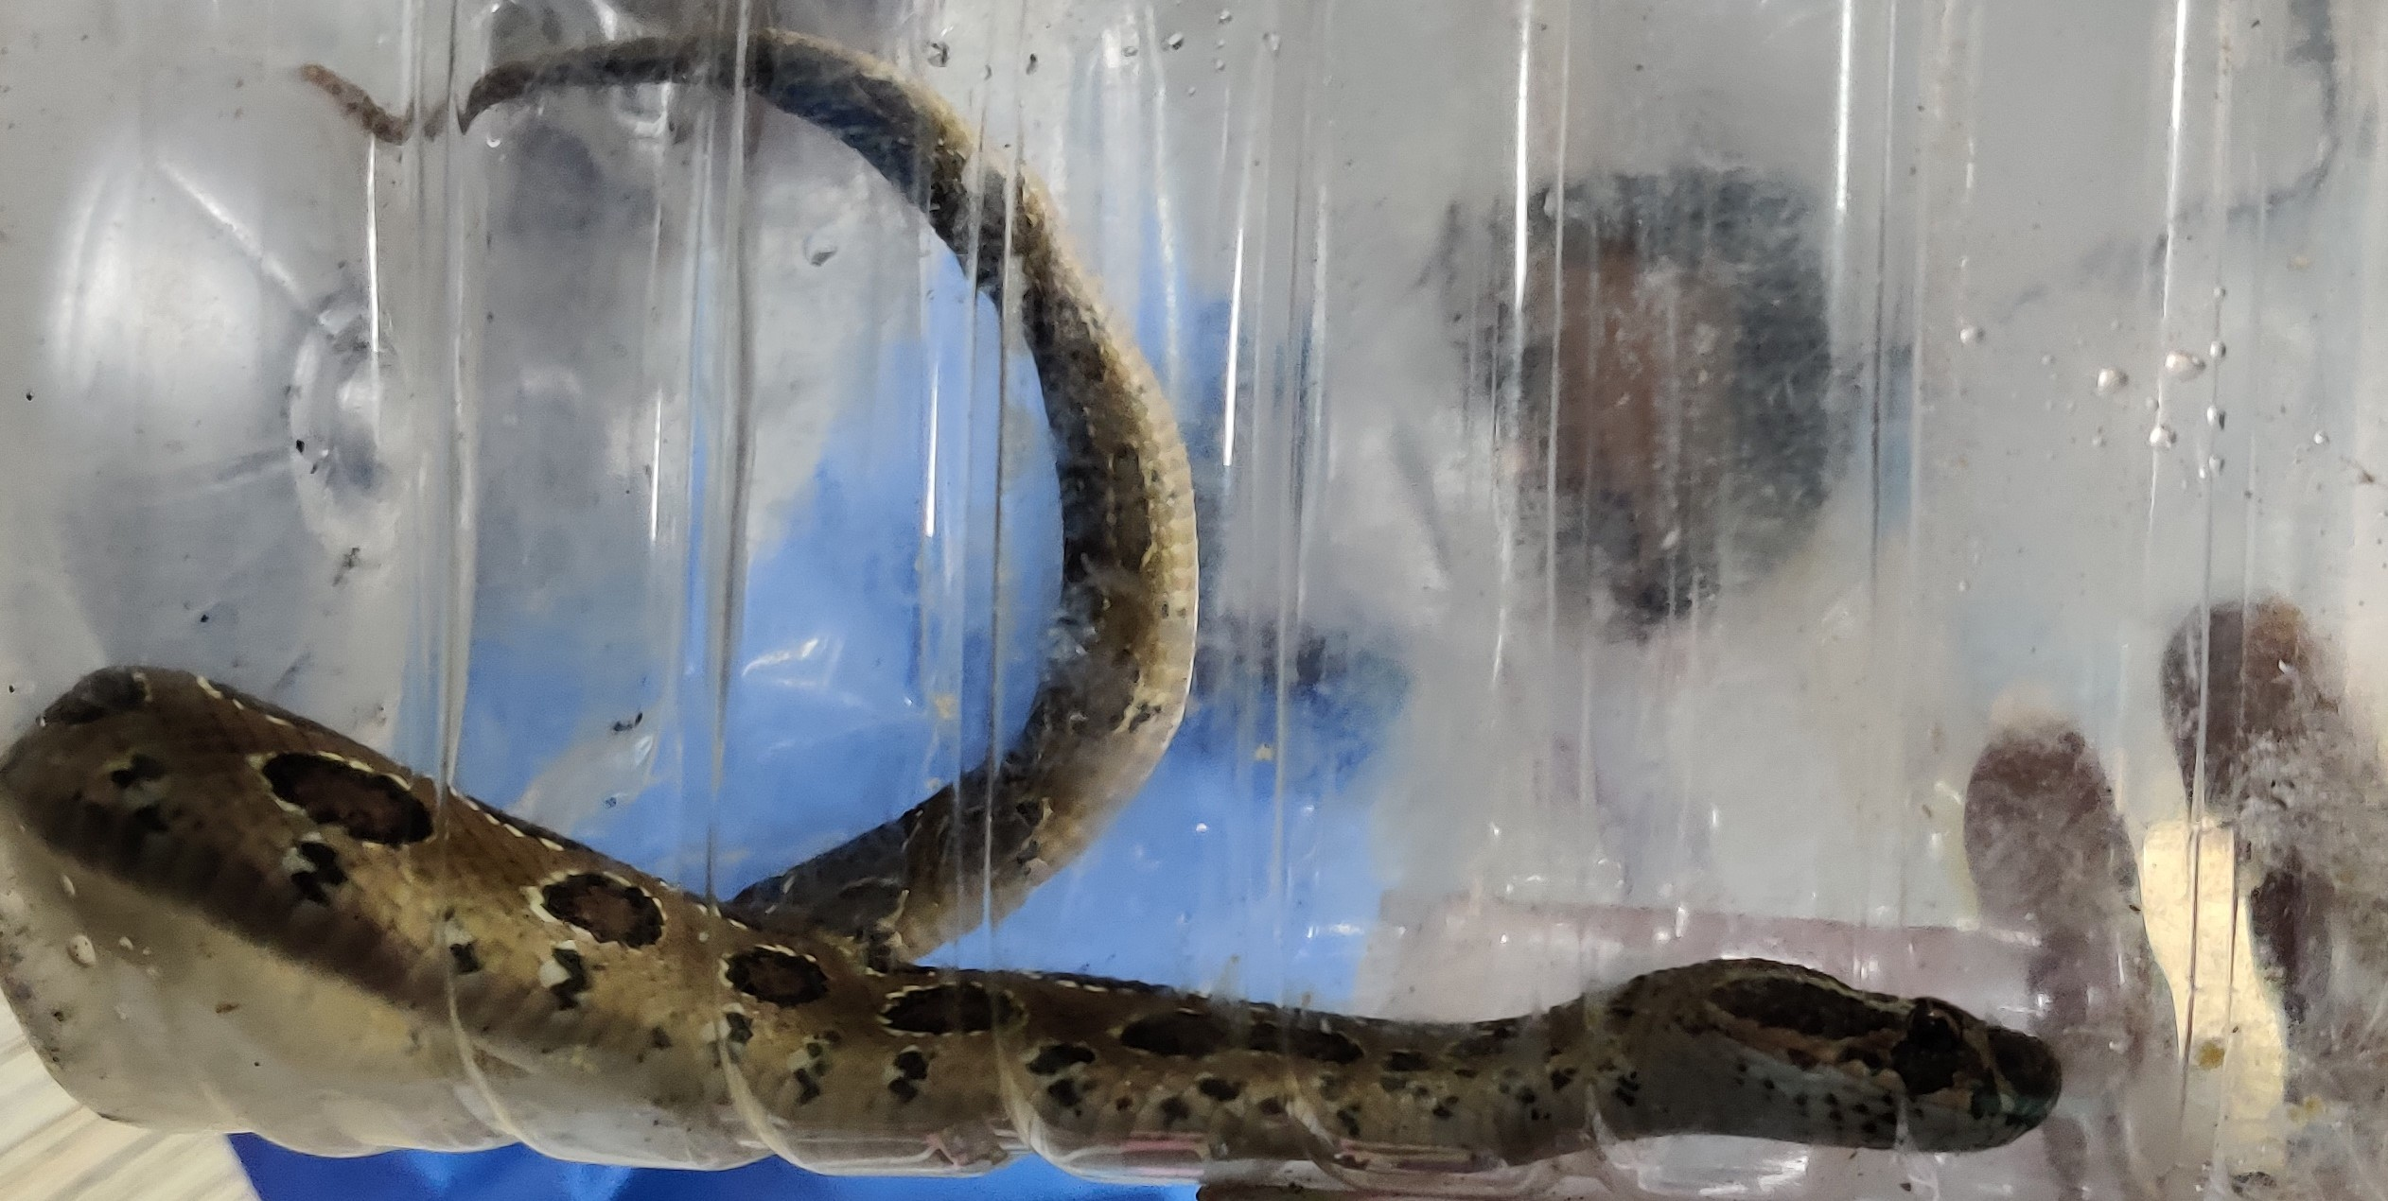

Slide 27
Important points
Bilateral dilated, poorly or a non-reacting pupil is not the sign of brain dead in elapid (cobra and krait) envenoming
Arterial puncture is contraindicated in patients with haemostatic abnormalities
ASV-Does not provide protection against Humped nosed Viper venom
Dose of ASV is same in children and pregnant women
In severe cases recently expired antivenom may be used if there is no alternative (WHO 2015).
Don’t try to kill the snake or handle dead snake especially pit vipers

Slide 28
Take home
Always start with 10 vials of ASV
Suspect snake bite in sudden onset neuroparalytic symptoms
Remember “CARRY NO RIGHT”
70 % are non-venomous bites and require no treatment
Cases have excellent survival if treated properly

Slide 29
Acknowledgements
Department of Medicine
Department of Pediatrics
Department of Surgery
YCMH for providing free ASV

Slide 30
THANK YOU

