Slide 1
CLINICAL MEETING AUG ‘20
Department of Psychiatry

Slide 2
AN INTERESTING CASE OF VIOLENT AND IMPULSIVE BEHAVIOUR
DR. MADHURA SAMUDRA
RESIDENT

Slide 3
THE CASE
A 35 year old male, graduated in Theology, married since 11 years was brought to the Psychiatry OPD by mother with complaints of – irritability and aggressive behaviour excessive consumption of alcohol mood instability impulsive behaviour reduced sleep decreased social interaction crying spells headache self harm behaviour
Symptoms were insidious in onset and episodic in nature.
Since past 4 years, increased in frequency in the past 2 years
Since 6 months

Slide 4
HISTORY OF PRESENT ILLNESS
Patient was apparently alright 4 years ago when a leopard allegedly invaded his poultry farm and ate his hens due to which he suffered financial loss in his business; he started drinking alcohol to cope with this, which was against his theological ethics. He would drink all day and would often become abusive or aggressive on minor provocations.
In August 2016, patient had a physical altercation with his sister in an intoxicated state and reported to have no memory of this incident.
In November 2016, patient’s extramarital affair ended after he discovered his partner had cheated on him. He allegedly tied her to his car and beat her, after which he drove her to the hospital. He felt bad for it but also conveyed that she deserved to be punished.
There is history of few more similar incidents in the following 2 years.

Slide 5
In 2018, patient had a physical altercation with his friend under influence of alcohol and had no memory of it the next day. Patient reported to file a police inquiry against his own name and allegedly tried to harm himself by slashing his wrists after finding out.
A few months later, patient’s friend passed a lewd comment on a female passerby when he allegedly broke his friend’s nose.
In 2019, his neighbor scolded his son after which the patient allegedly tried to throw the neighbor off their terrace until he was stopped by the bystanders.
In March 2020, patient allegedly abused his girlfriend physically until she had to be hospitalized.

Slide 6
Since the lockdown, patient’s mother noticed he was quieter than usual and would stay alone in his room. He expressed guilt over these past incidents and would say he wished to die. He was also sleeping and eating less.
There is h/o two self harm attempts by suffocating himself in the past one month, with the intent to die but was unsuccessful as he was interrupted by his wife both times.

Slide 7
PAST HISTORY
H/o head injury after an RTA in 2015 not associated with seizures / LOC / ENT bleed.
K/c/o seizure disorder since 4 years on T. Levetiracetam 500mg, Tab Clobazam 10mg. Last seizure : 31st may 2020.
No other comorbidities / significant surgical / psychiatric history in the past.

Slide 8
FAMILY HISTORY
Father is a known case of psychotic illness since 28years; was given 12 cycles of ECTs and is currently maintaining well off Rx. H/o Alcohol consumption in father since 20years.

Slide 9
PERSONAL HISTORY
H/o multiple complaints of physical altercations in school and college with his peers over issues like misbehaviour towards elderly and women for which he was expelled.
After graduation, he worked as a pastor and community preacher for 10 years. He started his poultry farm business in 2014 and was working as a part time model and boxer. He is currently working as a bouncer in a Private company.

Slide 10
Patient got married 11 years ago by arranged marriage, and gives h/o interpersonal issues with wife within one year. He allegedly had two extra marital affairs and is currently involved with someone since two years.
H/o consumption of alcohol since 4 years, daily consumption of 1-1.5 bottles of whiskey; H/o cigarette smoking since 2017, occasionally. Pt gives a/h/o consumption of cocaine by snorting on 2 occasions and injecting steroids while he was training to become a boxer.

Slide 11
PHYSICAL EXAMINATION
His general physical and systemic examination was within normal limits.
A 2x8cm scar seen over right forehead. FRONTAL ASSESSMENT BATTERY SCORE was normal.

Slide 12
MENTAL STATUS EXAMINATION
Patient was communicative, had normal speech and psychomotor activity. He conveyed his mood as sad with a euthymic affect with normal range and reactivity.
Ideas of grandiose ability + identity seen with ideas of guilt with H/H/W. Active suicidal ideas + No perceptual abnormality noted with a partial insight and impaired social judgment.

Slide 13
SUMMARY
Mr P, a 35 year old well educated, married male brought by mother with complaints of impulsive and abusive behaviour, excessive alcohol consumption, reduced sleep since 4 years followed by decreased social interaction and self harm behaviour in the past 6 months; episodic and gradually progressive in nature; with a past history of head injury and a seizure disorder on Rx, history of misconduct during childhood and family history of psychiatric illness. General physical examination revealed no abnormality; with a depressed mood, ideas of grandiosity, guilt and self harm on MSE. Provisional diagnosis according to ICD 10 – Emotionally unstable personality disorder (F60.3)

Slide 14
INVESTIGATIONS
Lab investigations were all within normal limits
MRI Brain showed few hyperintensities in bilateral frontal and peri-trigonal subcortical white matter along with ill defined FLAIR hyperintensities in left posterior temporo-occipital region s/o old infarct or gliosis.
EEG brain was abnormal and showed multifocal epileptiform discharge over both hemispheres with secondary incomplete generalization.

Slide 15
TREATMENT
Patient was started on Tab Risperidone 2mg HS. Mother reported significant improvement in irritability during his stay in the ward. Sodium valproate was considered as a mood stabilizer.
Neurology reference was done i/v/o MRI and EEG changes, Tab Sodium valproate 500mg HS was added and cross tapered with Tab Levetiracetam.
Patient was discharged on Tab Risperidone 4mg HS + Tab Sodium Valproate 500mg 1 – 0 – 2 + Tab Clobazam 10mg HS.
He is currently maintaining well on the above medication.

Slide 16
DISCUSSION
ICD 10 defines EUPD as a personality d/o with a marked tendency to act impulsively without consideration of the consequences, together with affective instability. Their outbursts of intense anger may often lead to violence or “behavioural explosions”. Emotionally unstable PD (BPD) patients are particularly known for their wide range of impulsive and risky behaviours. The rate of prevalence of impulsive behaviours is very high in BPD, ranging from 43% to 99%.
The key features of the definition refer to a pattern of behaviour rather than a single act; rapid unplanned reactions that occur before the opportunity to consciously weigh the consequences of an act.

Slide 17
DIAGNOSTIC CRITERIA
A pattern of unstable and intense interpersonal relationships
Disturbed self image / sense of self
Impulsivity in atleast two areas that are potentially self damaging (spending, sex, substance use, reckless driving, binge eating etc.)
Recurrent suicidal behaviour, threats, gestures or self mutilating behaviour
Emotional instability
Chronic feelings of emptiness
Inappropriate, intense anger or difficulty controlling it (eg. frequent displays of temper, recurrent physical fights)
Transient stress related paranoid ideation or dissociative symptoms
Frantic efforts to avoid real or imagined abandonment

Slide 18
TAKE HOME MESSAGE
Patients with seizure disorder (complex partial seizures or temporal lobe epilepsy) often have overlapping presentations with abnormal behavioural patterns commonly seen in EUPD (Borderline / Antisocial PD).
A detailed history and thorough evaluation can help resolve this conflict.

Slide 19
Thank you

Slide 20
CATATONIA AN UNUSUAL PRESENTATION OF WILSON’S DISEASE
DR. SUPRIYA DAVIS
RESIDENT

Slide 21
The case
An 18 yr old, Ms. D, studying in 12th std, from Dighi was brought to psychiatry OPD with complaints of:
Irritability
Low mood with crying spells
Reduced social interaction and interest in activities
Tremulousness
Drooling of saliva
Difficulty in walking
Maintaining abnormal posture
Disturbed sleep and appetite
x 6 months,
Increased since 3 months
x 10 days

Slide 22
History of presenting illness
Patient was apparently all right 6 months back when her parents started noticing that she was getting irritable on trivial matters and would start crying even on minimal provocation. These changes were also noticed by her college friends and they mentioned she was staying more aloof than usual.
Mother gives h/o IP issues between them over patient’s arrogant behaviour. One day following an altercation, patient stormed off and allegedly consumed half a cup of floor disinfectant. She was then rushed to the hospital for management.

Slide 23
Following this incident, patient started keeping to herself and would not interact with her family. Around 3 months ago, her mother discovered that she was involved with a boy from college and read a few abusive messages the boy had sent her. When patient was confronted about the same, she denied any such involvement and became agitated.
Her symptoms gradually worsened so much so that her parents found her crying most of the day. She would get anxious and breathless even if approached by her mother for a regular conversation.
Since 10 days, patient would tell her mother she was unable to write anything in college due to tremors in her hands and stopped going to college altogether. Her mother initially thought she was making excuses to not study, but noticed her hands used to tremble and she wasn’t able to hold anything for long.

Slide 24
Family members noticed progressive slowing in her activities along with frequent staring episodes. She would respond to her name only after being called 4-5 times. Gradually, her upper limbs started becoming stiff and the tremulousness worsened.
She was unable to eat as she could not close her mouth and had drooling of saliva. Her forearms remained flexed in uncomfortable positions for long periods without discomfort. She was unable to sleep due to these symptoms.
She was then taken to an Ayurvedic doctor where she was given some medication but showed no improvement after a week. Her symptoms only got worse and her food intake drastically reduced, due to which her parents got her to Medicine OPD in DYPMC and was subsequently referred to Psychiatry OPD to rule out dissociative disorder.

Slide 25
Background
No past medical/surgical history.
No family history of any psychiatric/neurological/medical/surgical illness.
No history of substance abuse.

Slide 26
Physical examination
Cardiovascular, Respiratory system and per abdomen examination were WNL
CNS:
Higher mental functions: Could not be assessed as pt was uncooperative.
Sensory system: Sensation to pain, touch and temperature was present.
Motor system:
Power: 3/5 Tone: Rigidity present in bilateral upper limbs with abnormal posturing and active resistance to manoeuvrings. Dystonia present in upper limbs. Nutrition: Normal

Slide 27
All reflexes were brisk.
Cerebellum:
Unable to assess due to rigidity.
Gait: Ataxia and unable to walk without support due to weakness in lower limbs.

Slide 28
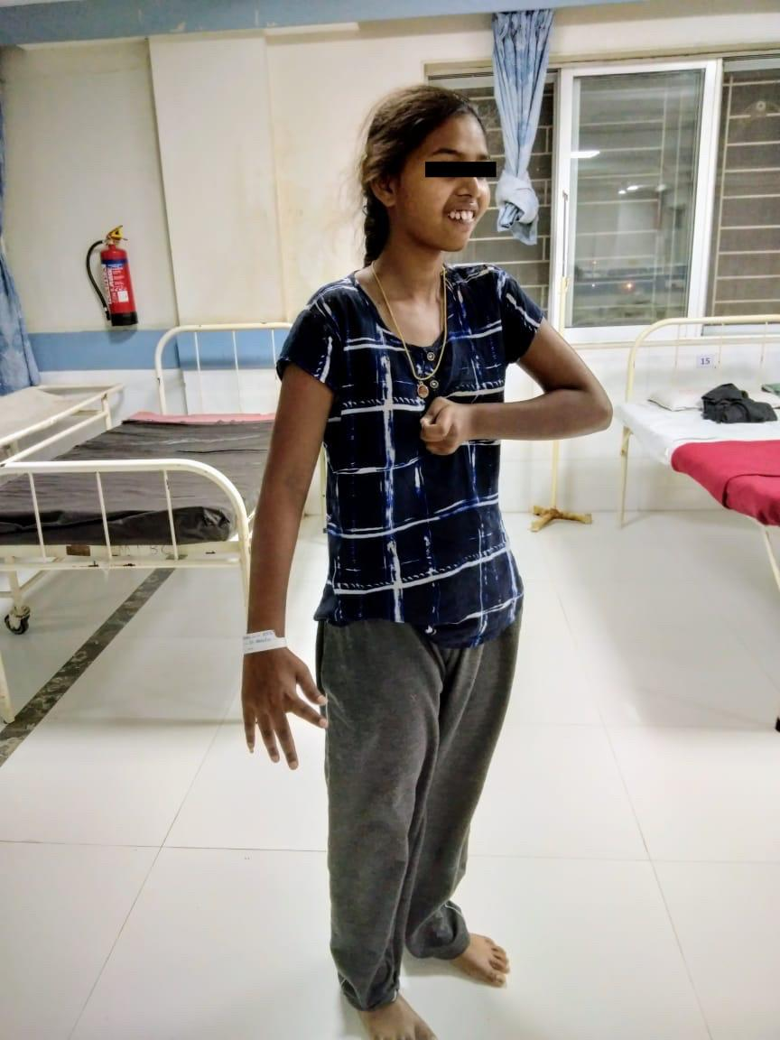
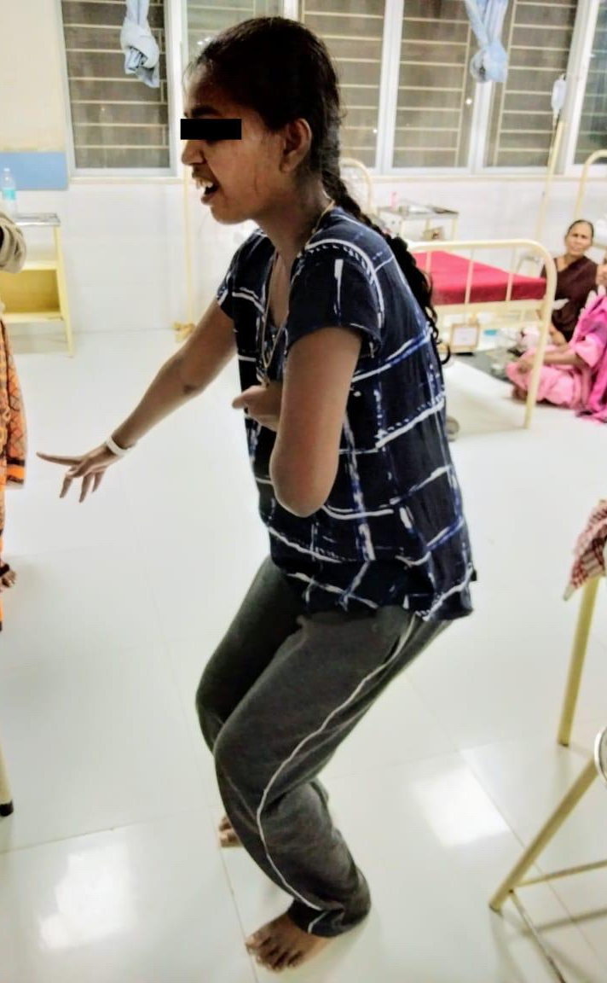

Slide 29
Mental status examination
A young wheelchair bound female, maintaining an abnormal posture, moderately groomed and kempt, maintaining eye contact with prolonged blinking and reduced psychomotor activity; a non-spontaneous speech with reduced rate, tone and volume; conveying her mood as pareshaan with a restricted, distressed and tearful affect.
Further MSE could not be assessed as she was not cooperative.
On examination, she showed the following features of catatonia:
Posturing/catalepsy
Rigidity
Waxy flexibility

Slide 30
Immobility/stupor
Staring
Grimacing
Negativism
Automatic obedience

Slide 31
Investigations
Her routine blood investigations were within normal limits.
USG abdomen and pelvis showed hepatic and splenic parenchymal abnormalities mostly due to metabolic disorder.

Slide 32
MRI brain showed symmetric signal abnormalities in bilateral caudate and lentiform nuclei, bilateral thalami, dorsal pons and splenium of corpus callosum- findings suggestive of metabolic/toxic encephalopathy.

Slide 33
GIANT PANDA’ SIGN
Axial T2-weighted MRI of the brain at the level of the midbrain showing the 'face of the giant panda' sign,
Pars reticulata of substantia nigra (ears of giant panda)
Red nuclei (eyes of giant panda)
Superior colliculi (chin of giant panda)

Slide 34
Serum ceruloplasmin: 0.05 mg/dL (20-35 mg/dL)
24hr urinary copper: 212.1 mcg/24hrs (15-60mcg/24hrs)

Slide 35
MANAGEMENT
Patient was admitted in female Psychiatry ward in February 2020 and was found to be depressive on primary interview as she had multiple stressors and appeared to hold abnormal posture.
Catatonia was suspected and she was given a trial of with Injection Lorazepam 2mg IV stat which improved her posturing. She was then started on Tab. Lorazepam 2mg QID.
She was referred to Neurology in view of presentation of abnormal posturing, ataxia, drooling and gait disturbance to rule out an organic cause.

Slide 36
In Neurology, due to abnormal radiological findings, raised urinary copper excretion and reduced serum ceruloplasmin along with a visible KF ring, she was diagnosed to have Wilson’s disease.

Slide 37
In Neurology ward, she was started on Tab. D-Pencillamine 250mg TDS, Tab. Zinc Acetate 50mg BD along with Tab. Trihexiphenidyl 2mg TDS for abnormal posturing as dystonia was suspected.
She was unable to tolerate Tab. D-Penicillamine (due to pancytopenia) and was subsequently discharged on Cap. Trientene 250mg BD, Tab. Trihexiphenidyl 2mg QID, Tab. Zinc Actetate 50mg BD and Tab. Zolpidem 5mg BD. Her interaction, behavioural disturbances and food intake improved slightly with gradual improvement in posturing.

Slide 38
She is continuing her chelation therapy and has is currently maintaining well with near total improvement and regular follow up in Neurology OPD.

Slide 39
Discussion: Wilson’s disease
Hepatolenticular degeneration is a rare inherited disorder affecting both the liver and the central nervous system first described by Wilson in 1912.
20% patients show psychiatric illness or behavioural disorder:
Personality change (alterations in lifestyle, relationships, disinhibition, bizarre or reckless behaviour, impulsiveness, declining school performance)
Irritability 18%
Labile mood
Aggression 14%
Cognitive impairment (mild)
Depression 21%

Slide 40
Psychiatric manifestations may precede neurological signs in the early stages of WD.
Catatonia is a syndrome that encompasses more than two dozen signs, some of which are relatively nonspecific and is a rare presenting symptom of WD.
It occurs in 8% of the population in neurological WD.
Bulbar symptoms take the form of spastic dysarthria and dysphagia.
KF rings and sunflower cataracts can be seen.
T2-weighted scans may show the ‘face of the giant panda’ sign.

Slide 41
Take home message
Sudden onset of personality change, first episode of behavioural disturbances in the absence of family history and presence of catatonic features requires detailed investigations to rule out underlying organic cause as in this case before concluding it to be a purely psychiatric disorder.
Hence one should be vigilant when one comes across such cases.

Slide 42
Thank you

Slide 43
A CASE OF EROTOMANIA
DR. SANA DHAMIJA
RESIDENT

Slide 44
THE CASE
A 37 year old female, Mrs. M , studied till 10th grade, married since 20 years , having 2 children was brought to the Psychiatry OPD with complains of –
Belief that she’s married to her cousin and they’re in love
Making inappropriate advances towards cousin brother
irritability and abusive behaviour since 10 days
Since 3 years

Slide 45
HISTORY OF PRESENTING ILLNESS
Patient was apparently alright 3 years ago when she suddenly reduced communication with her husband and would only respond to him over important household matters. She would interact normally with her children. Initially, the husband thought she was angry at him, but upon asking, she would deny anything.
Gradually, over the next few weeks, she completely stopped speaking with her husband and withdrew from her usual wifely duties. She would get irritable if the husband would initiate any physical intimacy and would say that she’s in love with someone else.

Slide 46
Upon hearing this, the husband thought she was pulling his leg and laughed it off. But he eventually realized that she was being serious as one day on a phone call with her sister she referred to the cousin brother as her husband.
When the sister questioned her she said that she was married to him in secrecy and had to maintain her original married status with the current husband to protect her “real” husband i.e. her cousin.
The family didn’t take it seriously as she just told these elaborate stories but never acted upon these anecdotes she told the sister.
A few months later she started ringing her cousin’s door bell who lived next door everyday and started asking for her “husband”. This created a conflict between the two neighbours.
She was taken to an Ayurvedic hospital and was started on some medication which she took for a year and was slightly better as reported by the husband.

Slide 47
One day before the admission patient went to the cousin’s place, rang the doorbell many times asking for her “husband” to come out and meet her.
When nobody opened the door and refused to answer her, she got very angry and banged her head against the door causing a swelling on her forehead. She then allegedly broke their door’s lock with a heavy stone from the road which prompted them to bring her to the hospital.

Slide 48
Upon asking, patient stated that the cousin brought a gun 3 years ago which was licensed on her name. This according to her signified that they were secretly married to each other and she belonged in his “custody”. She mentioned that he was on a secret mission and could not reveal to everyone that they were married. This gun was also connected to their combined property according to her.
When her cousin’s wife left him, patient suggested that being a part of the same mission and due to the mission’s covert nature they had to keep their relationship secret.

Slide 49
Upon questioning the family members it was established that no such marriage or gun exists and they were never together. The cousin in fact mentioned they used to meet during family events.
But the patient maintained that he loved her and brought her to the hospital to take care of her forehead swelling and is bound by his mission to not confess it to her in front of others.

Slide 50
BACKGROUND
No past medical history
No family history of any psychiatric illness

Slide 51
PHYSICAL EXAMINATION
General physical and systemic examination was within normal limits

Slide 52
MENTAL STATUS EXAMINATION
Her speech was spontaneous with normal rate tone and volume
Her mood was reported as bara vat ta and her affect was reactive and euthymic
Her thought showed delusion of love which was well systematized
Her verbatim being : “teen varsha poorvi, tyane majhya navavar ghoda ghetla hota, tyachya mission sathi, tevhapasun to majhyavar prem karto, amcha lagna pan jhala aahe. pan mission secret aahe na , manhun aamhi konala saangu shakat naahi, pan to majhyavar khup prem karto, te tar nakki aahe. Tyacha magcha lagna pan mission cha bhaag aahe” blushingly she added – “to nehmich majhi kaji gheto, mhanun tyane mala ithe bharti kela hota – dokyavar sooz aahe na ”

Slide 53
INVESTIGATIONS
Haematological, biomedical and radiological parameters including MRI were WNL.

Slide 54
SUMMARY
On the basis of the following :
Belief that she’s married to her cousin and they’re in love
Making inappropriate advances towards cousin brother since 3 years
irritability and abusive behaviour
with mental status examination showing a well systematized Delusion of Love
There was no evidence of any organic cause for the symptoms
This patient was diagnosed with DELUSIONAL DISORDER

Slide 55
MANAGEMENT
She was started on an antipsychotic: T. Olanzapine 20mg along with supportive psychotherapy.
Currently the patient is on regular treatment and has improved- no longer rings the cousin’s doorbell or tries to contact him.
However her belief that the cousin is in love with her and married to her persists. She does not act upon this belief anymore, is adjusted in her family life and her verbal relationship with the husband has improved.

Slide 56
DISCUSSION
Delusional disorder is characterized by the development of a delusion or set of related delusions that persist for at least 3 months (usually much longer), which occur in the absence of any mood episodes and without any characteristic symptoms of Schizophrenia.
In Erotomania, also known as De Clerambault syndrome or Psychose passionelle, the patient has a delusional conviction that another person of usually a higher status is in love with him or her. They exhibit “paradoxical conduct” – the phenomenon of interpreting all denials of love no matter how clear, secret affirmations of love.
Unlike Schizophrenia, in delusional disorder a person has an abnormality only in one delusional sphere of their life.

Slide 57
TAKE HOME MESSAGE
Delusional disorders are often called “incorrigible” but with treatment, patient stops acting on it and delusion eventually stays just encapsulated while the patient proceeds with their normal life.
Even though it is difficult to break the delusion, the patient not acting upon that delusion is a significant improvement seen with treatment.

Slide 58
Thank you

