Slide 1
Real-time Cluster Mapping & Monitoring in Field Surveys
Dr. Deepu Palal
Department of Community Medicine

Slide 2
Introduction
The Pimpri-Chinchwad Muncipal Corporation (PCMC), Pune, Maharashtra has an approximate population of 25 lakhs with a total COVID 19 cases of 90,618 as of now.
The peak incidence of COVID-19 cases was around the middle of September 2020.
We carried out the present study to understand the dynamics of transmission of the novel coronavirus in this population.
A crucial aspect of the study was sampling so that all strata of the population were sampled throughout PCMC, divided into 201 clusters consisting of 25 individuals.
The challenge was to keep track of all teams and their performance at all times.

Slide 3
The Significance
Plotting of households increases validity of the data and is a step towards quality control.
Helps in ensuring the necessary areas has been covered.
Provides an idea about the geography of each clusters.
Keeps track of the cooperation of individuals and the performance of survey teams.

Slide 4
The Problem
No software available in the market that plots data real time and create cluster maps that can be used in a survey.
EpiInfo by the CDC resembles the functionality that we require but the map is limited to the United States
All available GIS software/apps gives information only about the current location or live location of the field investigator. The data needs to be saved manually or written in the forms to be further plotted on to the map.

Slide 5
Time consuming -> Disadvantage outweights benefits.
Human error while copying coordinates.
Not feasible in a large study.

Slide 6
And the Solution…
A GIS app was developed In-house for tackling the above problems and deployed in one of the largest SARS CoV2 IgG antibody survey ever.
The Salient features are:
Shallow learning curve
Quick sharing of location in <10s
Offline support for poor cell reception areas
Real time monitoring of progress and feedback through an interactive web dashboard.
Can be programmed to work with any GPS application and telegram.
Android and iOS support.
Easy customization for all kinds of field surveys.
SMS support for sharing information to participants/public through a central number; keeps field investigator phone number confidential.

Slide 7
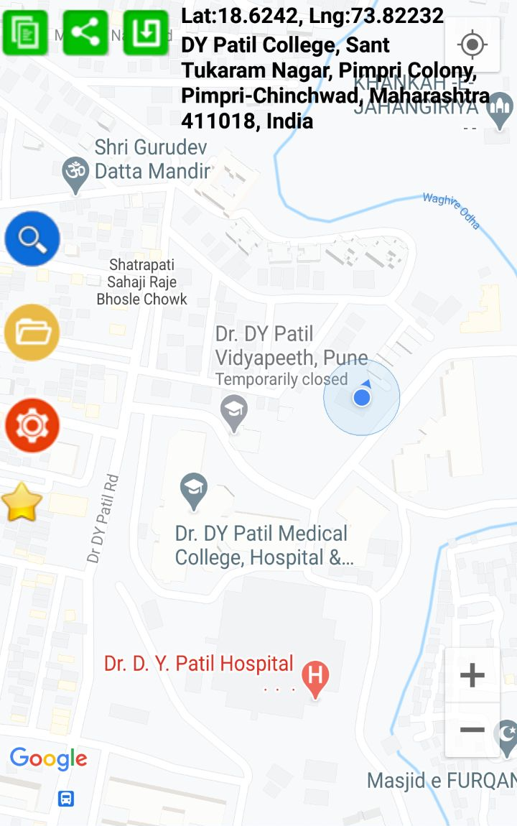
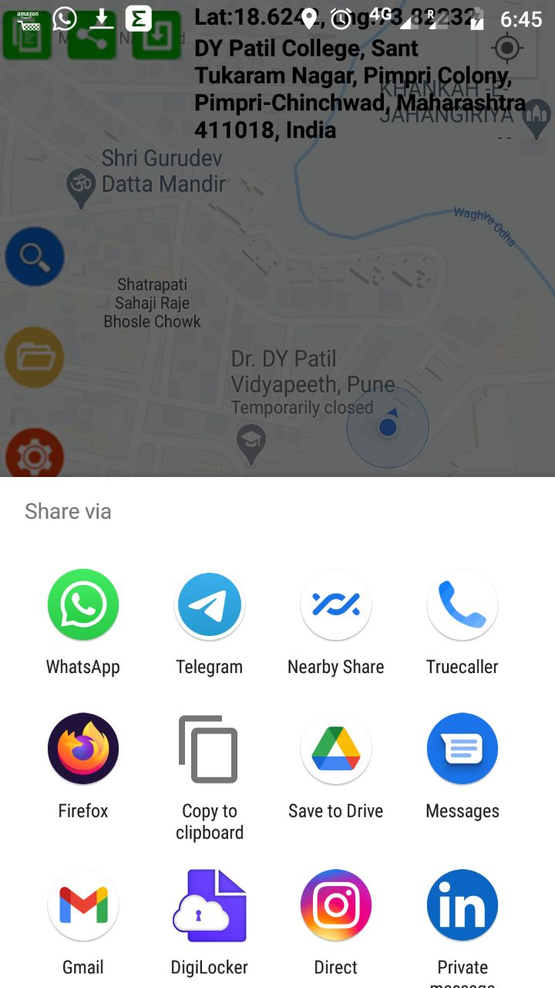
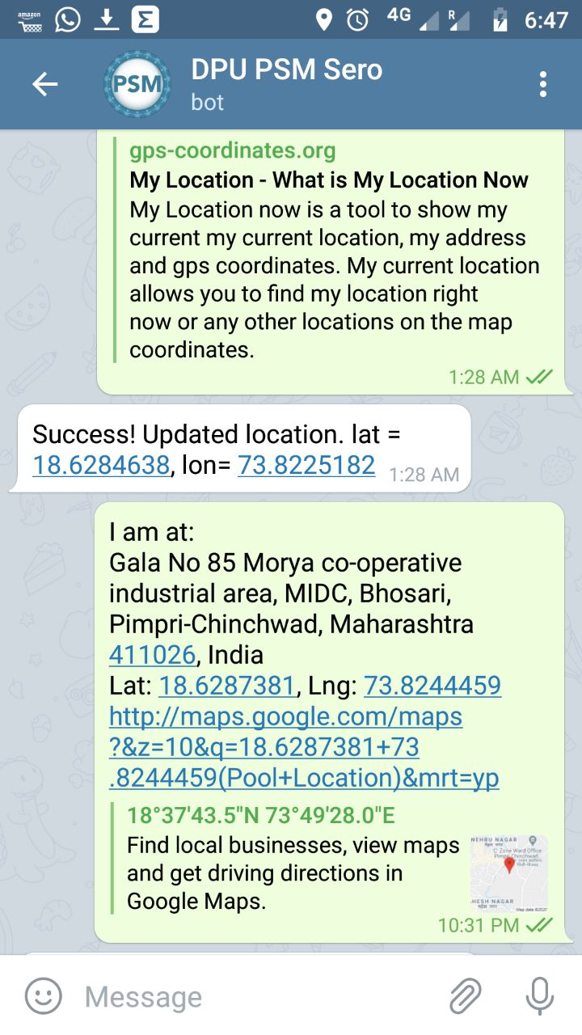
Location sharing as simple as 1,2,3…

Slide 8
Dashboard Accessible for public at http://test.techlabel.in

Slide 9
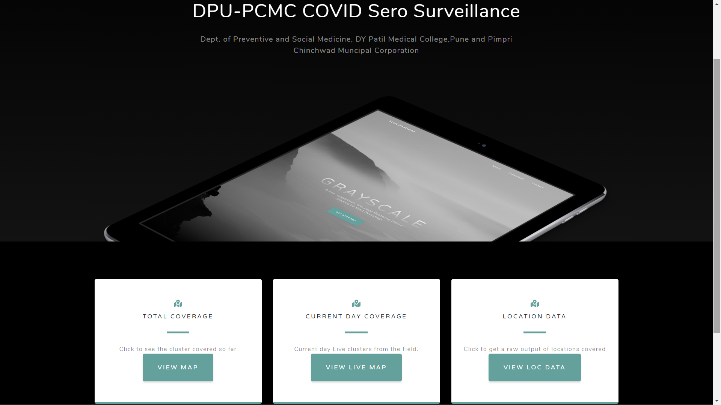

Slide 10
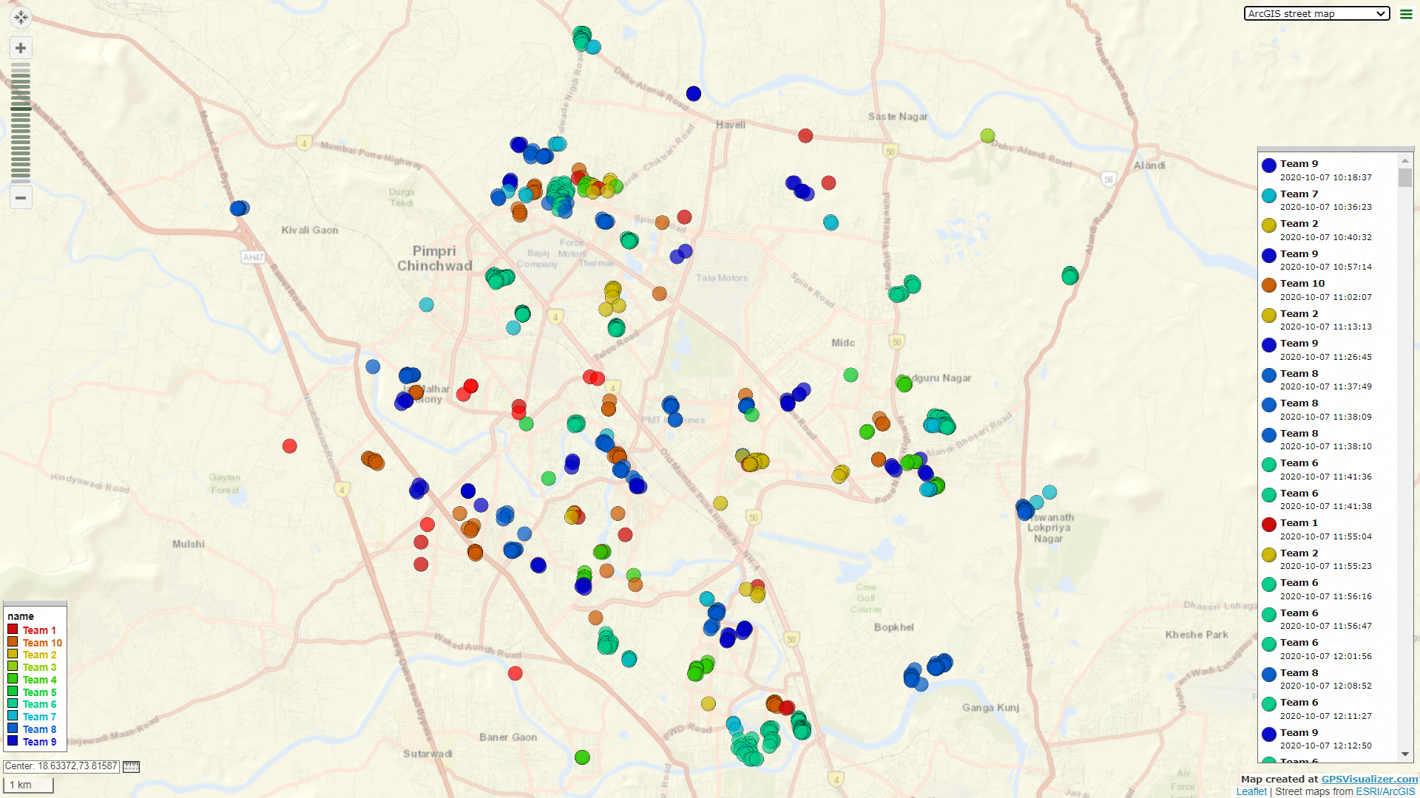

Slide 11
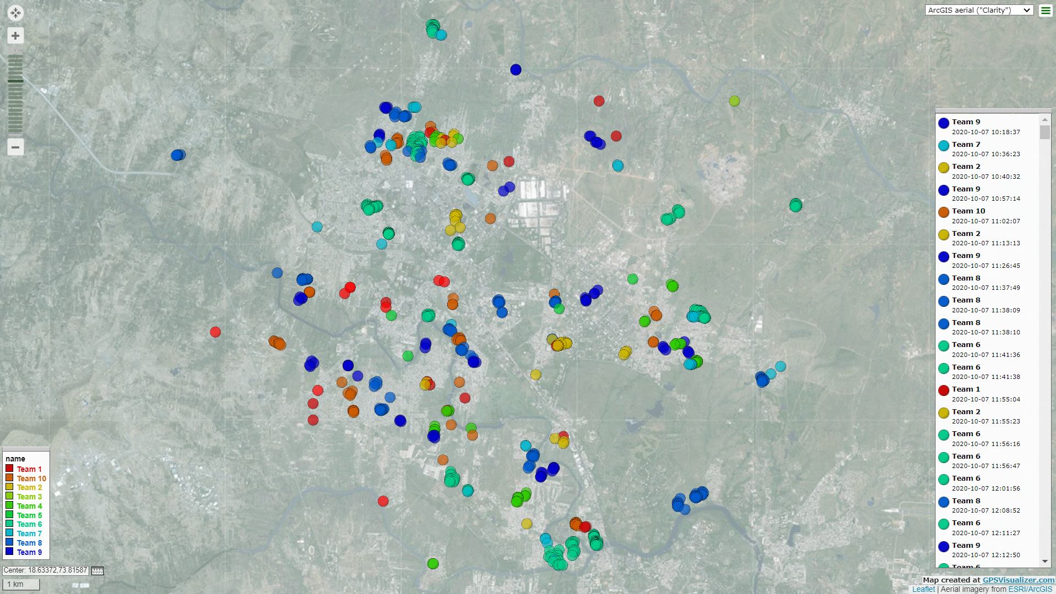

Slide 12
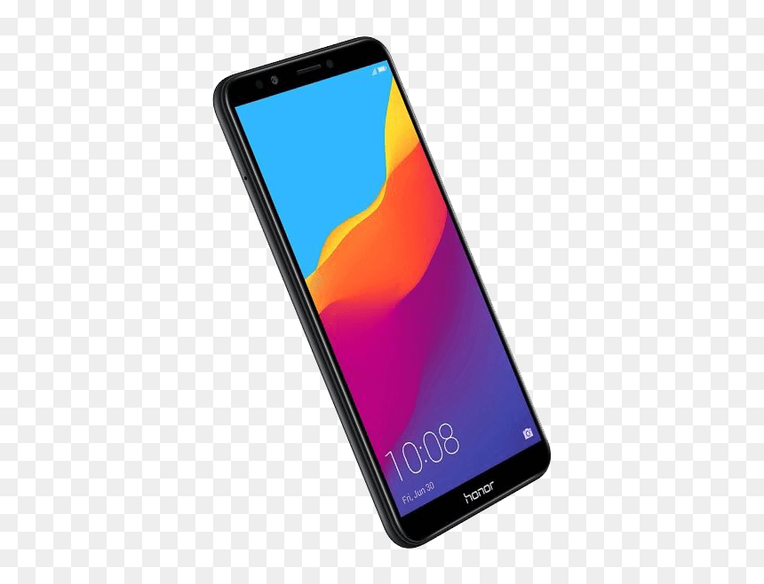
Cloud Server – Linux, Kernal 3.10.0-62.3.2.lve1.5.27.el7.x86_64, PHP 5.6.40, MySQL 5.7.32,
API call
Data send to Telegram bot (php) via Webhook
Frontend – For monitoring Progress
http://test.techlabel.in
End User – Field investigator

Slide 13
Location information sent to server
Sample data sent from GPS app
I am at: 2739, Dr. D.Y. Patil Medical College, Sant Tukaram Nagar, Pimpri Colony, Pimpri-Chinchwad, Maharashtra 411018, India Lat: 18.62423473, Lng: 73.82190293 http://maps.google.com/maps?&z=10&q=18.62423473+73.82190293(Pool+Location)&mrt=yp
User Authenticated? >>> Decode Message
Regex to search for pattern ……….//……..//…….
Script isolates the coordinates from the message.
>>>>>> Add Date Stamp >>>> success??
>>>>>> Add team No >>>>> success??
>>>>>>Save location>>>>>success??

Slide 14
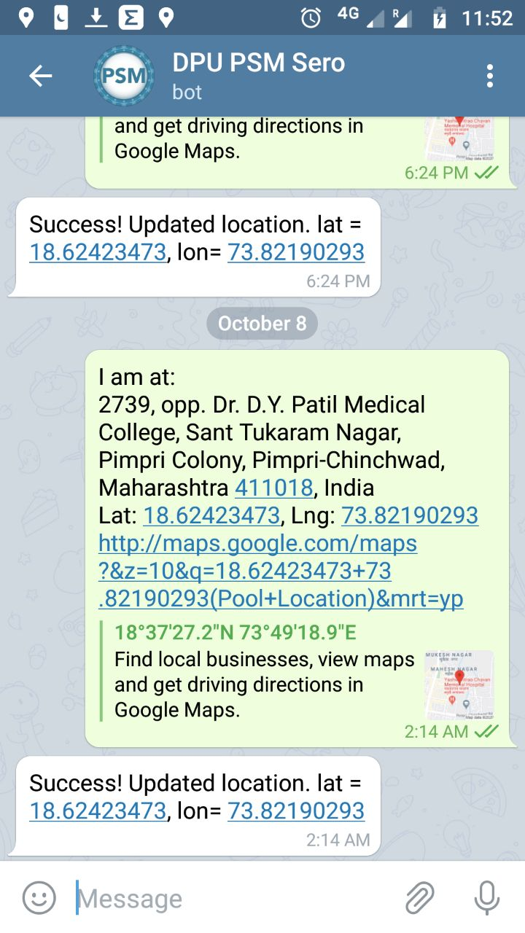
Acknowledge status
>>>>>> Add Date Stamp >>>> success??>>>>>Yes
>>>>>> Add team No >>>>> success??>>>>>Yes
>>>>>>Save location>>>>>success??>>>>>Yes
Data stored in MySQL database

Slide 15
Interactive Dashboard
Linux Server

Slide 16
A few examples of households taken in the survey…

Slide 17
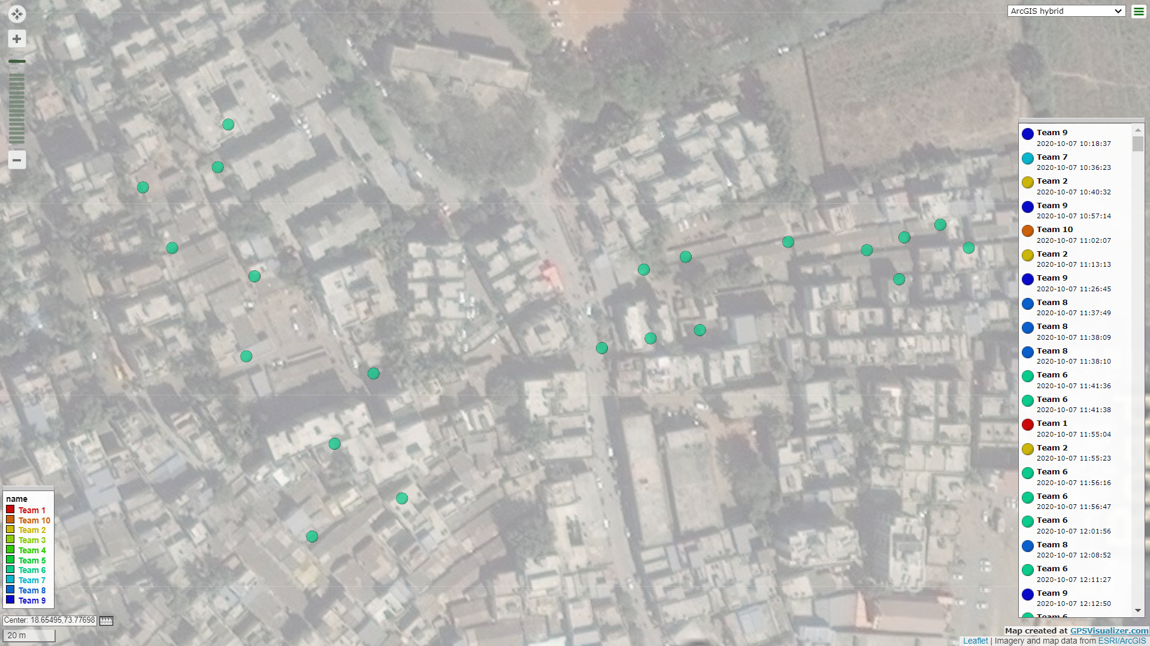

Slide 18
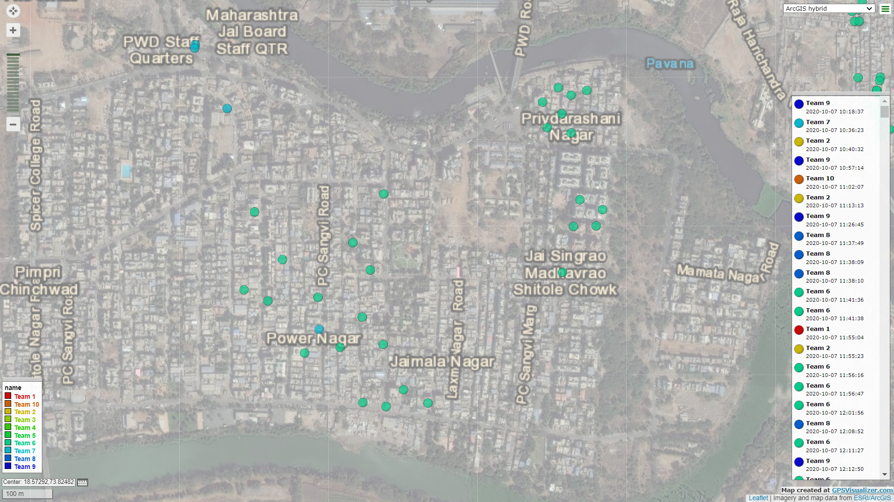

Slide 19
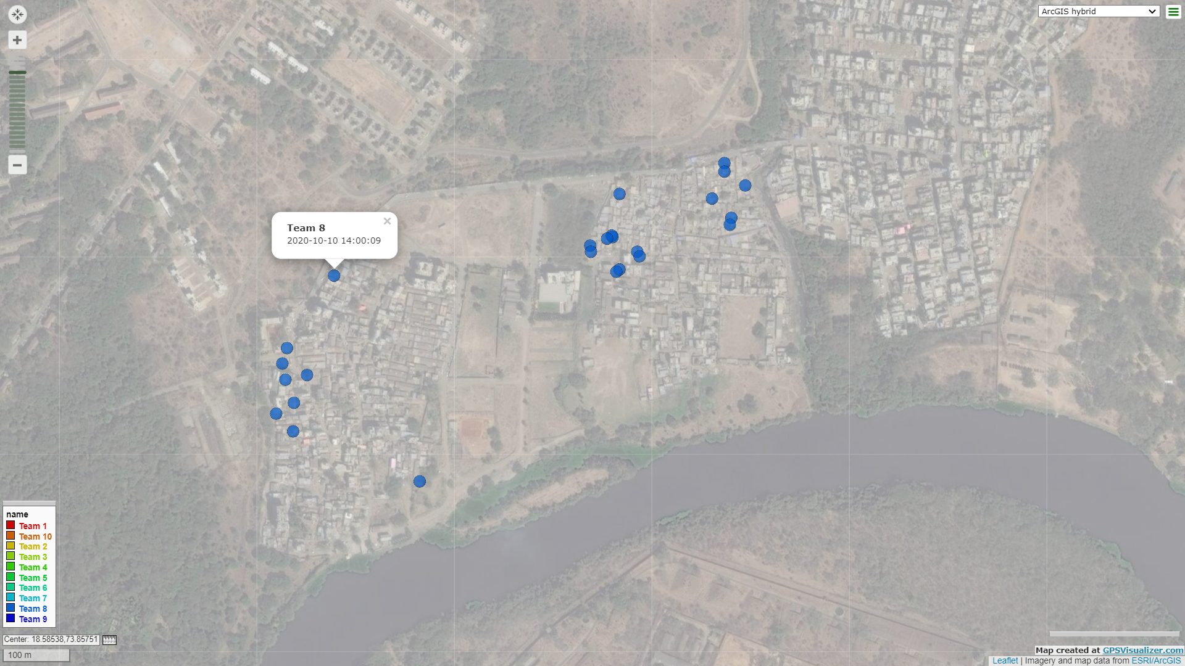

Slide 20
THANK YOU

