Slide 1
Population based SARS-COV2 IgG antibody survey in PCMC area
A study conducted by department of Community Medicine, Dr D Y Patil Medical College and Medical department, PCMC
Source of Funding: Pimpri Chinchwad Municipal Corporation

Slide 2
WHAT IS SERO-SURVEY?
Serosurvey: Collection and testing of serum (or proxy such as oral fluid) specimens from a sample of a defined population over a specified period of time to estimate the prevalence of antibodies against a given specific infectious pathogen as an indicator of immunity.(1)
It measures the proportion of a population that has antibodies to the relevant infection.
Major source of data that helps us in assessing the susceptibility profile of the population.
(1)https://www.who.int/immunization/monitoring_surveillance/burden/laboratory/Serosurvey_Manual_chapter_1.pdf

Slide 3
High quality serosurveys require that serum samples be collected from individuals that accurately represent the target population, usually achieved by conducting a probability household survey; that appropriate, standardized laboratory methods with excellent quality assurance and control be used; and that data be appropriately analysed and interpreted.
Deciding to perform a serosurvey that meets these criteria will therefore depend on available financial, logistical, laboratory and human resources.
It is essential to consider whether a serosurvey can provide answers to programme questions in a desirable time frame, taking into account the typically long delay between data collection and availability of results.

Slide 4
Methodology
Sample size: Assuming the seroprevalence rate of 5%, acceptable difference of 1% and design effect of 2.5% with 95% CI, sample size comes to 4641 which is rounded out to 5000.
Study design: Population based repeated cross-sectional study
Sampling technique:
Population proportionate to size sampling
200 clusters with 25 samples from each cluster
3 strata based on the housing structure, slum, tenements and housing societies with 50, 80 and 70 clusters each respectively.
Testing of samples will be done using ABBOTT CMIA- sensitivity is 92.7% and specificity is 99.9%

Slide 5
Duration of the sample and data collection : 7th October 2020 to 17th October 2020
10 field teams (Residents, MSWs and Phlebotomists) were recruited and trained in the Dept. of Community Medicine, Dr D Y Patil Medical College, Pimpri, Pune of 5th of October 2020.
They were trained about how to collect data from the population and sample collection. Data form filling, sample and form labelling, collection.
Also,this is a unique study as we also trained our staff to send their GIS location so that we could even map the households surveyed. So this whole survey was actually mapped using GeoSpatial technology and daily we could generate maps of the households covered of each team.

Slide 6
TEAMS | DAY 1 | ……… | DAY 10 | TOTAL
1 | 50 | ……… | 50 | 500
2 | 50 | ……… | 50 | 500
3 | 50 | ……… | 50 | 500
4 | 50 | ……… | 50 | 500
5 | 50 | ……… | 50 | 500
6 | 50 | ……… | 50 | 500
7 | 50 | ……… | 50 | 500
8 | 50 | ……… | 50 | 500
9 | 50 | ……… | 50 | 500
10 | 50 | ……… | 50 | 500
 |  |  |  | 5000

Slide 7
Training

Slide 8
ON FIELD

Slide 10
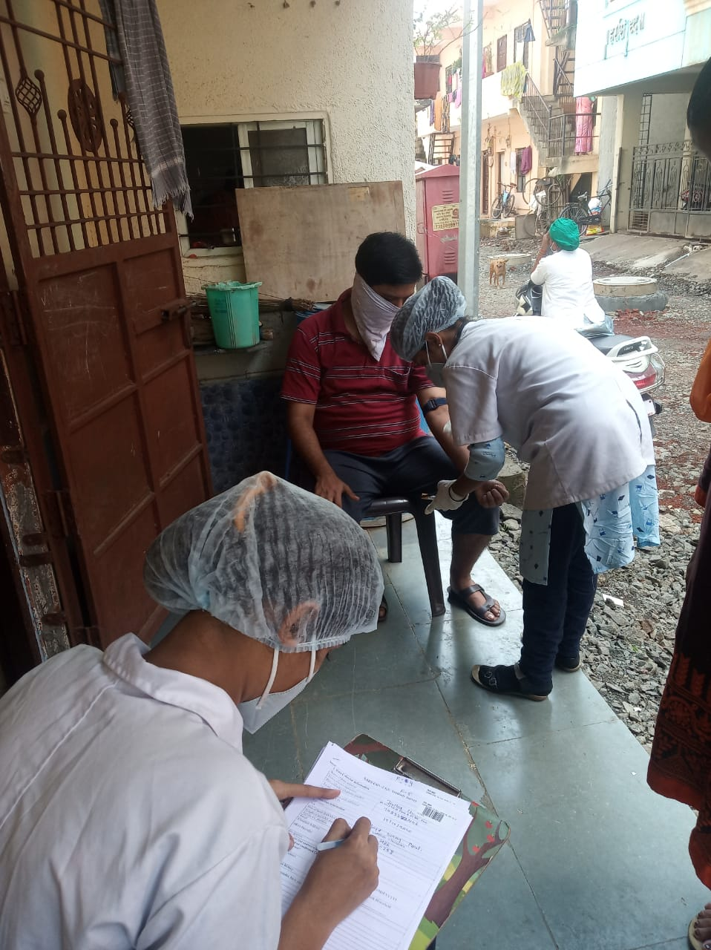

Slide 18
START OF SEROSURVEILLANCE

Slide 19
Gender Distribution
MALE: TOTAL- 2152 (43%)
FEMALE: TOTAL- 2848 ( 57%)
Notes:
43% male, 57% female

Slide 20
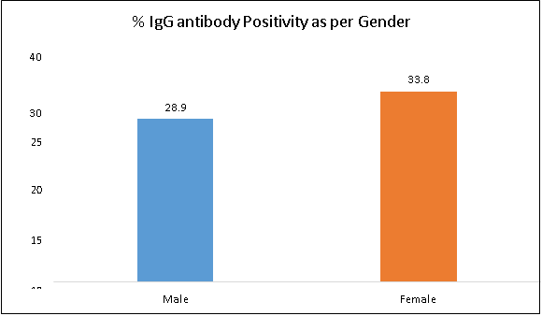
Gender wise SARS COV 2 IgG antibody positivity

Slide 21
Age Group Distribution
Total
12-18 390
19-30 1541
31-50 1985
51-65 786
> 66 298
Age

Slide 22
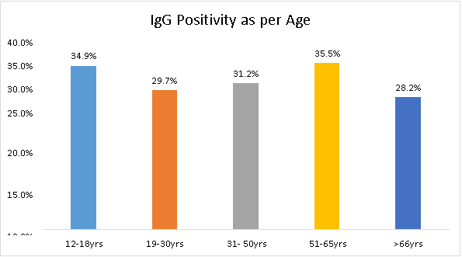
Age group wise SARS COV 2 IgG antibody positivity

Slide 23
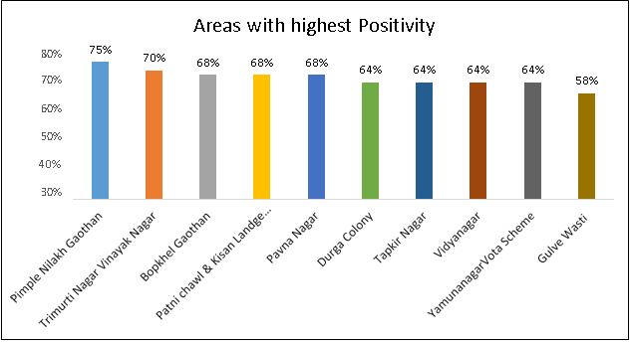
Ten areas with highest SARS COV 2 IgG antibody Positivity
Notes:
PNG- tenement, Trimu-HS, BG- tenemt, Patni-?, Pavna-slum, Durga-HS, Tap-slum, Vid-slum, Vota-slum, Gulve-slum/tenemt

Slide 24
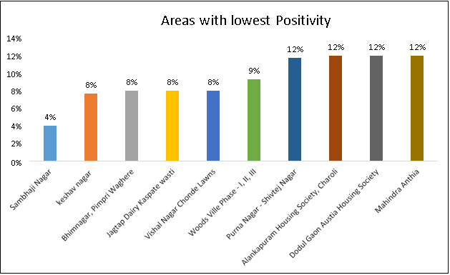
Ten areas with lowest SARS COV 2 IgG antibody Positivity
Notes:
Sambhji-HS, kes-tenmt, bhim-slum, Jptp-?, Vishl- HS/tenmt, Wood-HS, Purna- Anthia=HS,

Slide 25
Summary
Overall antibody seropositivity: 33.9%
Strata wise antibody positivity:
Slum 37.8%
Tenement 38.3%
Housing societies 27.7%
Highest seropositivity (35.5%) was observed in the age group of 51-65 years followed by adolescents between 12-18 years (34.9%)

Slide 26
Miscellaneous
Seropositivity among people with Influenza-like symptoms in last 3 months: 40.1%
Seropositivity among asymptomatic people: 29.7%
Seropositivity among RT-PCR tested and found positive for SARS COV 2: 86.8%
Seropositivity among RT-PCR tested and found negative for SARS COV 2: 32.1%
Infection fatality rate: 0.18%
Case fatality rate: 1.75%
Non-response rate received from the sample population was approximately 5-10%
Notes:
Infection fatality rate- (total deaths/total cases)x100
Case fatality rate- (total deaths/total deaths+total recovered)x100

Slide 27
Implications
Taking 34% infected, the total population exposed in PCMC = 846512.
This is about ten times more than detected by RT-PCR/Antigen (86735)
PCMC case detection better than reported from other studies where it has been reported 20-25 times more.
A large proportion of population was exposed which gives us sufficient reasons to believe second wave may not strike, even if it strikes, impact would be 34 – 50% lower than first wave (worst case scenario).

Slide 28
Implications
T cell immunity: Underestimation of immunity by sero-survey results
Population density: Cross immunity from other respiratory coronaviruses in Asia/Africa
SARS-CoV-2 seroprevalence worldwide: a systematic review and meta-analysis- Oct 24 2020: Serosurvey findings from all over the world, highest positivity rates from different parts of India (According to WHO, 10% are exposed)
https://www.ncbi.nlm.nih.gov/pmc/articles/PMC7584920/

Slide 31
Serosurveillance done in other states in India
Delhi: 23.48% (2)
Karnataka: 27.3% (3)
Mumbai: 57% slum, 16% non-slum (4)
Ahmedabad: 23.24% (5)
Kolkata: 27% (6)
Hyderabad: 19.7% (7)

Slide 32
Herd immunity is not BLACK and WHITE, it is incremental depending on social dynamics and any amount of herd immunity can act as speed breakers
First wave vs Second wave
Reinfection is very rare. There are isolated instances out of 40 million cases, so its not a PUBLIC HEALTH PROBLEM as it does not impact on the Population dynamics of transmission.

Slide 33
Implications
Population age profile
Population overweight profile
Our weakness
Diabetes, coronary heart disease, stroke and hypertension affects individuals 2-3 decades earlier than western counterparts
50% of diabetes and hypertension go undetected in people below 50 years of age

Slide 34
Western countries
Country | Total Cases | Total Deaths | Death/ 1 million | Approximate population | Median Age (years) | Overweight (%)
USA | 9,474,845 | 236,473 | 713 | 32.8 Crores | 38.1 | 67.9
Spain | 1,264,517 | 35,878 | 767 | 4.7 crores | 42.5 | 61.6
Italy | 709,335 | 38,826 | 642 | 6 crores | 45.5 | 58.5
France | 1,413,915 | 37,019 | 567 | 6.7 crores | 41.4 | 59.5
UK | 10,34,914 | 46,717 | 687 | 6.7 crores | 40.5 | 63.7
Germany | 5,44,346 | 10,622 | 127 | 8.3 crores | 47 | 57
Switzerland | 1,54,251 | 2,326 | 268 | 85.7 lakhs | 42.4 | 54.3
Sweden | 1,24,355 | 5,938 | 587 | 1.02 crores | 41.2 | 56.4
Belarus | 99459 | 985 | 104 | 94.9 Lakhs | 40 | 59.4

Slide 35
Asian countries
Country | Total Cases | Total Deaths | Death/ 1 million | Approximate population | Median Age (years) | Overweight (%)
India | 8229322 | 122642 | 89 | 130 crores | 27.9 | 19.7
Pakistan | 335093 | 6835 | 31 | 20 crores | 23.8 | 28.4
Afghanistan | 41501 | 1536 | 39 | 3.72 crores | 18.8 | 23
Sri Lanka | 11060 | 22 | 1 | 2.17crores | 32.8 | 23.3
Bangladesh | 409252 | 5941 | 36 | 16 crores | 26.7 | 20
Maldives | 11701 | 38 | 70 | 5.16 lakhs | 28.2 | 30.6
Nepal | 173567 | 960 | 33 | 2.81 crores | 24.1 | 21
Butan | 354 | NA | NA | 7.54 Lakhs | 27.6 | 27.1

Slide 36
SWOT Analysis
Strengths
Higher percentage of seropositivity
Relatively younger population
Lean population
Cross immunity by other respiratory coronaviruses
Weakness
50% of the people below 50 years of age are undetected for DM & HTN
Younger age of onset for DM, HTN & heart disease

Slide 37
Opportunity
To generate the awareness and capacity building for Early detection of DM, HTN and other life style diseases
Threat
Other neglected disease like dengue, TB, chikungunya and other ILIs might resurge while the focus is on COVID19
Reduced focus on the child nutrition might reduce their immunity to tackle COVID19

Slide 38
References
1.https://www.who.int/immunization/monitoring_surveillance/burden/laboratory/Serosurvey_Manual_chapter_1.pdf
2. https://economictimes.indiatimes.com/industry/healthcare/biotech/healthcare/delhis-sero-prevalence-study-finds-23-48-per-cent-people-affected-by-covid-19/articleshow/77082873.cms
3. https://economictimes.indiatimes.com/news/politics-and-nation/nearly-2-crore-people-in-karnataka-were-covid-19-infected-says-government-survey/articleshow/79041863.cms
4. https://www.thehindu.com/news/cities/mumbai/coronavirus-bmc-starts-second-phase-of-sero-survey-in-mumbai/article32315678.ece
5. https://indianexpress.com/article/cities/ahmedabad/second-survey-in-ahmedabad-sero-positivity-up-by-5-6-per-cent-since-june-no-herd-immunity-yet-6580951/
6. https://www.thestatesman.com/cities/kolkata/kolkata-one-four-people-covid-antibodies-1502922912.html
7. https://www.deccanchronicle.com/nation/in-other-news/110920/sero-survey-20-andhra-population-exposed-to-covid-19.html

Slide 39
Thank you

