Slide 1
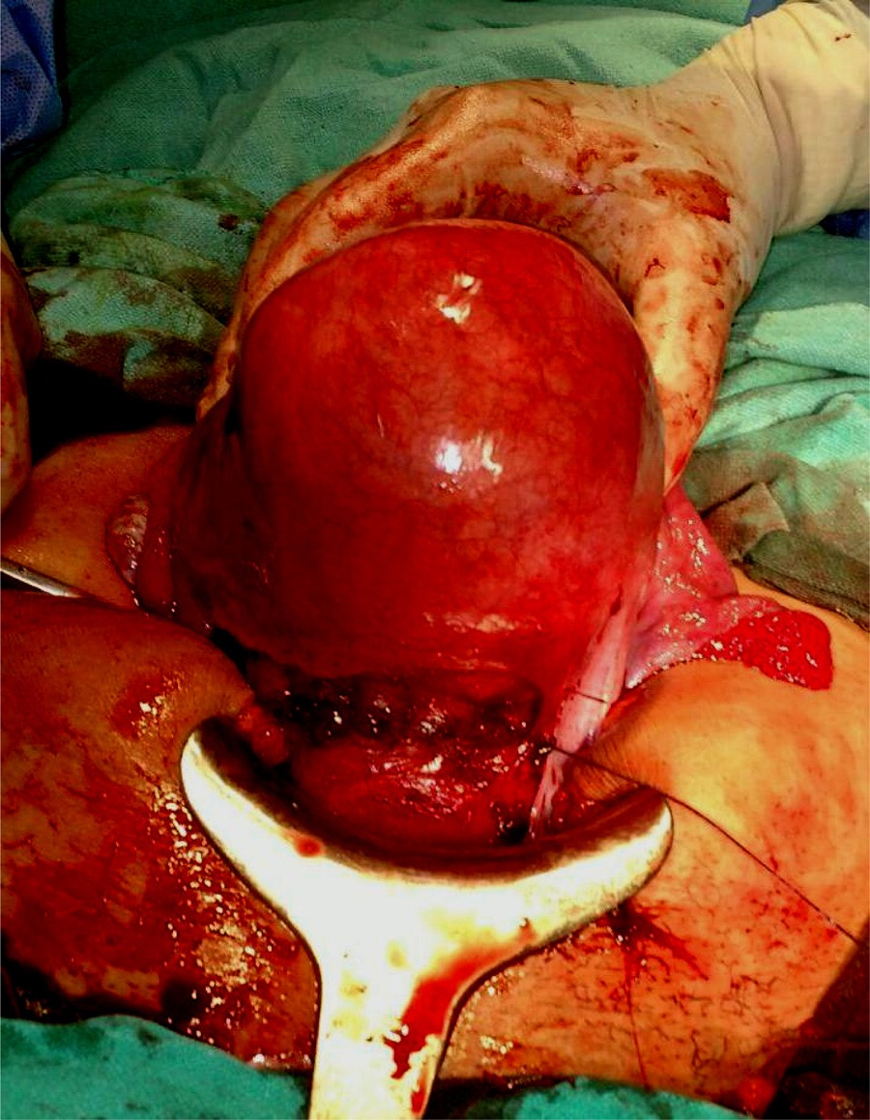
A Case of Cesarean Myomectomy
By Dr Alisha Das
Under guidance of Dr Hemant Deshpande,
Dept. of Obstetrics & Gynaecology,
Dr D. Y. Patil Medical College and Research Centre, Pimpri, Pune.

Slide 2
HISTORY OF PRESENTING COMPLAINTS
A 25 year old female Primigravida came on 30th March 2020 admitted under Unit-1 OBGY for regular ANC visit.
No H/O –
Pain abdomen, PV leak, PV bleed, decreased fetal movements, B/B complaints
Last menstrual period – 12th July,2019
Expected Date of Delivery - 17th April, 2020
Corresponding to 38 weeks on the day of caesarean section by dates, and 37.1 weeks by the first trimester ultrasonography of 8.2 weeks.

Slide 3
PAST MENSTRUAL HISTORY:
4 to 5 days / 28-32 days / normal flow (2 to 3 pads per day)/ not associated with passage of clots and dysmenorrhoea
OBSTETRIC HISTORY:
Married life 1 year , Prmigravida
PAST MEDICAL AND SURGICAL HISTORY:
No history of Diabetes mellitus , hypertension, tuberculosis , thyroid disorder.
No history of intake of OC pills routinely
No major surgery in the past and no prior blood transfusion.
PERSONAL HISTORY:
Normal sleep and bowel bladder habits
No history of smoking or alcohol consumption

Slide 4
GENERAL PHYSICAL EXAMINATION
Moderately built and nourished
Comfortable and co-operative at the time of examination
Height-165 cm
Weight- 65 kg
BMI – 23.875 kg/m²
Skin – normal in texture and colour
Pulse – 76 bpm regular in rate, rhythm and normal volume measured in left radial artery. No apex pulse deficit and radio radial delay
BP – 110/70 mmHg taken in left brachial artery in supine position
Breasts - clinically normal
Thyroid - clinically normal
Spine - clinically normal
No pallor, icterus, edema, cyanosis, lymphadenopathy, clubbing
CVS – S1 S2 normal . No murmurs
RS air entry bilaterally equal . No crepts , rales , rhonchi or abnormal breath sounds
No cervical lymphadenopathy

Slide 5
ABDOMINAL EXAMINATION
Inspection:
Umbilicus central and everted, flanks full
All quadrants move equally with respiration.
Linea nigra and striae gravidarum visible.
No striae , dilated veins, sinuses
Palpation :
Uterus fundal height corresponding to full term
Relaxed, cephalic, head floating, FHS + 142bpm
Back to maternal left, liquor adequate, EFW~2.5 kg
1st Leopold(Fundal grip): broad, soft and irregular structure s/o fetal buttocks
2nd Leopold(Lateral grip): Left: smooth, curved, resilient feel s/o fetal back
Right: irregular, knob like structures s/o fetal limbs
3rd Leopold(Pawlik's grip): smooth, hard and globular structure s/o fetal head
4th Leopold (Pelvic grip) : convergent fingers- not engaged.

Slide 6
PER VAGINAL EXAMINATION:
Cervix os admits tip
Cervix uneffaced
Station (-2)
Membranes (+)
Pelvis adequate

Slide 7
INVESTIGATIONS
Hemogram, blood sugar levels and liver and renal function test with blood electrolytes : WNL
HIV , HbsAg – negative
USG :
1st Trimester Scan: 37.1 weeks
Single Live Intrauterine gestaiton, of 8.2 weeks , FHs+154bpm
2nd trimester Scan:
1.) 38.1 weeks: (24/10)SLIUG of 15 weeks , FHS +148bpm, NT- 2.8 mm
2.) 37.6 weeks: (30/11)SLIUG of 20 weeks , FHS +152bpm, Normal anomaly scan

Slide 8
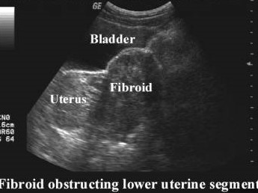
3rd trimester Scan:
1.)37.1 weeks : (08/02) SLIUG of 29.3 weeks, FHS +150bpm, placenta- fundoposterior, AFI - adequate, with
-A subserosal exophytic uterine fibroid of size 4.7 *2.3 cm arising from lower anterior uterine wall
- Another 4.2 * 3.6 cm subserosal fibroid noted along the lower segment in the right lateral wal'
cystic degeneration.
2.)34.4 weeks: (30/3) SLIUG of 34.1 weeks, FHS +146bpm, cephalic, placenta -fundoposterior, AFI- 9 cm, BPP-8/8, EFW- 2,67kg, with multiple uterine fibroids in the anterior wall of uterus along the lower uterine segment.

Slide 9
MANAGEMENT
In view of full term pregnancy with mild decrease in AFI and multiple anterior wall uterine fibroids, patient was planned for Elective LSCS with
- Arrangement of adequate blood
- High risk consent for Myomectomy/ Hysterectomy SOS
- Consent for Surgery
The patient was taken up for definitive surgery

Slide 10
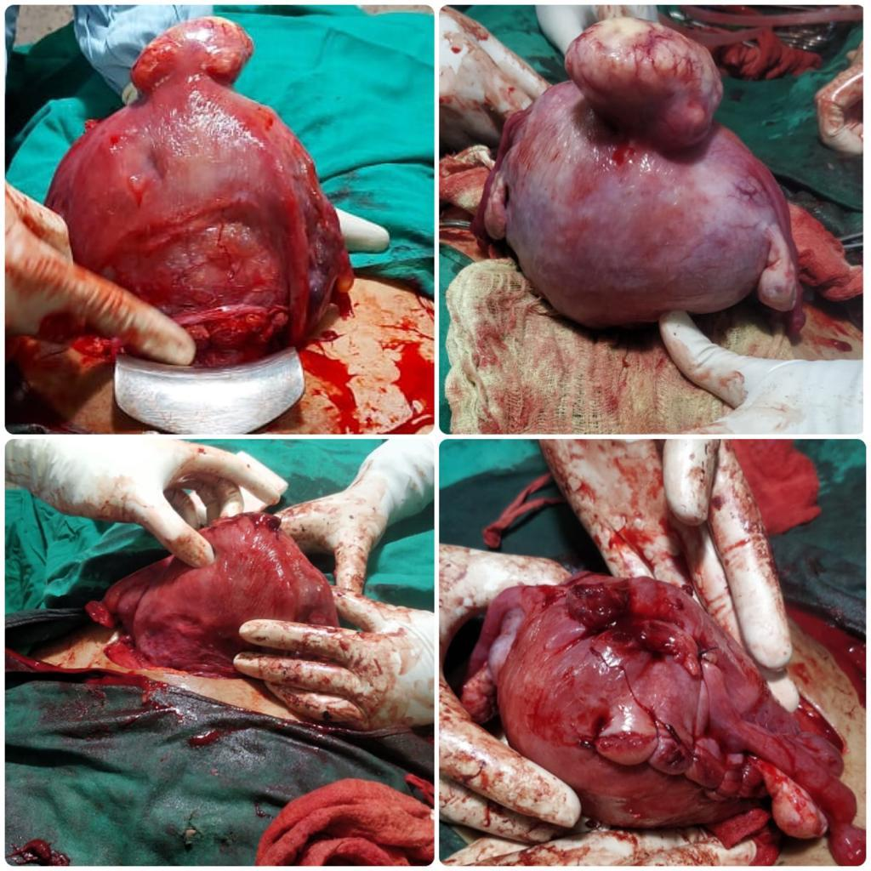
Patient was taken for Lower Segment Caesarean Section and further myomectomy was done for both anterior wall fibroids through the tunnel formed via the lower segment incision (Kehr incision)

Slide 11
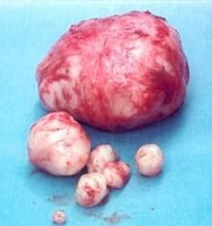
Specimen was resected post delivery of the baby and further steps of LSCS were continued.
Specimen was sent for histopathological examination

Slide 12
Patient withstood the prodedure well and delivered a healthy female child on 3rd April, 2020 at 9.29 am of 2.7kg birth weight, shifted to mother side
Patient was monitored in recovery then shifted to ward and post-op analgesics and antibiotics covered.

Slide 13
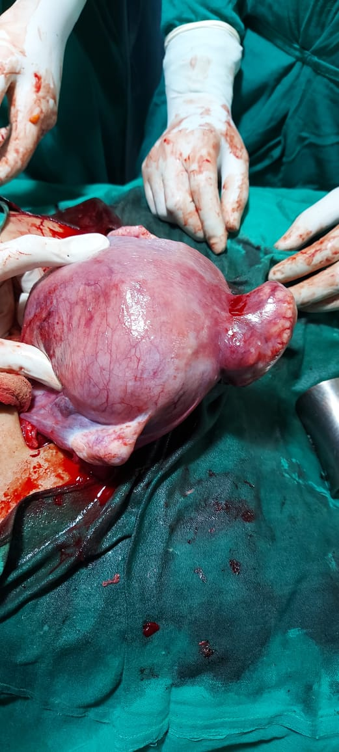
The patient had an uneventful post-operative period and was discharged after 8 days with full recovery.
Histopathology report was suggestive of uterine myoma

Slide 14
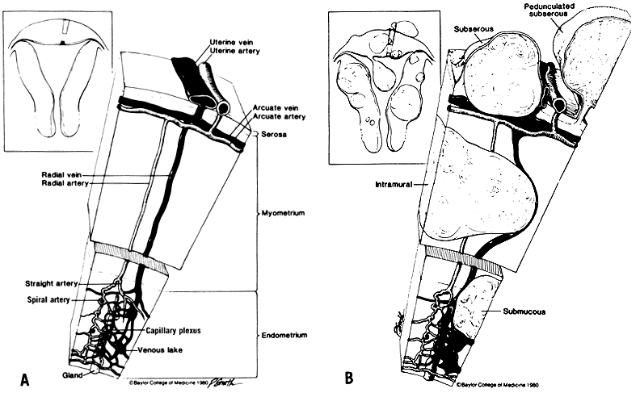
DISCUSSION
A leiomyoma, also known as fibroids, is a benign smooth muscle tumour.
Uterine fibroids are leiomyomata of the uterine smooth muscle.
Described based on location in the
uterus:
– Intramural: develop from within
uterine wall, do not distort uterine
cavity, <50% protruding into serosal
surface
– Submucosal: develop from
myometrial cells just below
endometrium, often protrude into and
distort uterine cavity
– Subserosal: originate from serosal
surface of uterus, >50% protrudes out
of serosal surface
– Cervical: located in the cervix, rather
than uterine corpus

Slide 15
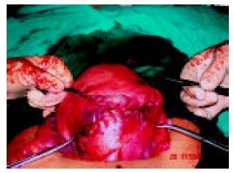
Uterine myomas are observed in
pregnancy more frequently now
than in the past
Because many women are delaying
child bearing till their late thirties,
which is the time for greatest risk
of myoma growth.
Also the use of ultrasonography has
improved the diagnostic capability
of detecting small myomas and
has increased our knowledge of
myomas in pregnancy.

Slide 16
PREVALENCE
The prevalence of uterine fibroids in
pregnancy varies between 1.6 and 10.7
percent depending upon the trimester of
assessment and the size threshold

Slide 17
CHANGES IN SIZE DURING PREGNANCY
The growth of fibroids during pregnancy using ultrasonography
have refuted the commonly held belief that fibroids increase in
size throughout gestation
• Indeed, the majority of uterine fibroids (49 to 60 percent) have
negligible (defined as <10 percent) change in volume across
gestation,
• while 22 to 32 percent increase in growth, and
• 8 to 27 percent decrease in size
• In those fibroids that do increase in size, most of the growth
occurs in the first trimester, with little if any further increase in
size during the second and third trimesters
• Larger fibroids (>5 cm in diameter) are more likely to grow,
whereas smaller fibroids are more likely to remain stable in size
• The mean increase in fibroid volume during pregnancy is 12
percent, and very few fibroids increase by more than 25 percent

Slide 18
TIME OF DIAGNOSIS
Simultaneous surgical removal of a previously
diagnosed myoma during cesarean section
Simultaneous surgical removal of a accidentally
diagnosed myoma during cesarean section
Unavoidable caesarean myomectomy with a huge uterine fibroid located in the lower segment
Avoidable caesarean myomectomy

Slide 19
SELECTIVE REMOVAL OF FIBROIDS
Myomectomy during caesarean delivery can be safely
effective procedure in safe hands. The main principles of myomectomy during pregnancy are;
1. It should be done by an experience person.
2. It should be done in in a well equipped tertiary institution
3. With the advent of better anesthesia and availability of blood
4. It should be done with full consent of the patient.
5. It should be done in selected patients according to site and size of myoma
6. It should be done with techniques that decrease blood loss( UAL ,UAE ,High Oxytocin )
7 - It is however important that baby must be delivered prior to attempting myomectomy
Selection of patients for caesarean myomectomy reduces blood loss, anaemia and other complications.

Slide 20
TIME OF REMOVAL OF FIBROIDS
Myomectomy was done after delivering the baby.
This was followed by suturing with adequate hemostasis
Large myoma situated over lower segment needing myomectomy before and for delivery of the fetus during LSCS
Sufficient grouped and matched blood must be made available
With prophylactic broad spectrum antibiotics to combat infection and
Analgesics were given in the postoperative period

Slide 21
FUTURE OF FERTILITY
The future fertility and or subsequent pregnancy outcome was unaffected by caesarean myomectomy
(Evidence level III)

Slide 22
FINAL SUMMARY
Management of fibroids during antenatal period is never surgical except torsion of pendculated fibroid.
Fibroids in pregnancy are common and incidence will increase in future.
Myomectomy at CS is not absolutely CONTRAINDICATED as believed earlier.
Decision depends on location, size and number.

Slide 23
FINAL SUMMARY
Enucleation is easier.
Preoperative counseling and consent.
Decision should be case to case basis.
Management at tertiary care hospital.

Slide 24
FINAL MESSAGE
Risk and Benefits to be evaluated in every case and decision individualized.

Slide 25
THANK YOU

