Slide 1
CASE OF HEMO-PERITONEUM – A DIAGNOSTIC DILEMMA
Dr NIKHILA SINGIREDDY
JR-2, Unit-IV
Department of Obstetrics and Gynaecology
Dr.D.Y.Patil Medical College, Pune

Slide 2
AIM OF PRESENTING THIS CASE
Selecting a case for presentation to a mixed audience and not speciality specific, is always a difficult task.
Keeping this in mind I chose this case not to highlight a rare case or any management marvel in obstetrics,but just to stress on an age old teaching:
“Clinical impression reigns supreme in a diagnostic work up”

Slide 3
CASE REPORT
25 year old G3P2L2 with 3 months of amenorrhea reported to labour room at 18:00 hrs with complaints of
H/o blunt trauma on the abdomen 15 days back followed by diffuse pain, she got an USG done after the trauma which showed no obvious abnormality*.
Breathlessness on exertion and unable to pass urine since 9 hours.**
No h/o nausea or vomiting
Bowel – constipated, last stool passed on the previous night
* USG report : SLIUG of 15 weeks of gestation.
**bladder catheterized – 1000ml urine drained – catheter left in situ

Slide 4
Past menstrual history :- Regular cycles
LMP :- 5/1/2020
BD :- 15.3weeks
By her 1St USG done at 14.1weeks, her gestational age 15.1 weeks
Obstetric history :-
- Previous 2 full term normal deliveries with out any complications
No significant past, personal and family history.

Slide 5
On examination
GC – The most striking feature was the significant pallor .
VITAL PARAMETERS – on admission
Pulse – 90 bpm
Blood pressure – 110/80 mmHg
Respiratory rate – 20 / minute
Temperature – 98.1℉
SPO₂ – 98% on room air

Slide 6
Systemic Examination
Cardiovascular examination:- S1 and S2 heard. No added sounds.
Respiratory examination :- Bilateral air entry equal.
Per abdominal Examination:-
Inspection:- No obvious abnormality
Palpation :- Diffuse tenderness all over abdomen
Rebound tenderness +
because of the tenderness and voluntary guarding , uterine height
could not be properly assessed
Auscultation : Bowel sounds sluggish
Per speculum examination :- Cervix and vagina healthy, No bleeding
Per Vaginal examination :- Uterus around 14-16 weeks, no significant forniceal
tenderness

Slide 7
Laboratory Investigations
Haemoglobin – 6.3gm%
TLC – 14500 (N-88, L-8, M-3, E-1)
Platelet count – 2.10lakh/mm3
Urine RE/ME – No abnormality detected
Renal function test – WNL
LFT - WNL

Slide 8
Clinical Impression
From the above clinical findings of rebound tenderness with severe pallor and a Hb of 6.3 G% the first impression was that this was a case of HEMOPERITONEUM
But our main concern at this point was what could be the CAUSE of hemoperitoneum in mid pregnancy ?????
Could it be
Pregnancy related – Ectopic ( Unlikely at this gestation), Traumatic rupture of uterus (Then why reporting after 15 days) OR was it a
Surgical etiology
So the next step was to extend our clinical hand and look for fresh ultrasonography findings

Slide 9
First USG in our hospital
USG was done first by resident on call and his impression was:
“Single intrauterine viable pregnancy of 15.1 weeks, Liver & Spleen
WNL”
*In the meantime we had already sent a call for the surgical resident for review to exclude any surgical cause

Slide 10
COULD IT BE A CASE OF UTERINE RUPTURE?
BUT ETIOLOGY?
This was the persistent query hovering in our minds. There was no obvious precipitating factor.
The dilemma was increasing by the minute
Ultrasonologically it was an intrauterine viable pregnancy clinically vital parameters were maintained and WNL
Hence, we requested for a faculty review of the USG and we specifically asked to look for the integrity of the uterine wall to rule out silent rupture of the uterus.

Slide 11
The second ultrasound
USG report of the second ultrasound done by faculty reported
‘SLIUG of 15.5 weeks with ?subchorionic bleed and free fluid in the peritoneal cavity’

Slide 12
Once the USG reporting was done , we had two options in front of us
Possibility of early separation of the placenta (“subchorionic bleed)”
Plan : transfuse blood, build hemoglobin and follow up with a MRI the next morning
OR
Possibility of a rupture uterus
Plan : immediate laparotomy
Going by clinical findings of severe pallor with rebound tenderness (even though vital parameters WNL and no USG evidence of rupture) we were convinced to go ahead with immediate laparotomy, but to further validate our decision we requested for tapping that revealed hemoperiteum.
Surgical Resident had landed up when the USG was on. He too concurred with the plan. We requested him to ask his faculty to be present for the laparotomy to help tackle any surgical surprise.

Slide 13
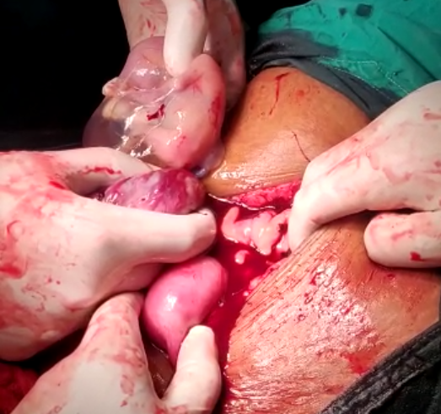
INTRA-OPERATIVE FINDINGS
Hemoperitonium of approx 2 Ltrs.
Bicornuate uterus with ruptured right uterine horn containing a live fetus enclosed in the amniotic sac and in process of expulsion.
LIVE INTRA UTERINE GESTATION
HEMOPERITONIUM

Slide 14
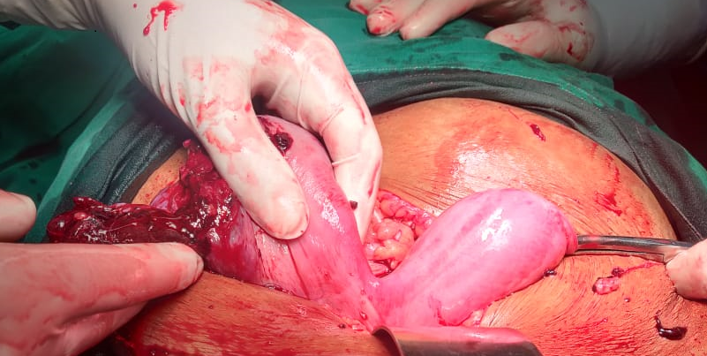
SITE OF RUPTURE
BICORNUATE UTERUS

Slide 15
DISCUSSION
Here was a case where there was a dilemma of deciphering the cause of the hemoperitoneum at 15 weeks of gestation, known to be a safe period in pregnancy.
Commonest cause of hemoperitoneum in 1st trimester is ectopic pregnancy and rupture of uterus in latter half of pregnancy.
Some reported causes of hemoperitoneum in the mid trimester are
Endometriosis
Organ rupture due to Trauma
Vessel rupture
Placenta percreta

Slide 16
Conclusion
Hemoperitoneum in absence of evident risk factors is often associated with non- specific signs/symptoms leading to delay in diagnosis
In this case even with normal vital parameters, non specific USG findings, clinically we betted on rupture of uterus and our hunch was vindicated by the laparotomy.

Slide 17
Take home message
“Clinical diagnosis still holds a very important place in sieving through the maze of differential diagnosis and zeroing down to the final diagnosis”

Slide 18
THANK YOU

