Slide 1
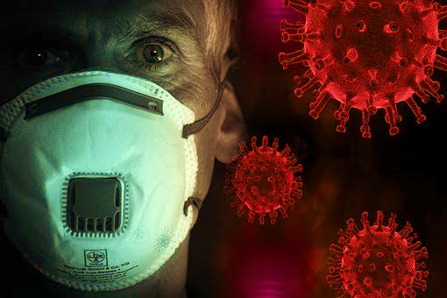
INCIDENCE,OUTCOME AND CHALLENGES IN HIGH RISK PREGNANCY – AN INSIGHT DURING COVID PANDEMIC
BY: DR.BHARGAVI N.(JR-3)
DR.SHAYARI JAIN(JR-3)
DR. MEENAL PATVEKAR(HOU)
TEAM UNIT 3 OBGY

Slide 2
INTRODUCTION
The novel corona virus-19
Infectious disease causing pneumonia and severe respiratory illness
SARS Covid-19: RNA Virus
First identified in Wuhan city, China
Emerged as an outbreak towards the end of 2019.
Declared as a global pandemic by WHO on 11th March 2020

Slide 3
THE PRESENT SCENARIO
Globally – 48.3 million positive cases
India - 8.36 million till date
Maharashtra-1.7 million at present
Fatality 1.75 million
Pregnant women affected in India 19,560

Slide 4
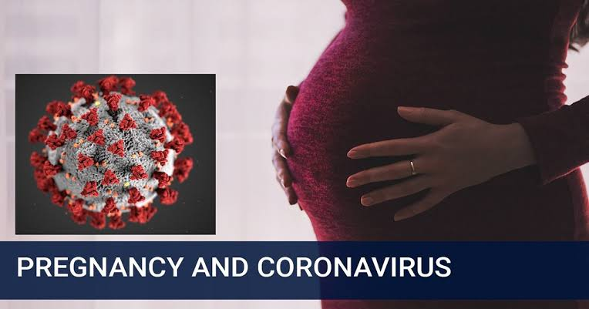
COVID 19 AND PREGNANCY
Any pregnancy can be challenging.
Limited evidence available about the effect of COVID 19 on pregnancy
Pregnant women listed under the moderate risk group.(ICMR guidelines)
Maximum risk of affection during last trimester .
(Government of India, Ministry of Health & Family Welfare, Directorate General of Health Services (EMR Division). Revised Guidelines on Clinical Management of COVID19. [Online] March 31, 2020. Accessed on April 5, 2020.)

Slide 5
COVID 19-HIGH RISK PREGNANCY
High risk pregnancies - defined to be a situation in which mother or foetus or neonate are at a high risk of mortality or morbidity.
(.Moosazadeh M, Naghibi SA, Khosravi S, Afshari M, Afsargharehbagh R. Outcomes of High-Risk Pregnancies in Northern Iran: Multivariate Logistic Regression Model. Iranian Journal of Health Sciences. 2015;3(4):40-6.)
High risk conditions include-
Severe Anemia
Preterm
Hypertension
Diabetes mellitus
Ante partum hemorrhage
IUGR
Previous LSCS
Greater level of attention and monitoring required in such cases.

Slide 6
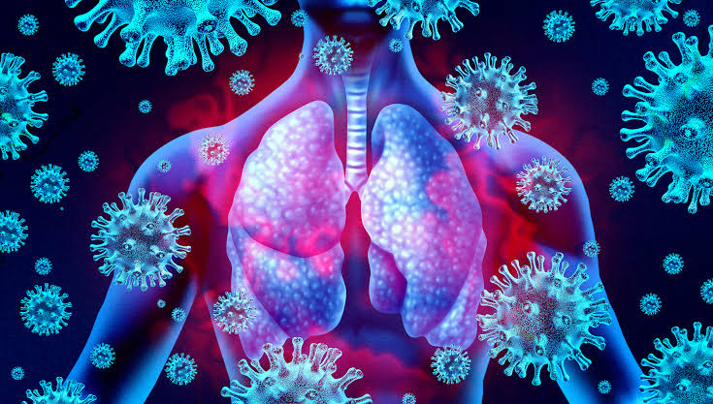
WHY PREGNANT WOMEN FACE SPECIAL RISK DURING COVID-19?
Pregnancy- immunocompromised and hypercoaguable state.
Effects on pulmonary system
Severe lung infection
Affecting pulmonary function
Reduced oxygen supply to the foetus.
Effects on coagulation pathway
Thromboembolism
Cerebrovascular accidents
DIC.

Slide 7
HIGH RISK PREGNANCY-INCIDENCE
In India, 20-30 % pregnancies belong to the high risk category.
(Jaideep KC, Prashant D, Girija A. Prevalence of high risk among pregnant women attending antenatal clinic in rural field practice area of Jawaharlal Nehru Medical College, Belgavi, Karnataka, India. Int J Community Med Public Health 2017;4:1257-9.)
High risk pregnancies are patients who have the probability of having a grave, and unpropitious or untimely outcome either in the mother or in the baby.

Slide 8
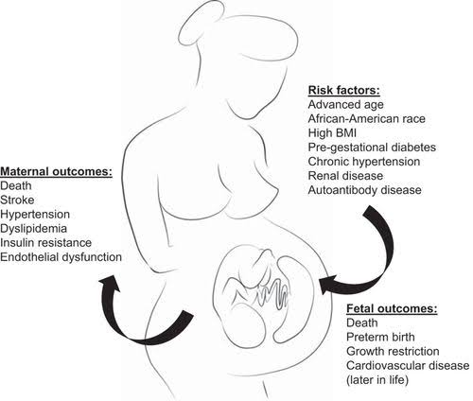
INCIDENCE, MATERNAL AND PERINATAL OUTCOME
AND CHALLENGES IN HIGH RISK PREGNANCY

Slide 9
CASE STUDY
AIM: To evaluate the incidence, maternal and perinatal outcome of High Risk Pregnancies during the Covid-19 Pandemic.
The study was conducted in DR. D. Y. Patil Medical Hospital
and Research Centre , Pune
A total of 444 samples were collected
Study Period : 1st April – 30st September 2020 on going study……
Inclusion criteria: Patients with high risk factors who attended OPD and came to
labour room for delivery.

Slide 10
OBSERVATIONS AND RESULTS

Slide 11
INCIDENCE
TOTAL NO. OF CASES | TOTAL HIGH RISK CASES | %
444 | 220 | 49.54%
Total percentage of high risk pregnancies dealt during the COVID times was: 49.54%

Slide 12
HIGH RISK FACTORS
Total(n=444) | 1 high risk factor | >2 high risk factor | >3 high risk factor
High risk pregnancies (n=220) | 114 | 82 | 24
Percentage | 51.81 % | 37.27% | 10.9%
.

Slide 13
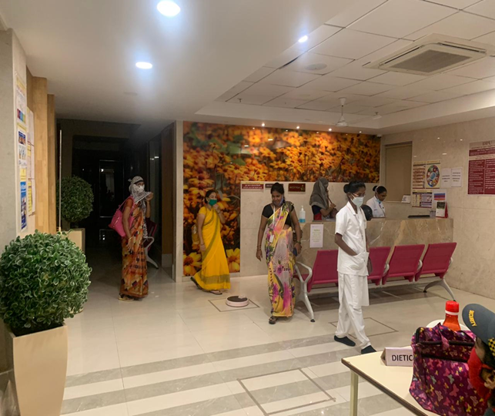
FACTORS - INCREASED INCIDENCE OF HIGH RISK PREGNANCIES
Fear factor
Disrupted antenatal check ups

Slide 14
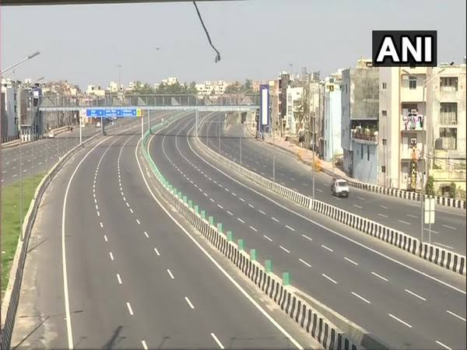
Lockdown
Lack of transport facility

Slide 15
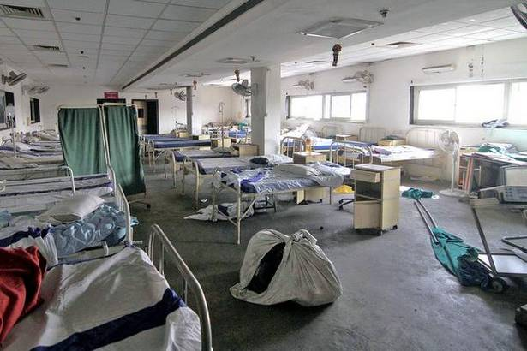
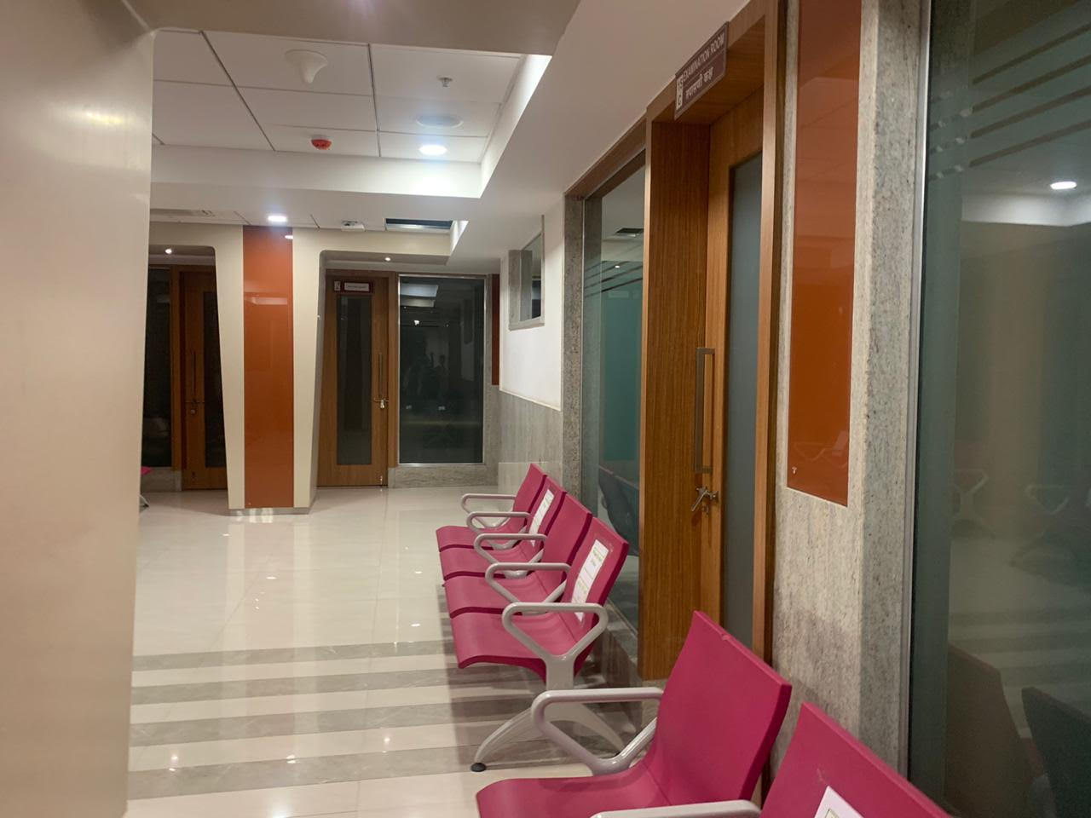
Closing down of peripheral hospitals
Unwilling to get admitted

Slide 16
Unaffordability and inability to access healthcare facility
No universal screening guidelines

Slide 17
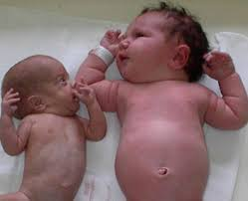
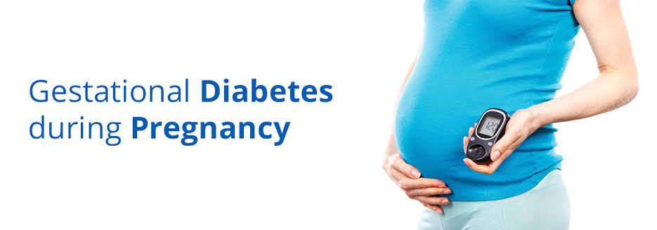
High risk pregnancies include:
ANEMIA
IUGR
PRECLAMPSIA
ABRUPTION PLACENTA

Slide 18
HIGH RISK FACTOR (Total=220) | OBSERVATION (DR. DY PATIL-UNIT3)
ANEMIA(n=70) | 31.81%
HYPERTENSION IN PREGNANCY(n=41) | 18.63%
PREVIOUS LSCS(n=38) | 17.27%
IUGR(n=36) | 16.36%
PRETERM ( n=34) | 15.45%
ABRUPTION(n=25) | 11.36%
GESTATIONAL DIABETES (n=5) | 2.27%
Anemia being the single highest factor associated with patients who delivered in our institution

Slide 19
MATERNAL OUTCOME
OUTCOME | TOTAL(n=220) | %
MATERNAL MORBIDITY | 195 | 88.63%
MATERNAL MORTALITY | 0 | 0%

Slide 20
Maternal Outcome
Maternal complications | Number(n=195) | Percentage
Injectable iron | 97 | 47.6%
Blood transfusion | 50 | 23.3%
Febrile Morbidity | 45 | 10.2%
Wound Infection | 10 | 5.45%
Diminished vision | 2 | 0.9%
Acute Renal Failure | 1 | 0.45%

Slide 21
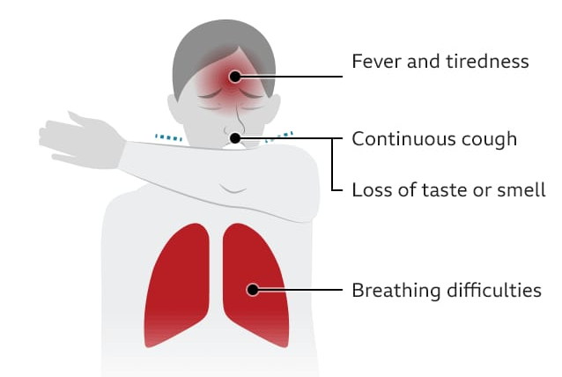
FEBRILE MORBIDITY
Isolated
Symptomatic treatment was given
COVID 19 RT-PCR , D-Dimer , Serum Ferritin , Fever profile sent.
ISOLATED PATIENTS | n=45 | %
COVID suspect | 30 | 6.7%
COVID positive | 15 | 3.5%

Slide 22
FETAL OUTCOME
OUTCOME | TOTAL(n=220) | %
PERINATAL MORBIDITY | 60 | 18.18%
PRETERM | 34 | 15.6%
IUGR | 9 | 4.09%
FETAL DISTRESS | 6 | 2.7%
MECONIUM STAINED LIQOUR | 6 | 2.7%
PERINATAL HYPOXIA | 5 | 2.2%
INTRA UTERINE DEATHS | 25 | 11.36%
PERINATAL MORTALITY | 13 | 5.9%

Slide 23
CHALLENGES FACED BY OBSTETERICIAN
Limited availability of information
Due to lack of knowledge of pathogenesis it was not clearly understood about the virus and its mode of spread.
Researchers were in the nascent stage , the clinical trials were inconclusive.
The various consequences and complications of the virus were unknown ,hence affecting the treatment of the disease.

Slide 24
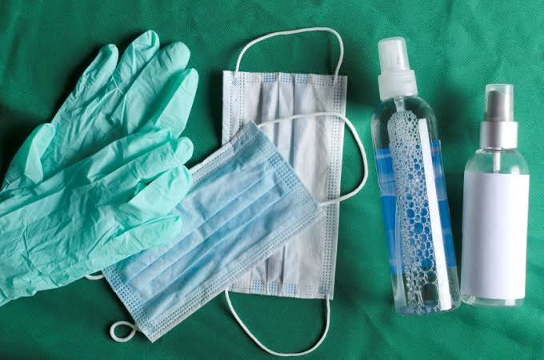
Shortage of resources
Limited provision of protective gears like PPE kits ,hand sanitizers, face shields and N95 masks for the protection of health workers.
The discomfort wearing the PPE kits for 24 hours during delivery was another problem faced by all of us.
Limited availability of equipment like thermal guns to detect temperature and pulse oximetry to monitor spo2.
Lack of isolation wards for COVID suspects.

Slide 25
Role of manpower
Doctors , nursing staff and para medical staff lesser in number as they were being recruited to other wards.
The constant fear of contracting the disease
Underprotection of health workers
Implementation of lockdown in the containment zones.

Slide 26
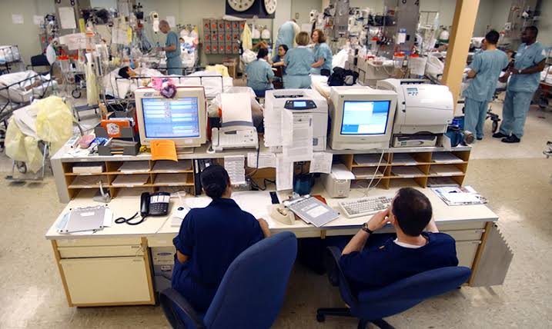
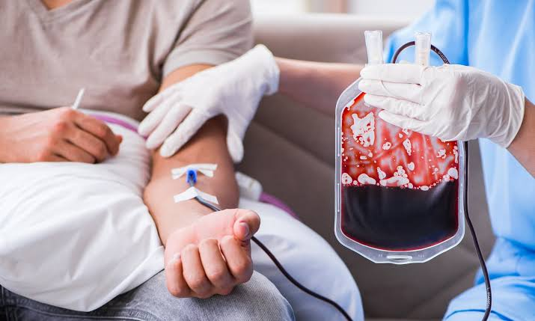
Dealing with high risk pregnancies like anemia, preterm labour, preclampsia and eclampsia with
Limited availability of
SICU
NICU
Blood and blood products
Non affording patients for the same added to the already worsened situation.

Slide 27
COUNSELLING
.
ISOLATION

Slide 28
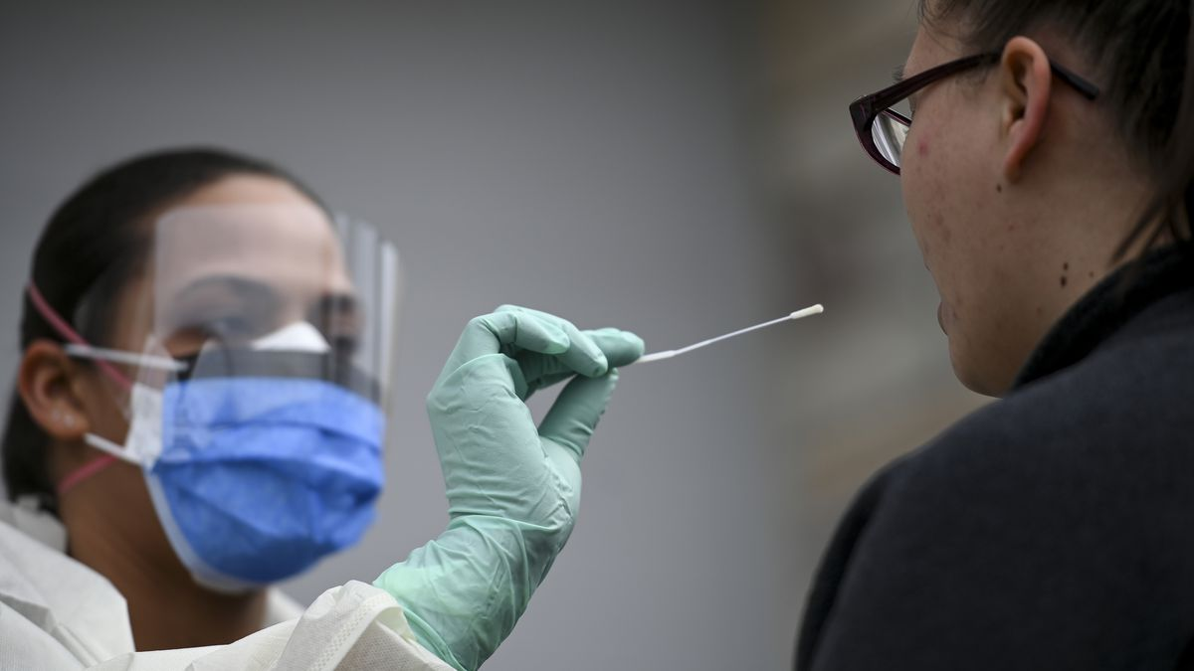
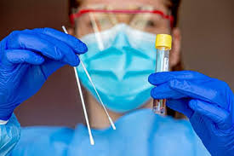
TESTING AND RETESTING
AFFORDABILITY

Slide 29
STIGMA
ACCEPTANCE

Slide 30
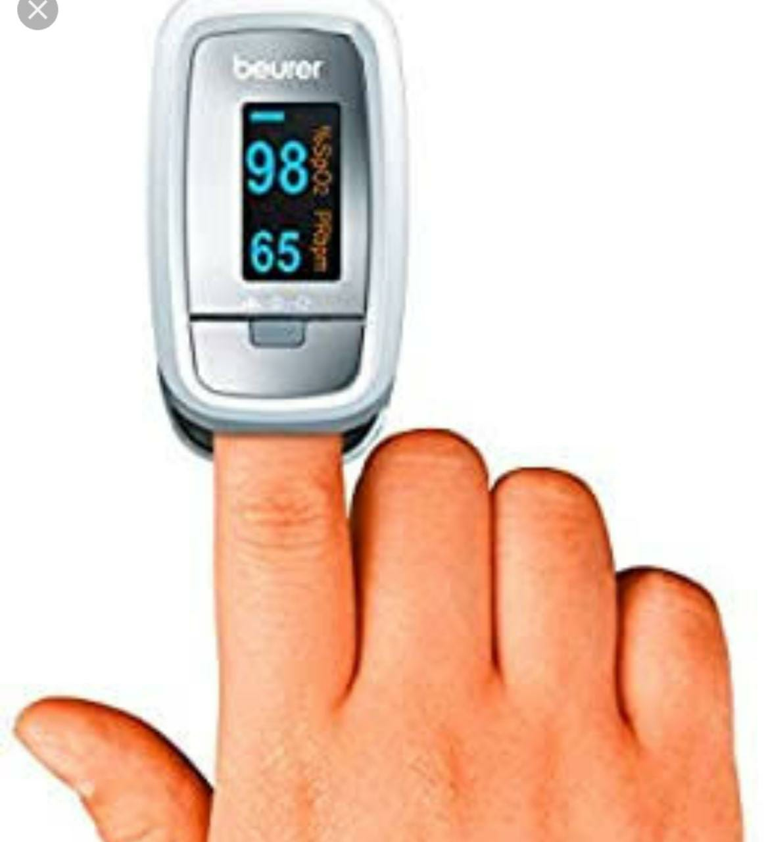
MANAGEMENT
Initially hospital management took decision and most of the problems solved
Guidelines and protocols established by the hospital
Screening of the patients done
TEMPERATURE CHECK
SPO2 MONITORING
SAMPLE SCREENING QUESTIONNAIRE

Slide 31
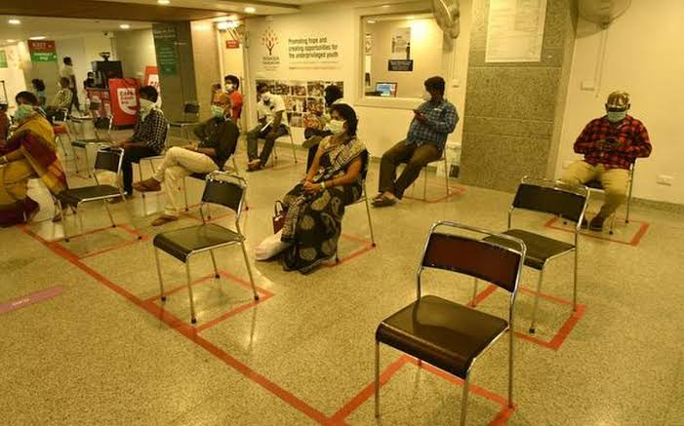
Staggering of patients in OPD was recommended
Limiting the number of relatives in the OPD
Social Distancing strictly followed
Hand sanitization was made a must for all

Slide 32
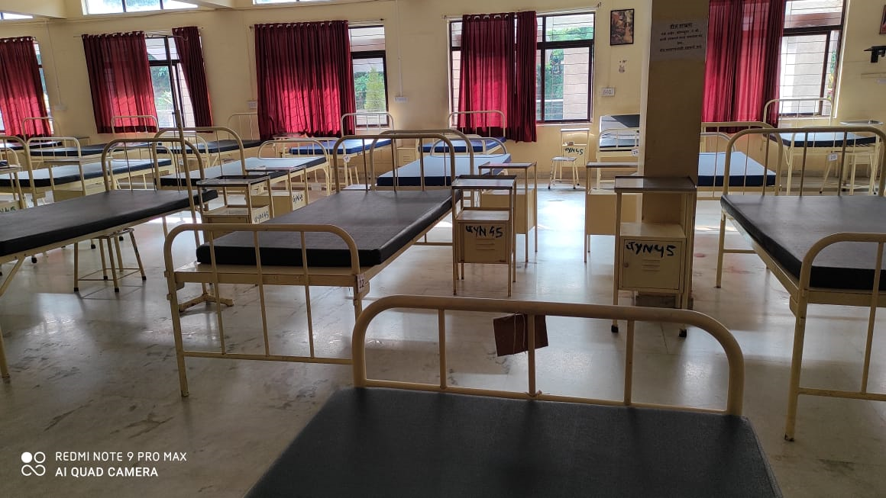
Doctors were given face shields and gowns
Isolation wards were set up.

Slide 33
CONCLUSION
Increased incidence of high risk pregnancies
Rise in maternal morbidity
Perinatal morbidity and mortality took a high toll
Rise in the number of “near miss” situations observed.
.

Slide 34
“Breathe, trust, let go and keep moving on, delivering miracles became the main motto then.”

Slide 35
TEAM UNIT-3 OBGY IN ACTION
Dr. Meenal Patvekar (HOU)
Dr. Yogesh Thawal(AP)
Dr. Shriraj Katakdhond (Asst.Prof.)
Dr. Prashant Suryarao ( Asst. Prof.)
Dr. Dipak S. Kolate( Asst. Prof.)
Dr. Bhargavi N.(JR-3)
Dr. Shayari Jain( JR-3)
Dr. Nidhi Praharaju(JR-2)
Dr. Sailaja Medam(JR-2)
Dr. Princy Khumujam(JR-2)
Dr. Avisha Malu(JR-1)
Dr. Dhanalaxmi Kale(JR-1)
Dr. Divyasree V.K.(JR-1)
Dr. Komal Khemchandani( JR-1)

Slide 36
“WE ARE IN THIS TOGETHER – AND WE WILL GET THROUGH THIS,TOGETHER”

