Slide 1
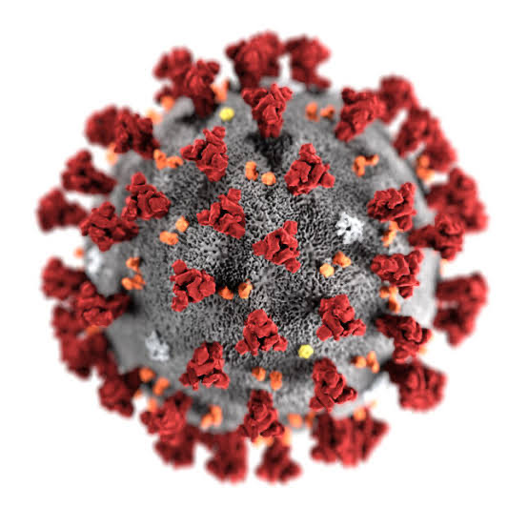
IMPACT OF COVID-19 LOCKDOWN ON OBSTETRIC OUTCOME
Dr.Nandini Bhosgi
Under the guidance of DR. VIDYA GAIKWAD
PROF and HOU DEPT. OF OBGY UNIT II

Slide 2
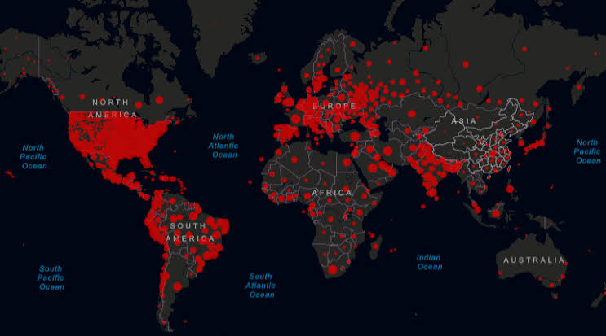
IMPACT OF COVID-19
Covid -19, discovered in Wuhan, China, in December 2019, affected 195 countries worldwide, 7.5 million affected,1.3 million dead. Pandemic status declared by WHO on 11th march 2020.India reported its First Positive case of the novel coronavirus (nCov) from Kerala on 30th January 2020.GOI declared nationwide lockdown on 24th March, when number of confirmed positive cases was 500, as a preventive measure against the spread of COVID 19 Pandemic in India.

Slide 3
LOCKDOWN
Limiting movement of the entire population as a preventive measure against the spread of COVID-19 pandemic
In India lockdown was imposed by GOI from
23 March to 30 July

Slide 4
ANTENATAL CARE
Systematic supervision of a woman during pregnancy to detect any complication / adverse event during pregnancy at the earliest
Aims
To screen the high risk antenatal cases
To prevent / detect / treat at the earliest any complication during pregnancy
To ensure continued risk assessment during pregnancy

Slide 5
IMPACT OF LOCKDOWN ON ANTENATAL CARE
SMALL HOSPITALS CLOSED
NO ACCESS TO TRANSPORT/ NO TIMELY ACCESS TO EMERGENCY OBSTETRIC CARE
FEAR OF COVID 19 INFECTION DURING HOSPITAL VISIT
late presentation of high risk ANTENATAL cases

Slide 6
Lack of access to right nutrition
Loss of family wages
lead to increase incidence of Anemia & its related complication during pregnancy
1) Preterm delivery
2) preeclampsia and it’s related complications like placental abruption
3) Fetal growth restriction & Intra uterine fetal demise
REDUCTION IN HEALTH SERVICES DURING LOCKDOWN AND OVERBURDENING OF MIDWIVES AND HEALTH WORKERS WITH COVID19 DUTIES DISRUPTED THE MEDICAL SUPPLIES AFFECTING THE MATERNAL CARE

Slide 7
Total number of deliveries during lockdown (April-July20)in OBGY department (all 5 units) - 1567
Total number of deliveries during lockdown - 602(in unit 2)
Number of High risk cases in the period of lockdown (April - July 20) - 506(in unit 2)
84% of total deliveries were high risk antenatal cases admitted for delivery during the period of lockdown

Slide 8
HIGH-RISK/ PREGNANCY COMPLICATIONS WHICH WE ENCOUNTERED IN OUR UNIT DURING THE PERIOD OF LOCKDOWN- APRIL TO JULY(4MONTHS)
HYPERTENSIVE DISORDERS IN PREGNANCY
ANEMIA IN PREGNANCY
ANTE PARTUM HAEMORRHAGE
INTRAUTERINE FETAL GROWTH RESTRICTION
PRETERM LABOR
POST PARTUM HAEMORRHAGE
POST-TERM PREGNANCY
INTRAUTERINE FETAL DEMISE

Slide 9
HYPERTENSIVE DISORDERS IN PREGNANCY
TOTAL NUMBER OF DELIVERIES IN OUR UNIT DURING LOCKDOWN-602
NUMBER OF CASES OF HYPERTENSIVE DISORDERS IN PREGNANCY DURING LOCKDOWN=312 (51.8%)
Gestational hypertension-162
Pre eclampsia-145
Non severe- 96
Severe(Bp >160/110mm of Hg)- 49
Eclampsia- 5

Slide 10
Majority of patients did not receive ANC care for consecutive 4 months, so presented late with complications
Abruptio placentae -9
Impending eclampsia -4
Eclampsia -5
Eclampsia with massive intra cerebral haemorrhage -1
With most of ambulance services diverted to covid19 related activities and suspension of transportation facilities.women in labour found it increasingly difficult to access maternal health service, and ignored impending warning symptoms of eclampsia.
Therefore severe preeclampsia cases increased three times during lockdown

Slide 11
HYPERTENSIVE DISORDERS IN PREGNANCY

Slide 12
ANEMIA
NUMBER OF CASES OF ANEMIA IN LOCKDOWN = 394
Mild (Hb 10-10.9) - 204
Moderate (Hb 7-9.9)- 109
Severe(Hb <7 ) -9
Very Severe (Hb <4) -2
Anaemia is a indirect cause of maternal morbidity and mortality leading to other obstetric complications.
During the period of lockdown we encountered more cases of moderate and severe anaemia.

Slide 13
ANEMIA

Slide 14
PRETERM LABOR
NUMBER OF CASES OF PRETERM LABOUR DURING LOCKDOWN = 192

Slide 15
Number of Nicu admissions before lockdown ( DEC 19 - March 20 ) = 142
NUMBER OF NICU ADMISSIONS DURING LOCKDOWN (APRIL - JULY 20 ) = 334

Slide 16
POST-TERM DELIVERY
NUMBER OF POST TERM DELIVERIES DURING LOCKDOWN (APRIL - JULY 20 ) = 159

Slide 17
NUMBER OF PROLONGED LABOUR CASES = 6
NUMBER OF OBSTRUCTED LABOUR CASES = 3
Non availability of adequate ambulance for covering maternity services led to the delay in reaching health care facility.

Slide 18
POST PARTUM HAEMORRHAGE
TOTAL NUMBER OF PPH CASES ENCOUNTERED DURING LOCKDOWN (APRIL - JULY 20 ) = 14
Out of this 5 cases were delivered in our unit and 9 were referred from outside

Slide 19
POST PARTUM HAEMORRHAGE

Slide 20
INTRA UTERINE FETAL DEMISE / STILL BIRTH
NUMBER OF IUFD CASES IN OBGY DEPT SINCE LOCKDOWN = 64
COVID-19 POSITIVE - 23 (35%)
COVID -19 NEGATIVE - 8 (12%)
COVID-19 STATUS UNKNOWN- 33 (51%)

Slide 21
INTRA UTERINE FETAL DEMISE

Slide 22
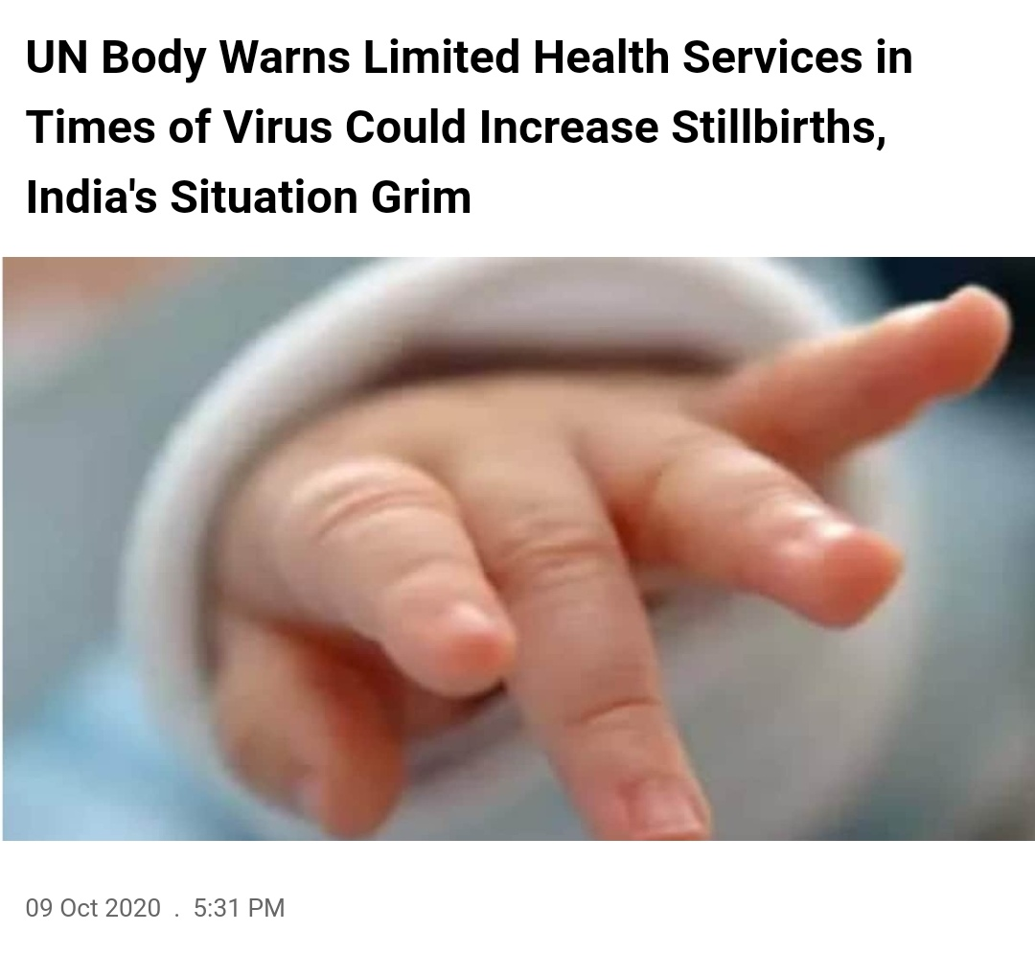
STILL BIRTH AND COVID-19
Reports also warned that COVID-19 pandemic could exacerbate the still births issue due to restrictions on health services
A 50% reduction in health care services due to pandemic could cause increase in the number of still births by 11.1%.
Pregnancy itself is a hyper coagulable state,COVID 19 infection leads to vascular thrombosis which may ? Cause uterine-placental insufficiency.

Slide 23
CONCLUSION
Patients could not avail the health care facilities due to lockdown restrictions during the 4 months from April to July 2020
Hence we encountered many high risk cases in large numbers as compared to before lockdown, like anaemia, severe pre eclampsia, eclampsia, Fetal growth restriction , Intra uterine fetal demise.
Most of these complications could have been prevented / detected / treated at early stage and thus highlighting the importance of systematic supervision of pregnant women in antenatal period and preventing maternal and perinatal morbidity and mortality
~THANK YOU~

