Slide 1
PATHOPHYSIOLOGY OF HEART FAILURE
BY DR SHILPI LAHOTY
1ST YEAR CARDIOLOGY RESIDENT

Slide 2
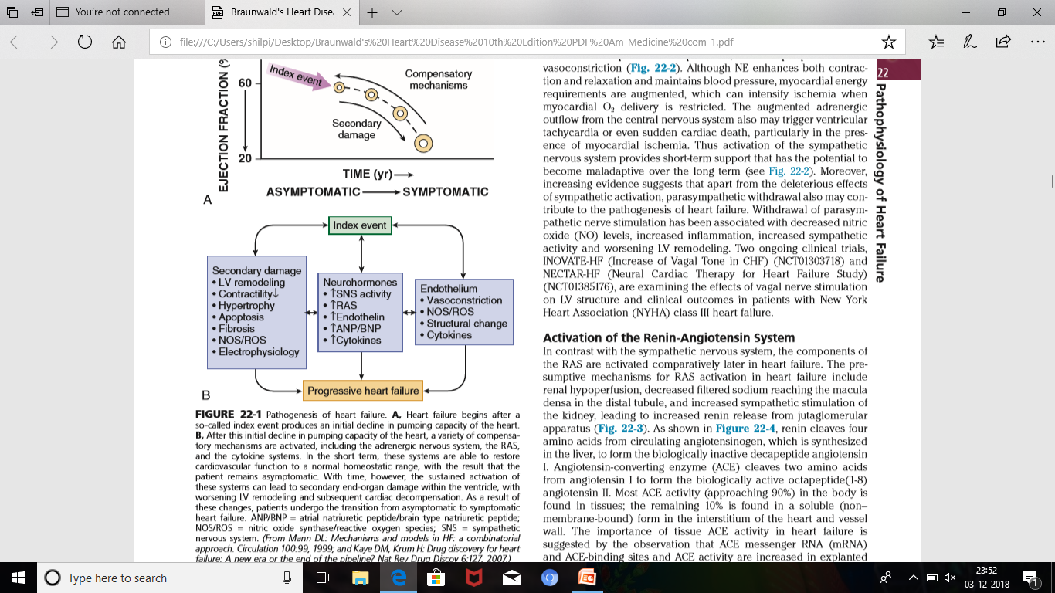

Slide 3
PATHOGENESIS
INDEX EVENT (abrupt like MI
insiduous like pressure or
volume overload or
hereditary conditions)
damages the heart muscle, with a resultant loss of functioning cardiac myocytes or, alternatively, disrupts the ability of the myocardium to generate force, thereby preventing the heart from contracting normally.

Slide 4
Cardiac damage
Sustained activation of neurohormonal and cytokine systems
End organ changes within the myocardium
LV remodelling
Disease progresses
More damage

Slide 5
NEUROHORMONAL MECHANISM
overexpression of biologically active molecules
deleterious effects on the heart and circulation
Progression of heart failure

Slide 6
RAS activation
ANS activation
Increased salt and water retention
Peripheral arterial vasoconstriction
Increased contractility
Maintains cardiac output
It has become apparent that a great many of classical neurohormones such as norepinephrine (NE) and angiotensin II are synthesized directly within the myocardium by myocytes and thus act in an autocrine and paracrine manner.

Slide 7
ACTIVATION OF SYMPATHETIC NERVOUS SYSTEM
HEART FAILURE
DECREASES CARDIAC OUTPUT
SYMPATHETIC TONE ACTIVATED AND WITHDRAWAL OF PARASYMPATHETIC TONE
(due to loss of inhibitory input from arterial baroreceptor)

Slide 8
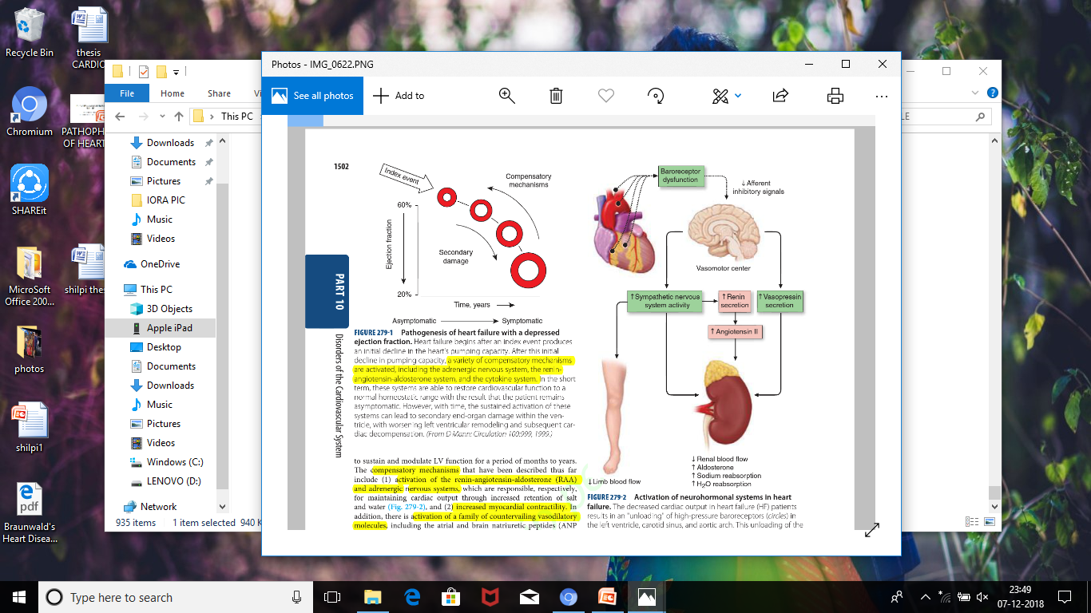

Slide 9
Healthy persons display low sympathetic discharge at rest and have a high heart rate variability.
In patients with heart failure
inhibitory input from baroreceptors and mechanoreceptors decreases and excitatory input increases
generalized increase in sympathetic nerve traffic and blunted parasympathetic nerve traffic, leading to loss of heart rate variability and increased peripheral vascular resistance.

Slide 10
As a result of the increase in sympathetic tone, there is an increase in circulating levels of NE, a potent adrenergic neurotransmitter.
In patients with advanced heart failure, the circulating levels of NE in resting patients are two to three times those found in normal subjects. Indeed, plasma levels of NE predict mortality in patients with heart failure.
Notes:
Whereas the normal heart usually extracts NE from the arterial blood, in patients with moderate heart failure the coronary sinus NE concentration exceeds the arterial concentration, indicating increased adrenergic stimulation of the heart.

Slide 11
However, as heart failure progresses there is a significant decrease in the myocardial concentration of NE. The mechanism responsible for cardiac NE depletion in severe heart failure is-
1) an “exhaustion” phenomenon
2) decreased activity of myocardial tyrosine hydroxylase, which is the rate-limiting enzyme in the synthesis of NE.

Slide 12
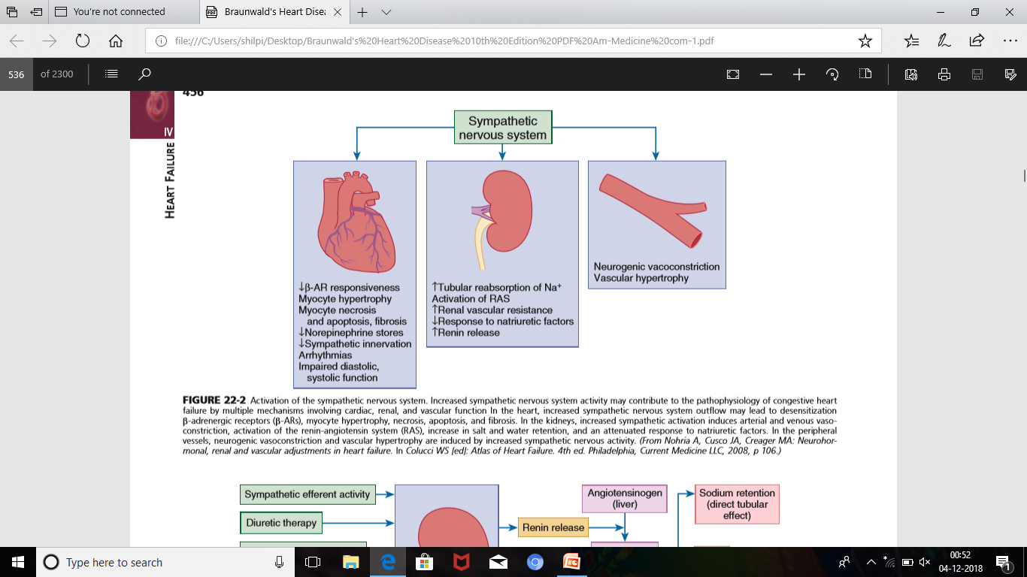

Slide 13
Withdrawal of parasympathetic nerve stimulation
1) decreased nitric oxide (NO)
2) increased inflammation
3) increased sympathetic activity
worsening LV remodeling.

Slide 14
ACTIVATION OF RENIN- ANGIOTENSIN SYSTEM
the components of the RAS are activated comparatively later in heart failure.
Decreased cardiac output
renal hypo-perfusion
decreased filtered sodium reaching the macula densa in the distal tubule
Increased sympathetic stimulation of the kidney, leading to increased renin release from jutaglomerular apparatus

Slide 15
In HF ACE mRNA are
ACE binding sites increased in
ACE activity explanted
heart
ATII can also be synthesized using Renin independent pathways:
angiotensinogen
kallikrein and cathepsin G
angiotensin I
chymase*
angiotensin II
Notes:
* ACE inhibitors when are used

Slide 16
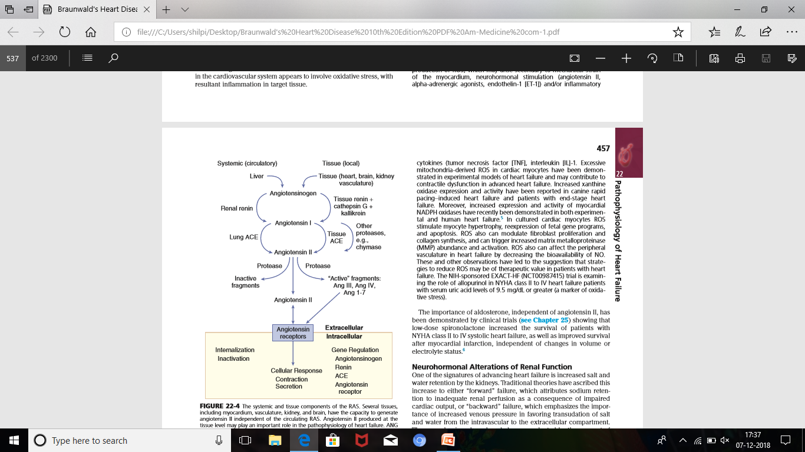

Slide 17
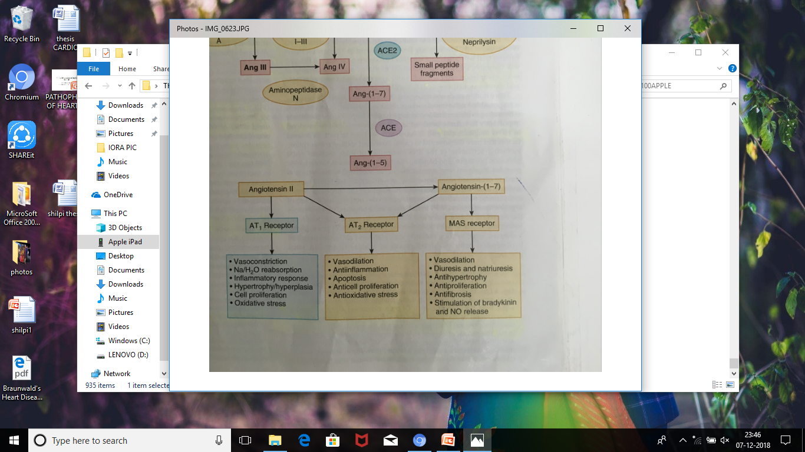

Slide 18
ANGIOTENSIN II
Sustained expression is maladaptive leading to fibrosis of the heart, kidneys, and other organs.
leads to worsening neurohormonal activation by enhancing the release of NE from sympathetic nerve endings
stimulates the zona glomerulosa of the adrenal cortex to produce aldosterone
sustained expression
1) hypertrophy and fibrosis within the vasculature and the myocardium(contributing to reduced vascular compliance and increased ventricular stiffness)
2) endothelial cell dysfunction
3) baroreceptor dysfunction
4) inhibition of NE uptake
leads to worsening of heart failure

Slide 19
OXIDATIVE STRESS
In the heart, the potential sources for ROS include--
mitochondria
xanthine oxidase
NADPH oxidase
ROS can modulate the activity of a variety of intracellular proteins and signaling pathways, including essential proteins involved in myocardial excitation-contraction coupling, such as ion channels, sarcoplasmic reticulum (SR) calcium release channels, and myofilament proteins, as well as signaling pathways that are coupled to myocyte growth.

Slide 20
In Heart failure
mechanical strain of the myocardium, neurohormonal stimulation and/or inflammatory cytokines are released
ROS increases due to due to increased production and also due to decrease anti-oxidant capacity
contribute to contractile dysfunction in advanced heart failure.

Slide 21
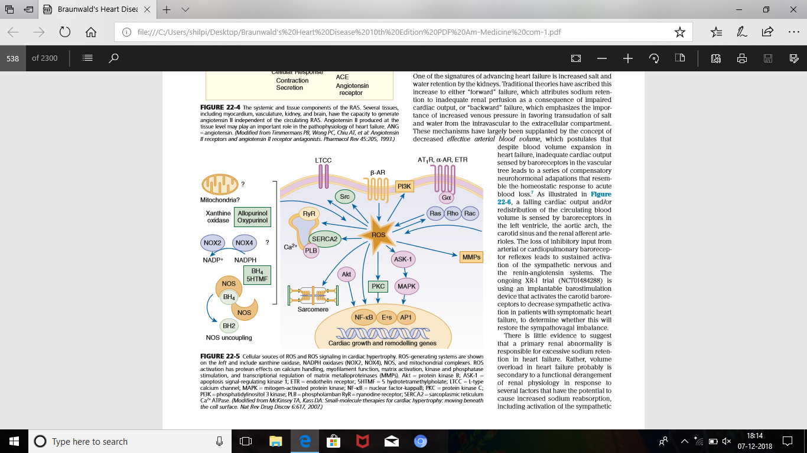
Notes:
ASK1--- APOPTOSIS SIGNAL REGULATING KINASE 1
CALCIUM CHANNELS
CONTRACTION PROTEIN
INCREASE MMPs
INCREASED GROWTH AND REMODELLING

Slide 22
ROS -- 1)stimulate myocyte hypertrophy
2)re-expression of fetal gene programs
3)apoptosis
4)modulate fibroblast proliferation and
collagen synthesis.
5)increased MMP abundance and
activation.
6)affect the peripheral vasculature in HF
by decreasing the bioavailability of NO.

Slide 23
Neurohormonal Alterations of Renal Function
Advancing heart failure
“Forward” failure leading to inadequate renal perfusion as a consequence of impaired cardiac output, or
“backward” failure increased venous pressure favoring transudation of salt and water from the intravascular to the extracellular compartment.

Slide 24
In heart failure
inadequate cardiac output
sensed by baroreceptors in the vascular tree leads to a series of compensatory neurohormonal adapations
The loss of inhibitory input from arterial or cardiopulmonary baroreceptor reflexes leads to sustained activation of the sympathetic nervous and the renin-angiotensin systems.

Slide 25
So, an implantable barostimulation device that activates the carotid baroreceptors to decrease sympathetic activity and increase vagal tone can improve quality of life and exercise capacity in patients with symptomatic HF.
IN HF activation of SNS and RAS leading to vasoconstriction and thereby decreasing RBF and blunting of renal responsiveness to natriuretic peptides.

Slide 26
Increased sympathetic stimulation---
decreased RBF leading to increased renal tubular sodium and H2O reabsorption .
increase ADH(non-osmotic) which leads to decrease excretion of H2O and increased endothelin production.
Moreover increased renal venous pressure
renal interstitial hypertension
Tubular injury and renal fibrosis.

Slide 27
VASOPRESSIN
AVP is elevated in many patients with heart failure, even after correction for plasma osmolality (i.e., nonosmotic release) and may contribute to the hyponatremia that occurs in heart failure.

Slide 28
V1a --- in vascular smooth muscle cells and leads to a)vasoconstriction
b)platelet aggregation
c) stimulation of myocardial GFs
Inhibited by RELCOVAPTAN
V1b--- in CNS and modulates ACTH secretion
V2--- in kidneys and stimulates adenylyl cyclase and leads to increased rate of insertion of water channels leading to water retention.
Inhibited by TOLVAPTAN and LIXIVAPTAN
V1a/V2 inhibitors--- CONIVAPTAN
Notes:
Acts via 3 receptors

Slide 29
IN HF
In order to offset the deleterious effects of the vasoconstricting neurohormones
A number of counterregulatory neurohormonal systems become activated
a)prostaglandin E2 (PGE2) and prostacyclin (PGI2)
b)natriuretic peptides, ANP and BNP
Notes:
1)vasodilator, PGE2 enhances renal sodium excretion and modulates the antidiuretic action of AVP.
2) once released, these cardiac peptides act on the kidneys and peripheral circulation to unload the heart, through increased excretion of sodium and water, while inhibiting the release of renin and aldosterone.

Slide 30
the renal effects of the natriuretic peptides appear to become blunted with advancing heart failure because of
a) low renal perfusion pressure
b) relative deficiency or altered molecular forms of the natriuretic peptides
c) decreased levels of natriuretic peptide receptors.

Slide 31
NATRIURETIC PEPTIDES
The natriuretic peptide system consists of five structurally similar peptides –
ANP
Urodilantin (an isoform of ANP)
BNP
C-type natriuretic peptide (CNP)
dendroaspis natriuretic peptide (DNP)

Slide 32
In response to increased cardiac wall tension, neurohormones and some physiological factors---- there is release in ANP and BNP
Both are synthesized as pro-hormones,
pro-ANP pro-BNP
corin furin
NT-ANP and ANP NT-BNP, BNP

Slide 33
ANP, BNP, CNP
degraded by
NPR-C mediated internalisation followed by lysosomal degradation
Via NEP ie neprilysin ,a membrane bound Zn containing metallopeptidases
Notes:
Natriuretic peptide receptor C

Slide 34
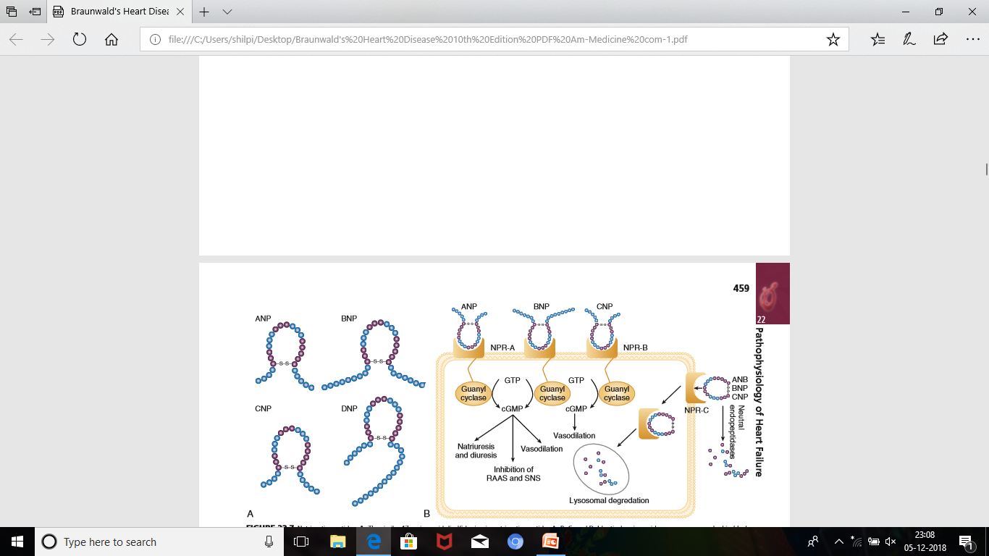

Slide 35
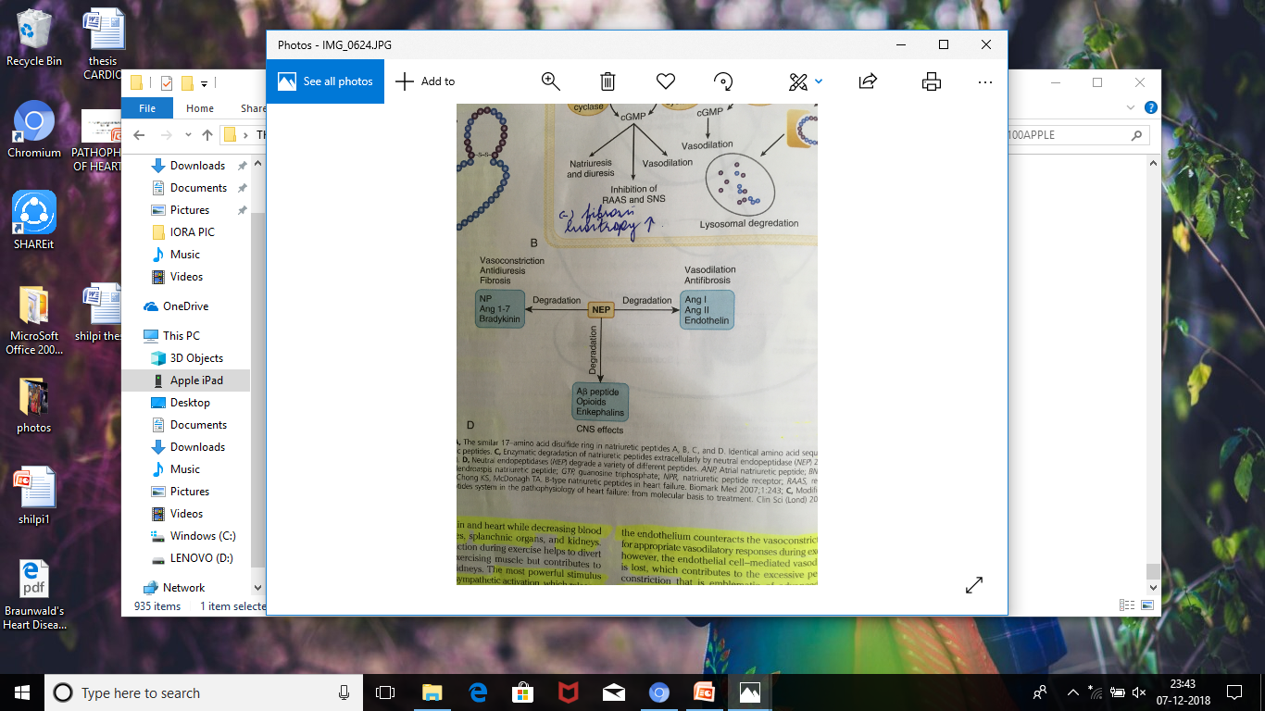

Slide 36
NEP degrades multiple peptides , including natriuretic peptides, angiotensin I, angiotensin II, ET-I, adrenomedullin, opioids, bradykinin, chemotactic peptides, enkephalins and amyloid beta peptide*.
NEP inhibition of degradation of natriuretic peptides results in vasorelaxation, natriuresis, inhibition of hypertrophy and fibrosis.
Notes:
*so helps in Alzeimers

Slide 37
On the other hand ,inhibition of degradation of other vasoactive peptides such as angiotensin II, angiotensin 1-7, endothelin , opposes the vasodilatory effects of natriuretic peptides.
The use of combined ATI receptor antagonist and a neprilysin inhibitor has shown a favourable outcome in HF.

Slide 38
Neurohormonal Alterations in the Peripheral Vasculature
In patients with heart failure, the complex interactions between the autonomic nervous system and local autoregulatory mechanisms tend to preserve circulation to the brain and heart while decreasing blood flow to the skin, skeletal muscles, splanchnic organs, and kidneys.
peripheral vasoconstriction is sympathetic activation, which releases the potent vasoconstrictor NE. Other vasoconstrictors that contribute to maintaining circulatory homeostasis include Angiotensin II, ET, neuropeptide Y, urotensin II, thromboxane A2, and AVP.

Slide 39
the increased concentrations of circulating vasoconstrictors contribute to the arteriolar vasoconstriction and to the maintenance of arterial pressure.
the sympathetic stimulation of the veins contributes to an increase in venous tone, which helps to maintain venous return and ventricular filling and to support cardiac performance by Starling’s law of the heart .

Slide 40
the vasoconstricting neurohormones
activate counterregulatory vasodilator responses
release of natriuretic peptides, NO, bradykinin, adrenomedullin, apelin, and vasodilating prostaglandins PGI2 and PGE2
normally the continuous release of NO (endothelium-derived relaxing factor) from the endothelium counteracts the vasoconstricting factors and allows for appropriate vasodilatory responses during exercise
As heart failure advances, however, the endothelial cell– mediated vasodilatory responsiveness is lost
So excessive peripheral arterial vasoconstriction .
Notes:
Of interest, the vasodilator response can be restored by the administration of L-arginine, a precursor of endothelium-derived NO.

Slide 41
Nitric oxide
produced by three isoforms of NO synthase (NOS).
NOS1 (neuronal NOS [nNOS]) detected in cardiac conduction tissue, in intracardiac neurons, and in the SR of cardiac myocytes
NOS2 (inducible NOS [iNOS])* normally expressed in the myocardium but is synthesized de novo in virtually all cells in the heart in response to inflammatory cytokines
NOS3 (so-called endothelial-constitutive NOS [eNOS]) expressed in coronary endothelium and endocardium and in the sarcolemma and T-tubule membranes of cardiac myocytes.
Notes:
*induction is calcium independent

Slide 42
NO
activates soluble guanylate cyclase
leads to the production of cGMP
activates protein kinase G
cascade of different signaling events.
In patients with heart failure, endothelium-dependent NO-mediated dilation of the peripheral vasculature is blunted, which has been attributed to decreased NOS3 expression and activity.

Slide 43
NO modulates the activity of several key calcium channels involved in excitation-contraction coupling as well as mitochondrial respiratory complexes.
Emerging evidence points to an imbalance between increasing free radical production and decreased NO generation in heart failure, which has been termed the nitroso-redox imbalance.
NOS uncoupling secondary to a deficiency of tetrahydrobiopterin may further contribute to the nitroso-redox imbalance.
Notes:
THB is a cofactor for production of NO by NO synthase

Slide 44
Bradykinin
Kinins are vasodilators
inactive protein precursors ,kininogens
kallikreins.
kinin
The biologic actions of the kinins are mediated by binding to B1 and B2 receptors.
Most cardiovascular actions are initiated by the B2 receptor, which is distributed widely in tissues, where it binds bradykinin and kallidin and its stimulation leads to vasodilation ( mediated by the activation of NOS3, phospholipase A2, and adenylyl cyclase).
Bradykinin
ACE and Neprilysin
breakdown products

Slide 45
ADRENOMEDULLIN
A vasodilatory peptide.
Circulating concentrations of adrenomedullin are elevated in cardiovascular disease and heart failure in proportion to the severity of cardiac and hemodynamic impairment.
Immunoassays that detect the prohormone form of adrenomedullin have been shown to predict heart failure–related death in the BAC (Biomarkers in Acute Heart Failure) trial.

Slide 46
APELIN
In the cardiovascular system, apelin elicits endothelium-dependent, NO-mediated vasorelaxation and reduces arterial blood pressure.
Apelin also demonstrates potent inotropic activity without stimulating concomitant cardiac myocyte hypertrophy. It also produces diuresis by inhibition of arginine vasopressin activity.
CLR325 is a apelin receptor agonist that is currently undergoing phase II clinical evaluation in patients with chronic HF.

Slide 47
ADIPOKINES
Adipokines include adiponectin, TNF, plasminogen activator inhibitor type 1 (PAI-1), transforming growth β, and resistin.
Leptin, the product of the ob gene, is predominantly synthesized and secreted by adipocytes , which act via a family of receptor (ob.R) isoforms, appear to play an important role in hypertension, hypertrophy, and heart failure.
Lack of leptin and/or leptin resistance may lead to an accumulation of lipids in nonadipose peripheral tissues, resulting in a variety of “lipotoxic” effects, including cardiac myocyte apoptosis.

Slide 48
ADIPONECTIN
Adiponectin modulates a number of metabolic processes, including glucose regulation and fatty acid oxidation.
Recent studies have demonstrated adiponectin expression in the heart.
Studies in adiponectin deficient mice demonstrated progressive cardiac remodeling after hemodynamic pressure overloading, whereas administration of adiponectin diminished the infarct size, apoptosis, and TNF production after myocardial ischemia-reperfusion in both wild-type and adiponectin-deficient mice.
Of interest, many studies have correlated decreased adiponectin levels with the development of obesity-linked heart failure.
Thus adiponectin has been proposed as a potential biomarker of heart failure and as a potential therapeutic target in its treatment.

Slide 49
INFLAMMATORY MEDIATORS
Although the primary role for these molecules
(TNF, IL1B, IL-6)
is to initiate repair of the injured myocardium
But when expressed for protracted periods of time and/or when expressed at high levels
these molecules provoke deleterious changes in cardiac myocytes and nonmyocytes, as well as changes in the myocardial extracellular matrix.

Slide 50
Angiotensin-II
upregulates the expression of TNF through a nuclear factor κ-B (NF-κB) dependent pathway
TNF leads to increased activation of myocardial ACE and chymase
Leads to upregulation of RAS
Circulating levels of proinflammatory cytokines including TNF and IL-6 are increased in patients with heart failure and correlate with adverse patient outcomes.

Slide 51
Conversely, the plasma concentrations of anti-inflammatory cytokines such as IL-10 are reduced in patients with heart failure and are decreased more in direct relation to the severity of the degree of heart failure, suggesting that the imbalance between pro- and antiinflammatory cytokine expression may contribute to progression of the disease process.

Slide 52
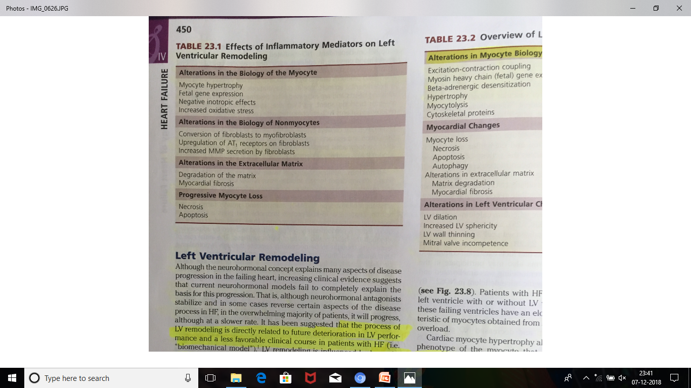

Slide 53
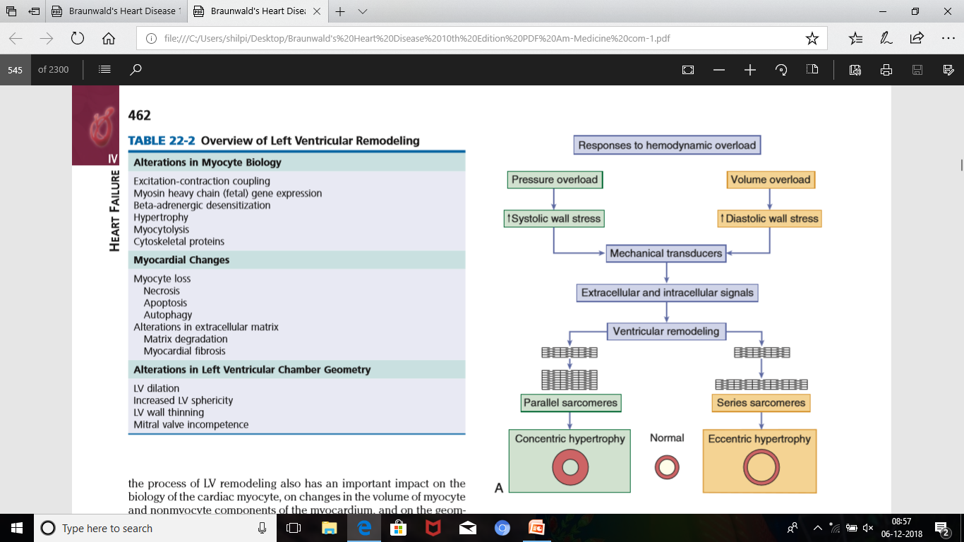
LEFT VENTRICULAR REMODELLING

Slide 54
Cardiac Myocyte Hypertrophy
Two basic patterns of cardiac hypertrophy occur in response to hemodyamic overload –
1)In pressure overload hypertrophy
the increase in systolic wall leads to the addition of sarcomeres in parallel
an increase in myocyte cross-sectional area, and increased LV wall thickening
“concentric” hypertrophy ( linked with alterations in Ca2+/ calmodulin-dependent protein kinase II–dependent signaling).

Slide 55
2)in volume overload hypertrophy
increased diastolic wall stress
leads an increase in myocyte length with the addition of sarcomeres in series
“eccentric” hypertrophy or a “dilated” phenotype
(linked with protein kinase B activation)

Slide 56
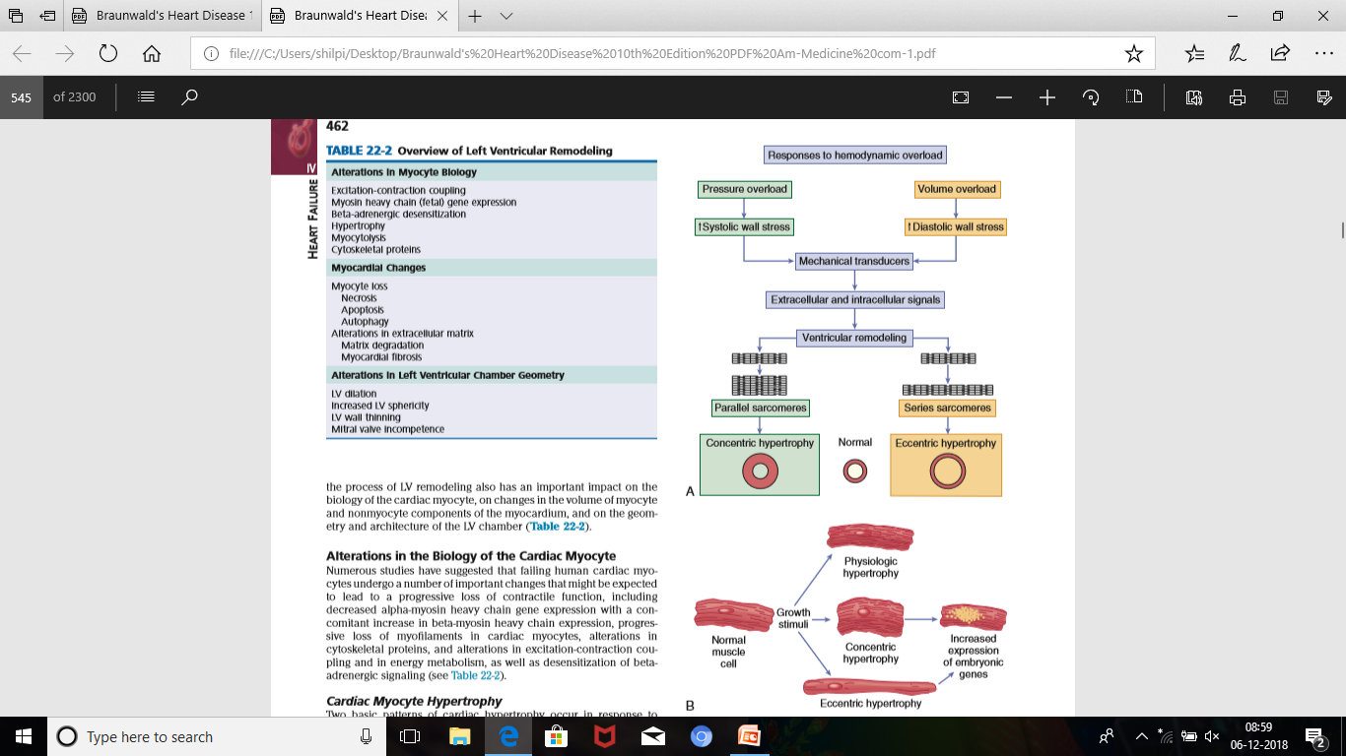
Notes:
Increased expression of maladaptive embryonic genes
Physiologic hypertrophy occurs with exercise.

Slide 57
activation of the fetal gene program may contribute to the contractile dysfunction that develops in the failing myocyte.
early stage of cardiac myocyte hypertrophy
characterized morphologically by increases in the number of myofibrils and mitochondria as well as enlargement of mitochondria and nuclei
At this stage, the cardiac myocytes are larger than normal, but with preservation of cellular organization
As hypertrophy continues
there is an increase in the number of mitochondria, as well as the addition of new contractile elements in localized areas of the cell.

Slide 58
Cells subjected to longstanding hypertrophy
obvious disruptions in cellular organization, such as markedly enlarged nuclei with highly lobulated membranes, accompanied by the displacement of adjacent myofibrils with loss of the normal registration of the Z-bands.
The late stage of hypertrophy
characterized by loss of contractile elements (myocytolysis) with marked disruption of Z-bands and severe disruption of the normal parallel arrangement of the sarcomeres, accompanied by dilation and increased tortuosity of T tubules.

Slide 59
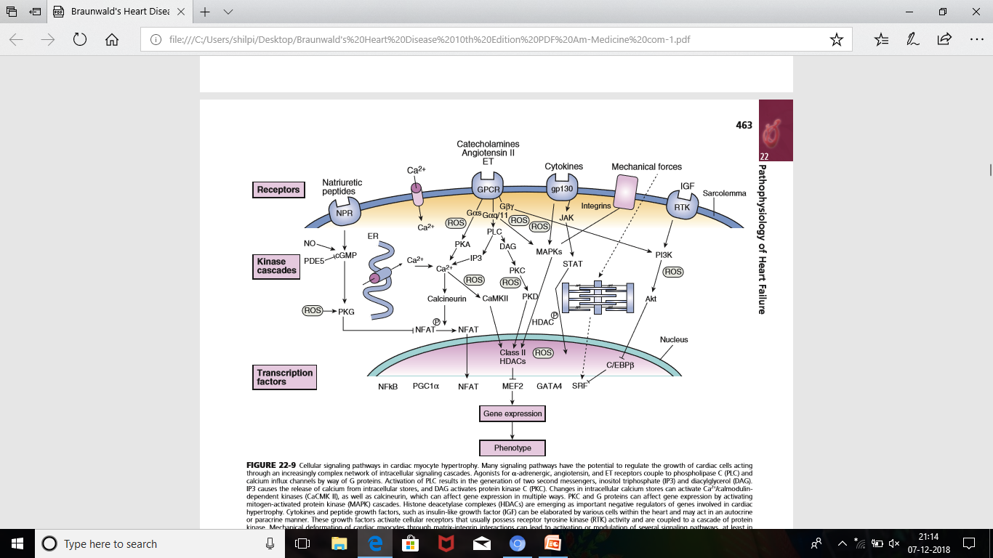
CELLULAR SIGNALLING PATHWAYS
Notes:
AGII via Gpr couples to phospholipase C and Ca influx channels. PLC activates IP3 and DAG, IP3 stimulates release of intracellular calcium and thereby stimulates calcineurin and CAMKII, affects gene expression.
MAPK– mitogen activated protein kinase
HDAC histone deacetylase complexes are negative regulators of gene involved in hypertrophy
Cytokines and IGF stimulate receptor tyrosine kinase and activates protein kinases and modulates gene expression

Slide 60
Alterations in Excitation-Contraction Coupling
In the failing myocardium
a decline in force generation is seen with higher heart rates that is secondary to a decrease in amplitude of intracellular Ca2+, a prolonged decline of the Ca2+ transient, and increased levels of diastolic calcium
The reduced intracellular Ca2 transient is secondary to depletion of Ca2+ from the SR, which is the consequence of three major defects in calcium cycling that occur in the failing heart:
(1) increased leak of calcium through RyRs;
(2) impaired SR calcium uptake due to reduced SERCA2a (SR calcium pump) protein levels and function,
(3) increased expression and function of the sarcolemmal Na+/Ca2+ exchanger (NCX).
Notes:
Phosphorylation and destabilisation of ryanodine receptor
the presence of microdomains in close proximity to the RyR, where there is increased PKA phosphorylation and more cyclic AMP and decreased activity of the type 4 phosphodiesterase (PDE4D3).Drugs with the ability to bind to and stabilize the RyR (referred to as RYCALs), such as the diltiazem derivative JTV 519, have been shown to attenuate experimental heart failure and are currently being developed as novel therapeutic class drugs in the treatment of heart failure.

Slide 61
Action Potential Duration and Sodium Handling
the increased inward Na+ current through the NCX and persistent activity of the sodium channel also may contribute to prolongation of the action potential. The latter mechanism, also termed the late sodium current, may be important in the pathogenesis of cardiac arrhythmias in heart failure.
Under normal conditions, Na+ channels inactivate a few milliseconds after depolarization. However, it is now recognized that some Na+ channels remain open (or reopen), leading to a small but persistent influx of Na+ throughout the plateau of the action potential, which generates a “late” sodium current (INa).Although the amplitude of late INa is small compared with peak INa, the current is sufficient to lead to a substantial influx of Na+ into the cell in heart failure, with consequent prolongation of the action potential and early after depolarizations, which may be a significant source of increased arrhythmias in heart failure.

Slide 62
High levels of intracellular Na
increased sodium-proton exchange activity
may lead to cellular acidosis
Increased intracellular Na+
influences the driving forces for the NCX so decreased calcium extrusion
this when combined with reduced activity of the SERCA2a pump
elevated diastolic cytosolic calcium levels
disturbed diastolic function in heart failure.

Slide 63
higher NCX expression with moderately elevated intracellular Na+
excess transsarcolemmal calcium elimination
and diastolic function will be rather preserved but with increased arrhythmias secondary to increased NCX activity.

Slide 64
Abnormalities in Contractile and Regulatory Proteins

Slide 65
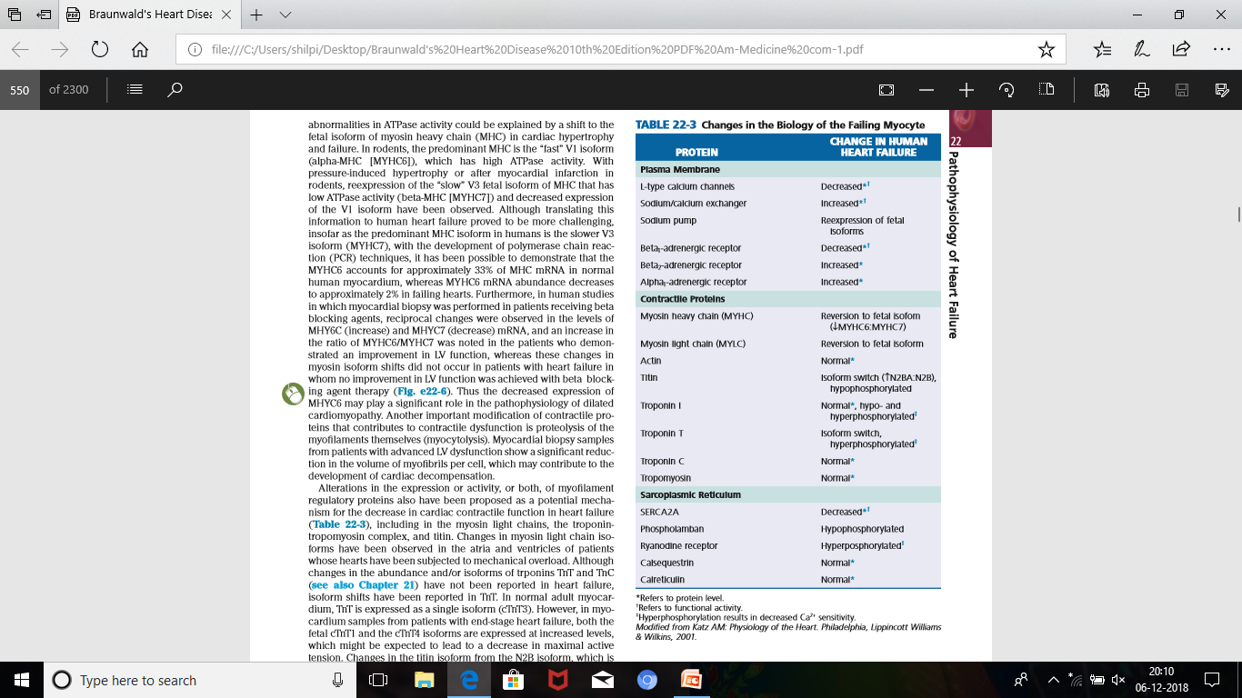

Slide 66
Beta-Adrenergic Desensitization
Ventricles obtained from patients with heart failure demonstrate a marked reduction in beta-adrenergic receptor density, isoproterenol mediated adenyl cyclase stimulation, and the contractile response to beta-adrenergic agonists.
The downregulation of beta-adrenergic receptors probably is mediated by increased levels of NE in the vicinity of the receptor
In patients with dilated cardiomyopathy, this reduction in receptor density involves primarily the beta1-receptor protein and mRNA and is proportional to the severity of heart failure. By contrast, the level of beta2-adrenergic receptor protein and mRNA are unchanged.

Slide 67
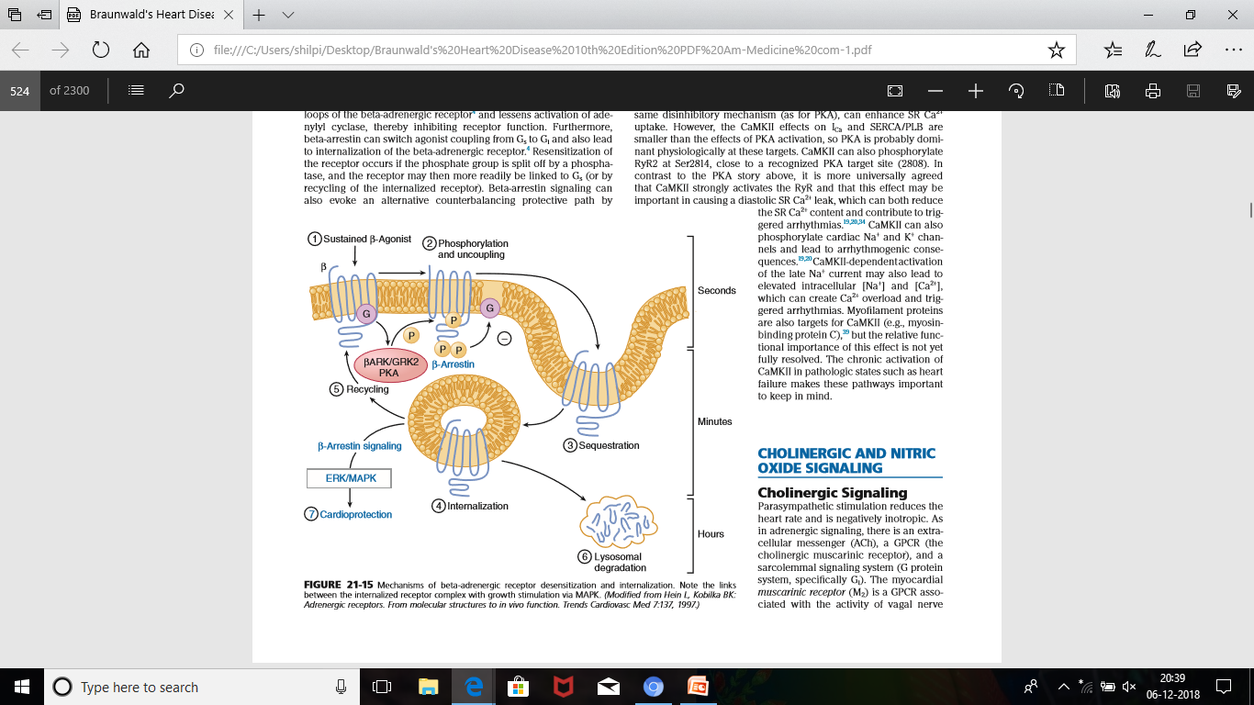
Notes:
GRK2--- G-protein coupled receptor kinase 2

Slide 68
Desensitization of the beta receptors can be both beneficial and deleterious in heart failure. By reducing LV contractility, desensitization may be deleterious;
however, by reducing energy expenditure of the energy-starved myocardium and protecting the myocyte from the deleterious effects of sustained adrenergic stimulation, this adaptive response is beneficial.
Interestingly, lymphocyte GRK2 protein levels were shown to be independent predictors of Cardiovascular mortality in patients with HF and added prognostic and clinical value in HF.

Slide 69
ALTERATIONS IN THE MYOCARDIUM
The alterations that occur in failing myocardium may be categorized broadly into
1) Changes that occur in the volume of cardiac myocytes--- progressive myocyte loss, through necrotic, apoptotic, or autophagic cell death pathways, may contribute to progressive cardiac dysfunction and LV remodeling.
2) Changes that occur in the volume and composition of the extracellular matrix

Slide 70
NECROSIS
Regulated necrosis is an important component of myocardial infarction, heart failure, and stroke.
The hallmark features of necrosis are loss of plasma membrane integrity and depletion of cellular adenosine triphosphate (ATP). Dysfunction of the plasma membrane in necrotic cells leads to cell swelling and rupture. There is also swelling of organelles such as the mitochondria.
In the heart, increased plasma membrane permeability allows calcium to leak into the cell, exposing the contractile proteins to very high concentrations of this activator, which in turn initiates extreme interactions between the myofilaments (contraction bands), further contributing to disruption of the cellular membrane. Neurohormonal activation also can lead to necrotic cell death.

Slide 71
The rupture of cell membranes with cell necrosis releases intracellular contents, so-called DAMPS (danger-associated molecular patterns)
which evoke an intense inflammatory reaction
leading to the influx of granulocytes, macrophages, and collagen-secreting fibroblasts into the area of injury
fibrotic scar
alter the structural and functional properties of the myocardium

Slide 72
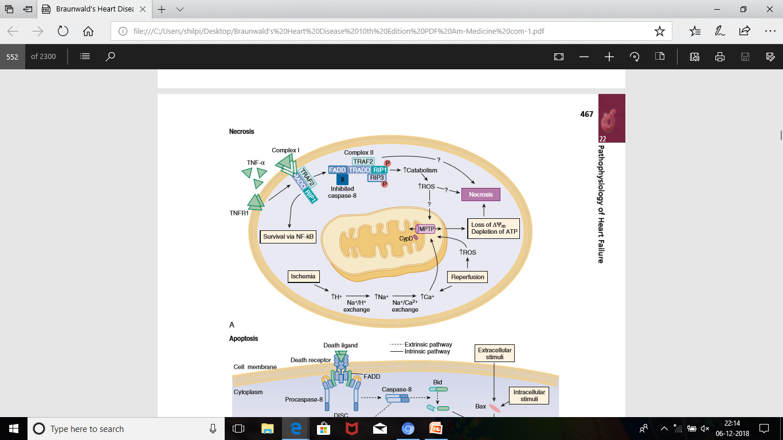
Notes:
MPTP--- mitochondrial permeability transition pore
Opened by increased Ca, oxidative stress, decreased ATP generation

Slide 73
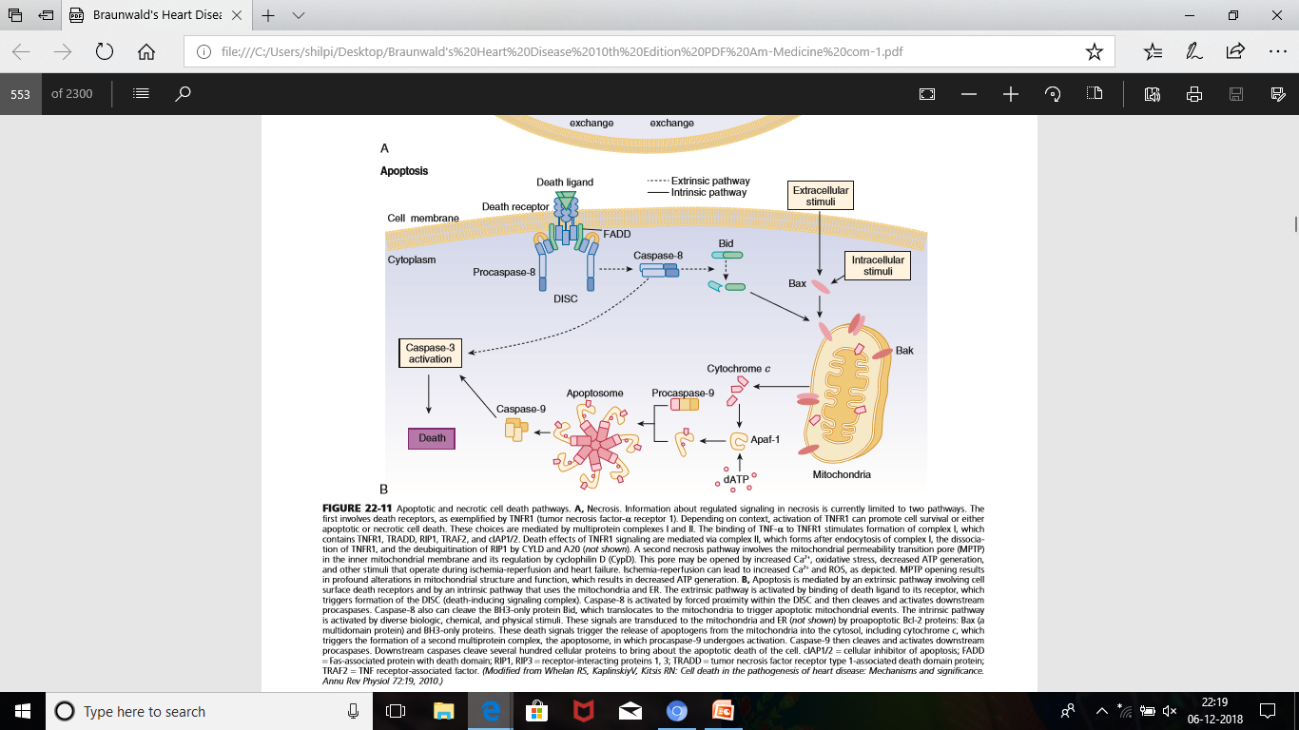
APOPTOSIS
Notes:
DISC– death inducing signalling complex
Apaf1– apoptotic protease activating factor1

Slide 74
Under pathologic circumstances, such as acute ischemia and/or in dilated cardiomyopathy, the apoptotic program can be triggered inappropriately, resulting in inadvertent cell death that can lead to organ failure.
Cardiac myocyte apoptosis has been shown to occur in failing human hearts.
Many of the factors that have been implicated in the pathogenesis of heart failure, including catecholamines acting through beta1-adrenergic receptor, angiotensin II, ROS , inflammatory cytokines (e.g., TNF), and mechanical strain, have been shown to trigger apoptosis in vitro.

Slide 75
AUTOPHAGY
Autophagy refers to the homeostatic cellular process of sequestering organelles, proteins, and lipids in a double-membrane vesicle inside the cell (autophagosome), where the contents are subsequently delivered to the lysosome for degradation.
Recent studies have demonstrated the existence of autophagic cell death in hypertrophied, failing, and hibernating myocardium.
Approximately 0.3% of the cardiac myocytes in explanted hearts from patients with heart failure exhibited autophagic cell death, whereas the predominant form of cell death in pressure overloaded human hearts was mainly by autophagy and oncosis.

Slide 76
ALTERATION IN ECM
The myocardial ECM consists of a basement membrane, a fibrillar collagen network that surrounds the myocytes, proteoglycans and glycosaminoglycans, and specialized proteins such as matricellular proteins.
The major fibrillar collagens in the heart are type I and III, with a ratio of type I to type III of approximately 1.3 to 1.9:1.
Notes:
1,2,3,5,11

Slide 77
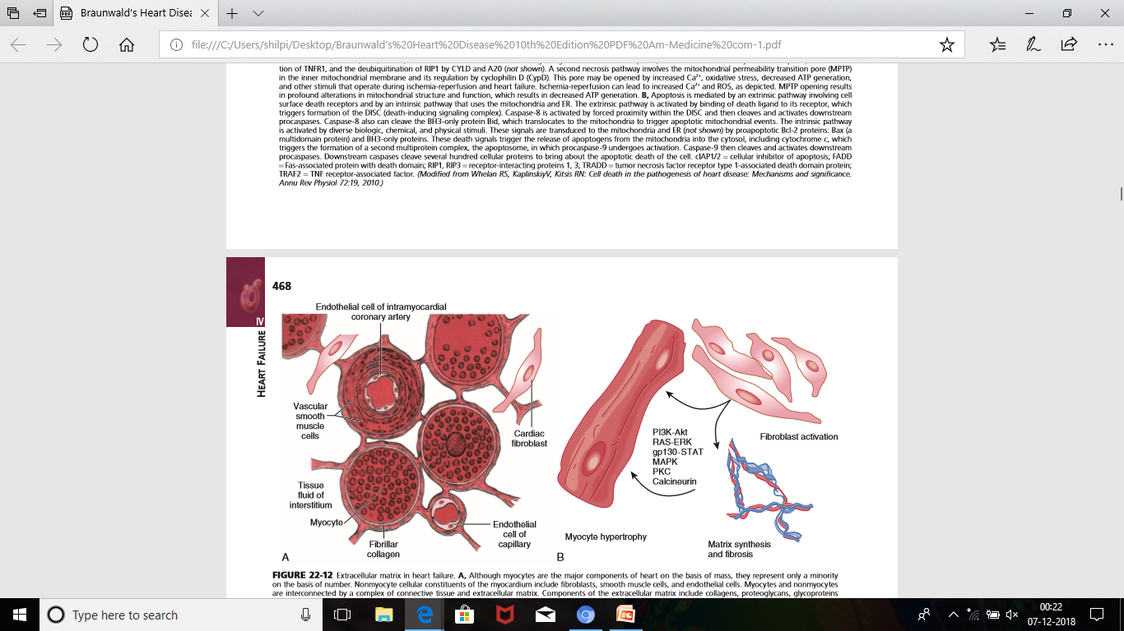

Slide 78
The organization of myocardial fibrillar type I and type III collagen ensures the structural integrity of adjoining myocytes and is essential for maintaining alignment of myofibrils within the myocyte through the interaction of collagen and integrins and the cytoskeletal proteins.
Matricellular proteins are a class of nonstructural ECM proteins exerting regulatory functions, most likely through their interactions with cell surface receptors, the structural proteins, and soluble extracellular factors such as growth factors and cytokines.

Slide 79
Osteopontin (OPN [Eta-1]) is a matricellular protein that is expressed in various cell types, including cardiac myocytes and fibroblasts. OPN is likely to be involved in the communication between the ECM and cardiac myocytes, which implies a role in cardiac remodeling after hemodynamic overloading.
OPN is markedly upregulated in animal models of cardiac hypertrophy and failure and/or in myocardial ischemia and in the hearts of patients with dilated cardiomyopathy
Its elevation in the peripheral circulation of patients is directly related to heart failure disease severity.

Slide 80
During cardiac remodeling important changes in the ECM--
1)changes in fibrillar collagen synthesis and degradation
2) changes in the degree of collagen cross-linking
3) loss of collagen struts that connect the individual cardiac myocytes.
Markers of collagen turnover have been shown to be increased in patients with dilated cardiomyopathy .

Slide 81
In patients with idiopathic or ischemic dilated cardiomyopathy, serum N-terminal type III collagen peptide (PIIINP) levels have been shown to be independent predictors of mortality.
In the RALES trial, serum PIP and PIIINP were decreased in the spironolactone-treated patients but not in the placebo group, suggesting that aldosterone may play an important role in ECM synthesis
Notes:
PIP– serum C-terminal peptide type 1 collagen pro-peptide

Slide 82
Cardiac Fibroblasts and Mast Cells
The cardiac fibroblast accounts for almost 90% of nonmyocyte cells in the heart
Responsible for the secretion of a majority of ECM components in the heart, such as collagens I, III, and IV and laminin and fibronectin.
fibroblast
mechanical stress and/or neurohormonal
myofibroblasts activation
( characterized by increased expression of α- smooth muscle actin and enhanced secretory activity.)

Slide 83
Myofibroblasts migrate into the area surrounding tissue injury where they are responsible for the collagen secretion and contraction/ realignment of the nascent collagen fibers, and thus play an important role in the final scar formation at the site of injury.
cardiac fibroblasts and myocytes release
transforming growth factor-β1 (TGF-β1), fibroblast growth factor-2 (FGF2), members of the IL-6 family, and IL-33.
regulate neighboring cells.

Slide 84
Mast cells, which reside in the myocardium, also play an important role in remodeling of the ECM.
they are capable of releasing profibrotic cytokines and growth factors that influence ECM remodeling.
In experimental studies, mast cells that are recruited to the heart during inflammation were responsible for TGF-β1–mediated fibroblast activation, myocardial fibrosis, and LV diastolic dysfunction

Slide 85
Histologic signatures of advancing heart failure is
1) the progressive increase in collagen content of the heart (myocardial fibrosis).
2) quantitative increase in collagen types I, III, VI, and IV along with fibronectin, laminin, and vimentin and a decrease in the ratio of type I collagen to type III collagen.
progressive loss of cross-linking of collagen in the failing heart, as well as loss of connectivity of the collagen network with individual myocytes, would result in profound alterations in LV structure and function.

Slide 86
cardiac myocyte cell necrosis
collagen accumulation
microscopic scarring
increased myocardial stiffness
decreased myocardial shortening for a given degree of afterload.
In addition, myocardial fibrosis may provide the structural substrate for atrial and ventricular arrhythmias, thus potentially contributing to sudden death .
the use of ACE inhibitors, beta blocking agents, and aldosterone receptor antagonists has been associated with a decrease in myocardial fibrosis in experimental heart failure models.

Slide 87
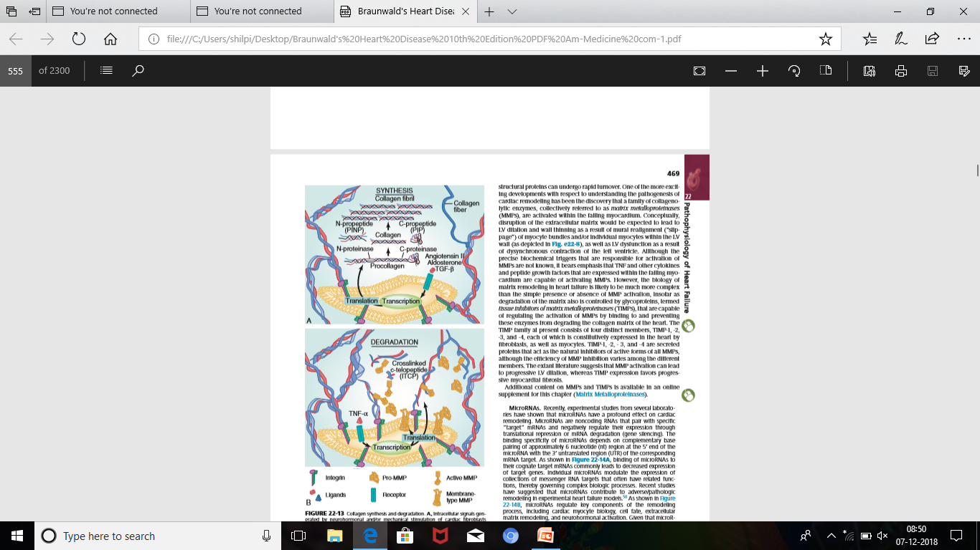

Slide 88
MMP activation can lead to progressive LV dilation, whereas TIMP expression favors progressive myocardial fibrosis.
Notes:
MMP– matrix metalloproteinases
TIMP– tissue inhibitors of matrix metalloproteinases

Slide 89
Alterations in Left Ventricular Structure
The alterations in the biology of the failing myocyte, as well as in the failing myocardium, are largely responsible for the progressive LV dilation and LV dysfunction that occur during cardiac remodeling.
remodeled heart was not only larger but also more spherical in shape. Change in LV shape from a prolate ellipse to a more spherical shape results in an increase in meridional wall stress of the left ventricle, thereby creating a de novo energetic burden for the failing heart.

Slide 90
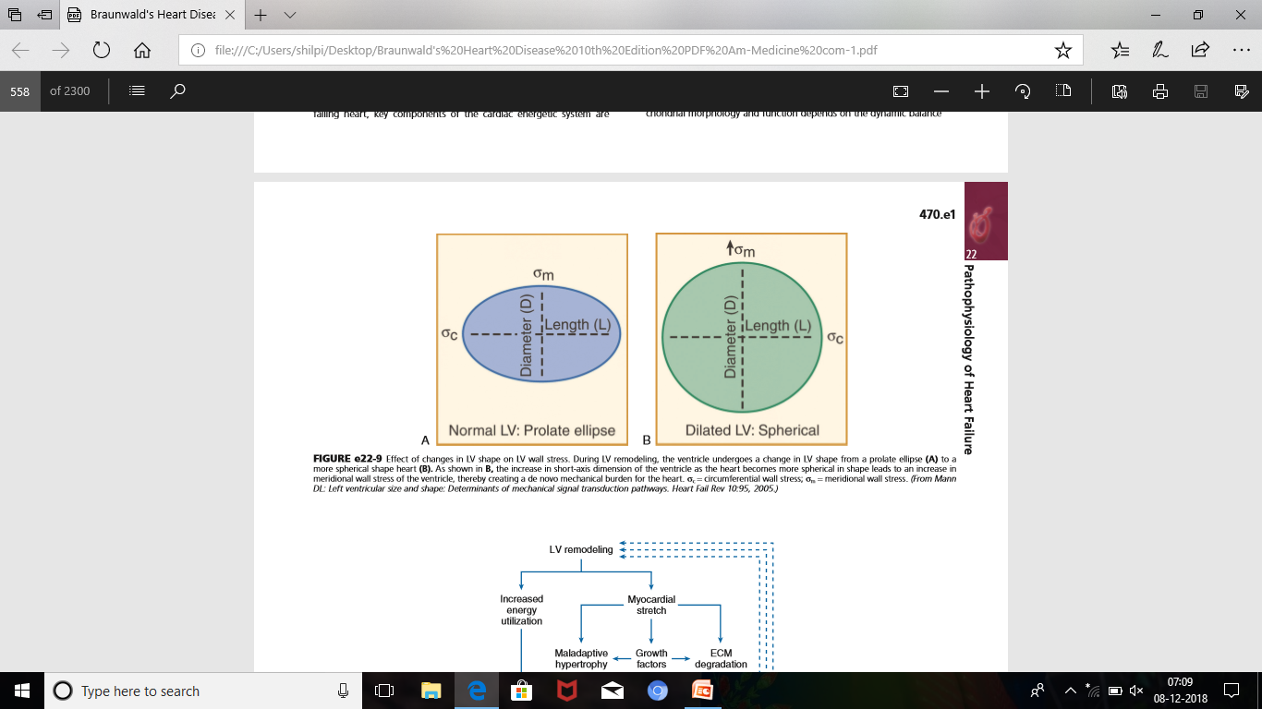
Notes:
LV wall stress = LV pressure * radius/2* LV wall thickness

Slide 91
Energy transfer in the cardiac myocyte occurs in three stages, including uptake and metabolism, energy production through oxidative phosphorylation, and energy transfer by means of the creatine kinase shuttle.
Studies of myocardial ATP concentrations in humans with end-stage cardiomyopathy have shown that ATP concentration, the total adenine nucleotide pool (ATP, ADP, and AMP), creatine kinase (CK) activity (required for synthesis of ATP), the concentrations of creatine phosphate (CrP) are all decreased in heart failure.

Slide 92
In addition, decreased levels of creatine phosphokinase which would slow phosphocreatine shuttle, thereby further exacerbating energy utilization in the failing heart is now proven
Thus in the failing heart, key components of the cardiac energetic system are downregulated.
Under normal conditions, the adult heart derives most of its energy through oxidation of fatty acids in mitochondria.

Slide 93
In experimental heart failure models, an initial decrease is seen in the oxidation of fatty acids secondary to downregulation of fatty acid–metabolizing genes, with a resultant shift toward glycolytic metabolism.
In addition to loss of substrate, ATP generation may be impaired in the failing heart secondary to abnormalities in mitochondrial dynamics.
abnormalities in mitochondrial dynamics may contribute to the cell death through apoptotic and/or autophagic cell signaling pathways

Slide 94
In addition to the increase in LV end-diastolic volume, LV wall thinning also occurs as the ventricle begins to remodel.
The increase in wall thinning along with the increase in afterload created by LV dilation leads to a functional “afterload mismatch” that may further contribute to a decrease in forward cardiac output.
Increased LV wall stress also can lead to sustained expression of stretch-activated genes (angiotensin II, ET, and TNF) and/or stretch activation of hypertrophic signaling pathways.

Slide 95
Moreover, the high end-diastolic wall stress might be expected to lead to episodic hypoperfusion of the subendocardium with resultant worsening of LV function, as well as increased oxidative stress, with the resultant activation of families of genes that are sensitive to free radical generation (e.g., TNF and IL-1β).
progressive LV dilation leads to pulling apart of the papillary muscles resulting in incompetence of the mitral valve and the development of “functional mitral regurgitation.”
In addition to the loss of forward blood flow, mitral regurgitation results in further hemodynamic volume overloading of the ventricle.
Notes:
Myocardial recovery and remission

Slide 96
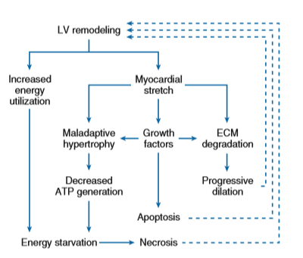

Slide 97
THANK YOU

Slide 98
DEFINATION
The current American Heart Association guidelines defines heart failure as a complex clinical syndrome that results from structural or functional impairment of ventricular filling or ejection of blood, which in turn leads to the cardinal clinical symptoms of dyspnoea and fatigue and signs of heart failure , namely edema and rales.

