Slide 1
COR TRIATRIATUM SINISTER IN ADULT
Dr Smruti Hindaria
Assistant Professor,Department of CVTS

Slide 2
CASE
32 years old lady
c/o breathlessness and palpitations on exertion since childhood, aggravated since 3 months
2D ECHO - All 4 PV draining into a confluence, right lower PV is narrowed & entering into the confluence, confluence draining into RA at SVC-RA junction, RA-RV dilated, severe PAH +, membrane seen in LA
Room air SpO2 88%
o/e - central cyanosis+
Patient started on sildenafil 1 month prior to planned surgery

Slide 3
CARDIAC CT
Right upper & middle lobe veins; and the right lower lobe vein are draining into a smallchamber seen posterior and to the right of the left atrium measuring 35 x 28 x 28 mm in size.
This chamber is separated from the left atrium by a thin septum except a small communication inferolaterally, measuring 8 mm in diameter.
Confluence of the right upper lobe and middle lobe veins is also continuous with a smallcaliber horizontal draining channel extending to the left in subcarinal location.

Slide 4
Thehorizontal draining channel measures 13 x 4 mm in diameter at its right end and 16 x 14mm in diameter at its left end at its confluence with left-sided pulmonary veins. The left upper and lower lobe pulmonary veins are seen to drain into this common channel whichthen extends superiorly to drain into the left innominate vein.
The vertical vein measures 29mm in diameter in left parahilar region and 26 mm at its opening into the innominate vein.

Slide 5
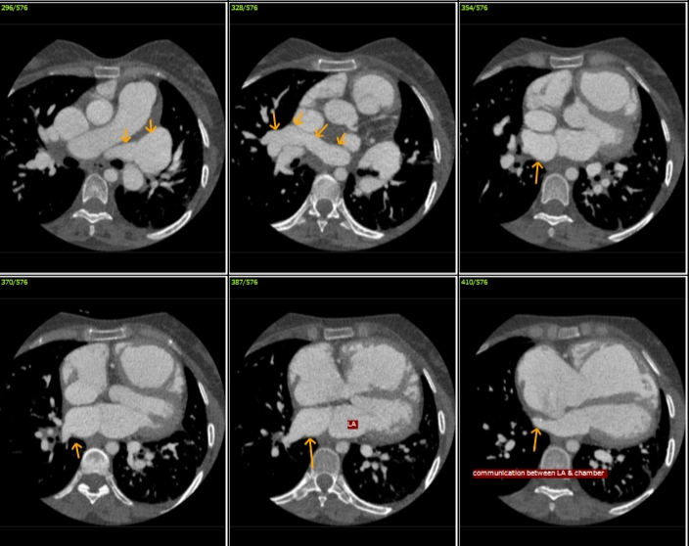
CARDIAC CT

Slide 6
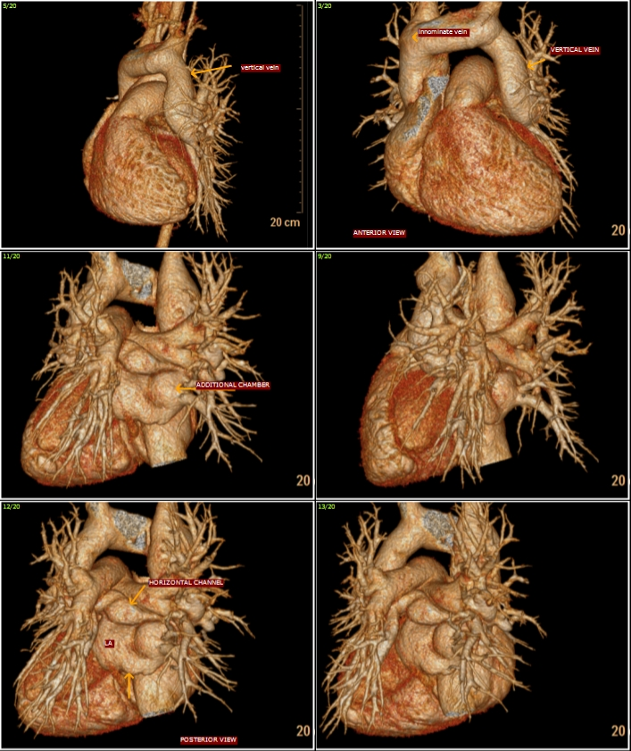
CARDIAC CT

Slide 7
SURGICAL PLAN
Total intracardiac repair of Cor triatriatum on Cardiopulmonary Bypass

Slide 8
INTRAOPERATIVE FINDINGS
Dilated RV,MPA, PA pressure 60/30
Large 5 cm diameter vertical vein arising from left venous chamber draining into innominate vein
Left venous chamber communicating via narrow horizontal channel to cor chamber
Cor triatriatum with right pulmonary veins draining into it, 6mm perforation in cor septum
5mm OS ASD

Slide 9
SURGICAL CORRECTION
Excision of cor septum
Common posterior venous channel anastamosis to LA roof extending upto LA appendage
Ligation and closure of vertical vein
Patch closure of IAS

Slide 10
POST OPERATIVE CARE
Patient electively ventilated for 24 hours i/v/o severe preoperative PAH
milrinone infusion continued for 24 hours post-op
Extubated on POD1
Post extubation SpO2 99% on 4 lit O2
Drainage was minimal
Oral pulmonary vasodilators started immediately after referral to Pulmonary medicine department (tab endoblo -T)

Slide 11
Patient was discharged on POD 5 on -
warf
Ecosprin
Metoprolol XL
Cardace
Lasilactone
Endobloc-T

Slide 12
On follow-up 2D ECHO after 1 month, pulmonary flow was seen entering LA, normal PA pressure, good BVF
Patient remains well on 6 month follow up. Only low dose cardace continued.

Slide 13
COR TRIATRIATUM
Classic (or typical) cor triatriatum, or cor triatriatum sinister,is a rare congenital cardiac anomaly in which the pulmonary veins typically enter a “proximal” left atrial chamber separated from the “distal” left atrial chamber by a partition in which there are one or more restrictive ostia

Slide 14
Infants with classic cor triatriatum, with a small aperture
between the proximal and distal chambers, usually present
with evidence of low cardiac output, including pallor, tachypnea, poor peripheral pulses, and growth failure.
When there is associated left-to-right shunting due to connection of the proximal chamber to the right atrium or because of associated PAPVC, evidence of pulmonary overcirculation and venous obstruction may be present in the chest radiograph, and right ventricular enlargement is prominent.

Slide 15
In children and young adults, the classic presentation is with signs and symptoms of pulmonary venous hypertension.

Slide 16
In most patients, the aperture is severely restrictive, and
approximately 75% of persons born with classic cor triatriatum die in infancy.
However, when the proximal chamber communicates with the right atrium through a fossa ovalis atrial septal defect, the prognosis is better because the proximal chamber decompresses into the right atrium . These patients present with signs of a large left-to-right shunt and generally survive longer than those with an obstructive aperture. Rarely, cor triatriatum may be discovered in an
adult.

Slide 17
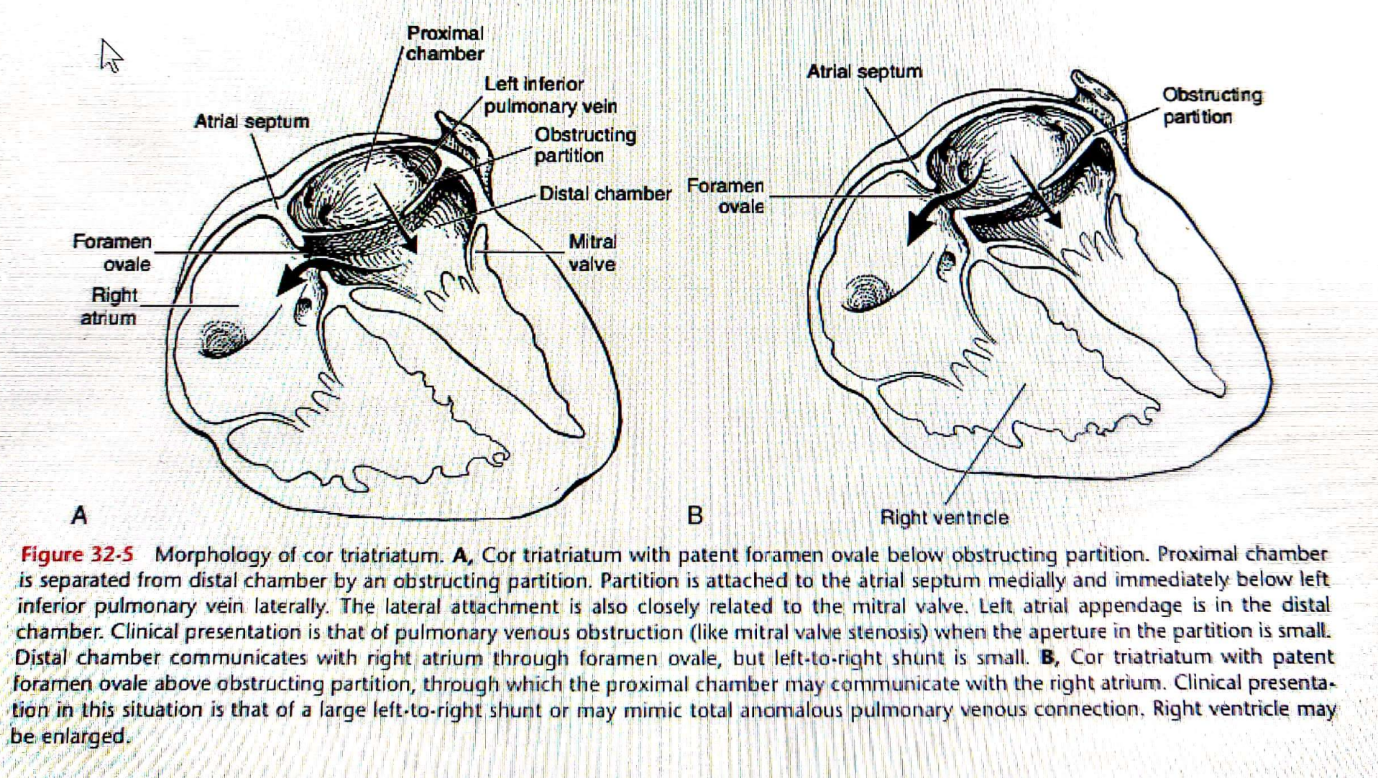

Slide 18
Conclusions
Rare case - On review of literature, only 8 cases of Cor triatriatum in adults have been reported so far in individual case series. Our patient survived to adulthood, also had uneventful pregnancy before presentation.
Complex anomaly - not straightforward anatomy
Repeated preop discussions and planning to be prepared for on table possibilities
Excellent preoperative images - Radiology dept
Management of Pulmonary hypertension - Pulmo med dept

Slide 19


