Slide 1
ANNUAL CLINICAL MEETING
DEPARTMENT OF OTORHINOLARYNGOLOGY AND HEAD AND NECK SURGERY

Slide 2
BUCCAL MALIGNANCY AND ULCERS CASE SERIES
DR. SHUBHANGI PRASAD

Slide 3
EPIDEMIOLOGY
Buccal mucosa- commonest site for oral cancers in South East Asia- upto 40% cases
Carcinogenic agents- tobacco, areca nut, alcohol (synergistic effect)
In India- male to female ratio: 4:1
Typically occurs over 40 years of age
Oral submucous fibrosis and lichen planus- premalignant conditions

Slide 4
From January 2019 to December 2020, over 1 year period, 15 carcinoma buccal mucosa patients were admitted under ENT dept at Dr D Y PATIL HOSPITAL, and evaluated
Detailed history was taken and thorough clinical examination was done
The combined assessment of biopsy reports and imaging was used
TNM staging was done based on clinical examination
7 of the cases which involved base of tongue or with distant metastasis (stage IV b or IV c) were sent for palliative chemoradiotherapy.
Rest of the above mentioned cases were either stage I, II, III or IVa and were managed by surgical intervention and adjuvant therapy wherever necessary.

Slide 5
Presentation- verrucous, or exophytic, or ulceroproliferative character
Pain with intra oral mass, ulceration or trismus
Patients who chew betel often have erythroplakia of buccal mucosa, or submucous fibrosis and trismus
Buccal carcinoma associated with paan chewing is less likely to metastasize to regional lymph nodes, because of local fibrosis associated with submucous fibrosis
Trismus- difficult for examining physicians and surgeons

Slide 6
INVESTIGATIONS
Biopsy: it should include the deep margins of tumour in addition to the mucosa at the periphery of the lesion.
The imaging modality depends on the clinical extent of disease (puffed cheeks)
CT- for bone involvement.
MRI- for soft tissue extent
USG for cervical lymphadenopathy

Slide 7
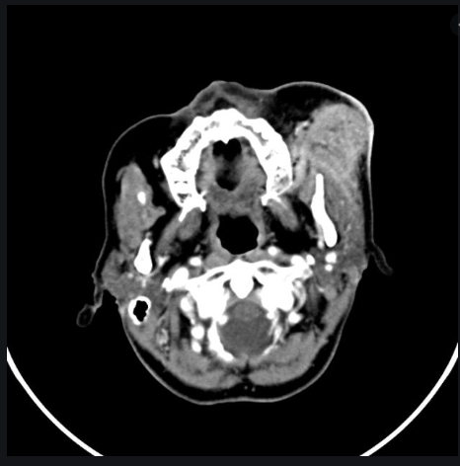
CT scan gives assessment for tumour location, spread and is the imaging of choice if suspecting bone involvement e.g. mandibular involvement

Slide 8
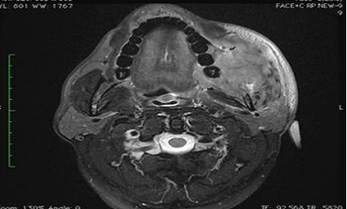
MRI gives accurate soft tissue involvement and extent.

Slide 9
RISK FACTOR STUDY IN ABOVE CASES
CASES | ALCOHOL | TOBACCO CHEWING/MISHRI | SMOKING
8 | YES | YES | YES
4 | YES | YES | NO
2 | YES | NO | YES
1 | YES | YES | YES

Slide 10
According to detailed clinical examination, biopsy reports, and imaging studies, out of the 15 cases, 7 cases were inoperable, either due to extensive local infiltration, or due to distant metastasis. Palliative chemoradiotherapy was given to these patients.
The rest 8 cases were operated according to their subsequent staging

Slide 11
CASE NUMBER | STAGE | LN INVOLVEMENT | SURGICAL MANAGEMENT | HISTOPATHOLOGICAL FINDING
3 | T1N0M0 | No | Wide Local Excision | Leukoplakia
1 | T1N0M0 | No | Wide Local Excision | Erythroplakia
2 | T2N0M0 | No | Wide Local Excision | Squamous Cell Carcinoma
1 | T1N1M0 | Yes (Ipsilateral IB) | Wide Local Excision with Supraomohyoid Neck Dissection | Squamous Cell Carcinoma
1 | T4aN2aM0 (Mandible involvement) | Yes (Ipsilateral IB) | Wide Local Excision + Hemimandibulectomy + MRND Type III | Poorly Differentiated

Slide 12
Of the above 8 operated cases, 1 case was diagnosed as poorly differentiated on HPE examination, and 2 cases were having positive tumour margins, and these cases were sent for post operative radiotherapy.

Slide 13
An ulceroproliferative growth on the right buccal mucosa of size 1x2 cm, 0.5cm behind the angle of mouth, with no palpable lymph node

Slide 14
An ulceroproliferative growth of size 3x4cm present on the left buccal mucosa, adjacent to left lower 1st and 2nd molar, with induration around the margins and palpable ipsilateral level IB lymph node

Slide 15
An ulceroproliferative growth of size 5x6cm present on the right buccal mucosa, involving the right lower gingivobuccal sulcus and right retromolar trigone, and bilateral palbable level IB lymph nodes

Slide 16
An ulceroproliferative growth of size 3x2cm present on the right buccal mucosa, adjacent to right 3rd molars, invading the right retromolar trigone and the right lower gingivobuccal sulcus, with submucous fibrosis of hard palate and left retromolar trigone, as well as the rest of the buccal mucosa with bilateral palpable level IB lymph nodes

Slide 17
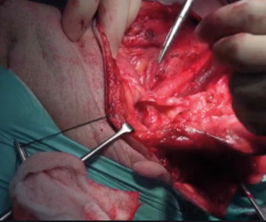

Slide 18
CONCLUSION
Even in node negative cases, elective neck dissection should be done as it significantly reduces the nodal recurrence as well as the local recurrence (especially in T2 or tumour thickness >5mm)
Surgical procedure has to be selected based on the stage of the disease and the extent of the disease.
Post operative adjuvant therapy (radiation/chemotherapy) is preferred for-
LN metastasis (2 or more)
Extracapsular spread
Positive margins or margins <3mm
Stage III/IV

Slide 19
ANNUAL CLINICAL MEETING
DEPARTMENT OF OTORHINOLARYNGOLOGY AND HEAD AND NECK SURGERY

Slide 20
SCHWANNOMAS IN ENT
DR. AASTHA BHATNAGAR

Slide 21
INTRODUCTION
Schwannomas, also known as neurilemmomas, are benign peripheral nerve sheath tumours.
They originate from any nerve covered with Schwann cell sheath.
Schwannomas constitute 25–45% of benign tumours of the head and neck.
About 4% of head and neck schwannomas present as a Sinonasal schwannoma.
We saw 2 cases in our OPD – A Sinonasal schwannoma and a Facial Nerve schwannoma.
Complete extracapsular excision of the tumours was achieved by micro-neurosurgical technique .

Slide 22
Benign Nasal Spindle Cell Schwannoma
of the Left Nasal Cavity

Slide 23
History
Chief Complaints:
Left sided nasal obstruction since 2 years
Left sided nasal discharge since 1 year
H/O Anosmia since 6 months +
H/O Pain below the left eye +
H/O Epistaxis since 2 months +
H/O Excessive sneezing +
H/O Epiphora +
H/O Nasal Twang +
H/O Nasopharyngeal Insufficiency +

Slide 24
EXAMINATION
General Examination:
Conscious, Cooperative and well oriented to time, place and person
BP: 150/90 mmHg
P: 72 bpm
RR:12 cycles/min
No pallor, icterus, clubbing, cyanosis, lymphadenopathy, edema.
Systemic Examination:
CVS: WNL
RS: WNL
PA: WNL
CNS: WNL

Slide 25
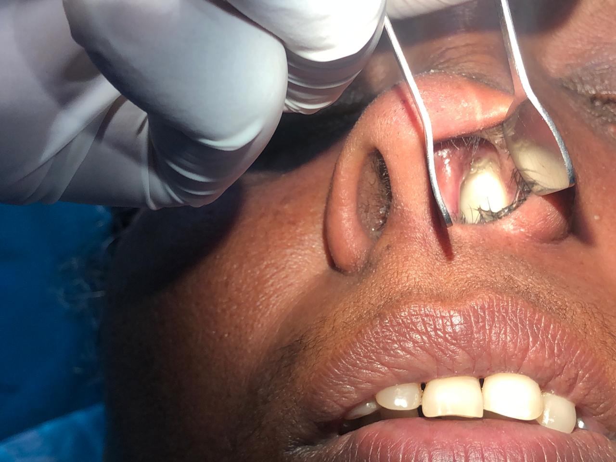
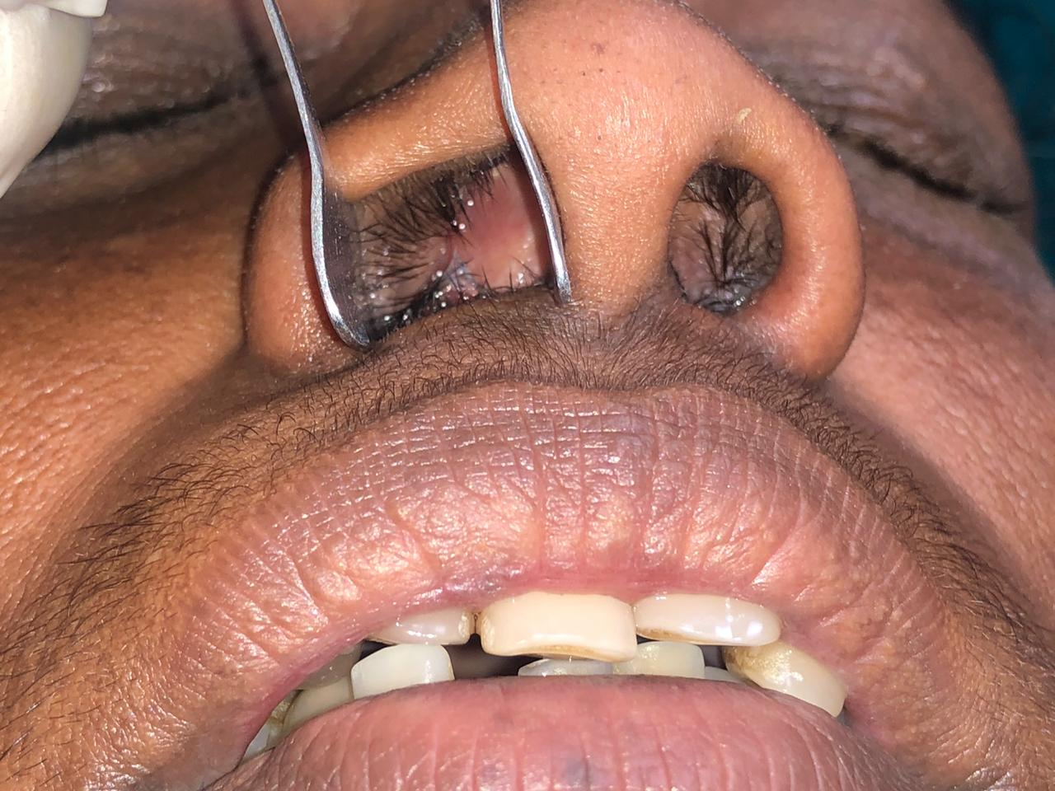
Local Examination:
Nose:
Saddle nose deformity +. Widening of nasal bridge +
Pearly white Nasal mass present in the left nasal cavity filling the entire cavity, pushing the septum towards right . Mucopurulent discharge present.
Probe Test – Attached Posteriorly.
DNS to Right.
Left sided ethmoid, maxillary sinus tenderness present.

Slide 26
Eye:
Epiphora +
Infra-orbital numbness + -- S/O Maxillary invasion.
Inter-canthal distance : Normal
Throat :Hard palate – Normal
Soft Palate – Normal
B/L grade 2 tonsillar enlargement
Neck: No Neck nodes palpable.
Ear : WNL

Slide 27
LAB INVESTIGATIONS:
CBC , Sr. Electrolytes, LFT, RFT, Sr. Ca, Sr. Mg - WNL
Perimetry – Study WNL
CT Brain + Paranasal Sinuses –

Slide 28
Management – Endoscopic Debulking of Nasal Mass using Coblater.
Intra-Operative Findings:
Mass occupied the left sphenoid sinus and eroded nasal floor.
Seen originating from the sphenopalatine fossa. Vidian Nerve visualized.
HPE of left nasal mass arising from the left sphenopalatine foramen – S/O Ancient schwannoma

Slide 29
Facial Nerve Schwannoma

Slide 30
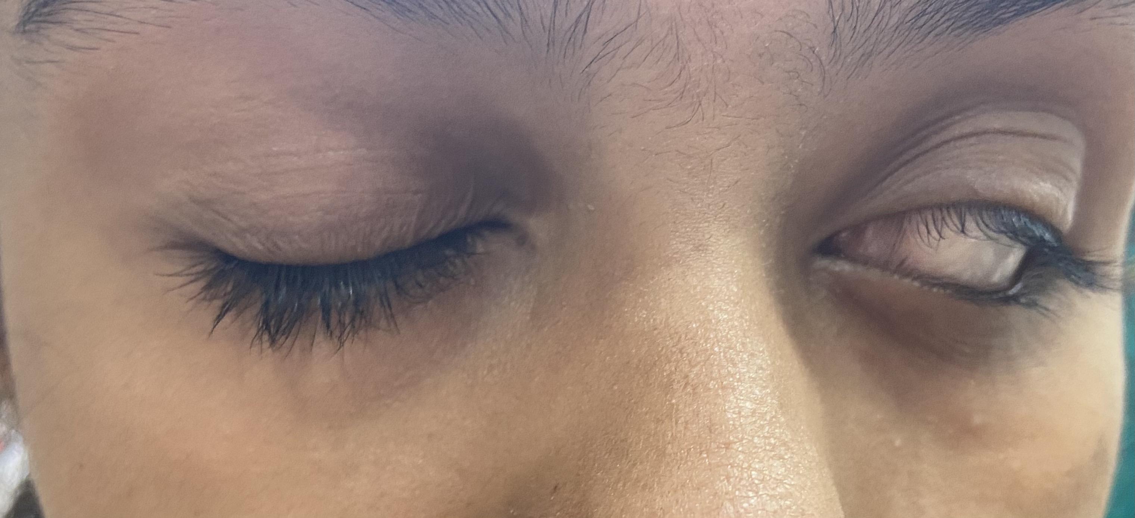
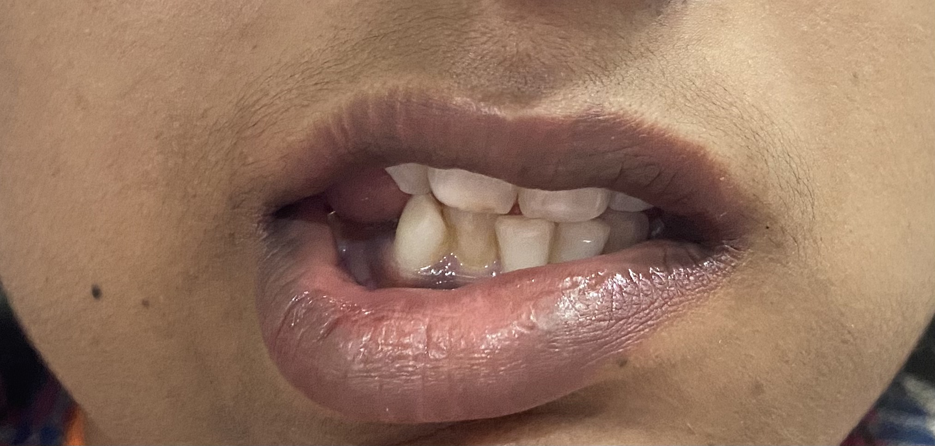
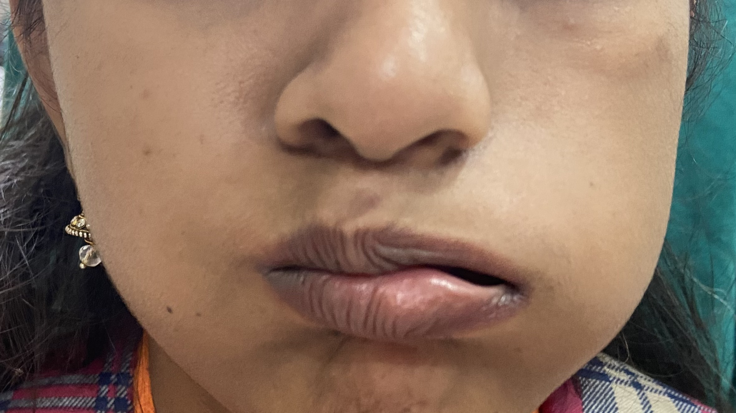
History
Chief Complaints:
Left sided facial weakness since 4mth
-Insidious onset, gradually progressive
H/O left eye watery discharge
H/O left sided aural fullness
H/O reduced hearing from left ear

Slide 31
EXAMINATION
General Examination:
Conscious, Cooperative and well oriented to time, place and person
BP: 110/80 mmHg
P: 72 bpm
RR: 18 cycles/min
No pallor, icterus, clubbing, cyanosis, lymphadenopathy, edema.
Systemic Examination:
CVS: WNL
RS: WNL
PA: WNL
CNS: WNL

Slide 32
EAR
Right ear: TM retracted
Left ear: reddish mass present behind intact TM
Tuning fork tests:
 | Right | Left
Rinne’s (256) | Positive | Negative
(512) | Positive | Positive
(1024) | Positive | Positive
Weber’s | Lateralised to left
ABC | Same as examiner | Same as examiner

Slide 33
Nystagmus: absent Fistula test: Negative for both ears Rhomberg’s test: Negative Facial nerve examination: Left sided facial nerve palsy, LMN type, grade 5 of House Brackmann classification NOSE: NAD THROAT: NAD

Slide 34
Investigations
CBC , Sr. Electrolytes, LFT, RFT, Sr. Ca, Sr. Mg - WNL
Mastoid X-ray B/L Schuller’s view
PTA:
Right ear: 15 dB AB gap
Left ear: 20 dB AB gap

Slide 35
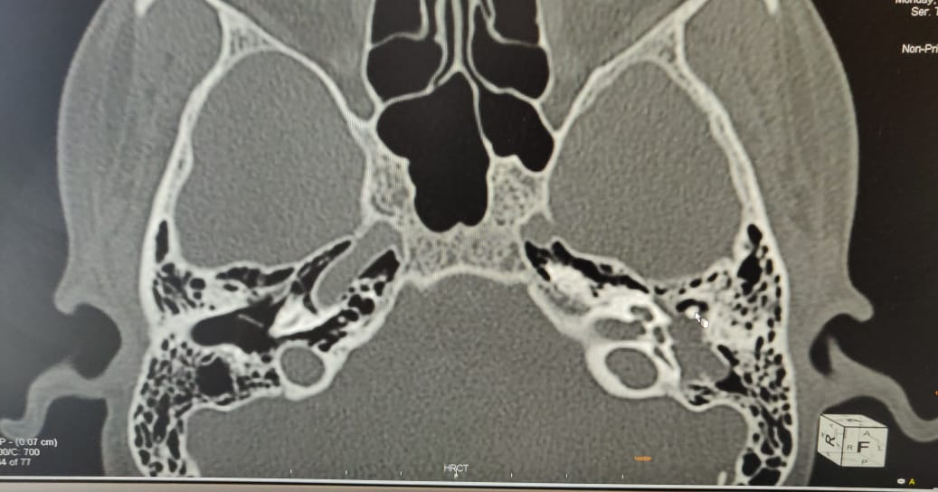
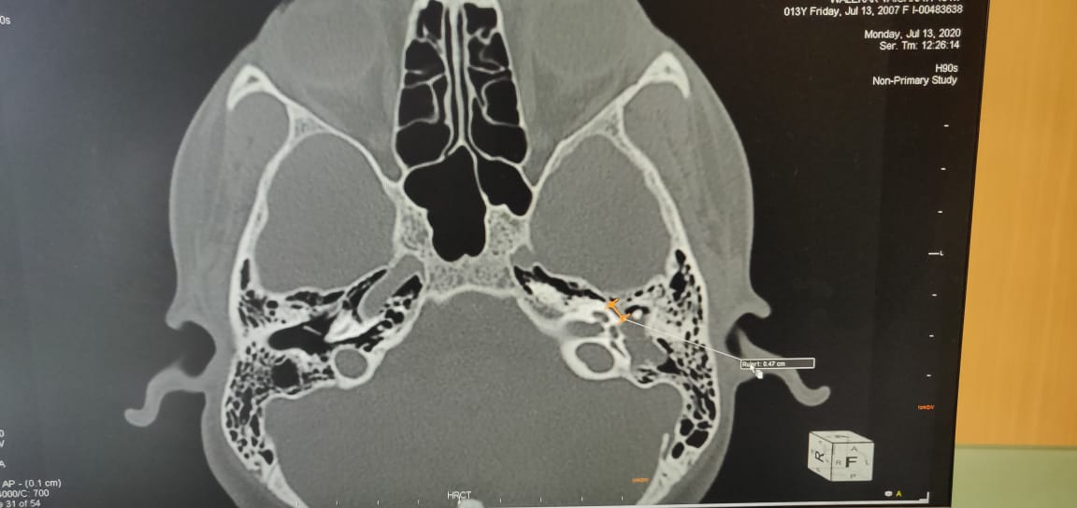
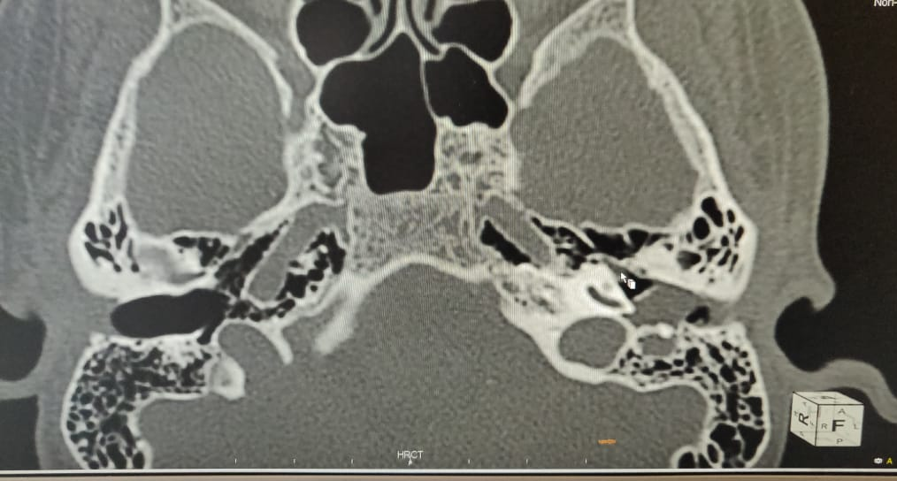
HRCT Temporal bone - Soft tissue mass of left middle ear involving mastoid and tympanic segment of left facial nerve, aditus, antrum.
MRI Temporal bone - soft tissue mass involving mastoid and tympanic segment of left facial nerve, no intralabyrinthine/intracranial involvement

Slide 36
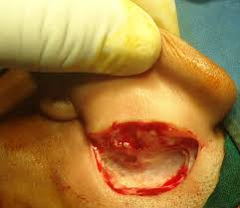
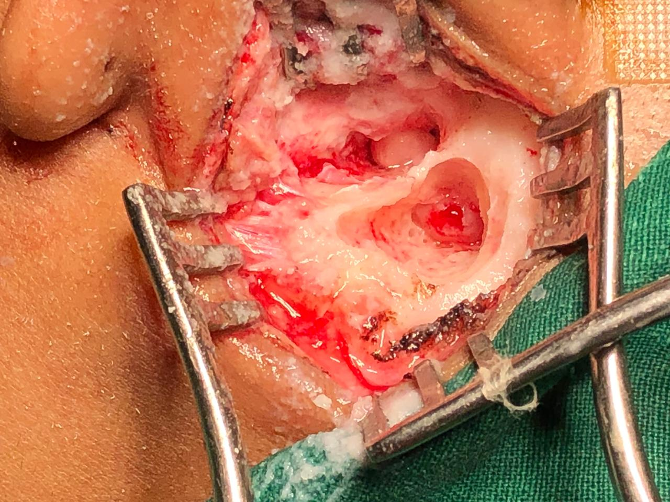
INTRAOPERATIVELY

Slide 37
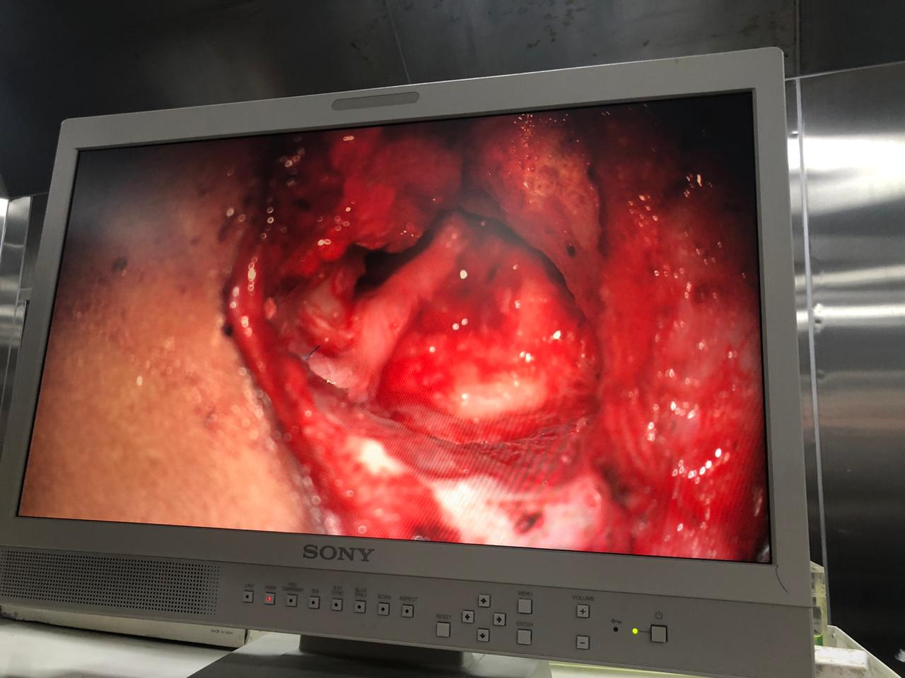
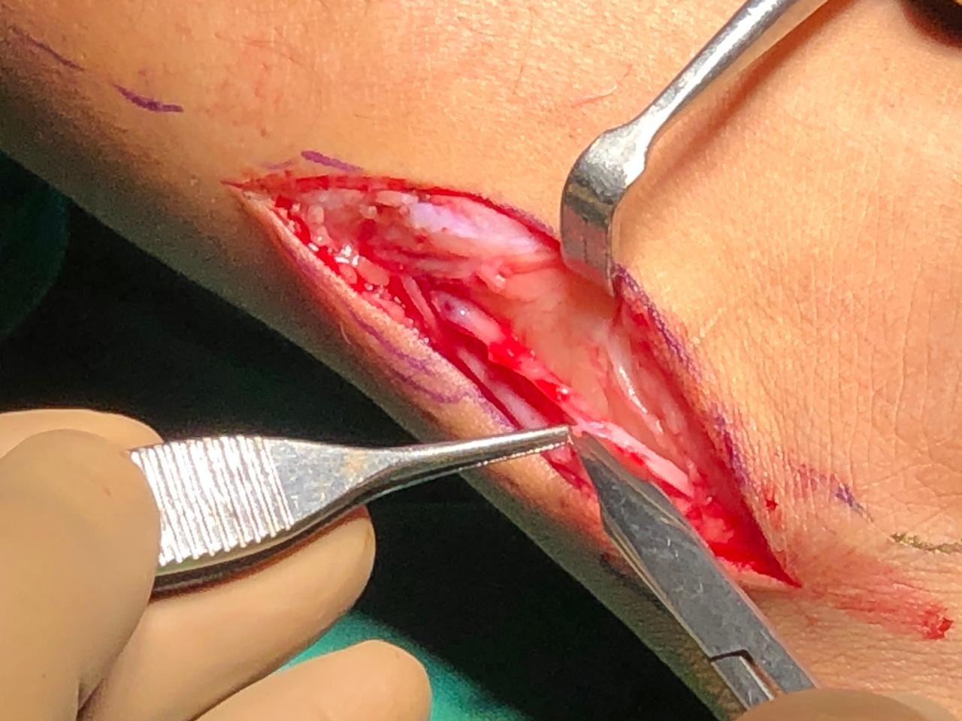
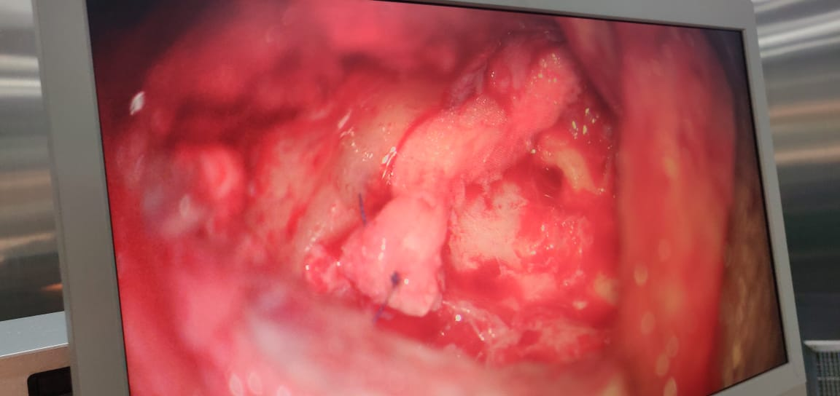
Management
Patient was planned for left facial nerve schwannoma excision
Along with nerve grafting
Sural nerve was to be used as a nerve graft

Slide 38
Conclusion
Head and neck schwannoma though rare should be considered as a differential diagnosis of a unilateral slow growing mass in the head and neck region, particularly in an adult.
Schwannomas are always a diagnostic dilemma as they are asymptomatic for long time, and histopathology is the gold standard for diagnosis.
As a rule, treatment is surgical and dictated by the location of the tumour and nerve of origin. Due to its rarity, complex anatomical location and morbidity risk post-excision, they can pose a formidable challenge to surgeons.

Slide 39
ANNUAL CLINICAL MEETING
DEPARTMENT OF OTORHINOLARYNGOLOGY AND HEAD AND NECK SURGERY

Slide 40
EMBRYONAL RHABDOMYOSARCOMA OF RIGHT MIDDLE EAR
DR. ANUJA SATAV

Slide 41
Introduction
Rhabdomyosarcomas are soft tissue cancers derived mainly of undifferentiated mesoderm .
Embryonal rhabdomyosarcomas are the most common subtype.
Most common in children (0-4 years old) with incidence of 4 in 1 million.
Most commonly involved sites in head and neck region are nasal and oral cavities, second most common being the orbit and middle ear.
Anaplasia is a very important prognostic feature with significant nuclear variation and presence of atypical multipolar mitotic figures.

Slide 42
Case History:
9 year old male came with the chief complaints of :
discharge from right ear since childhood
symptoms of facial nerve palsy since 9 days
he was suspected to have right squamosal COM with facial paralysis.
He was operated for Right canal wall down Modified Radical Mastoidectomy with facial nerve decompression on 14-02-2020

Slide 43
Patient presented with following symptoms a month later :
Right postauricular swelling since 6 days associated with right ear discharge.
Otoscopic findings revealed polypoidal mucosa in the right EAC highly suggestive of recurrence of CSOM.
Associated with pain over the mastoid region.
No h/o nausea or vomiting
No h/o giddiness
No h/o tinnitus
No h/o fever
No h/o any other nose and throat complaints

Slide 44
On examination:
General Examination:
Patient is conscious, cooperative oriented to time, place and person
Pulse- 77 bpm
BP – 100/60 mmHg
RR- 22 Cycles/min
Systemic Examination:
CVS: S1 S2 present
RS : Breath sounds equal on both sides
CNS : within normal limits
Per Abdominal: no obvious organomegaly seen

Slide 45
Local Examination
Patient presented with postauricular swelling of size 3×2 cm with mastoid tenderness, local rise of temperature and eversion of pinna
Tuning fork tests:
 | Right | Left
Rinne’s : 256Hz | Negative | Positive
512Hz 1024Hz | Negative | Positive
 | Negative | Positive
Weber’s | Lateralized to right ear
Absolute bone conduction | Reduced | Same as examiner

Slide 46
Persistent deviation of angle of mouth to the left and incomplete eye closure suggestive of no improvement in signs of facial nerve palsy Grade V
Nystagmus : Absent
Fistula test : Negative
Rhomberg’s test : Negative
Nose:
Throat:
Within normal limits

Slide 47
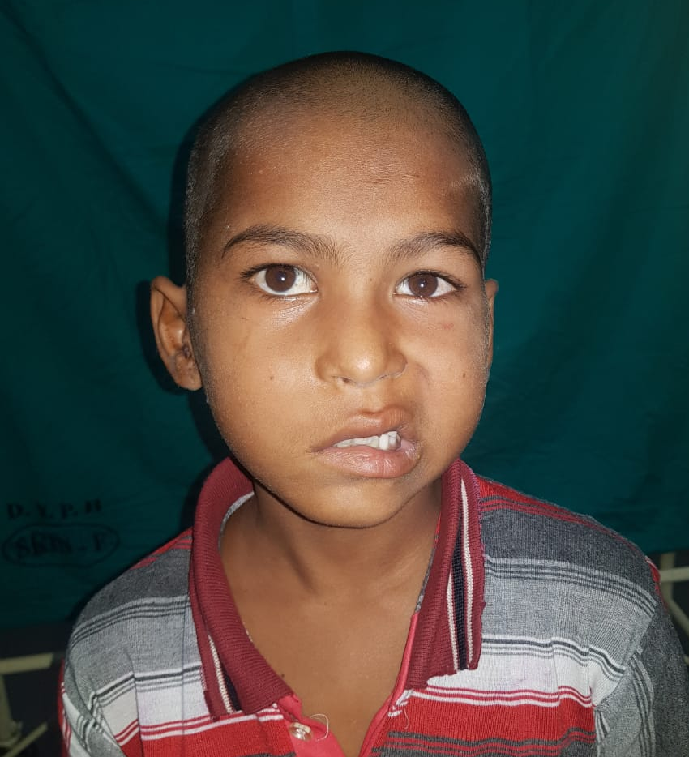

Slide 48
Investigations:
HRCT Temporal bone S/O: Soft tissue mass 46 x 25 x 35mm seen in region of right petromastoid region, middle ear and EAC. Destruction of Right Petrous Canal , walls of vertical portion of right carotid canal and Jugular Foramen, tegmen tympani and sinodural plate. Intracranial extension of soft tissue in posterior cranial fossa and involvement of right sternocleidomastoid.

Slide 49
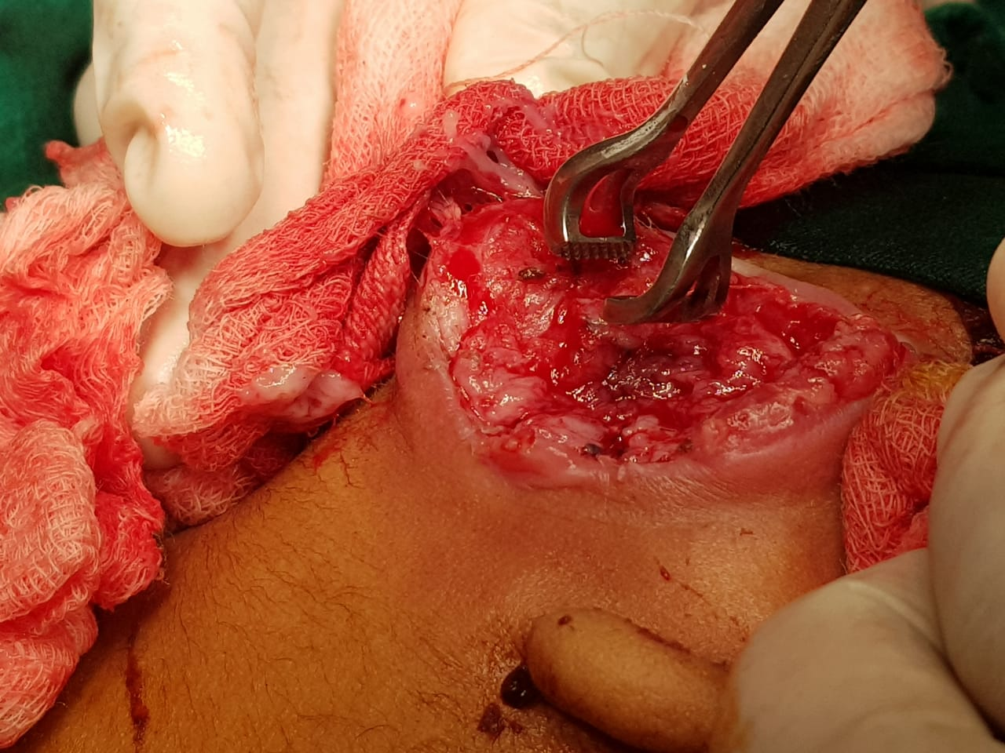
Intraoperatively
On exploration of the swelling it opened up to be firm mass which was adherent to the skin, for which debulking was done and specimen sent for HPE and IHC.
Following which the wound was sutured.
Histopathological examination S/O :
Round cell tumor
Immunohistochemistry S/O:
Embryonal Rhabdomyosarcoma highly positive for Desmin , Myogenin, CD99, FLI-1

Slide 50
Patient later developed symptoms of bleeding from the postauricular swelling and episodes of seizures.
Following the workup it suggested spread of the malignant condition to lungs.
Thus indicative of stage 4 disease according to TNM staging
HRCT Thorax S/O: Multiple soft tissue density roughly rounded nodules in both lungs.
Patient was further referred to higher center for chemo-radiotherapy and palliative management.

Slide 51
Conclusion:
Rhabdomyosarcomas are a rare class of carcinomas and highly aggressive tumors
Immediate management with respect to stage of the disease is necessary
For every Pediatric case of Cholesteatoma and middle ear granulation tissue on exploration, sample should be sent for histopathological examination

Slide 52
THANK YOU

