Slide 1
Ossifying fibroma :a benign neoplasm
Presenter : Dr sabreena mukhtar

Slide 2
Case History
A 46yr old female
Chief complaints
Swelling over floor of mouth x 1yr
Gradual onset ,progressive, not associated with pain
Difficulty in swallowing
Difficulty in articulation
No h/o trauma, weight loss, previous surgery, tooth fall

Slide 3
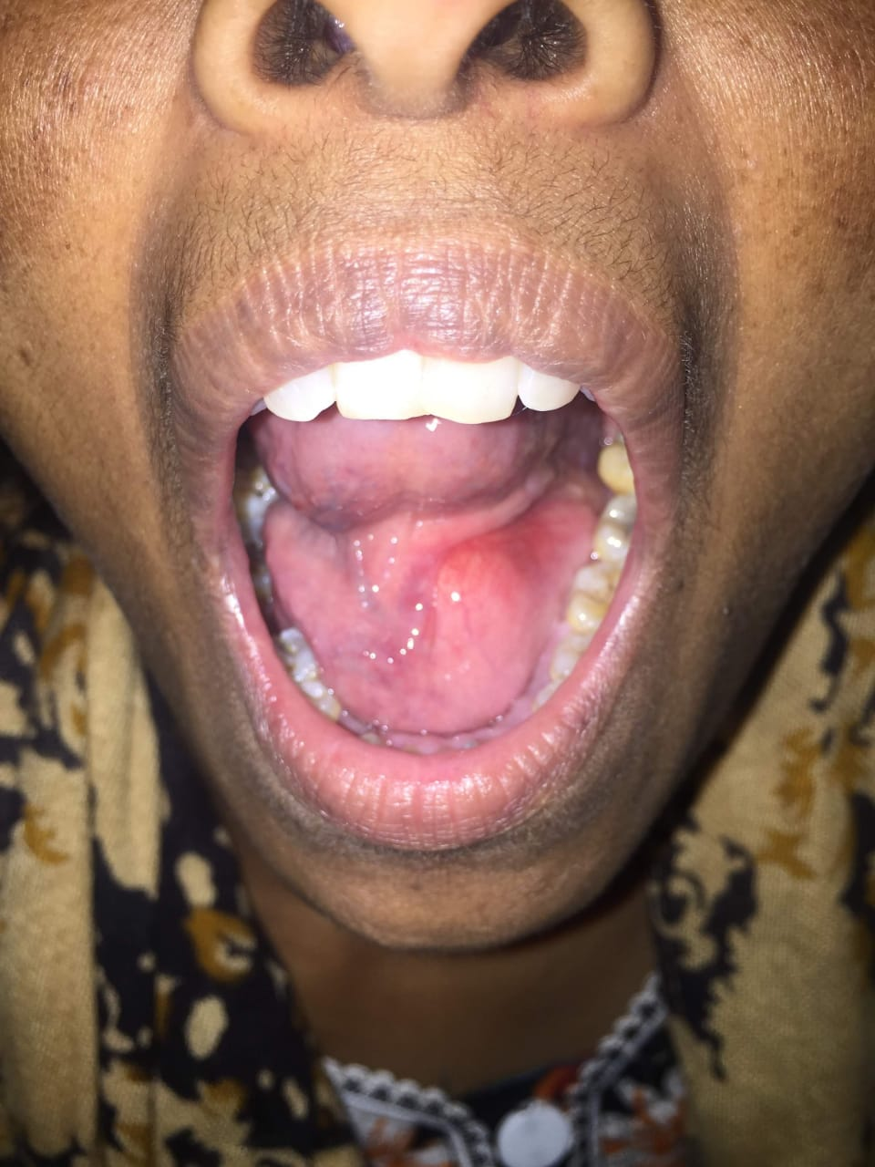
Examination
Inspection
5x4cm smooth, round swelling arising from floor of mouth, pushing tongue upwards, more towards left, pinkish in color.

Slide 5
Palpation
Consistency bony hard, smooth surface, non compressible, non tender, non mobile,
No glow on trans illumination
No palpable neck lymph nodes.

Slide 6
Imaging
USG neck
Normal no significant findings
Orthopantogram
Bony mass arising from left mandible
CT Head & Neck
A lobulated well define bond density lesion noted in the oral cavity at the floor of mouth in left sublingual space, measuring 3.6 x 4 x 3.3cm.
Lesion seen attached to left medial aspect of mandible at the mylohyoid line
No extension noted
No soft tissue component

Slide 10
Procedure
Treatment Plan:
Total surgical excision Under General anaesthesia .
Notes:
Under General anaesthesia
Neck extended, tongue secured
Curved Incision over the most prominent part of swelling taken
Submucosal plane dissection done all around
Bone chiseled from all over starting from alveolar line and dissecting the lesion from the left and anterior margin of mandible till it was completely mobilized .
Removed from stock
Mucosa Closed with vicryl
RT secured

Slide 20
Histopathology
Fibrous tissue with bony bits
Foci of oval to spindle cells with intervening fibrous tissue and calcification
Areas of ossification noted
Impression – Fibroma with calcification
Follow up of patient was done after 6 months where patient appeared symptom free without any clinical evidence of recurrence

Slide 21
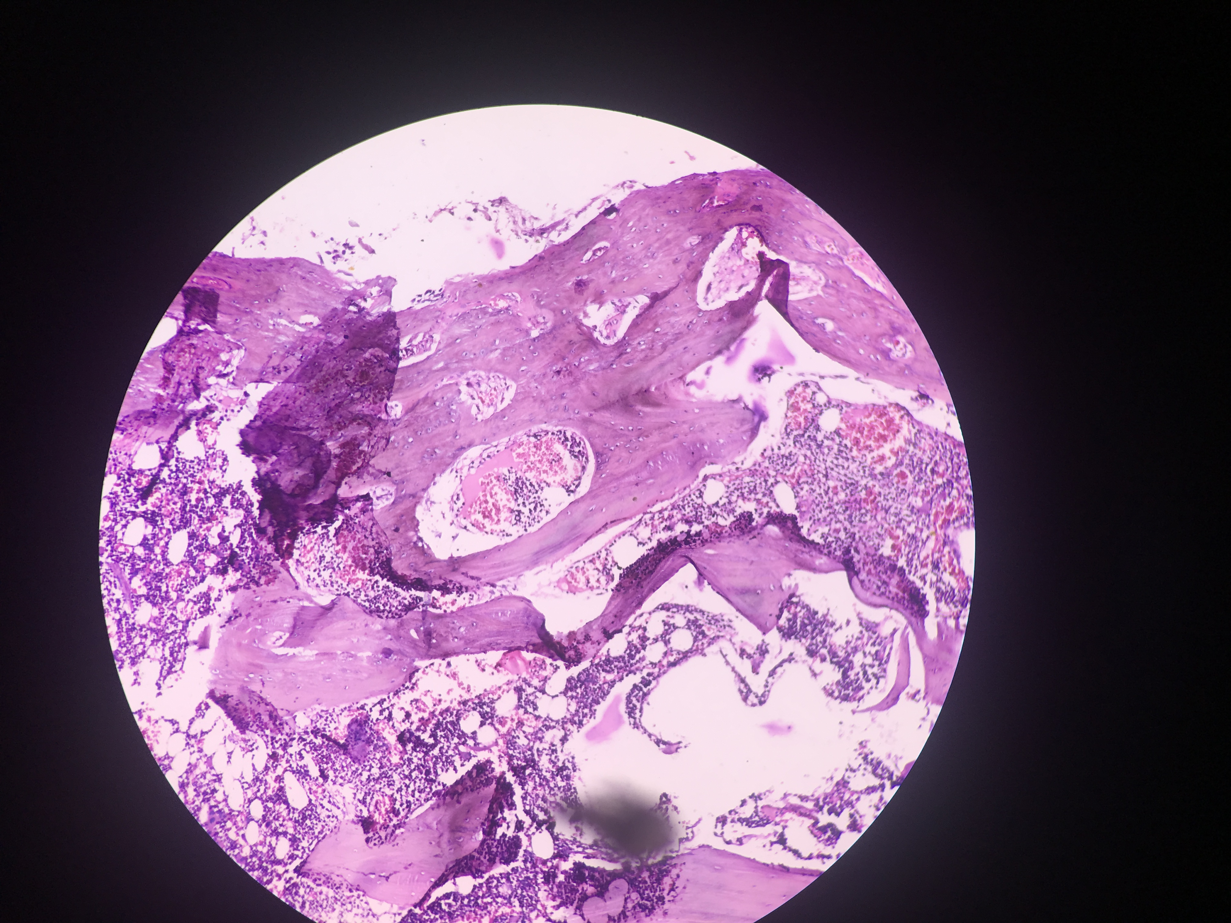

Slide 22
Discussion
Ossifying Fibroma
It is a odontogenic benign tumor of the jaw a type of fibro osseous lesion may have odentogenic, traumatic developmental origon .
A mutation in a tumor supressor gene HRPT2 a protein product known as para fibronin leads to tumor formation.
Clinically of two types:
ossifying fibroma
Cementifying fibroma
Central ossifying fibroma is more common in females than males and involves mandible more than maxilla.

Slide 23
Tumor shows a female preponderance with a ratio of 5:1
Mostly seen in mandible 70-90%(pre molar and molar region) followed by maxilla ,
ethmoid and orbital regions
It presents as a painless swelling.
Conventional radiographs specialized imaging techniques like CT and CBCT help to delineate from other similar lesions of jaw.

Slide 24
Differential diagnosis include other radio opaque lesions such as fibrous dysplasia, calcifying epithelial odontogenic tumor, calcifying epithelial odontogenic cyst, osteogenic sarcoma.
They have locally aggressive behavior with high recurrence rate particularly in partial and incomplete excisions, with complete removal being the gold standard treatment.
Prognosis is good without any metastasis .

Slide 25
Ossifying fibromas are entities with different morphological features that can be mistaken for other benign osseofibrous lesions. This similarity and over lapping micro characteristics with other similar lesions make pre operative diagnosis a challenge. Multidisciplinary approach, comprehending clinical, radiological and pathological aspects and an accurate histopathological report post operatively are mandatory for the correct diagnosis and appropriate treatment.

