Slide 1
A Rare Case Report: Submandibular Solitary Fibrous Tumor
Dr. Ashutosh Kumar
JR 2
Dept Of E.N.T and
Head and Neck Surgery

Slide 2
Case Report
A 32-year-old male patient reported to the Department of ENT with the chief complaint of swelling in the left neck region since 4 years .
The patient first noticed the swelling 4 years back when it was initially roughly of size 0.5cm*0.5cm, which had progressively increased to the present size.
No history of Significant weight loss,
No history of Evening rise of temperature.
No history of Dental caries.

Slide 3
Past History:
Known case of DM Type 2 and Hypertension since 5 years on regular medication.
No history of Tuberculosis or major surgical illness in the past.
Family History:Not Significant
Personal History:Not significant

Slide 4
On Local examination:
A diffuse, roughly oval swelling was seen in the left submandibular region, measuring approximately 5 × 4 cm in size. The overlying and surrounding skin was normal.
The swelling extended anteroposteriorly 1 cm posterior to the chin up to 1 cm anterior to the angle of mandible.
Superoinferiorly, it extended 1 cm below the inferior border of mandible toward the submandibular area up to a distance of 2 cm (inferiorly). No visible pulsations were seen.
On palpation The swelling was firm, mobile, non tender, non-reducible, and non-fluctuant, and no pulsations were felt.
Lymph nodes were not palpable. No abnormalities were found in relation to the teeth and soft tissues on intraoral examination. However, on bimanual palpation of the left submandibular area, a firm swelling was noted.

Slide 5
Systemic Examination: NAD
Based on the Clinical features, a Provisional diagnosis of
Chronic lymphadenitis
Tubercular lymphadenitis,
Benign lymphoid hyperplasia,
Lymphoma,
Sialadenitis,
Pleomorphic Adenoma were included under the differential diagnosis.

Slide 6
Investigations
Fine needle Aspiration cytology (FNAC) was inconclusive and biopsy was advised
Ultrasonography: Revealed a well defined heterogenously hypoechoic lesion of size 6*4*3.5 cm in the left submandibular region with intrinsic vascularity on colour doppler? Neoplastic lesion.No evidence of any enlarged Lymph node was noted.

Slide 7
CT Scan
A well defined large heterogenously enhancing left submandibular space lobulated mass lesion insinuating along the floor of mouth with maintained fat planes, most likely suggestive of benign non aggressive soft tissue tumor?. Fibrous origin – Desmoid/Fibroma .

Slide 8
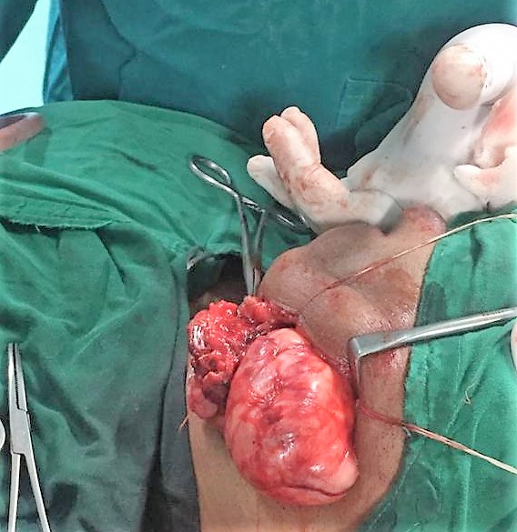
Intraoperative
Fig:Left Submandibular gland was excised along with the mass.

Slide 9
The lesions measured from 3 to 7 cm in greatest diameter and presented grossly as well-circumscribed, encapsulated, soft to rubbery tissue masses
Excised Submandibular Gland

Slide 10
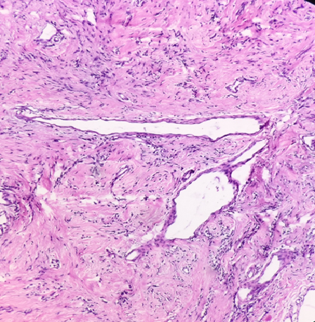
Histopathology
Low Power section shows wavy collagen fibres with spindle shaped nuclei, and patternless architecture of hypo and hypercellular areas.

Slide 11
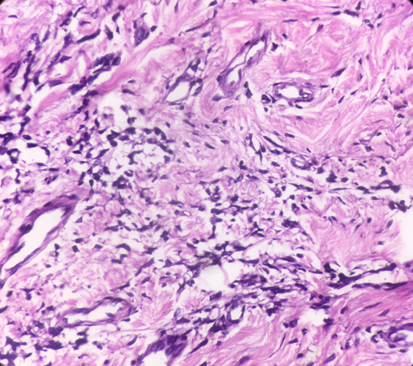
High power view showing Hypercellular areas showing abundant spindle shaped fibroblastic cells with oval to spindle shaped nuclei.

Slide 12
High power view showing hypocellular pattern showing predominantly wavy and hyalinised collagen fibres with few spindle shaped nuclei

Slide 13
Low power view showing Hyper and hypocellular areas showing hyalinization.

Slide 14
ImmunoHistochemistry
Positive | Negative
CD34 | Desmin
 | S100

Slide 15
Brown areas indicate that this tumour cells are positive for CD34, which confirm its diagnosis as solitary fibrous tumour.

Slide 16
Post Operative
The drain along with the sutures were removed on Post operative Day 4 and 7 respectively.
Suture site was healthy.
Patient was discharged on Post operative Day 10 and is on regular follow up .

Slide 17
Discussion
Solitary Fibrous Tumours of the Head and Neck region are extremely rare. The clinical diagnosis is often difficult to establish, and this lesion may be indistinguishable from other soft tissue neoplasms.
Solitary Fibrous Tumor were initially associated only with mesothelial-lined surfaces, most commonly arising from the pleura and other serosal regions.
Even though more than 50% of these tumours are located in the thoracic cavity, extrathoracic tumours have been reported in various sites such as the liver, skin and the head and neck .
In the head and neck region, Solitary Fibrous Tumor have been reported in many sites, but the oral cavity is the most common site .

Slide 18
Although Solitary Fibrous Tumor are commonly benign, 10% to 15% of extrapleural Solitary Fibrous Tumor have shown malignant characteristics in the form of metastatic disease . Solitary Fibrous Tumor are slow growing masses that can be very difficult to distinguish from other soft tissue tumours.
The clinical symptoms are dependent on location, usually due to compression rather than tissue infiltration.
The diagnosis is strongly dependent on the microscopic appearance and characteristic Immunohistochemical staining for CD34 and Bcl2. Therefore, definitive diagnosis is usually made Post tumour resection.

Slide 19
There are no distinctive imaging features that are diagnostic of these rare tumours.
Dense enhancement of the lesion on Computed Tomography or Magnetic Resonance imaging may be suggestive and should prompt inclusion of Solitary Fibrous Tumor as a differential diagnosis.
The classic histological appearance of an Solitary Fibrous Tumor is characterised by a variety of growth patterns, the most typical being a random arrangement of spindle cells in a collagenous background, with a prominent vascularity that results in a hemangiopericytoma-like pattern.

Slide 20
Mitoses and necrosis are usually absent. However, an estimated 10% -15 % of benign Solitary Fibrous Tumor can behave in a malignant fashion .
Histologically, a number of other soft tissue neoplasms have a striking resemblance to Solitary Fibrous Tumor .
Therefore, differential Immunohistochemical staining helps distinguish Solitary Fibrous Tumor from other soft tissue tumours, including
Benign fibrous Histiocytoma
Dermatofibrosarcoma protuberans,
Myofibroma, Fibromas, and
Neurogenic tumors, and other
Vascular soft tissue tumours, such as hemangiopericytomas
Synovial sarcomas.

Slide 21
In the immunohistochemical studies, the cells are typically positive for vimentin, CD 34, Bc1-2 and CD 99 and negative for S-100 protein, cytokeratin, desmin, actin, and myogenin .
Benign fibrous histiocytomas typically stain negative for CD34 and Bcl2 . In our case, the tissue showed marked positivity for CD34, while it was negative for S100 and Desmin.
Therefore, the microscopic and immunohistochemical profile was consistent with a Benign solitary fibrous tumour

Slide 22
The recommended management for Benign Solitary Fibrous Tumor is complete surgical excision of the neoplasm, and such excision with free margins is an important prognostic factor.
Recurrence of Solitary Fibrous Tumor have been reported 30 years after surgical excision despite complete excision. Therefore, long-term follow up is essential even in cases pathologically diagnosed as benign.

Slide 23
CONCLUSION
Clinicians should include Solitary Fibrous Tumor in the Differential diagnosis of tumours that arise from soft tissues of the head and neck.
Distinguishing a Solitary Fibrous Tumor from various spindle Neoplasms can be difficult. Therefore, Immunohistochemical staining is important.
Suggested management is complete excision of the mass with long term follow up, because of the potential for recurrence and malignant transformation.

Slide 24
Thank you!!

