Slide 1
ABDOMEN - A HUMAN PANDORA’S BOX
Dr. Brinda Shingala
under the guidance of
Dr (Brig) Sukesh Kathpalia
Dr. D Y Patil Medical College, Pune

Slide 2
INTRODUCTION
In the last two decades, there have been many great advances in radio-imaging. To an extent that diagnosis is almost certain preoperatively in a case of lump in abdomen.
Even with these sophisticated modalities, management of a case of large lump in abdomen especially in the reproductive age group remains challenging – abdomen still remains a Pandora’s Box.

Slide 3
MY CASE
37year-old, unmarried came with complaints of
gradual abdominal distension
dull aching pain in the lower abdomen
indigestion for the last 6 months.
Menstrual history - normal.
Past and family history - non-contributory.

Slide 4
General Examination
Height 143cm.
Weight 37kgs.
BMI 18.8 kg/m2
Pallor was present. No lymphadenopathy including the Virchow’s node.

Slide 5
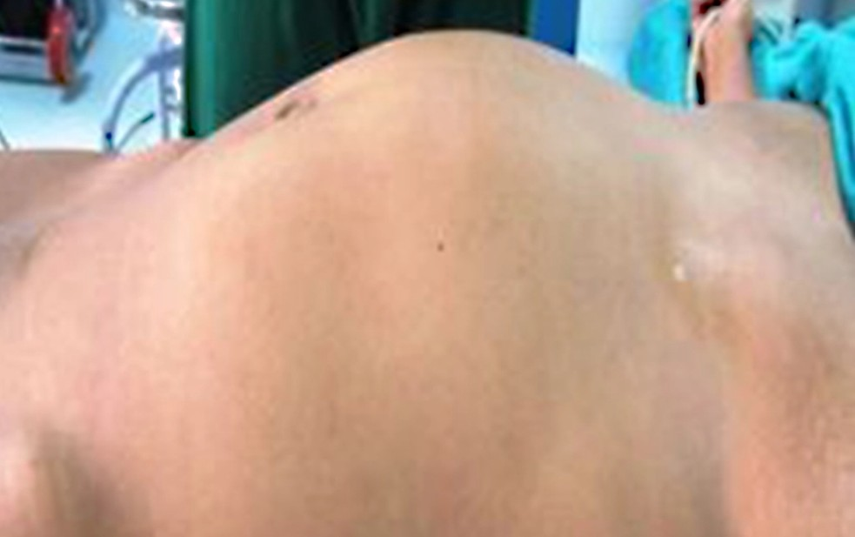
Physical Examination
Abdomen was uniformly distended.
The mass was appeared solitary, non tender, mobile and cystic. The lower margin of the mass could not be reached. A dull note was felt over the mass. Shifting dullness was absent.
External genitalia appeared normal.
Being unmarried gynaecological examination was not done.

Slide 6
Investigations
Haemoglobin- 7.8 g/dl.
Tumour markers-
CA 125 – 74 U/ml
CEA < 0.5 ng/ml
Rest of her labs were normal.
Ultrasonography
Right adnexal 25x20x18cm
cystic lesion seen extending in the upper abdomen.
Left ovary was visualised.
Right ovary was not clearly visualised
CT scan
Thin walled, mixed density, moderately heterogeneous enhancing abdomino-pelvic mass of 30x27x8cm arising from the right adnexa. Uterine size was normal.
No evidence of ascites or peritoneal deposits.
Left adnexa - normal.

Slide 7
Provisional diagnosis
Mucinous cystadenoma
The patient was counselled for exploratory laparotomy.
Possibility of hysterectomy was explained and its consent was taken.
The cause of anaemia was found to be iron deficiency and two units of packed red cells were transfused pre-operatively

Slide 8
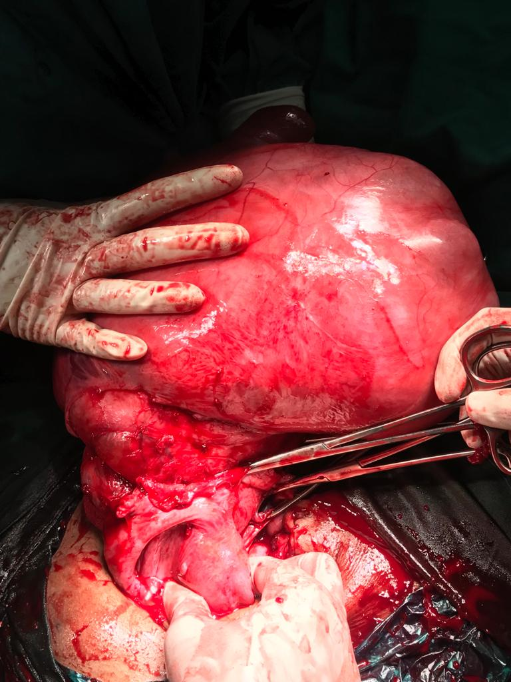
Intra-operative Findings
Bosselated appearance, irregular margins, smooth surface, solid and cystic components were felt.
No adhesions were seen.
Uterus, ovaries and the fallopian tubes on both sides were normal and separate from the mass. They were preserved.
The mass was seen arising from the right cornua of the uterus.
After careful dissection of the overlying peritoneum around the base, it was clamped, transfixed, ligated, and sent for frozen section.

Slide 9
The frozen section report- a 3.7kg benign neoplasm with cystic degeneration measuring 35x30x28cms.
Haemostasis was achieved and the abdomen was closed en-mass.
The final histopathology report showed a leiomyoma with degeneration with no features of atypia.
The post-operative period was uneventful, and the patient was discharged on post-operative day 10 after suture removal

Slide 10
TAKE HOME MESSAGE
Knowing what we may find once the abdomen is opened is not always certain before the surgery despite a complete evaluation; hence it is aptly called a Pandora’s box.
Differential diagnosis should always be kept in mind before operating as it helps to tackle rare situations where the intraoperative diagnosis may differ from the preoperative diagnosis.

Slide 11
THANK YOU

