Slide 1
A COMMON TUMOUR AT AN UNCOMMON LOCATION
Dr. Prajakta Khose, JR II, OBGY, Dr. D.Y. Patil Medical college, Pune
Under guidance of Dr. Samar Rudra, Professor, OBGY, Dr. D.Y. Patil Medical College, Pune

Slide 2
HISTORY
30 year P2L2 tubectomised female
Complaints of mass coming out of vagina since last two years - no aggravating or relieving factors ; spotting P/V on and off
Referred to us as a case of utero-vaginal prolapse for vaginal hysterectomy
H/O regular menstrual cycles
Had two previous normal deliveries without any complications
No other history of any significance

Slide 3
GENERAL AND SYSTEMIC EXAMINATION
Vitally stable
No pallor
CVS, RS examination revealed no abnormality
Abdomen - Soft, non-tender

Slide 4
GYNAECOLOGICAL EXAMINATION
A bi-lobed growth of ~ 8x3cm was found on the anterior vaginal wall and protruding about 3cm outside the introitus giving a impression of uterine prolapse
Two distinct but connected lobes were felt extending from upper third to lower third of the anterior vaginal wall
The urethral meatus and cervix were pushed upwards by this mass; not easily visualised with a Sim’s speculum

Slide 5
GYNAECOLOGICAL EXAMINATION (cont)
On using a larger Sim’s speculum, the urethra was seen high up in the anterior vaginal wall overlying the mass. The cervix was also high up in the vault of the vagina. Visualised with difficulty. However, cervix appeared normal
Pelvic examination revealed a parous size ante-verted uterus, bilateral adnexa free and non-tender

Slide 6
PROVISIONAL DIAGNOSIS
‘Vaginal mass for evaluation’

Slide 7
INVESTIGATIONS
Routine lab parameters within normal limits
Pap smear study negative for any intra-epithelial lesion
USG pelvis confirmed our clinical finding

Slide 8
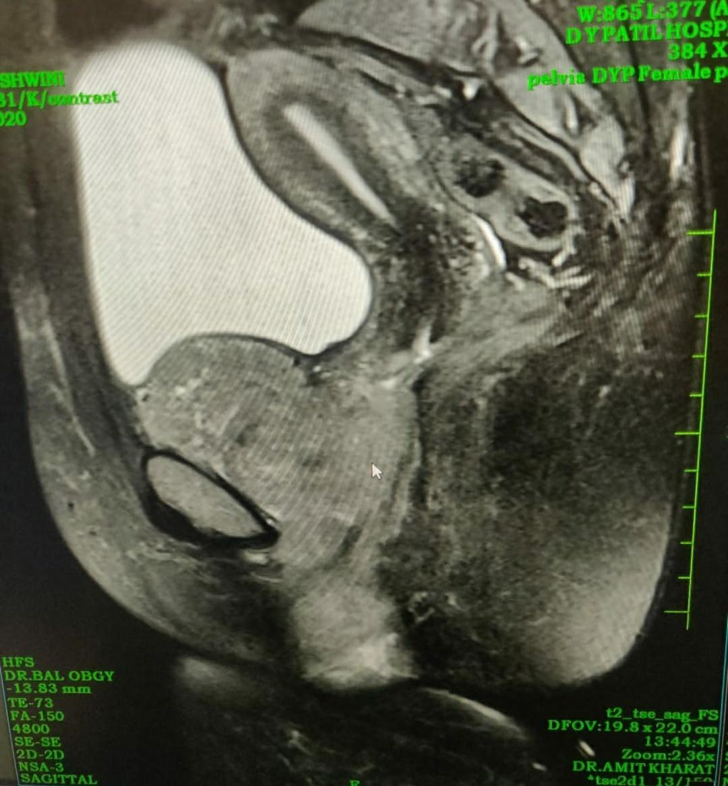
MRI FINDINGS
MRI lower abdomen and pelvis revealed a large well-defined lobulated heterogeneously enhancing solid lesion in the vagina of size 11.7x7x6.3cm
Extending in the anterior aspect of pelvis behind the pubic symphysis possibly through a breach in the paravaginal tissue anteriorly
Mass is indenting and displacing the urinary bladder superiorly
Not showing any bladder wall invasion
Uterus
UB
PUBIC SYMPHYSIS
VAGINAL MASS

Slide 9
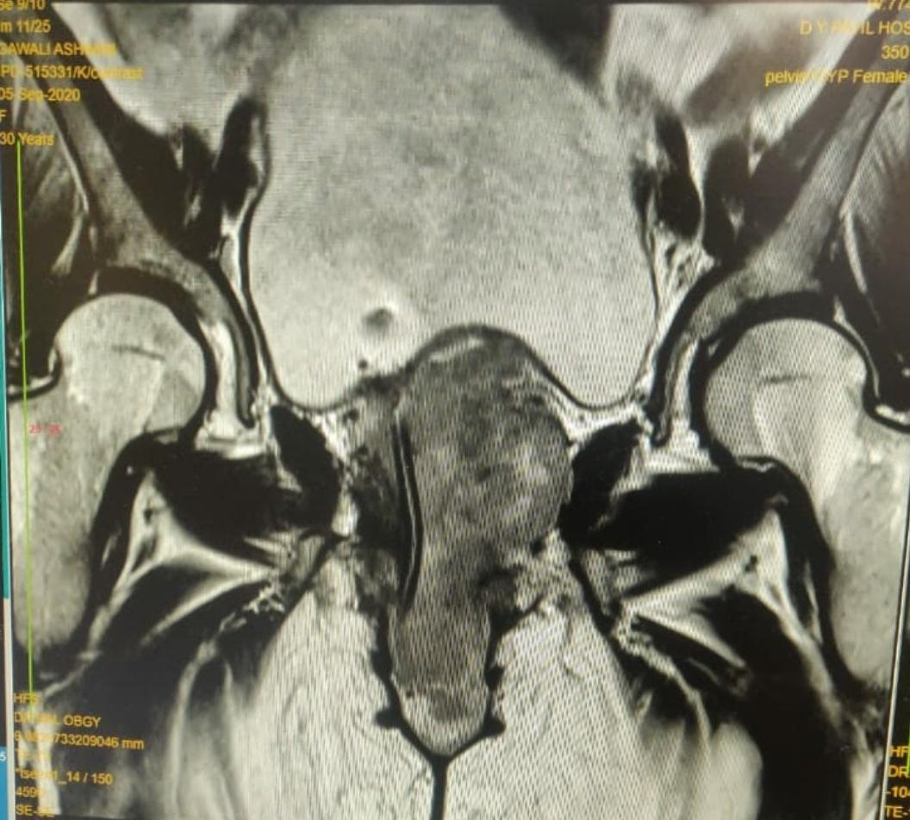
MRI FINDINGS (cont)
Antero-posterior view shows
Urethra (Foley’s catheter in-situ) visualised on right side of mass
Ill-defined portion of the mass also seen on right side of urethra at the base of the bladder
Upper urethra has been partially encircled by the mass at the bladder neck
URINARY BLADDER
VAGINAL MASS
URETHRA

Slide 10
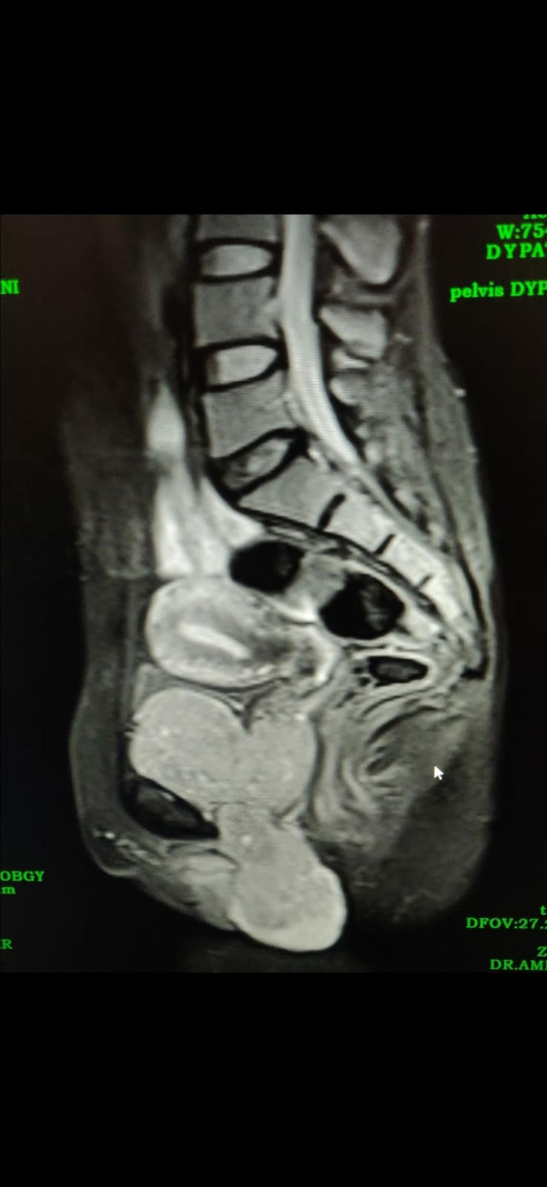
MRI FINDINGS (cont)
Relation of the mass with the urinary bladder and uterus shown
Three distinct lobes are seen; lower one extending inferiorly, protruding below the vaginal introitus separating the labial folds
Urethra is passing posterior to the mass in between the upper two lobes
UTERUS
URINARY BLADDER
MASS

Slide 11
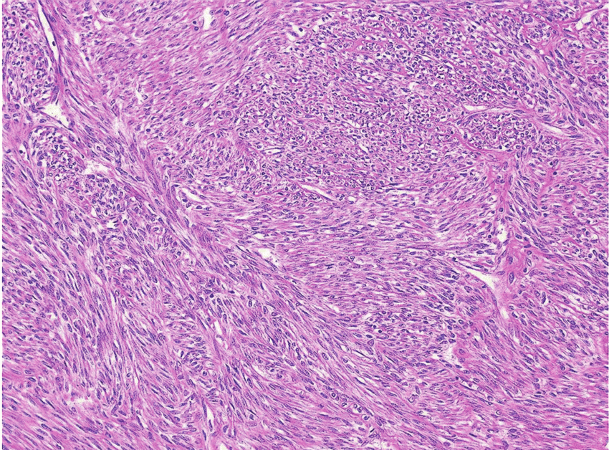
INVESTIGATIONS (cont)
Trucut biopsy revealed a benign spindle cell lesion suggestive of leiomyoma

Slide 12
PRE-OPERATIVE PREPARATION
Urosurgeon was consulted keeping in mind the close proximity of the mass to the urethra and bladder base. Possibility of infiltration to be ruled out
Cystoscopy revealed no abnormality
Anaesthetic fitness was obtained for vaginal mass excision. Anaesthetist planned procedure under general anaesthesia in view of anticipated difficulty
The Urology team was kept informed about the planned procedure and requested to be present in the OT

Slide 13
Antecipated intraoperative problem
Anterior wall of the vagina is generally difficult to visualize during any surgery.
The mass was adjacent to clitoral area which is very vascular.
It was partially encircling upper urethra at the bladder
neck.
Close proximity of the whole length of urethra to the mass.

Slide 14
INTRA-OPERATIVE FINDINGS
Under anaesthesia, mass was palpated again with Foley’s catheter in situ. Mass was found extending up to right side of anterior fornix close to bladder base and overlying the urethra
A vertical incision was made over the visualised area of the mass just adjacent to the urethral opening. With sharp and blunt dissection, mass was separated from vaginal wall, urethra and bladder base posteriorly (catheter indicating the course and position of urethra and bladder).

Slide 15
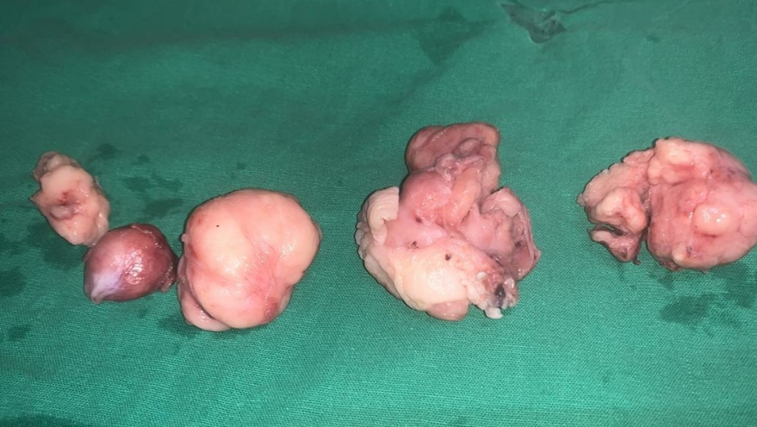
INTRA-OPERATIVE FINDINGS (cont)
Multiple, lobular, leiomyomatous masses were removed in piece-meal
There was suspicion of urethral/bladder injury. However dye test was negative and urethral catheter was not seen through urethral wall indicating no breech in the urethral wall. However we suspected some partial damage to few muscular fibers of urethra
Reviewed by Urologist. Gave few interrupted sutures on the suspicious area

Slide 16
INTRA-OPERATIVE FINDINGS (cont
Wound closure was done :
Deep tissue closed by few interrupted sutures
Vaginal mucosa closed
Approximate blood loss of 800ml ; 1 PRBC transfused per-operatively
Specimen sent for histopathology

Slide 17
POST-OPERATIVE CARE
Foley’s catheter was kept in-situ in view of suspected urethral injury
Mirabegron-Solifenacin was initiated by Urologist
Rest of the post-operative recovery was uneventful ; discharged with Foley’s catheter in-situ on post-operative day 5
Foley’s catheter was removed 10 days post-surgery and patient voided freely
Histopathology reported the mass to be a leiomyoma of the vagina
Followed up on out-patient basis. Recuperated well.

Slide 18
FINAL DIAGNOSIS
‘Leiomyoma of the anterior vagina’

Slide 19
DISCUSSION
Vaginal leiomyomas are a rare clinical entity and only 300 cases have been reported¹
Other vaginal tumours include angio-myxoma, papilloma, hemangioma, mucus polyp
Mostly seen in 30-50 year age group, high incidence in Caucasians²
Usually seen as single, well-circumscribed masses arising from midline anterior wall^{3,4}, less commonly from posterior and lateral walls (as seen in our case)
Chakrabarti I, De A, Pati S. Vaginal leiomyoma. Journal of mid-life health. 2011 Jan;2(1):42.
Bernett HG, Jr, Erlich MM. Myoma of the vagina. Am J Obstet Gynecol 1941;42:314-320.
Young SB, Rose PG, Reuter KL. Vaginal fibromyomata: Two cases with pre-operative assessment, resection and reconstruction. Obstet Gynecol. 1991;78:972-974.
Shimada K, Ohashi I, Shibuya H, Tanabe F, Akashi T. MR imaging of an atypical vaginal leiomyoma. Am J Roentg. 2002;178:752-754.

Slide 20
DISCUSSION (cont)
Difficulty in diagnosis as it’s a rare presentation, may be mistaken for utero-vaginal prolapse⁵ (like in our case)
Cases of para-urethral vaginal leiomyoma has been reported by Constantini et al⁶ (similar to our case)
Usually managed by surgical removal through vaginal approach
5. Dane C, Rustemoglu Y, Kiray M, Ozkuvanci U, Tatar Z, Dane B.Vaginal leiomyoma in pregnancy presenting as a prolapsed vaginal mass. Hong Kong Med J. 2012 Dec 1;18(6) – 533.
6. Constantini E, Cochetti G, Porena M. Vaginal para-urethral myxoid leiomyoma: case report and review of the literature. International Urogynaecology journal. 2008 Aug 1;19(8): 1183-1185.

Slide 21
AIM OF PRESENTATION
Highlight rarity of the presentation of the condition
Intraoperative difficulty to tackle such masses in the particular area in close proximity to urethra and bladder

Slide 22
THANK YOU

