Slide 1
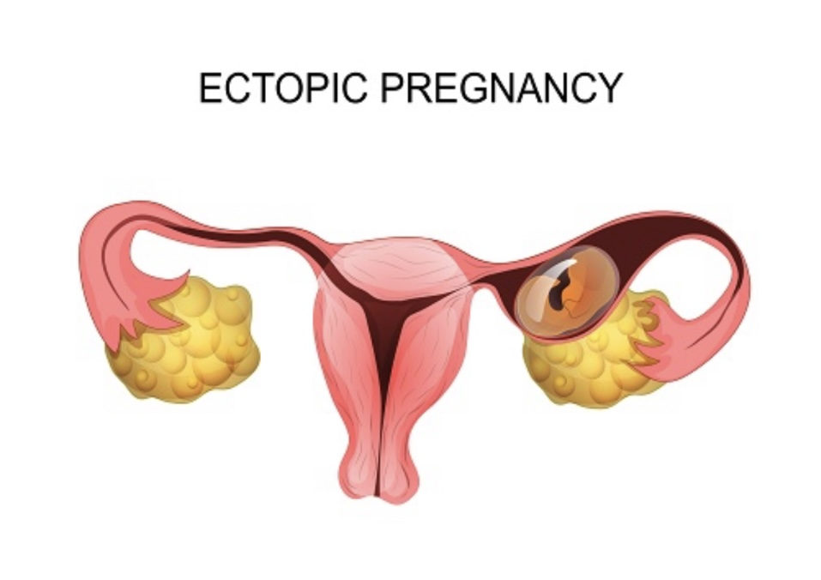
Dr.MEDAM SAILAJA
JR-3

Slide 2
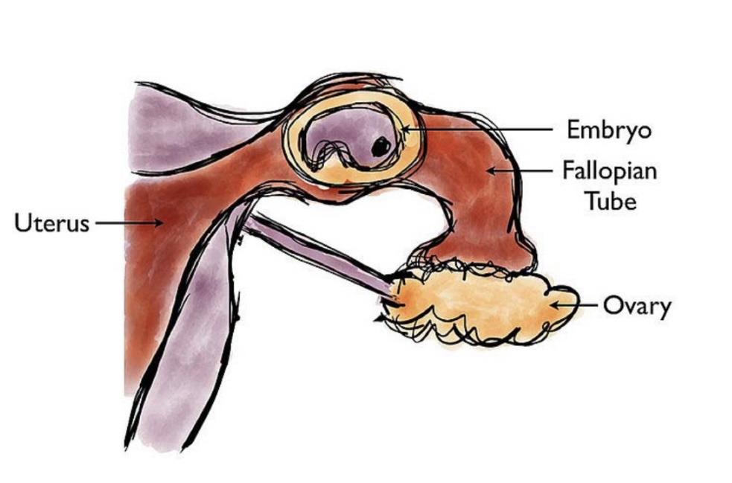
DEFINITION: ECTOPIC PREGNANCY
Fertilized ovum is implanted and develops outside the endometrial cavity

Slide 3
IMPLANTATION SITES

Slide 4
PATHOPHYSIOLOGY OF IMPLANTATION

Slide 5
Why an ectopic pregnancy occurs ?
PID
H/O Abortions
Previous ectopic
IUD
OCPs
Infertility
Tubectomy
Appendicitis
Uterine anomalies
Developmental defects of tube

Slide 6
Possible outcomes
Tubal rupture
Tubal abortion
Tubal mole
Tubal perforation
Continuation of pregnancy-rare

Slide 7
CLINICAL APPROACH
History
Detailed examination
Investigation

Slide 8
CLASSICAL TRAID
Amenorrhea
ECTOPIC PREGNANCY
Abdominal Pain
Abnormal Vaginal Bleeding

Slide 10
DIFFERENTIAL DIAGNOSIS
OBSTETRICS:-
1.Ectopic pregnancy
2.Abortions
3.Corpus luteal heamatoma
GYNECOLOGY
1.PID
2.Ovarian cyst
3.Endometrosis
4.Fibriod
NON-GYNECOLOGICAL
1.Appendicitis
2.Urinary tract infection
3.Renal colic
4.Perforated peptic ulcers

Slide 11
MANAGEMENT
Expectant
Medical
Surgical

Slide 12
EXPECTANT MANAGEMENT
CRITERIA:-
1.Tubal Unruptured ectopic pregnancy
2.Haemodynamically stable
3.G.sac < 3.5 cm without heart beat
4.Beta HCG <1000 IU/L & falling in titre
5.Minimal symptoms and are compliant with follow-up
Jurkovic D and Wilkinson H (2011). Diagnosis and management of ectopic pregnancy. British Medical Journal, 342, d3397

Slide 13
MEDICAL MANAGEMENT
METHOTREXATE
DOSE:- 50 mg/m²
^{CRITERIA:-}
^{1.size of G.sac <4cms}
^{2.Beta-HCG < 5000IU/L}
^{3.Absent cardiac activity}
FOLLOW UP

Slide 14
SURGICAL MANAGEMENT
LAPAROSCOPIC
LAPAROTOMY

Slide 15
INDICATIONS
1.Ruptured ectopic
2.Size of G.sac >5cms
3.Hemodynamically Unstable
4.Heterotopic pregnancy

Slide 16
LAPAROTOMY
Salpingostomy
Salpingectomy
Segmental resection & anastomosis
Milking or Fimbria expression

Slide 17
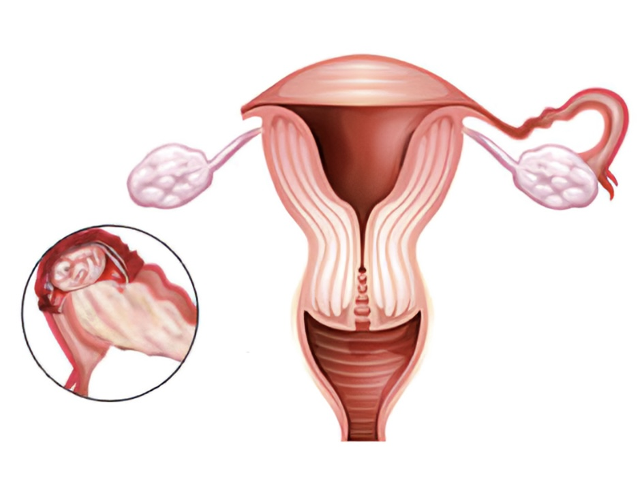
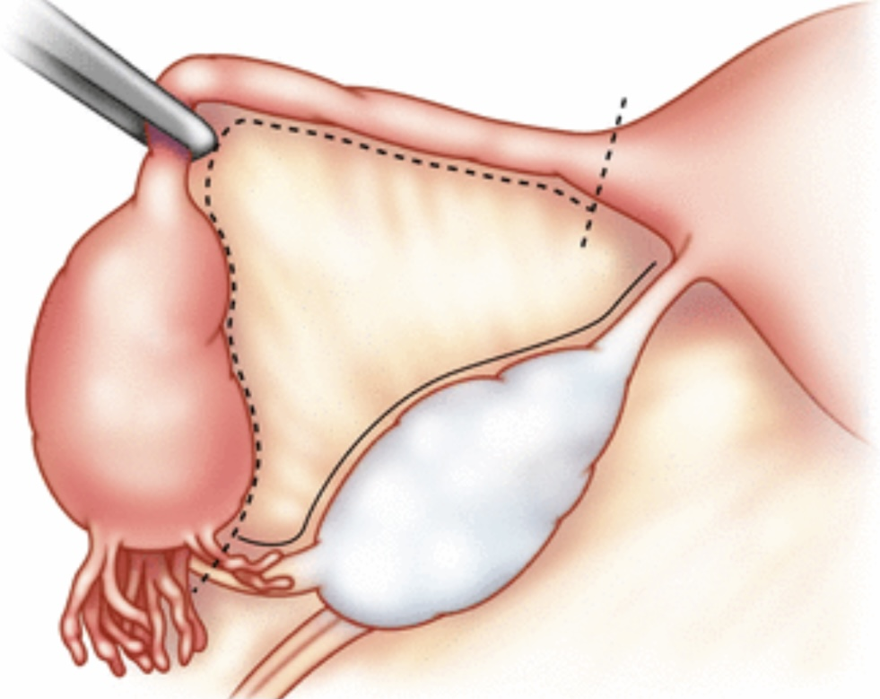
LAPAROSCOPIC SALPINGECTOMY
Gold standard

Slide 18
THINK ECTOPIC

Slide 19
TAKE HOME MESSAGE
High index of clinical suspicion
Early Recognition & clinical diagnosis
T.V.S plays important role
Serial Beta-HCG levels
LAPAROSCOPY –Gold Standard

Slide 20
THANK YOU
UNIT-III

