Slide 1
MISUSE OF ORAL CONTRACEPTIVES WITH LIFE THREATENING COMPLICATION IN A CASE OF FIBROID UTERUS
DR. NEHA ELLATH
Under the guidance of DR. VIDYA GAIKWAD
PROF and HOU DEPT. OF OBGY UNIT II

Slide 2
CASE
A 37 year old female, P3L3 Tubectomised, a homemaker of low socio economic class from Khed, Pune.
Was brought to Dr. D. Y. Patil Hospital casualty with Complaints of (her mother being the informant)
P/V bleeding with passage of clots since 10 days
Headache and Altered sensorium since 3-4 days
Vomiting since 2 days
No H/O of trauma, ENT bleed, loss of consciousness, seizures

Slide 3
MENSTRUAL and OBSTETRIC HISTORY
Menstrual history: Irregular menstrual bleeding since 1 year
LMP: not known
since 1 year:
Irregular, heavy flow
with passage of clots and dysmenorrhea
1 year ago:
regular, moderate flow
no h/o passage of clots or dysmenorrhea
Obstetric history:
Married since 16 years
P3L3 (full term normal deliveries)
Last child birth 11 years ago
Tubectomised

Slide 4
PAST HISTORY
Patient had similar menstrual complaints, Irregular, heavy menstrual bleeding with passage of clots and dysmenorrhea 1 year ago for which she was prescribed Oral Contraceptive Pills OVRAL-G Norgestrel 0.5mg + Ethinyl Estradiol 50µg for 3 cycles
However patient had been taking OCP’s on and off without prescription since 1 year to control heavy menstrual bleeding and for relief of dysmenorrhea
Her mother in addition, gives history of her daughter taking these pills sometimes 2 or 3 times a day (i.e. 100-150µg of Ethinyl Estradiol)
No history of taking anticoagulants, bleeding diathesis, hypertension, diabetes mellitus, thyroid illness, tuberculosis, asthma, epilepsy.

Slide 5
PERSONAL AND FAMILY HISTORY
Personal history:
No bowel or bladder complaints
No addictions
No known drug allergies
Family history: Not significant

Slide 6
GENERAL EXAMINATION:
Patient was conscious but drowsy
Glasgow Coma Score (GCS): 13, Eye response-3 Verbal response-4 Motor response-6 (E3V4M6)
Afebrile, Pulse: 68/min, Respiratory rate: 18/min, Blood pressure: 100/50 mm of Hg
SpO2 :98% on room air
Pallor +++
No icterus, cyanosis, edema, generalized lymphadenopathy
CNS EXAMINATION:
Bilateral pupils equal & reactive to light
Moving all 4 limbs however paucity of movements on right side of body

Slide 7
PER ABDOMEN EXAMINATION: soft non tender
PER VAGINAL EXAMINATION:
Local examination: bleeding ++
Speculum examination: bleeding ++
Bimanual examination:
uterus 12 week size
Anterior and lateral fornicial fullness noted Cervix dilated
? Fibroid polyp felt inside the os
CARDIOVASCULAR SYSTEM: S1 S2 heard
RESPIRATORY SYSTEM: air entry equal on both sides

Slide 8
USG (abdomen+ pelvis) findings:
Bulky uterus with Submucosal fibroid measuring approx. 6x6cm showing peripheral vascularity on Doppler compressing and pushing lower endometrium on left lateral side with minimal streak of fluid in lower endometrial cavity
CT Brain findings:
Intraparenchymal hemorrhage in the left parieto-temporo occipital region measuring approx. 3.8x 2.7x 2.2cm
Mass effect by effacement of body, temporal and occipital horn of left lateral ventricle.
Midline shift of 8mm to right side with subfalcine and uncal herniation.
MRI Brain showed Cerebral Venous Sinus Thrombosis

Slide 9
Lab investigations:
Hb: 8.8gm/dL
Plt count: 148,000/µL
PT: 16.2sec
INR: 1.4
UPT negative
Rest labs WNL

Slide 10
DIAGNOSIS
Patient was diagnosed with Submucosal fibroid with Cerebral Venous Sinus Thrombosis with Left parieto-temporo occipital bleed with Midline shift to right side

Slide 11
MANAGEMENT - MEDICAL
IV Antibiotics
Inj. Mannitol
Inj. Levetiracetam
Tab. Primolut N 5mg TDS (for P/V bleeding)
4 PCV
4 FFP’s

Slide 12
MANAGEMENT - SURGICAL
Patient underwent left fronto temporo parietal decompressive craniectomy with left temporal hematoma evacuation from superior temporal gyrus
Post operative period was uneventful without neurological deficit

Slide 13
FOLLOW UP
Patient was discharged on
Tab. Warfarin 2mg OD x1month
Inj. Enoxaparin 0.6cc sc BD x1month with weekly PT/INR monitoring
Tab. Primolut N 5mg TDS x21days
Patient is currently being followed up in gynecology and neurosurgery OPD and hysterectomy has been planned after a month

Slide 14
DISCUSSION
Women who use estrogen containing hormonal contraceptives are at increased risk for venous thrombosis and thromboembolism.⁽¹⁰⁾
The progesterone-only oral contraceptives and the levonorgestrel-releasing IUDs were not associated with venous thrombosis.⁽¹⁰⁾
Consumption of oral contraceptive pills (OCP) is a known risk factor for cerebral venous sinus thrombosis (CVST) among women.
Pulmonary embolism and cerebral thrombosis, both venous and arterial, are 7 to 10 times more frequent in the ‘pill’ users than in the non-users. ⁽¹²⁾

Slide 15
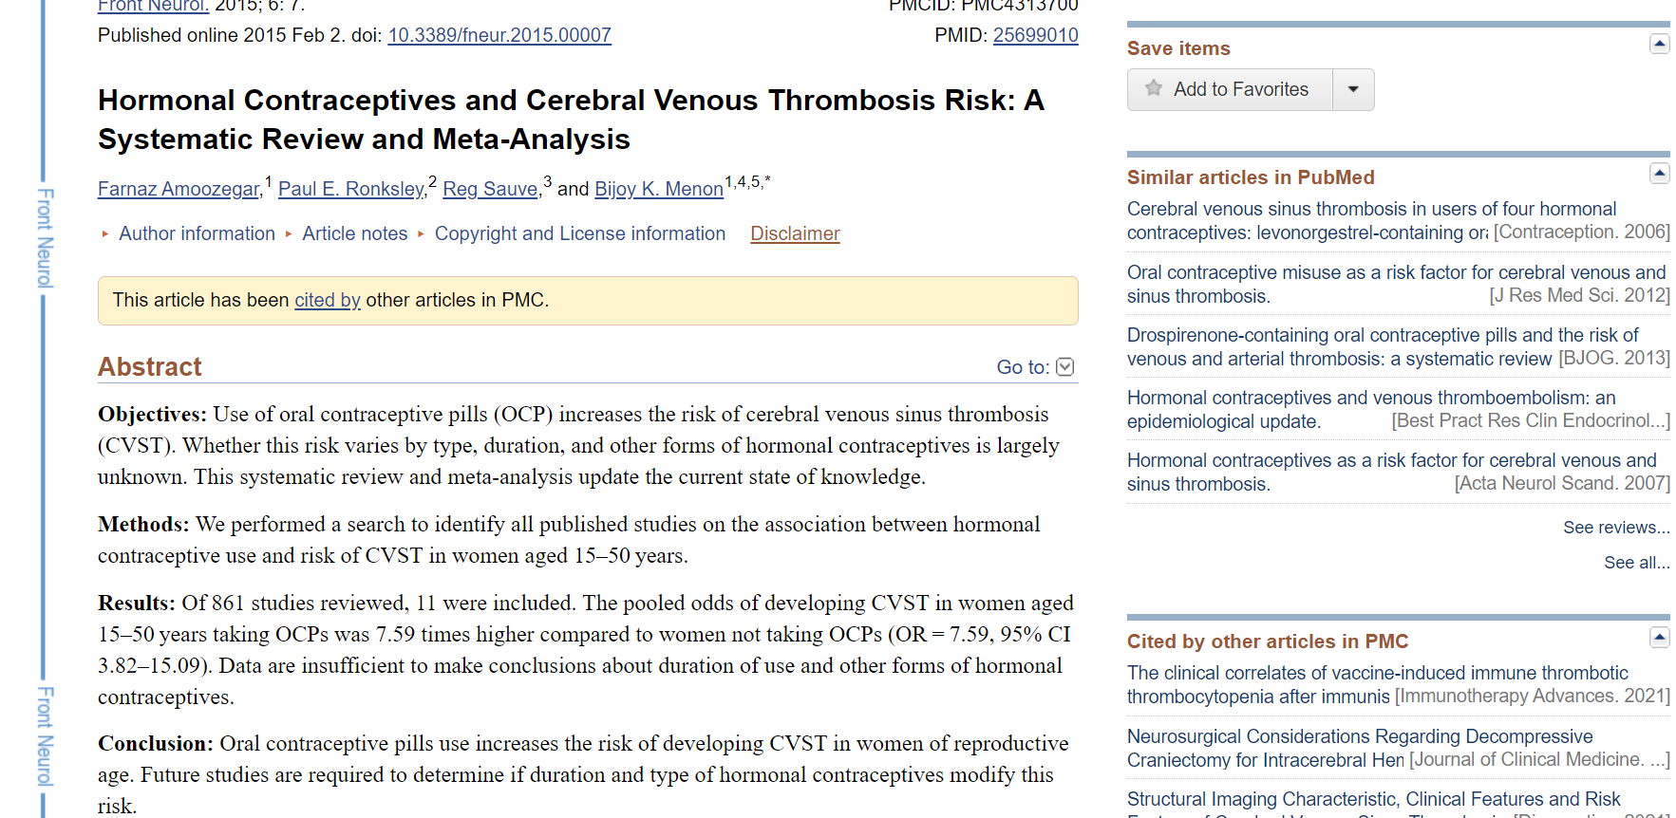

Slide 16
DISCUSSION (CONT.)
Venous thrombosis and thromboembolism are due to a derangement in the clotting mechanism in the platelet aggregation, increased fibrinogen, factor VII, VIII, X and decreased fibrinolysis caused by the estrogen component of the pill. ^{(9,12)}
Leiomyoma (fibroid) is itself erythropoietic and Polycythaemia increases the risk of thromboembolism⁽¹¹⁾
Islands of extramedullary erythropoiesis have been documented, a high level of erythropoietin activity has been reported within uterine Leiomyomas⁽¹¹⁾
The tumor may press on the ureter and affect the erythropoietic function of the kidney⁽¹¹⁾
Arteriovenous shunts have also been found in these tumours and these may also play a role⁽¹¹⁾

Slide 18
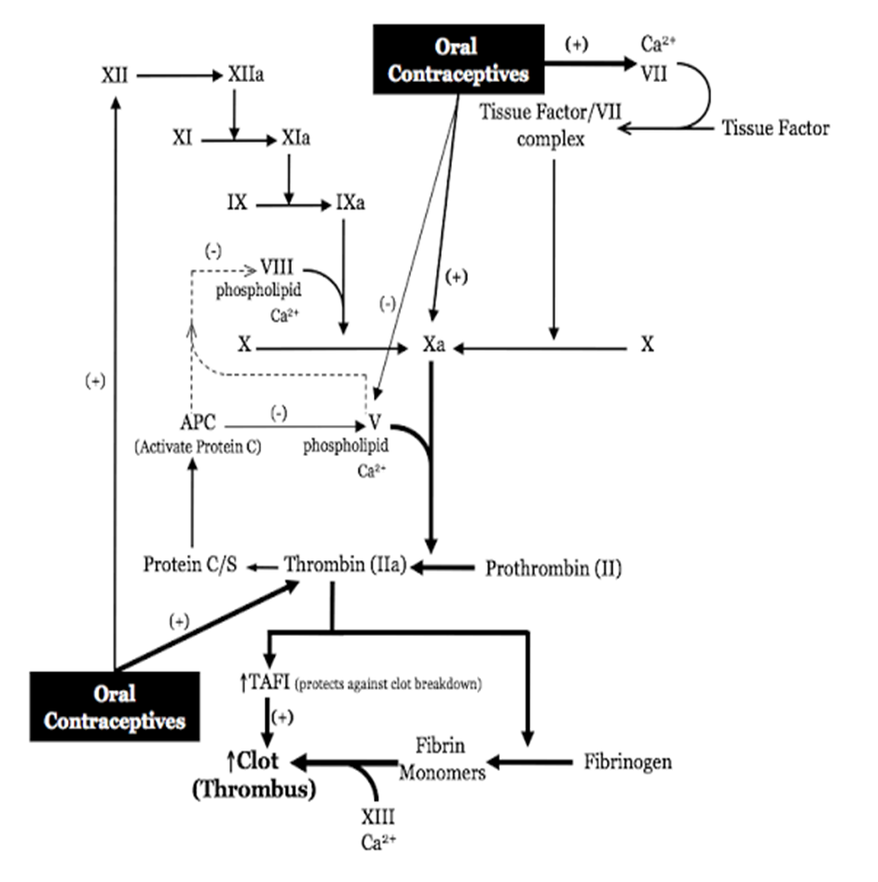

Slide 19
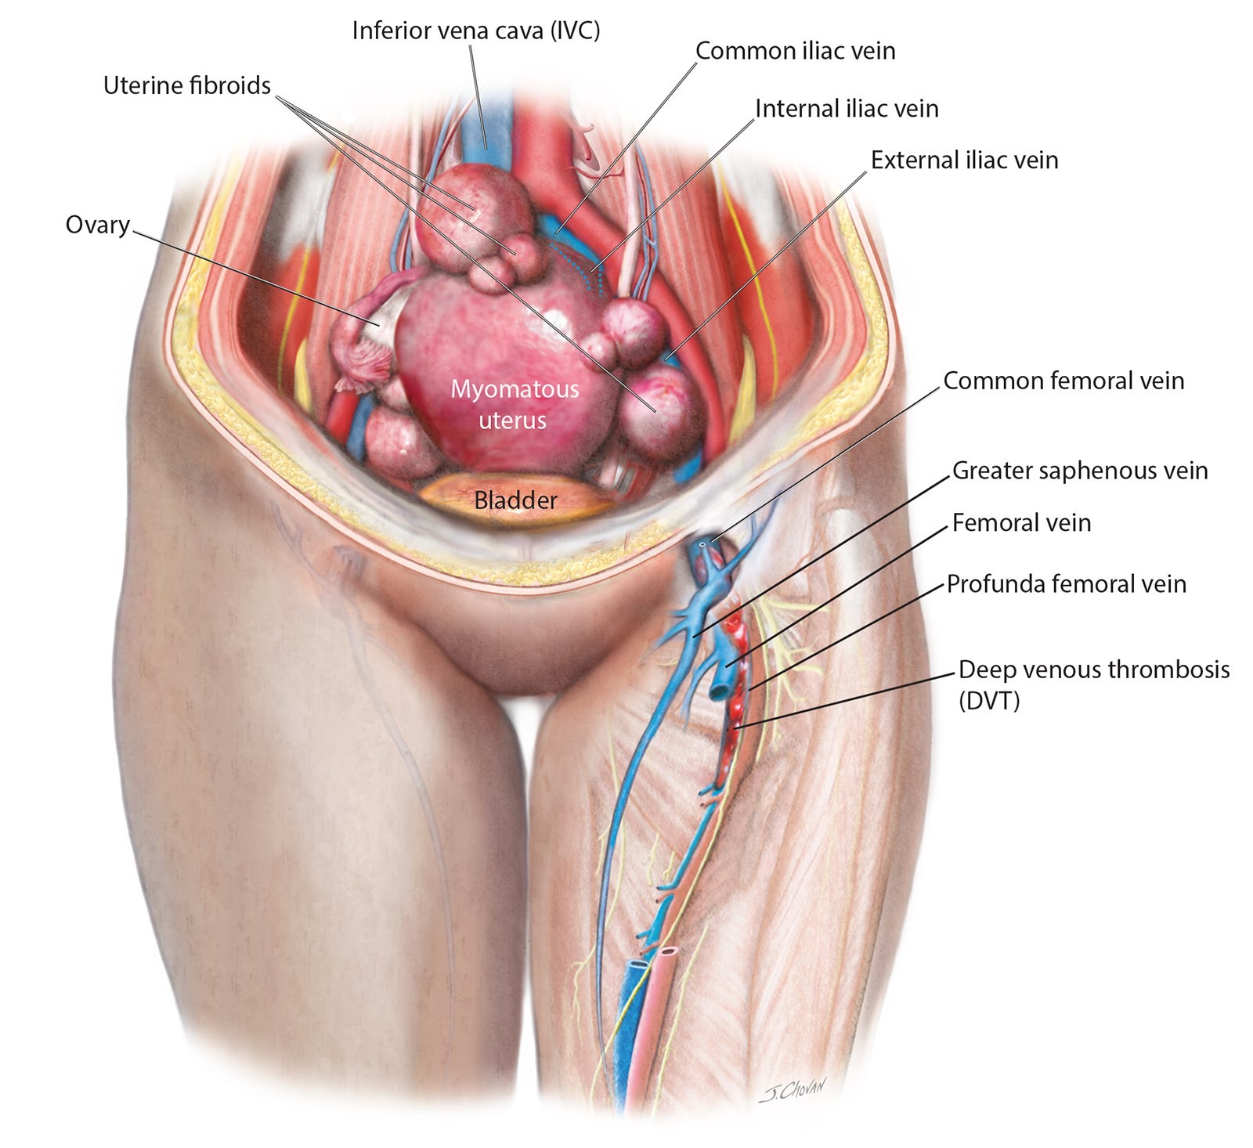

Slide 20
DISCUSSION (CONT.)
When compared with higher-dose 50µg estrogen OC’s, lower estrogen-dose 30-35µg ethinyl estradiol (EE) OC’s have less risk of a thromboembolic event. ⁽²⁾
A Danish study showed that combination OC’s with 20 µg of EE have an 18% further less risk compared with 30 to 40 µg OC’s after adjustment for duration of use. ⁽³⁾

Slide 21
RECOMMENDATIONS
OCPs are ideally started on any day between day 1 and 5 of the cycle, given for 21 days and stopped.
This will be followed by withdrawal bleed.
A new packet of pills is started counting the 1st day of withdrawal bleed as day 1.
The patient should be called for follow-up after 3 months for the assessment of blood pressure and enquired for the presence of any other problems.
Thereafter, annual visit is required for assessing side effects, checking blood pressure, and evaluating glucose intolerance and lipids.
OCPs need to be stopped in the presence of any side effects or if abnormal glucose tolerance or dyslipidaemia is detected.

Slide 22
RECOMMENDATIONS (cont.)
Counselling regarding risks, benefits and contraindications should be done in detail before starting OCPs
Obtaining a thorough past, medical and family history, calculating the BMI are important before prescribing OCPs
Proper patient selection is necessary to minimise risks associated with OCP use
Increased risk of DVT in women using OCPs warrants that DVT should be ruled out in all women on OCPs⁽²⁾

Slide 23
RECOMMENDATIONS (cont.)
In women with chronic menorrhagia it is important to rule out haemoglobinopathies and coagulopathies⁽¹⁾
Careful monitoring of women who take OCPs for venous thrombosis, hypertension, lipid profile, breast, cervical and liver cancer is essential
OCP use in obese women have additional metabolic risk and should be carefully monitored by appropriate surveillance
Levonorgestrel intrauterine device can be offered in those with menorrhagia

Slide 24
CONCLUSION
Over-the-counter (OTC) availability of oral contraceptives is a controversial subject and not just because of the political debates over reproductive health care.
Benefits could include
wider availability, no need for provider prescription
lower costs due to absence of associated healthcare expense
general cost decline of most medications which have gone OTC in the past
Concerns include
Misuse
lack of supervision
increased adverse effects as a result of inadequate medical screening prior to use

Slide 25
REFERENCES
Martinelli I, Sacchi E, Landi G, et al. High risk of cerebral-vein thrombosis in carriers of a prothrombin-gene mutation and in users of oral contraceptives. N Engl J Med 1998;338(25):1793-1797.
Gerstman BB, Piper JM, Tomita DK, et al. oral contraceptive estrogen dose and the risk of deep venous thromboembolic disease. Am J Epidemiol 1991;133(1):32–37.
Lidegaard O, Lokkegaard E, Svendsen AL, et al. Hormonal contraception and risk of venous thromboembolism: national follow-up study. BJM 2009;339:b2890.
Comp PC. Should coagulation tests be used to determine which oral contraceptive users have an increased risk of thrombophlebitis? Contraception 2006;73(1):4–5.
Spitzer WO, Lewis MA, Heinemann LA, et al. Third generation oral contraceptives and risk of venous thromboembolic disorders: an international case control study. Transnational Research Group on Oral Contraceptives and the Health of Young Women. BMJ 1996;312(7023):83–88.
Heinemann LA, Dinger JC, Assmann A, et al. Use of oral contraceptives containing gestodene and risk of venous thromboembolism: outlook 10 years after the third-generation “pills scare”. Contraception 2010;81(5):401–407.
Stegeman BH, Bastos M, Rosendaal FR, et al. Different combined oral contraceptives and the risk of venous thrombosis: systematic review and network meta-analysis. BMJ 2013;347:f5298.
Effect of different progestagens in low estrogen oral contraceptives on venous thromboembolic disease. World Health Organisation Collaborative Study of Cardiovascular Disease and Steroid Hormone Contraception. Lancet 1995;346(8990):1582-1588.
Clinical gynecologic endocrinology and infertility, Leon Speroff and Marc A. Fritz
Berek & Novak’s Gynecology
Jeffcoate’s Principles of Gynaecology
Shaw’s Gynaecology

Slide 26
THANK YOU

