Slide 1
Placenta Percreta
-AN OBSTRETICIAN’S NIGHTMARE
Under Guidance Of Dr. Hemant Deshpande (HOD)
Dr Chetan Gulati JR 2 Dr D. Y. Patil Medical College,Pune

Slide 2
A 29 year old woman, G2P1L1 previous LSCS with 9 months of amenerrohea, was referred to us from a PHC with complaints of PV leak for ten hours.

Slide 3
Patient DEtails
Name : Mrs X
Age : 29 years
Address : Pimpri, Pune
Education : 9th Std / Home maker
SE Status : Lower Middle Class ( According to Mod. Kuppuswamy Classification)
Obstetric Score : G2P1L1
LMP : 03/11/20
EDD : 11/08/21
BD : 39 weeks

Slide 4
History of Presenting IllNESS
CHIEF COMPLAINTS
PV leak since 10 hrs.
No h/o pain abdomen
No h/o bleeding PV
No h/o backache
No h/o foul smelling discharge
No h/o trauma

Slide 5
history of present pregnancy
FIRST TRIMESTER
- UPT was done at 45 days of amenorrhea - No h/o hyperemesis gravid arum - No h/o fever with rash - No h/o radiation exposure & drug intake - No h/o UTI - No h/o bleeding PV

Slide 6
second trimester
- H/o of quickening at 5 months - No h/o UTI, Bleeding PV, features s/o pre eclampsia - H/o TT - 2 doses at 5 and 7 months - H/o Iron & Calcium supplementation intake
Anomaly scan was done at 19 weeks and was normal

Slide 7
ROUTINE ANTENATAL investigations
Haemogram : Hb - 10.2g/dL
Blood Group : O positive
Rest all routine investigations were also found to be within normal limits.

Slide 8
THIRD TRIMESTER
Able to perceive foetal movements well No h/o bleeding PV No h/o fever No h/o white discharge PV No h/o features of pre eclampsia
Growth scan done at 34 weeks which was found to be corresponding, with adequate liquor and placenta at fundo-posterior position

Slide 9
OBSTETRIC HISTORY
Married since 7 years G1- MCH/ 5 years ago/ Emergency LSCS i/v/o Fetal distress
G2- Spontaneous Conception

Slide 10
MensTRUAL HISTORY
Age of menarche - 15 years
3-4days/28-32 days cycle/RMF
No h/o passage of clots
No h/o dysmenorrhea
LNMP : 03/11/20

Slide 11
Past History
No history suggestive of - Diabetes, Hypertension, Bronchial Asthma, Epilepsy, Thyroid Disorders.
No h/o of - blood transfusion - episodes of vaginal bleeding - Prolonged hospital stay

Slide 12
General examination
General Condition – Fair,
Afebrile
Pulse - 80bpm
BP - 110/70 mm Hg
CVS – S1/S2 normal, regular
Respiratory-B/L air entry equal. No added sounds
Height-154 cm
Weight-56 KG
BMI-22.8

Slide 13
Obstetric examination
PER ABDOMEN
Uterus full Term Cephalic Relaxed Head 3/5th Palpable Back of the baby on left side Clinically liquor was less FHS +148 BPM –Regular No scar tenderness
PER SPECULUM
Leak +, Liquor clear

Slide 14
Obstetric examination
PER VAGINUM
Cervical Os 1-1.5 cm dilated Cervix Minimally Effaced Cervix Posterior Station -3 Membranes Absent Pelvis Adequate

Slide 15
Text
A decision was taken to perform an Emergency Caesarean Section in view of Previous CS with PROM along with Poor Bishop’s score

Slide 16
Intra-opERATIVE
The abdomen was opened through previous transverse scar under SA
Uterovescical pouch was opened and bladder was pushed down
Incision was made in the lower uterine segment and a healthy male child of 2.6kg was delivered
The placenta, however, could not be removed with gentle traction, and no plane of cleavage could be identified between the uterine wall and the placenta.
Uterus was exteriorized and placenta was found to be firmly adhered to the uterine wall and serosa on the fundal region
An intra-op diagnosis of morbidly adherent placenta was made.

Slide 17
INTRA OPERATIVE FINDING

Slide 18
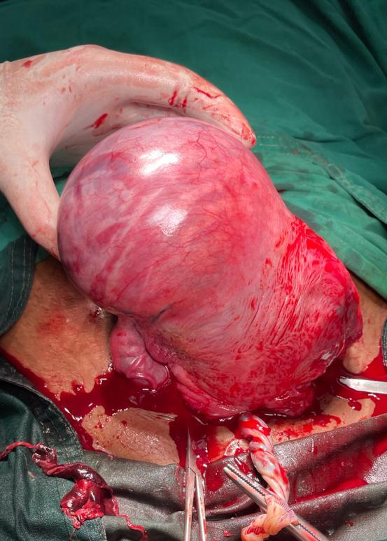
MANAGEMENT
A decision to perform an emergency obstetric hysterectomy was taken
A subtotal hysterectomy was performed after counselling and taking informed consent of the relatives
The patient’s vitals and urine output were monitored constantly
The post-op period was uneventful and the patient was discharged with a healthy baby after one week
Histopathology of the specimen was consistent with placenta percreta

Slide 19
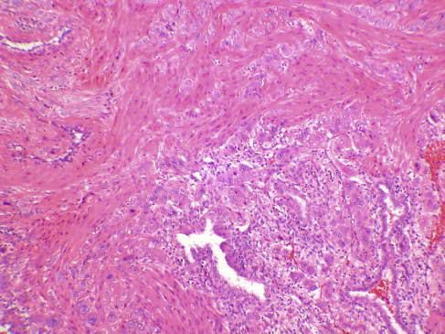
Histopathology
MICROSCOPIC EXAMINATION

Slide 20
WHY?

Slide 21
WHY?
Relationship of previous Cs and adherent placenta
Manual Removal of placenta

Slide 22
WHY?
How was the morbidly adherent placenta not picked up at usg?

Slide 23
DISCUSSION
The incidence of all forms of placental adhesion ( placenta accreta, increta and percreta )has been rising in the last few decades due to increasing cesarean section rates
Other predisposing conditions include
Instrumentation of endometrium
Placenta previa
Uterine malformations
Previous Caesarian section

Slide 24
The treatment for placenta percreta is primarily surgical with hysterectomy being the treatment of choice
Conservative management is desirable in rare cases which includes to leave the placenta in situ, uterine or internal iliac artery ligation and transcatheter arterial embolization have also been tried
Complications include DIC, Iatrogenic injury to ureter, bladder and other viscera
A multidisciplinary team approach is relevant in managing these patients to reduce morbidity and mortality.

Slide 25
Carry home message
Please do not remove placenta manually in every case of Caesarean section, let it deliver on its own.
Routine manual removal can damage basal layer of decidua resulting in complications in future as it probably happened in this case

Slide 26
REFERENCES
-RCOG –Greentop Guidelines
-Williams obstetrics-25th edition
-ACOG guidelines-2020
-Te linde’s Operative Gynecology-12th edition
. Miller DA, Chollet JA, Goodwin TM. Clinical risk factor for placenta previa-placenta accreta. Am J Obstetric Gynecology 1997; 177: 210.
- Buetow MP. Sonography of placenta percreta during the
. Levine D, Hulka CA, Ludmir J, Li W, Edelman RR. Placenta accreta: Evaluation with color Doppler US, power Doppler
US, and MR imaging. Radiology 1997; 205: 773-6.

Slide 27
THANK YOU

