Slide 1
Case Presentation

Slide 2
40 year female
c/o
Headache
Since 3 months aggravated since 2 weeks
More in the morning and in recumbent position
Headache was more on bending forward
Associated with nausea and vomiting after which headache was relieved
she also complained of blurring of vision in both eyes since 2 weeks

Slide 3
Examination
Visual acuity was 6/6 in both eyes
Fundus- Bilateral mild papillodema
Rest all normal

Slide 4
Radiology

Slide 8
Intraop

Slide 9
Intraop finding: Cholesterol crystals, calcification and a thick tumour wall
HPE S/o Colloid Cyst

Slide 10
Discussion
Benign masses, filled with proteinaceous fluid
Found posterior to the Foramen of Monro and arises from the anterior roof of the third ventricle
Colloid cysts make up between 0.5% to 1% of intracranial tumors
Disease mostly affects people above the ages of 40 years.

Slide 11
Wall lined with epithelial and goblet cells secreting protein-rich fluid
Colloid cysts are the most common masses of the foramen of Monro
Sudden increase in size can lead to drop attacks, dementia, coma, and death

Slide 12
At the level of the Foramen of Monro, the cyst may prevent drainage of cerebrospinal fluid from the lateral ventricles to the third ventricle
This can lead to, hydrocephalus and resulting transependymal edema from the increased intracranial pressure (ICP) may be seen.

Slide 13
Workup
CT:
A CT brain without contrast is the initial test of choice.
Approximately 2/3 of colloid cysts appear hyperdense on imaging.
The lesions are usually round or ovoid and are well delineated.

Slide 14
MRI: Important for neurosurgeons, because the surgical success rate is lower in colloid cysts that have decreased MRI T2-signal intensity
Lumbar puncture: Can be fatal as non-draining obstructive hydrocephalus can lead to herniation

Slide 15
Treatment
VP shunt:
For patients who are symptomatic and have a higher degree of ventriculomegaly
Microsurgical resection through the transcortical transventricular or transcallosal approach is considered the standard of surgical treatment for symptomatic patients.
-involves a craniectomy over the middle frontal gyrus.

Slide 16
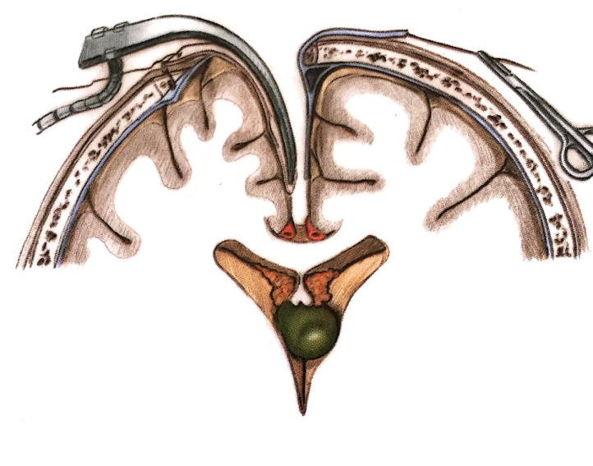
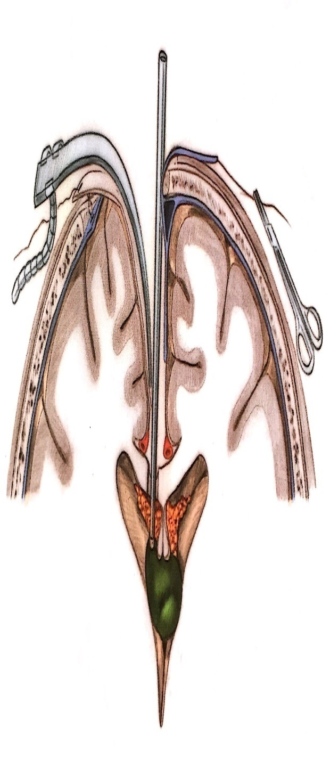
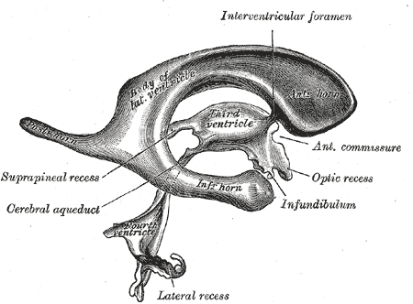
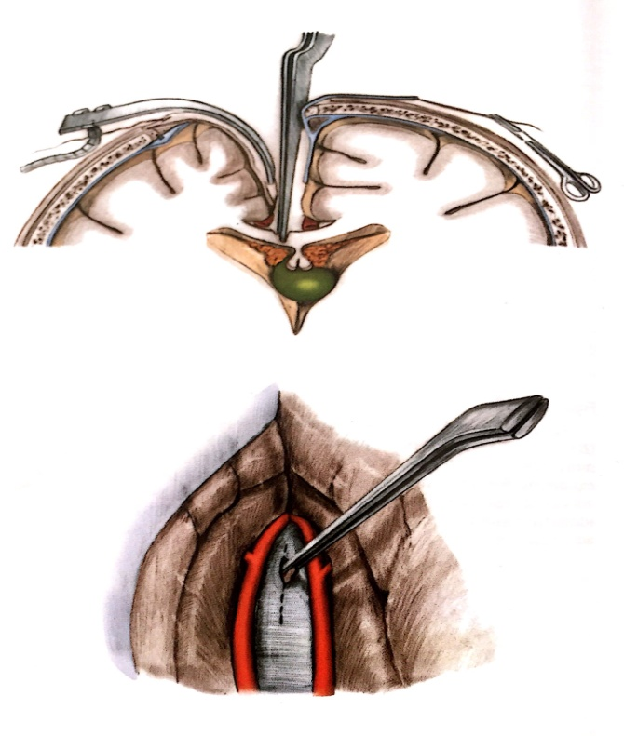
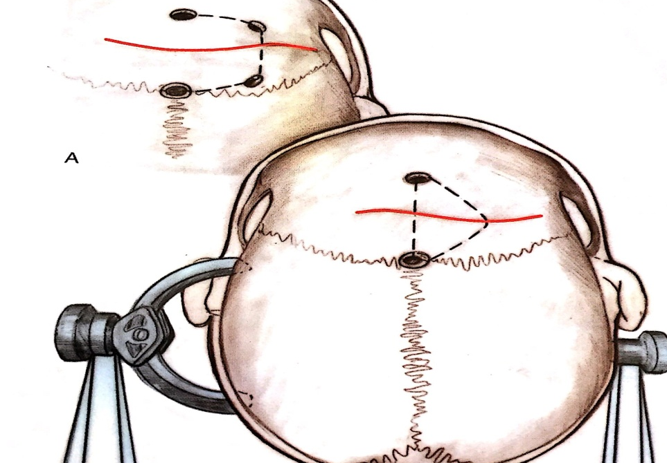
Conventional Surgical Technique
OPEN TECHNIQUE
INTER HEMISPHERIC
APPROACH
ANATOMY OF THE
VENTRICLES
INCISION &
CRANIOTOMY
EXCISION OF TUMOUR
OPENING OF THE
VENTRICLES

Slide 17
We used endoscopic approach which is minimally invasive and is done through a single burr hole.
This approach can be used for all classic colloid cysts and the ones which occur highly over the third ventricle roof.

Slide 18
ENDOSCOPY
ENDOSCOPIC SURGICAL TECHNIQUE
ANATOMY OF THE
VENTRICLES
SCHEMATIC OF ENDOSCOPY

Slide 19
Anatomical risk zones for colloid cysts of the third ventricle
Divided into 3 zones along the sagittal axis:
Zone I: from the lamina terminalis to a vertical line drawn from the mammillary body and tangential to the massa intermedia
Zone II:from the posterior boundary of Zone I to the rostral apex of the midbrain tegmentum at the inlet of the cerebral aqueduct
Zone III: from the posterior boundary of Zone II to the posterior limit of the third ventricle.
The term “risk zone” refers collectively to Zones I and III

Slide 22
Thank You!!!

