Slide 1
Case Report
Department of Neurosurgery
Dr. D.Y.Patil Medical College & Hospital
Pimpri, Pune

Slide 2
History
12year , Female
c/o Headache * 2 weeks
Worsened on forward bending
Associated with vertigo and vomiting
No history of fever, seizures or visual symptoms

Slide 3
Examination
Patient conscious, oriented and obeying commands
Pupils BERL
Fundus suggestive of early papillodema
Perimetry showed generalized scotomatous points

Slide 4
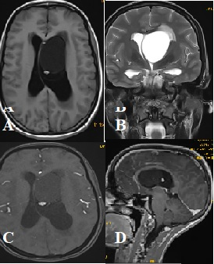
Imaging

Slide 5
Large cystic Intraventricular mass in the frontal horn of the left lateral ventricle measuring 4*5*3.2 cm
Hypointense on T1
Hyperintense on T2 and FLAIR
No contrast enhancement seen in the lesion

Slide 6
Small solid nodule of 7*6mm seen in the periphery of the lesion along posterior aspect
Lesion caused displacement of septum pellucidum to the right and dilatation of both lateral ventricles with mild periventricular ooze
D/D: ependymal cyst, arachnoid cyst, choroid plexus cyst, colloid cyst.

Slide 7
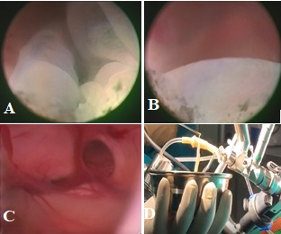
Intraop findings

Slide 8
Procedure
Endoscopic exploration with excision of cyst
Intraop findings:
Large cyst in the lateral ventricle with a gritty surface and a frond like movement within the ventricle
On aspiration: Clear CSF like fluid
Cyst was removed completely and sent for HPE

Slide 9
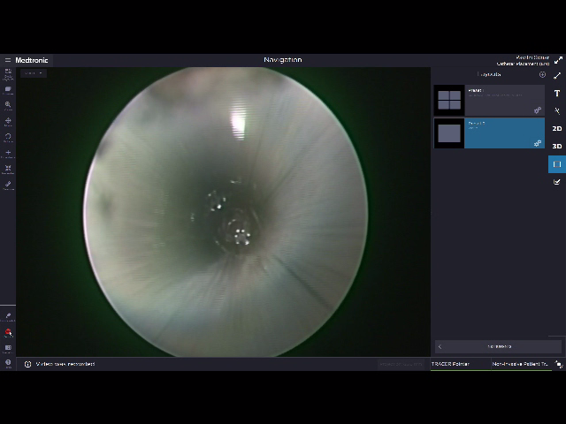

Slide 11
3rd ventricle was inspected for any remnants of the cyst.
Ventricle irrigated with RL solution.

Slide 12
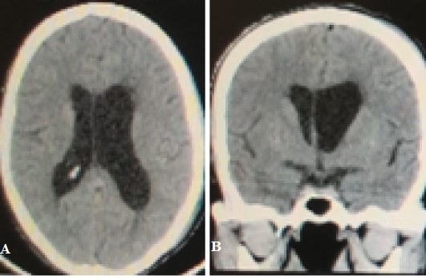
Post op CT
Complete excision of the cyst with septum pellucidum attaining its normal midline position

Slide 13
HPE suggestive of Neurocysticercosis
Post op period uneventful
Patient discharged on Albendazole for 1 month
Improvement in post operative perimetry

Slide 14
Discussion
NCC is uncommon in childhood due to long incubation period of the disease which ranges from several months to 30 years.
NCC is divided into parenchymal and extraparenchymal forms
Extraparenchymal includes
Intraventricular
Subarachnoid
Occasional spinal

Slide 15
<17 years of age constitute 0.8–27.5% of diagnosed cases of NCC
The cysts reach the ventricular system through the choroid plexus
More frequently found in the fourth ventricle, likely due to the gravitational forces which favor migration from supratentorial ventricles or may directly enter through the choroid plexus.

Slide 16
Cyst attached to the ventricular wall involutes and eventually resolve
Cysts which are not attached may migrate and block the cerebrospinal flow causing obstructive hydrocephalus.

Slide 17
Clinical features of IVNCC with hydrocephalus:
Headache
Nausea, vomiting
Altered sensorium
Papillodema or
Present infrequently with features of Brun’s syndrome.
Mechanism of hydrocephalus is either ventricular obstruction or arachnoiditis.

Slide 18
Brun’s syndrome
First described in 1902
Characterized by sudden onset of severe headaches, vomiting associated to a vestibular syndrome triggered by an abrupt movement of the head.

Slide 19
Pathophysiology
Mobile deformable intraventricular mass leading to an episodic obstructive hydrocephalus from an intermittent or positional CSF obstruction with elevation of ICP (ball valve mechanism).

Slide 20
Diagnosis of NCC includes
Systematic evaluation of clinical features
Neuroimaging
Serology(has limited role because of low sensitivity and specificity)

Slide 21
Identification of a scolex in a cystic lesion is the pathognomonic radiological finding.
Scolices appear as rounded or elongated bright nodules within the cyst cavity.
NCCT is sensitive for calcified and parenchymal lesions, but is insensitive for extraparenchymal disease.
MRI is preferred diagnostic test for extraparenchymal NCC

Slide 22
Treatment
Antiparasitic drugs
Surgery
Symptomatic medications.

Slide 23
Corticosteroids represent the primary form of therapy for meningitis, cysticercal encephalitis and angitis.
Praziquantel and albendazole have been used with success to treat NCC
They destroy 60%- 80% of parenchymal brain cysticerci after a course.
The most accepted regimens of cysticidal drugs are albendazole, 15 mg/kg per day for 1 week, and praziquantel, 50 mg/kg per day for 2 weeks.

Slide 24
Medical management alone is not recommended because of the limited effectiveness of albendazole and praziquentel.
Principles of surgery include managing hydrocephalus and removal of the cyst.
Neuroendoscopy is preferred over microsurgery and ventriculoperitoneal shunt.

Slide 25
Even in the emergent case of Bruns syndrome, neuroendoscopy has been proven both diagnostic and curative, as endoscopic third ventriculostomy (ETV) or septum pellucidotomy can be done to prevent delayed hydrocephalus in addition to cyst removal.
Under Endoscopic visualization, cysticerci appear as a “full moon” which is considered pathognomonic for IVNCC.

Slide 26
According to literature intraoperative cyst rupture causing post operative ventriculitis is rare.
In our case cyst rupture occurred intraoperatively however patient did not have postoperative ventriculitis.

Slide 27
Conclusion
Intraventricular NCC presenting as Brun’s syndrome is very rare.
Timely intervention can prevent mortality.
Neuroendoscopy is a viable option.

Slide 28
Thank You!!!!

