Slide 1
Case Report
Department of Neurosurgery
Dr. D.Y.Patil Medical College & Hospital
Pimpri, Pune

Slide 2
Clinical picture
35 year, Female
C/o low backache since 2 years aggravated since last 3 months
Patient had sacral hypoaesthesia
No motor deficit

Slide 3
Imaging

Slide 5
Intra-operative findings
Patient was taken up for surgery in prone position
A posterior linear midline incision was taken from L4 to S5(buttock cleft).
Once tumor was visualized biopsy was taken and decompression started
Tumor was highly vascular and procedure had to be abandoned due to massive intra-tumoral bleeding and hemodynamic instability.

Slide 6
Hemostasis was achieved by packing with mops and with the use of hemostats.
4 units of blood had to be transfused at the same time.
Wound was closed

Slide 7
Post operative
Patients neurology was unchanged.
Patient was stabilized in the ICU.
HPE s/o GCT

Slide 10
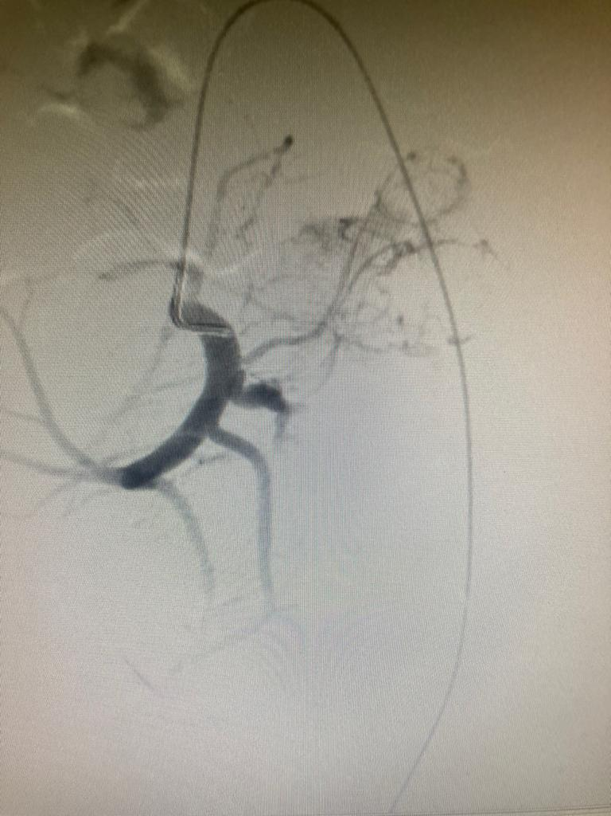

Slide 11
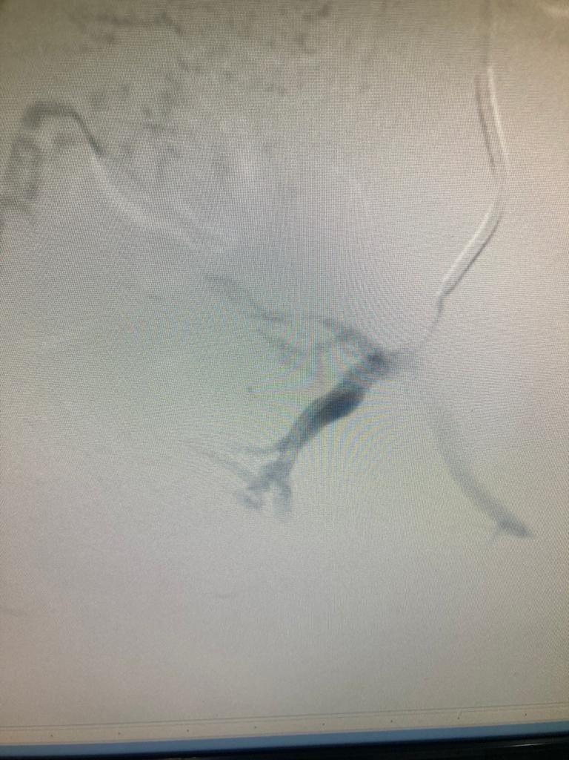

Slide 13
Re-surgery
Patient was taken up for re-exploration on POD 8.
A sacrectomy with near total resection of tumor with lumbo-pelvic fixation was done with b/l gluteus maximus musculocutaneous flap was performed.

Slide 17
Intra op C-Arm imaging

Slide 19
Post-operative imaging

Slide 22
Post operative period
Postoperatively, the patient did not have any added motor deficit.
Sacral hypoaesthesia aggravated
Developed urinary retention and needed catheterization.
Developed wound gaping with a non discharging sinus on POD 10 after 2nd surgery. Regular dressing was done with antibiotics as per culture sensitivity was given.

Slide 23
At present, wound healed by secondary intention and sinus closed.
Patient is currently ambulatory without support without pain with bladder catheterized and no fecal incontinence
Metastatic workup did not reveal any other similar lesions. Giving RT was deferred as possibility of malignant transformation.
Patient discharged and asked to follow up with oncology and urology(Urodynamic studies).

Slide 24
Post op MRI

Slide 26
Giant cell tumors (GCTs)
Rare
3–7% of all bony tumors.
Usually affect epiphyses in long bones.

Slide 27
Benign, locally aggressive lesions
Adverse effects from compression
Gross Total Resection of GCT is curative.
Anything short of total resection usually results in recurrence within 4 years.
RT (controversial) - reserved for lesions that cannot be completely resected.

Slide 28
Sacral tumors
Complex anatomy
Tumors involving the sacrum and related neural & pelvic structures constitutes a heterogeneous group.
The intrasacral space is unique for regional expansion, resulting in delayed presentation as the tumor slowly grows in and fills the sacrum

Slide 29
Most lesions are direct effective disorder embryogensis
Persistent embryonic cell rest
Failure of regression
Defective cleavage of germ cell layers

Slide 30
Different sacral tumors
Teratoma – most common primary Tx of the sacrococcygeal region in children
Chordoma – most frequent primary Tx in adults
Inflammatory – Abscess
Neurofibroma
Schwannoma
Neuroblastoma
Metastasis
Osseous giant cell Tx

Slide 31
Primary vs metastatic tumours
Primary
Goal: Cure / long term survival
Adjuvant Rx – limited
Surgery - Enbloc
Metastatic
Goal : Palliation
Adjuvant Rx – Available
Surgery – Intralesional

Slide 32
Problems to expect
Deep location of the tumour within the pelvis
Intimate relation with surrounding neurovascular structures
Consideration of with lateral illiac articulation
Difficulty with instrumentation/ visualization
Fusion rare
Neurological deficits

Slide 33
Concerns
Age > 50 years
Immune deficency, steroids
Rapid weight loss
CT/RT/Steroids – Healing
Coagulopathy
Wound complications/ Infection/ dehiscence - High
Establish diagnosis
Operate on the right patient
Appropriate approach
Bone quality - ? Fusion
Hardware failure
Timing of surgery

Slide 34
Evaluation
Core biopsy
Excisable ?
Rule out mets – CT, PET,
MRI – entire spine MRI (esp in chordomas)
Vascular – CTA
Embolizaiton

Slide 35
Surgical principles for sacral Tx
Preservation and maximization of neurological function.
Protection of ventral abdominal & pelvic structures.
Stabilization through lumbo-pelvic fixation as necessary.
It is important to maintain the integrity of the sacral nerve roots.

Slide 36
Preservation of sphincter function.
Amputation below S3 nerve root results in minimal functional deficits.
Resection of all sacral nerve roots result in saddle anesthesia and sexual dysfunction.

Slide 37
Surgical options
Intralesional debulking
GTE
En bloc resection

Slide 38
Deficits associated with level of resection
Below S3
Preserve b/l S3 roots
Will regain B/B/S function
Low long term morbidity
Mid sacrectomy(S2-3)
Variable neurological dysfunction
b/l S2 and one S3 preserved – regain function but not necessarily normal
Loss of b/l S3 and 1 S2 – Variable function

Slide 39
Total secrectomy
Loss of B/B/S and LE function
Both L5 Preserved – ambulatory but not atheletic function
Above L5 – non ambulatory. Later a nerve or tendon transfer via preserved femoral nerve can be performed.

Slide 40
Planning approach
Anterior vs Posterior vs Both
Bowel prep
Temporary urethral stents
Posterior
No rectal involvement
No anticipated large defect
Below S2
Lesser morbidity

Slide 41
Lumbo-Pelvic stabilization
Enbloc resection of tumors along with total sacrectomy is the mainstay of treatment for most primary osseous tumor of the sacrum.
Pelvic ring stability is the most important biomechanical aspect to consider.
Two vital components of pelvic ring integrity are pubic symphysis anteriorly and SI joints posteriorly.

Slide 42
50% of the SI joints must remain intact to maintain pelvic ring integrity.
Surgical stabilization must be strongly considered if more than 50 % of the SI joint is removed.
Spino-pelvic reconstruction is often an unavoidable necessity for most sacral tumor resections.

Slide 43
Take home message
Sacral tumors require prior planning with detailed imaging like CTA and DSA.
Need for a interdisciplinary management.
Consideration for spinopelvic stabilization when > 50% of of the SI joint needs to be removed, due to aggressive nature of the disease.
Proper patient counseling and realistic expectations of the functional outcomes.
Wrong operation on the wrong patient by the wrong surgeon

Slide 44
THANK YOU

