Slide 1
CASE PRESENTATION
Department of Neurosurgery
Dr. D.Y.Patil Medical College & Hospital
Pimpri, Pune

Slide 2
HISTORY
46 years/Female
c/o neck pain with radiation of pain to right upper limb since 4 years aggravated since 3 months
Right sided weakness
h/o trauma 2 month
Restriction of neck movements(predominantly flexion)

Slide 3
EXAMINATION
Short neck.
Restriction of neck movements.
Weak right corneal and gag reflex.
Decreased touch and deep pressure in the right half of the body.
Deep tendon reflexes exaggerated both upper and lower limbs
Spastic quadriparesis
Hoffman’s positive
Joint level | Right | Left
Shoulder abduction Adduction Flexion Extension | 2/5 2/5 2/5 3/5 | 3 4/5 4/5 4/5
Elbow flexion Extension | 3/5 3/5 | 4/5 4/5
Wrist flexion extention | 3/5 3/5 | 3/5 3/5
Hand grip | 50% | 70%
Hip | 4/5 | 4/5
Knee | 4/5 | 4/5
Ankle | 4/5 | 4/5

Slide 4
PRE OP RADIOLOGY

Slide 5
RADIOLOGY

Slide 6
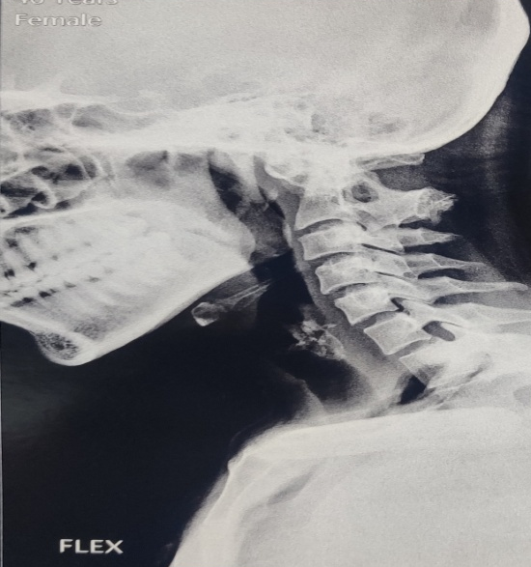

Slide 7
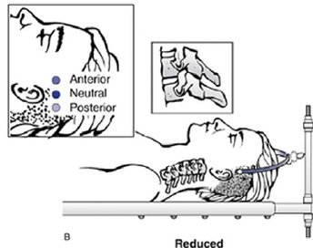
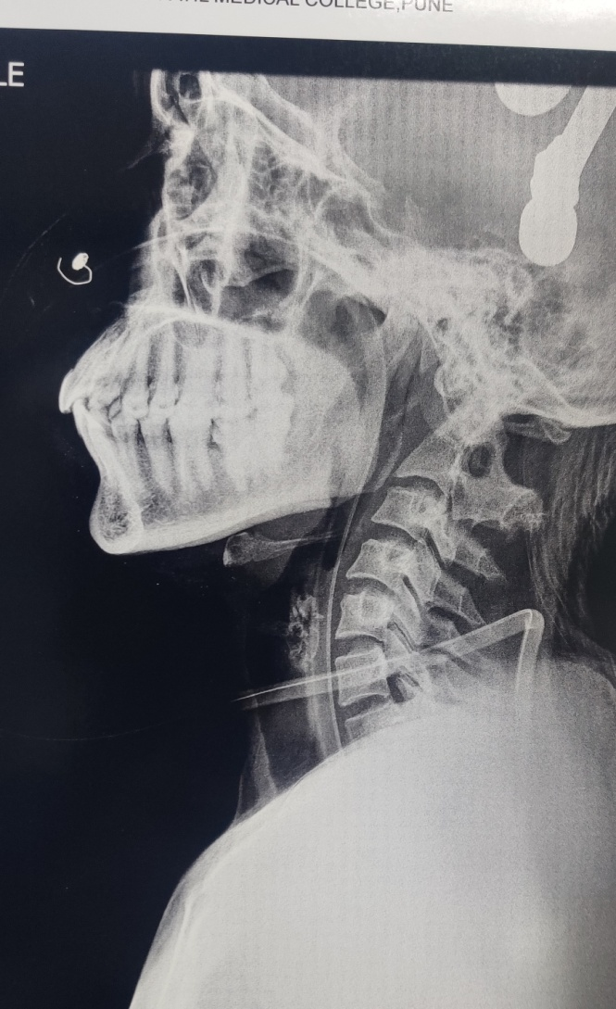
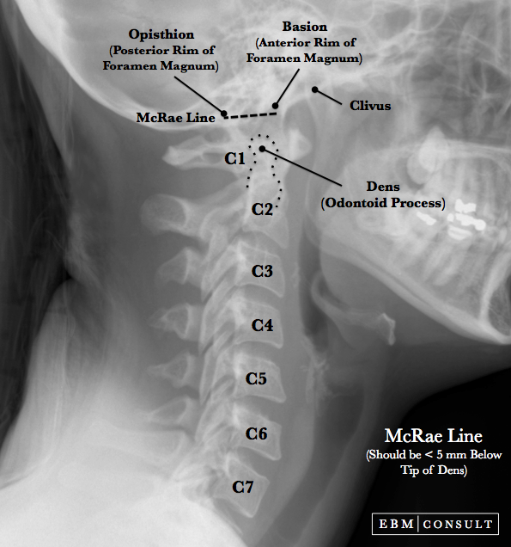
In pre op period traction given in neck extension with Gardner well skeletal traction tongs.
Reduction in BI was seen on extension.

Slide 8
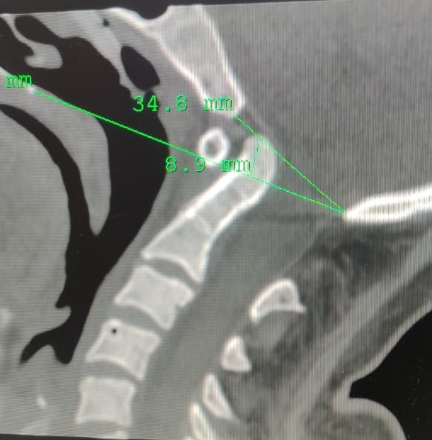
AFTER TRACTION
The reduction of BI was as demonstrated in the CT.

Slide 9
INTRAOP -Anterior extra-pharyngeal cage distraction and fixation

Slide 10
POST OP
POD 0
Spasticity and tightness of lower limbs decreased in immediate post op period.
Mild deviation of tongue to the right.
Grade 2 facial palsy
POD 1
Improvement of sensation over the face and right half of the body
Decrease in radicular symptoms.
Pt was started on RT feeds as gag was weak

Slide 11
POD 7
Power improved in all 4 limbs and was able to ambulate with support, tolerated sips of water
POD 10
Tolerated soft diet and RT was removed 2 days later
Able to walk short distances without support and could get up from chair without support
POD 14
Facial palsy improved.
Could walk the entire corridor of the ward without support.
Sutures were removed with wound healed by primary intention.
Pt was discharged with a Philadelphia collar for 3 months.

Slide 12
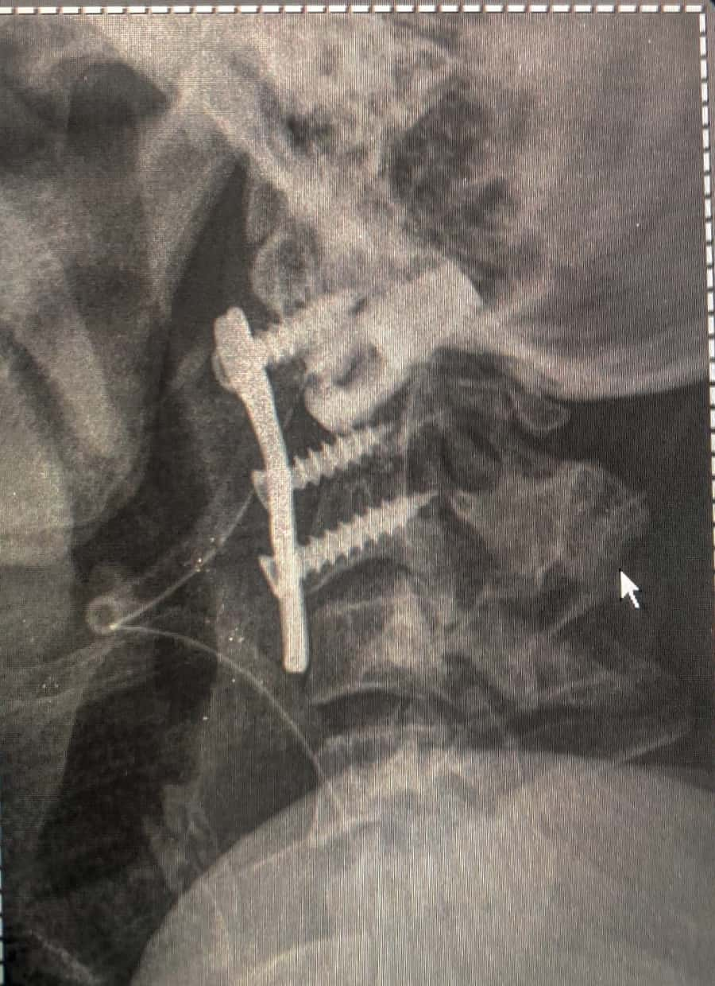
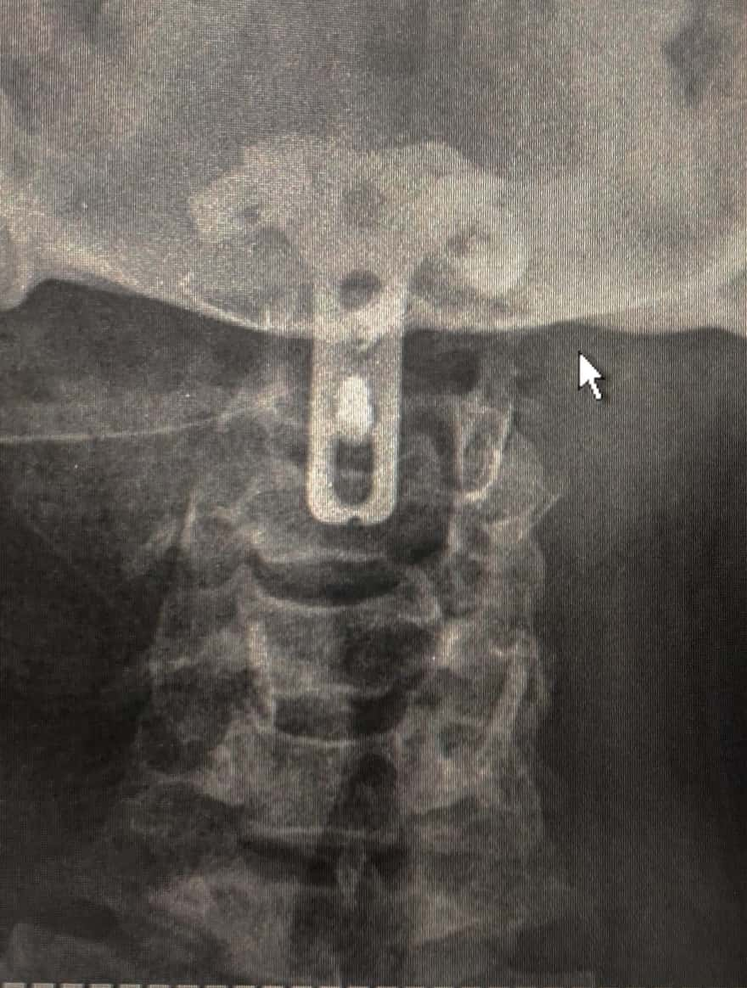
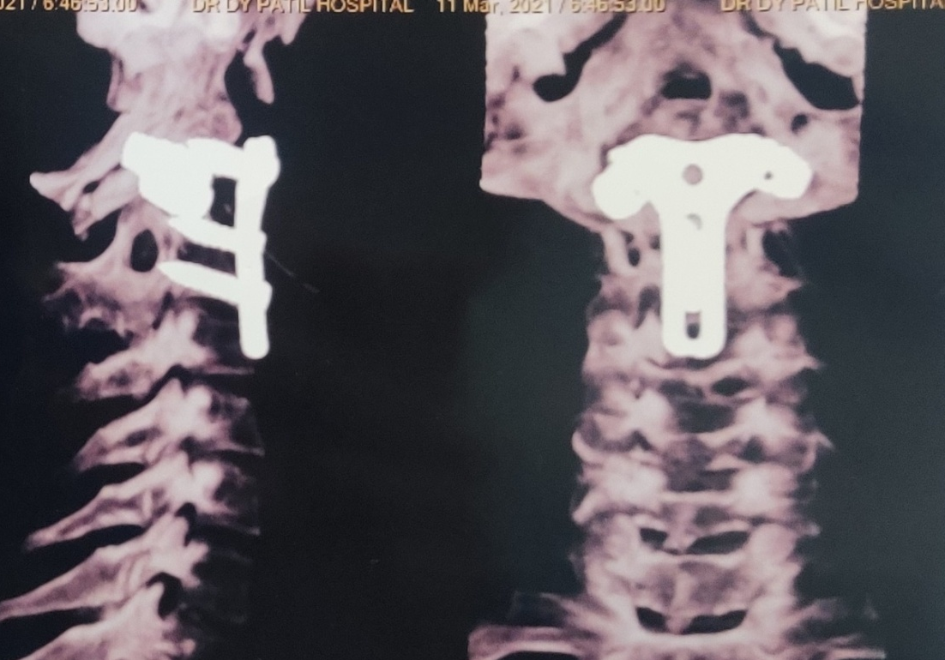
POST OP IMAGING

Slide 13
CVJ anamolies
Craniovertebral junction refers to the occipital bone that surrounds the foramen magnum and the atlas and axis vertebrae.
Up to the 1970s, surgical treatment of CVJ disorders – posterior (foramen magnum) decompression with removal of the posterior arch of the atlas and axis.
High mortality & morbidity

Slide 14
Congenital anomalies of the skull base and the atlanto-occipital region involve the osseous, neural, and vascular structures.
Symptoms attributed to the underlying neurovascular and osseous structures.
Can have syndromic associations.

Slide 15
AAD
Atlantoaxial dislocation refers to a loss of stability between the atlas and axis (C1–C2), resulting in loss of normal articulation.
Could be traumatic, inflammatory, idiopathic, or congenital abnormalities.
Ligamentous laxity may be due to an inflammatory process or to an intrinsic defect in collagen fibers that form ligaments.

Slide 16
Atlantodental interval (ADI) –
small slitlike space between the posterior aspect of the anterior atlas ring and the anterior aspect of the odontoid process.
Normally constant in distance during movement of the head and generally does not exceed 3 mm for adults and 5 mm for children.
Neutral and dynamic cervical radiographs are often used to diagnose atlantoaxial instability and dislocation

Slide 18
Treatment of atlantoaxial dislocation is aimed at the correction of the sagittal alignment of the upper cervical spine and the stabilization in anatomical alignment.
The main procedures reported in the literature are posterior occipitocervical/C1–C2 fusion after transoral odontoidectomy or periodontoid tissue release.

Slide 19
Basilar invagination
A primary developmental defect implying prolapse of the vertebral column into the skull base
Associated with developmental anomalies such as occipitalization, assimilation, and blocked vertebra.
Associated with syringomyelia
Platybasia refers to an abnormal obtuse basal angle formed by the clivus and the anterior skull base.
2 types –ventral & paramesial

Slide 20
Surgical stabilization may involves a posterior-only decompression and fusion, or an anterior decompression with posterior stabilization.
Anterior extrapharyangeal cage distraction and fixation.

Slide 21
THANK YOU

