Slide 1
AN UNCOMMON CASE OF PNEUMONIA
Dr. K. srihitha
Department of respiratory medicine
Dr d.y.patil medical college and hospital, pune

Slide 2
CLINICAL COURSE
39yr old female
Non smoker
No known comorbidities
Onset of illness : 2017
C/o breathlessness, cough with expectoration and wheeze along with seasonal variation and h/o allergic rhinitis since childhood.
Diagnosed as Bronchial asthma with Allergic rhinitis and started on MDI ICS & LABA.
Pt had partial control of symptoms over 2 yrs.

Slide 3
Feb 2019 pt had c/o fever, cough, rhinorrhea and increased breathlessness from mMRC I to II along with wheeze for which she went to an outside hospital.
No h/o chest pain and hemoptysis.
LAB
Hb : 11.8
TLC : 9800
EOSINOPHILS : 8% with AEC of 800/uL
RFT & LFT : WNL
Pt was subjected to Bronchoscopy which was normal and her BAL was negative for any organisms and tuberculosis bacteria.
Pt was managed on antibiotics and inhalers were continued.
Pt had no significant improvement.

Slide 4
LAB
Hb : 11.90
TLC : 10600 with
Neutrophils : 49%
EOSINOPHILS: 24% with
AEC: 2644/uL
Lymphocytes : 21%
Monocytes : 6%
Platelets : 1.6L
RFT & LFT : WNL
In March 2019 pt presented to our OPD with low grade fever and increased breathlessness.
On examination
PR: 100/min, regular; RR: 20/min;
BP : 120/80mmHg; SpO2: 92% on room air
Resp system: B/L NVBS with B/L Rhonchii and B/L Crepts (infra scapular area)
No pallor/icterus/clubbing/cyanosis/edema/
lymphadenopathy

Slide 5
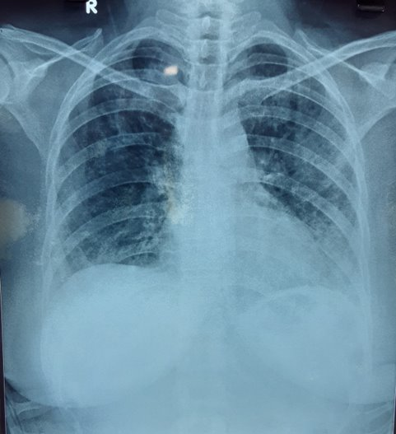
CHEST XRAY
S/o Diffuse B/L Reticulo-nodular opacities (Lt > Rt)

Slide 6
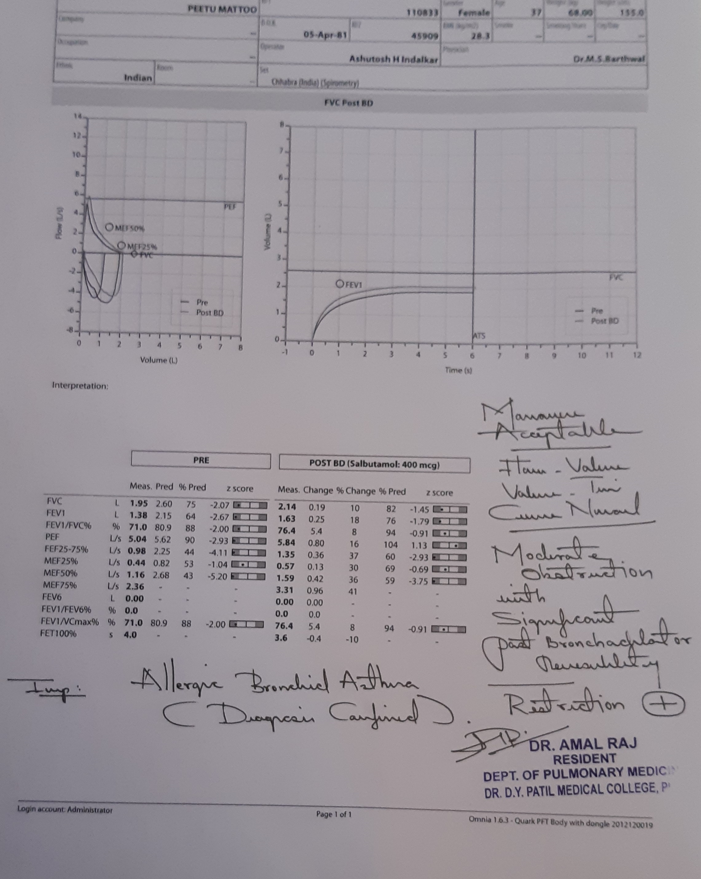
SPIROMETRY
PRE | POST
 | Meas | %pred | Change | %Change
FVC | 1.95L | 75%
FEV1 | 1.38L | 64% | 0.25 | 18%
FEV1/FVC | 71.0L | 88%
S/o Moderate Obstruction with Significant Post-Bronchodilator Reversibility
Mild Restriction+

Slide 7
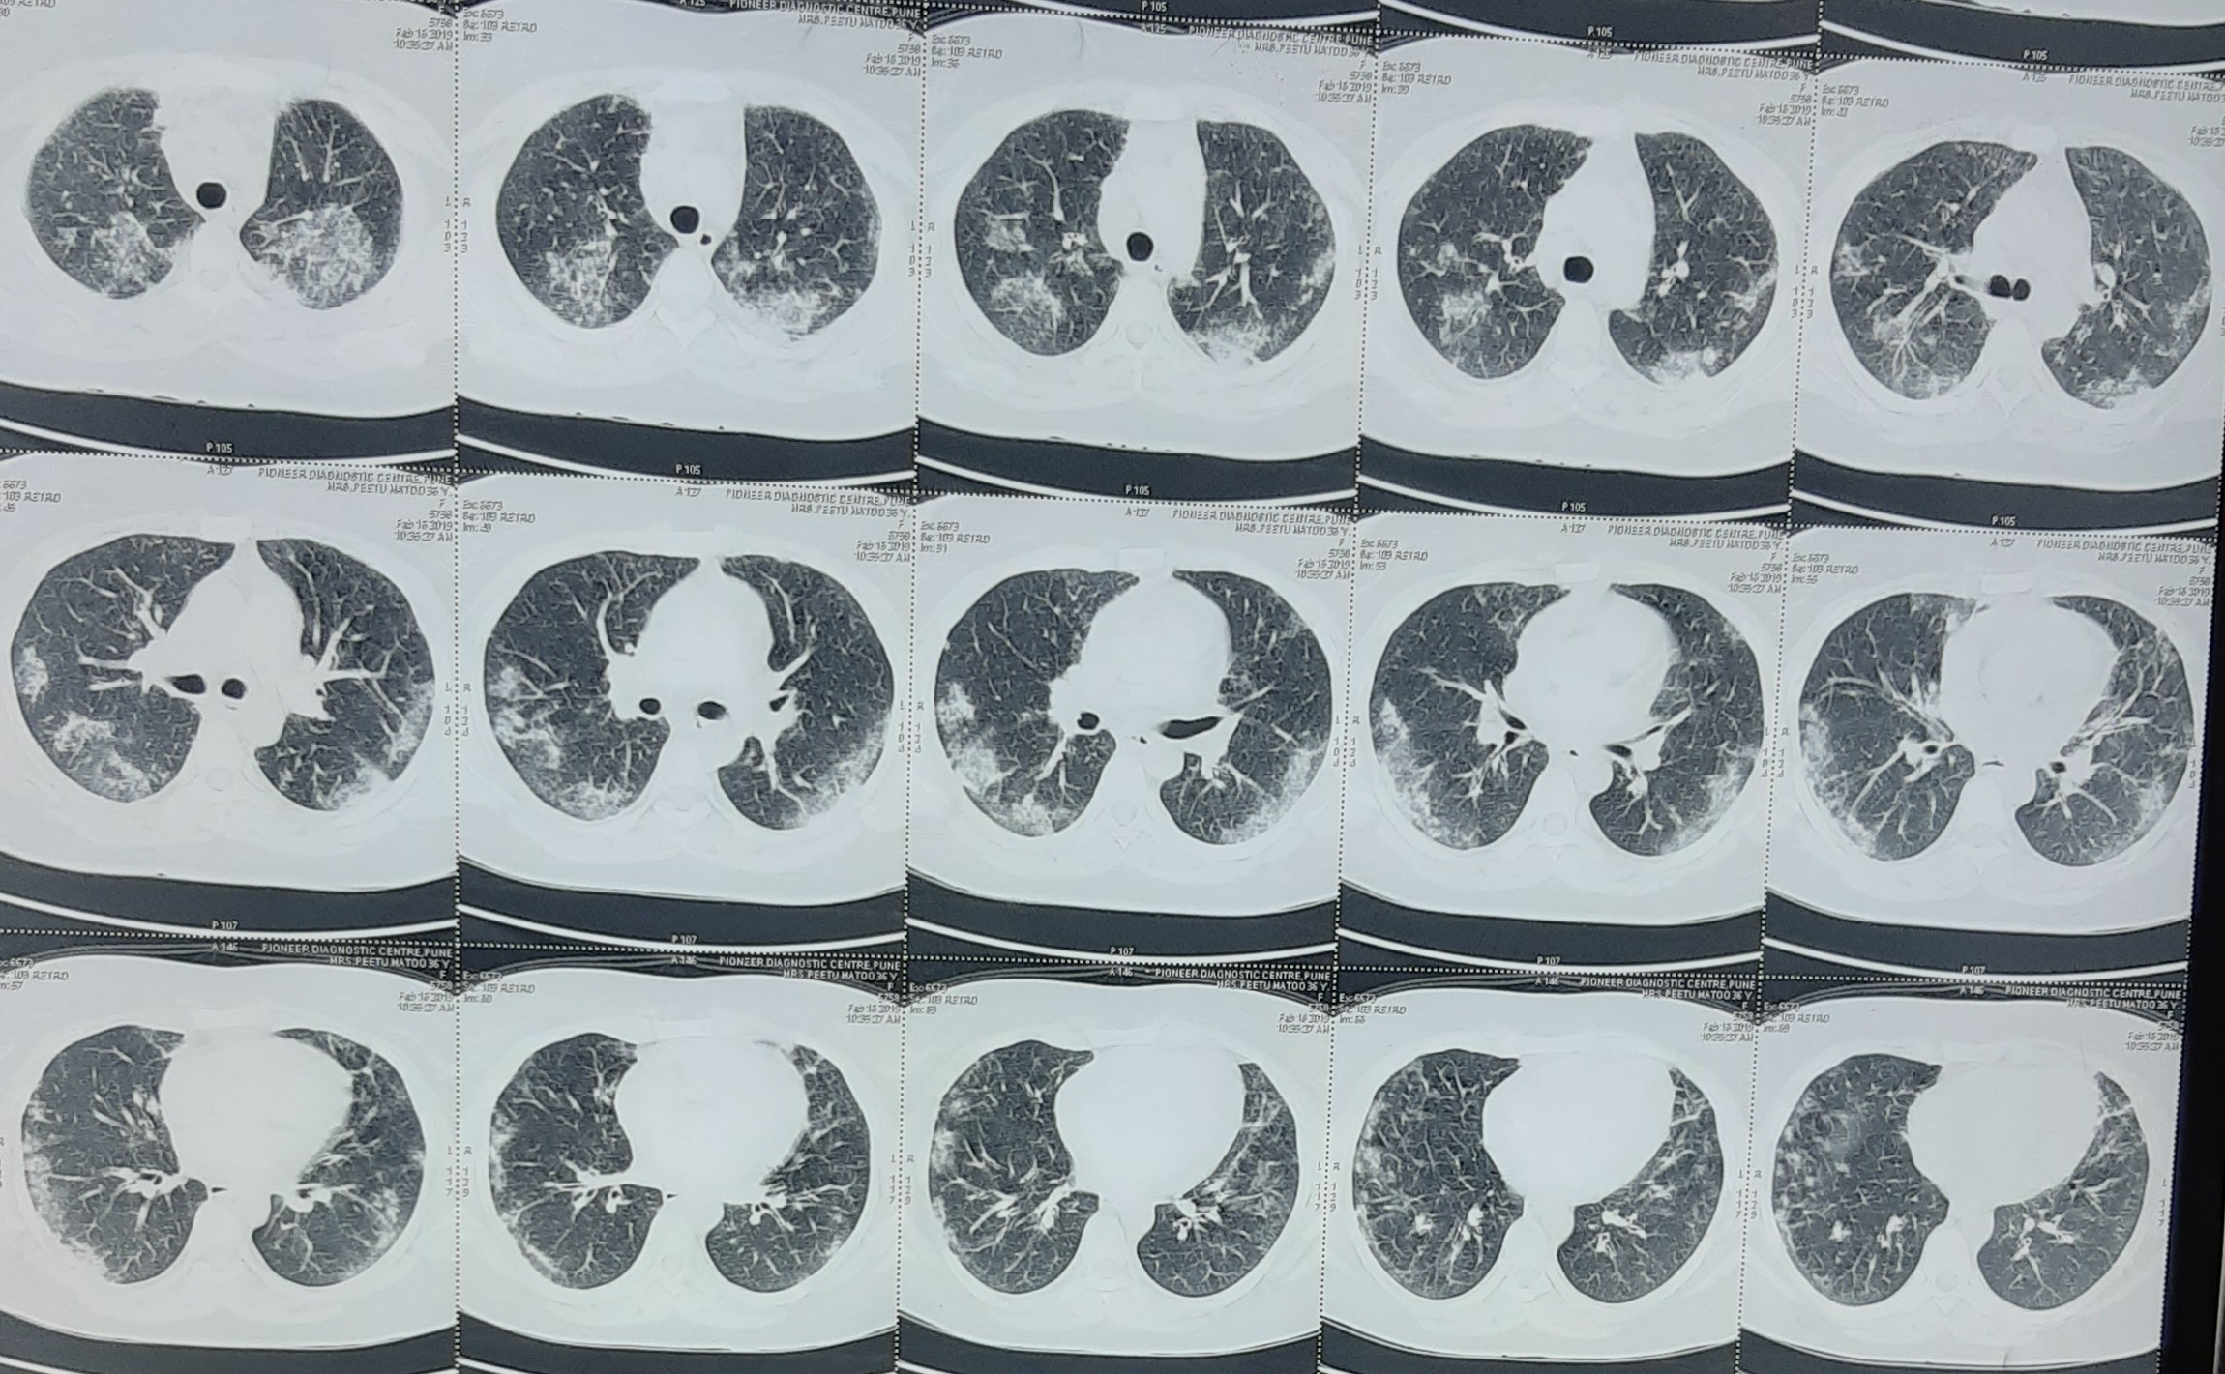
CT THORAX
S/o : Multiple patchy and confluent areas of ground-glass opacities with early alveolar consolidation affecting both lungs predominantly in the peripheral portion with central sparing.

Slide 8
This pt had
Allergic Bronchial Asthma (moderate, persistent)
Persistent fever, cough, breathlessness
Increased blood eosinophil count
Both lungs patchy areas of ground-glass opacities predominantly in peripheral regions (radiologically)
This is a classical presentation of CHRONIC EOSINOPHILIC PNEUMONIA
Pt was started on oral corticosteroids (Methylprednisolone 16mg BD) along with inhalers and nasal spray.
She showed good response to OCS; which were eventually tapered and stopped after 6 weeks.

Slide 9
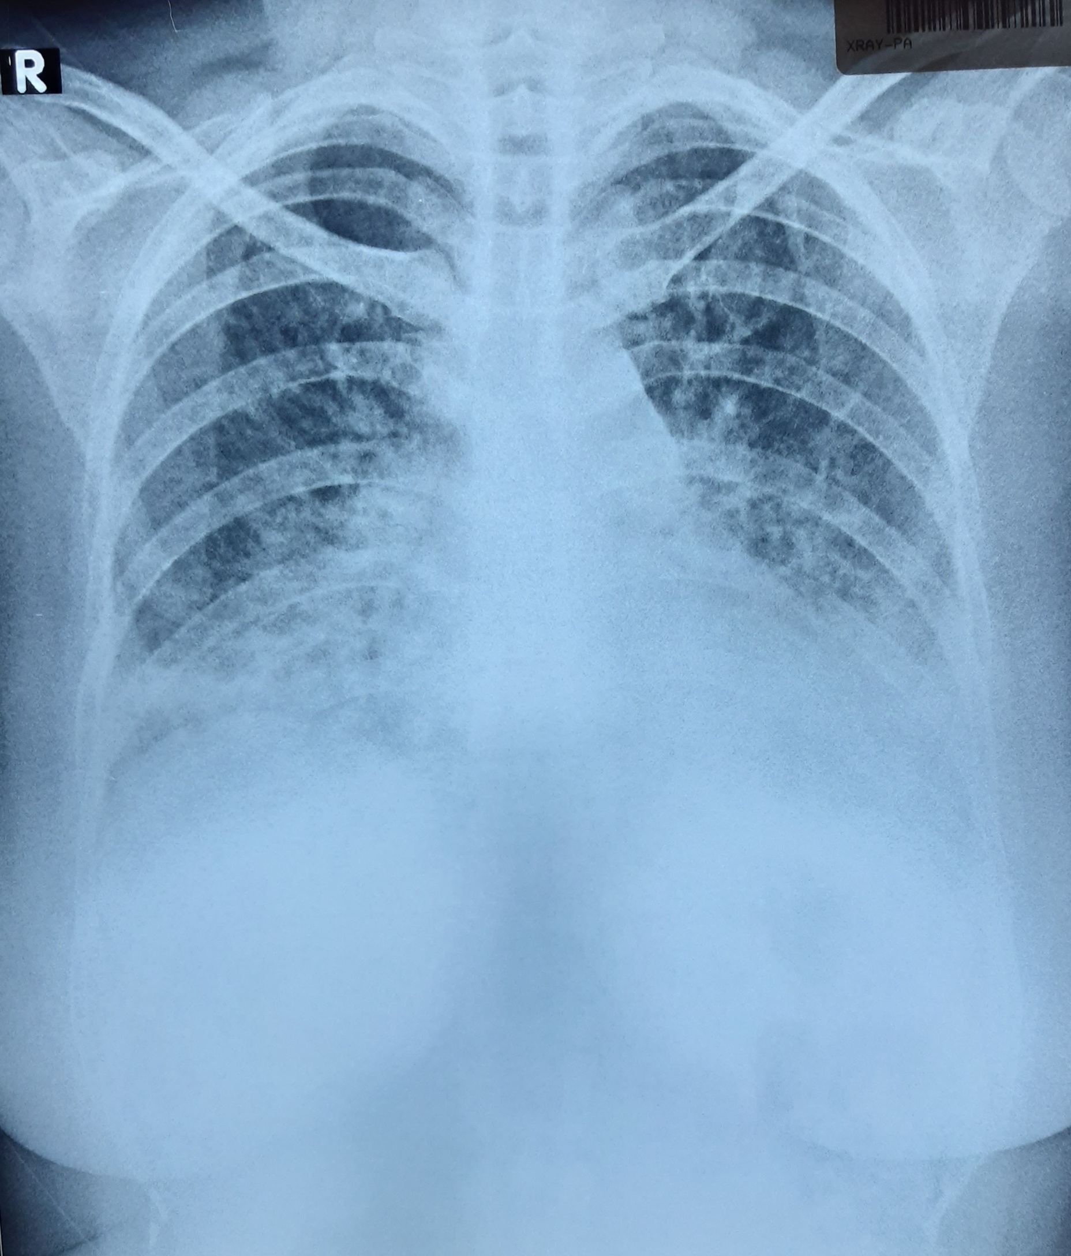
In September 2019, pt again had c/o increase in fever/cough and breathlessness ; with an
EOSINOPHIL Count : 20% and AEC : 900/uL
Reticulonodular opacities in the peripheries (radiologically)
These features are suggestive of Relapse.
She was restarted on OCS and tapered over 8 wks.

Slide 10
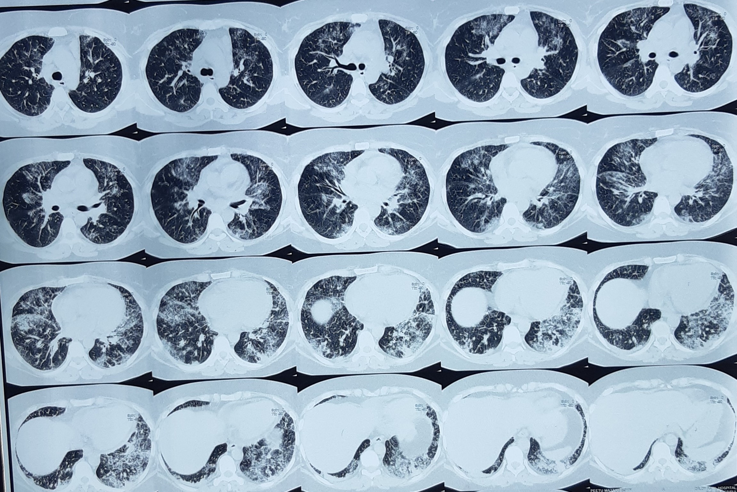
In November 2020 pt again presented with
similar c/o fever, cough with expectoration and breathlessness.
Radiological features of ground-glass opacities in both lungs now affecting both central and peripheral regions (more severe intensity compared to the previous episode).
LAB
Hb : 10.40
TLC : 17,600
EOSINOPHILS : 36%
AEC : 6,336/uL
Serum IgE : 4,110 IU/mL

Slide 11
DIFFERENTIAL DIAGNOSIS
Allergic bronchopulmonary aspergillosis
Eosinophilic granulomatosis with polyangitis
Drug-induced eosinophilic pneumonia
Other infections like tuberculosis
Bronchoscopy with biopsy was advised but pt was not willing for the same.
Other investigations were done;
Sputum for AFB and Gene Xpert
Sputum for Gram/ZN/C&S Negative for Tb and other organisms
Sputum for Liquid culture
ANA blot : Negative
c-ANCA & p-ANCA : Negative
IgG specific to Aspergillus : Negative

Slide 12
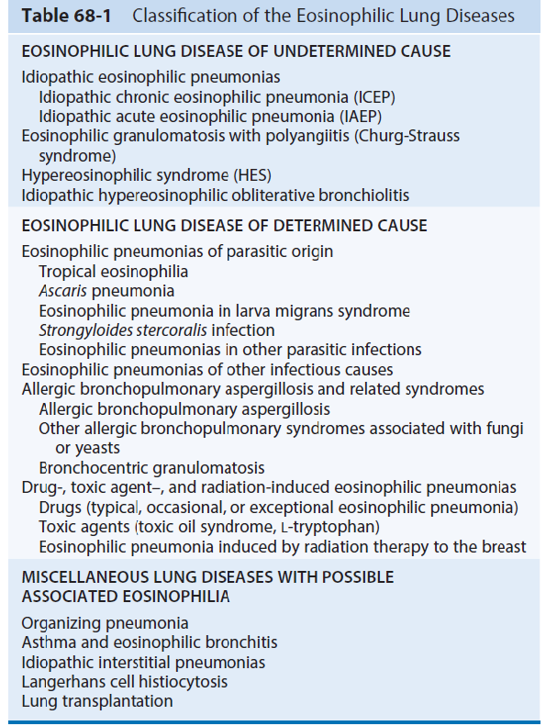
DISCUSSION

Slide 13
CEP was first described as a clinical entity by Carrington et al in 1969.
Although CEP may develop in people of any age, the peak incidence occurs in persons 30 to 45 years of age.
Women are affected approximately twice as often as men.
Most patients with CEP are nonsmokers.
In addition, approximately one-third to one-half of patients have antecedent atopy, allergic rhinitis, nasal polyps, or urticaria.
Up to two-thirds have adult-onset asthma preceding (by several weeks to years) or arising concurrently with the occurrence of CEP.

Slide 14
Peripheral blood eosinophilia is common in CEP with 88 to 95 percent of patients showing elevated eosinophil counts (>6 percent).*(Marchand E, Reynaud-Gaubert M, Lauque D, et al. Idiopathic chronic eosinophilic pneumonia. A clinical and follow-up study of 62 cases. The Groupe d'Etudes et de Recherche sur les Maladies "Orphelines" Pulmonaires (GERM"O"P). Medicine (Baltimore) 1998 )
Total immunoglobulin E (IgE) is elevated (mean 506 IU/mL or approximately 1214 ng/mL) in approximately 50 percent of patients.*(Jederlinic PJ, Sicilian L, Gaensler EA. Chronic eosinophilic pneumonia. A report of 19 cases and a review of the literature. Medicine (Baltimore) 1988)
Typical symptoms include a productive cough (33 to 42 percent), fever (67 percent),
breathlessness (57 to 92 percent), weight loss (57 to 75 percent), and night sweats.

Slide 15
The pulmonary infiltrates associated with CEP are typically dense and patchy areas of airspace consolidation with ill-defined margins usually affecting the outer two-thirds of the lung fields.
Infiltrates are most commonly bilateral, tend to be located in the mid to upper lung zones, and may mimic loculated pleural fluid.
The finding of bilateral peripheral or pleural-based, nonsegmental, consolidative
opacities are described as "photographic negative of pulmonary edema which is
highly s/o CEP when seen on chest Xray or HRCT.*(Gaensler EA, Carrington CB. Peripheral opacities in
chronic eosinophilic pneumonia: the photographic negative of pulmonary edema. AJR Am J Roentgenol 1977)

Slide 16
Symptomatic or radiographic relapse is common ( 50 to 80% of cases) either after cessation of therapy or, less commonly with tapering of glucocorticoid dose.*(Marchand E, Reynaud-Gaubert M, Lauque D, et al. Idiopathic chronic eosinophilic pneumonia. A clinical and follow-up study of 62 cases. The Groupe d'Etudes et de Recherche sur les Maladies "Orphelines" Pulmonaires (GERM"O"P). Medicine (Baltimore) 1998)
Relapses may involve radiographic infiltrates in the same or different anatomic
distribution compared to the original disease.
​
With each exacerbation, the diagnosis needs to be reconfirmed to ensure that the symptoms are due to CEP (eg; recurrent radiographic opacities) rather than an alternative explanation such as an asthma flare or infection.*(Jederlinic PJ, Sicilian L, Gaensler EA. Chronic eosinophilic pneumonia. A report of 19 cases and a review of the literature. Medicine (Baltimore) 1988)

Slide 17
THANK YOU

