Slide 1
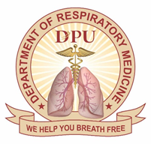
Rare case of pulmonary sequelae of COVID-19 disease
Dr. Kiran Ashok Balani
Department of Respiratory Medicine
Dr. D. Y. Patil Medical College Hospital & Research Centre, Pune

Slide 2
Chief complaints
29 year male, clerk in IT company, non smoker, no known comorbidites
Presented to us on 06/11/2020 with:
Chief complaints:
Breathlessness
1 month, increased since 5 days
mMRC Grade 3
No orthopnea/paroxysmal nocturnal dyspnea/wheeze/palpitations
Cough
scanty whitish expectoration- 15 days
Chest pain
5 days
Right sided
Sudden in onset, radiating to back
No history of fever/loss of appetite

Slide 3
Tested COVID-19 positive on 09/10/2020, hospitalized in outside private hospital in ICU and was managed with NIV, Inj. Remdesivir and 1 dose of Tocilizumab and then discharged on 23/10/2020
At the time of discharge, dyspnea was mMRC grade 1 with
occasional cough
Patchy consolidation seen in both the lungs predominantly in both lower lobes with air bronchograms.
Then he presented to us on 06/11/2020 with the complaints mentioned previously

Slide 4
Clinical course
Examination
General physical examination: WNL
Vitals:
Temp : 97.4˚F
PR : 124 bpm, regular, good volume, all peripheral pulses well felt
RR : 32 breaths/min
BP : 120/70 mmHg, right arm supine position
SpO2 : 78% on room air (FiO2- 21%)

Slide 5
Clinical course
Examination
R/S : Diminished intensity of breath sounds on right side
CVS : S1, S2 heard, no murmurs
P/A : Soft, non tender, no organomegaly; bowel sounds heard
CNS : No focal neurological deficit

Slide 6
Investigations in EM
ECG- sinus tachycardia
Trop I- <10
ABG at 12 lit/min O2 via face mask-
pH- 7.37 pO2- 72.4
pCO2-38.2 HCO3-20.1
PaO2/FiO2- 106
Acute hypoxemic respiratory failure with normal acid base
Right sided pneumothorax
Tube thoracostomy was done in EM on 06/11/2020
Shifted to COVID ICU

Slide 7
Investigations
Hb | 15.4 | Sr LDH | 347
TLC | 10,400 | D-dimer | 560.22
Platelets | 1.76 lacs | CRP | 0.17
Blood Urea | 20 | Sr Procal | 0.02
Creat | 0.76 | Sr Ferritin | 108.89
Sr Proteins | 6.00 | PT, INR | 11.8, 1.02
Pleural fluid analysis
Proteins | 5.70
Glucose | 23
TLC | 4800
PMN | 10%
Lymphocytes | 30%
Eosinophils | 50%
ADA | 12
ABG -10 litres O2 via face mask
PaO2/FiO2- 126
Exudative (as per Light’s criteria)
pH | 7.387 | pO2 | 75.8
pCO2 | 37.6 | HCO3 | 22.1

Slide 8
Clinical course
COVID-19 RT-PCR (08/11/2020)- Negative, and shifted to male pulmonary ward
O/E-
Temp- 97.5˚F
PR- 90/min
RR- 26 breaths/min
BP-110/80mmHg
SpO2- 98% on 8litres with non rebreathing mask
No significant clinical improvement was observed in dyspnea and hypoxia, though the lung had expanded.
Possibilites-
Pulmonary thromboembolism.
Secondary bacterial infection.

Slide 9
CT pulmonary angiography + HRCT was done (09/11/2020)
Partial thrombosis in Left Upper Lobar Artery and segmental arteries of apicoposterior segment of left upper lobe
Diffuse GGO’s with interlobular septal thickening and subpleural bands
Pneumatocele in left upper lobe
Multiple small cysts in right lung
Resolving pneumothorax with ICD in situ in right lung
B/L lower limb venous doppler- Normal study.
2D ECHO- Normal study.

Slide 10
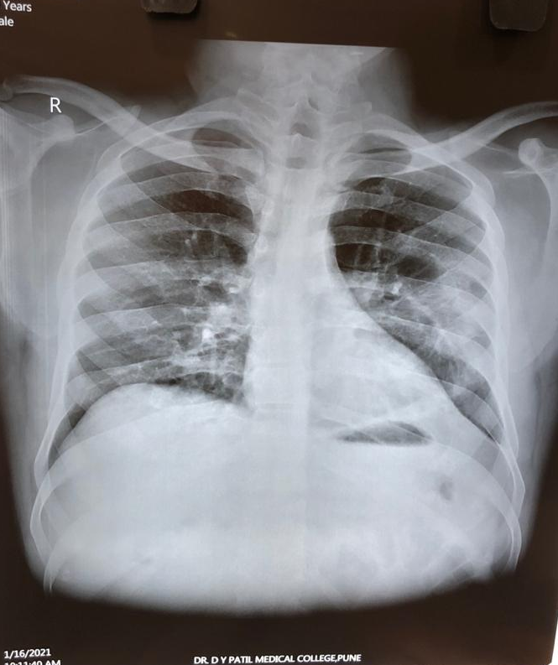
Management
Patient was started on Inj. Enoxaparin 0.6ml twice daily followed by Tab. Warfarin (maintaining INR at therapeutic range of 2-3). He responded well.
ICD was removed after complete lung expansion and he was discharged on oral anticoagulants.
He is on regular follow-up with us and the pneumatocele is gradually getting absorbed.

Slide 11
DISCUSSION
While the current focus of management of COVID-19 is on the acute phase, attention is shifting to potential post-COVID-19 sequelae.
Pulmonary
Cardiovascular
Neurologic
Post-intensive care syndrome
Pulmonary fibrosis
Pneumothorax
Pneumatoceles
Myocardial ischemia
Myocarditis
Arrhythmias
Cardiomyopathy
Pulmonary thromboembolism
Acute cerebrovascular disease
Peripheral neuropathy
Encephalopathy
Guillain-Barre syndrome
A spectrum of psychiatric, cognitive, and/or physical disability (e.g. muscle weakness, insomnia, depression, delirium)
Post COVID-19 sequelae

Slide 12
Spontaneous pneumothorax
Is one of the emerging respiratory complications of COVID-19 pneumonia. This has been described in mechanically ventilated patients, as well as on NIV or HFNC.
Potential causes include the high airway pressures delivered by these modalities of respiratory support, as well as spontaneous rupture of fragile small airways infected by the virus.
A literature search for spontaneous pneumothorax in COVID-19 yielded 25 cases till date.ˡ
Nunna K, Braun AB, BMJ Case Rep 2021;14:e238863

Slide 13
Pneumatocele
Are thin-walled, air filled spaces within the lung usually occurring in association with acute pneumonia and are common in infants and young children, but unusual in adults.
Causes include:
Severe pneumonia(Staphylococcus aureus, Streptococcus pneumoniae, or Acinetobacter)
Thoracic trauma.
Hydrocarbon ingestion.
Positive pressure ventilation.
One of the rare abnormality findings in COVID-19 patients. If clinician suspect pneumatocele finding, the progression of the disease should be monitored due to possibility of its infection.
Asymptomatic pneumatocele should be conservatively managed with close observation.

Slide 14
Pulmonary fibrosis and role of anti-fibrotics
Pirfenidone and Nintedanib, despite having different modes of action, are similarly effective in attenuating the rate of lung function decline by about 50%.
The role of these drugs in the prevention and treatment of post-COVID fibrosis is unclear at present.
There is, however, a clear rationale for their potential usefulness.
It is worth noting that both these drugs take at least 1-3 months to demonstrate an effect. This was the time period at which the FVC started to improve compared to placebo in the INBUILD, INPULSIS, and ASCEND trials.
Thus, adding them at a late stage in patients already needing ventilator support may not be ideal.
Since it is patients with the severe ARDS that are most likely to end up with fibrosis, this might be the group to consider their use in.
DOI:10.4103/lungindia

Slide 15
D-dimer and COVID-19
D-dimer is considered as an inflammatory as well as thrombotic marker. Inflammatory-when all other markers are raised and thrombotic-when other markers are low but d-dimer is raised.
Though D-dimer elevation has been observed describing the clinical features of COVID-19, whether the level of D-dimer is a marker of severity has not been examined.
In-hospital mortality has been associated with increased D-dimer levels, suggesting that the assay may be used as a useful biomarker for clinical outcome in COVID-19.
Clinical attention to VTE risk should particularly be paid in patients with high D-dimer levels.
However, a negative d-dimer should never prevent further investigation of thromboembolism if its clinical suspicion is high.*
An imaging diagnostic test is suggested (CTPA) to determine embolism in regard to the irregularities in the quantitative determination of d-dimer levels. A d-dimer test alone is not sufficient.*
Pulmonary embolism should continue to remain a differential diagnosis in hypoxemic patients even after recovery from COVID-19.
American journal of respiratory and critical care medicine-atsjournals.org;159:1445-1449
Yao et al. Journal of Intensive Care (2020)

Slide 16
Clinical pearls
Spontaneous pneumothorax and Pneumatocele are rare complications seen in COVID-19.
Late onset pulmonary arterial thrombosis is uncommon but that emphasizes the need for post COVID prophylactic oral anticoagulants(moderate to severe disease and in those with risk factors)
Protocols suggest that patients hospitalized with COVID-19 especially those with high risk, should be strongly considered for extended thromboprophylaxis up to 45 days post discharge.*
Mean time from onset of symptoms to development of pneumothorax in non-mechanically ventilated patients was 19 days among the cases reported so far. Therefore, pneumothorax should be on the D/D if a patient presents with sudden onset of chest pain or respiratory distress even after resolution of symptoms.*
DOI:https://doi.org/10.1016/j.chest.2020.05.559
Nunna K, Braun AB, BMJ Case Rep 2021;14:e238863

Slide 17
Thank you

