Slide 1
A Rare Case of Primary Pulmonary Tumor
Dr. Prathyusha Alakunta
Department Of Respiratory Medicine
Dr. D.Y. Patil Medical College & Research Centre , Pune

Slide 2
25 year old male
Tobacco chewer since 5 years
No Known Comorbidities
Chief Complaints:
1.Breathlessness for 1 month - MMRC Grade 1 non progressive ,
No Orthopnea/PND
2. Chest pain for 1 month - Right sided, Diffuse, Dull aching and non
radiating, no h/o palpitations/sweating
No history of fever/cough/hemoptysis/wheeze

Slide 3
Past history:
History of right below knee amputation 10 years back
No History of any comorbidities
No History of any other significant illness in the past.
Pt

Slide 4
CLINICAL COURSE
Pt
General Examination : Conscious, oriented
No pallor/Icterus/clubbing/cyanosis/lymphadenopathy/ pedal edema
VITALS : Temp - Afebrile
Pulse rate - 80/min
BP -110/80 mmHg
RR -20/min
SPO2 - 98% on room air

Slide 5
CLINICAL COURSE
R/S - Right sided decreased intensity of breath Sounds
CVS - S1 S2 heard , no murmurs
P/A - Soft , no organomegaly
CNS - No focal neurological deficit

Slide 6
INVESTIGATIONS
HB | 14.2 | Total Bilirubin | 0.39 | Sr.Ca | 9.30
TLC | 9900 | Conjugated | 0.18 | Sr. Na | 134
PBS | Normocytic Normochromic | Unconjugated | 0.24 | K + | 5.1
Sr. urea | 17 | SGOT | 17 | CL | 103
Creatinine Sr.protien | 0.74 7.2 gm% | SGPT Serum glucose | 20 140 mg/dl | Sr. Mg2+ | 2.20

Slide 7
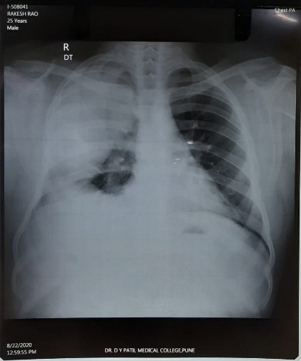
S/O Right upper and middle zone homogenous opacity
S/O right sided heterogenous lesion of size 9.2 7.1 cms in upper and middle zone s/o solid mass/consolidation.
Chest X ray
USG Thorax

Slide 8
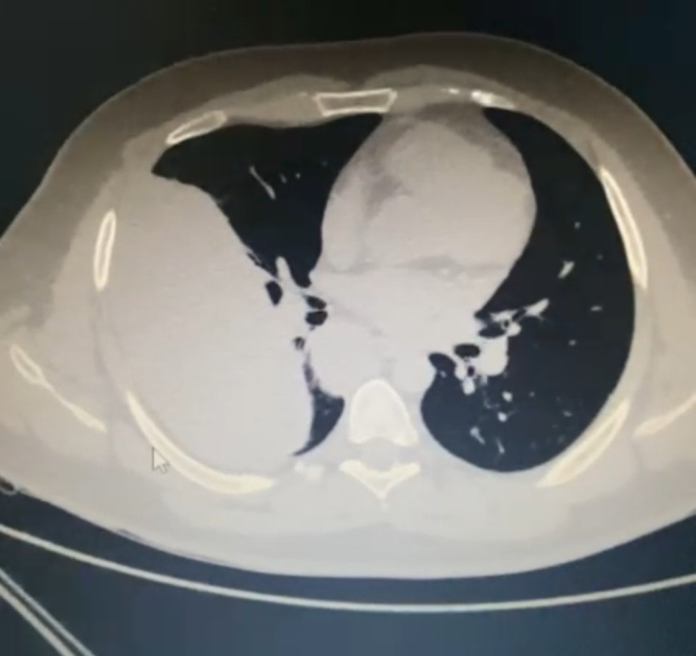
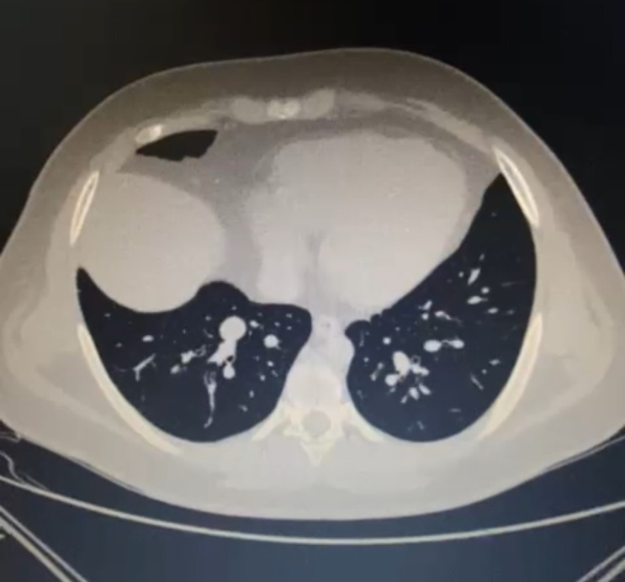
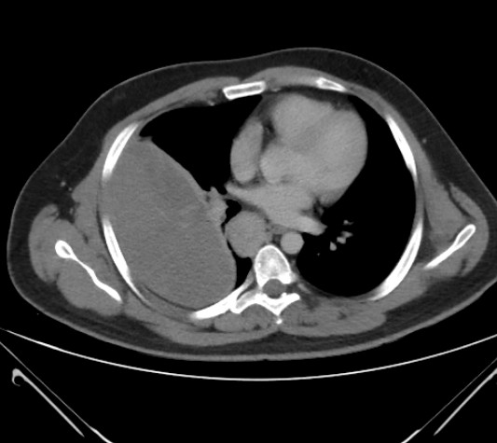
CECT THORAX
S/O Lobulated pleural based mass lesion in the right hemithorax
well defined lesion in the medial basal segment of the right lower lobe
Well defined lobulated mass in the sub carinal region

Slide 9
USG Guided Core Needle Biopsy
Gross – Received 6 core needle biopsies in linear tissue strands ranging from 0.3 to 1.2 cm in length, greyish white in colour.
Microscopy – Section displayed fascicles of spindle cells with uniform elongated, hyperchromatic nuclei. Herring bone pattern and hemangiopericytomatous pattern were also present.There was no pleomorphism, calcification or myxoid change in the section studied. No epithelial components were there.
Features were likely suggestive of the following –
Monophasic synovial sarcoma
Hemangiopericytoma
Fibrosarcoma
The following IHC’s were done to confirm the diagnosis – a. EMA b. TLE1
c. CD56 d. CD34 e. S100 f. Ki67 g. BCL2

Slide 10
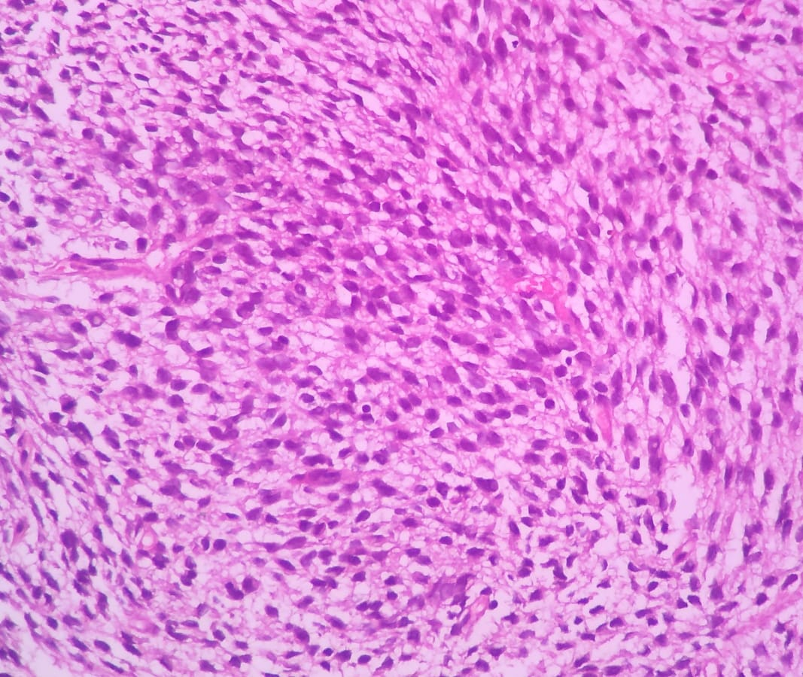
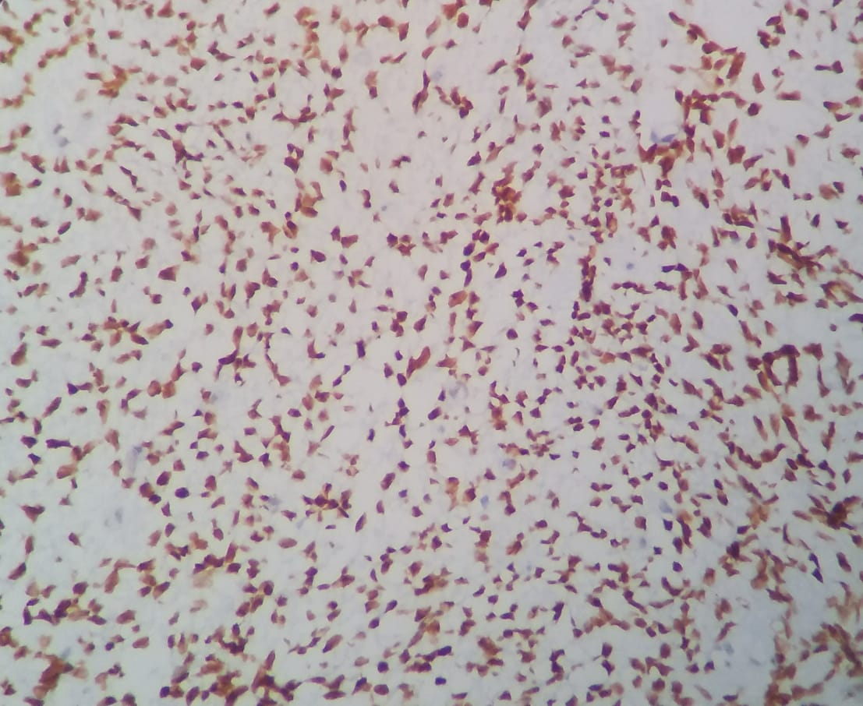
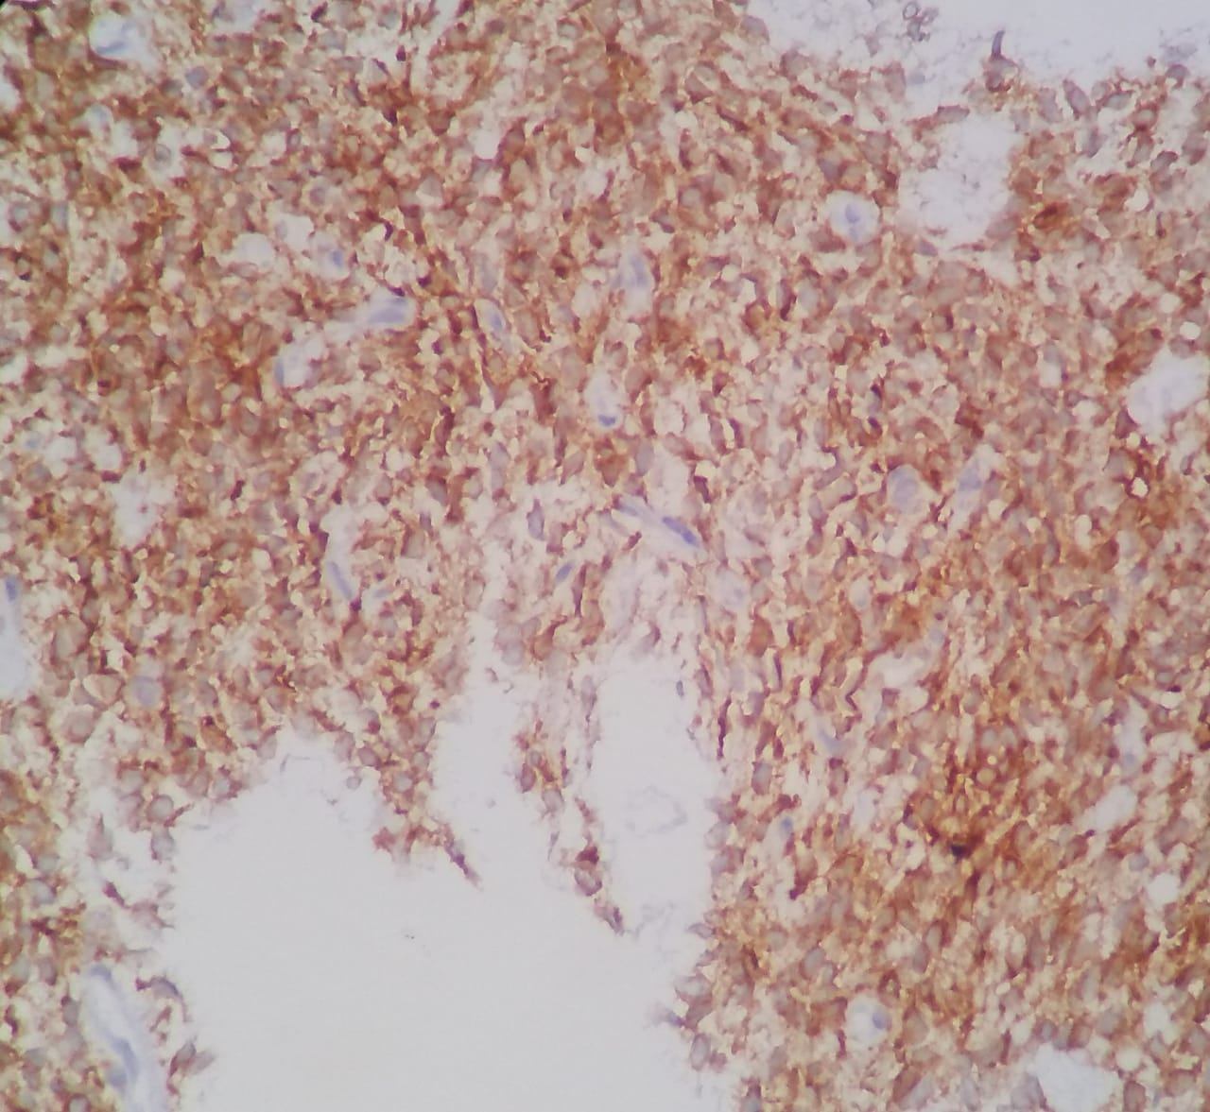
Histopathological Examination
Monophasic growth pattern
TLE1 Positive
Bcl2 Positive

Slide 11
IHC Interpretation
 | EMA | BCL2 | TLE 1 | S100 | CD34 | Ki 67
SYNOVIAL SARCOMA | Positive | Positive | Specific for synovial sarcoma | Negative in 80% cases | Negative | Variable
HEMANGIOPERICYTOMA | Negative | Variable | Negative | Negative | Positive | Variable
FIBROSARCOMA | Negative | Negative | Negative | Negative | Negative | High
IHC revealed – BCL2, EMA and TLE 1 Positivity and CD34, S100 negativity with Ki 67 index around 50% confirming Monophasic Synovial Sarcoma.

Slide 12
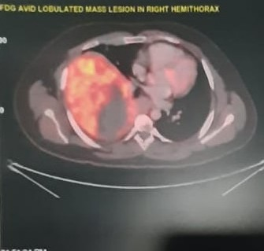
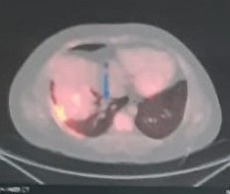
FDG PET CT SCAN
FDG avid lobulated pleural based soft tissue mass seen in the right hemithorax.
Right LL lobe lung nodule and pleural based nodule appears metastatic.
Focal metabolically active lesions seen in DD of both femur and R proximal tibia s/o ? Marrow metastasis

Slide 13
DIAGNOSIS
Primary Pulmonary Synovial
Sarcoma
(T4 N2 M1)

Slide 14
TREATMENT
Patient was started on chemotherapy after
oncologist opinion
Patient underwent 3 cycles of chemotherapy of :
Ifosfamide and Doxorubicin
Patient was lost to follow up after Chemotherapy

Slide 15
DISCUSSION
Blastoma
Carcinoid Tumors
Carcinosarcoma
Epitheloid hemangioendothelioma
Malignant lymphoreticular disorders
Malignant melanoma
Malignant germ cell tumours
Salivary gland type Tumors
Sarcomas- soft tissue sarcomas
chondrosarcoma
osteosarcoma
Rare Primary Lung Malignancies
Primary Soft tissue sarcomas of the lung
Leimyosarcoma
Synovial sarcoma
Spindle cellsarcoma
Rhabdomyosarcoma
Malignant fibrous histiocytoma
Fibrosarcoma
Angiosarcoma
Malignant hemangiopericytoma
Neurogenic sarcoma
Kaposi sarcoma
liposarcoma

Slide 16
Synovial sarcoma represent tumors more frequently in peri articular tissue and
rarely detected in the lungs
Primary pulmonary sarcomas accounts for 20% of all primary rare lung
malignancies
Leiomyosarcoma is the most frequent Primary lung parenchymal sarcoma.
Synovial sarcoma is the second most frequent subtype

Slide 17
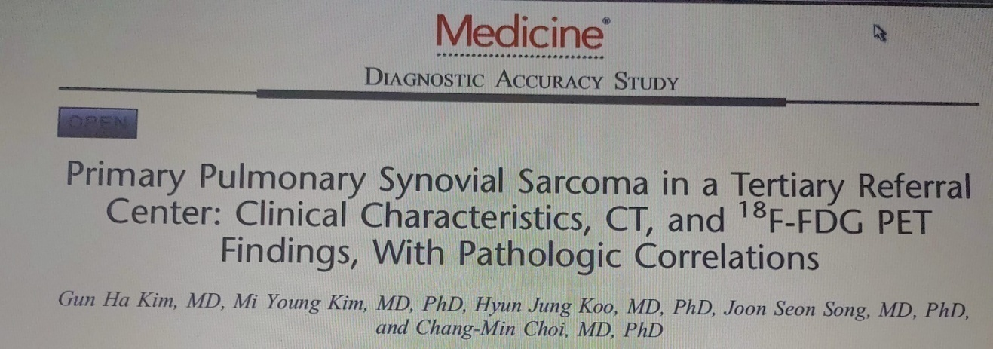
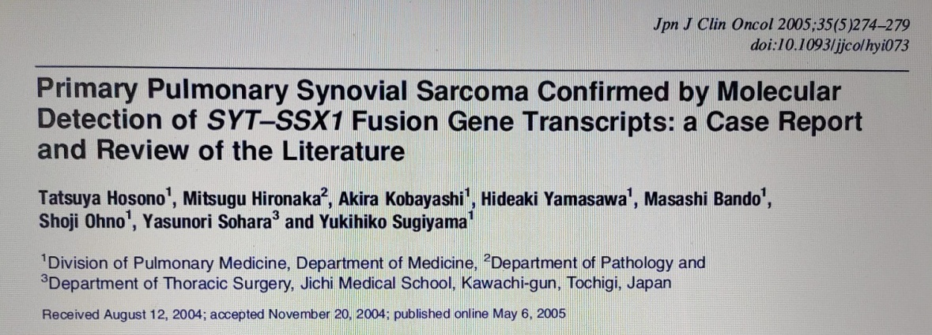
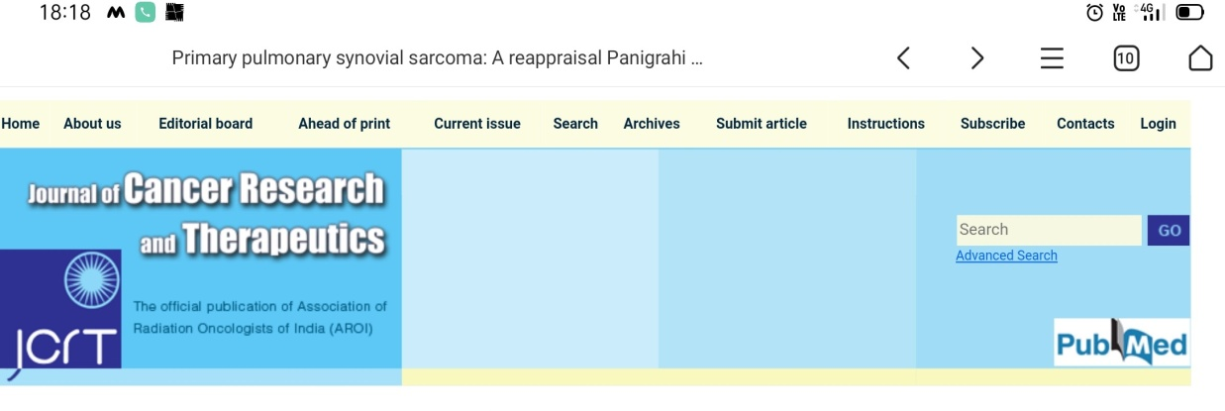
Primary pulmonary sarcomas accounts for <0.5% of lung cancers
Among all the subtypes of Primary pulmonary sarcomas, incidence of PPSS was 18.2% [14/77]
Among all SS originating from all anatomic locations, only 5.9% [14/217] were of Primary pulmonary origin
Overall 60 cases till 2005
10 cases in INDIA till 2016

Slide 18
SS is a spindle cell tumor of mesenchymal origin with variable epithelial cell differentiation representing 10% of all soft tissue sarcomas
SS mainly occurs in adolescents and young adults between 15 and 30 years of age, usually seen in extremities of the joints, most commonly around the knee in more than 80% of the cases
SS can occur in other sites like intra thoracic organs, intra abdominal,abdominal wall,head and neck region,skin, blood vessels, neural tissue etc.
It is a highly aggressive malignant tumor with poor prognosis and a 1 year survival rate of 55%

Slide 19
TREATMENT
Surgery is the mainstay of the initial treatment and complete resection is obtained in 80% of the cases
In case of unresectable lesions – Chemoradiation is the best strategy
It is a chemosensitive tumor, treatment with Adriamycin alone or in combination with Ifosfamide remains standard chemotherapy in metastatic disease

Slide 20
Clinical pearls
Primary Pulmonary Synovial Sarcoma is extremely rare, metastasis to the lung is far more common than PPSS
Clinical imaging and investigations are necessary to exclude alternate primary sources, while definitive diagnosis depends on IHC staining
IHC plays a crucial role in diagnosis of SS, especially in monophasic type, as it can be easily misdiagnosed as other types of sarcomas

Slide 21
Acknowledgements
Department of Pathology

Slide 22
Thank you

