Slide 1
A rare case of Invasive Ductal Carcinoma of breast with lesion in contralateral breast.
Dr.Yevvari Sameera
MD
Fellow in breast imaging
Guide:Dr.Pratiksha Yadav MD,PhD
Professor and HOD of Department of Interventional radiology,
Dr.D.Y.Patil medical college and research centre.

Slide 2
54 year old female came with a complaint of palpable lump in left breast that she observed 1 and half months back.
There is no associated pain or nipple discharge.
Relevant history:
She attained menarche at 14 years of age and reached menopause at 49 years.
The patient has single child who was born when she was 32 years of age. The child was breast fed for 8 months.
There is no family history of breast cancer.
She is a non smoker and non alcoholic.
She was not obese.
There is no history of intake of hormone replacement therapy.

Slide 3
She was worked up for palpable breast lump outside with an ultrasound of both breasts and a USG guided biopsy of left breast mass, that revealed:
Infiltrative ductal carcinoma (Grade-2),
Modified RB score – 2+2+2=6
With no DCIS seen in the cores
No lymphovascular or perineural invasion referred to our department for mammography.
IHC: ER – positive;PR and HER-2 negative
She was referred to our department for further imaging.

Slide 7
Ultrasound:

Slide 8
Right(contralateral) breast

Slide 11
USG guided biopsy of the lesion of right breast was done.
HPE revealed:
Invasive lobular carcinoma
Histological grade A-glandular differentiation (Score-3);
B-Nuclear pleomorphism (Score-2)
C-Mitotic rate (Score-1)
Overall grade-6
Necrosis is not identified
Lymphovascular invasion is present
IHC: ER, PR –Positive; HER-2 and E-cadherin- Negative

Slide 14
In view of bilateral and multifocal carcinoma breast with different histological subtype and bone metastases, the patient is treated with systemic chemotherapy.

Slide 15
Discussion:
Bilateral Breast Carcinoma is an uncommon presentation with an incidence of 2-5% of all breast malignancies.
The second tumour in the contralateral breast can be either synchronous (within 6 months of the primary tumour) or metachronous (after 6 months of the primary).
The incidence of bilateral breast cancer is about 3% of all breast cancers: the synchronous tumors represent 0.6%, while the metachronous are 2.2%.

Slide 16
Two primary breast cancers may be a result of a genetic predisposition, exposure to common environmental risk factors, or an accumulation of two unrelated events .
In young patients, the relative risk of developing metachronous bilateral breast cancer is high. The risk of developing a contralateral primary breast cancer in patients with a history of previous breast cancer is about 5 times higher as compared to the occurrence of breast cancer in an unaffected individual.
Cases of metachronous bilateral breast cancer with different histopathological and molecular structures are rare.

Slide 17
Compared with IDC, ILCs are generally diagnosed at more advanced stage, more frequent node invasion, and more often luminal type .
Breast cancer is associated with female hormones, environmental and lifestyle factors, and genetic risk factors (BRCA, TP53, CDH1).
Germline mutations in BRCA1 and TP53 are associated with IDC, BRCA2 with both ductal and lobular type.
Mutations in CDH1 are exclusively associated with ILC.

Slide 18
Role of imaging:
Mammography
Tomosynthesis
Ultrasound of breast
Breast MRI

Slide 19
Breast MRI:
Breast MRI is indicated in:
Screening of high risk individuals with genetic predisposition
Dense breast composition
In a case of diagnosed breast cancer, MRI has a role in:
Multifocal and multicentric/bilateral breast cancer
Preoperative assessment of extent of lesion
Evaluation of axillary lymphadenopathy
In re-assessment after neoadjuvant chemotherapy

Slide 20
References:
Friedman PD, Swaminathan SV, Herman K, Kalisher L. Breast MRI: the importance of bilateral imaging. American Journal of Roentgenology. 2006 Aug;187(2):345-9.
Kappikeri VK, Kriplani AM. Bilateral synchronous carcinoma breast-a rare case presentation. SpringerPlus. 2015 Dec;4(1):1-5.
Singla A, Kaur N, Walia DS, Singla D. Bilateral metachronous breast carcinoma: a rare case report. International Journal of Applied and Basic Medical Research. 2018 Apr;8(2):126.
Padmanabhan N, Subramanyan A, Radhakrishna S. Synchronous bilateral breast cancers. Journal of clinical and diagnostic research: JCDR. 2015 Sep;9(9):XC05.
Londero AP, Bernardi S, Bertozzi S, Angione V, Gentile G, Dri C, Minucci A, Caponnetto F, Petri R. Synchronous and metachronous breast malignancies: a cross-sectional retrospective study and review of the literature. BioMed research international. 2014 Jan 1;2014.

Slide 21
Breast Interventions done in D.Y.Patil medical college
Imaging guided aspiration of breast abscess
USG guided FNAC of the breast lesion/axillary lymphnode
Imaging guided Tru Cut biopsy of breast mass using 14 G needle
Preoperative imaging guided wire needle localization for non palpable lesions

Slide 22
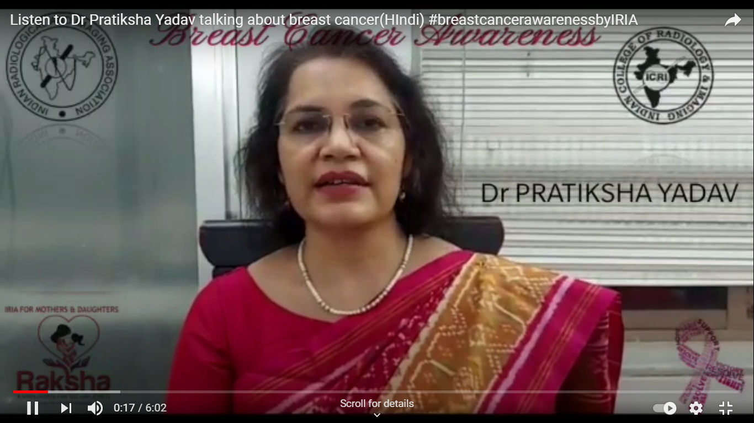
Extended activities in the department:

Slide 23
Thank you.

