Slide 1
Utility of t2wi in differentiating gct and chordoma of sacrum
- Dr. Ayesha Erum Hadi
MD- Radiodiagnosis
(Fellow in MSK Imaging)
Under the Guidance of -
Dr. Amit Kharat
DNB, P.hD, FICR

Slide 2
CLINICAL HISTORY:
34year old female patient came with –
Chief complain of Back pain radiating to bilateral legs (more on the right side) since 2 months
Associated with tingling and numbness
History of trauma 3 months ago
History of constipation since 1 month

Slide 3
Conventional imaging - X-RAY

Slide 4
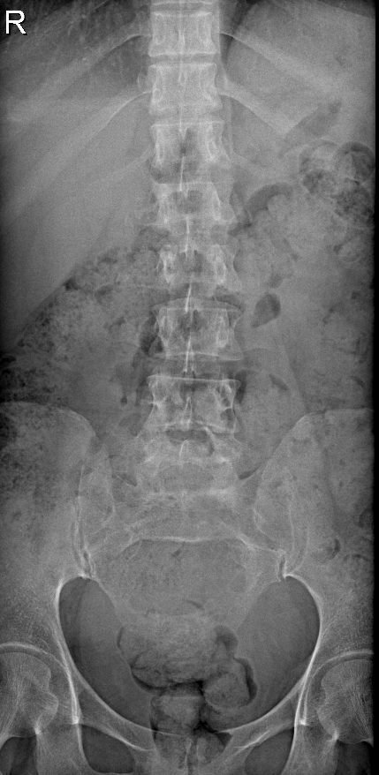
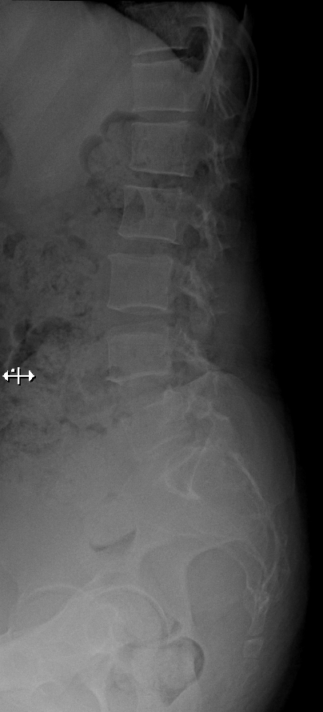
AP
LATERAL
Notes:
Xray AP and lateral Image show - A large, fairly defined, expansile, lytic lesion is noted involving the sacrum from S2-S4 (Right>Left), bony discontinuity of the anterior cortex of the sacral vertebra noted – neoplastic etiology
Loss of lumbar lordosis.
Anterior osteophytes noted at multiple vertebral levels. Visualized bones are normal in density.
Pre-spinal soft tissue is normal.

Slide 5
Computed Tomography (Plain with contrast)

Slide 6
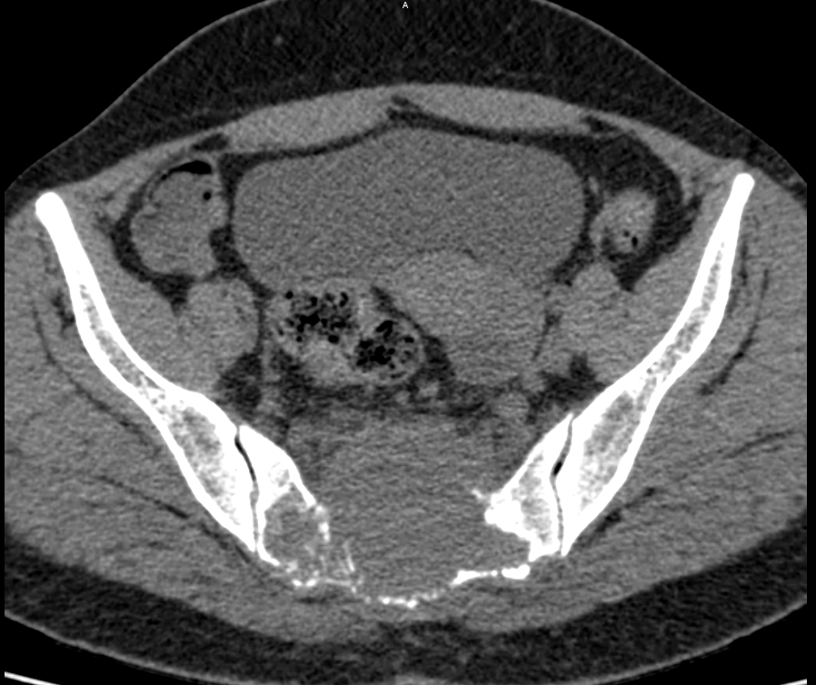
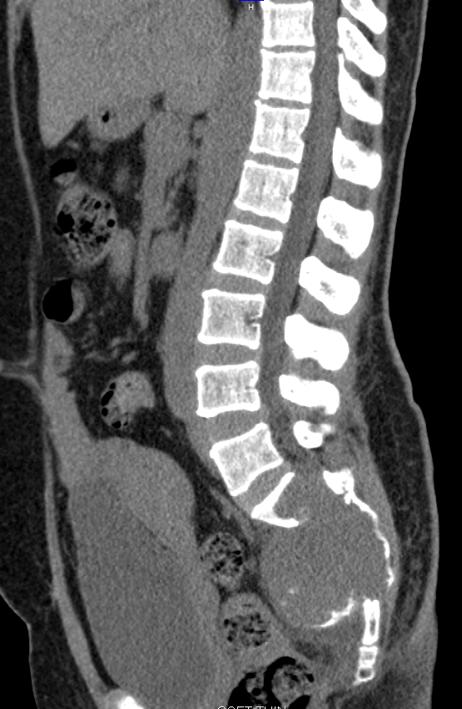
AXIAL AND REFORMATTED SAGITTAL CT IMAGE
Notes:
A large, well-defined, expansile lytic lesion is noted involving the sacrum with involvement of S1 to S5 vertebrae. It shows associated soft tissue component, extending in the presacral space.
The lesion shows hyperdense foci are seen in the lesion ?destroyed bone fragments ?? Calcification. The lesion expands anteriorly with destruction of the pelvic surface of sacrum causing slight anterior displacement of the rectum with maintained fat planes. Posteriorly it involves the sacral canal, the sacral crest and dorsal surface of sacrum.

Slide 7
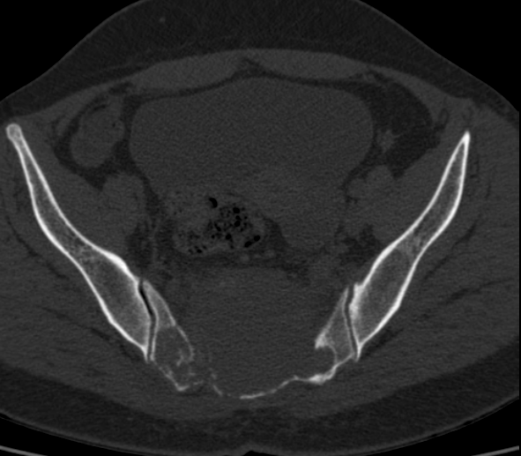
AXIAL CT IMAGES IN BONE WINDOW
Notes:
Laterally the lesion is reaching upto the articular surface of the SI joints bilaterally with erosion of the articular surface on right side.

Slide 8
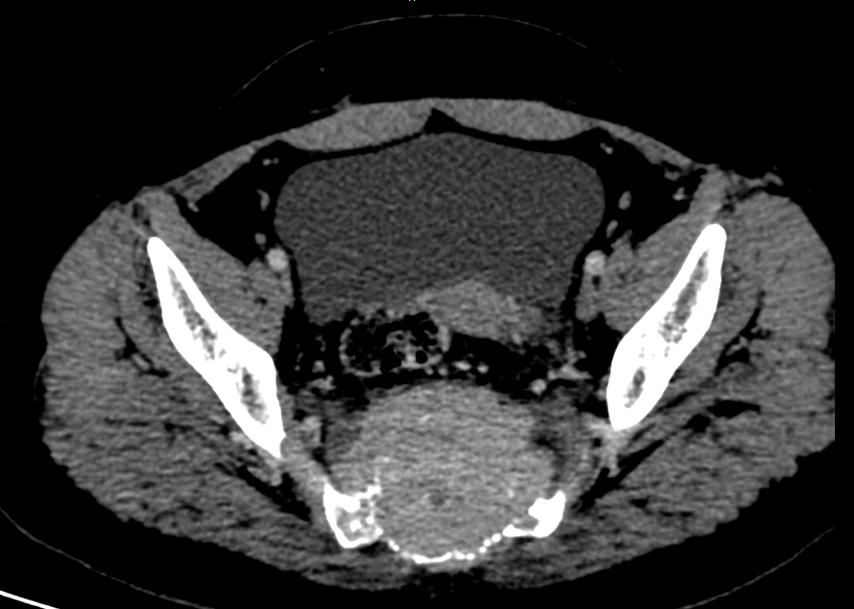
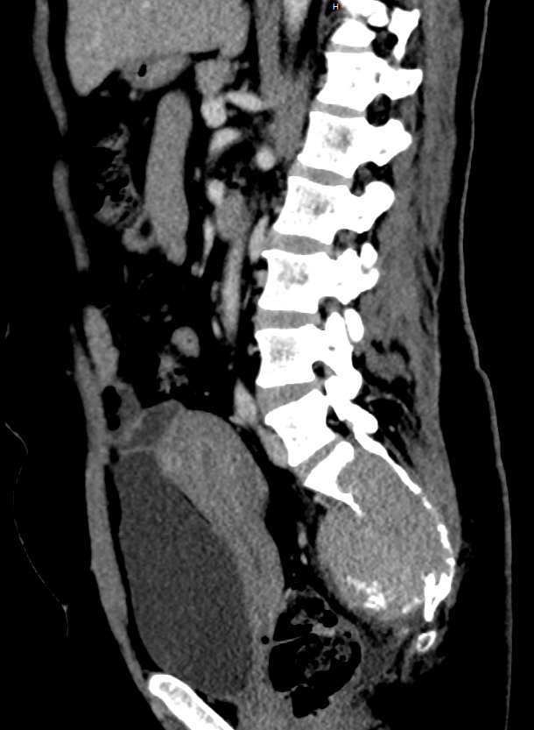
AXIAL AND REFORMATTED SAGITTAL POST CONTRAST CT IMAGE
Notes:
Summary : A large, well-defined, expansile lytic lesion involving the sacrum with associated enhancing soft tissue component– likely suggestive of neoplastic etiology - primary bone tumor.
Differential Diagnosis includes:
Chordoma
Giant cell tumor
Plasmacytoma

Slide 9
MRI – PLAIN WITH CONTRAST

Slide 10
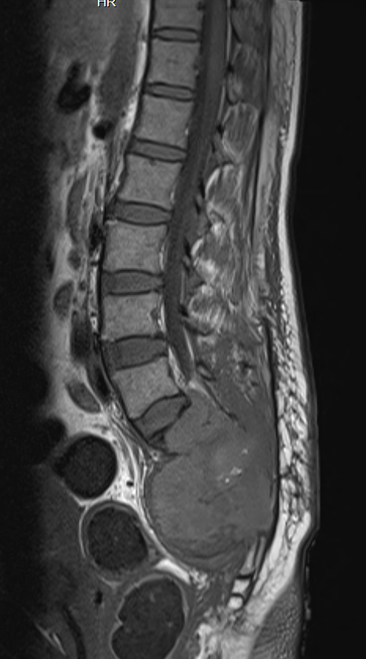
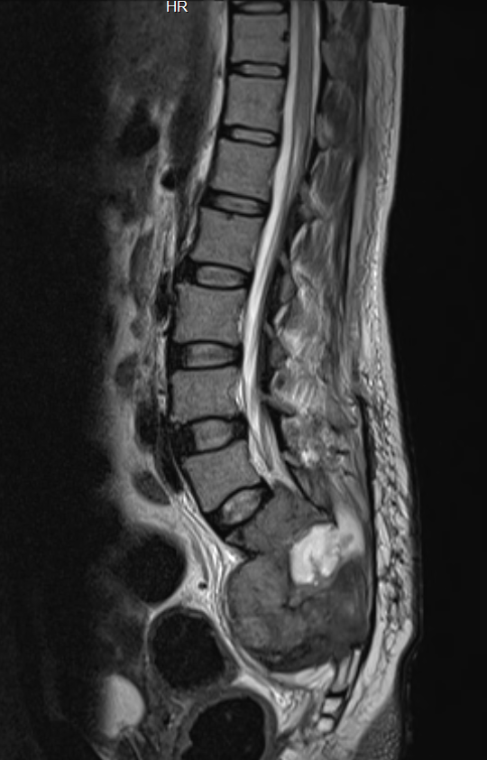
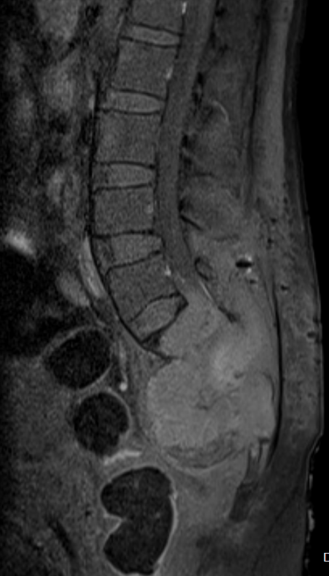
T1WI- SAG
T2WI- SAG
T1- FAT SUPPRESSED SAG
Notes:
Lobulated mass lesion is seen centered at sacrum causing destruction of sacrum. The lesion is iso to hypointense to muscles on T1W images, iso- to hyperintense on T2W images. Lesion is seen extending up to the superior endplate of S1 vertebra with soft tissue extending in spinal canal till the level of lower margin of L5 vertebra. . However there is NO involvement of the inter vertebral disc spaces.

Slide 11
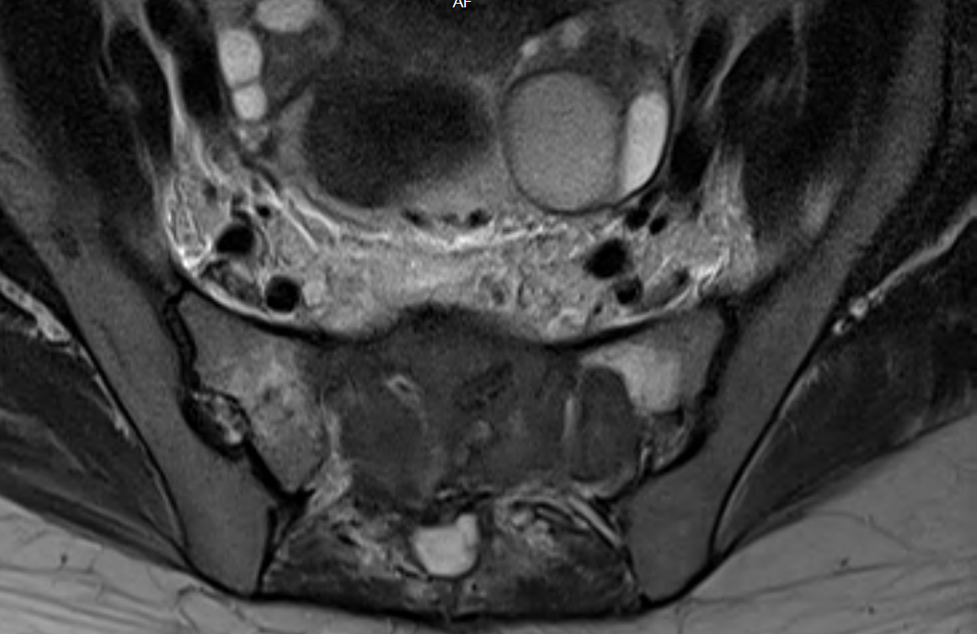
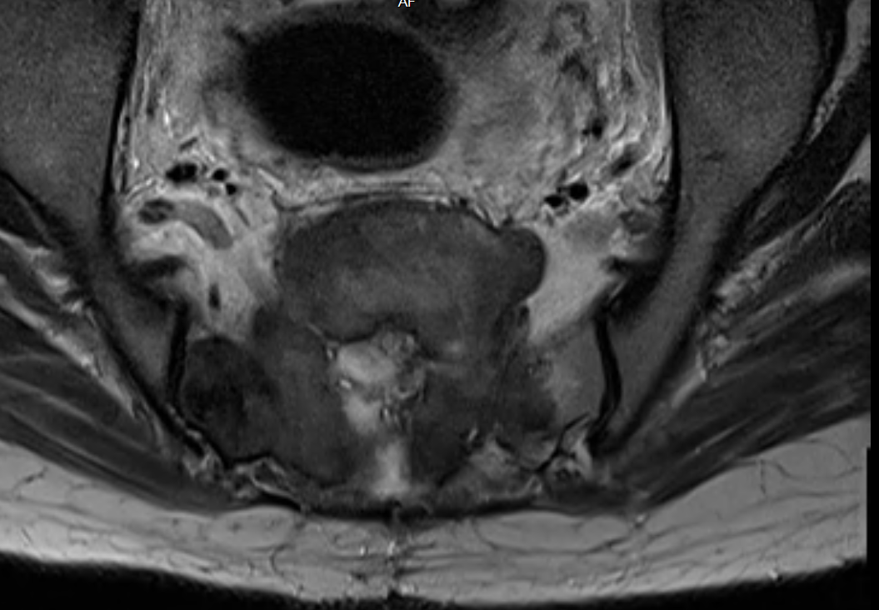
AXIAL T2WI IMAGE
Notes:
Severe narrowing of sacral canal is seen with adjacent soft tissue edema and there is no involvement of the rectum.

Slide 12
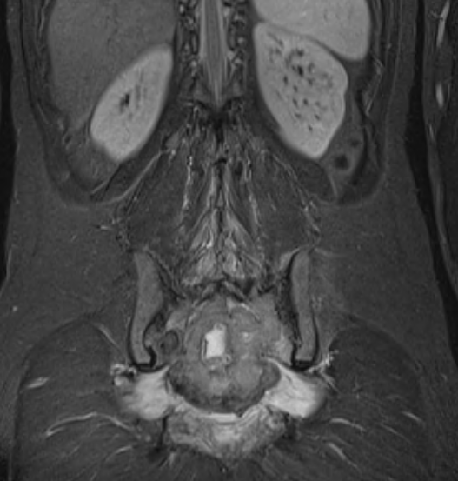
CORONAL STIR IMAGE
Notes:
Coronal T2 IR image - Involvement and edema of bilateral pyriformis muscles is seen

Slide 13
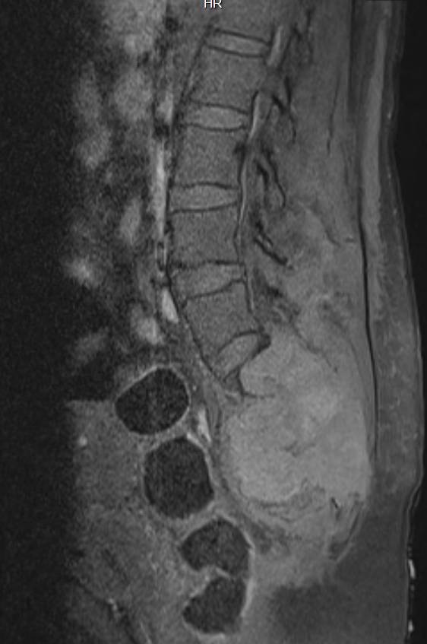
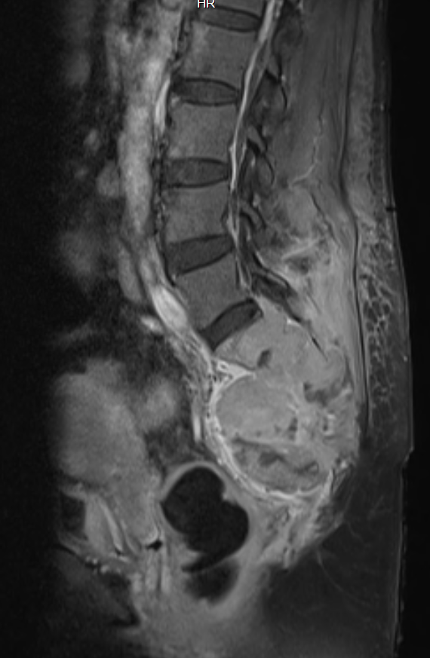
SAGITTAL PRE AND POST CONTRAST IMAGES
Notes:
On postcontrast study the lesion shows heterogeneous enhancement with nonenhancing necrotic areas.

Slide 14
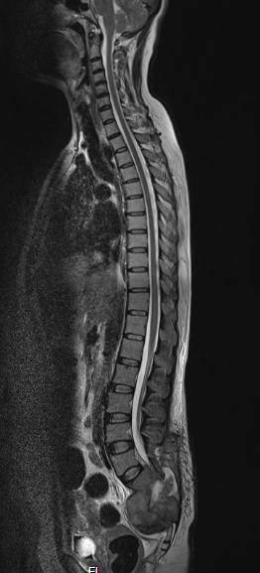
WHOLE SPINE SCREENING

Slide 15
SUMMARY:
X-Ray (AP and lateral Lumbo sacral spine) – Expansile lytic lesion involving the sacrum from S1-S4 vertebral level with bony discontinuity noted in the anterior cortex of sacrum.
CECT – Lumbo sacral spine – Expansile lytic lesion with associated soft tissue component extending into the presacral space with –
- Destruction of the pelvis surface anteriorly, with anterior displacement of rectum
- Extension into the sacral canal posteriorly with marked narrowing of the canal.
- Laterally, extension into the sub articular surfaces of bilateral Sacro-iliac joint (Right >Left)
-Heterogenous post contrast enhancement.
MRI (plain with contrast)– Lumbo-sacral spine with whole spine screening –
- T1WI and T2WI – Iso – hypo intense.
- Extension of the soft tissue lesion into the spinal canal up to the lower margin of L5 vertebral level and posteriorly into the sacral canal causing marked compression.
-Involvement of para spinal muscles and pyriformis muscles.
- Heterogeneous post contrast enhancement with non enhancing areas – likely necrotic.

Slide 16
DIFFERENTIAL DIAGNOSIS
Giant cell tumor
Chordoma

Slide 17
BIOPSY and HISTOPATHOLOGY

Slide 18
Gross Description - Received specimen of skin, subcutaneous tissue and bone in multiple tissue pieces aggregating to 13x10x4.5cm, largest piece measuring 13x6x4.5cm with skin flap measuring 13x2cm. All the other pieces were brownish in colour, firm in consistency. Largest piece was soft at skin but firm to hard at bony part.

Slide 19
Microscopy - Sections show cellular tumor exhibiting regularly spaced giant cells within a mononuclear cell background. High power shows osteoclastic giant cells against a mononuclear background.
Impression - Giant cell tumor of bone.

Slide 20
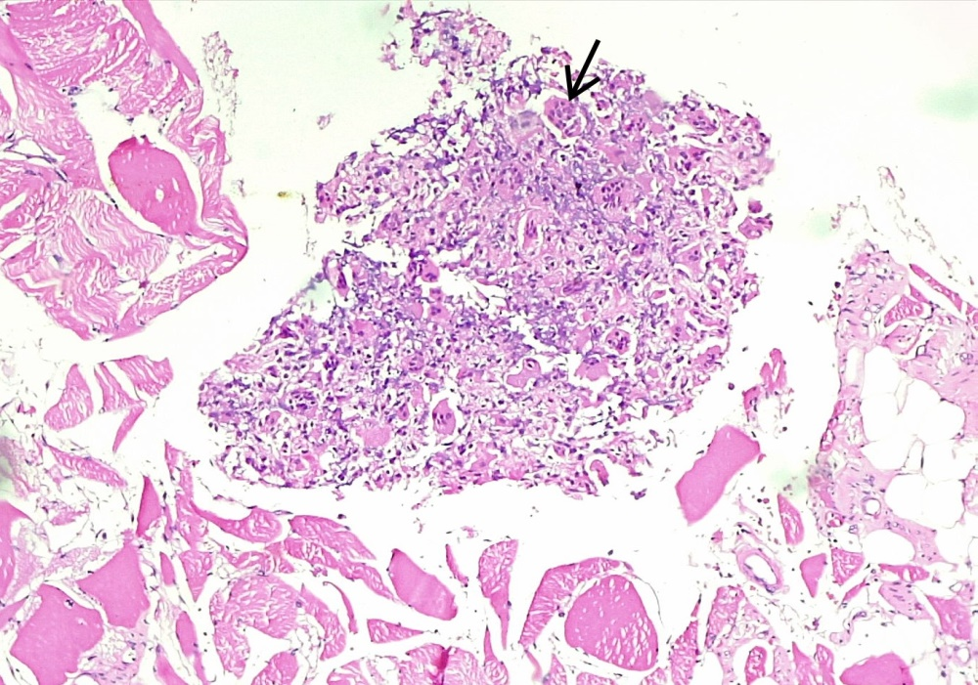
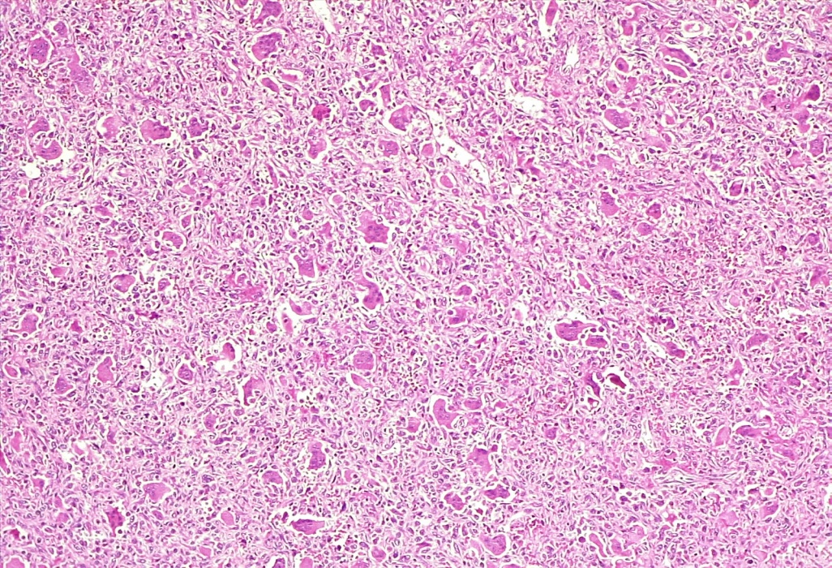
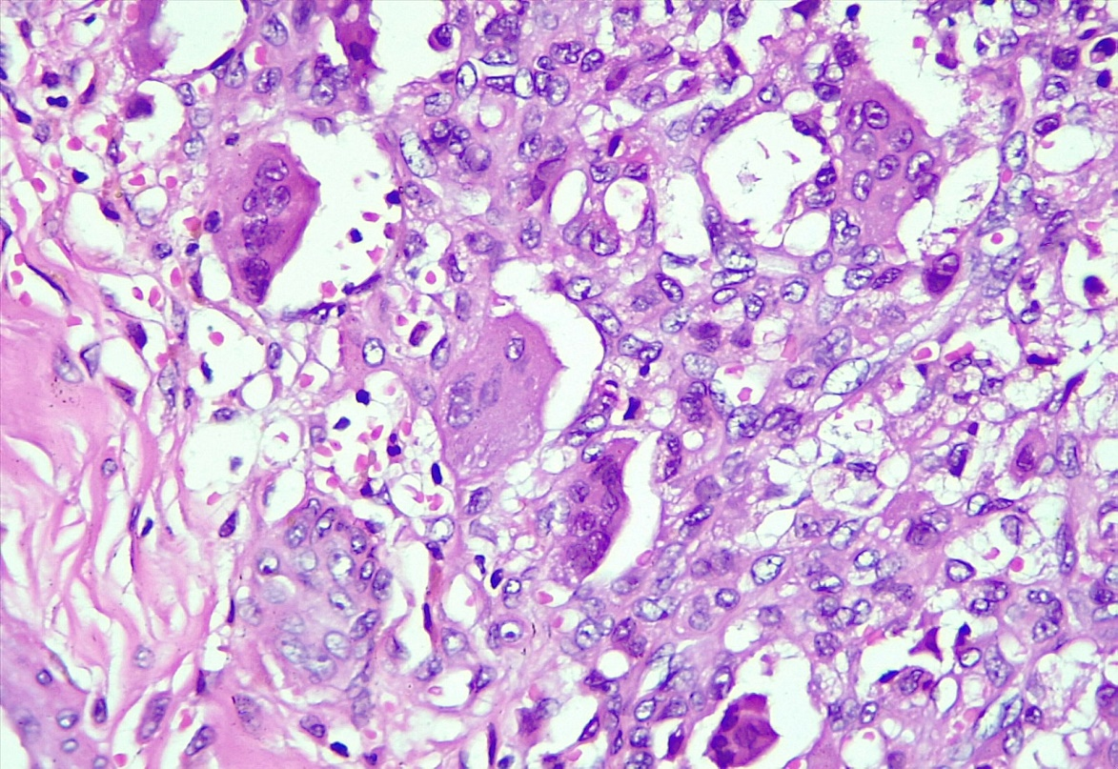
A. Arrow : Giant cells arranged regularly H&E, x10 B. Multiple giant cells against a mononuclear background H&E, x100 C. Osteoclastic giant cells H&E, x400.

Slide 21
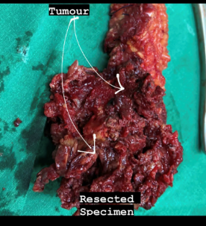
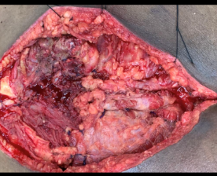
INTRA OPERATIVE IMAGES:
Image credits: Dept. of Neurosurgery.
Notes:
Tumor was embolized pre operatively, and en- bloc near total resection was achieved coupled with lumbo-pelvic fixation.

Slide 22
SACRAL GCT VS SACRAL CHORDOMA
 | GCT | CHORDOMA
Location in Sacrum | Upper sacrum (above S4) | Lower sacrum (Below S3)
Midline/Eccenteric | Eccenteric | Midline
Septations | Not so common | Very Common
Cystic areas | Present | Absent
Involvement of SIJ | Yes | No

Slide 23
 | GCT | Chordoma
Age: | . Typically affect younger patients between 20 and 30 years. | 30 to 60 years, peak in the fifth decade
CT findings | Bone residues can be present. Cortex thinned with bone expansion within cortical rupture | Irregular and fuzzy bone residues - which indicate a rapid and intensive bone destruction and is a malignant feature of the tumor
Notes:
SC is a rare malignant bone tumor that arises from developmental embryonic remnants of the notochord

Slide 24
 | GCT | Chordoma
MRI findings: | Relatively low signal intensity on T2WI and could be a key differential feature in excluding other tumors that generally demonstrate high signal intensity on T2-weighted MR images | Relatively high signal intensity on T1WI and marked brightening on T2WI with multiple iso signal-intensity septa
Notes:
OnT2-weighted MR images . low to iso signal. This appears to be caused by the relative collagen content of fibrous components and hemosiderin within the tumor
Although this feature is not unique to giant cell tumors of the spine, it is quite helpful in making a differential diagnosis because most other spinal neoplasms (metastases, myeloma, and chordoma) show high signal intensity on the long-TR MR images. This appearance may be the initial imaging characteristic suggestive of a correct diagnosis

Slide 25
PROGNOSIS?
Giant cell tumors in the axial skeleton, particularly in the sacrum, are associated with a poorer prognosis because the tumors are larger and more difficult to excise completely. In many cases, a complete resection is only possible in limited sacral lesions, and imaging plays a key role in a presurgical evaluation
In general, sacral lesions that spare the majority of the S1 segment and the sacroiliac joint are amenable to a complete excision.
Giant cell tumors that cannot be excised entirely are often treated with a combination of partial curettage and radiation therapy

Slide 26
REFERENCES:
1. Murphey MD, Andrews CL, Flemming DJ, Temple HT, Smith WS, Smirniotopoulos JG. From the archives of the AFIP: primary tumors of the spine—radiologic pathologic correlation. RadioGraphics 1996; 16:1131-1158 [Crossref] [Medline] [Google Scholar]
2. Aoki J, Tanikawa H, Ishii K, et al. MRI findings indicative of hemosiderin in giant cell tumor of bone: frequency, cause, and diagnostic significance. AJR 1996; 166:145-148 [Abstract] [Google Scholar]
3. Kumar R, Guinto FC Jr, Madewell JE, David R, Shirkhoda A. Expansile bone lesions of the vertebra. RadioGraphics 1988; 8:749-769 [Crossref] [Medline] [Google Scholar]
4. Resnick D. Diagnosis of bone and joint disorders, 3rd ed. Philadelphia, PA: Saunders, 1995:3785-3806 [Google Scholar]
5. Randall RL. Giant cell tumor of the sacrum. Neurosurg Focus 2003; 15:E13 [Crossref] [Medline] [Google Scholar]

Slide 27
THANK YOU!

