Slide 1
AN INTERESTING CASE OF PERICARDITIS
Dr Nikhith Soman JR III
Under the guidance of Dr Tushar Kalekar
Department of Radiology

Slide 2
HISTORY
22 year old female
Abdominal distension and breathlessness x 1 month
a/w cough with expectoration and low grade fever
a/w loss of appetite and weight
O/E - generalized edema, reduced breath sounds in the bilateral lower zone with maintained SPO2.
Blood investigation - raised ESR (70 mm/hr) and total leukocyte counts (14,500) with lymphocytosis.

Slide 3
RADIOLOGICAL INVESTIGATIONS

Slide 4
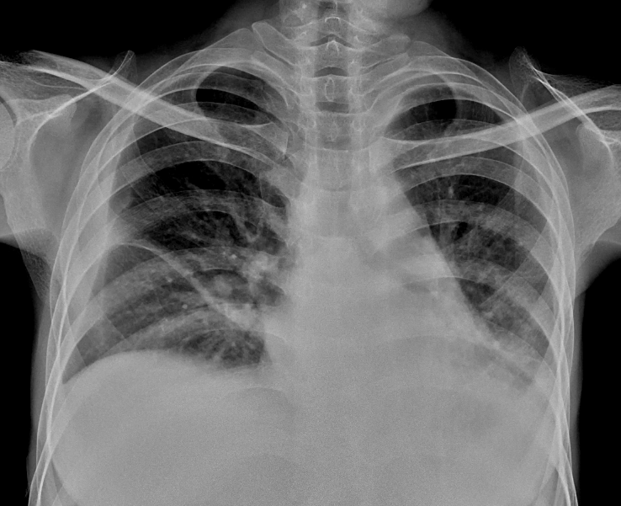
CHEST X-RAY
AP window fullness
Pleural effusion with consolidation
Pleural effusion

Slide 5
CECT THORAX, ABDOMEN AND PELVIS

Slide 6
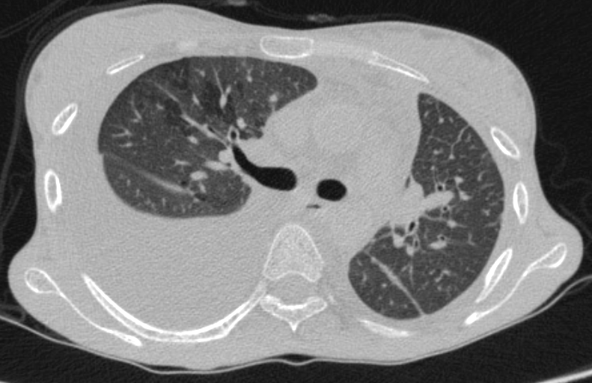
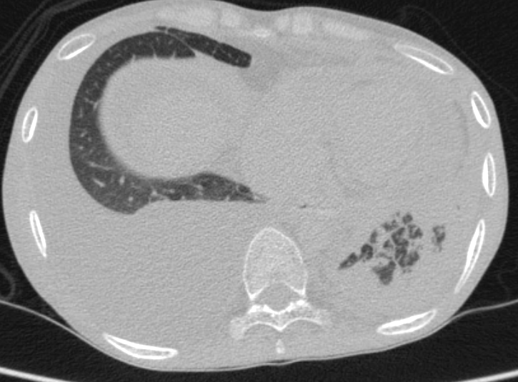
Air trapping
Consolidation
Pleural effusion

Slide 7
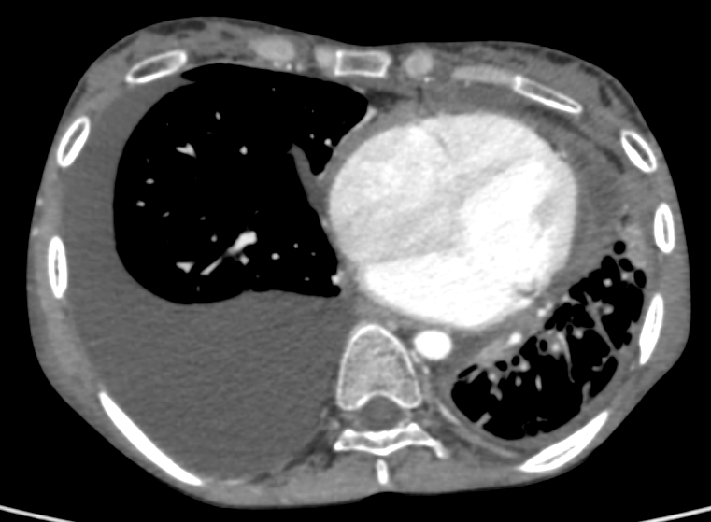
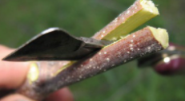
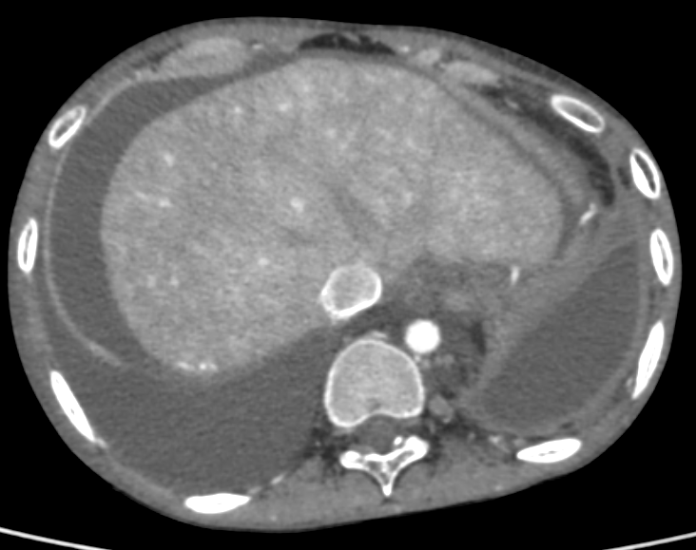
Pericardial effusion with septae
Split Pleura sign
Pleural effusion
Diaphragm Sign

Slide 8
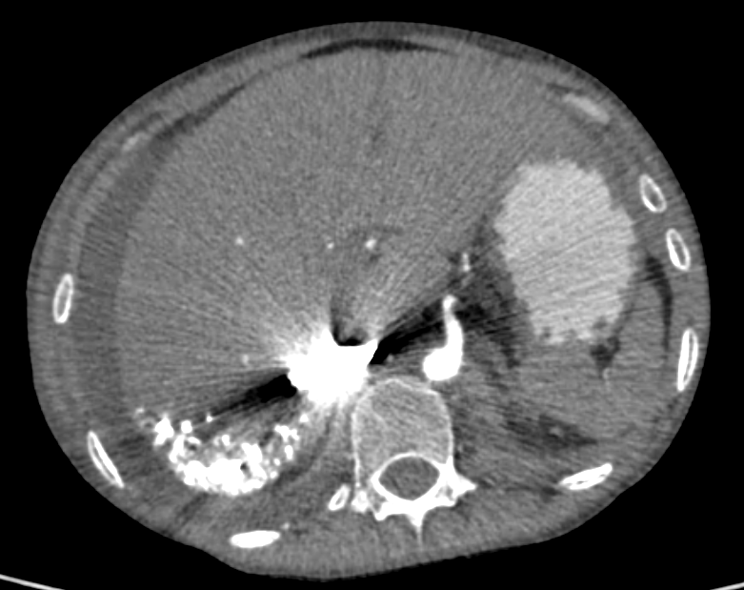
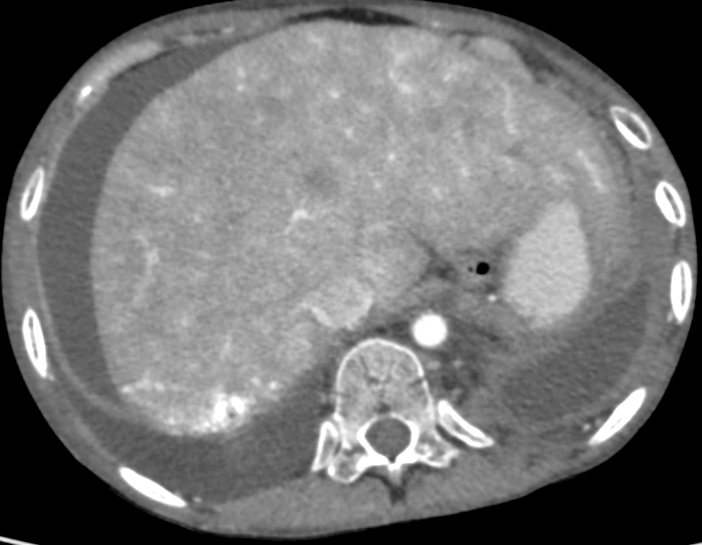
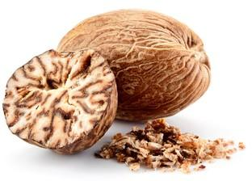
Nutmeg Liver
Contrast reflux into IVC

Slide 9
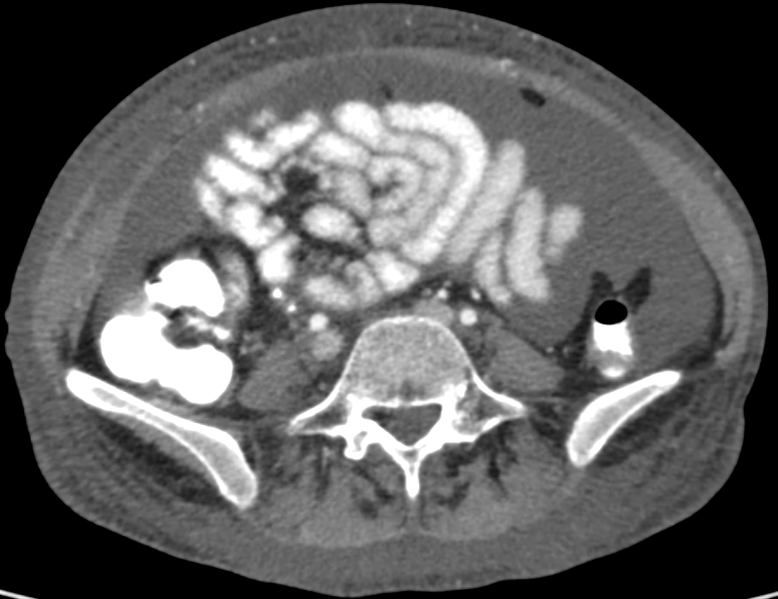
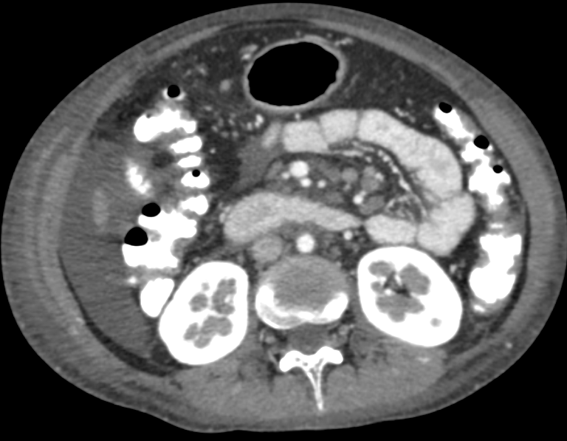
Ascites
Mesenteric lymphadenopathy

Slide 10
CT FINDINGS
Thorax -
Patchy areas of consolidation left lower lobe.
Empyema in left hemithorax
Moderate right sided pleural effusion.
Mild cardiomegaly with pericardial effusion. No pericardial calcifications.
Abdomen and pelvis –
Congestive hepatopathy
Moderate ascites
Suggest
2D ECHO for cardiac evaluation.
Ascitic/pleural fluid assay to rule out tuberculosis.

Slide 11
2 D ECHO was done i/v/o CT findings
Biatrial enlargement.
Thickened pericardium.
IVC dilated.
TR and MR.
Ventricular hypokinesia.
Reduced EF (27%).
Cardiac MRI was suggested to rule out constrictive pericarditis.

Slide 12
CARDIAC MRI

Slide 13
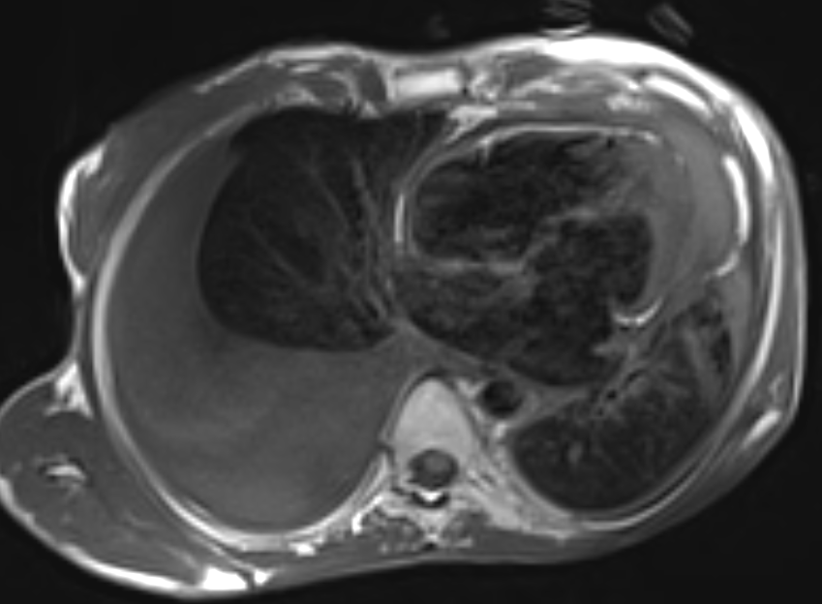
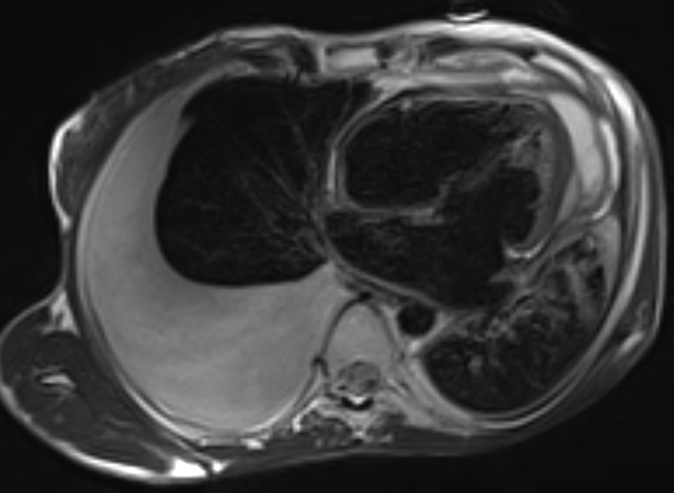
Pericardial effusion with septae
Thickened pericardium
Pleural effusion

Slide 14
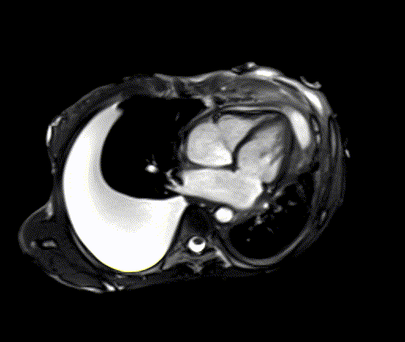
Wall motion abnormality
Septal Bounce
Tricuspid Regurgitation

Slide 15
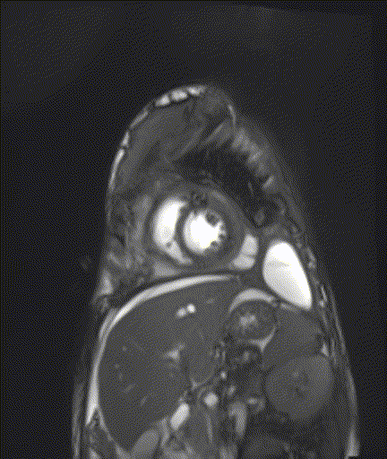
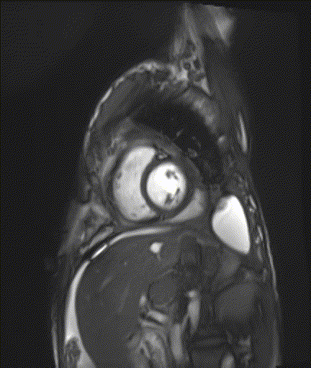
Septal Bounce

Slide 16
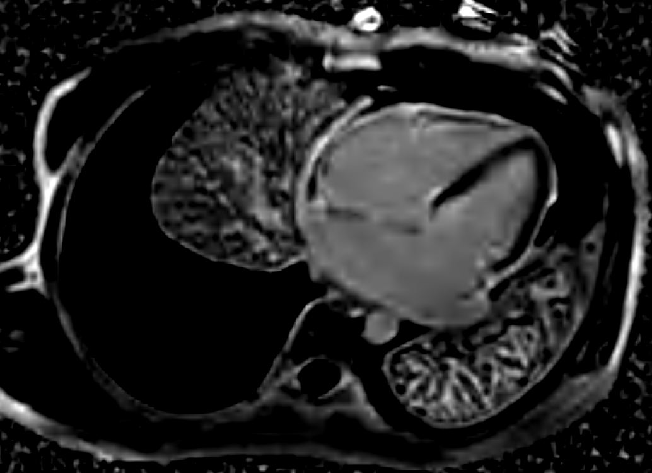
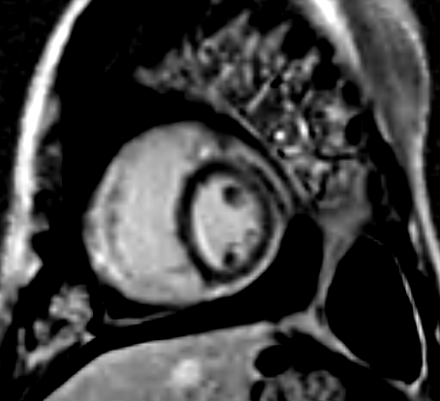
Pericardial contrast enhancement

Slide 17
Cardiac MRI findings
Mild cardiomegaly with dilated both atria.
Diffuse pericardial thickening and enhancement with loculated pericardial effusions.
Tricuspid regurgitation.
Abnormal myocardial wall motion (right ventricle) and paradoxical movement of Interventricular septum with early diastolic septal bounce.
Features are classical of constrictive pericarditis.

Slide 18
FOLLOW UP
On subsequent investigations, the patient was diagnosed with Tuberculosis.
Was started on antitubercular treatment and is on follow up.
Pericardiectomy was advised for management of constrictive pericarditis.

Slide 19
DISCUSSION

Slide 20
CONSTRICTIVE PERICARDITIS
Causes
Idiopathic, Tuberculosis, Postsurgical, post radiation.
Pathophysiology
Fibrosed pericardium - restricts late diastolic filling, due to limited cardiac volume.
Elevated venous pressures, ventricular interdependence and reduced cardiac output.

Slide 21
IMAGING IN CONSTRICTIVE PERICARDITIS
Morphological Abnormalities
Functional Abnormalities

Slide 22
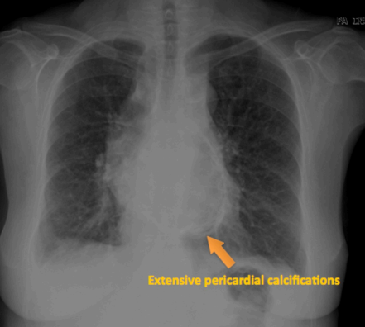
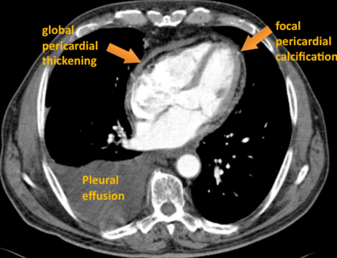
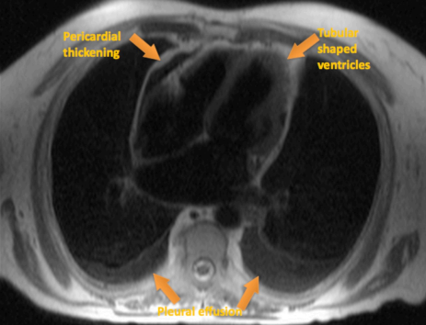
MORPHOLOGICAL ABNORMALITIES
Image courtesy: B. Graça et al, Constrictive pericarditis: Morphological, functional and haemodynamic evaluation

Slide 23
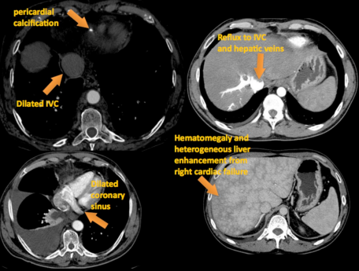
Image courtesy: B. Graça et al, Constrictive pericarditis: Morphological, functional and haemodynamic evaluation

Slide 24
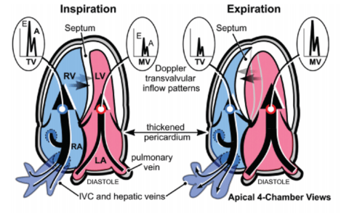
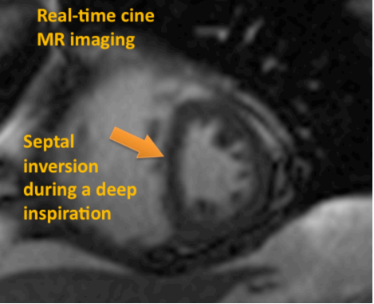
FUNCTIONAL ABNORMALITIES
Right ventricular filling begins slightly before left ventricular filling, the change in pressure equates to paradoxical leftward motion of the interventricular septum.

Slide 25
DIAGNOSIS
Chest Xray - pericardial calcification
2D Echo - Diagnostic in classical cases
CT is superior to MRI in detecting calcification
MR imaging - Equivocal cases, pericardial thickness, septal motion defects

Slide 26
REFERENCES
Bogaert J, Francone M. Cardiovascular magnetic resonance in pericardial diseases. Journal of Cardiovascular Magnetic Resonance. 2009 Dec;11(1):1-4.
Hancock EW. Differential diagnosis of restrictive cardiomyopathy and constrictive pericarditis. Heart. 2001 Sep 1;86(3):343-9.
Dal-Bianco JP, Sengupta PP, Mookadam F, Chandrasekaran K, Tajik AJ, Khandheria BK. Role of echocardiography in the diagnosis of constrictive pericarditis. Journal of the American Society of Echocardiography. 2009 Jan 1;22(1):24-33.
Napolitano G, Pressacco J, Paquet E. Imaging features of constrictive pericarditis: beyond pericardial thickening. Canadian Association of Radiologists' Journal. 2009 Feb;60(1):40-6.
Graça B, Donato P, Ferreira M, Alves FC. Constrictive pericarditis: Morphological, functional and haemodynamic evaluation. European Congress of Radiology-ECR 2010.

Slide 27
THANK YOU

