Slide 1
Scalp swelling – A rare presentation of a metastasis
DEPARTMENT OF RADIO-DIAGNOSIS
Presenting Resident: Dr Nagi Reddy (JR-III)
Guide: Dr Sanjay M Khaladkar
Head of the Department : Dr R S Kuber

Slide 2
History
44 year old female patient, presented with –
Tender swelling over the right fronto-temporal region.
Associated with pain and watering in the right eye.
No H/O trauma/fever.

Slide 3
USG- LOCAL SWELLING
An ill-defined heterogeneous solid lesion over the right temporo-frontal region measuring approx. 4 x 3 x 1 cm, with central and peripheral vascularity on color Doppler.
However underlying soft tissue and bone involvement could not be clearly delineated.
MRI was advised.

Slide 4
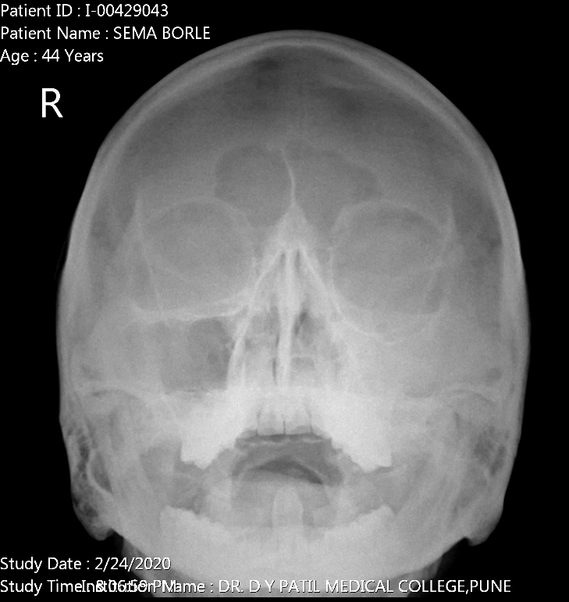
Radiograph skull- Waters view

Slide 5
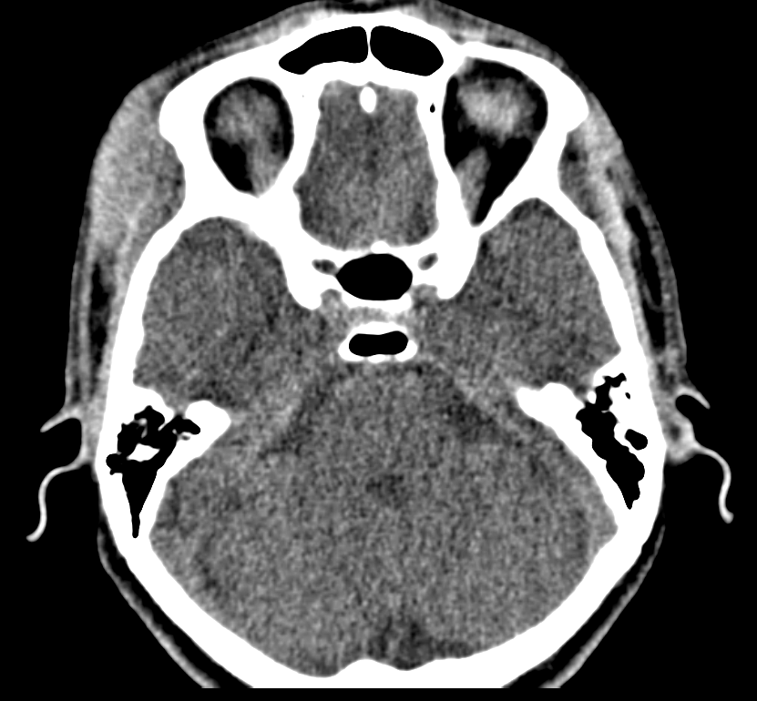
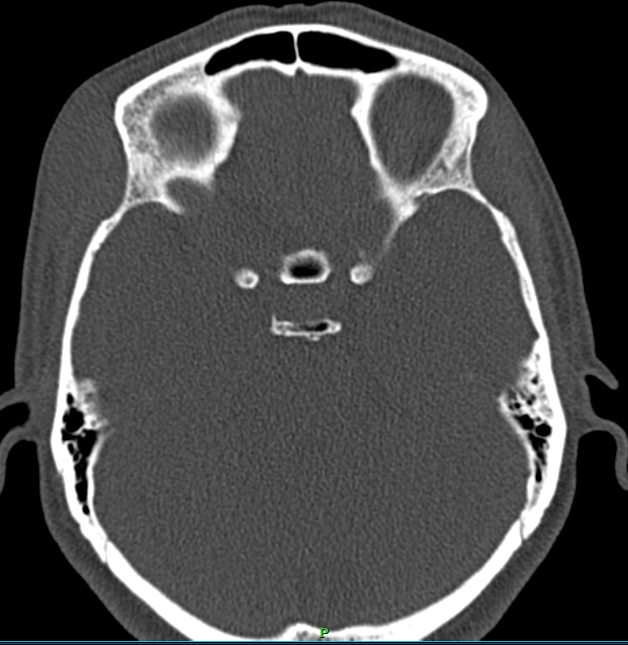
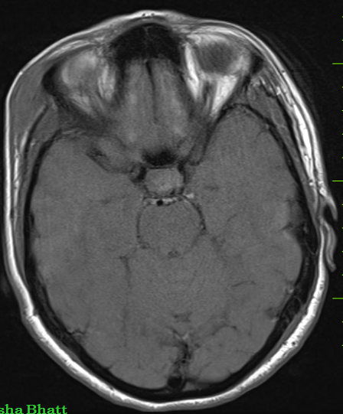
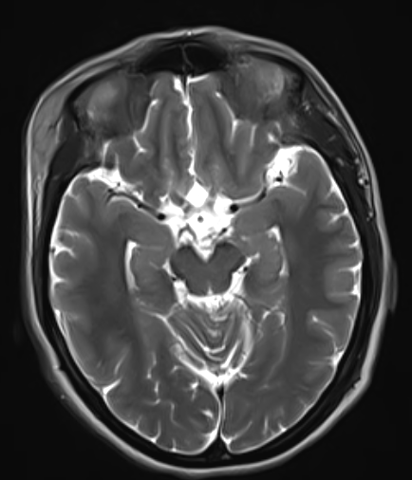
T1WI
T2WI

Slide 6
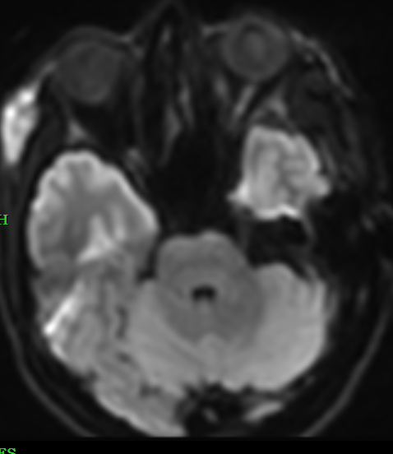
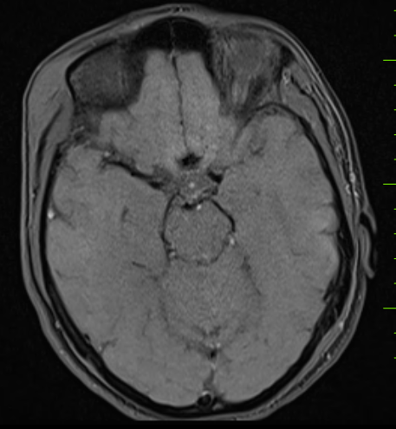
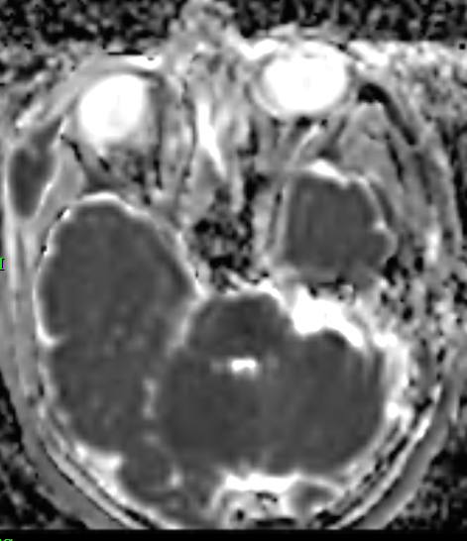
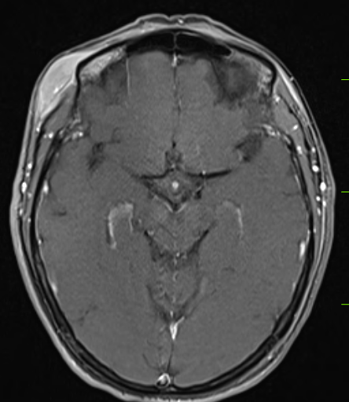
DWI
Pre-con
Post-con

Slide 8
Patient came with fresh complaints;
After 2 months
C/O yellowish discoloration of eyes since 1 week
Pain over the right hypochondriac region.
Newly developed swelling over the right arm.

Slide 9
USG - ABDOPELVIS
Liver shows asymmetrically dilated Intrahepatic biliary radicals in both lobes, due to a nearly isoechoic ill-defined mass lesion at the bifurcation of common hepatic duct which is also marginally infiltrating into the cystic duct. This mass lesion measured around 6x5x4 cm compressing & displacing the portal vein which appears normal in caliber.

Slide 10
Gall bladder is slightly over-distended (Volume is around 80 cc) & shows a significantly thickened wall, measuring around 7.5 mm. Gall Bladder lumen shows mild sludge seen within. CBD collapsed & measuring around 1 mm in diameter.

Slide 11
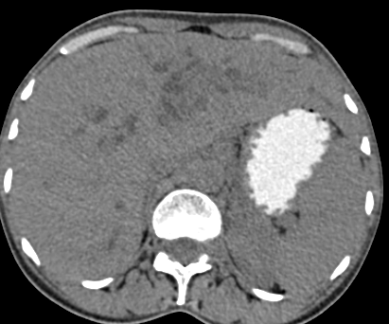
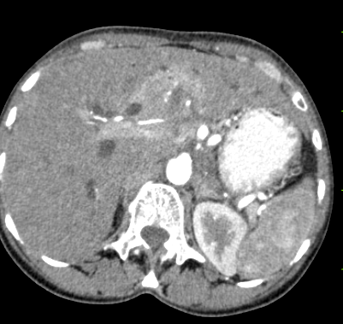
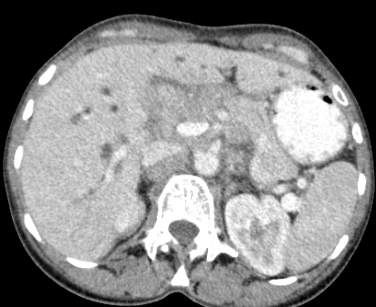
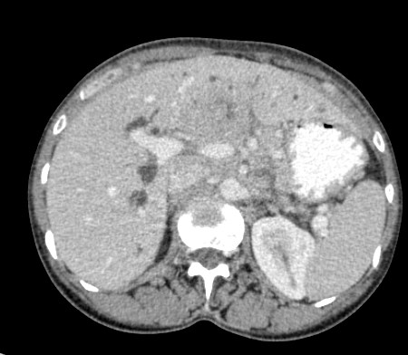
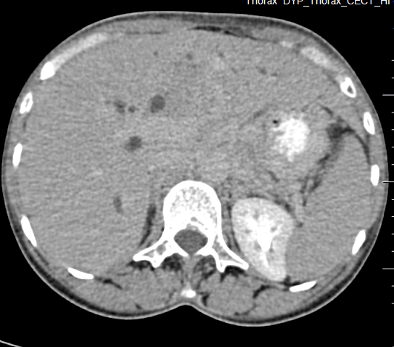
Unenhanced
Arterial
Portal
Venous
Delayed

Slide 12
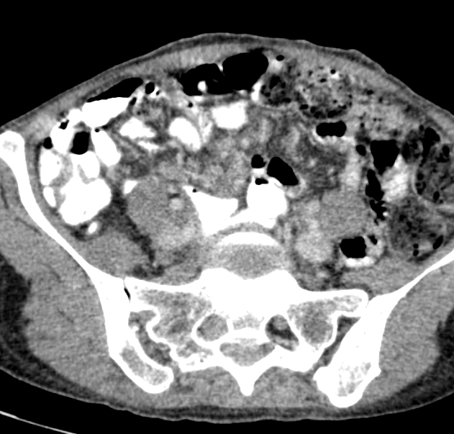
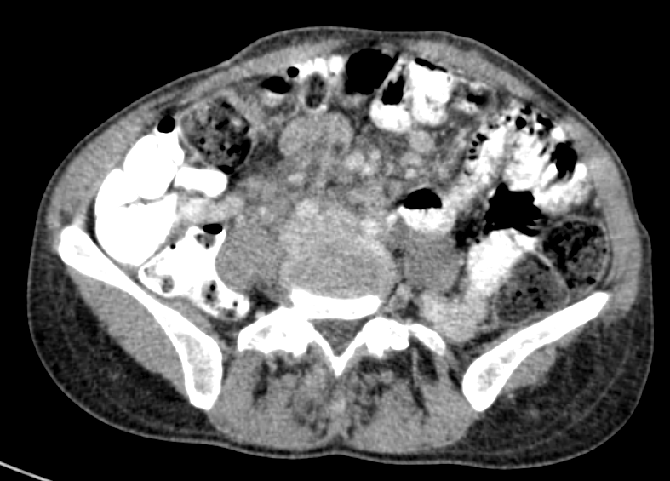
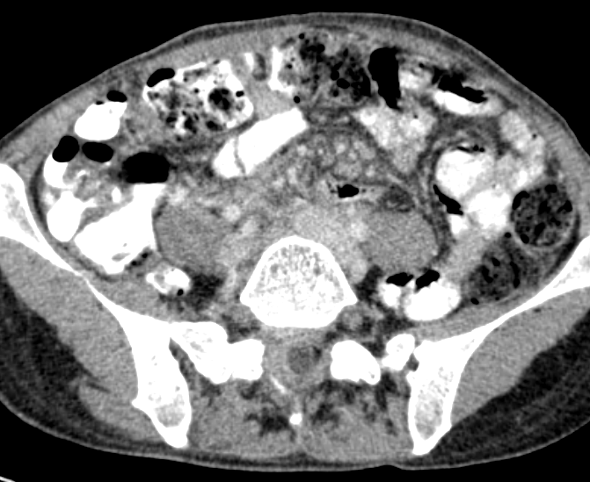
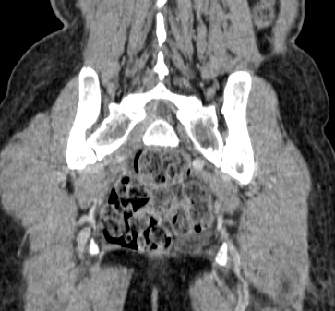
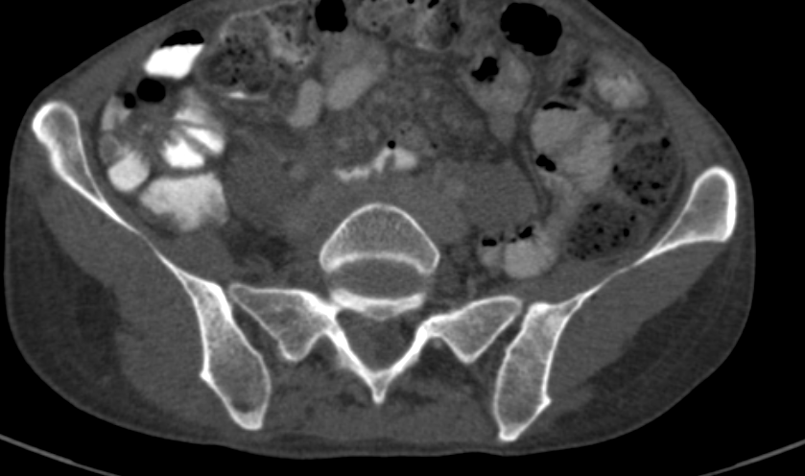

Slide 13
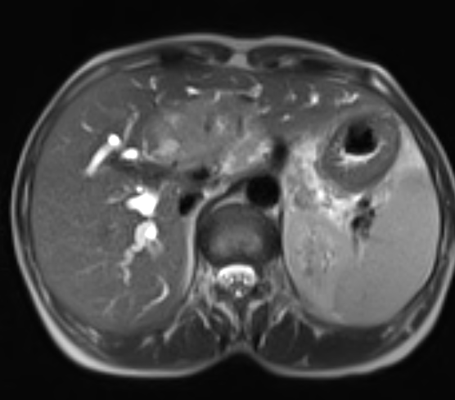
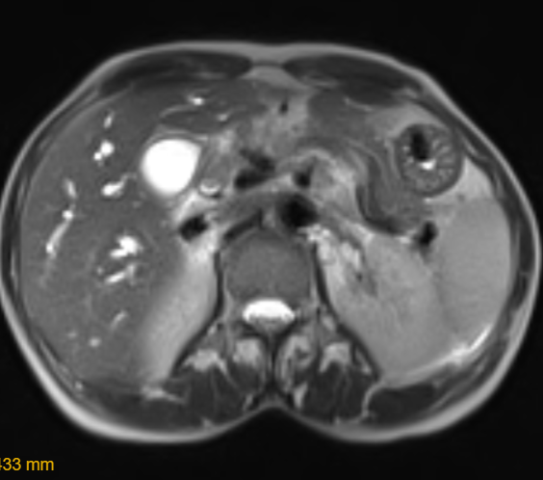
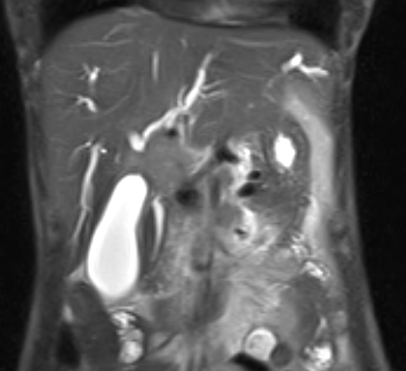
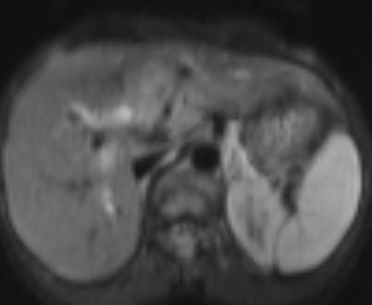
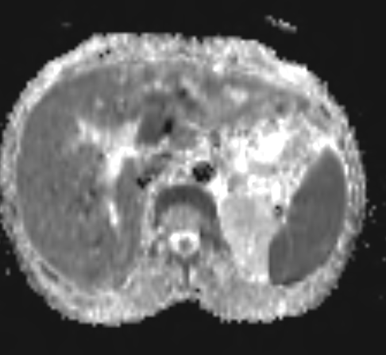

Slide 14
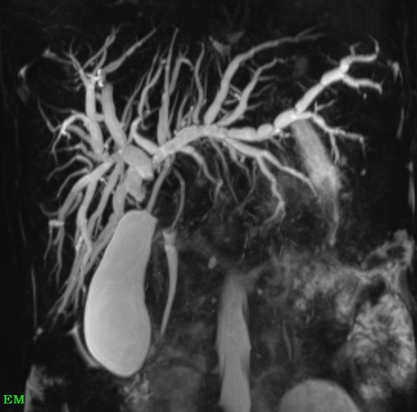
Maximum Intensity Projection (MIP)

Slide 15
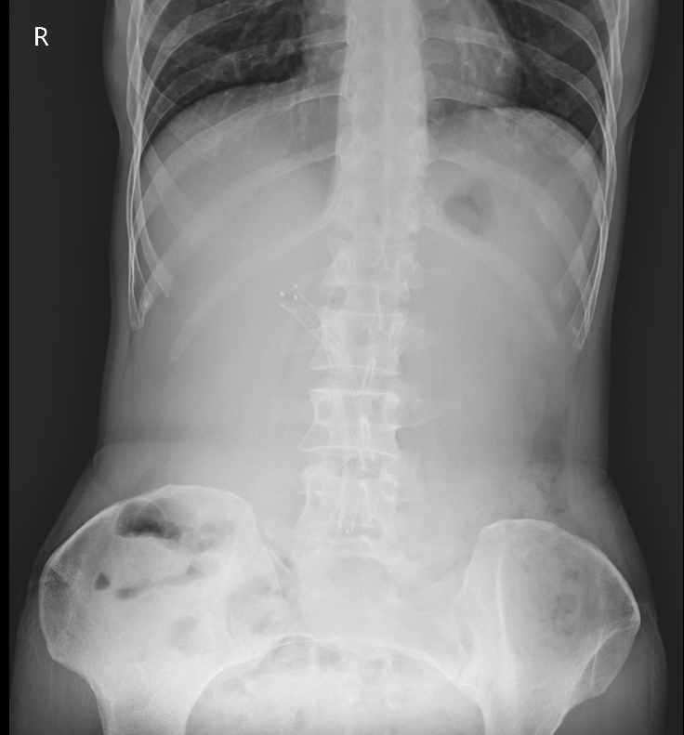
Post biliary stenting

Slide 16
Biopsy from liver lesion
Pathology - Poorly differentiated sclerosing cholangiocarcinoma.

Slide 19
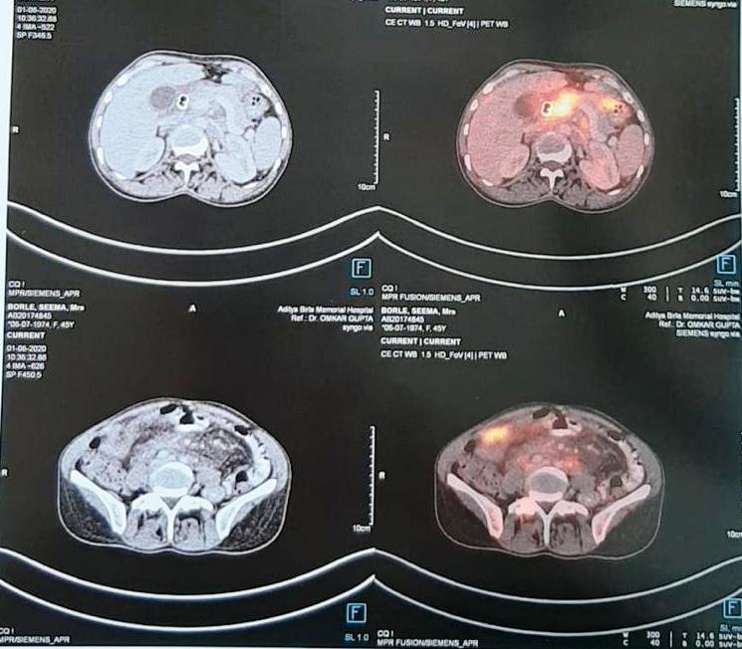

Slide 20
DIAGNOSIS
Hilar cholangiocarcinoma with hepatic parenchymal infiltration and involving 1st order RHD, LHD, proximal CBD and cystic duct.
[ Bismuth classification - Type V ]
Regional and distant nodal spread, skeletal, spinal and cutaneous metastasis -- being the rarity of this case.
TNM staging - Stage IVB

Slide 21
TREATMENT
Extrahepatic biliary drainage and metallic biliary stent placement done with two stents.
4 Cycles of chemotherapy was given with FOLFOX.
Kept on Capecitabine tablets.

Slide 22
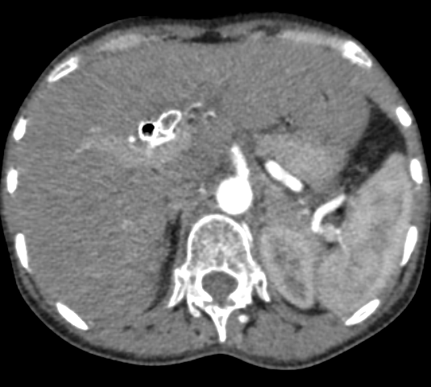
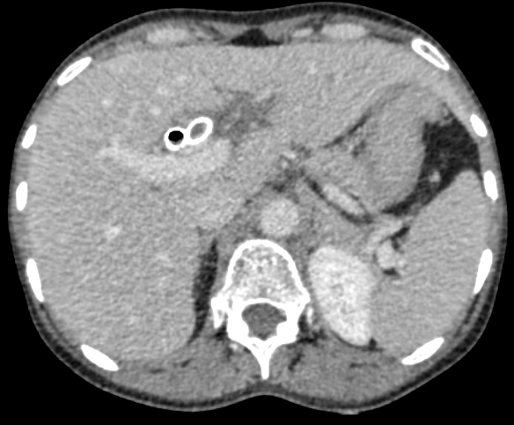
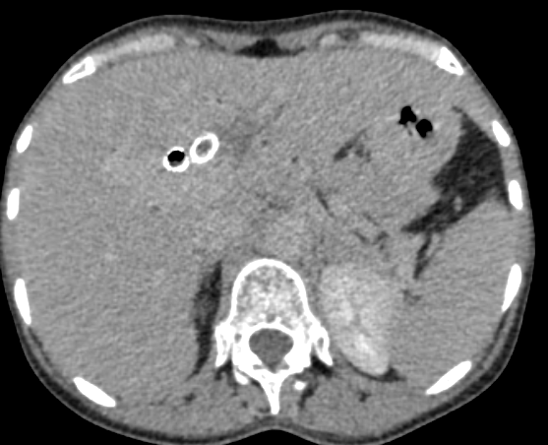
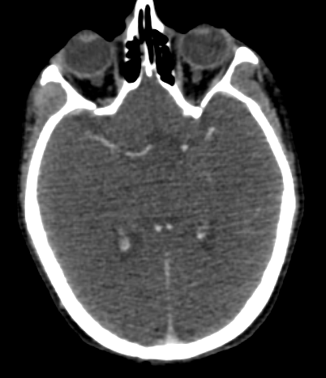
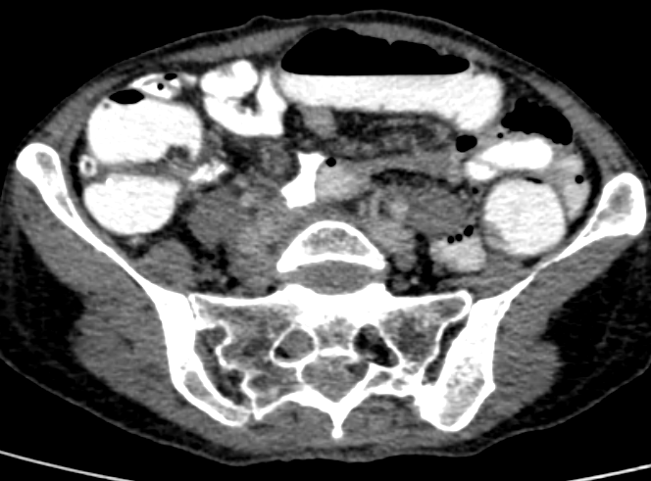
Follow up scan after 2 months
Arterial
Venous
Delayed

Slide 23
DISCUSSION
Cholangiocarcinomas are rare malignant epithelial tumors arising from the biliary tree and have a poor prognosis and high morbidity
Types of Cholangiocarcinoma:
1) Intrahepatic
2) Hilar
3) Extrahepatic

Slide 24
These are prone to metastasize to the lung, liver, peritoneum, and retroperitoneal lymph nodes, while cutaneous metastasis is uncommon.
Cutaneous metastasis
1) Seeding along
PTBD tract
2) Distant metastasis
hematogeneous route
Notes:
Liu M et al observed 8 out of 29 cases skin metastasis was the first sign of cholangiocarcinoma and suggested bile duct examination should be performed for cutaneous metastasis of unknown origin. [1]

Slide 25
There are few reports about cutaneous metastasis of cholangiocarcinoma, included following sites:
Scalp - most common region for cholangiocarcinoma
Axillary region
Thigh
Arm [1,2]

Slide 26
Mechanism of scalp metastasis[3]
Abdominal visceral malignancy
Venous communications to vertebral venous plexus
Intracranial venous sinuses
Emissary veins
Scalp veins

Slide 27
Approach to cutaneous metastasis
Cutaneous metastasis are solitary/multiple, usually <2cm in size and comprises of 5% visceral malignancies and 2% of cutaneous malignancies.[4,5]
Few underlying malignant causes :
Melanoma (Overall most common malignancy)
Ca. Breast (MC visceral malignancy)
Ca. Lung
Ca. Ovary
Colorectal carcinoma
Oral squamous cell carcinoma
Ca. Prostate
Rarely cholangiocarcinoma.

Slide 28
Clinically or Radiologically suspicious cutaneous lesion
Basic radiological survey
Female
CXR
USG Breast/Mammo
USG abdo-pelvis
Male
CXR
USG abdo-pelvis
TRUS (If indicated)
Further cross sectional imaging can be done with CT/MRI/PET based on the findings obtained through above mentioned investigations

Slide 29
CONCLUSION
Whenever addressing scalp metastasis of unknown origin, we should keep the possibility of bile duct-derived carcinoma in mind.

Slide 30
REFERENCES
1.Varma K, Singh A, Misra V. Cutaneous Metastasis from Cholangiocarcinoma Presenting as Thigh Mass. Journal of clinical and diagnostic research: JCDR. 2016 Sep;10(9):ED23.
2. Baghmar S, Panda D, Arora A, Patidar Y, Yadav V, Rastogi A. Cutaneous metastasis from intrahepatic cholangiocarcinoma. Tropical Gastroenterology. 2017 Jun 22;38(2):125-7.
3.Lu CI, Wong WR, Hong HS. Distant cutaneous metastases of cholangiocarcinoma: report of two cases of a previously unreported condition. Journal of the American Academy of Dermatology. 2004 Aug 1;51(2):108-11.
4. Juan YH, Saboo SS, Tirumani SH et-al. Malignant skin and subcutaneous neoplasms in adults: multimodality imaging with CT, MRI, and 18F-FDG PET/CT. AJR Am J Roentgenol. 2014;202 (5): W422-38. doi:10.2214/AJR.13.11424 - Pubmed citation
5. Manohar K, Mittal BR, Bhattacharya A et-al. Asymptomatic Distant Subcutaneous Metastases Detected by (18)F-FDG-PET/CT in a Patient with Breast Carcinoma. World J Nucl Med. 2012;11 (1): 24-5. doi:10.4103/1450-1147.98742 - Free text at pubmed - Pubmed citation

Slide 31
Thank you

