Slide 1
Dr. Rahul Arkar Faculty Interventional Radiology

Slide 2
Case 1.
56 Yrs. / M.
Right handed.
Principal.
Severe Headache, Vomiting.
HTN on Rx.
Dr. Rahul Arkar, Dr. Sambhaji Pawal.
Department of Interventional Radiology,
Dr. D. Y. Patil Medical College, Hospital & Research Centre, Pune.

Slide 3
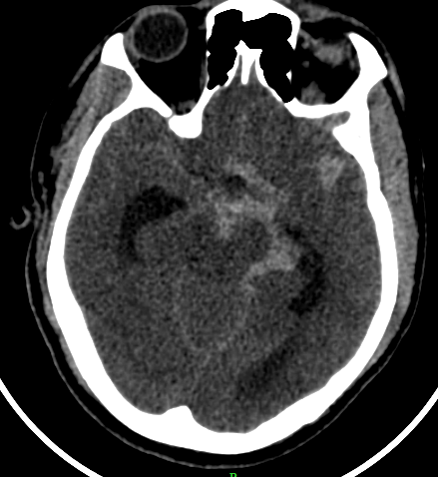
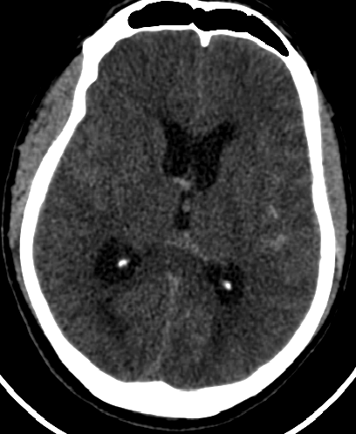
09/03/2020
Dr. Rahul Arkar, Dr. Sambhaji Pawal.
Department of Interventional Radiology,
Dr. D. Y. Patil Medical College, Hospital & Research Centre, Pune.

Slide 4
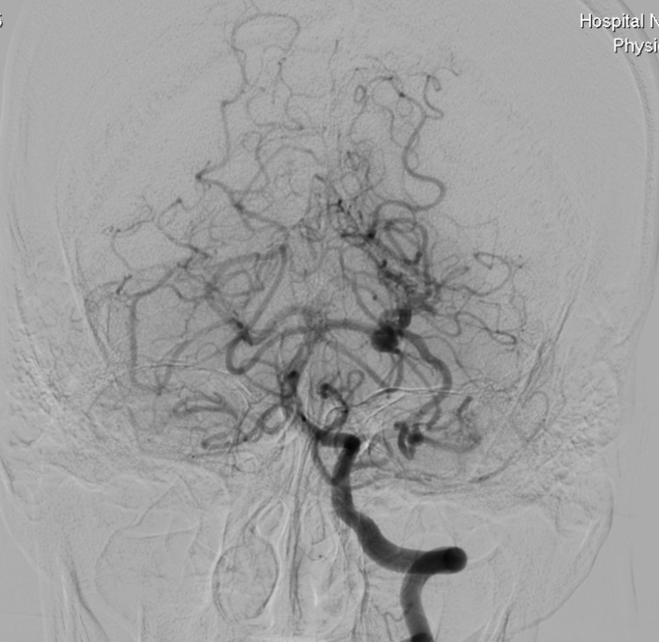
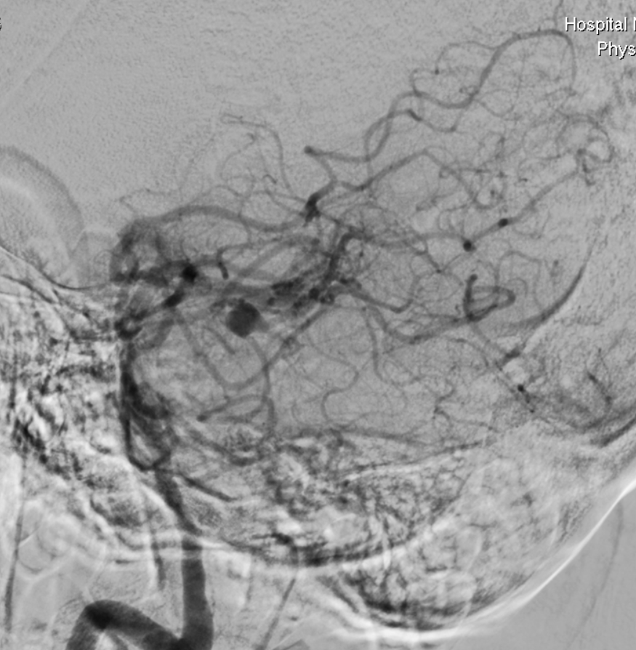
10/03/2020
Dr. Rahul Arkar, Dr. Sambhaji Pawal.
Department of Interventional Radiology,
Dr. D. Y. Patil Medical College, Hospital & Research Centre, Pune.

Slide 5
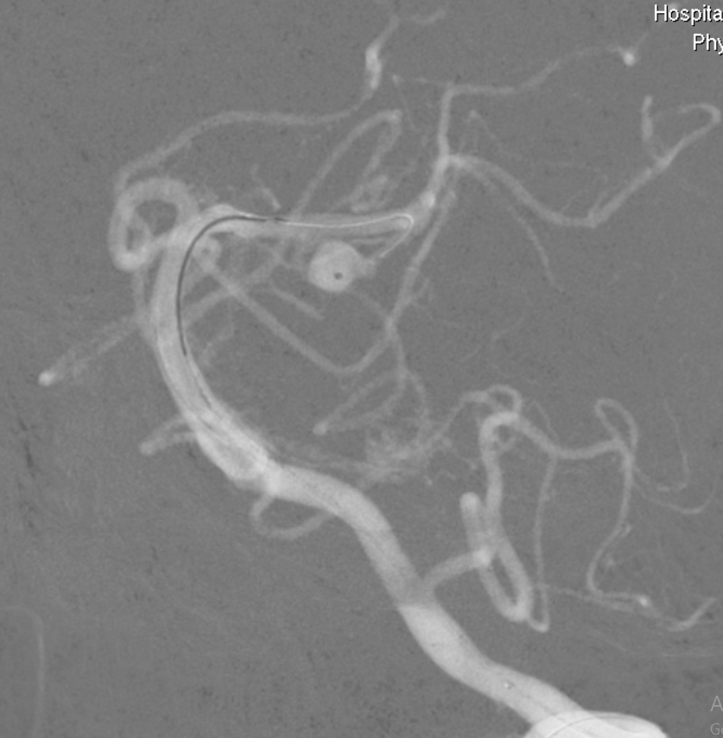
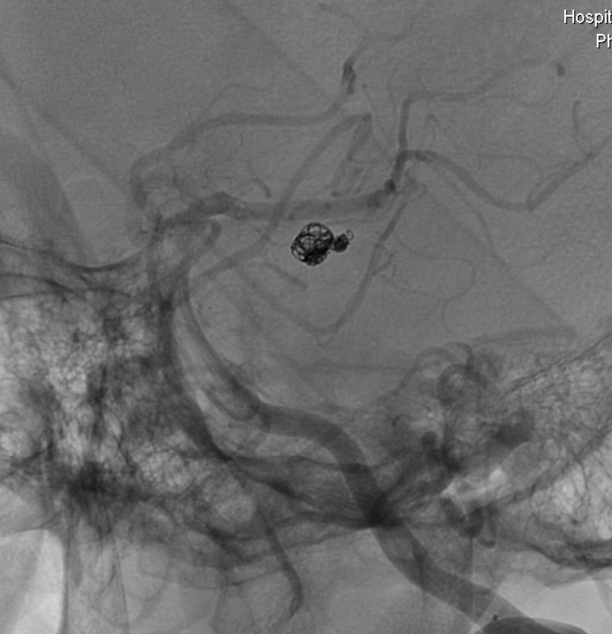
11/03/2020
Dr. Rahul Arkar, Dr. Sambhaji Pawal.
Department of Interventional Radiology,
Dr. D. Y. Patil Medical College, Hospital & Research Centre, Pune.

Slide 6
Dr. Rahul Arkar, Dr. Sambhaji Pawal.
Department of Interventional Radiology,
Dr. D. Y. Patil Medical College, Hospital & Research Centre, Pune.

Slide 7
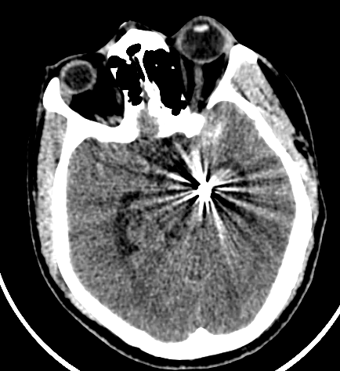
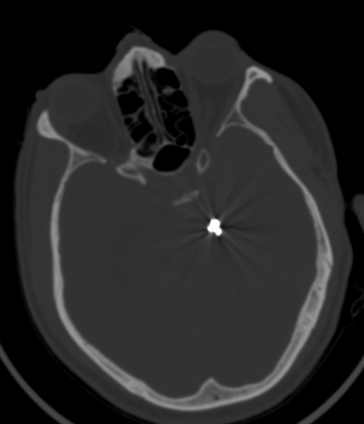
11/03/2020
Dr. Rahul Arkar, Dr. Sambhaji Pawal.
Department of Interventional Radiology,
Dr. D. Y. Patil Medical College, Hospital & Research Centre, Pune.

Slide 8
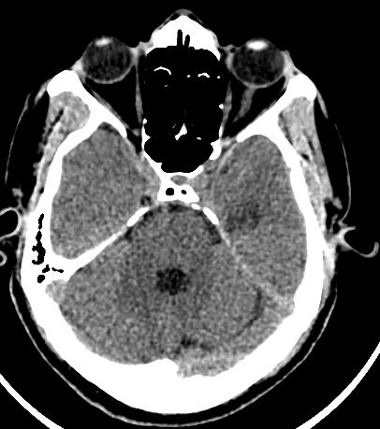
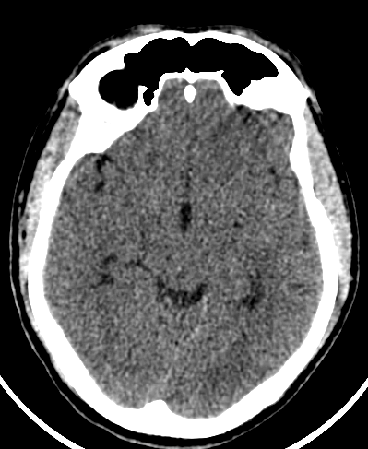
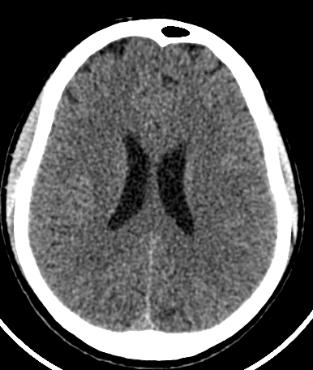
18/03/2020
Dr. Rahul Arkar, Dr. Sambhaji Pawal.
Department of Interventional Radiology,
Dr. D. Y. Patil Medical College, Hospital & Research Centre, Pune.

Slide 9
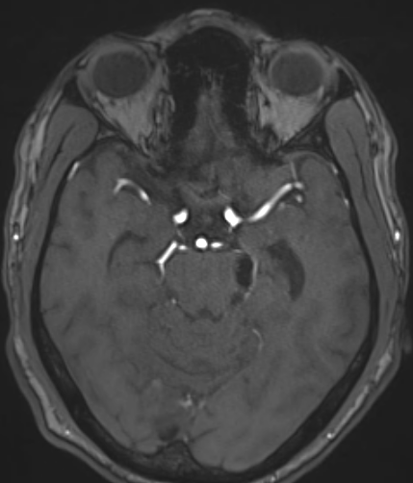
30/07/2020
Dr. Rahul Arkar, Dr. Sambhaji Pawal.
Department of Interventional Radiology,
Dr. D. Y. Patil Medical College, Hospital & Research Centre, Pune.

Slide 10
Case 2.
65Yrs. / F.
Massive Haemoptysis.
P/h/o pulmonary Koch’s.
HTN on Rx.
Dr. Rahul Arkar, Dr. Sambhaji Pawal.
Department of Interventional Radiology,
Dr. D. Y. Patil Medical College, Hospital & Research Centre, Pune.

Slide 11
Dr. Rahul Arkar, Dr. Sambhaji Pawal.
Department of Interventional Radiology,
Dr. D. Y. Patil Medical College, Hospital & Research Centre, Pune.

Slide 12
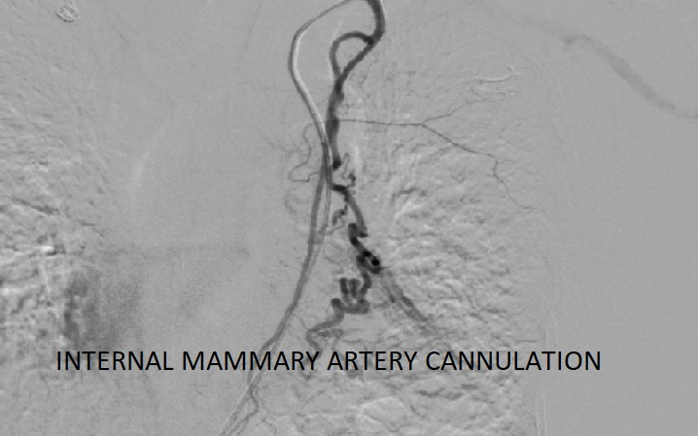
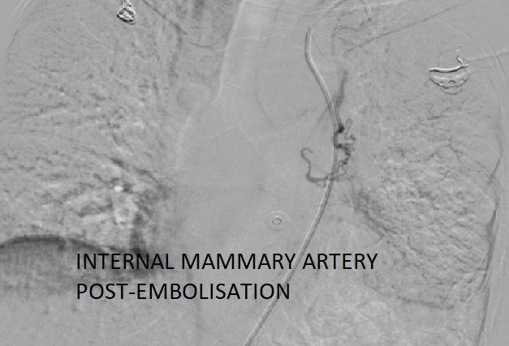
Dr. Rahul Arkar, Dr. Sambhaji Pawal.
Department of Interventional Radiology,
Dr. D. Y. Patil Medical College, Hospital & Research Centre, Pune.

Slide 13
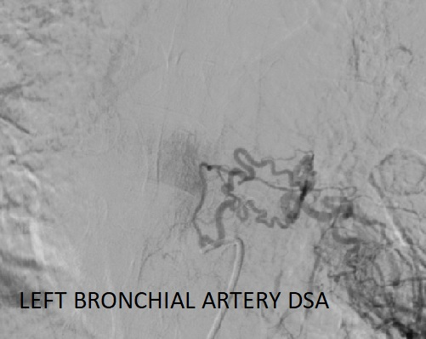
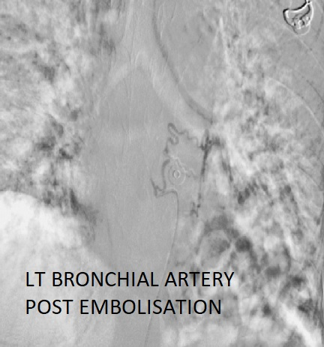
Dr. Rahul Arkar, Dr. Sambhaji Pawal.
Department of Interventional Radiology,
Dr. D. Y. Patil Medical College, Hospital & Research Centre, Pune.

Slide 14
Case 3.
37 Yrs. / M.
Malena.
Hb
Dr. Rahul Arkar, Dr. Sambhaji Pawal.
Department of Interventional Radiology,
Dr. D. Y. Patil Medical College, Hospital & Research Centre, Pune.

Slide 15
Dr. Rahul Arkar, Dr. Sambhaji Pawal.
Department of Interventional Radiology,
Dr. D. Y. Patil Medical College, Hospital & Research Centre, Pune.

Slide 16
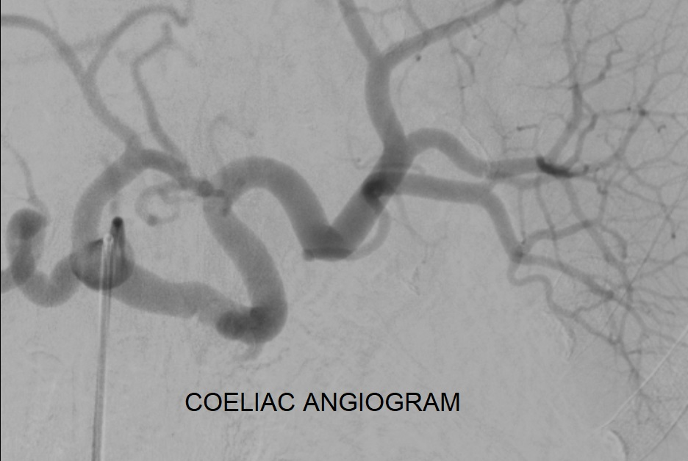
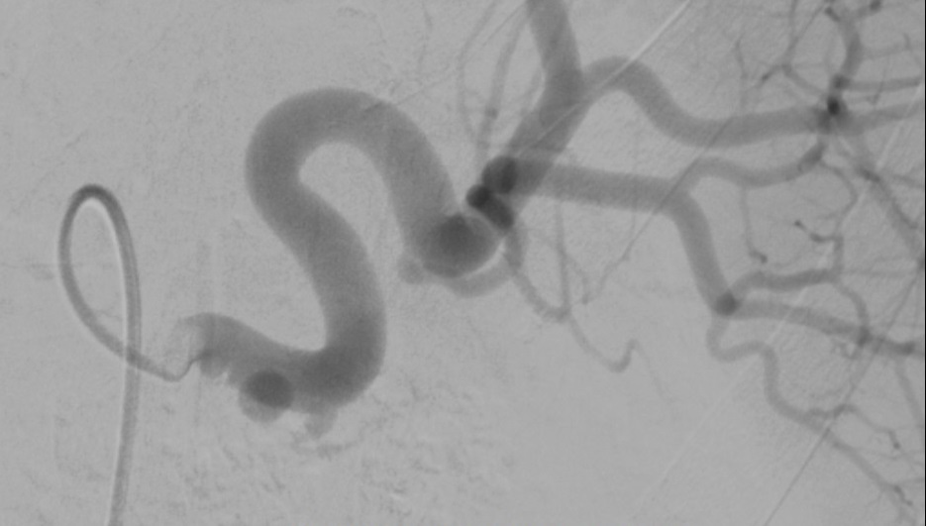
Dr. Rahul Arkar, Dr. Sambhaji Pawal.
Department of Interventional Radiology,
Dr. D. Y. Patil Medical College, Hospital & Research Centre, Pune.

Slide 17
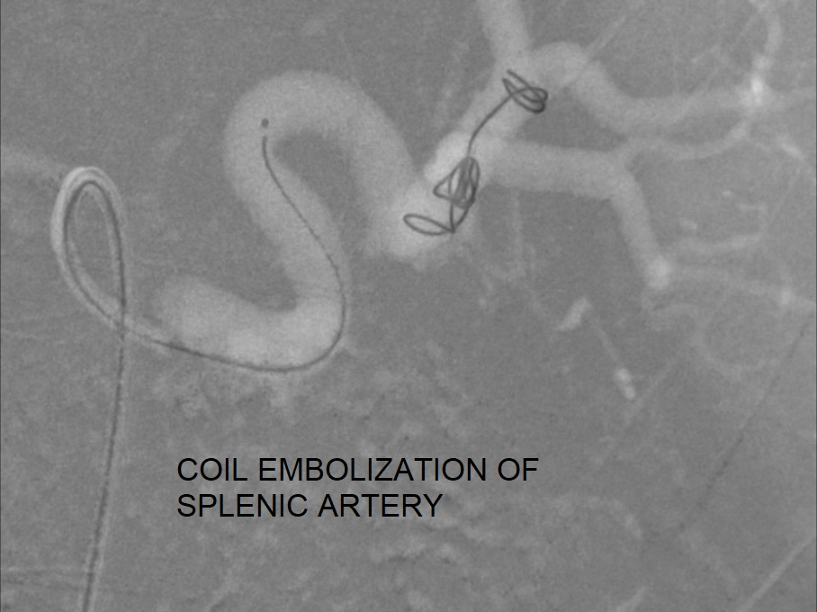
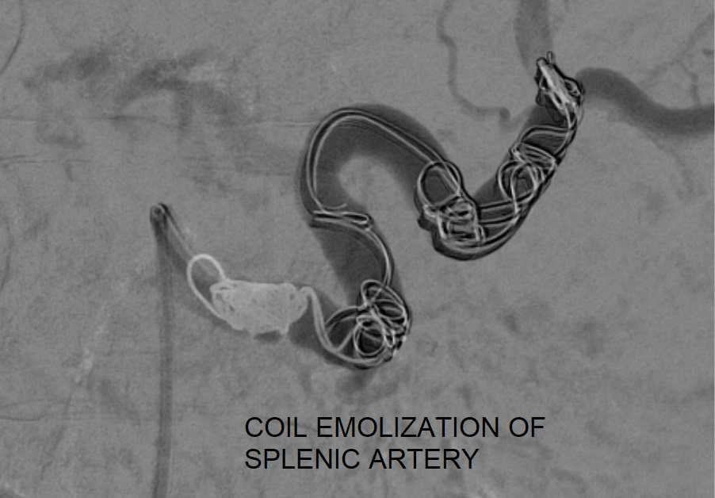
Dr. Rahul Arkar, Dr. Sambhaji Pawal.
Department of Interventional Radiology,
Dr. D. Y. Patil Medical College, Hospital & Research Centre, Pune.

Slide 18
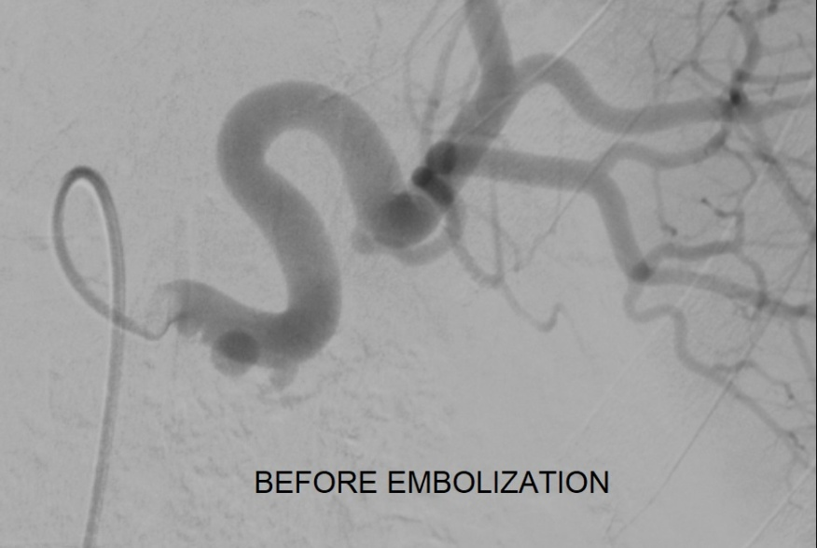
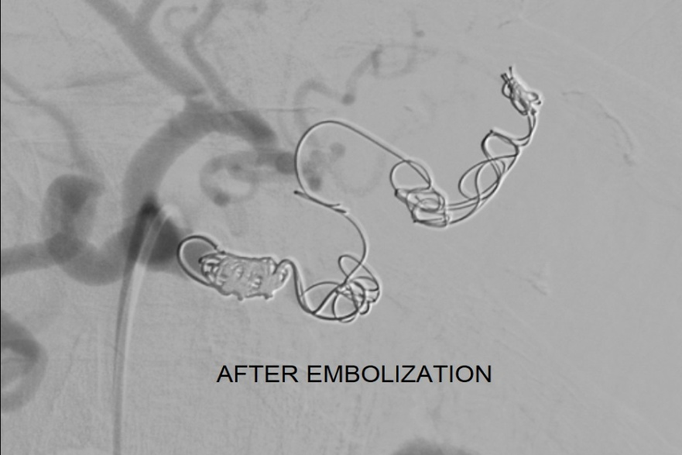
Dr. Rahul Arkar, Dr. Sambhaji Pawal.
Department of Interventional Radiology,
Dr. D. Y. Patil Medical College, Hospital & Research Centre, Pune.

Slide 19
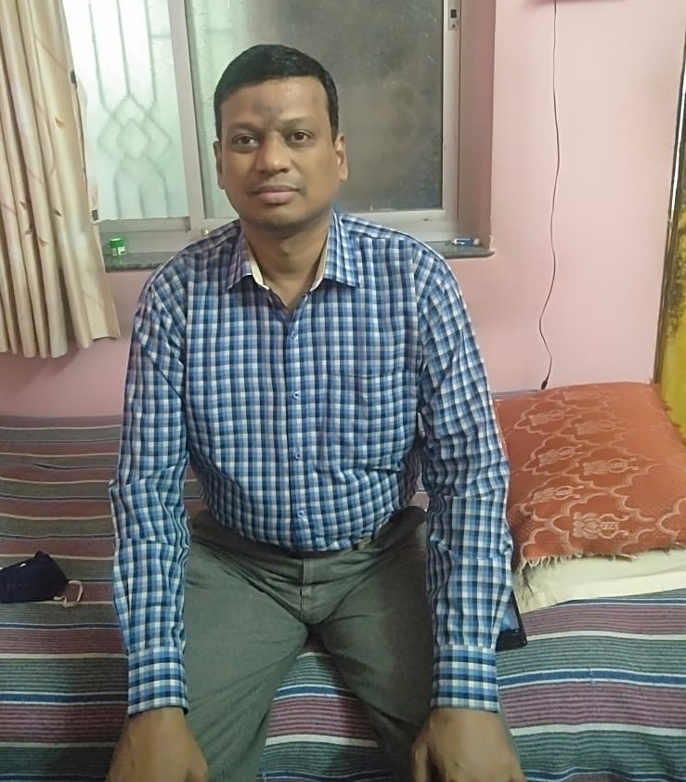

Slide 20
Case 4.
85 Yrs. /F.
Right Handed.
K/c/o HTN, DM on Rx.
Recurrent stroke.
Dr. Rahul Arkar, Dr. Sambhaji Pawal.
Department of Interventional Radiology,
Dr. D. Y. Patil Medical College, Hospital & Research Centre, Pune.

Slide 21
Dr. Rahul Arkar, Dr. Sambhaji Pawal.
Department of Interventional Radiology,
Dr. D. Y. Patil Medical College, Hospital & Research Centre, Pune.

Slide 22
Dr. Rahul Arkar, Dr. Sambhaji Pawal.
Department of Interventional Radiology,
Dr. D. Y. Patil Medical College, Hospital & Research Centre, Pune.

Slide 23
Dr. Rahul Arkar, Dr. Sambhaji Pawal.
Department of Interventional Radiology,
Dr. D. Y. Patil Medical College, Hospital & Research Centre, Pune.

Slide 24
Dr. Rahul Arkar, Dr. Sambhaji Pawal.
Department of Interventional Radiology,
Dr. D. Y. Patil Medical College, Hospital & Research Centre, Pune.

Slide 25
Teamwork
No matter how brilliant your mind or strategy,
if you are playing a solo game,
you will always lose out to a team.
-Reid Hoffman-
Dr. Rahul Arkar, Dr. Sambhaji Pawal.
Department of Interventional Radiology,
Dr. D. Y. Patil Medical College, Hospital & Research Centre, Pune.

