Slide 1
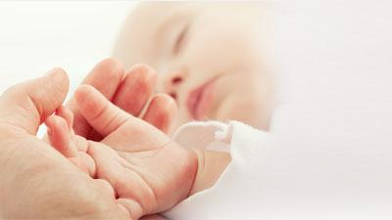
VIRILISING ADRENAL TUMOUR
DR. ASHLESHA SHIMPI
M.Ch (Pediatric Surgeon)
Department of Pediatric Surgery
Dr.D.Y.Patil Hospital, Pune

Slide 2
CLINICAL SCENARIO
One and half year male child
Increased height and weight since 6 months
Increase in size and length of genitalia
Appearance of pubic hair
Deepening of voice
No significant past history
Diagnosed to have hypertension on admission- started on amlodipine 1.5mg

Slide 3
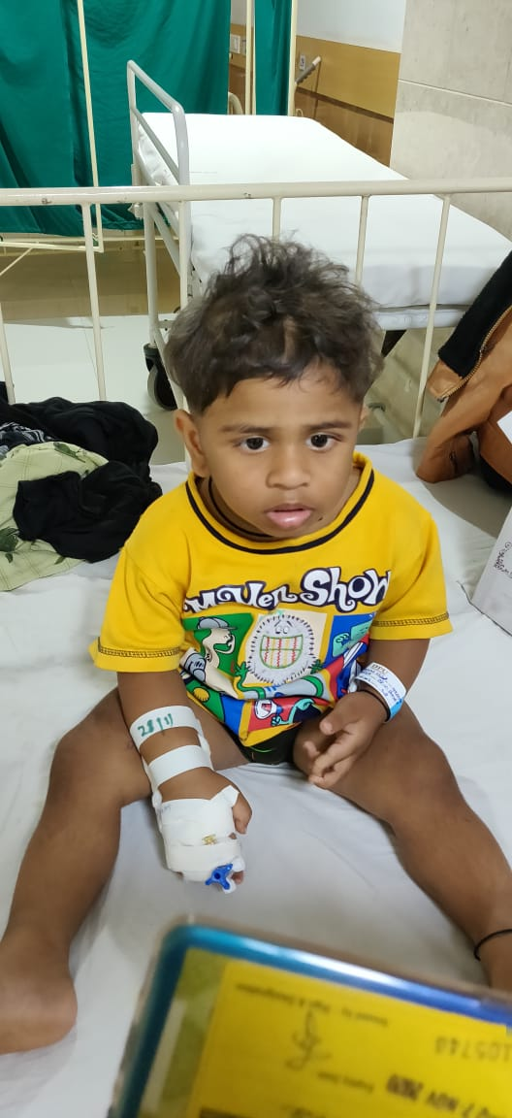
CLINICAL PHOTO

Slide 4
CLINICAL PHOTO

Slide 5
HORMONE PROFILE
17 hydroxy progesterone- 9.41 (HIGH)
TSH- 0.68
Beta HCG- 5
DHEA- 1401 (HIGH)
Testosterone- 2169.6 (HIGH)
Cortisol- 13.6

Slide 6
ENDOCRINOLOGIST TREATMENT
Inj hydrocortisone 100mg/m2 stat
thereafter
Inj hydrocortisone 25mg/m2 in 4 divided doses

Slide 7
RADIOLOGICAL WORKUP
USG-A+P- 6*4CM mass in right supra renal fossa ? Supra renal mass
CECT-5.7*3.7 cm heterogeneous enhancing mass in Rt supra renal fossa
Rt adrenal is not separate
No obvious calcification or necrosis
Impression: Rt suprarenal active androgen secreting adrenal tumour

Slide 8
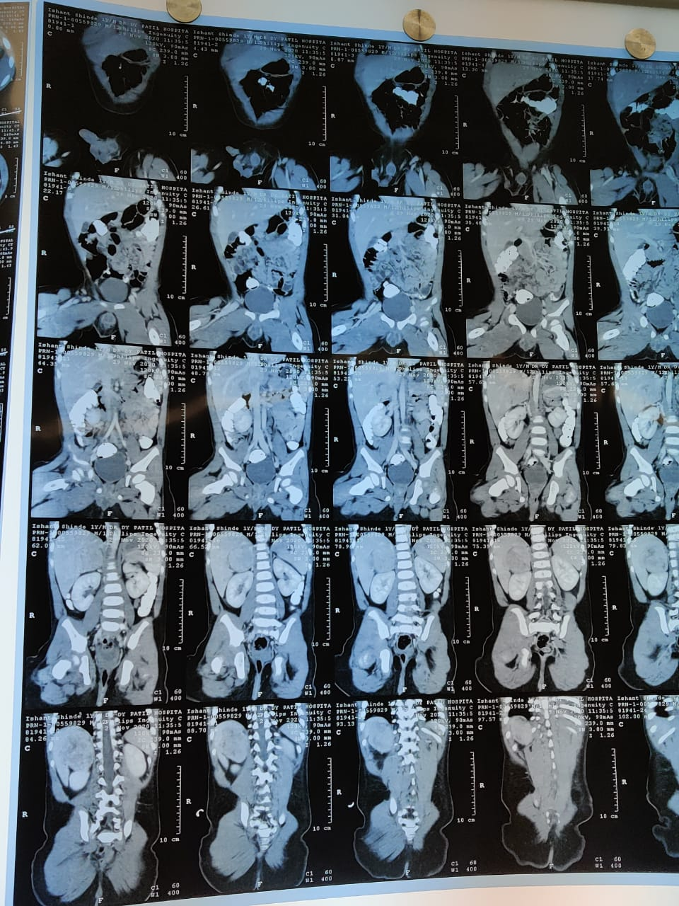
CECT

Slide 9
SURGICAL MANAGEMENT
Exploratory laparotomy with WLE of the tumour
Findings-
Tumour encased in the gerotas fascia on rt.
Abutting the superior pole of kidney
In close proximity to the liver and biliary tree
Large draining vessels
Para aortic enlarged lymph node also excised
Tumour Excised in toto

Slide 10
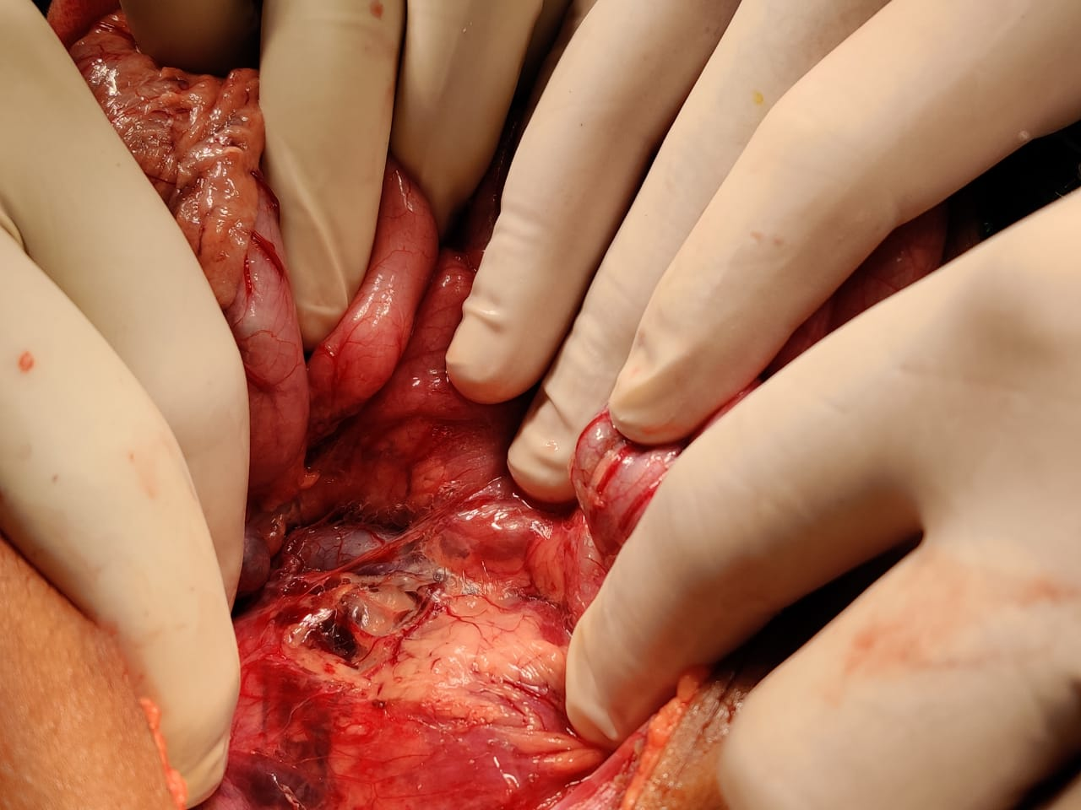
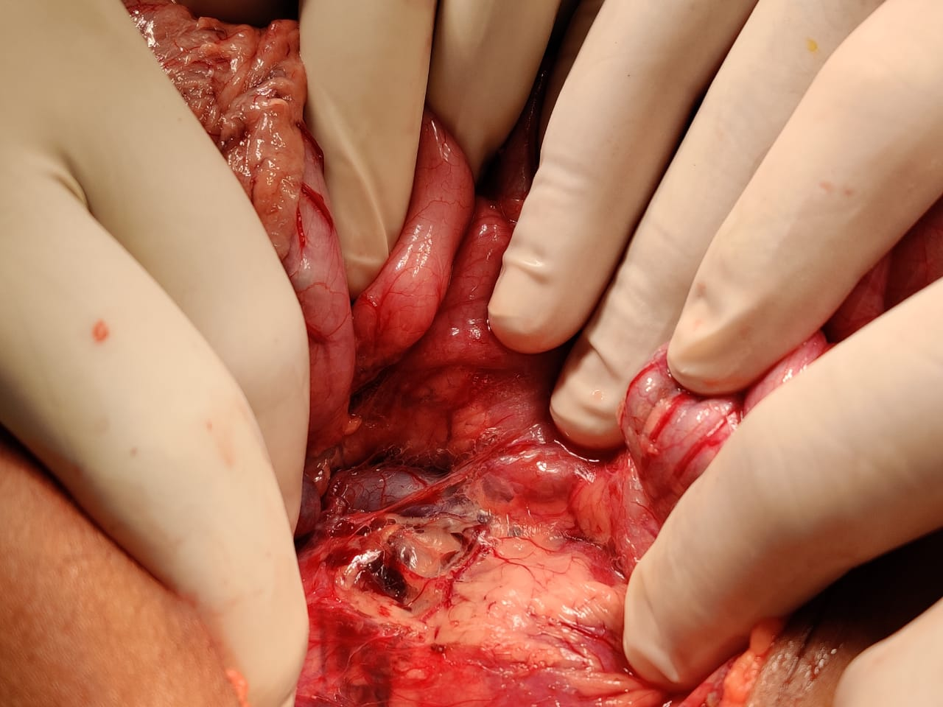
INTRAOPERATIVE PHOTOS

Slide 11
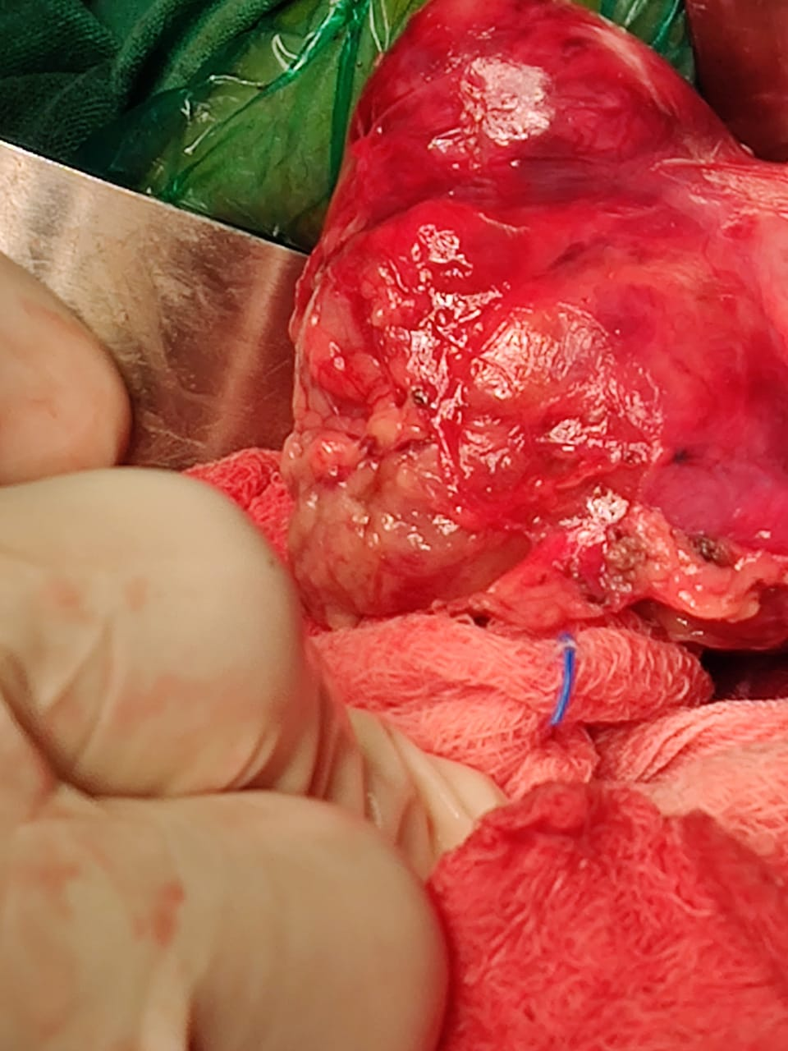
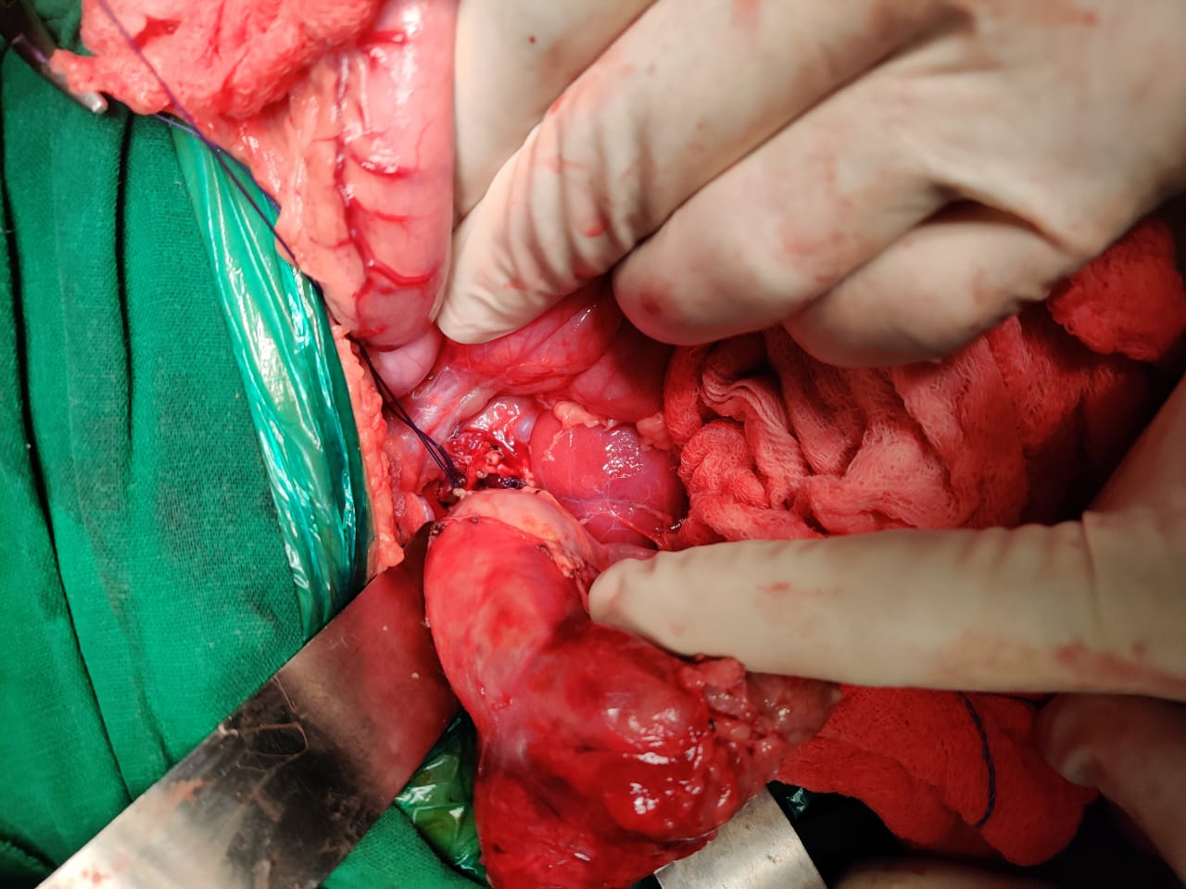
INTRAOPERATIVE PHOTOS

Slide 12
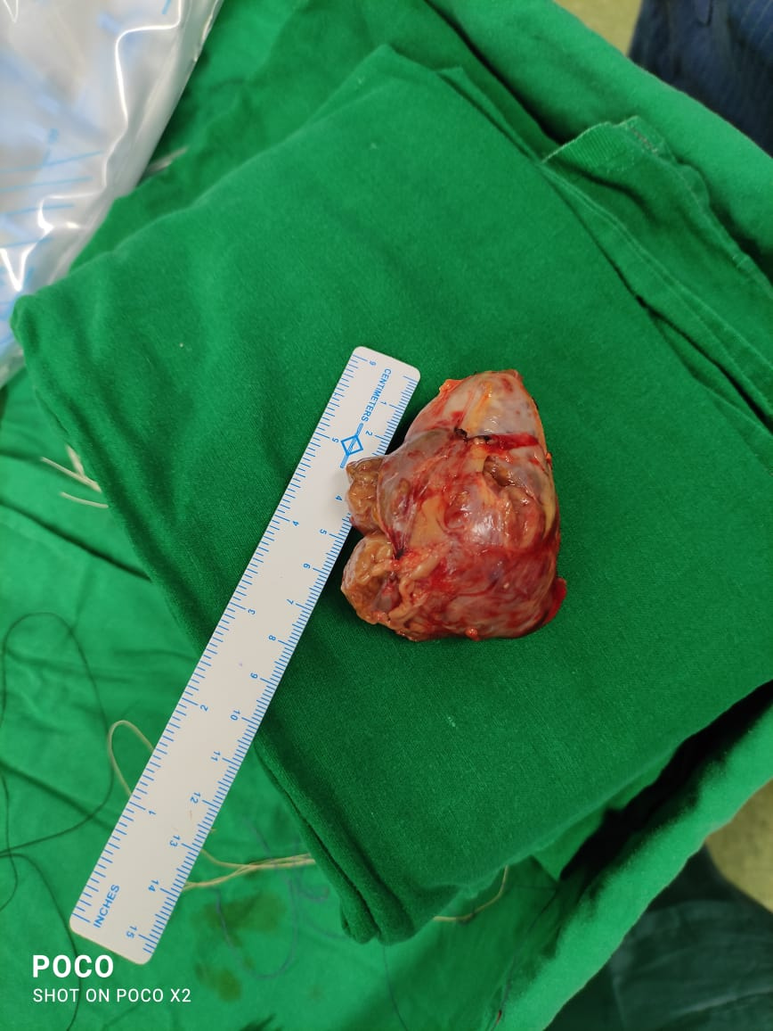
TUMOUR SPECIMEN

Slide 13
HISTOPATHOLOGY
The modified Weiss criteria are employed to distinguish the benign from the malignant tumors.
Vascular invasion- 0 (absent)
Mitotic rate- 0 (absent)
Clear cells- 2 (< 25%)
Necrosis- 1 (present)
Abnormal mitosis -0 (absent)
Capsular invasion-0 (absent)
Total score- 3 (ACC)

Slide 14
POSTOPERATIVE MANAGEMENT
Patient treated in PICU
Started on orals in 4 days
Kept on hydrocortisone postoperatively
Discharged on day 9 postop on hormone supplements
Advised PET scan
Advised postoperative chemotherapy

Slide 15
DISCUSSION
Adrenocortical tumours (ACT) are a rare but important cause of virilisation in infancy and childhood.
They have incidence of one to two cases per million population and are still more rarer in the pediatric age group.
Adrenocortical carcinomas can be functional or may be unassociated with syndromes of hormone overproduction.
It is very important to differentiate an adrenocortical adenoma from a carcinoma, as both share a large number of phenotypic features, and assess their prognosis, as adrenocortical carcinoma may need an adjuvant therapy.

Slide 16
DISCUSSION
Adrenocortical carcinoma (ACC) and adrenocortical adenoma are the two ends of a spectrum that need to be differentiated.
These carcinomas are also seen with increased frequency in children with the Li-Fraumeni syndrome, Beckwith-Wiedermann syndrome, and congenital adrenal hyperplasia.
A slight preponderance in the female population has been noted.
Virilizing adrenal carcinoma is a very rare entity.
Grossly, carcinomas, as compared to adenomas, are large and weigh more than 100 g and associated with symptoms of marked hormone overproduction, is to be considered malignant with poor prognosis.

Slide 17
DISCUSSION
All adrenocortical carcinomas are highly malignant tumors, and hence, they need to be resected.
Surgery is the single most important procedure for the successful treatment of ACC.
The role of chemotherapy in the management of childhood ACC has not been established.
Mitotane, an insecticide derivative that produces adrenocortical necrosis, has been extensively used in adults with ACC, but its efficacy in children who highlight a case of virilizing adrenocortical carcinoma, a very aggressive tumor, which is very rare in the pediatric age group and requires surgery, is not known.

Slide 18
ACKNOWLEDGEMENTS
Dr. Pranav Jadhav –HOD, Professor Pediatric Surgery
Department of Pediatric Surgery
Department of Pediatrics and Endocrinology
Department of Anesthesia

Slide 19
QUESTIONS

Slide 20
THANK YOU!

