Slide 1
Neurological Manifestations Of covid-19 infection in children
Dr. Shiji Chalipat
Associate Professor
Pediatric Neurologist
Department of Pediatrics
Dr. D.Y.Patil Medical College & Hospital, Pune
Dr. Khushboo Khubchandani
Fellow Pediatric Neurology
Department of Pediatrics
Dr. D.Y.Patil Medical College & Hospital, Pune

Slide 2
Introduction
Coronavirus disease 2019 (COVID-19) is a potentially serious condition caused by a novel coronavirus- the “severe acute respiratory syndrome coronavirus-2 (SARS-CoV-2)”.
COVID-19 infection is most commonly characterized by respiratory system involvement.
Subsequently, neurological manifestations have been reported in many cases, seen more often in adult patients than pediatric patients. The reported prevalence is 36.4% in adults and 1% in children.
Favas, T.T., Dev, P., Chaurasia, R.N. et al. Neurol Sci 41, 3437–3470 (2020) ; Boronat S (2021) Front. Neurol. 11:613832.

Slide 3
Introduction
We had 60 pediatric cases of Covid-19 infection, of which 20 patients had neurological manifestations.
The spectrum of neurological manifestations of Covid-19 infection is broad, and includes both, CNS & PNS involvement.

Slide 4
pathophysiology
The main host-cell receptor of SARS-CoV-2 is angiotensin-converting enzyme 2 (ACE2).
Given that ACE 2 is expressed in both neurons and glial cells, direct viral invasion of the central nervous system (CNS) is a possible mechanism for neurological manifestations of COVID-19.
More recently, an immune-mediated neurological syndrome has also been proposed, and many cases reported subsequently.

Slide 5
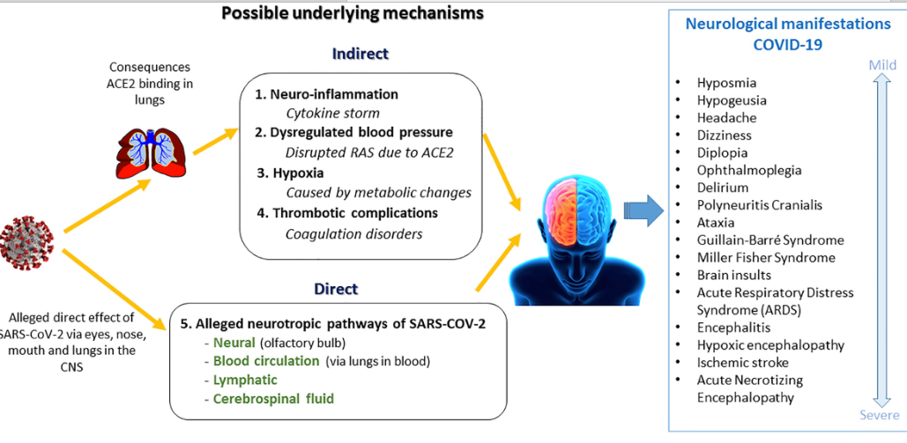
Wenting A, Gruters A, v and Neurological Manifestations and Underlying Mechanisms: A Scoping Review. Front. Psychiatry 11:860.

Slide 6
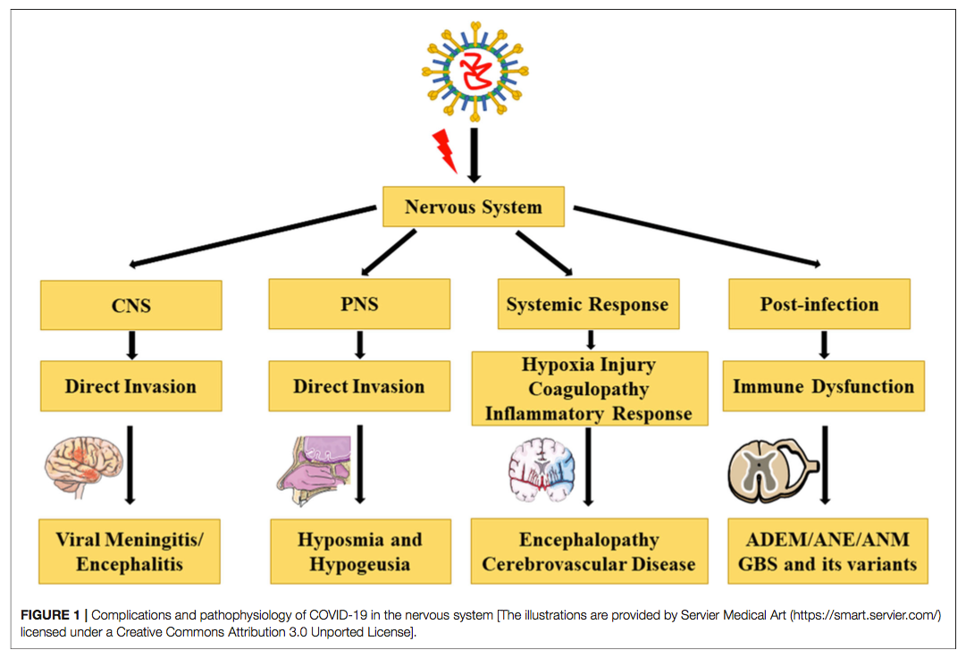
Yu H, Sun T and Feng J (2020) Complications and Pathophysiology of COVID-19 in the Nervous System. Front. Neurol. 11:573421.

Slide 7
We describe a series of twenty Covid-19 patients who presented with neurological manifestations.

Slide 8
pattern of presentation
1. Acute Neurological Manifestations
Seizures
Febrile Encephalopathy
2. Immune mediated neurological presentations/ para-infectious complications
LMN Facial palsy- Bell’s palsy
Mild Encephalopathy with Reversible Splenial Lesion (MERS)
Anti-MOG antibody syndrome with optic neuritis & transverse myelitis

Slide 9
Distribution of cases
Seizures – 9
Simple febrile seizures - 3
Febrile status epilepticus - 4
Unprovoked seizures - 2
Febrile encephalopathy – 6
TOTAL CASES- 20
Postcovid demyelinating syndromes – 5
LMN Facial palsy – Bells palsy - 1
Mild Encephalopathy with Reversible Splenial lesion ( MERS) - 2
Anti-MOG antibody syndrome with optic neuritis and transverse myelitis - 2
ACUTE- 15
DELAYED-5

Slide 10
DETAILS OF CASES WITH SEIZURES( 9 CASES)
PRESENTATION | CASE | AGE/GENDER | CONTACT WITH COVID | COMORBID CONDITIONS | EXAMINATION
SIMPLE FEBRILE SEIZURES -3 | CASE 1 | 2Y/M | NO | NO | NORMAL
 | CASE 2 | 1.5Y/M | NO | NO | NORMAL
 | CASE 3 | 2Y/M | NO | NO | NORMAL
FEBRILE STATUS EPILEPTICUS – 4 | CASE 4 | 2.5 M/ F | YES | NO | NORMAL
 | CASE 5 | 4Y/F | NO | NO | NORMAL
 | CASE 6 | 5Y/M | NO | NO | NORMAL
 | CASE 7 | 10 Y /M | NO | NO | NORMAL
UNPROVOKED SEIZURES – 2 | CASE 8 | 7Y/F | YES | NO | NORMAL
 | CASE 9 | 10Y/M | NO | YES | NORMAL

Slide 11
PRESENTATION | CASE | cbc | CRP | d-dimer | ferritin | csf | eeg | MRI BRAIN | MANAGEMENT | OUTCOME
SIMPLE FEBRILE SEIZURES | CASE 1 2Y/M | Hb-11, tlc-6500, 60%n, plat.-1.6 lac | 0.3 | 109 | 116 | not done | not done | not done | supportive | Good
 | CASE 2 1/5Y/M | Hb-9.6, tlc-12500, 68%n, plat.-2.8 lac | 5.8 | 51 | 89 | not done | not done | not done | supportive | Good
 | CASE 3 2Y/M | Hb-12.8, tlc-3500, 36%n, plat.- 96000 | 4.5 | 368 | 82 | not done | not done | not done | supportive | good
FEBRILE STATUS | CASE 4 2.5 M/F | Hb-9.6, tlc-12500, 68%n, plat.-2.8 lac | 5.8 | 351 | 90 | normal | BACKGROUND SLOWING | NORMAL | Aeds symptomatic | good
 | CASE 5 4 Y/ F | HB-10.4, TLC-12200 , 78%N PLAT-1 lac | 7.3 | 676 | 1520 | not done | normal | normal | Aeds symptomatic | good
 | CASE 6 5Y/M | HB-16, TLC-41000 , 60%N PLAT-58,000 | 29.6 | 19,980 | 18,239 | NOT DONE | NORMAL | NORMAL | Aeds symptomatic | good
 | CASE 7 10Y/M | HB-16, TLC-41000 , 60%N PLAT-58,000 | 24.4 | 8,980 | 7,988 | NORMAL | NORMAL | normal | Aeds symptomatic | GOOD

Slide 12
PRESENTATION | CASE | cbc | CRP | d-dimer | ferritin | csf | eeg | MRI BRAIN | MANAGEMENT | OUTCOME
UNPROVOKED SEIZURES – 2 | CASE 8 7Y/F | Hb-9.8, tlc-4800, 58%n, plat.-1.5 lac | 2.8 | 89 | 88 | NOT DONE | NORMAL | NORMAL | AED, SYMPTOMATIC | GOOD
 | CASE 9 10Y/M | Hb-11, tlc- 3600, 46%n, plat.-1.8 lac | 1.9 | 94 | 122 | NOT DONE | ABNORMAL | CHANGES OF HIE | AED, SYMPTOMATIC | GOOD

Slide 13
DETAILS OF CASES WITH FEBRILE ENCEPHALOPATHY - 6
CASE | AGE/GENDER | CONTACT WITH COVID | COMORBID CONDITIONS | EXAMINATION
CASE 10 | 5M/M | NO | NO | Encephalopathic, HYPOTONIA, BRISK DTR
CASE 11 | 5M/M | YES | NO | encephalopathic,HYPOTONIA, exaggerated dtr
CASE 12 Dengue with Covid-19 infection | 10 Y / M | NO | NO | encephalopathic, exaggerated dtr
CASE 13 | 3 Y / M | NO | developmental delay with dysmorphism with CONGENITAL HEART DISEASE | prolonged post-ictal drowsiness (24 hrs) f/b excessive irritability
CASE 14 | 12 Y / F | YES | NO | SE,comatose, with mods
CASE 15 MIS-C with pancreatitis, in a k/c/o Epilepsy | 10 Y/M | NO | KNOWN CASE OF EPILEPSY | Seizures with severe Tenderness of abdomen

Slide 14
CASE | cbc | CRP | d-dimer | ferritin | csf | eeg | MRI BRAIN | MANAGEMENT | OUTCOME
CASE 10 5M/M | Hb-9.8, tlc- 3000, 40%n, plat.-1.4 lac | 1.2 | 368 | 89.7 | NORMAL | NORMAL | NORMAL | supportive | NORMAL
CASE 11 5 M/ M | Hb-12.4, tlc- 5400, 55%n, plat.-1.9 lac | 1.7 | 165 | 72.8 | NORMAL | DIFFUSE SLOWING | NORMAL | supportive | NORMAL
CASE 12 10 Y/M | Hb-10.2, tlc- 3200, 76%n, plat.-1 lac | 37 | 982.6 | 651 | NORMAL | DIFFUSE SLOWING | NORMAL | supportive | NORMAL
CASE 13 3Y/ M | Hb-13, tlc- 4600, 64%n, plat.-2.2 lac | 35.2 | 723 | 362 | normal | NORMAL | NORMAL | SUPPORTIVE | NORMAL
CASE 14 12 Y/ F | Hb-3.5, tlc-2800, plat.- 88,000 | 27.5 | 884 | 694 | NOT DONE | NOT DONE | ct- diffuse cerebral edema | SUPPORTIVE, STEROIDS | DIED
CASE 15 | Hb-9.5, tlc-3500, plat.-1.1 LAC | 58 | 1058 | 1288 | NOTT DONE | RT. FOCAL ied | normal | supportive | normal

Slide 15
DETAILS OF CASES WITH IMMUNE MEDIATED NEUROLOGICAL PRESENTATIONS- 5
CASE | AGE/GENDER | CONTACT WITH COVID | RECENT HISTORY OF INFECTIION | CLINICAL PRESENTATION | COMORBID CONDITIONS | EXAMINATION
CASE 16 | 8 Y/F | NO | YES | Rt. Sided facial palsy | NO | lmn type rt. sided facial palsy
CASE 17 | 13 Y/F | NO | YES | vomiting, loose stools, irritability, GTCS-1 episode | NO | encephalopathic
CASE 18 | 12 Y / F | NO | YES | cough, cold, altered sensorium | NO | encephalopathic, RT. SIDED 3RD NERVE PALSY
CASE 19 | 5.5 Y / M | NO | YES | headache, acute painful loss of vision of rt. eye | NO | painful ocular movements, diminished collour vision, v/a- fc+, pappilitis
CASE 20 | 8 Y / F | NO | NO | acute painful loss of vision of left eye | NO | painful ocular movements, diminished colour vision, v/a- fc+, pappilitis

Slide 16
CASE | cbc | CRP | d-dimer | ferritin | VIT. D | csf | eeg | MRI BRAIN | DIAGNOSIS | MANAGEMENT | OUTCOME
CASE 16 8 Y/F | HB-11.6, TLC-5200 , 56%N, PLAT-1.8 lac | 18.6 | 562 | 478 | NOT DONE | not done | not done | not done | BELL’S PALSY | oral prednisolONE | partial improvement on discharg
CASE 17 13 Y/ F | HB-5.6, TLC-1200 ,78% N PLAT-60,000 lac | 30.7 | 1960 | 983 | LOW | normal | DIFFUSE SLOWING | restricted diffusion in splenium | MERS | MPS, oral prednisolONE | normal, blood counts were in improving trend on discharge
CASE 18 12 Y/F | HB-13.2, TLC-8400 , 68%N PLAT-2.2 lac | 35.2 | 2400 | 1423 | LOW | normal | not done | restricted diffusion in splenium | MERS | MPS, oral prednisolONE | NORMAL
CASE 19 5.5 Y/ M | HB-12.4, TLC-9200 , 56%N PLAT-1.5 lac | 3.1 | 434 | 96 | LOW | normal | NOT DONE, VEP ABNORMAL | rt. on with LETM | ANTI-MOG AB SYNDROME | MPS, oral prednisolONE | NORMAL
CASE 20 8 Y/ F | HB-10.4, TLC-8900 , 68%N PLAT-2.8 lac | 1.1 | 128 | 58 | NORMAL | normal | NOT DONE, VEP ABNORMAL | BILATERAL ON | ANTI-MOG AB SYNDROME | MPS, oral prednisolone+ IVIG | NORMAL

Slide 17
Clinical summary
Clinical characteristics
Age group – Mean age – 6.13 years
(2.5 months – 12 years)
Gender – Male – 14 (70%) ; Female – 6 (30%)
Contact with covid – only in 4 children
Delayed presentation – 4 out of 5 had fever and upper respiratory symptoms 10-14 days prior.
Time of presentation – acute- 15 and delayed – 5
Pre existing comorbid conditions – only 3 children
Commonest presentation- seizures, followed by encephalopathy

Slide 18
Clinical summary
Investigations
Raised inflammatory markers-10/20 cases fulfilling the criteria of MIS-C
Low Vitamin D- 4/13 cases
EEG- done in 13 , abnormal in 6 cases
MRI done in 16 cases, Abnormal in 7 cases.
Abnormal Neuroimaging patterns were- splenial hyperintensity, optic neuritis, transverse myelitis, cerebral edema.
Majority of children were given symptomatic treatment- including steroids & LMWH in MIS-C cases. The demyelination group was given steroids +/- IVIG.
Short-term outcome was good in all cases. Except one.
RT PCR positive - 11 cases, Covid antibodies positive - 9 cases
Management
Outcome

Slide 19
Discussion

Slide 20
Neurological involvement in children related to Covid-19 infection
Discussion
Acute presentation
Seizures and status epilepticus
Immune mediated neurological presentations or parainfectious complications
Bells palsy
Guillain Barre syndrome
ADEM
MERS
Optic neuritis
Transverse myelitis
Acute haemorrhagic necrotizing encephalopathy
Autoimmune encephalitis
Febrile Encephalopathy
Meningitis / Encephalitis
Stroke
Refractory status epilepticus

Slide 21
Discussion
Clinical characteristics
Youngest child in our cohort was 2.5 months. A case series from U.K. by Schupper et al has reported neurological manifestation in a 2 month old baby with MCA stroke who presented with refractory status epilepticus.
Males were more in our cohort (70%), but there is no specific age or gender predisposition seen as per literature.
Most of the affected children did not have any comorbidities, or pre-existing conditions, except three cases- two were known case of Epilepsy and one was a case of developmental delay.
This is similar to the reported cases, where most of the cases occurred in previously healthy children.
Lindan C.E et al ,The Lancet Child and Adolescent Health, 5 (3) , pp. 167-177

Slide 22
Discussion
Clinical characteristics
Our cases showed both, the acute and delayed neurological manifestations of Covid-19.
Delayed presentation were the cases of post-Covid demyelination, who were rt-PCR negative and Covid- antibody positive.
This is in accordance with the reported cases, where both, early and delayed manifestations have been reported.
Lindan C.E et al ,The Lancet Child and Adolescent Health, 5 (3) , pp. 167-177

Slide 23
Discussion
Investigations
Blood investigations showed raised inflammatory markers in 10/20 cases, suggestive of cytokine storm indicative of MIS-C (Multisystem Inflammatory Syndrome in Children).
One child had co infection with Dengue
Vitamin D levels were done in 13/20 cases; were low in 4 patients- 3 cases of delayed presentation and one case of febrile encephalopathy.
Low Vitamin D levels are itself risk factor for autoimmune neurological conditions, and could have been possible aggravating factor in these cases.
Abdel-Mannan et al. JAMA Neurol. 2020;77(11):1440–1445.

Slide 24
Discussion
CSF was done in 10/20 cases, and was normal in all of them, which is similar to the reported cases in literature.
EEG was done in 13/20 patients – 6 patients had abnormal EEG in the form of diffuse slowing of background activity especially in children with febrile encephalopathy. This is in accordance with the reported literature.
Abdel-Mannan et al. JAMA Neurol. 2020;77(11):1440–1445.

Slide 25
Discussion
Neuroimaging
Neuroimaging was done in 16 cases, out of which 10 cases had normal imaging, which included cases presenting with febrile seizures and acute encephalopathy (except one, who had severe diffuse cerebral edema), and in case of facial nerve palsy.
Lindan C.E et al ,The Lancet Child and Adolescent Health, 5 (3) , pp. 167-177

Slide 26
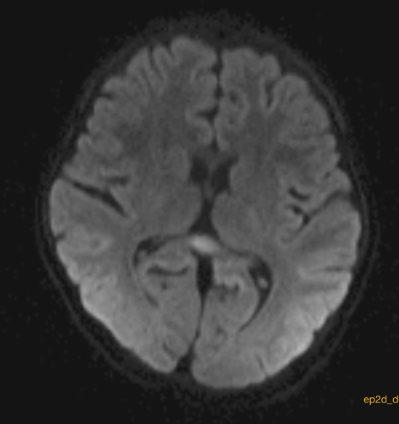
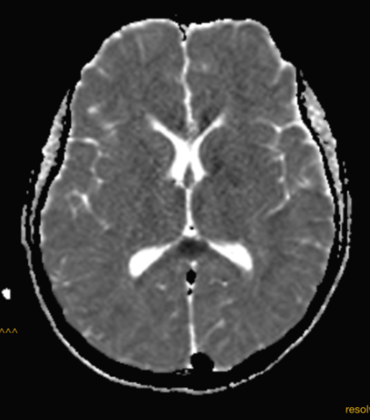
MRI brain DWI sequences showing hyperintensity in splenium of corpus callosum with diffusion restriction on ADC sequence.

Slide 27
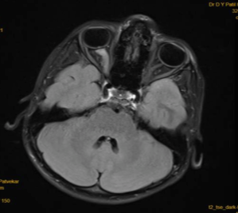
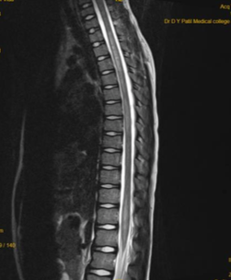
MRI brain T2 Flair showing
swollen right optic nerve
MRI spine T2WI saggital section showing
longitudinal extensive transverse myelitis

Slide 28
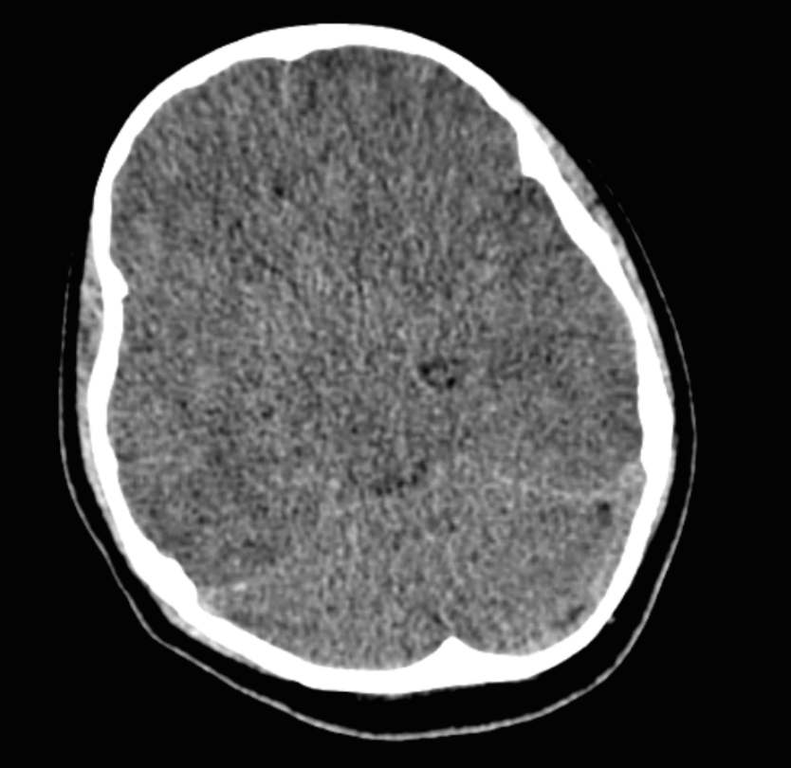
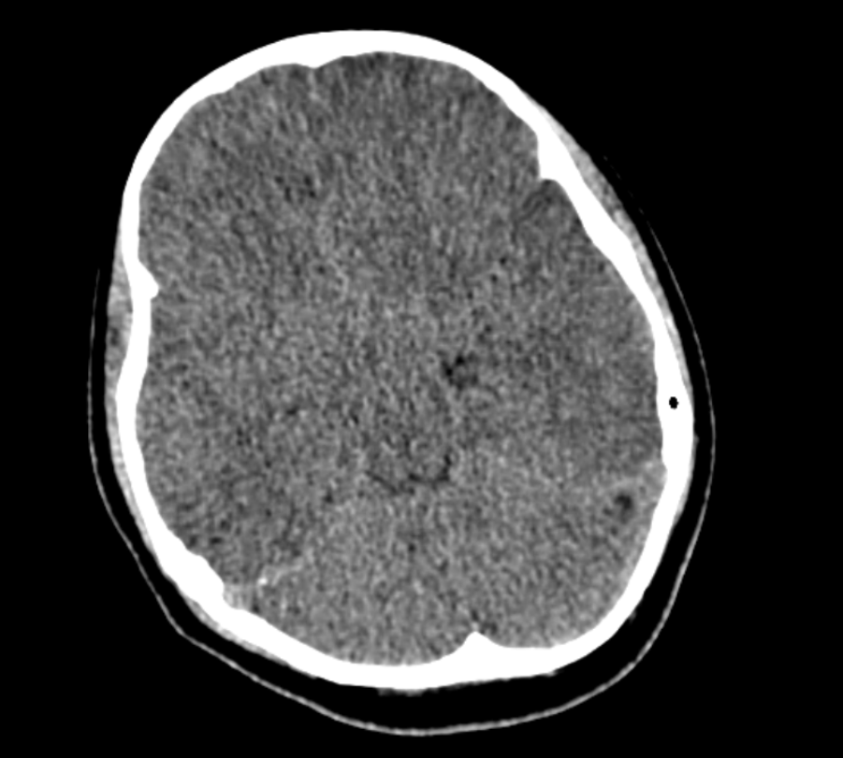
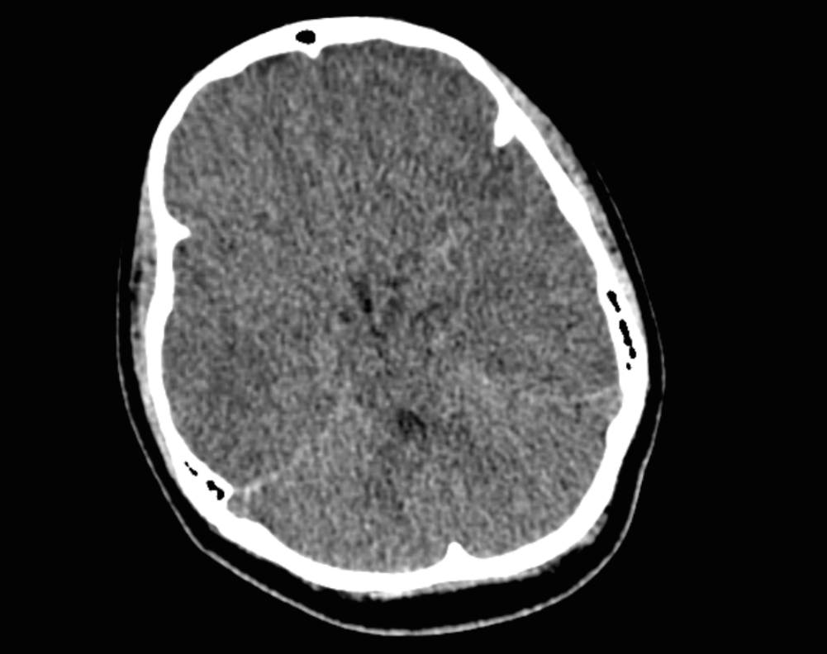
CT brain of patient with febrile encephalopathy showing loss of grey-white differentiation, with chinking of ventricles, sylvian fissure and cisterns, suggestive of severe cerebral edema

Slide 29
Published in The Lancet Child Adolescent Health in Dec. 2020
It was multicentre international study, which included children with encephalopathy related to severe acute respiratory syndrome coronavirus 2 (SARS-CoV-2) infection and abnormal neuroimaging findings.
38 children were included.
The most common imaging patterns were postinfectious immune-mediated ADEM like changes (16 patients), myelitis (8 patients), and neural enhancement (13 patients).
Splenial lesions (7 patients) and myositis (4 patients) were predominantly observed in children with multisystem inflammatory syndrome.
Cerebrovascular complications in children were less common than in adults. Significant pre-existing conditions were absent and most children had favourable outcomes.

Slide 30
Anti MOG ( Myelin Oligo dendrocyte ) antibody syndrome and covid
Adult case reports
Only one pediatric case reported by Vraka et al from Manchester – UK – presented as ADEM
Even though myelitis has been reported in children as post covid , they were not reported as part of anti MOG Antibody disease
No pediatric reports of anti MOG associated optic neuritis and myelitis till date

Slide 31
Discussion
Treatment included-
Symptomatic management- anti-seizure medications
Immunosuppressive therapy- Methyl prednisolone, followed by oral prednisolone +/- IVIG
Vitamin D supplementation- in deficient cases
Antibiotics, analgesics, LMWH, steroids (based on D-dimer & other inflammatory markers)

Slide 32
Discussion
Outcome
Short term outcome was good in all patients, except one child who died within 24 hours of presentation. Rest all cases showed symptomatic improvement, with improved sensorium and no residual weakness/deficits at the time of discharge.
Long-term outcome are yet to be assessed.
Lindan C.E et al ,The Lancet Child and Adolescent Health, 5 (3) , pp. 167-177

Slide 33
Sr.No. | Study | No. of patients (age group) | Symptoms | rt-PCR/Antibody | CSF | EEG | MRI | Outcome
1. | Mannan et a. July 2020 | 4 (8-15 y) | Encephalopathy, headache, brainstem signs, muscle weakness | -/+ | Normal (2 pts.) | Mild slowing of background | Splenial hyperintensity | Complete recovery
2. | Lakshman Raj et al 2020 | 3 (8 m-2 y) | SE, encephalopathy | +/- | Not done | Not done | Not done | good
3. | Schupper et al June 2020 | 2 (2 mo-5 yr) | SE, encephalopathy | 1 -/+ 2 +/- |  | 1- slowing 2- NCSE | MCA infarction, cerebral edema, SAH | died
4. | Burr et al Oct. 2020 | 1 (2 yr) | Fever, altered sensorium, extrapyramidal movements | +/+ | Anti-NMDR Ab + | Not done | Not done | good
5. | Decio et al Dec. 2020 | 1 (15 mo) | Rt. LMN Facial palsy | -/+ | Not done | Not done | Facial nerve enhancement | good

Slide 34
CONCLUSION
To conclude, neurological manifestations are increasingly being observed in Pediatric Covid-19 cases, ranging from headache, seizures to encephalopathy and demyelination.
Further insights are needed into the predisposing risk factors & pathophysiology, to take potential preventive measures.

Slide 35
THANKYOU

Slide 36
Tai-Heng Chen, Journal of the Neurological Sciences 418 (2020) 117096

Slide 37
Published in The Lancet Child Adolescent Health in Dec. 2020
It was multicentre international study, which included children with encephalopathy related to severe acute respiratory syndrome coronavirus 2 (SARS-CoV-2) infection and abnormal neuroimaging findings.
38 children were included.
The most common imaging patterns were postinfectious immune-mediated ADEM like changes (16 patients), myelitis (eight patients), and neural enhancement (13 patients).
Splenial lesions (7 patients) and myositis (4 patients) were predominantly observed in children with multisystem inflammatory syndrome.
Cerebrovascular complications in children were less common than in adults. Significant pre-existing conditions were absent and most children had favourable outcomes.

Slide 38
A case report of 15 month old girl with rt. peripheral facial nerve palsy, without any other neurological signs.
Covid-19 antibody positive, rt-PCR negative
patient was given oral prednisolone @ 1mg per kg per day for 6 days followed by taper.
Complete clinical resolution was noted.

Slide 39
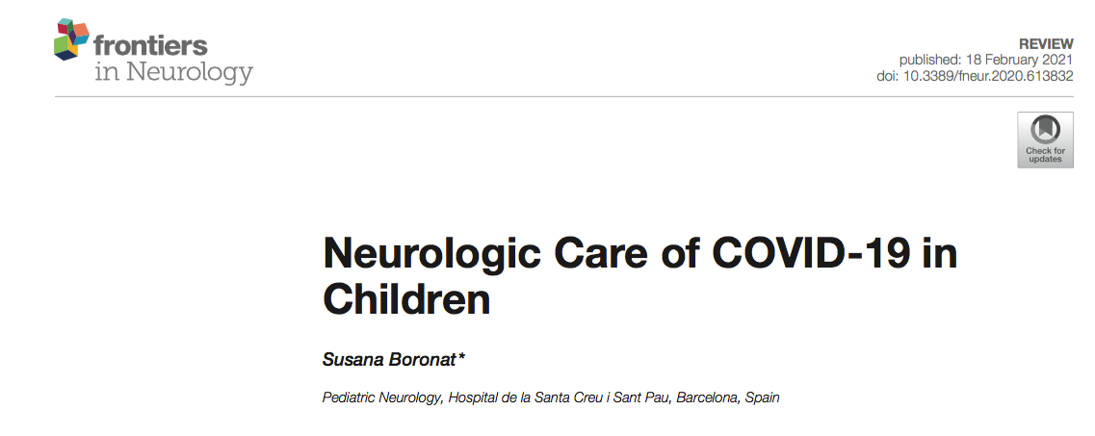
A systematic review- 21 studies
Neurological complications of SARS-CoV-2 infection in children are much less frequent than in adult population.
Around 16% of children show non-specific neurological symptoms as headache, while more severe and specific neurological complications occur only around 1% of cases.

Slide 40
Children with SARS-CoV-2 multisystem inflammatory syndrome are especially at risk for neurological complications.
Encephalopathy is the more frequent abnormality, sometimes with symptomatic seizures, and it is usually transitory, without long-term neurological sequelae.
In some patients, EEG and brain MRI show transient abnormalities, which usually resolve with time.

Slide 41
A case-series study
Patients younger than 18 years who presented with SARS-CoV-2 infection and neurological symptoms to Great Ormond Street Hospital for Children (London, UK) between March 1, 2020, and May 8, 2020, were included.
Of the 27 children with COVID-19 pediatric multisystem inflammatory syndrome, 4 patients (14.8%) who were previously healthy had new-onset neurological symptoms.
Symptoms included encephalopathy, headaches, brainstem and cerebellar signs, muscle weakness, and reduced reflexes.
Splenium signal changes were seen in all 4 patients on magnetic resonance imaging of the brain.
CSF studies was normal in all 4 cases. EEG showed miil slowing in 3 cases.Neurological improvement was seen in all patients, with 2 making a complete recovery by the end of the study.

Slide 42
The spread to CNS- direct/hematogenous
Direct spread and damage- via ACE2, NRP1 receptor, on olfactory nerves, neurons and glia
Hypoxic damage- Hypoxia induces an excessive accumulation of anaerobic metabolites in the mitochondria and acid metabolites in brain, leading to edema of the brain cells and obstruction of the cerebral blood flow. This may predispose to hypoxic encephalopathy and ischemic stroke.

Slide 43
Coagulopathy- Elevated D-dimer, FDPs, PT, aPTT.
The hypercoagulability seen in patients with COVID-19 may predispose to a stroke.
Inflammatory Response- coronavirus can induce proinflammatory cytokine signals from astrocytes and microglia cells, releasing a large amount of inflammatory factors such as IL-6, IL-12, IL-15, IL-1β, and TNF-α. This is one of the pathophysiological processes responsible for CNS damage caused by inflammatory factors.

Slide 44
Immune Dysfunction- Excessive unregulated cellular and humoral response.
Cellular Response- Peripheral CD4+ T and CD8+ T cell numbers are significantly reduced, although are in a hyperactivated state.
There are high concentrations of proinflammatory CCR6+ Th17 in CD4+ T cells and cytotoxic granules in CD8+ T cells, suggesting overactivation of T cells.
A significant and progressive decrease in the lymphocytes is considered a sign of severity.
Humoral Response- increased immunoglobulin G (IgG) response
This suggests that antibody-dependent enhancement (ADE) is present in SARS-CoV-2 infection, which can promote cellular uptake of virus–antibody complexes (virus- anti–S-IgG) , leading to enhanced invasion of the virus.
Activation of the immune cells in the brain may cause chronic inflammation and neurological damage- ADEM, ANE, ANM, and GBS and its variants.

