Slide 1
Choledochal cysts in children- A 5 year experience
Dr. Aniruddha Bhagwat MB, MS, MCh
Dept. Of Pediatric Surgery
Dr. D Y Patil Medical College Hospital and Research Center, PCMC, Pune

Slide 2
Nomenclature
Debatable.
Should they be called Cysts per se?
Or Choledochal malformations?

Slide 3
Clinical
Presentation
Uncommon
Older children 2-10 years
F>M
Abdominal mass
Jaundice
Pain +/-
Fever cholangitis
Spontaneous cyst rupture
Stone formation in cyst or G.B.
Infection – cyst wall inflammation, fibrosis, infection

Slide 4
Differential Diagnosis
Biliary calculi
CBD dilatation
Pancreatic cysts
Anomalous Pancreato-biliary dysjunction APBDJ
Pseudo-cysts and other intra abdominal cystic lesions.

Slide 5
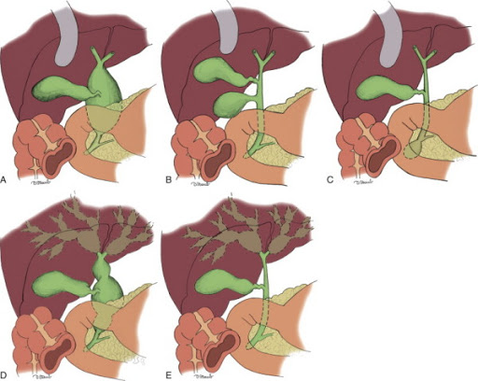
Todani Classification
I Dilatation of extrahepatic bile duct only
IA Cystic
IB Saccular
IC Fusiform
II Diverticulum
III Choledochocele
IV Intra and extra hepatic duct dilatation
IV a Intra and extrahepatic cysts
IV b Multiple extrahepatic cysts
V Caroli’s disease

Slide 6
Surgical Principles Treatment modalities
Early surgery
Complete cyst excision or complete excision of cyst mucosa
Absorbable sutures with knots on outside
Wide and adequate drainage of anastomosis
Complete cyst excision + P-D/
H-J with Roux en Y
+/- Lillie’s valve
Older Partial excision + C-D/ C-J
Laparoscopic
Robotic
ERCP with sphincterotomy
Liver Transplantation

Slide 7
Inflamed or infected cysts
Excessive bleeding
Hazardous dissection
Infection and fibrosis
Poor anastomotic healing
Anastomotic leakage
Stricture
Atrophy
Metaplasia
Polyps
Adenocarcinoma

Slide 8
Physiologic disturbances
PD more physiologic
Sphincter of Oddi bypassed and non functional. (HJ/PD)
G.B removed. (HJ/PD)
Storage of bile and release on stimulation by CCK-PZ
Biliary gastric reflux –dyspepsia, alkaline gastritis, erosions
Pancreato-biliary refux- anastomotic strictures, recurrent cholangitis, fever, jaundice
Biliary pancreatic reflux
Pancreatitis

Slide 9
December 2014 to January 2020
Age wise distribution | Choledochal Cysts | Incidence
Age | Number of cases | Incidence %
Less than 1 yr | 7 | 46.68
2 – 5 yrs | 4 | 26.66
6-10 yrs | 2 | 13.33
11-16 yrs | 2 | 13.33
15 cases of Choledochal cysts were operated
All were below 16 years age
CE + PD (6)
ERCP +sphincterotomy + stenting (1)
CE + HJ + Roux (8)

Slide 10
Investigations:
Hemogram
RFT
LFT
Coagulation profile
Urine RE
H-H-H markers
Covid 19 RT PCR
Stool RE
Chest X-ray
USG abdomen
CECT abdomen
MRCP
Tc99m Hepato-biliary scintiscan DISIDA
ERCP
Cholangiogram

Slide 11
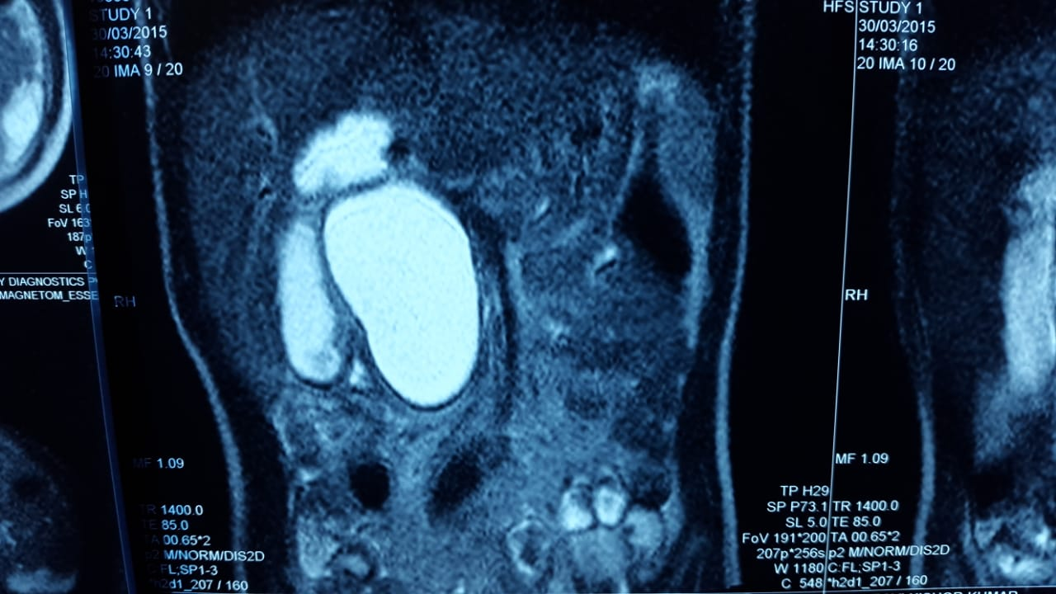
MRCP

Slide 12
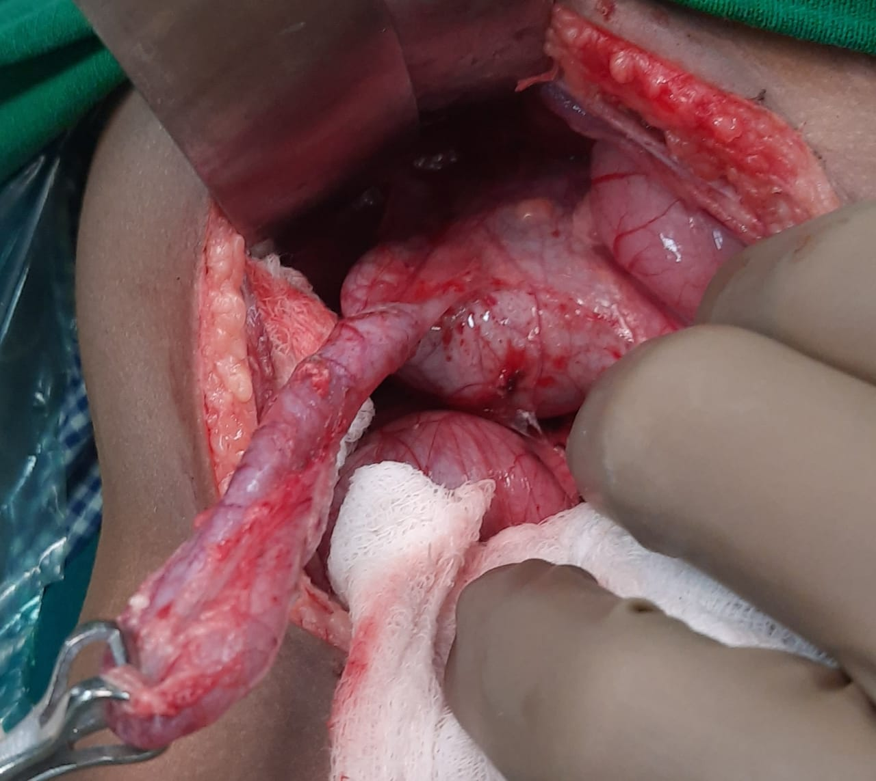
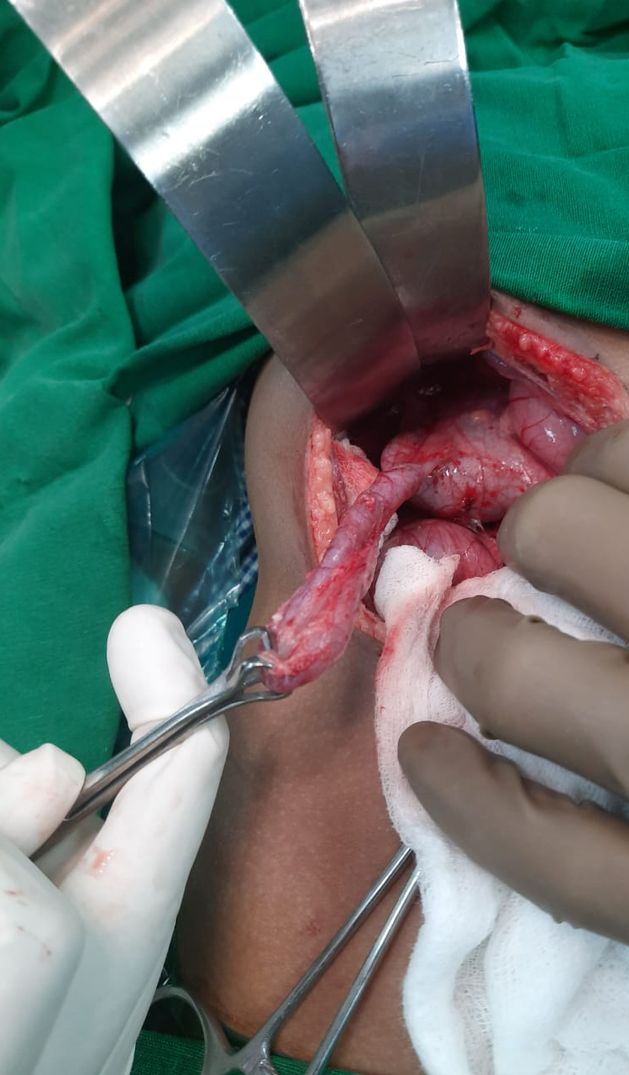
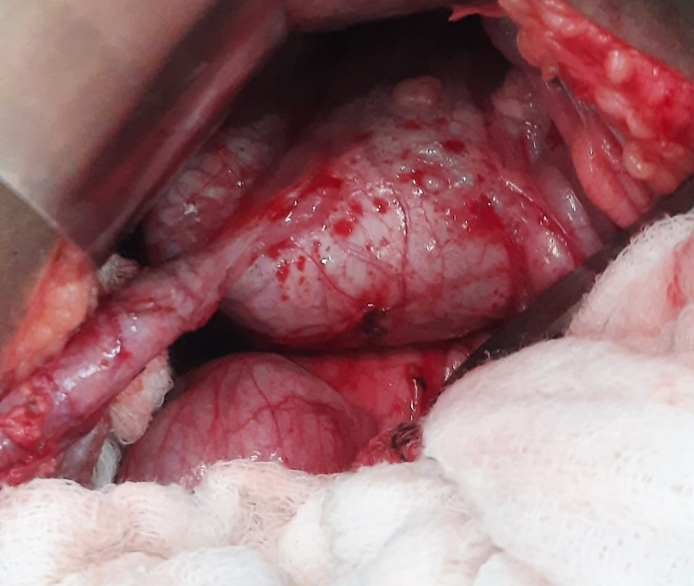
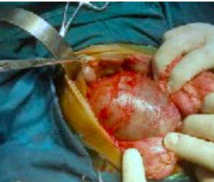
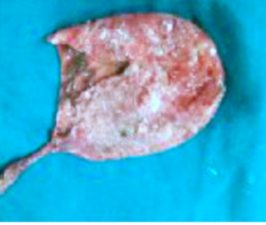

Slide 13
ERCP

Slide 14
Type 1 (12=80%) Type 5 excluded Type 2 (1 =6.67%) One case of type 3 excluded Type 4 (2 =13.33%) Left PVO, Portal HT, ?Forme fruste cyst with CBD diln, perforation, bile peritonitis
Results-
Complications-
Mean age at presentation 4.12+/- S.D.
M:F 1:1
Mean time to oral feeds 5 +/- 1d
Mean in-hospital stay 11 +/-3 d
Mean duration of ADK drain 5 d
Mean antibiotic Tx duration 7 +/-2 d
One anastomotic leak. Tx conservatively
One SSI
No deaths
No Haemorrahage
No Intestinal obstruction adhesions/kinking/mesenteric herniation/ intussusception Pancreatic injury pseudo-aneurysm

Slide 15
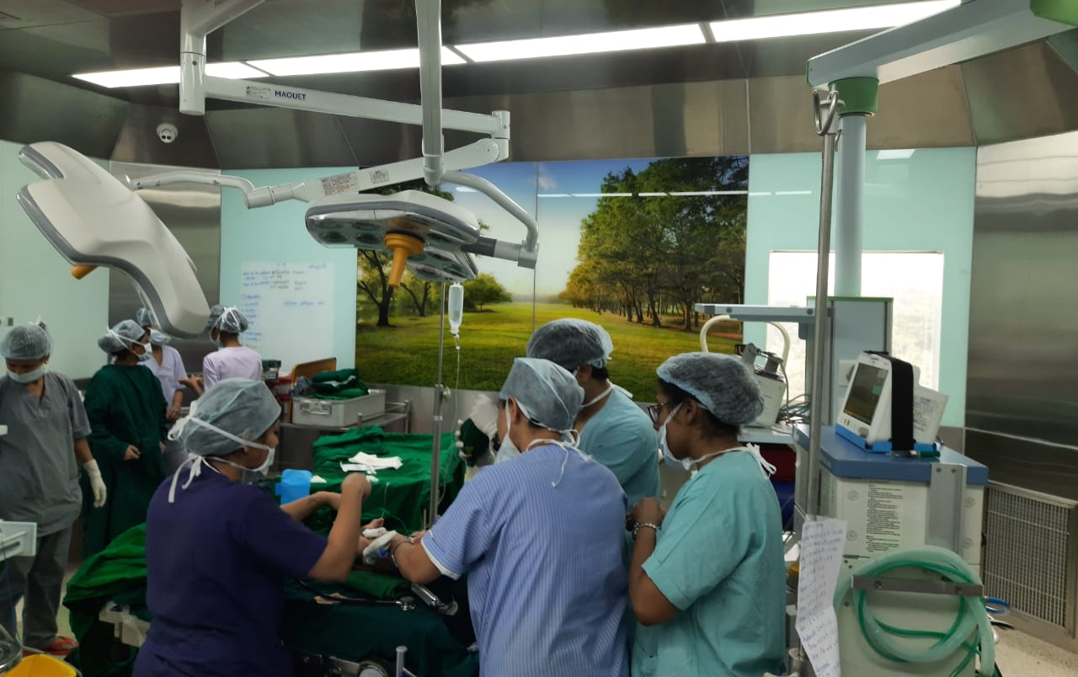
Thank you for patient listening.

