Slide 1
A RARE CASE OF MULTIPLE INTRACARDIAC MASSES IN A NEONATE

Slide 2
CLINICAL HISTORY
NEONATAL HISTORY:
A 4 day old term female child was referred to our hospital for post natal mechanical ventilation and for further management.
On admission, the baby was on:
Mechanical Ventilation:
SIMV (PC+PS)
FiO2: 30%
Pressures: 14/5
Respiratory Rate: 32/min
SPO2 96%

Slide 3
VITALS AND OTHER PARAMETERS:
HR 150/min. (120-160/min)
BP: 60/40 mm of Hg (systolic: 60-90, diastolic: 20-60)
BSL: 75mg/dL (45-126mg/dL)
Urine passed
Stools passed
MATERNAL HISTORY:
A 24 year old female, G3P2L1A1 married since 8years, delivered a healthy female child 7 years ago and had 1 spontaneous abortion 5 years ago.

Slide 4
During the present pregnancy (LMP: 20th august,2020) serial antenatal USG scans were done.
USG 1 (10weeks of gestation) – NAD
USG 2 (18weeks) – NAD
USG 3 (25weeks) – NAD
USG 4 (30weeks) - Multiple focal round homogenous echogenic masses, largest measuring 8X6.5mm in rt atrium were seen.
Provisional diagnosis: Multiple Cardiac Rhabdomyomas

Slide 5
Foetal 2Decho (38weeks): revealed increase in size of the tumours
She delivered a term female child weighing 2400g at birth (LBW) by LSCS on 29/05/2021.

Slide 6
PERINATAL EVENTS:
Baby had no signs of spontaneous ventilation and also developed peripheral cyanosis.
Spontaneous respiration was assumed after 1minute of PPV.
Baby was shifted to NICU i/v/o Respiratory distress and taken on BIPAP.
The patient was then shifted to our hospital and taken up for emergency open heart surgery.

Slide 7
LAB INVESTIGATIONS
Hb: 12 g/dL (11-17.3g/dL)
TLC: 8500/µL (3.1-21.6/µL
Platelet Count: 42000/dL (1,50,000-4,50,000/dL)
Blood group: A negative
T.Bilirubin: 14.98µmol/L ( 5-17 µmol/L)
SGOT: 38 IU/L (5-40 IU/L)
SGPT: 16 IU/L (5-40 IU/L)
ALP: 126 IU/L (35-130 IU/L)
Na+: 134 (139-162 mEq/L)
K+: 5 (5.0-7.7 mEq/L)
Cl-: 94 (93-112 mEq/L)
Serology (HIV/HBsAg/ HCV): Non-reactive
PT: 14.10 (10.6-14.19)
INR: 1.15 (0.89-1.16)
aPTT: 30.50 (20.40-33.87)

Slide 8
2D ECHO
T1: Large left atrial mass 12X13mm attached to Posterior Mitral Leaflet, flopping between Left Atrium and Left Ventricle
T2: 6mm mass attached to lateral papillary muscles
T3: 9X7mm mass filling Right Ventricular apex, likely bigger and infiltrating the myocardium
T4: 4mm mass attached to the lower Intraventricular septum over the right ventricular surface
T5: 8mm mass attached to Intra-atrial septum over the right atrial surface

Slide 9
Multiple cardiac masses with largest obstructing the mitral valve.
Small ASD
Dilated pulmonary arteries, left atrium and left ventricles

Slide 10
Pt was taken up for Emergency Open Heart Surgery for Tumour excision + ASD closure.
The tumours excised were sent to the Department of pathology for HPE.

Slide 11
GROSS FINDINGS
Five, well circumscribed, grey white soft tissue masses
Ranging from 0.4 to 1.4cm

Slide 12
10X

Slide 13
10X

Slide 14
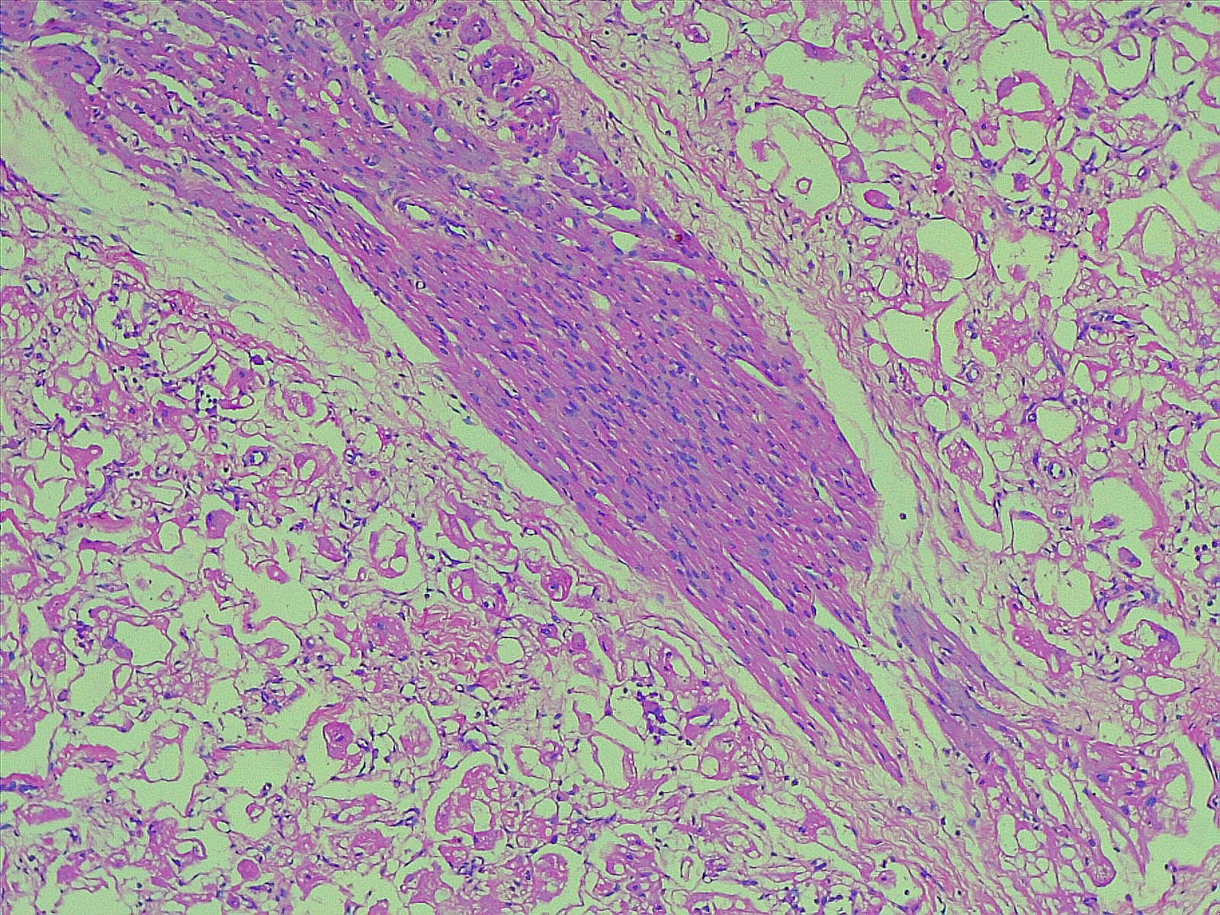
10X

Slide 15
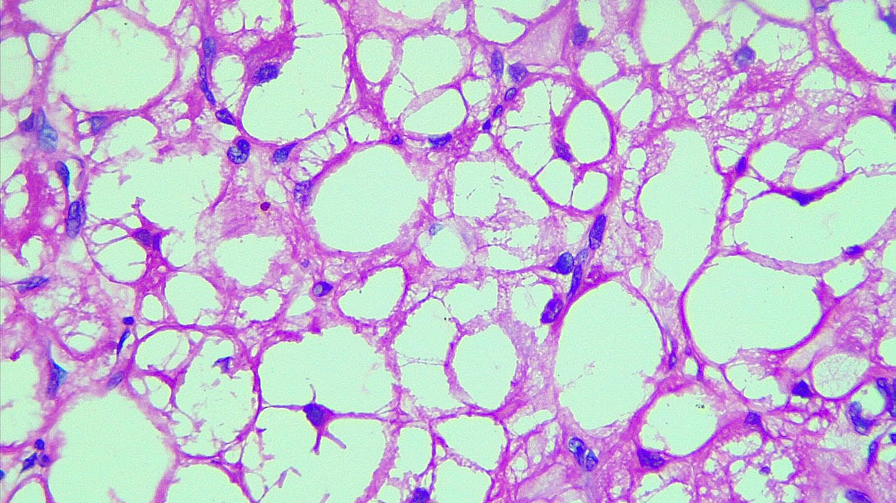
40X

Slide 16
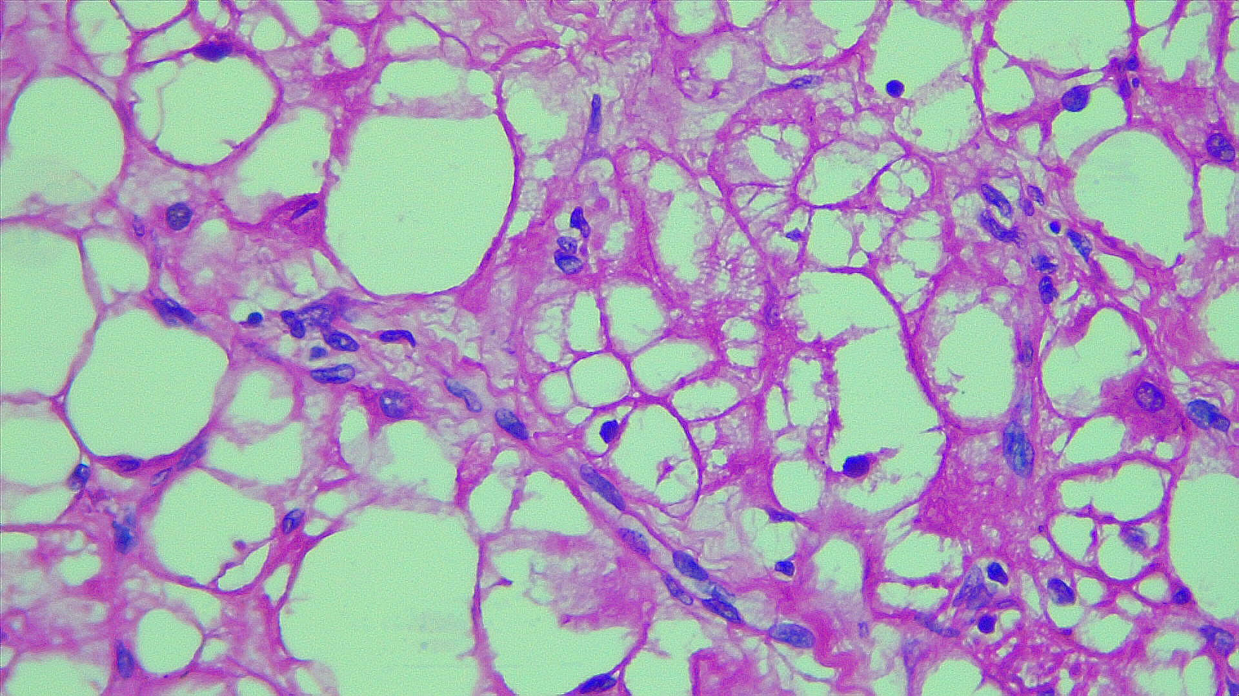
40X

Slide 17
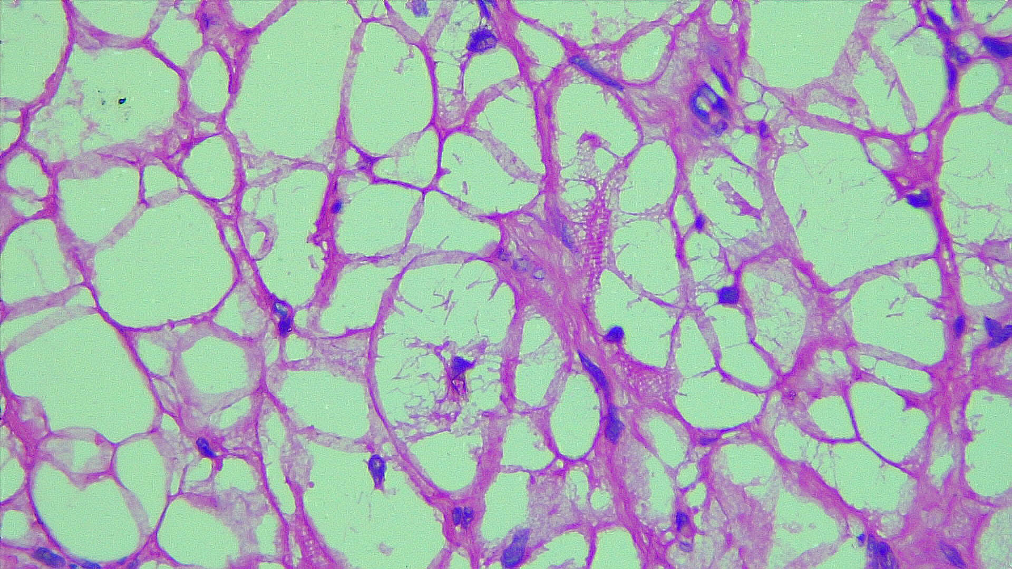
40X

Slide 18
FINAL DIAGNOSIS
MULTIPLE INTRACARDIAC RHABDOMYOMAS

Slide 19
DISCUSSION
Foetal cardiac tumours are rare, occurring in 0.08-0.2% of pregnancies.
Most of them are diagnosed within the first year of life and can be diagnosed in the antenatal (Gestational age at diagnosis ranges from 21-38 weeks) as well as in the post natal period.
About 90% are benign.
Cardiac rhabdomyoma is the commonest cardiac tumour (60% of cardiac tumours), followed by fibromas (25-30%)

Slide 20
CARDIAC RHADOMYOMA:
Rhabdomyoma is a benign tumour of striated myocytes.
C/F : Depending upon the location (V>A>IVS>IAS) and dimension of the tumor; symptomatic presentation is variable including :
Hydrops
Cardiac murmurs
Cyanosis
Arrythmias
Hemodyanamic compromise

Slide 21
Imaging :
2D Echo → Cardiac rhabdomyomas show a homogenous echogenicity different from that of other cardiac masses.
Cardiac MRI → On T1 weighted images, signal characteristics are almost identical to those of the normal myocardium. On T2 weighted images, their signal intensity is increased.

Slide 22
Etiology :
Reportedly, 70-90% cardiac tumours are found to have close association wit tuberous sclerosis.
TS is an autosomal dominant condition is associated with two genes – TSC1 (tuberin) and TSC2 (hamartin).
A smaller proportion occurs sporadically or in association with congenital heart disease.
Pathogenesis : Rhabdomyoma is a lesion of striated cardiac muscle without proliferative activity, and is as such considered to be hamartoma of the embryonic cardiac myoblasts.

Slide 23
Macroscopic appearance :
Well circumscribed, typically multiple, white to yellow masses.
Variable size (ranging from 1 to 10 cm)
Microscopic appearance :
Well delineated nodules.
Cells are large, round to polygonal in shape with clear cytoplasm
Spider cell appearance- Pathognomonic feature
Mitotic activity is absent
Fibrosis and calcification are rare

Slide 24
SPECIAL STAINS AND IMMUNOHISTOCEMISTRY:
PAS stain highlights abundant glycogen in the tumour cells
IHC markers include: Actin,
Desmin
Myoglobin
Tuberin
Hamartin

Slide 25
OTHER TECHNIQUES FOR DIAGNOSIS:
ELECTRON MICROSCOPY: Intercalated disc like structures around the periphery, with abundant glycogen and a decreased number of mitochondria
DIFFERENTIAL DIAGNOSIS:
Glycogen storage disease
Histocytoid cardiomyopathy

Slide 26
MANAGEMENT and PROGNOSIS:
The natural history of cardiac rhabdomyomas is of complete or partial regression with consequent resolution of symptoms. Tumours increase in size until 32weeks of gestation and then regress progressively.
Most patients can be managed conservatively, which includes:
Frequent monitoring
Anti-arrhythmics
Unresectable rhabdomyomas with TS may be treated with Everolimus, an mTOR pathway inhibitor

Slide 27
The prognosis of the patients is chiefly determined by the size and location of the tumours. Large tumours (>20mm) may cause severe haemodyanamic compromise or persistent arrhythmias and thus necessitate surgical excision.
Orthotropic cardiac transplantation is indicated in infants of rhabdomyoma with severe myocardial ischemia.

Slide 28
CONCLUSION
Cardiac rhabdomyomas are benign from the cardiovascular standpoint in most affected foetuses.
An early prenatal diagnosis may help for an adequate planning of perinatal monitoring and treatment with involvement of a multi disciplinary team.
The association of tuberous sclerosis with cardiac rhabdomyomas raises important questions on the quality of life for neonates surviving tumour resection. Termination of pregnancy should be considered when TS is detected during prenatal check-ups.
However in our case, the baby died 4 hours post-op due to cardiac failure and thus could not be evaluated further.

Slide 29
REFERENCES
Rosai and Ackerman Surgical Pathhology-11th edition
WHO Classification of Thoracic Tumours- 5th edition
Enzinger and Weiss’s Soft Tisuue Tumours- 7th edition
Cardiac rhabdomyoma with tuberous sclerosis: a case report by Sefa Kelekci , H Fehmi Yazicioglu
Prenatal diagnosis of cardiac rhabdomyoma, a case report by Anaya-Reyes P, Rodríguez-Rábago MJ
Accelerated regression of cardiac rhabdomyoma by mTOR inhibitors in a neonate with heart failure: A case report by Krishna Prasad

Slide 30
THANK YOU

