Slide 1
An interesting case of sellar mass
By: Dr Neha Agarwal
Guide: Dr C R Gore

Slide 2
Clinical presentation
43 year old male presented with chief complaints of visual disturbances in the right eye since 1 month.
Associated with occasional frontal headache.
No h/o HTN, Thyroid disorder.
No h/o chest pain, dyspnoea on exertion/palpitation.
No h/o limb weakness/slurring of speech/seizures/vertigo.
Newly diagnosed Type 2 Diabetes Mellitus.

Slide 3
O/E:
Coarsening of facial features/ Acromegaly (+)
Temporal hemianopia in Right eye (+)
VITALS
BP - 132/84 mmHg
PR - 88 b/min
SpO2 - 99%RA
Temp - Afebrile

Slide 4
S/E
PA - Soft, non tender
CVS - S1S2 heard
RS - NAD
CNS – conscious, oriented, power and tone was normal
On Diagnostic Nasal Endoscopy(DNE)- Hypertrophied mucosa, B/L middle and inferior turbinate hypertrophy (+), and sphenoid sinus could not be visualized.

Slide 5
INVESTIGATIONS
CBC, LFT, RFT, Electrolytes- WNL
Glycated hemoglobin (HbA1C) – 8.6 % (4 to 5.6 %)
Hormonal assay:
HGH- 17 ng/ml (0.4 to 10 ng/ml)
LH- 5.4 IU/L (1.4 to 15.4 IU/L)
Cortisol- 7.20 ug/dl (3 to10 ug/dl)
FSH- 10.6 IU/L (1.5 to 12.4 IU/L)
ACTH- 44.6 pg/ml (10 to 60 pg/ml)
Prolactin- 15.61 ng/ml (<20 ng/ml)
T3- 110.54 ng/dl (80 to 220 ng/ml)
T4- 7.6 ug/dl (5 to 12 ug/dl)
TSH- 2.69 uIU/ml (0.5 to 4.15 uIU/ml)

Slide 6
Radiology
2 D Echo/ Color Doppler- WNL
CXR – No obvious abnormality detected
CECT Brain and PNS – A well defined mildly hyperdense heterogeneously enhancing lesion with few calcifications measuring 3.9x3.4x2.5 cm is noted in sellar and supra sellar region causing widening of the sella with thinning and bulging of the floor of sella into the sphenoid sinus. There is extension into cavernous sinus. Findings are suggestive of Pituitary Macroadenoma.
MRI showed sellar mass measuring 3.2x2x1 cm causing compression of optic chiasma and optic nerve. Features suggestive of Pituitary Macroadenoma.

Slide 7
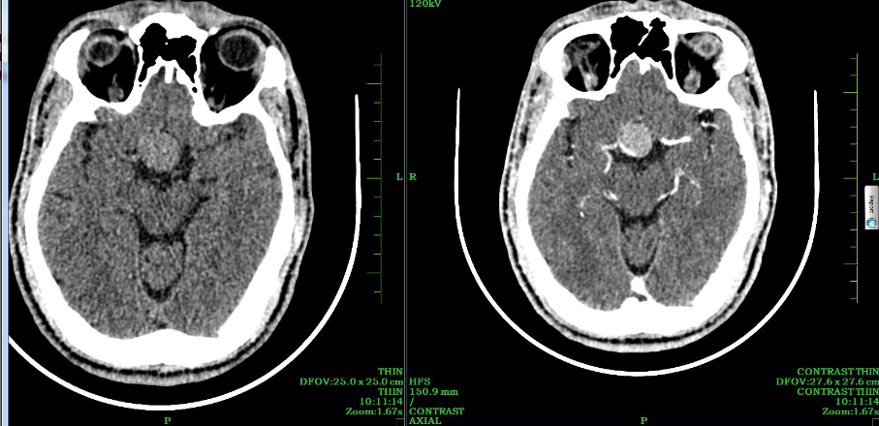

Slide 8
SURGERY
ENDOSCOPIC TRANSNASAL TRANS SPHENOIDAL PITUITARY TUMOR EXCISION WAS DONE.

Slide 9
GROSS MORPHOLOGY
Received specimen in multiple tissue bits and pieces ranging from 0.3 to 1.2 cm, grayish white in color.
All tissue was processed.

Slide 10
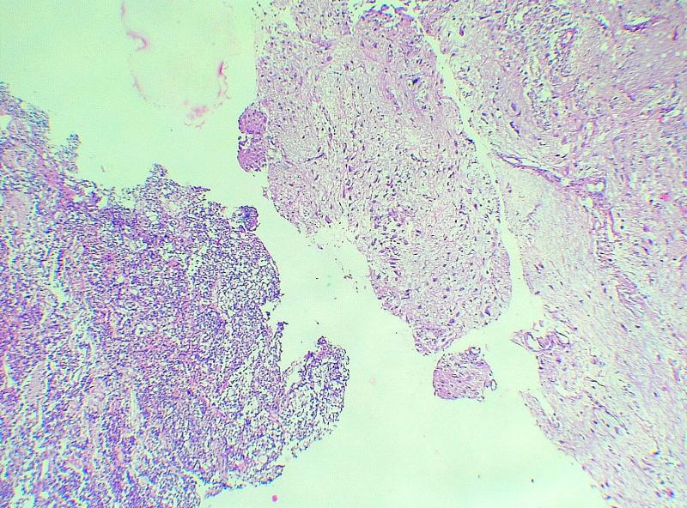
Adeno + Neurohypophysis 4X

Slide 11
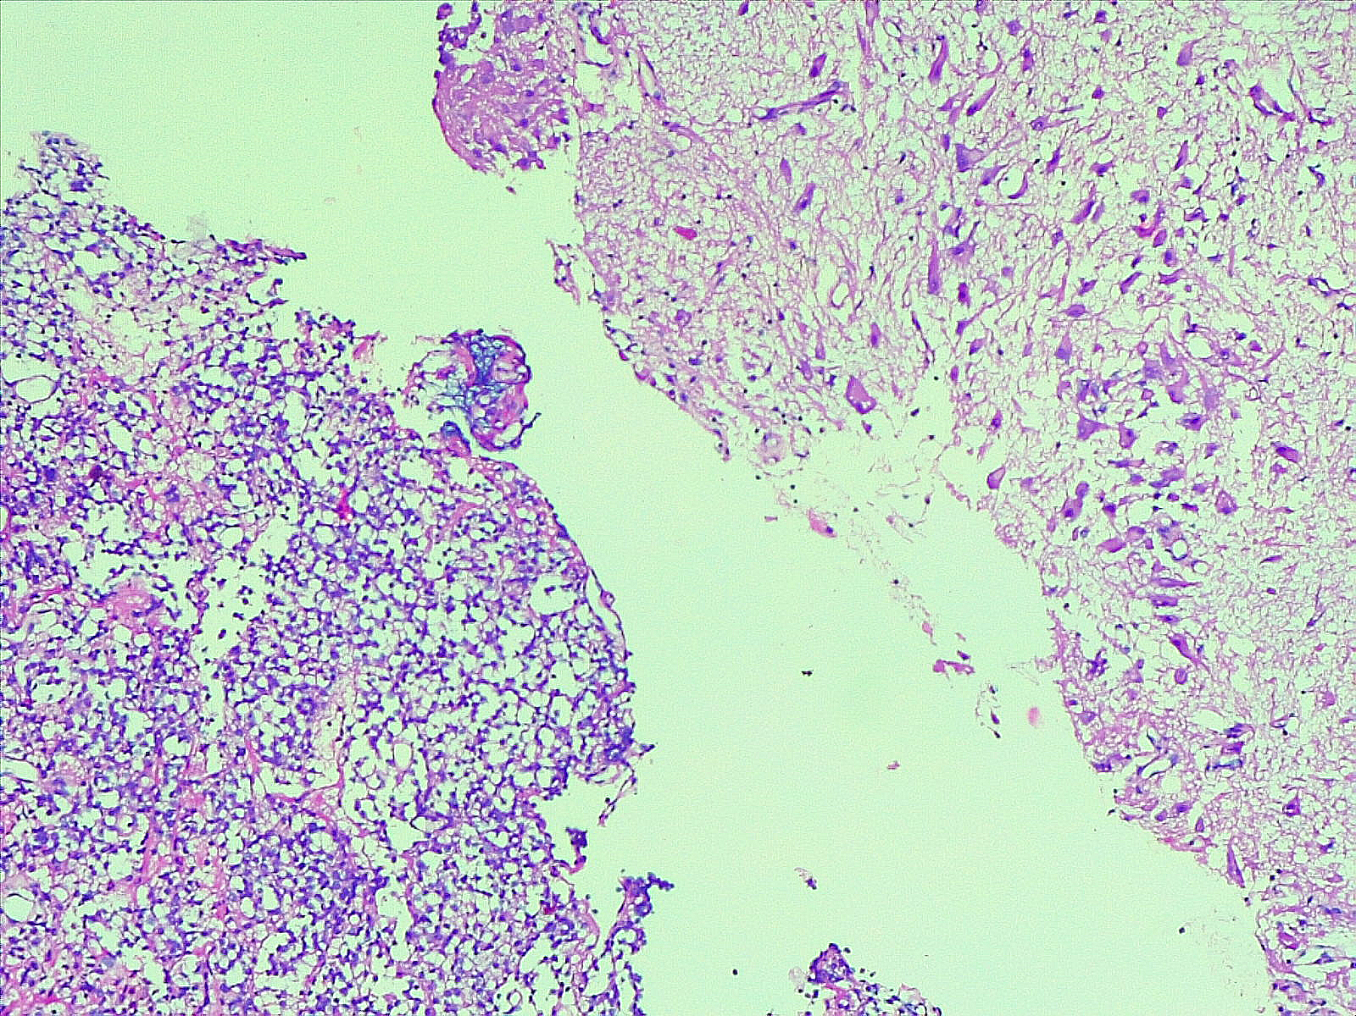
Adeno + Neurohypophysis 10X

Slide 12
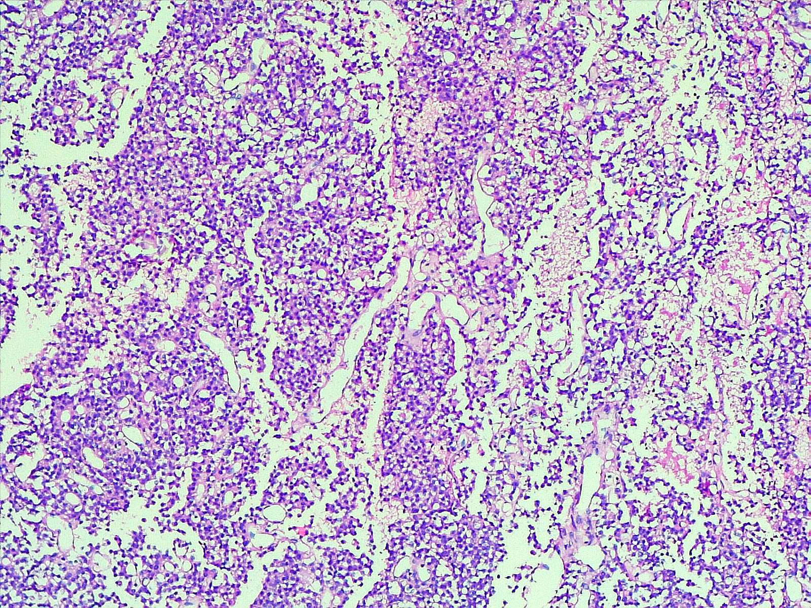
Adenohypophysis 10X showing pituitary adenoma
Notes:
Tumor-nest-.numerous vascular channels and no e/o necrosis

Slide 13
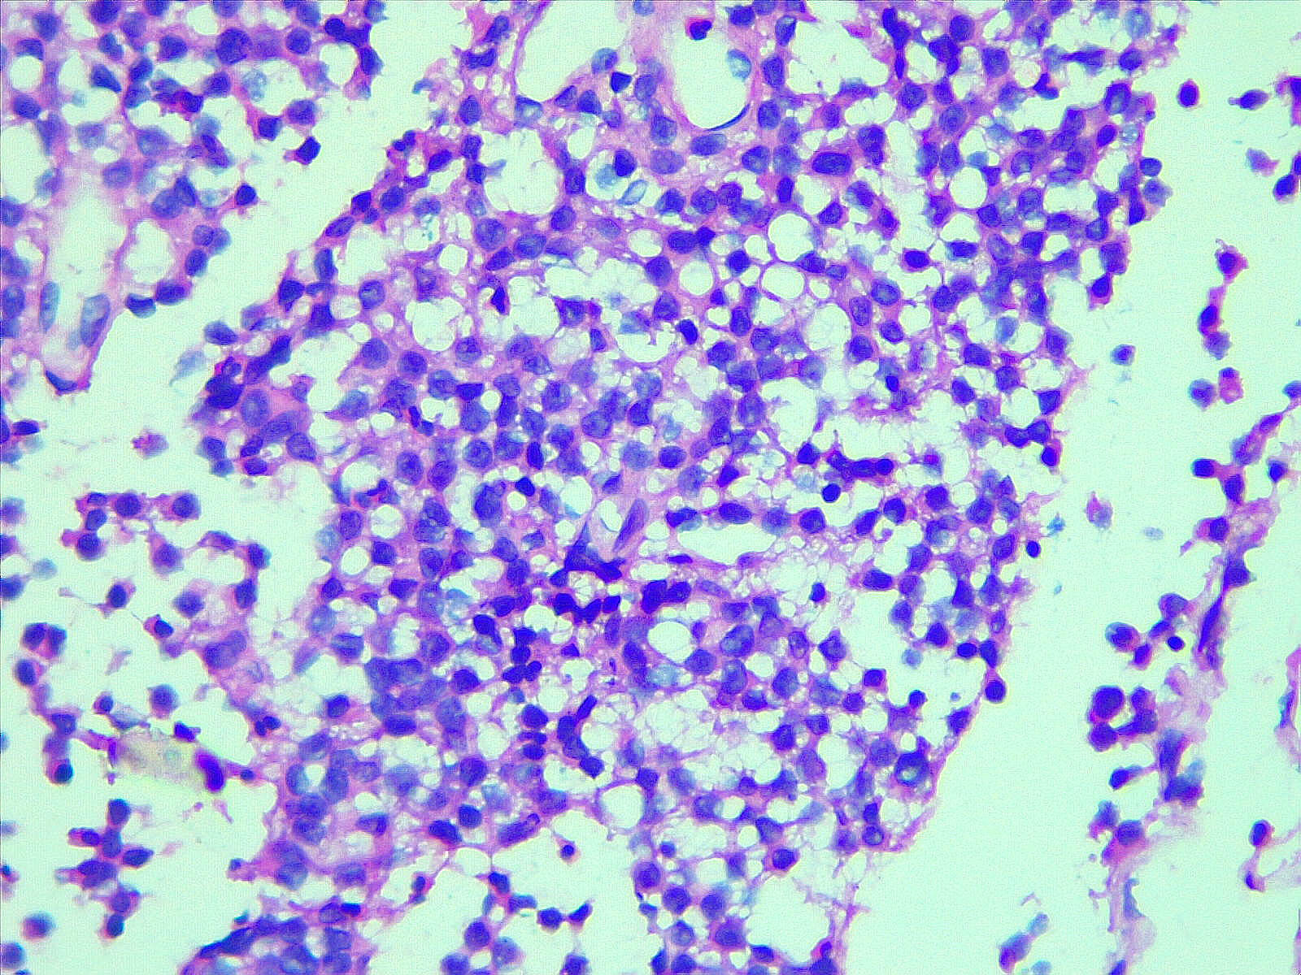
Adenohypophysis 40X showing pituitary adenoma
Notes:
Nucles , cytoplam, mitosis

Slide 14
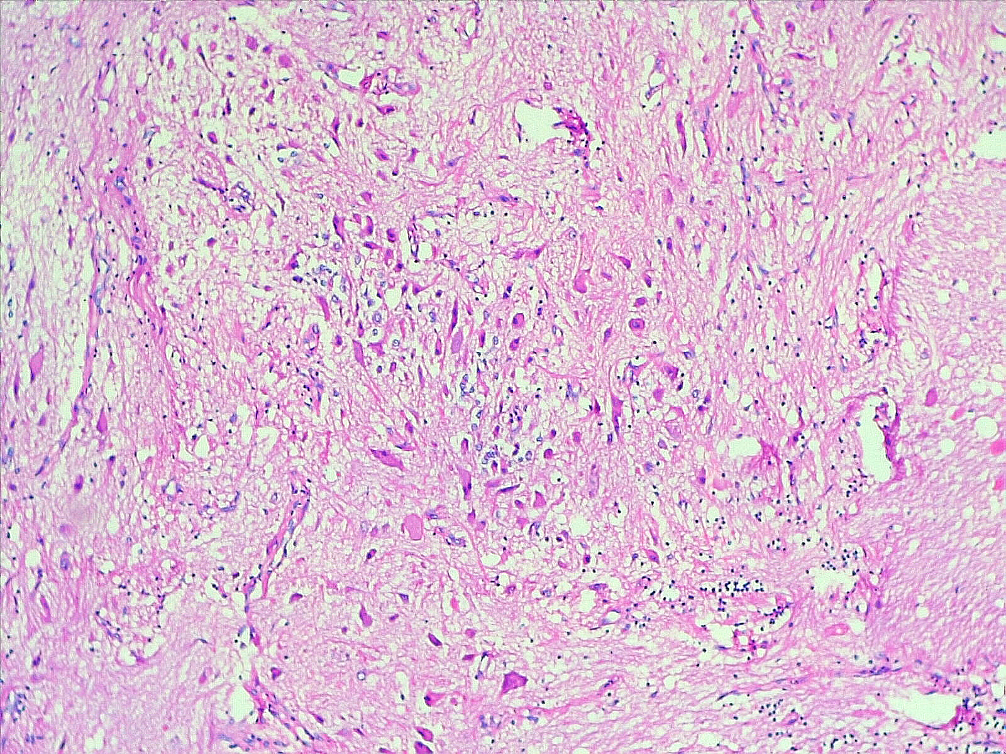
Neurohypophysis 10X
Notes:
Dense fibrillary background+randomly oriented bizzare uni/bi or multipolar neoplastic ganglion cells

Slide 15
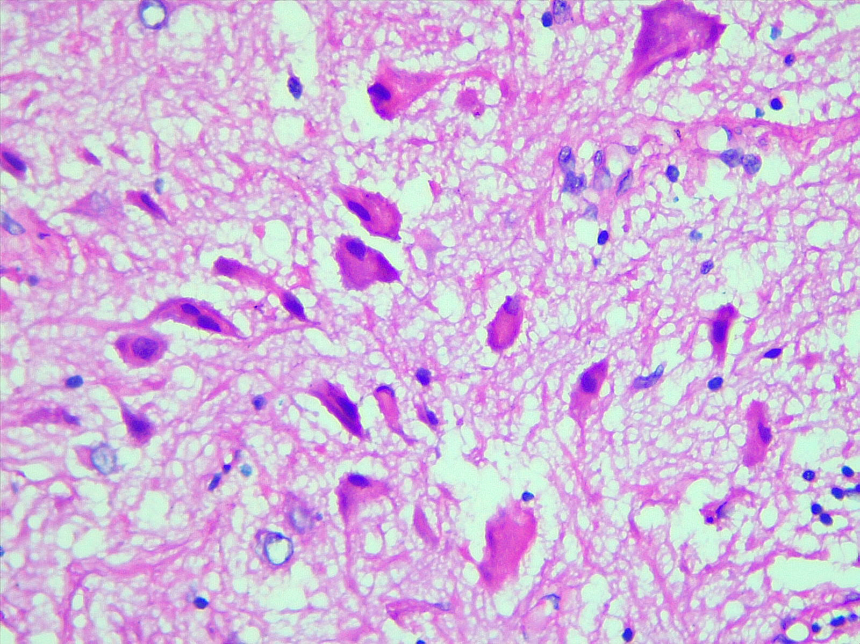
Neurohypophysis 40X

Slide 16
Notes:
Cause of retic stain.Reticulin archi n acinar pattern of normal PG is largely effaced.

Slide 17
DIAGNOSIS
Mixed Gangliocytoma- Pituitary adenoma.

Slide 18
DISCUSSION- GANGLIOCYTOMA
Well differentiated neuroepithelial tumors composed of neoplastic ganglion cells (gangliocytoma) or combination of neoplastic ganglion and glial cells (ganglioglioma)
It is a slow growing and non-metastasizing tumor.
These rare lesions may occur either alone or in association with functioning pituitary adenoma( majority GH tumors). These mixed pituitary tumors have been rarely reported worldwide.

Slide 19
Epidemiology
< 2% of all brain tumors
Ages 2 months to 70 years, with predilection for children and young adults
Clinical features- Seizures and headache followed by bitemporal hemianopia
Sites- Throughout CNS but > 70% involve the temporal lobe
Grading- WHO grade I neoplasms
Radiology : Circumscribed solid mass or cyst with a mural nodule, Variable enhancement, variable calcification

Slide 20
Positive stains
Ganglion cells: synaptophysin+, chromogranin+, NeuN+ / -, Neurofilament+, CD34+ (70 - 80%)
Glial component: GFAP+

Slide 21
PITUITARY ADENOMA
Neuroendocrine tumor of the anterior pituitary gland composed of secretory cells with pituitary hormone production.
Main tumor types include somatotroph, lactotroph, thyrotroph, corticotroph, gonadotroph, and plurihormonal.
Epidemiology
Most common type of tumor found in sellar region;10 - 15% of primary brain tumors.
Mainly fourth to seventh decade; women have slightly greater incidence.

Slide 22
Sites
Majority occur in sella tursica within the adenohypophysis.
Rare examples occur in extrasellar region on pituitary stalk
Clinical features
Most patients have clinical features of hormone excess (usually micro-adenoma)
Larger adenomas (macro-adenoma defined as > 1 cm) have mass effects, such as headache and visual disturbance
Hemorrhagic necrosis of large adenoma may be a surgical emergency

Slide 23
Diagnosis
Classified according to pituitary cell lineage:
Somatotroph
Lactotroph
Thyrotroph
Corticotroph
Gonadotroph
Classification requires immunohistochemical staining for main pituitary hormones .

Slide 24
Positive stains
All synaptophysin positive
Routine hormone stains include prolactin, ACTH, GH, TSH, LH, FSH
Reticulin (useful in identifying normal acinar architecture versus distorted and fragmented staining pattern in adenomas)
Negative stains- GFAP, CK7, CK20, TTF1

Slide 25
Mixed pituitary tumors have rarely been reported worldwide and diagnosis can only be made on histopathology sections.
Complete excision of the tumor is curative.

Slide 26
THANK YOU

