Slide 1
AN INTERESTING CASE OF HEMOTHORAX
PRESENTED BY
DR OMKAR GUTTA
RESIDENT
UNDER THE GUIDANCE OF
FACULTY OF UNIT 2
GENERAL SURGERY

Slide 2
CASE SUMMARY
A 25 year old male, a labourer by profession was referred to the casualty from private hospital on 10/3/2021 at 6am with the alleged history of fall from height (around 15-20 feet) on his back while working at a construction site near tathawade on 6/3/21 at 1pm.
Patient C/O blunt trauma to back of chest and lower back
Followed by which patient experienced localised pain in the back of chest and in the lower back with sudden weakness of right lower limb
Patient also C/O breathlessness after the trauma
No history of loss of consciousness, ENT bleed
No history trauma to head, fever
No history abdominal pain, nausea and vomiting

Slide 3
Treatment History
Patient was taken to private hospital and diagnosed as left hemothorax for which ICD was inserted which drained 3600ml in 3 days, following which 3 units PCV was transfused
Past History – Not significant
Family History – Not significant
Personal History – Not significant

Slide 4
GENERAL EXAMINATION
Conscious, cooperative and well oriented to time, place and person
Averagely built and nourished
Afebrile
Pulse rate : 102 per minute
Blood pressure : 120/80 mm of Hg
Respiratory Rate : 19/minute
SPO2 : 85% on room air
GCS- 15/15
No pallor, icterus, Cyanosis, Clubbing, Generalised Lymphadenopathy, Pedal oedema

Slide 5
SYSTEMIC EXAMINATION
RESPIRATORY SYSTEM EXAMINATION
INSPECTION – skin appears normal, ICD drain in the 5th intercostal space, chest expansion decreased on the left side
PALPATION – tenderness present at the left chest wall at the 5th, 6th, 7th and 8th ribs posterior aspect, no Crepitations
PERCUSSION – dull note on left lower thorax
AUSCULTATION – Decreased air entry on left lower side
PER ABDOMEN EXAMINATION
Soft, non tender, other parameters within normal limits
OTHER SYSTEMIC EXAMINATION – Within Normal limits

Slide 6
INVESTIGATION | VALUE
HB | 7.2
TLC | 13300
PLATELETS | 1,37,000
P/L/M/E | 85/5/10/0
ESR | 8
BLOOD GROUP | A POSITIVE
TOTAL BILIRUBIN | 0.66
CONJUGATED BILIRUBIN | 0.34
UNCONJUGATED BILIRUBIN | 0.32
SGOT/SGPT/ALP | 208/81/46
TOTAL PROTEIN/S.ALBUMIN | 4.7/2.4
INVESTIGATION | VALUE
UREA/S.CREATININE | 37/0.4
Na+/K+ | 142/4.3
RBS | 142
PT/INR | 12.7/1.15
HIV/HbsAg/HCV | Non-reactive
COVID RTPCR | Negative

Slide 7
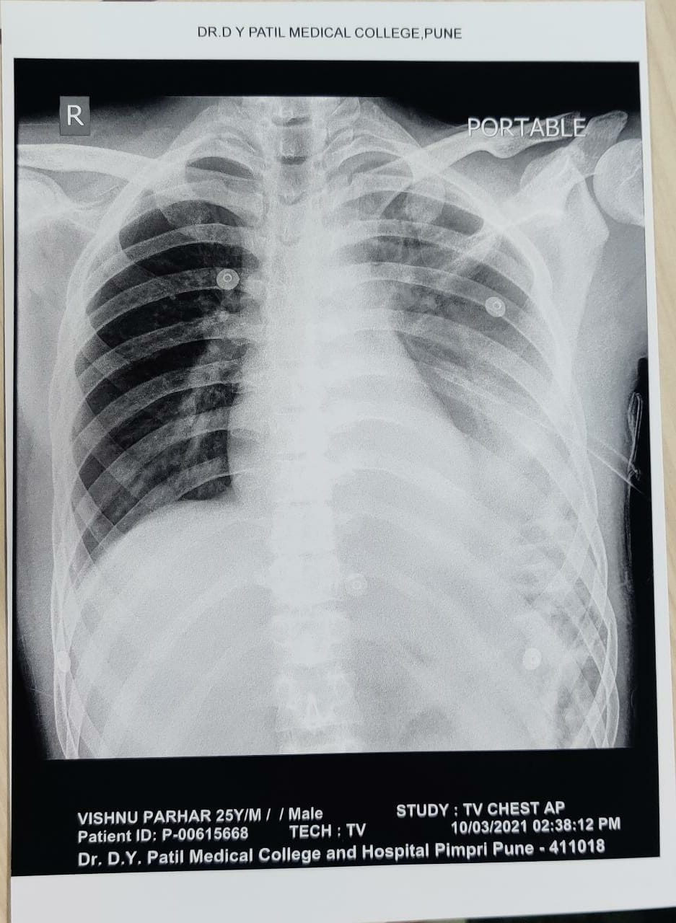

Slide 8
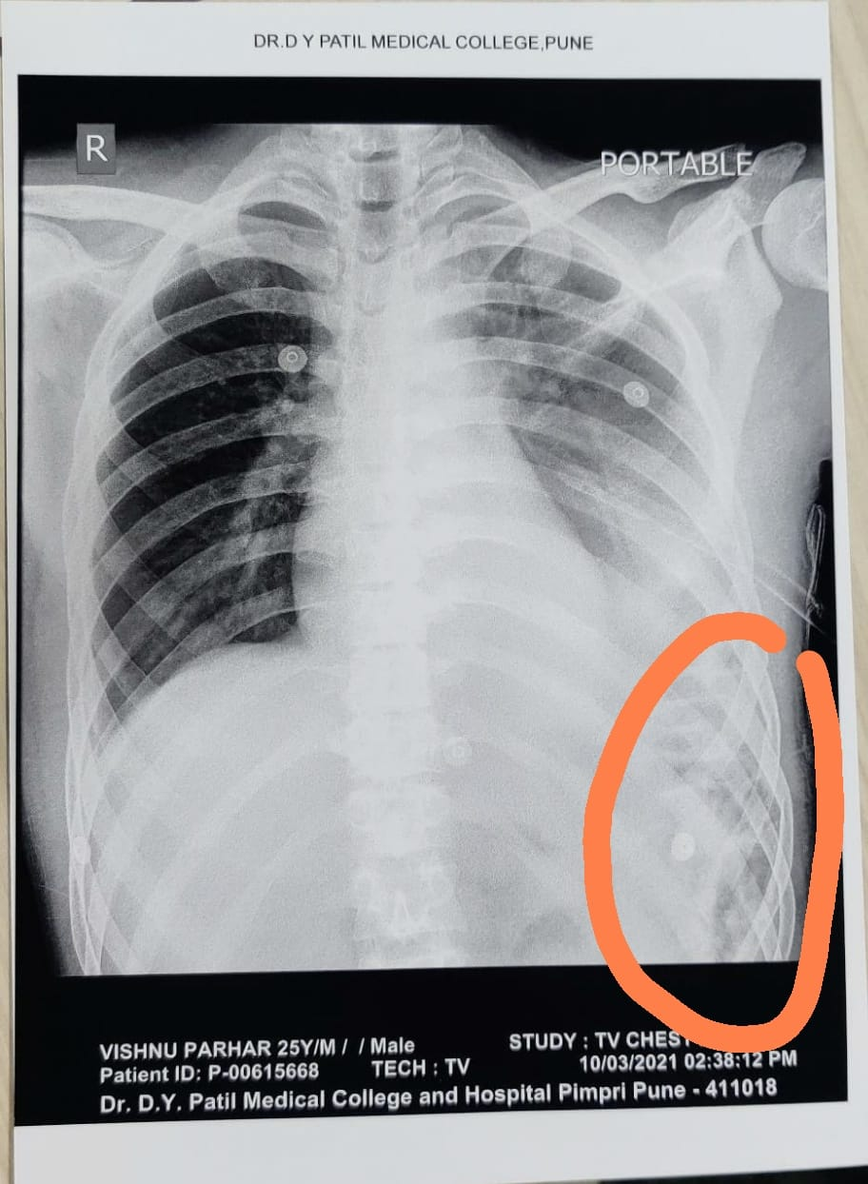

Slide 9
IMAGING
CECT (Abdo+Pelvis)
Laceration of Left hemidiaphragm (14X7cm) with intrathoracic herniation of spleen, pancreatic tail, mesentery and colon with splenic lacerations and arterial bleed with devascularisation (>50%) graded as AAST GRADE IV INJURY. A subcapsular hematoma measuring 6 mm in thickness, along posterior aspect of spleen also noted
Moderate left hemopneumothorax (volume 275 cc) in the left lower lobe of lung with ICD in situ in the 5th intercostal space whereas mild right haemothorax in the right lower lobe of lung
Fractures of the 9th 10th and 11th ribs with linear fractures of transverse processes of T10, T11, L1 and L2 vertebrae and comminuted displaced right scapular fracture

Slide 10
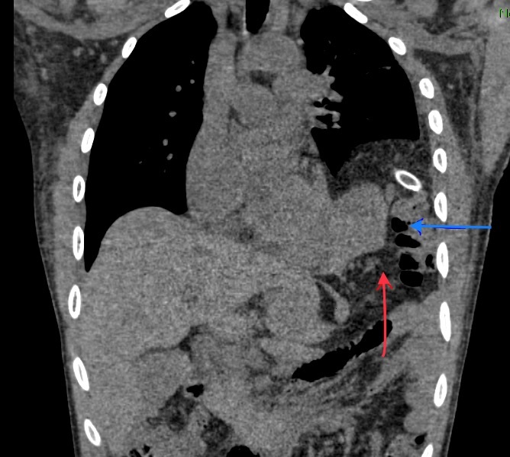
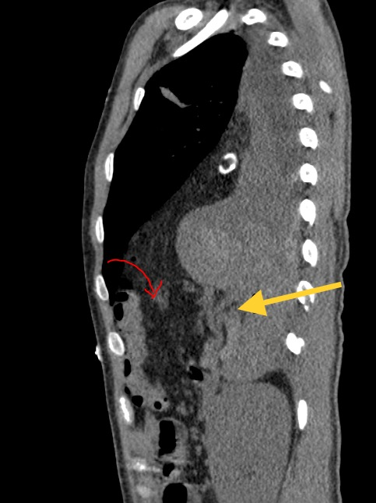

Slide 11
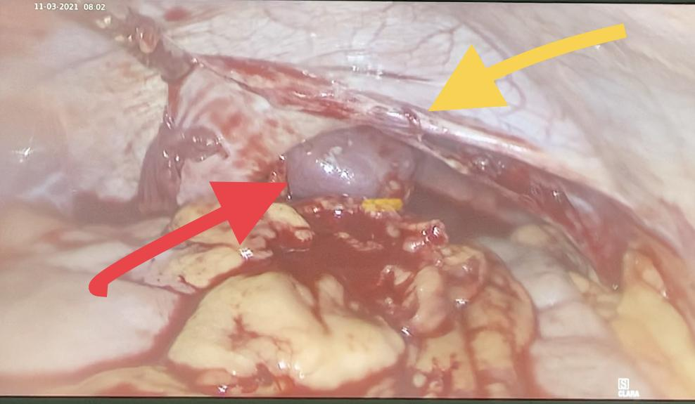

Slide 12
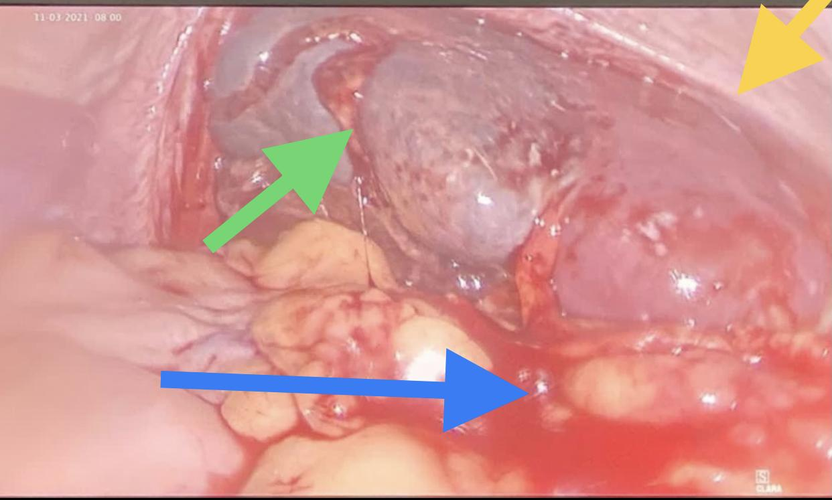

Slide 13
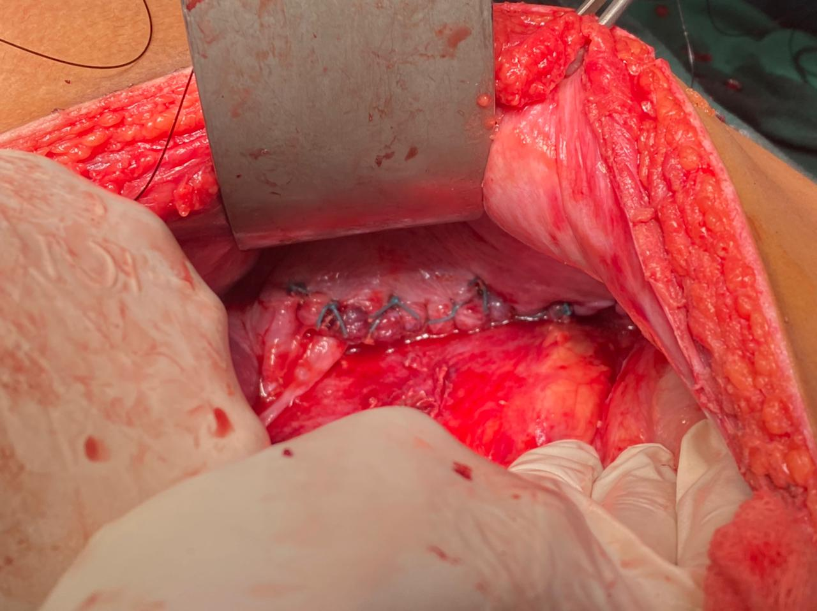
LACERATED DIAPHRAGM – INTRAOP PICTURE
LACEARTED DIAPHRAGM
SUTURED – INTRAOP PICTURE

Slide 14
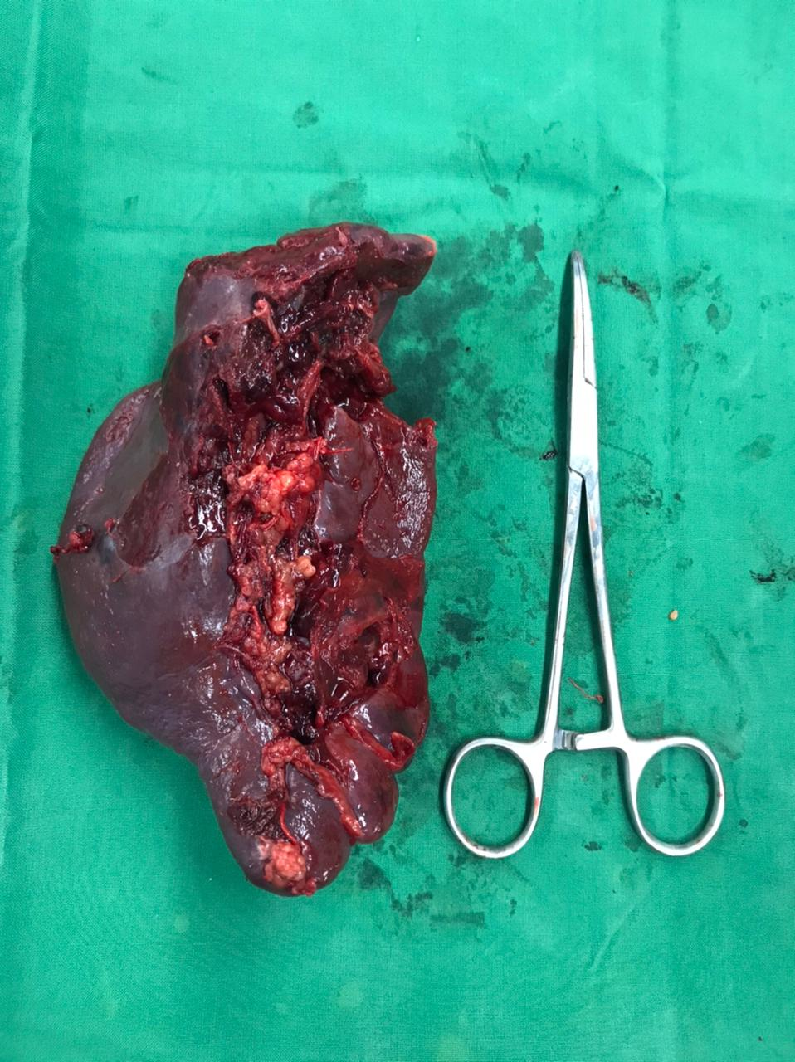
SPLEEN SPECIMEN SENT FOR HISTOPATHOLOGICAL INVESTIGATIONS

Slide 15
MANAGEMENT
As the patient was vitally stable and there was no evidence of acute abdominal injury, the patient underwent Diagnostic Laparoscopy to confirm the CT findings
There was evidence of pulled up mesentery, spleen, transverse colon and omentum towards left hemithorax with evidence of splenic laceration on upper pole with active bleeding on the same side
Patient further underwent exploratory Laparotomy. The intra-op findings were suggestive of splenic rupture at the upper pole with active bleeding, 15X10 cm rupture in left hemi-diaphragm with herniated transverse colon, omentum, spleen in the left hemithorax through it. There was evidence of 500 ml intrathoracic collection of blood and about 500 ml of blood collection in perihepatic and splenic fossa
Patient further underwent splenectomy with repair of diaphragmatic rupture
A 28 number abdominal drain was placed in situ

Slide 16
DISCUSSION
This case is unique due to the rarity of such occurrence and is interesting as sometimes the emergency assessment points out to tension pneumothorax in such cases.
In such cases of polytrauma, the diagnosis of diaphragmatic rupture can go undetected mainly because of other more apparent findings such as hemothorax become the point of initial focus.
Spleen and liver injury were the commonly associated injury in blunt diaphragmatic rupture after bone fractures

Slide 17
The patient in this case presented with pain in the left hypochondrium and left upper back. The common clinical symptoms in diaphragmatic rupture are marked respiratory distress and diffuse abdominal pain.
Rapid diagnosis can be done in bedside with ultrasound (eFAST) later supported with adjuvant imaging modalities like Xray and CT scan.
Major features in plain radiographs (Chest X-ray) like loss of diaphragmatic contour, elevated left diaphragm than the right (more than 4 cm), small or large bowel in chest, gas bubbles in the chest, presence of nasogastric tube in the chest, and pleural collection with obliteration of the costophrenic angle, mediastinal shift, pneumothorax, hemopneumothorax, loss of gastric bubble under left cupola and/or pneumoperitoneum may suggest diaphragmatic rupture

Slide 18
CT scan is a valuable tool in detecting diaphragmatic hernia with blunt abdominal trauma. The CT signs of diaphragmatic injury include direct visualization of injury with free edge of the disrupted diaphragm, intrathoracic herniation of visceral content, collar sign, dependent viscera sign, intramuscular hematoma and peridiaphragmatic active contrast extravasation.
Overall, multi-detector CT scan has a sensitivity of 78% for left sided diaphragmatic injuries with specificity of 100%
Treatment of traumatic diaphragmatic rupture is surgical with abdominal approach (laparotomy) for repair in acute cases.
In chronic case, thoracic approach (thoracotomy) can also be used

Slide 19
Diaphragmatic rupture is a rare condition(0.46%) following injury mainly caused by penetrating trauma (2/3 cases) followed by blunt trauma in rest of the cases
Prevalence of the rupture in young males in mid thirties with a majority of cases with left sided rupture (75% of cases) mainly because the right side of the diaphragm is protected by liver
Left sided diaphragmatic injury is commonly associated with herniation of the spleen and stomach into the thorax.

Slide 20
The most concerning effects of diaphragmatic rupture are compromise of diaphragmatic function, intra-abdominal bleeding from viscera injury, herniation related strangulation with laceration and impairment of venous return to the heart
These injuries need to be addressed quickly by surgical approach either from thoracotomy or laparotomy

Slide 21
TAKE HOME MESSAGE
Although a rare entity, diaphragmatic rupture can occur in cases of blunt abdominal trauma.
It can be associated with herniation of abdominal contents into the thorax.
High clinical suspicion with imaging helps in the diagnosis.
Chest tube insertion should be done with caution in such cases

Slide 22
THANK YOU

