Slide 1
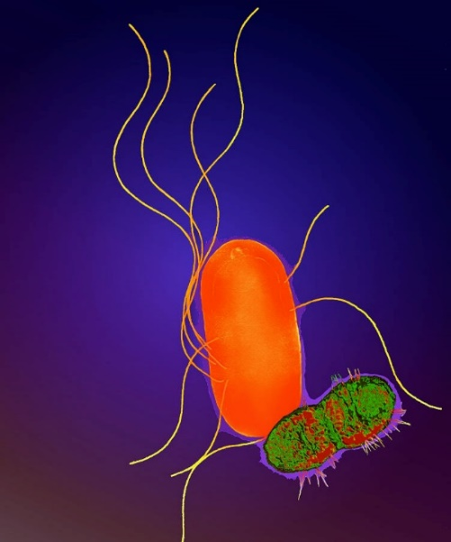
Wound Infection due to a rare Proteus species
Present By
Dr. Sahjid Mukhida
PG Resident
Department of Microbiology
Notes:
Good afternoon everyone. I am Dr. Sahjid Mukhida Post graduate student from Department of Microbiology. I am presenting a case of Wound infection due to a rare proteus species.

Slide 2
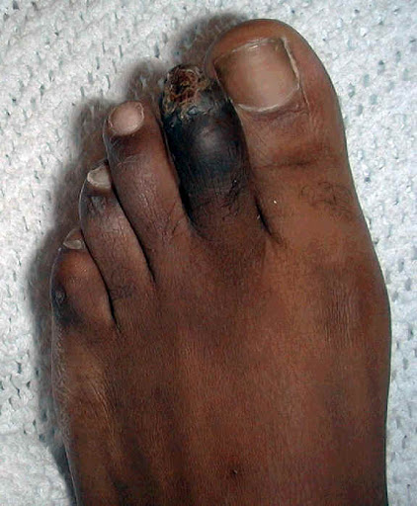
CASE Details
On 9th of October 2020, A 65 Years/Male presented with
Punched out ulcer over left 2nd toe
Size: 2x1 cm
Discharge: Purulent, foul smelling, blood stained
Appearance : Black discoloration with thickened skin around the ulcer site
Ulcer base at meta tarsal bone
Notes:
A 65yrs old male presented to the surgery OPD with punched out ulcer over left second toe. Ulcer Size was 2X1 cm with irregular margins and purulent foul smelling blood stained discharge. The skin was thickened around the ulcer site and appeared blackish in color. The ulcer base was at meta tarsal bone.

Slide 3
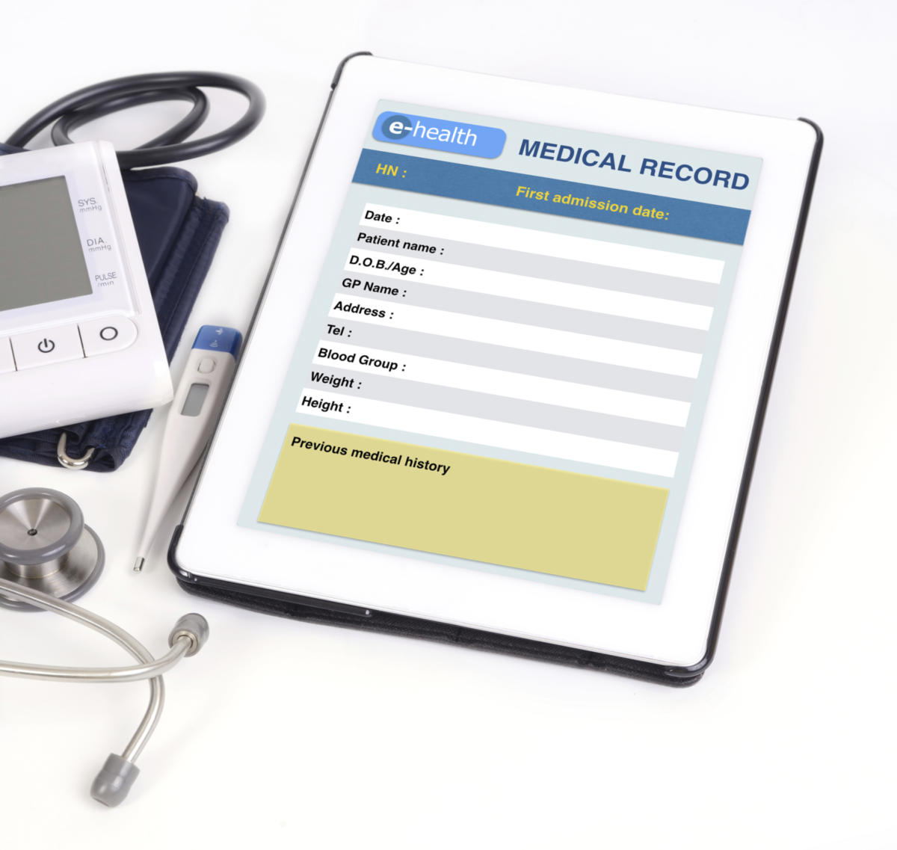
History
K/C/O Type II diabetes – 6 years (Tab: Metformin)
CAD - angioplasty- 2 years back
A bleb like swelling on left 2nd toe before 1 month, burst and formed an ulcer
Initially small in size, progressed to the current size
Previous discharge from wound was yellowish, foul smelly and non bloody
Another ulcer developed below the left 2nd toe
Notes:
Patient was a known case of type II diabetes from past 6 years with medication. He underwent angioplasty for Coronary Artery Disease 2 years back. A bleb like swelling was seen on left second toe which burst and formed an ulcer. The ulcer was ever increasing which had foul smelling yellowish discharge. Another ulcer developed beside the existing wound

Slide 4
Continue…..
There was no
Numbness
Restriction of movements
Local temperature rise, Fever, chill, rigors, cough, breathlessness, calf pain, edema
Comorbidities not present
Bronchial Asthma, Epilepsy
Polyuria, polydypsia, blurred vision, DVT
Notes:
Patient did not have any complaints like numbness or movement restriction. There was no rise in local temperature or complaint related to fever or edema and Comorbidity like BA, Epilepsy, blurred vision were not present.

Slide 5
On Admission
Systemic evaluation
CVS- S1S2 present, No additional heart sound
CNS: No focal neurological deficit
RS: B/L air entry- present, No added sounds present
GIT: No organomegaly
Lab investigation
Hb: 10.4g/dLCK-Mb: 51 IU/L
TLC: 10400/$µl$ Troponin I: <10 Pg/dL
BSL: 315 mg/dL2D ECHO: EF: 35%, Mild TR/ Mild MR
HbA₁C : 9 mmol/mol ECG: T wave depression in V3-V6
Notes:
At the time of the admission, systemic evaluations were done and found to be within normal limit
Laboratory parameters : CK-Mb, BSL, HbA1C were found to be deranged due to CAD and Type II DM.

Slide 6
Management
9th October : After admission, patient was started on empirical antibiotic therapy with Amoxycillin + Clavulanic acid
13th October : Tissue sample from infection site was sent for culture and sensitivity.
14th October: Due to progressive wound size, Left 2nd toe amputation was done
Proteus vulgaris |  | Pseudomonas aeruginosa
Sensitive | Resistant | Sensitive | Resistant
Amikacin, Gentamycin, Ceftazidime, Ciprofloxacin, Piperacillin + Tazobactum Ceftazidime + Clavulanic acid, Norfloxacin, Ceftazidime + Tazobactum, Cefoxitin, Cefotaxime, Ceftrixone, Amoxycillin + Clavulanic acid | Ampicillin | Amikacin, Gentamycin, Ceftazidime, Carbenicillin, Ciprofloxacin, Piperacillin, Piperacillin + Tazobactum Ceftazidime + Clavulanic acid, Ceftazidime + Tazobactum, | Cefoxitin, Cefotaxime Ceftrixone Amoxycillin+Clavulanic acid
After this susceptibility report, antibiotic were changed from Amoxycillin+ Clavulanic Acid to Piperacillin+Tazobactum and Metronidazole.

Slide 7
Cont…..
Pseudomonas aeruginosa ( 17th October 2020)
Sensitive | Resistant
Amikacin, Gentamycin, Ciprofloxacin, Ceftazidime, Ceftazidime + Clavulanic acid, Ceftazidime + Tazobactum, Piperacillin, Piperacillin + Tazobactum | Cefoxitin, Cefotaxime, Ceftrixone Amoxycillin + Clavulanic acid
Regular wound cleaning, skin debridement and dressing were done but wound was not healing.
Amputation was planned upto meta tarsal but due to progression of the necrosis, below knee amputation was performed on 28th October 2020.
After below knee amputation, Piperacillin + Tazobactum was replaced by Cefoperazone + Sulbactam (1.5g)/BD.

Slide 8
4th November: Due to fever spike, Urine sample was sent for culture and sensitivity and it was reported as “No growth”.
7th November: As wound was not-healing, a repeated swab was sent for culture and sensitivity which also isolated Pseudomonas aeruginosa but different susceptibility testing.
Pseudomonas aeruginosa
Sensitive | Resistant
Amikacin, Gentamycin Colistin, Tigecycline, Ofloxacin, Tobramycin | Carbenicillin, piperacillin, Ciprofloxacin, Cefoxitin, Cefotaxime, Ceftrixone, Ceftazidime, Ceftazidime + Clavulanic acid, Ceftazidime + Tazobactum, Piperacillin+Tazobactum, Meropenem, Imipenem, Amoxycillin + Clavulanic acid
After above susceptibility report, antibiotic treatment was changed from Cefoperazone+ Sulbactam to Amikacin.
Notes:
After 10 days of amputation, surgical site was not healing, Repeated swab was sent for c/s which isolated Pseudomonas aeruginosa but with different sensitivity.

Slide 9
17th November: Even after prolonged antibiotics treatment, infection was not subsiding at the wound site and another swab was repeated.
These are the 2 isolates:
Acinetobacter species |  | Proteus species
Sensitive | Resistant | Sensitive | Resistant
Colistin, Tigecycline | Ampicilin, Norfloxacin, Amikacin, Cotrimoxazole, Chloramphenicol, Cefoxitin, Cefotaxime, Ceftrixone, Ceftazidime, Ceftazidime + Clavulanic acid, Piperacillin+Tazobactum, Meropenem, Imipenem,, Amoxycillin + Clavulanic acid, Ofloxacin, Gentamycin | Tigecycline | Ampicilin, Norfloxacin, Amikacin, Cotrimoxazole, Chloramphenicol, Cefoxitin, Cefotaxime, Ceftrixone, Ceftazidime, Meropenem, Colistin Ceftazidime + Clavulanic acid, Ofloxacin, Ceftazidime + Tazobactum, Pipercillin+Tazobactum, Meropenem, Imipenem, Gentamycin, Amoxycillin+Clavulanic acid

Slide 10
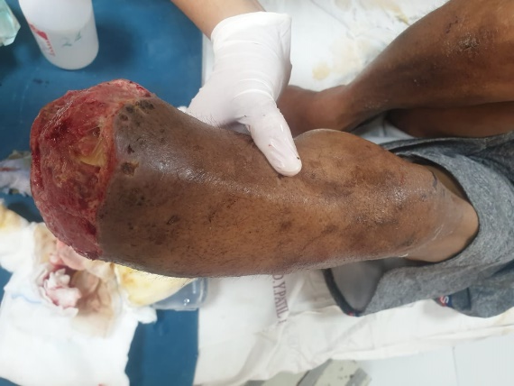
MANAGEMENT
Date | Details
9th October 2020 | Patient admitted in the hospital for treatment
13th October 2020 | Culture swabs were sent and empirical treatment was started
14th October 2020 | Left 2nd toe amputation done when size increased from 2x1 cm to 3x1 cm in 3 days
15-25th October 2020 | Regular wound cleaning, skin debridement and dressing were done. Wound was not healing and gangrene increased. Wound swab send for culture and sensitivity to microbiology lab.
28th October 2020 | Amputation was planned upto meta tarsal but due to progression of the necrosis, below knee amputation was performed

Slide 11
Medical management
Antibiotics:
Inj. Augmentin (1.2g/TDS) for 8 days
Inj. PipTaz (4.5g) TDS for 11 days
Inj. Metronidazole (100ml)/TDS for 15 days
Inj. Cefoperazone + sulbactum (1.5g)/BDS for 12 days
Inj. Amikacin (500mg)/BDS for 4 days
Stopped after 20th November 2020
Inj. Tigecyclin (100mg/BDS) for 2 days
Analgesic :
Inj. Tramadol (50mg/ml)/TDS
Inj. PCT (1g/TDS)
Type II DM :
Inj. Human insulin (12U/TDS)
Inj. Lantus (10U/OD)
CAD management :
Tab Metoprolol (5mg/TDS)
Tab Cilostazol (200mg/BDS)
Tab Ecosprin (75mg/BDS)
Supplementary: Multi vitamins
Blood Transfusion: 2 unit PCV transfusion on 18th and 28th October 2020
Notes:
Start with Amoxycillin-Clavulanic acid but after 1st amputation and C/S report, Piperacillin + Tazabactum and Metronidazole were given. After Below Knee amputation B L+ BLI and Linezolid were added.

Slide 12
Microbiology Lab: Culture and sensitivity report
Date | Type of sample | Results | Organism if any | Sensitive drug | Resistance drug
13/10/20 | Tissue C/S | Growth | Proteus vulgaris; Pseudomonas Aeruginosa | Amikacin, Gentamycin, Ceftazidime, Ciprofloxacin, Piperacilin + Tazobactum Ceftazidime + Clavulanic acid Ceftazidime + Tazobactum | Ampicilin, Colistin Cefoxitin, Cloxacilin Cefotaxime Ceftrixone Amoxycilin+Clavulanate
17/10/20 | Tissue C/S | Growth | Citrobacter freundii ; Pseudomona aeruginosa | Amikacin, Gentamycin, Ceftazidime, Ciprofloxacin, Piperacilin + Tazobactum, Ceftazidime + Clavulanic acid Ceftazidime + Tazobactum | Cefoxitin Cloxacilin Cefotaxime Ceftrixone Amoxycilin+Clavulanate
4/11/20 | Urine | No growth |  | - | -
7/11/20 | Pus | Growth | Pseudomonas aeruginosa | Amikacin, Gentamycin Colistin, Tigecyclin | ALL OTHER DRUGS
17/11/20 | Pus | Growth | Proteus spp. Acinetobactor spp | Tigecyclin | ALL DRUGS INCLUDING COLISTIN
Notes:
These is the samples summary received to microbiology lab for culture and sensitivity test. Urinary system infection probability is rule out by urine culture. Blood culture not done because systemic infection symptoms not observed. After more then 20 days of below knee amputation, culture and sensitivity report showed multi drug resistance.

Slide 13
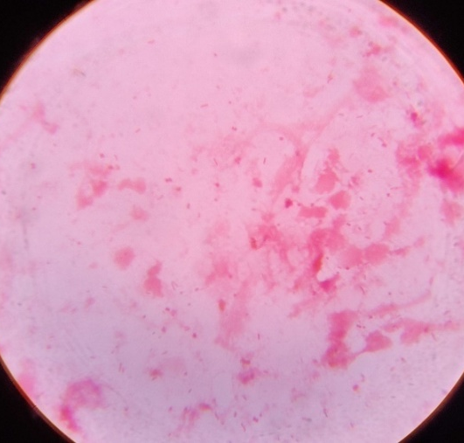
Culture and sensitivity test process ……..
Pus (Swab) samples were processed for gram stain, Z-N stain, culture on blood agar and MacConkey agar.
Gram stain showed gram negative bacilli in the smear.
Blood Agar : Swarming was seen.
MacConkey Agar: Smooth, Non Lactose Fermenting colonies with distinct odor
Gram Stain
Blood agar
Swarming
MacConkey Agar
NLF colonies
Notes:
All pus-swab samples are regularly processed for gram staining, Z-N staining, culture and sensitivity test. Swarming was observed on blood agar and smooth non lactose fermenting colonies with distinct odor.

Slide 14
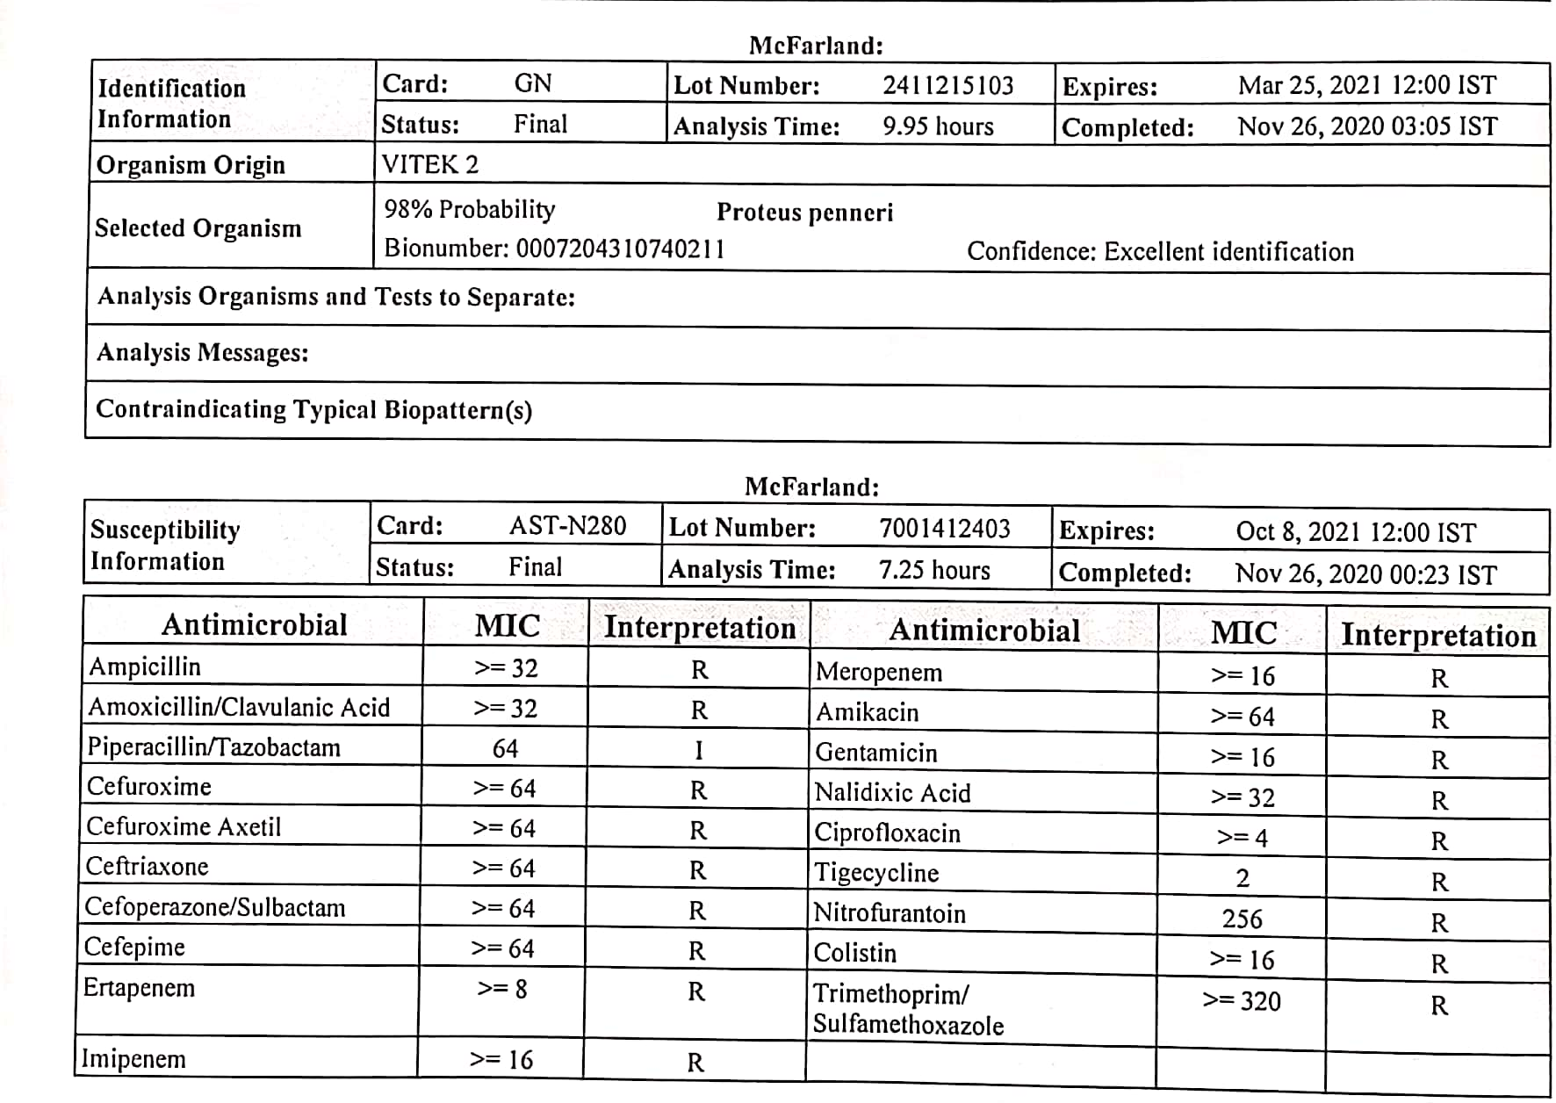
Identification (Automation)
Bio chemical reaction did not match with the common Proteus spp.
Isolate was subjected to automation (Vitek 2c) for species identification and ABST.
Proteus penneri was identified which was resistant to most antibiotic groups including Tigecycline (MIC - 2) and Colistin (MIC >16 )
Notes:
During identification bio—chemical reactions did not match with the common proteus species. Proteus species was reported and isolate was tested on automation (Vitek-2C) for species identification. Vitek reported Proteus penneri with multi drug resistance including tigecycline and Colistin

Slide 15
Bio-Chemical Reaction ¹
Test | P. penneri | P. vulgaris | P. mirabilis
Microscopic morphology | Gram Negative Rods | Gram Negative Rods | Gram Negative Rods
Hemolysis (sheep blood agar) | Beta | Beta | Beta
Urease | Positive | Positive | Positive
Indole production | Negative | Positive | Negative
Esculin hydrolysis | Negative | Positive | Negative
Acid from Maltose | Positive | Positive | Negative
Acid from Sucrose | Positive | Positive | Negative
Citrate | Negative | Negative | Variable
Ornithine decarboxylase | Negative | Negative | Positive
Hydrogen sulfide production | Negative | Positive | Positive
Salicin | Negative | Positive | Negative
Notes:
Isolate was again tested for all routine bio-chemical reactions and special test like Ornithin decarboxylase test. Isolate’s Bio-Chemical reaction were matching with Proteus penneri which was reported by automation. Production of hydrogen sulfide in Triple Sugar Ion agar test is a characteristic of Proteus species but P penneri is an exception.

Slide 16
Bio Chemical reactions
I | MR | C | U | TSI | G | S | L | M
P. vulgaris
P. mirabilis
P. penneri
Notes:
Bio-chemical reactions comparison among Proteus species.

Slide 17
Further samples received for Culture & sensitivity test
Date | Type of sample | Results | Organism if any | Sensitive drug | Resistance drug
17/11/20 | Pus | Growth | P. penneri Acinetobactor spp | Tigecyclin | All drugs including colistin
23/11/20 | Pus | Growth | P. penneri P. aeruginosa | All drugs are resistant including Colistin (MIC >16) and Tigecycline (MIC 2)
25/11/20 | Pus | Growth
01/12/20 | Pus | Growth | P. penneri S. pyogenes | All drugs are resistant including Colistin (MIC >16) and Tigecycline (MIC 2)
 | Pus
05/12/20 |  |  |  | Cip, Pen-G, Va, Linezolid | Erythromycin, Clindamycin, Cotrimoxazole
Notes:
To rule out the contamination, repeated samples were collected pre and post Cleaning of wound. Proteus penneri was isolated in all the samples.

Slide 18
Clinical course
After Proteus penneri was reported with multi drug resistance (Tigecycline MIC-2), Tigecycline was prescribed but the drug could not be administered due to poor patient compliance
Regular dressing and tissue debridement were performed twice a day for 10 days and it continued for once a day
As the infection was not subsiding, decision for above knee amputation was taken but patient relatives did not gave consent.
On 9th December 2020 mid night patient had ARDS- symptoms, was shifted to ICU for management, but unfortunately patient could not be resuscitated.
Pulmonary embolism was established as the cause of death

Slide 19
Discussion
Surgical site infection is one of the major cause of hospital associated infections²
P. penneri is an underreported pathogen.
Proteus penneri named individually in 1982 from Proteus vulgaris bio-group³
Gram negative, facultative anaerobic, Non Lactose fermenting, non capsulated, pleomorphic, motile, rod-shaped bacterium¹
It is an Invasive pathogen and can cause hospital associated infections like UTI or open wound infections⁴
In our case, it was isolated after 20 days of below knee amputation so it may be a possible hospital associated infection
Number of reports of this organism are few, as it is often isolated along with other organisms like Pseudomonas aeruginosa, Acinetobacter species and other gram negative organism.

Slide 20
Cont…..
Proteus species are known to be intrinsically Resistant to Nitrofurantoin, Tetracycline, Tigecycline and polymyxins.
Proteus penneri is also known to be intrinsically Resistant to other β-lactams and macrolides.
Though it is known to be Sensitive to group of antibiotics like aminoglycosides, Carbapenems, aztreonam, quinolones and co-trimoxazole.⁶
Feglo et al.⁷ and Pandey et al⁸ reported MDR Proteus penneri from wound site infection.
In our case P. penneri isolated was multi-drug resistant including Carbapenems and colistin⁴
Mortality in this case may be due to the presence of co-morbidities present
Notes:
Other Proteus species like P. mirabilis is naturally sensitive to all beta lactams and chloramphenicol while P. penneri is resistant to beta lactams and chloramphenicol too.

Slide 21
Take home message
Rapid and correct identification of such rare and resistant strains are of utmost importance as they can be significant nosocomial threat.
Automation guide to identify this type of rare isolates and drug sensitivity to prompt treatment
Hospital associated bacterial infection like Proteus penneri which have proven pathogenicity and it need continuous emphasis on effective infection control practices to warrant appropriate therapeutic plan

Slide 22
References
Koneman EW, Allen SD, Janda WM, et al; Color Atlas & Textbook of Diagnostic Microbiology, 7th edition,Philadelphia;Lippincott:2017
Kaistha N, Bansal N, Chander J. Proteus penneri lurking in the intensive care unit: An important often ignored nosocomial pathogen. Indian J anaesth. 2011 Jul-aug; 55(4):411-413
O’Hara CM, Brenner FW, Miller JM. Classification, identification and clinical significance of Proteus, Providencia and Morganella. Clin Microbiol Rev. 2000;13:534–46.
Krajden S, Fuksa M, Petrea C, Crisp LJ, Penner JL. Expanded clinical spectrum of infections caused by Proteus penneri. J Clin Microbiol. 1987;25:578–9
Stock I. Natural antibiotic susceptibility of Proteus spp., with special reference to P. mirabilis and P. penneri strains. J Chemother. 2003 Feb;15(1):12-26. doi: 10.1179/joc.2003.15.1.12. PMID: 12678409.
CLSI. Performance standards for Antimicrobial susceptibility testing, 30 edition CLSI supplement M100 Wayne, PA: Clinical Laboratory Standards Institute 2020
Feglo PK, Gbedema SY, Quay SN, Adu-Sarkodie Y, Opoku-Okrah C. Occurrence, species distribution and antibiotic resistance of Proteus isolates: A case study at a Komfo Anokye Teaching Hospital (KATH) in Ghana. Int J Pharm Sci Res 2010;1:347-52
Pandey A, Verma H, Asthana AK, Madan M. Extended spectrum beta lactamase producing Proteus penneri: A rare missed pathogen?. Indian J Pathol Microbiol 2014;57:489-91

Slide 23
ACKNOWLEDGEMENT
Surgery department
Dr. D. Y. Patil Medical College, Hospital and Research Centre,
Dr. D. Y. Patil Vidyapeeth, Pimpri, Pune, Maharashtra

Slide 24
Thank You
Very Much !

