Slide 1
“A Rare case of neonatal Meningitis”
Department of Microbiology
Presenter: Dr Sriram K
Junior Resident

Slide 2
History of present illness…
A term male baby weighing 3kg, was delivered by normal vaginal delivery (on 16/11/20).
Baby didn’t cry even after vigorous stimulation and was intubated and shifted to NICU in view of Perinatal Hypoxia.
Provisional diagnosis of “Perinatal Hypoxia with Stage II Neonatal Encephalopathy” was made.
Also baby was having bouts of convulsions for which he was put on anticonvulsant therapy.
O/E- HR- 146/min, RR- 70/min, BSL- 128mg/dL

Slide 3
As a part of NICU protocol and in view of increasing WBC count (24,100/µL), Blood culture was sent to Department of Microbiology.
Patient was intubated.
ET secretions were also sent for culture and sensitivity.
Empirically patient was started on Amoxycillin+Clavulinic acid (75mg/Kg/day) BD and Gentamicin(4mg/Kg/day) OD.
Acinetobacter sp. was isolated and reported from Blood culture and Pseudomonas sp from ET tube secretion (CFU>10⁵/mL).

Slide 4
Acinetobacter sp reported from blood
Sensitive | Resistant
Norfloxacin Amikacin Gentamicin Ceftazidime Ceftazidime+Clavulinic acid Ceftazidime+Tazobactam Cotrimoxazole Piperacillin+Tazobactam Meropenem Amoxicillin+Clavulinic acid | Ampicillin Cefoxitin Cefotaxime/Ceftriaxone Chloramphenicol
Pseudomonas sp reported from ET secretions
Sensitive | Resistant
Amikacin Ceftazidime Ceftazidime+Clavulinic acid Ceftazidime+Tazobactam Carbenicillin Piperacillin Piperacillin+Tazobactam Colistin Tigecycline | Gentamicin Cefoxitin Cefotaxime/Ceftriaxone Ciprofloxacin Meropenem Amoxicillin+Clavulinic acid Fosfomycin Ofloxacin Tobramycin Imipenem

Slide 5
Acinetobacter spp. Report from blood
Sensitive to:
Norfloxacin
Amikacin
Gentamicin
Ceftazidime
Ceftazidime+Clavulinic acid
Ceftazidime+Tazobactam
Cotrimoxazole
Piperacillin+Tazobactam
Meropenem
Amoxicillin+Clavulinic acid
Resistant to:
Ampicillin
Cefoxitin
Cefotaxime/Ceftriaxone
Chloramphenicol

Slide 6
Pseudomonas spp. Report ET tube secretions(19/11/20)
Sensitive to:
Amikacin
Ceftazidime
Ceftazidime+Clavulinic acid
Ceftazidime+Tazobactam
Carbenicillin
Piperacillin
Piperacillin+Tazobactam
Colistin
Tigecycline
Resistant to:
Gentamicin
Cefoxitin
Cefotaxime/Ceftriaxone
Ciprofloxacin
Meropenem
Amoxicillin+Clavulinic acid
Fosfomycin
Ofloxacin
Tobramycin
Imipenem

Slide 7
Continue…..
Antibiotic escalation was done according to the reports, from Amoxycillin+Clavulinic acid and Gentamicin to higher antibiotics Colistin and Gentamicin as per drug susceptibility report on 19th November 2020.
As on 23rd Nov. No major improvement was seen.
Blood culture was repeated (as no clinical improvement) and antibiotic escalation was done to Colistin(50,000IU/Kg/day) TDS and Ceftazidime(100mg/Kg/day) TDS.
Sample plated on 23rd Nov. report dispatched on 25th Nov. as Gram negative Non-Lactose fermenting organism isolated, resembling Pseudomonas sp.
Some Biochemical tests and other supplementary tests were not characteristic of Pseudomonas species.

Slide 8
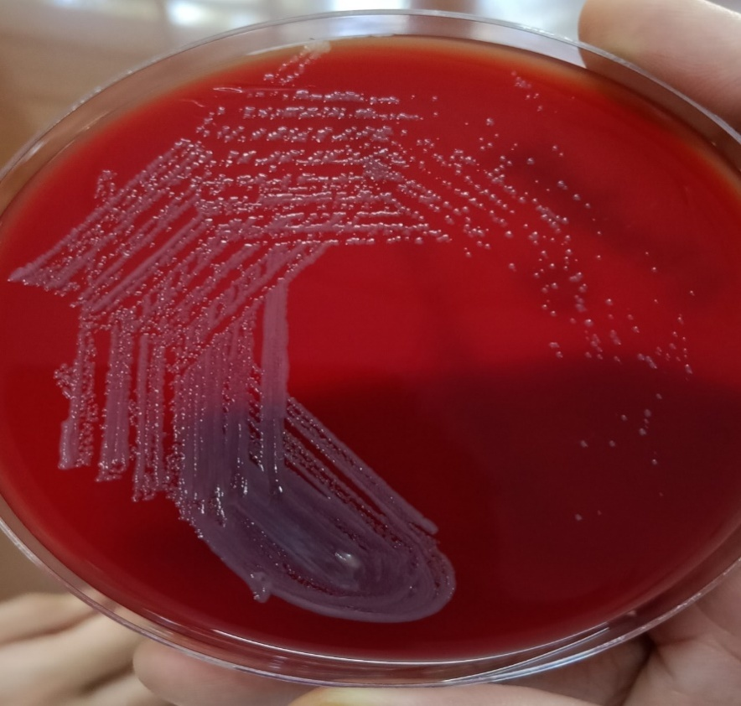
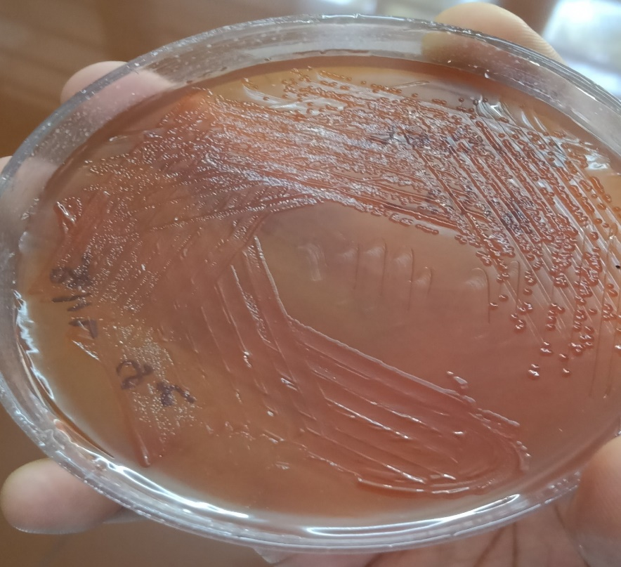
The colonies were similar to Pseudomonas sp.,in a sense that they were Non lactose fermenting colonies, but unlike the colonies of Pseudomonas sp. they were circular and convex looking, rather than spreading out on the culture plate.
It was Non-motile
Test for indole and urease positive
And it utilized mannitol unlike Pseudomonas spp.

Slide 9
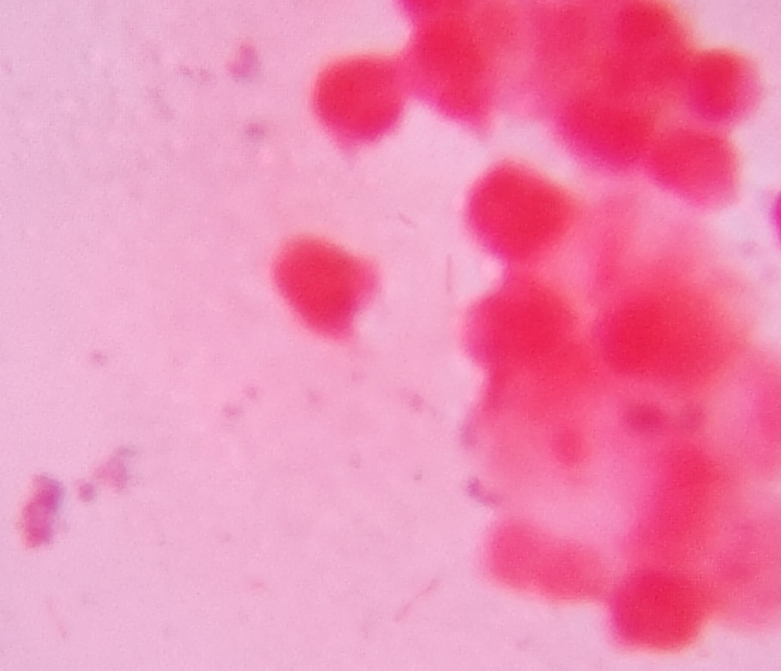
Organism was initially reported as Pseudomonas sp. without delay and later it was processed by Automation (Vitek-2C) for accurate identification and drug susceptibility.
Vitek 2C identified the isolate as
“Elizabethkingia meningoseptica”
At this moment patient was already on Colistin(50,000IU/Kg/day) and Ceftazidime(100mg/Kg/day).
As the baby was not showing any improvements even after treatment with anticonvulsant, to rule out Meningitis a CSF tapping was done and CSF was sent for culture and sensitivity. Same organism “Elizabethkingia meningoseptica” was identified from CSF too.
On 4th Dec Linezolid was started
Direct Microscopy

Slide 10
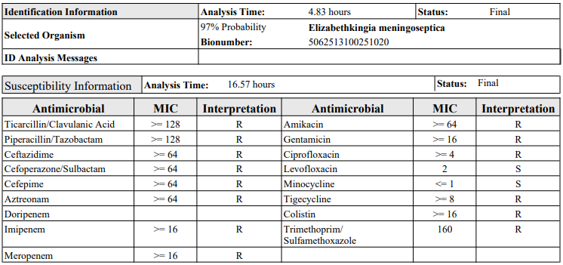
Vitek 2C Report:

Slide 11
Outcome
The baby’s guardians were not willing for further treatment in the hospital and hence was discharged against medical advice
Patient was hemodynamically stable at the time of discharge but convulsions were still persistent
At the time of discharge the baby was put on Syrup Linezolid(10mg/Kg/day) 1.5mL TDS and Tab. Levofloxacin 250mg in 10mL of water of which 1.2mL BD for 15days
Patient condition till date: baby alive, no indication of septicaemia

Slide 12
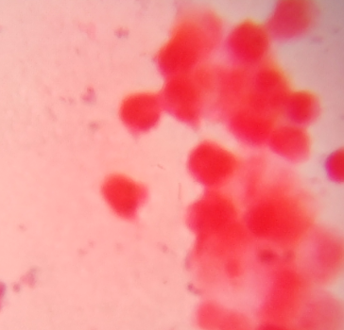
Discussion
Elizabethkingia meningoseptica organism named after the American scientist “ Elizabeth O King” who was studying unclassified bacteria associated with pediatric meningitis at the Centers for Disease Control and Prevention in Atlanta.
It is widely distributed in nature (Eg Fresh Water, Soil or Salt Water).
Microscopic appearance : Gram Negative slender, slightly curved rod, non spore forming and aerobic organism.
Direct Microscopy

Slide 13
Intrinsically Resistant : Aminoglycosides, Tetracycline, chloramphenicol, β-lactams, Colistin(ESBL, Carbapenem hydrolyzing MBL producer)(Bhat KS et al)(Principles and practice of infectious diseases edition 9).
Organism is reportedly sensitive : quinolones, minocycline, Cotrimoxazole, rifampicin and novobiocin(Bhat KS et al, Ghafur M et al)(Principles of internal medicine edition 19).
Also some reports have suggested Sensitivity towards : Vancomycin, Clindamycin, Macrolides(Bhat KS et al)

Slide 14
It is more of an opportunistic infection mostly affecting immunocompromised individuals(Ghafur A et al) known to cause neonatal septicemia and meningitis(Bhat KS et al)
Quite often the organism is misidentified as Pseudomonas spp based on the routine biochemical tests employed for identification(Arbune M et al)
The organism is known to be resistant to majority of the antibiotics used in treating gram negative bacteria but it was found that it responds well antibiotics used for Gram positive organism(Ghafur A et al, Bhat KS et al)

Slide 15
Source ….
A Root cause analysis and source analysis was done by Hospital Infection Control team, where Multiple samples were collected from Health care workers and Hi-touch areas of NICU and Labor room too, but, Unfortunately the same organism was not isolated in any of the samples.
Notes:
Being a rarely isolated organism but ubiquitous in nature

Slide 16
TAKE HOME MESSAGE
Elizabethkingia meningoseptica is an emerging nosocomial infection(Arbune M et al) with high risk of complication and mortality especially in neonates.
It is often misidentified and hence Early accurate diagnosis by Automation is needed for prompt and effective treatment.
Effective Infection control practices in Hospital are necessary to prevent Elizabethkingia meningoseptica epidemics.

Slide 17
References
Ghafur A, Vidyalakshmi PR, Priyadarshini K, Easow JM, Raj R, Raja T. Elizabethkingia meningoseptica bacteremia in immunocompromised hosts: The first case series from India. South Asian J Cancer. 2013 Oct;2(4):211-5. doi: 10.4103/2278-330X.119912. PMID: 24455635; PMCID: PMC3889038.
Bhat K S, Priya R, Krishnan L, Kanungo R. Elizabethkingia meningoseptica bacteremia in a neonate: A case report and mini-review of the literature. J Curr Res Sci Med 2016;2:42-5
Arbune M, Fotea S, Nechita A, Stefanescu V. Emerging Infection with Elizabethkingia Meningoseptica in Neonate. A Case Report. J Crit Care Med (Targu Mures). 2018 Jul 1;4(3):96-100. doi: 10.2478/jccm-2018-0013. PMID: 30582002; PMCID: PMC6294984.
Harrison’s Principles of Internal Medicine edition 19
Mandell, Douglas and Bennett’s Principles and Practice of infectious diseases edition 9

Slide 18
Acknowledgement
Department of Paediatrics
Dr D Y Patil Medical College Hospital & Research Centre
Dr D Y Patil Vidyapeeth

Slide 19
Thank you

