Slide 1
A case of Mayer-Rokitansky-Küster-Hauser (MRKH) Syndrome

Slide 2
CASE REPORT
22 years young, active, educated female with complaints of
Primary amenorrhea
Well developed secondary sexual characteristics
History
Thelarche – 13 years
Pubarche-15 years
Menarche-not yet
Cyclical abdominal pains
No lump abdomen

Slide 3
K/C/O : hypothyroidism on medications
Asymptomatic and euthyroid at the time of presentation.
No other known co-morbidities
No h/o similar complaints in the family
Local examination:
Secondary sexual characters appear normal
Absent vagina
Vaginal dimple present, Urethra normal
Systemic examination: Essentially normal

Slide 4
Investigations
Haematology and Biochemistry- Essentially normal
Hormonal profile - FSH / LH / Prolactin -- within normal range
Chromosomal Studies 46 XX, No chromosomal anomaly
USG Abdomen- Hypoplastic (? Streaky hypoplasia) uterus
Normal bilateral ovaries
MRI Rudimentary uterine anlage / Hypoplastic uterus
Type I Mullerian Duct Anomaly (AFS classification)

Slide 6
MANAGEMENT
Requirements
Normal sexual life
Restoration of body image
Plan Vaginoplasty
-Sensate ( Erogenous)
-Durable
-Normal feel
-Non stenosing
-Non-disfiguring

Slide 7
Horse Shoe shaped Labia Minora Flap

Slide 9
Post-op Custom made conformers Regular dilatation Healthy, patent vagina
Urethra
Vagina

Slide 10
Discussion

Slide 11
Congenital
Vaginal Absence
Acquired

Slide 12
Congenital
A- Complete
Utero-vaginal agenesis (complete form of the MRKH syndrome)
Intersex conditions (testicular feminization syndrome)
B- Partial
Distal or proximal vaginal atresia ( incomplete forms of the MRKH syndrome)
Intersex conditions (congenital adrenal hyperplasia, androgen insensitivity syndrome, mixed gonadal dysgenesis)

Slide 13
Acquired
Colpocleisis (pharmacologically or radiation-induced)
Vaginal defects secondary to
Cancer
Trauma i.e; child birth,
Infection
Chronic inflammatory disease
Iatrogenic

Slide 14
Mayer-Rokitansky-Küster-Hauser syndrome
Second commonest cause of primary amenorrhea
(1 per 4000-5000 female births)
Sporadic Presentation
vaginal atresia with other variable müllerian duct abnormalities
Failure of the caudal development of the müllerian ducts
Usually undetected until the patient presents with primary amenorrhea despite normal sexual female development

Slide 15
normal vulva with an absent vagina, or a vagina that is represented by a shallow dimple
Hypoplastic uterus and cervix.
Normal ovarian development and function.
Normal secondary sexual characters.
present with cyclical abdominal pain and increasing abdominal mass due to accumulation of menstrual products.
Renal anomalies are seen in 34–49% and skeletal anomalies in 10–15% (Klippel-Feil)

Slide 16
Vaginoplasty
Appropriate location
Appropriate direction (postero- superiorly)
Appropriate size
Width (4cm), Depth (6-10 cm)
Appropriate lining by elastile tissue
Full thickness skin or mucosa
Appropriate lubrication
Neither permanently moist nor malodorous
Appropriately sensate
At least at the introitus level
Skin graft is associated with dryness and breakdown, hair growth and contracture.

Slide 17
Techniques
Frank's technique (1938)
Abbe-McIndoe Inlay Graft Method (1898-1938)
Vecchietti procedure (1965)
Davydov Technique (1969)
Williams Vulvo-Vaginoplasty
Omental Flaps (Bostwick 1979)

Slide 18
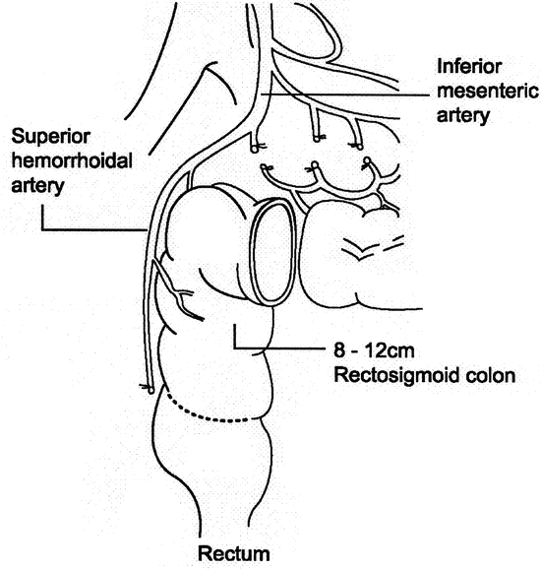
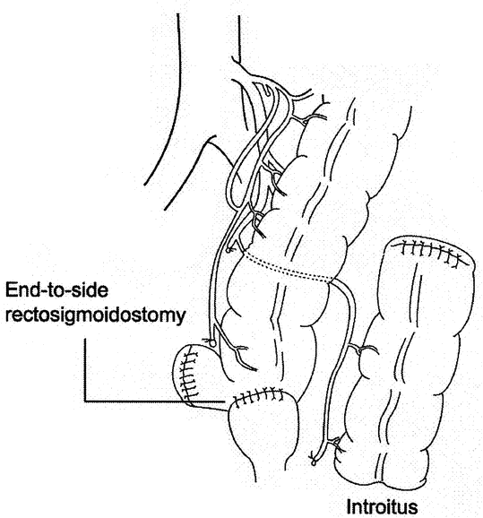
Baldwin Intestinal Transposition Variants (Colovaginoplasty)

Slide 19
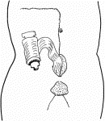
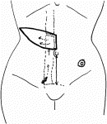
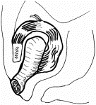
Inferior epigastric pedicled TRAM flap (Tobin 1988)

Slide 20
Transversus and Rectus Abdominis Musculoperitoneal (TRAMP) Composite Flap

Slide 21
Gracilis Myocutaneous Flap (1976)

Slide 22
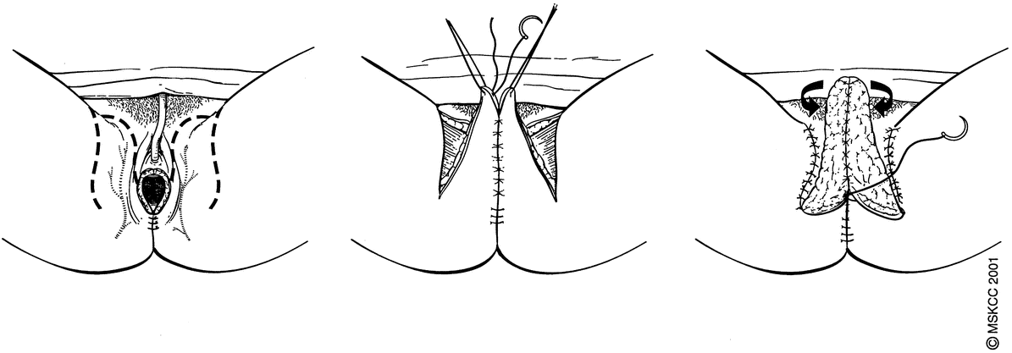
Pudendal thigh flap Wee 1989 – Singapore flap

Slide 23
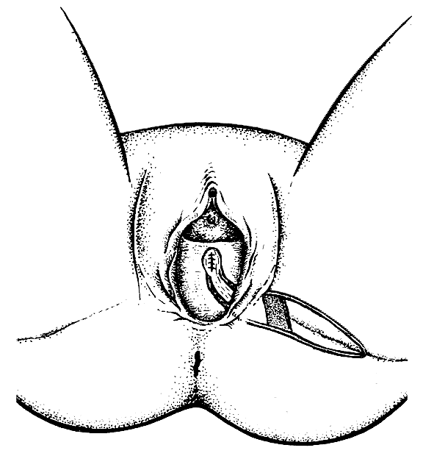
Medial thigh flap Baek 1983, Wang 1987
Anteromedial thigh flap Hayashi 1988
Superomedial thigh flap Hirshowitz 1982
Anterolateral thigh flap Luo 2000
Extended groin flap Moschella 1994
Infragluteal thigh flap Knoll (1997), Hashimoto (1999)

Slide 24
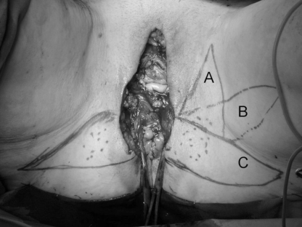
Lotus petal flap(Yi and Niranjan 1996)

Slide 25
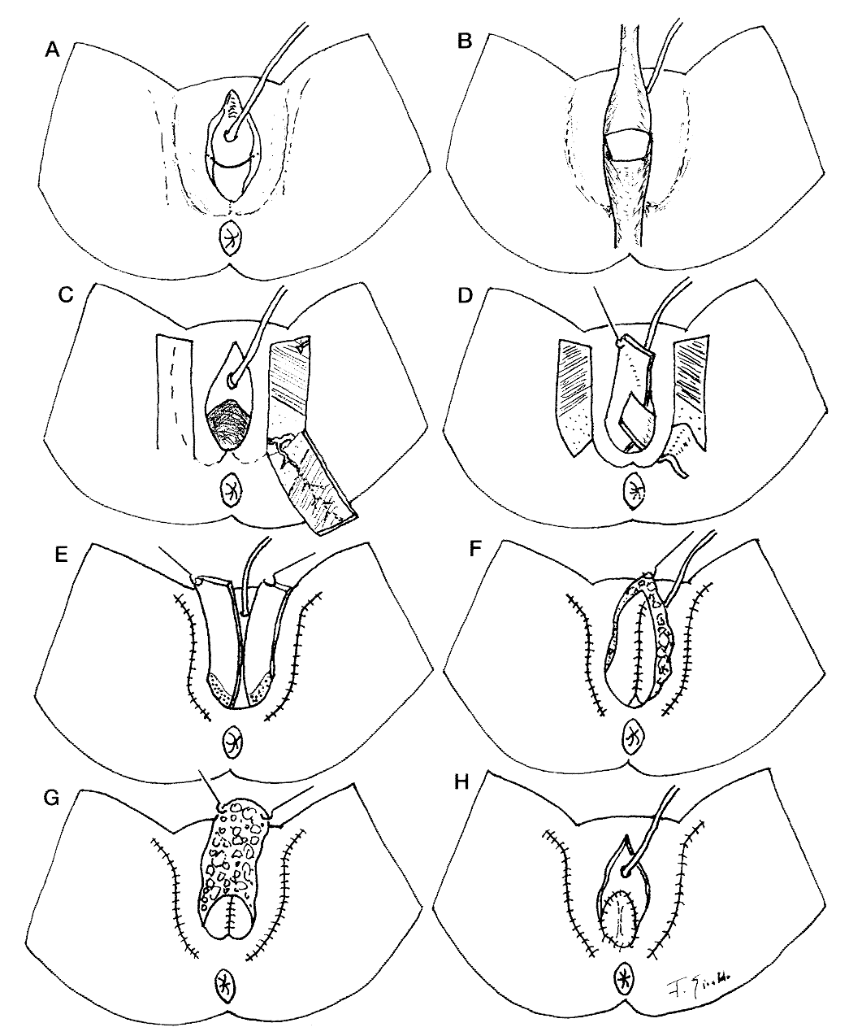
Malaga flap (Giraldo 1996)

Slide 26
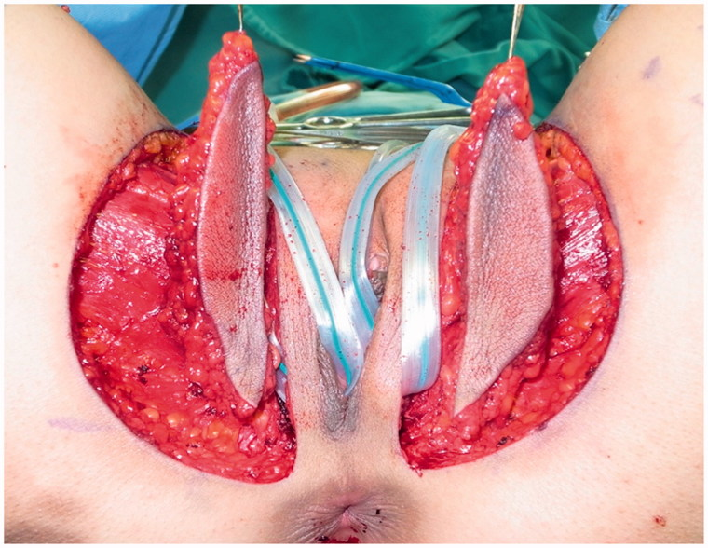
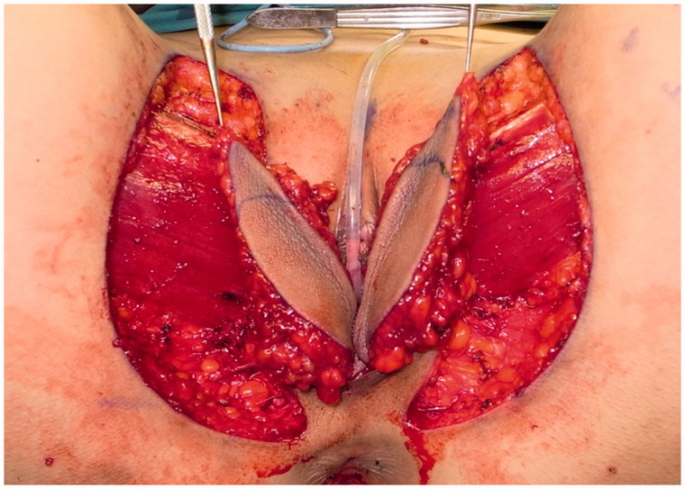
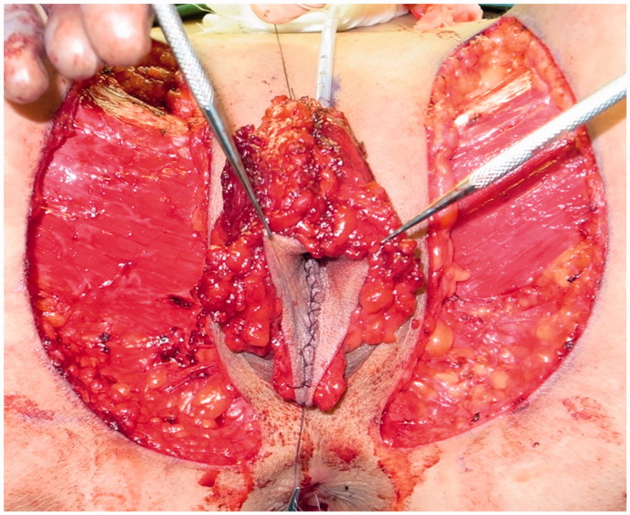

Slide 27
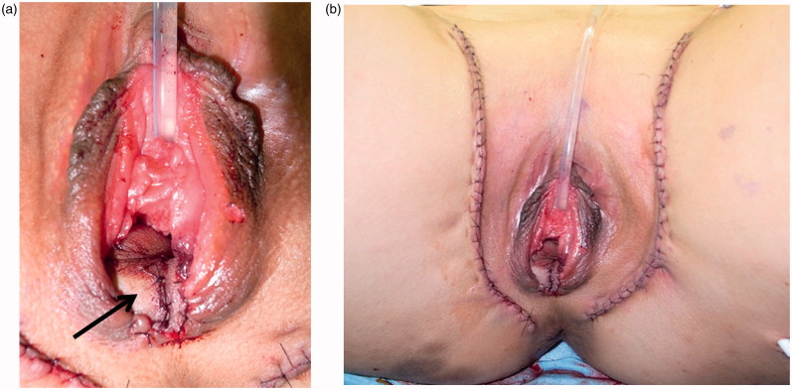

Slide 28
Drawbacks
Extensive surgery
Perigenital scars
Hairy skin
Bulky and heavy
Inadequate sensation
Dyspareunia
Tendency to prolapse

Slide 29
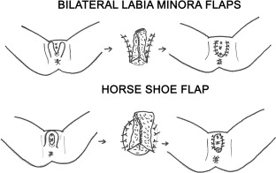

Slide 34
Advantages
Appropriate
Skin- Thin, pliable, hairless, soft, well vascularized, full thickness.
Strength - No breakdown/ stenosis
Thickness- No excessive subcutaneous tissue or fascia
Bulk- Non bulky, Adheres well in the created space, No prolapse
Sensation- Maintains erogenous sensation
Scars- No visible donor site scarring
Lubrication- Adequate lubrication, No discharge. Non odorous
After care - Manageable by self dilatation
Requires dilatation for three months at least.

