Slide 1
An interesting case of lump abdomen
Dr. Vipul metta
Surgery resident

Slide 2
Introduction
An elderly female was referred from gynaecology opd to surgery with a huge lump in abdomen.
They suspected a uterine growth but wanted a surgical opinion.
Her outside sonography was suggestive of a uterine leiomyoma
We felt that the growth was not uterine and rather a growth from the large bowel and investigated the patient further.
Clinically it was a GIST from large bowel

Slide 3
CLINICAL HISTORY
A 51 year old post menopausal female patient presented with complaint of lump in the left lower abdomen since 2 months.
Complains of dull pain over left side of lower abdomen.
No history of altered bowel habits or blood in stools
No history of fever or vomiting.
No history of hematuria or burning micturition
No history of weight loss
No history of cough or other respiratory complaints
No history of vaginal discharge

Slide 4
General Examination
Conscious and well oriented.
Moderately Built and nourished
Afebrile
Vitals- stable
No pallor, icterus, cyanosis, clubbing, generalized lymphadenopathy, edema

Slide 5
PER ABDOMEN
On inspection
Umbilicus was central and Inverted
No abdominal distention
A 15X10 cm lump is seen in the left lumbar and left iliac regions not moving with respiration
On palpation
A 15 cm x 10 cm swelling in the left iliac fossa extending upto peri umbilical and left lumbar regions
It was non tender, hard swelling with irregular surface upper border was ill defined
Lump was non-ballotable and dull to percussion.
No organomegaly or free fluid.

Slide 6
Hernial orifices normal
Per rectal examination was normal.
On per vaginal examination was normal.
other Systemic Examination within normal limits
Provisional diagnosis :
GIST arising from descending and sigmoid colon

Slide 7
Investigations
Hb: 12.2 g/dl
WBC count: 12,400/mm3
Platelet: 2.80 lakh/mm3
B.Urea - 31 mg/dl
S. creatinine: 0.89 mg/dl
LFTs: normal
Serology: negative
Chest X-ray: Normal
ECG : Normal

Slide 8
USG - Abdomen and pelvis
A 11X11 cm hypo echoic mass lesion in Left iliac Region upto left Supra umbilical Region likely to be arising from sigmoid colon
Liver is normal in size and echogenicity
Uterus was normal
Mild hydroureteronephrosis on the left side, right kidney and ureter are normal
Rest of sonographic findings are normal
CA-125 – normal
CEA - within normal limits
COLONOSCOPY-
Extrinsic compression seen in the sigmoid
no intraluminal mass or growth
Rest of bowel appears normal

Slide 9
MRI Abdomen and pelvis
A 11cm(AP) x11.5cm(transverse) x12cm(vertical) lobulated heterogenous mass lesion in left lumbar and left Iliac fossa Region arising from recto sigmoid with heterogeneous enhancement post contrast.
There are non enhancing cystic areas within the mass
It is displacing the Adjacent Bowel loops, Causing Mass effect on the Left mid ureter with Resulting mild hydronephrosis and proximal Hydroureter on left side.
No hepatic metastases
Rest abdomen is normal
Suggestive of Mesenchymal Stromal tumor - ?? GIST

Slide 10
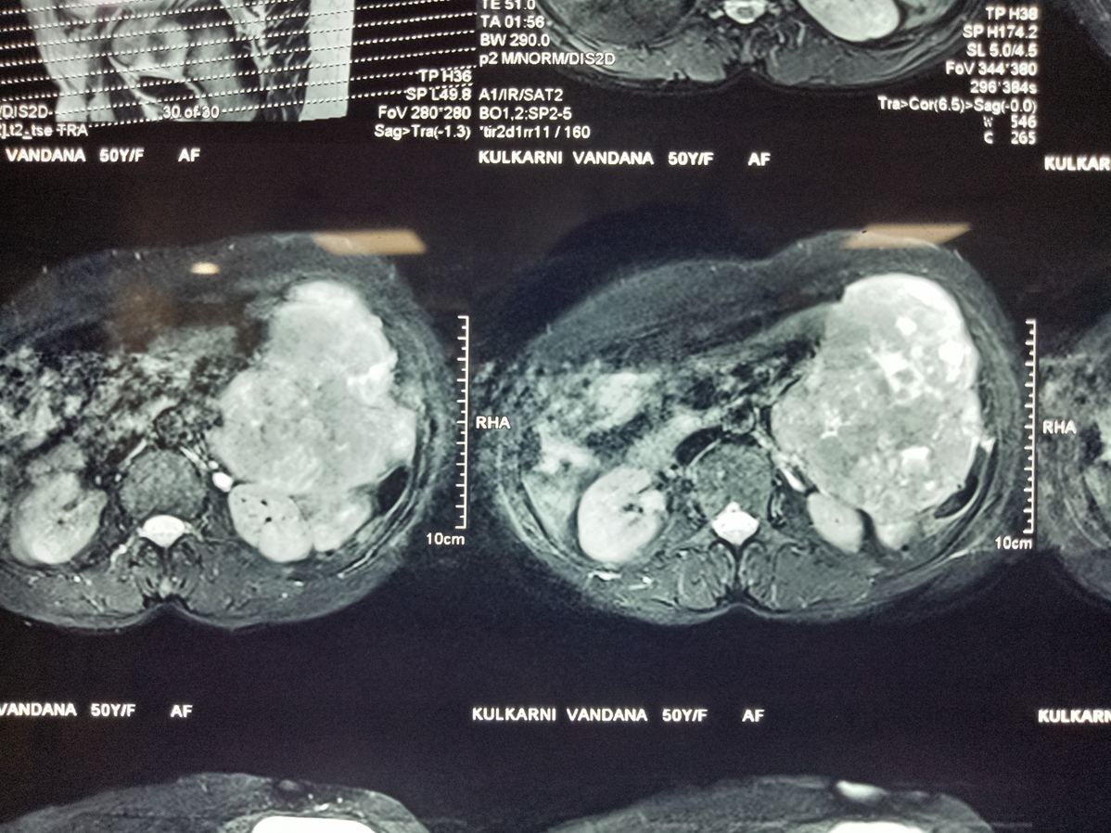
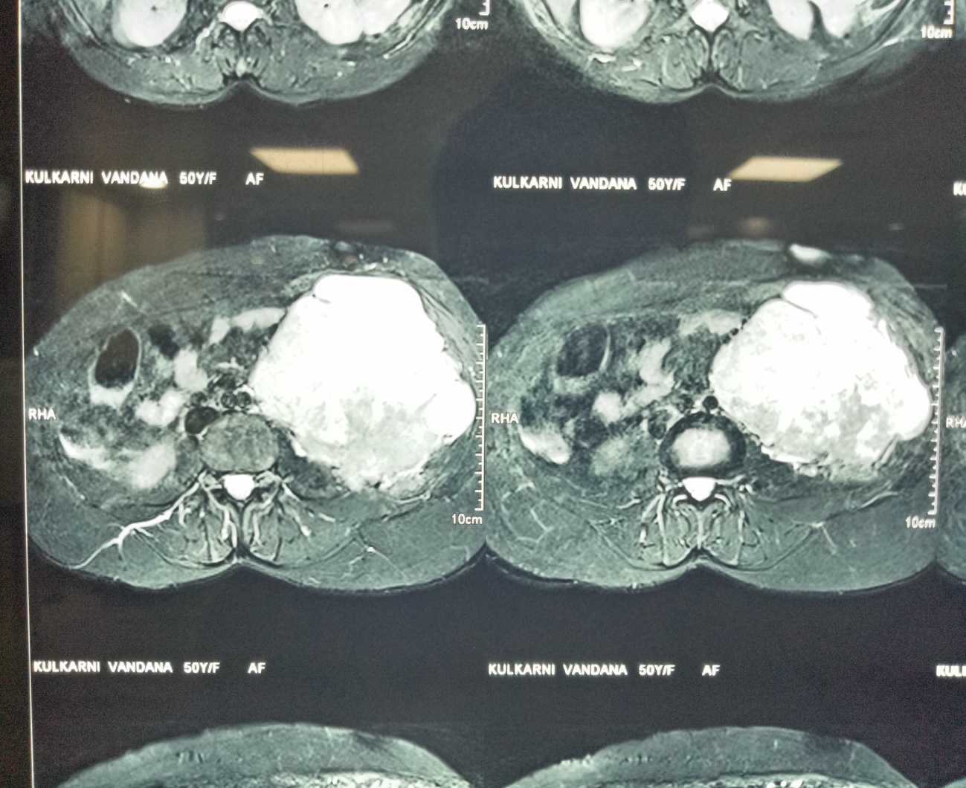
MRI – Abdomen and Pelvis

Slide 11
Intra operative finding
Patient Underwent explorative laparotomy under General anaesthesia with a stand by urologist
A large Irregular mass with Nodular surface arising from the wall of sigmoid colon occupying most of the left half of the abdominal cavity. The left ureter was seen to be encased by the mass causing dilated proximal ureter and compressing the left kidney
No peritoneal or liver nodules found
No enlarged lymph nodes found
Rest of the bowel was normal

Slide 12
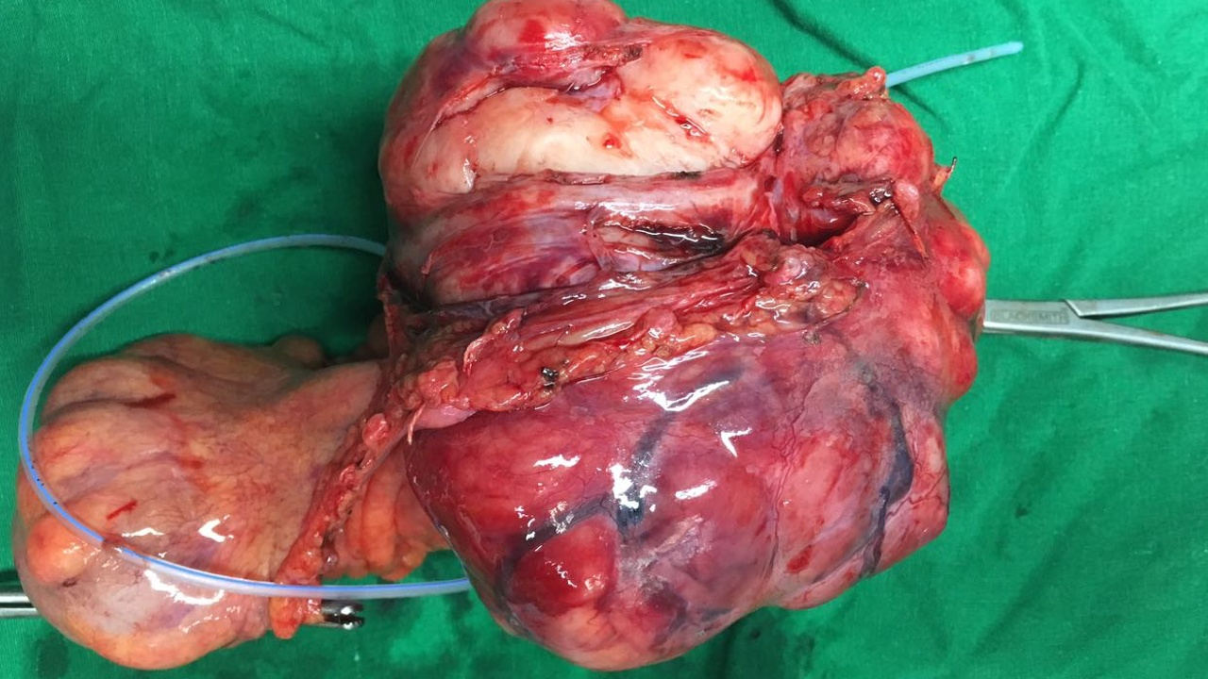
Mass encasing the mid ureter which was excised along with it from the colon.

Slide 13
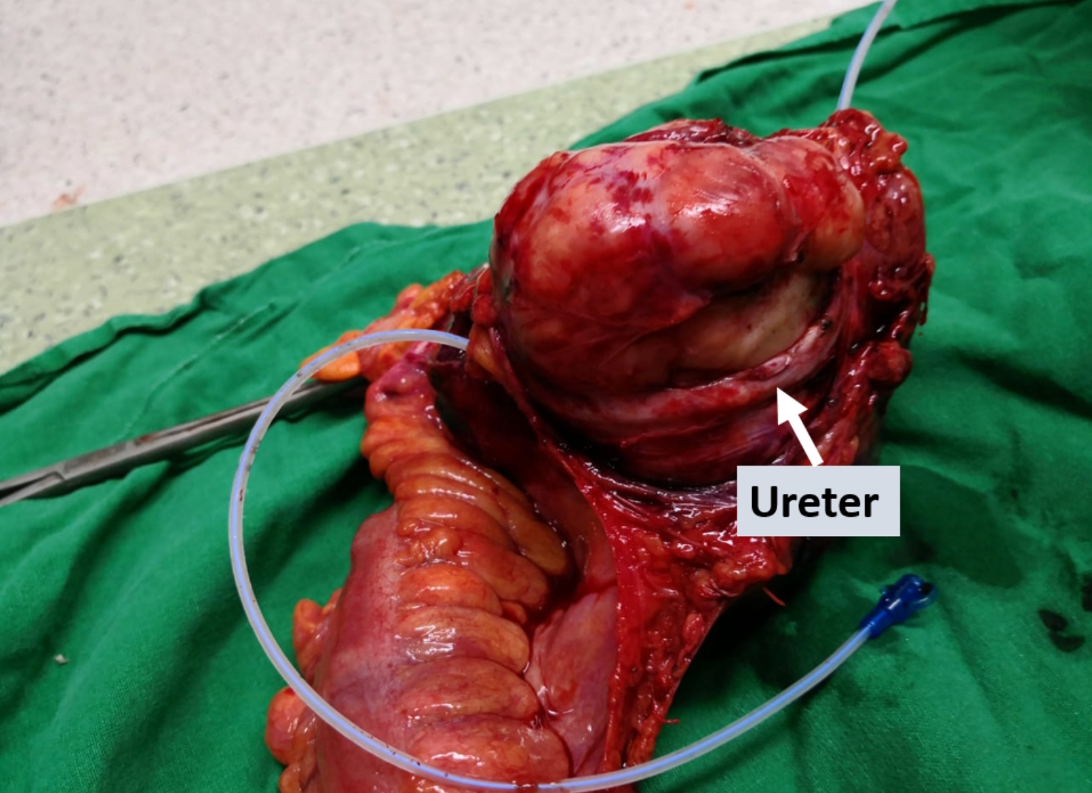

Slide 14
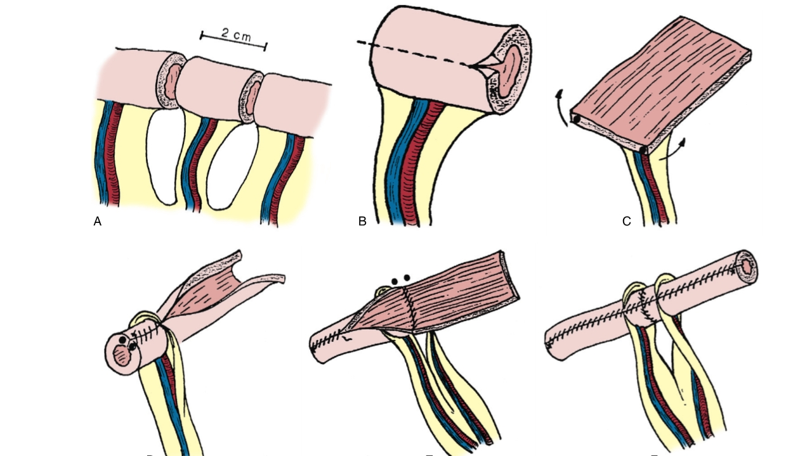
Procedure
Sigmoidectomy with Colo - rectal anastomoisis with ileal interposition.
Yang - monti’s procedure with left Dj stenting

Slide 15
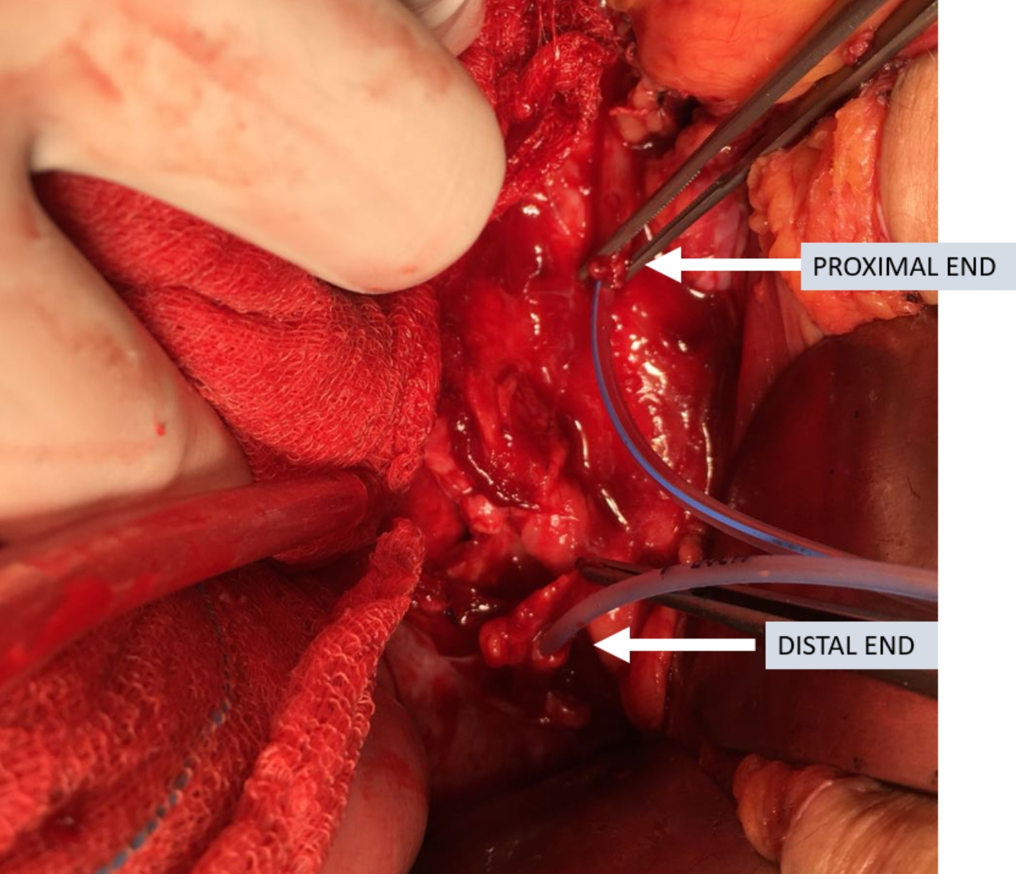

Slide 16
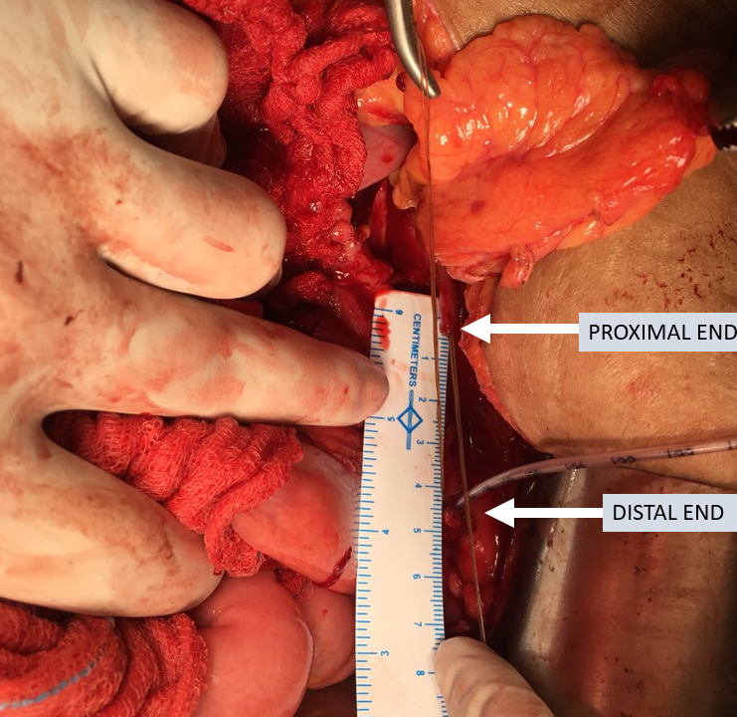
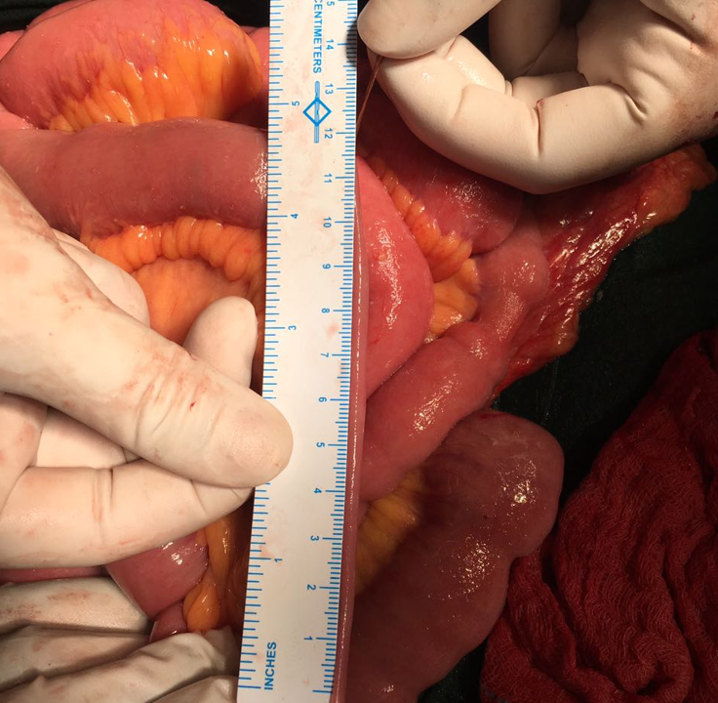
Distance between the proximal and distal cut ends of ureter
Length of ileal graft needed

Slide 17
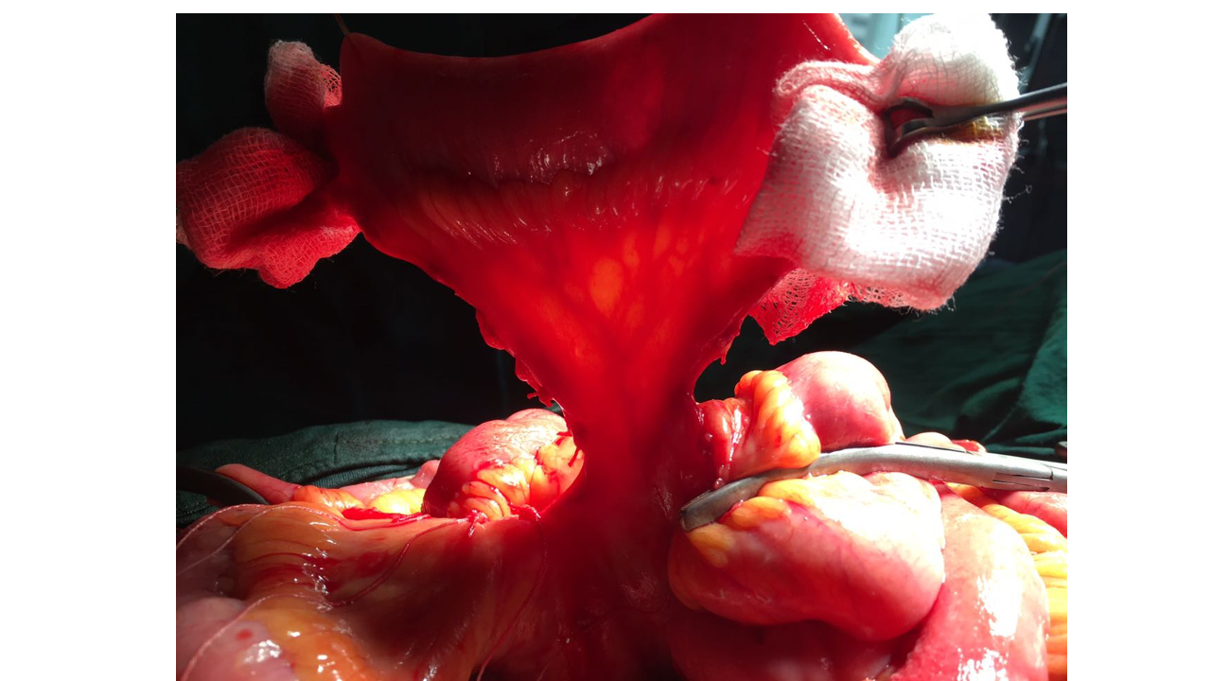
The ileal graft used for reconstruction of ureter. Two such grafts were used

Slide 18
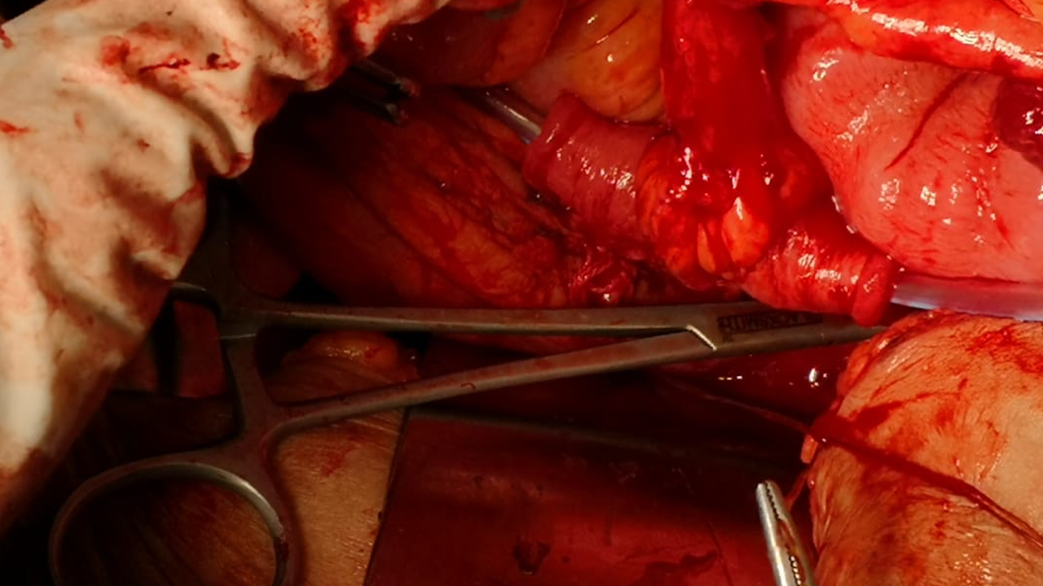
The ileum was opened vertically and sutured horizontally and tubularized for uretero- ileal anastomosis

Slide 19
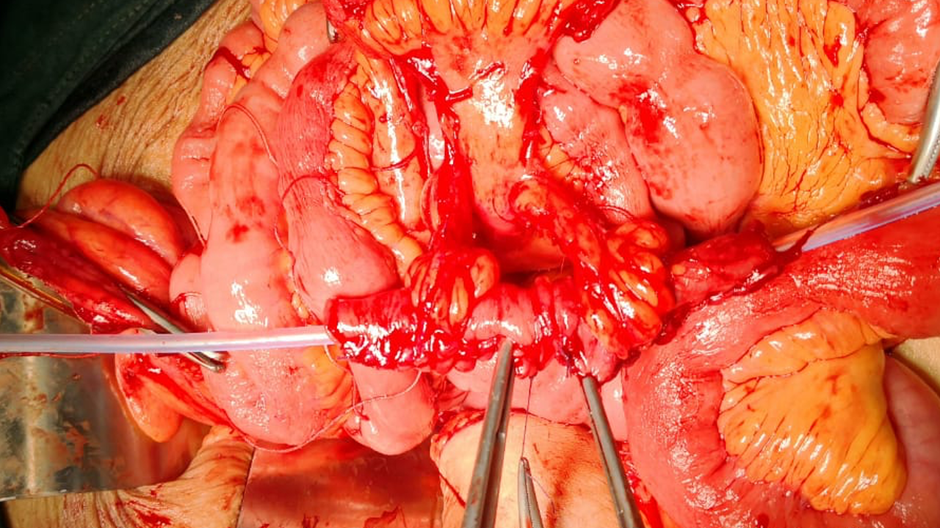
Ileo ileal anastomosis

Slide 20
Ileal graft
Dj stent
Distal ureter
Ileum anastomosed to distal ureter with dj stent

Slide 22
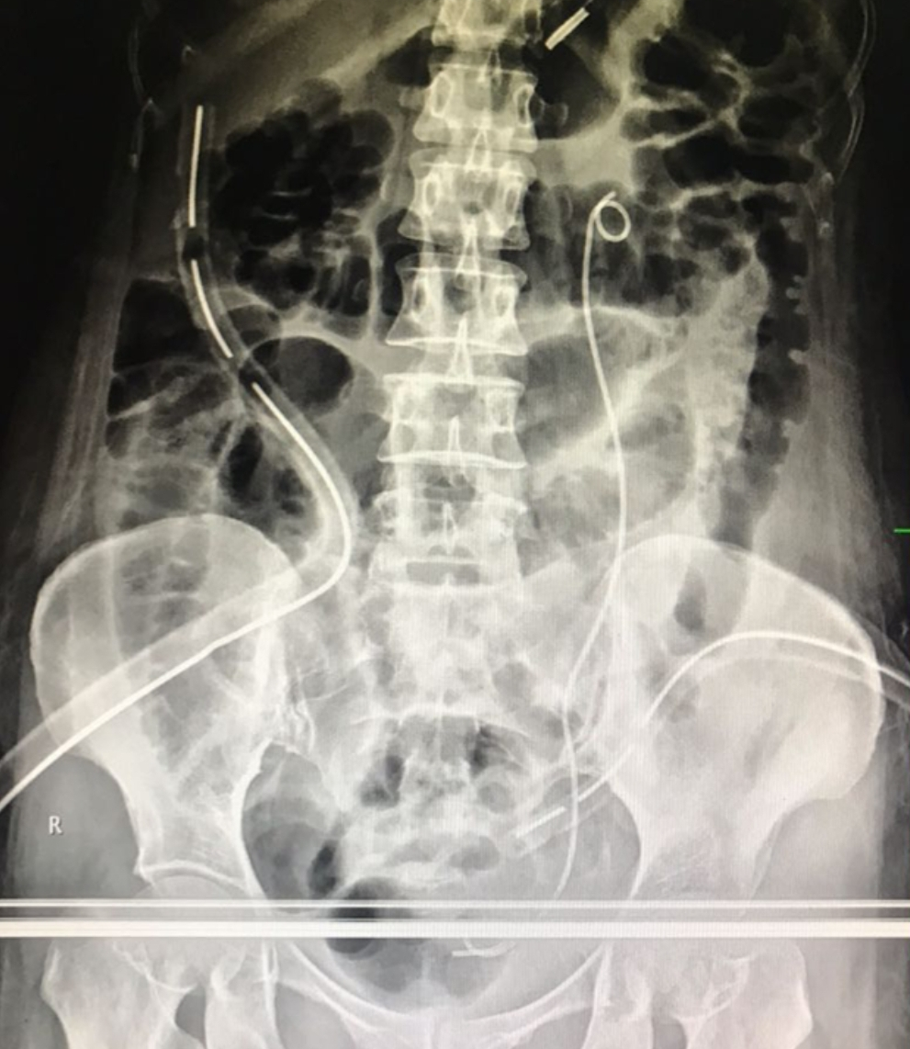
-At the end of procedure patient had
2 uretero ileal anastomoses
2 ileoileal anastomoses
-Drains were placed in the pelvis and hepatorenal pouch
-Patient was shifted to sicu and monitored

Slide 23
Post operative period
Patient had good urinary output initially
From pod 3 there was an increase in the pelvic drain collection with a slight decrease in urine output suggesting an anastomotic leak
Iv pyelography was done which showed a block in the ureter due to mucous plug from the ileal secretions
Cystoscopy was done on pod 7 and the dj stent was replaced with a silicon stent
Left PCN was done to divert the urine
Over 3 weeks the patient recovered and the nephrostomy was closed
Drains were removed as the drain output reduced
Patient recovered well and was discharged.

Slide 24
Histopathology examination
HPE suggestive of a spindle cell tumor arising from sigmoid colon, possibilities of
-low grade MALIGNANT PERIPHERAL NERVE SHEATH TUMOR
-GASTROINTESTINAL STROMAL TUMOR
-LEIOMYOSARCOMA.
IHC was done
CD 117 negative
DOG 1 negative
Desmin positive
Smooth muscle actin positive
Pathological examination suggestive of LEIOMYOSARCOMA of sigmoid colon

Slide 25
DISCUSSION
Primary mesenchymal sarcomas of the gastrointestinal tract are rare and constitute only 0.1–3% of all gastrointestinal tumors .
Leiomyosarcoma (LMS) is the most common variant of these tumors and represents only 0.12% of all colon malignancies.
LMS most commonly originates in the uterus, GI tract, and retroperitoneum. With in the GItract, the stomach is the most common site followed by the small intestine, colon, and rectum.
Surgery is the main treatment for primarycolonic LMS, asmost of the reported cases were diagnosed using surgically resected specimens. While adjuvant chemotherapy and/or radiation are often used in the management of primary colonic LMS, there are conflicting data on their efficacy and impact on overall survival.[4]
Due to increased incidence and histological similarity with GIST, in past leiomyosarcoma, were misdiagnosed as GIST. Immunohistochemistry is the crux of the diagnosis. GIST stains positive for CD 34 and C‑kit (CD 117) andstains negative for desmin in contrast to leiomyosarcomas which are positive for desmin and negative for CD117, CD34, and DOG1.[5]
Immunohistochemistry is unavoidable tool in diagnosis of leiomyosarcoma and should be considered in GIST, particularly in unusual sites. In contrast to GIST which is curable with surgery followed by imatinib (in intermediate and high risk patients), leiomyosarcomasbehave aggressively requiring radical excision of tumor followed by intensive cytotoxic chemotherapy regimens. Radiotherapy has only a limited role.[6]

Slide 26
REFERENCES
[1] A. Yaren, S. De˘girmencio˘glu, N. Callı Demirkan, A. G¨okçen Demiray, B. Tas¸k¨oyl¨u, and G. G. Do˘gu, “Primary mesenchymal tumors of the colon: a report of three cases,” Turkish Journal of Gastroenterology, vol. 25, pp. 314–318, 2014.
[2] K. Iwasa, K. Taniguchi, M. Noguchi, H. Yamashita, and M. Kitagawa, “Leiomyosarcoma of the colon presenting as acute suppurative peritonitis,” Surgery Today , vol. 27, no. 4, pp. 337–344, 1997.
[3] P. Singh, B. Bello, C. Weber, and K. Umanskiy, “Rectal leiomyosarcoma in association with ulcerative colitis: a rare condition with an unusual presentation,” International Journal of Colorectal Disease, vol. 29, no. 7, pp. 887-888, 2014.
[4] Babichev Y, Kabaroff L, Datti A, et al. PI3K/AKT/mTOR inhibition in combination with doxorubicin is an effective therapy for leiomyosarcoma. J Transl Med 2016;14:67.
[5] Aggarwal G, Sharma S, Zheng M, Reid MD, Crosby JH, Chamberlain SM, et al. Primary leiomyosarcomas of the gastrointestinal tract in the post‑gastrointestinal stromal tumor era. Ann Diagn Pathol 2012;16:532‑40.
[6] Cite this article as: Kiran P, Shiny PM, Dhanya KS, Aravindan KP. Diagnosis of leiomyosarcoma of colon. J Can Res Ther 2015;11:1035.

