Slide 1
DUAL THYROID ECTOPIA : A CASE REPORT
PRESENTER : DR. AMALA GHALSASI
CO-AUTHOR : DR. (MRS.) D.S. NIRHALE
DR. D. Y. PATIL MEDICAL COLLEGE, HOSPITAL AND RESEARCH CENTRE PIMPRI, PUNE

Slide 2
INTRODUCTION
Ectopic thyroid refers to thyroid tissue being in locations other than the normally located thyroid gland.^{[1]}
Ectopic thyroid is a rare developmental anomaly with a reported prevalence between 1:100000 and 1:300000 and a clinical incidence 1:4000 to 1:10000. ^{[2]}
It is more unusual for two distinct foci of ectopic thyroid tissues to be present simultaneously.
Only 30 cases of dual ectopic thyroid so far have been reported in literature, with the majority of them in the midline region of the anterior neck. ^{[3]}

Slide 3
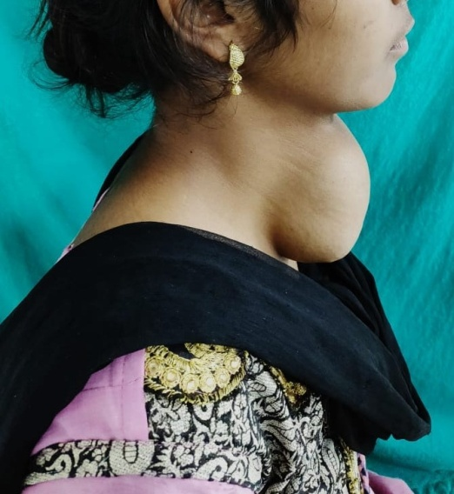
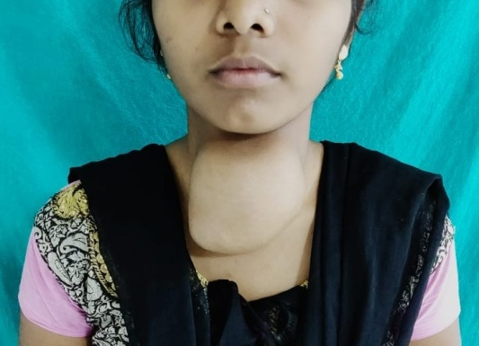
CASE REPORT
A 18 year old female patient came with the complaints of swelling in anterior aspect of neck since 7 years which had gradually progressed in size over this period
Patient had no complaints suggestive of hyper or hypothyroidism
On examination : 10 x 10 cm spherical swelling in anterior aspect of neck with smooth surface ,well defined margins, extending from the hyoid bone to the suprasternal notch, cystic in consistency, moving with deglutition
There was no obvious swelling in oropharynx

Slide 4
WORK UP
Ultrasound of neck was suggestive of 8 x 6 cm cystic lesion with calcific foci . Thyroid lobes and isthmus could not be visualized separately.
FNAC of swelling was suggestive of colloid goitre.
CT scan of neck revealed :
1. Ectopic lingual thyroid at base of tongue in midline at the site of foramen caecum ( 9x8x13mm).
2. Large, lobulated, multiseptate, hypodense lesion measuring 8.9 x 8.5x6.9 cm in midline extending on either side of midline in pretracheal region suggestive of complex thyroglossal cyst .
3. Normal orthotopic thyroid gland not seen in usual location.

Slide 5
Radioiodine scan was suggestive of :
1. Functioning thyroid tissue in the thyroglossal cyst
2. Ectopic lingual thyroid
Patients TFT’s were : T3- 1.1,T4 – 8.1,TSH- 32.1
Patient was started on L- Thyroxine 150 mcg daily
Indirect laryngoscopy was normal.
As patient had no complaints related to lingual thyroid only thyroglossal cyst excision was planned .
Thyroglossal cyst excision was done and specimen was sent for histopathological examination.
Histopathogy report was consistent with thyroglossal cyst with thyroid tissue with changes of multinodular goitre .No evidence of malignancy.

Slide 6
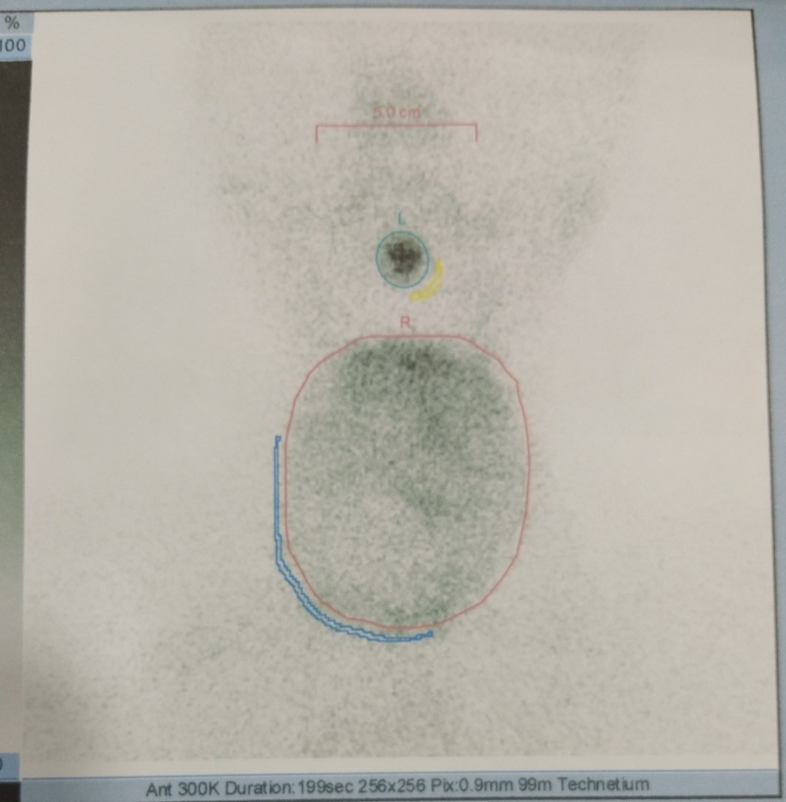
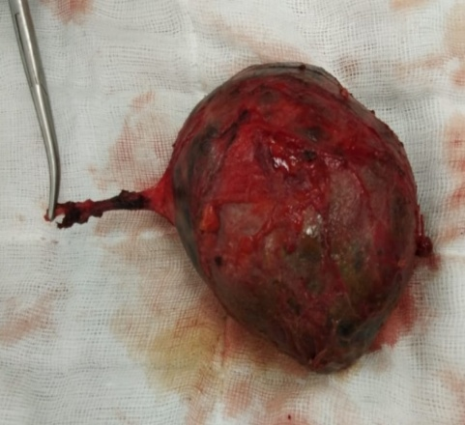
Technitium 99 scan
Excised specimen of Thyroglossal cyst with duct

Slide 7
DISCUSSION AND CONCLUSION
Most ectopic thyroid glands are asymptomatic and benign and commonly detected during periods of increased demand for thyroid hormones, e.g., puberty and pregnancy.
Malignant transformation has been reported in 1-3% of cases, and approximately 80% of such tumors are papillary carcinomas. ^{[4]}
Radionuclide thyroid imaging employing Technetium-99m pertechnetate, iodine-131 or iodine 123 is useful in the evaluation for ectopic thyroid.
This is crucial to know before surgical removal of the ectopic tissue since in more than half of the patients with thyroid ectopy, no other functioning thyroid tissue exists. ^{[5]}

Slide 8
REFERENCES
Ibrahim NA, Fadeyibi IO. Ectopic thyroid: etiology, pathology and management. Hormones (Athens). 2011;10(4):261–9.
Noussios G, Anagnostis P, Goulis DG, Lappas D, Natsis K. Ectopic thyroid tissue: anatomical, clinical, and surgical implications of a rare entity. Eur J Endocrinol. 2011;165
Yoon JS, Won KC, Cho IH, Lee JT, Lee HW. Clinical characteristics of ectopic thyroid in Korea. Thyroid. 2007;17:1117–21.
Madhurkar R, Acharya D, Ravichandra G, Vasu CK, Haris A. Dual thyroid ectopia: A rare case report. J Evol Med Dent Sci 2013;2:5601-4
Sood A, Seam RK, Gupta M, Raj Sharma D, Bhardwaj P. Dual ectopic thyroid: A case report with review of literature. Iran J Radiol 2011;8:29-32.
Ibrahim NA, Fadeyibi IO. Ectopic thyroid: Etiology, pathology and management. Hormones (Athens) 2011;10:261-9.
Hari CK, Kumar M, Abo-Khatwa MM, Adams-Williams J, Zeitoun H. Follicular variant of papillary carcinoma arising from lingual thyroid. Ear Nose Throat J 2009;88:E7.
Yoon JS, Won KC, Cho IH, Lee JT, Lee HW. Clinical characteristics of ectopic thyroid in Korea. Thyroid 2007;17:1117-21

