Slide 1
CASE DETAILS
11 yr old female child referred to our opd for renal transplant evaluation.
Donor was her maternal grandmother with positive history of recent onset hypertension.
Patient had history of multiple surgeries in the past for correction of various congenital abnormalities

Slide 2
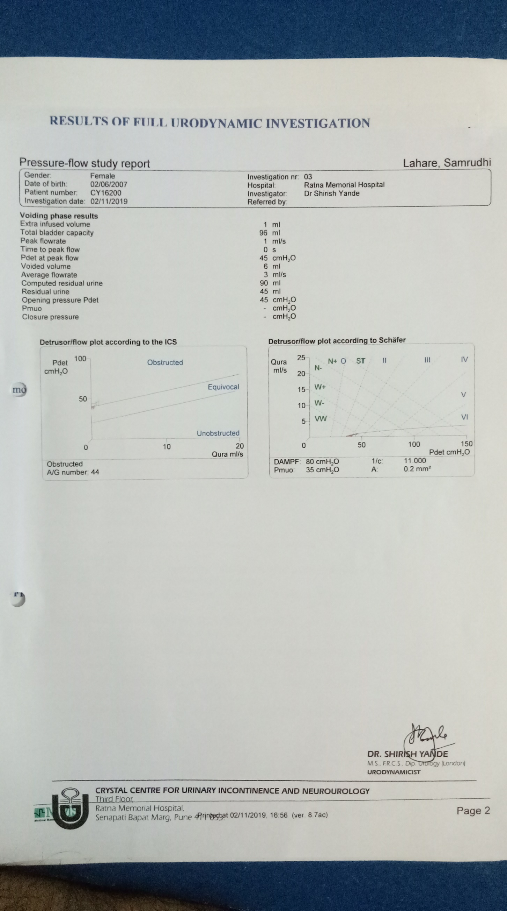
INVESTIGATIONS
USG KUB | Bilateral gross Hydronephrosis and Hydroureteronephrosis Bilateral paper thinned cortex. Lost B/L CMD Pre void 85 ml, post void 50 ml
Urodynamics.
Radionuclide MCU | Suggestive of Rt. VUR grade IV
Cystoscopy and RGP | Small Capacity Bladder Multiple Trabeculations Right Gross Hydroureteronephrosis secondary to VUR.

Slide 3
REVIEW
Structural urologic abnormalities resulting in dysfunctional lower urinary tract leading to end stage renal disease may constitute up to 20-30% in the pediatric population.
Few similar cases have been reported in literature with most extensive multi institutional review being of David A. Hatch et.al. that out of 30 pediatric patients with requirement for transplant with urinary diversion/bladder augmentation:
1) 17 had augmented bladder
2)12 had incontinent urinary conduits.
3)1 had continent urinary reservoir

Slide 4
CASE DETAILS
In view of the high grade Rt.VUR and anticipated risk of post transplant recurrent UTI , pre transplant Rt. Nephroureterectomy was done.
Post which patient was planned for Live related donor renal transplantation after 6 weeks once patient had recovered from first surgery

Slide 5
PLAN
As the patient was having neurogenic bladder and was not willing for life long CIC a decision for urinary diversion by ileal conduit was taken.
The native ureter and the new transplanted kidney’s ureter were Re implanted into an isolated segment of ileum,with Distal end of ileal segment coming out of abdomen as stoma.

Slide 6
SURGERY
Live Related donor Renal transplantation with urinary diversion using ileal conduit and reimplantion of the native ureter and transplanted kidney ureter into the conduit
Donor kidney was placed into the Rt. Iliac fossa ,with vascular anastamosis done to the iliac vessels (Rt).

Slide 7
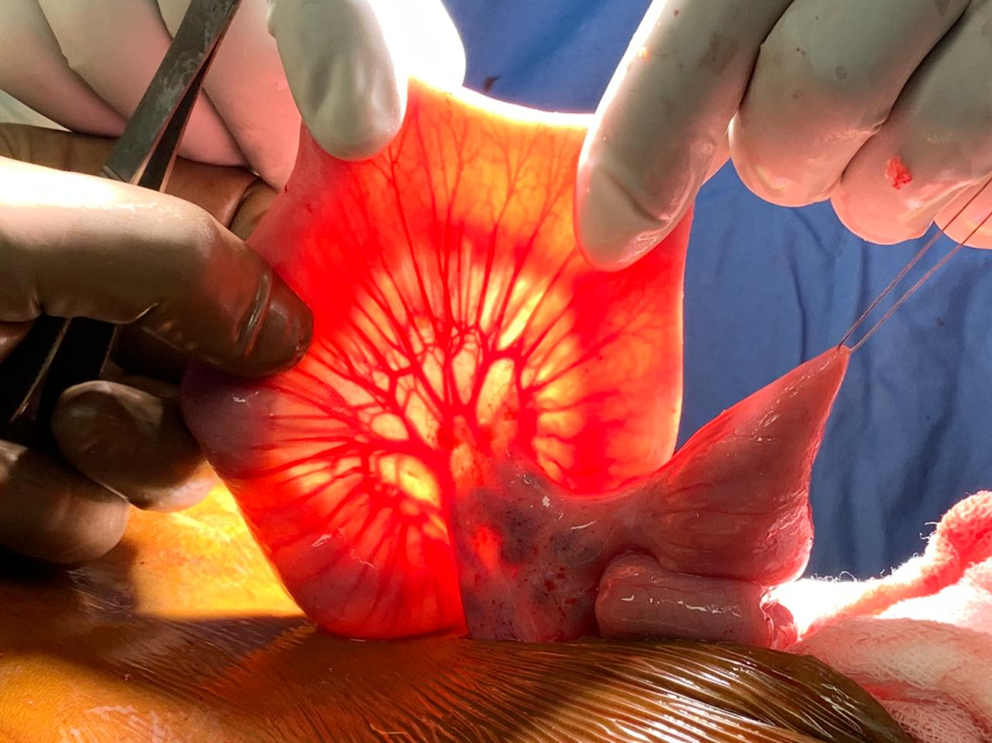
Segment of ileum for conduit
Mesentric vessels

Slide 8
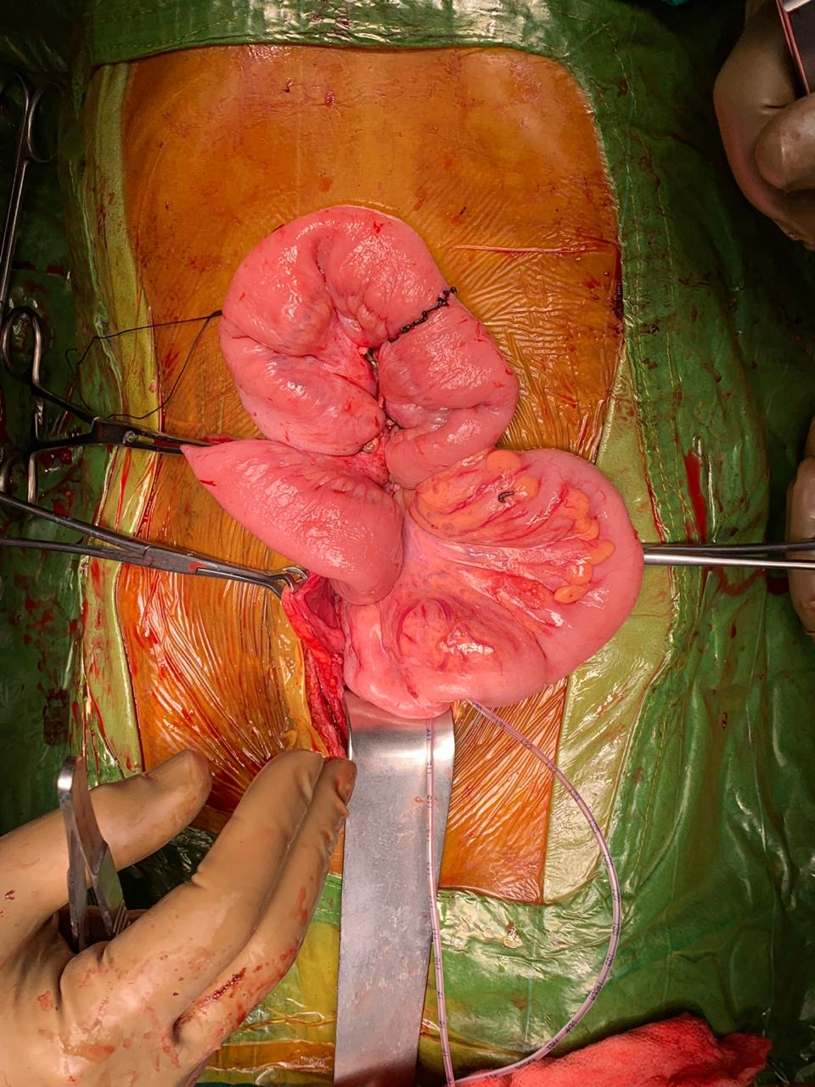
Ileoileal anastamosis
Isolated segment for conduit

Slide 9
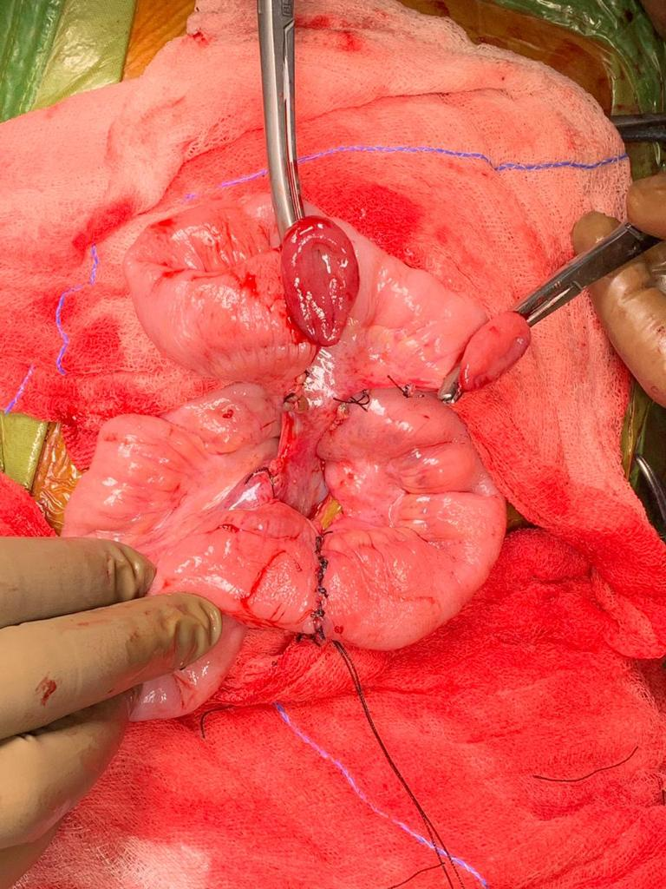
Isolated ileal segment
Mesentry supplying the
conduit segment
Ileoileal anastamosis

Slide 10
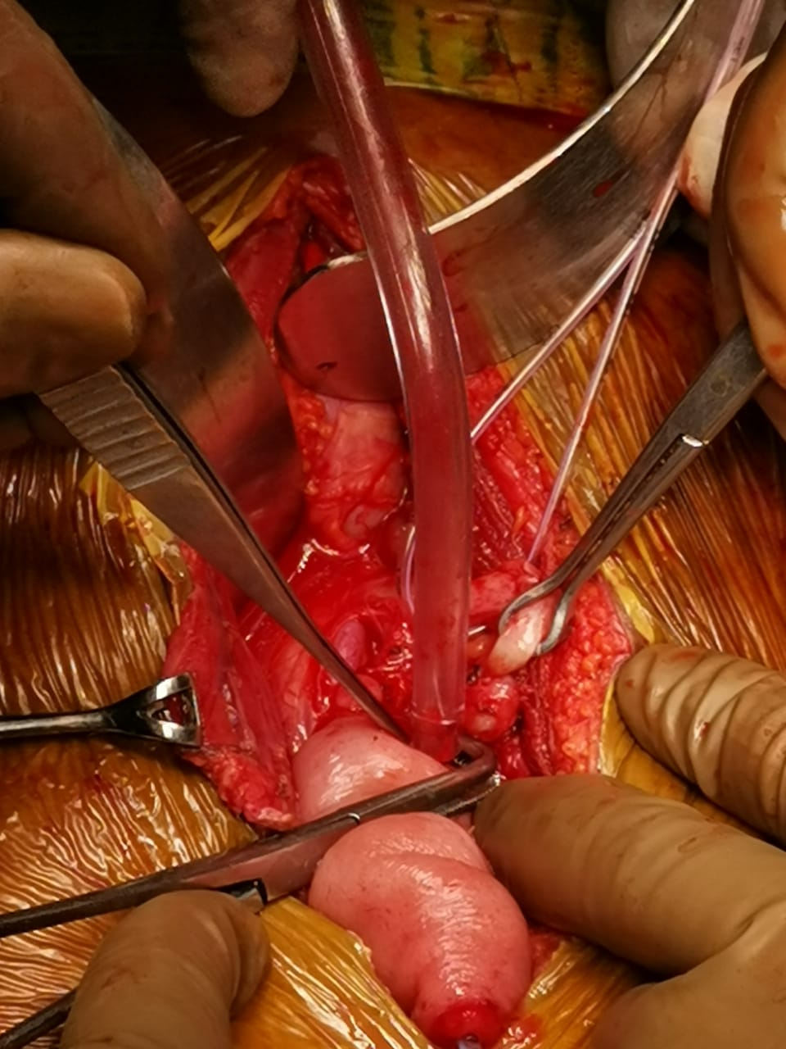
Left ureter being isolated for
reimplantation

Slide 11
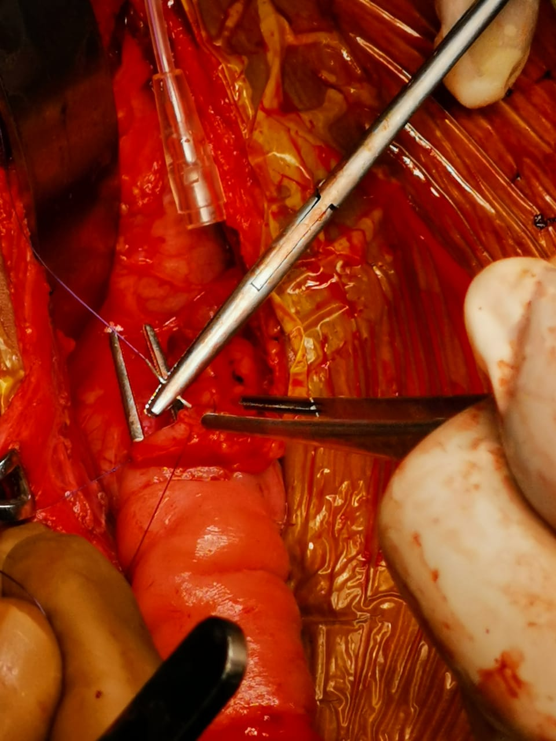
Primary stitch for reimplant
With vicryl 3-0 RB

Slide 12
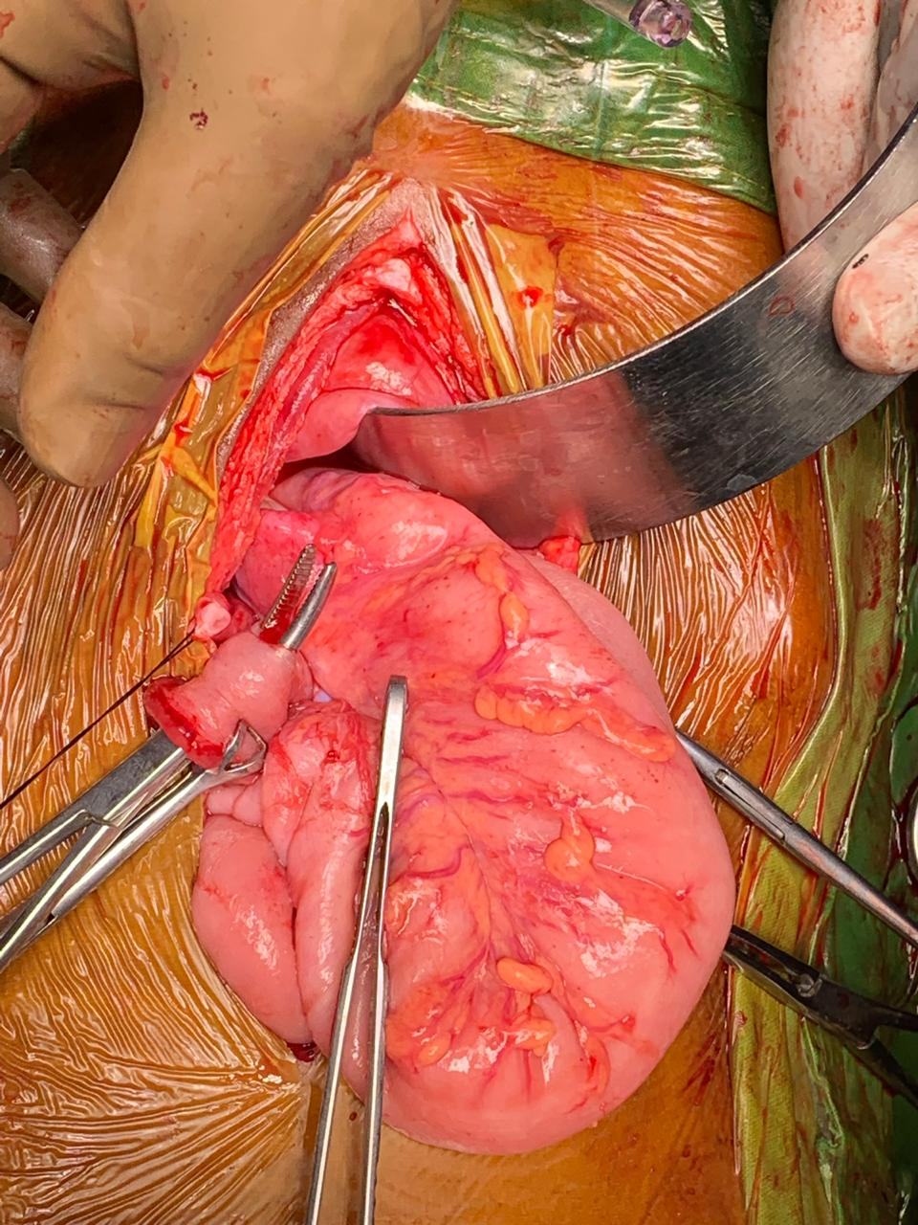
Reimplantation site
ureter

Slide 13
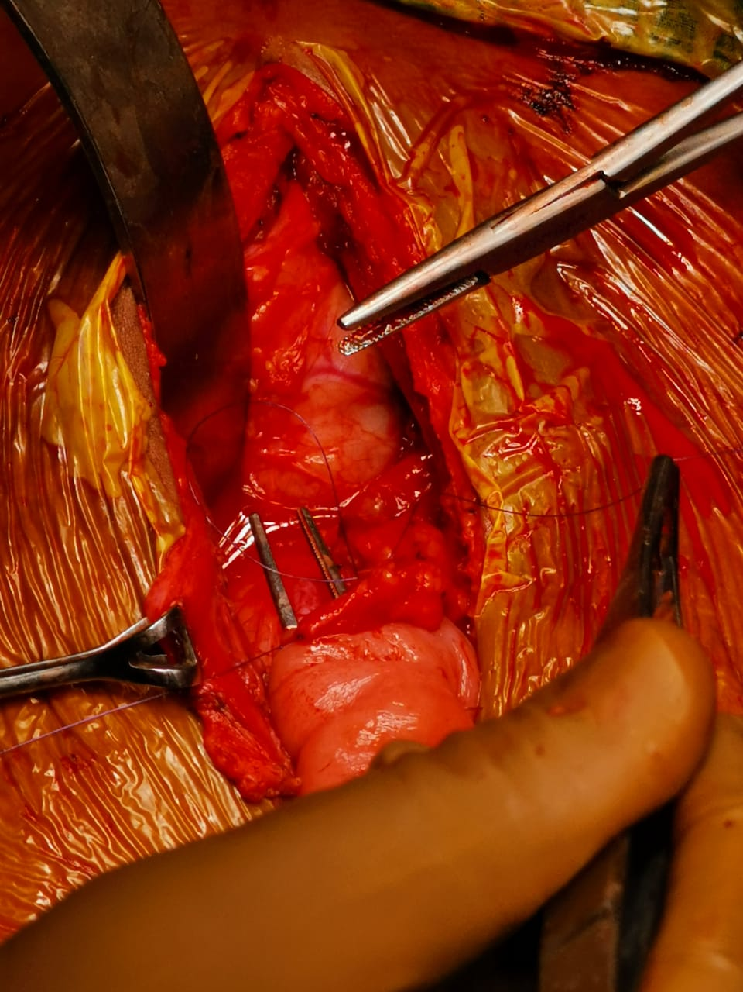
Spatulated ureter

Slide 14
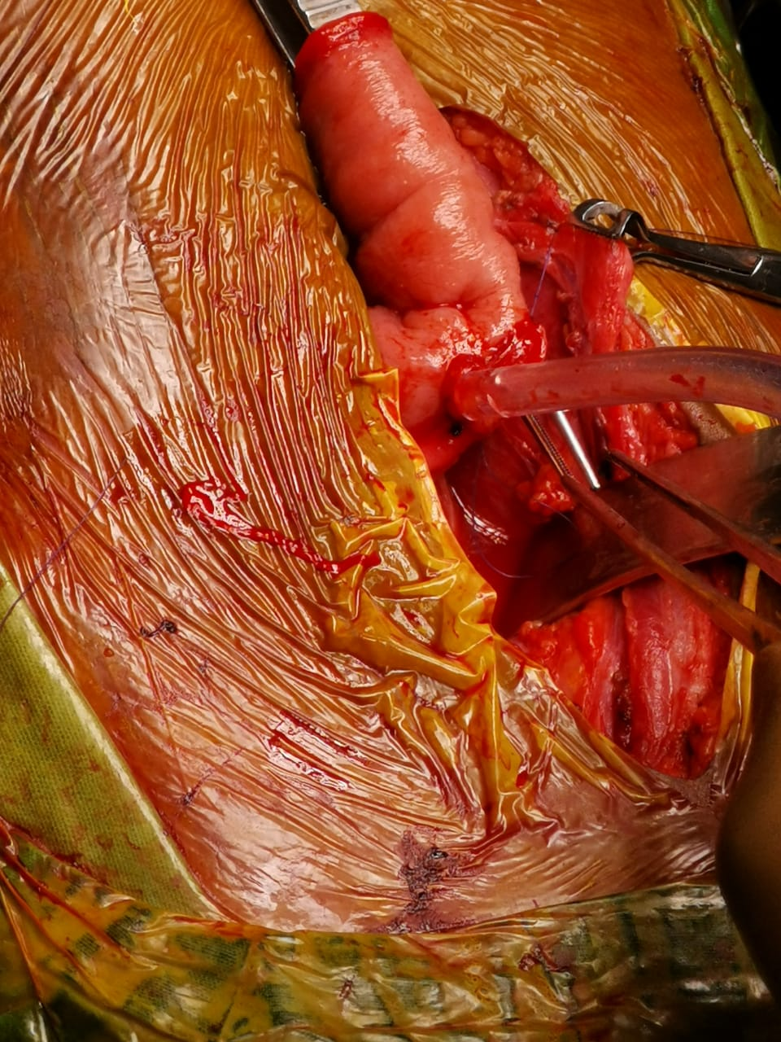
Left ureter
Right ureter

Slide 15
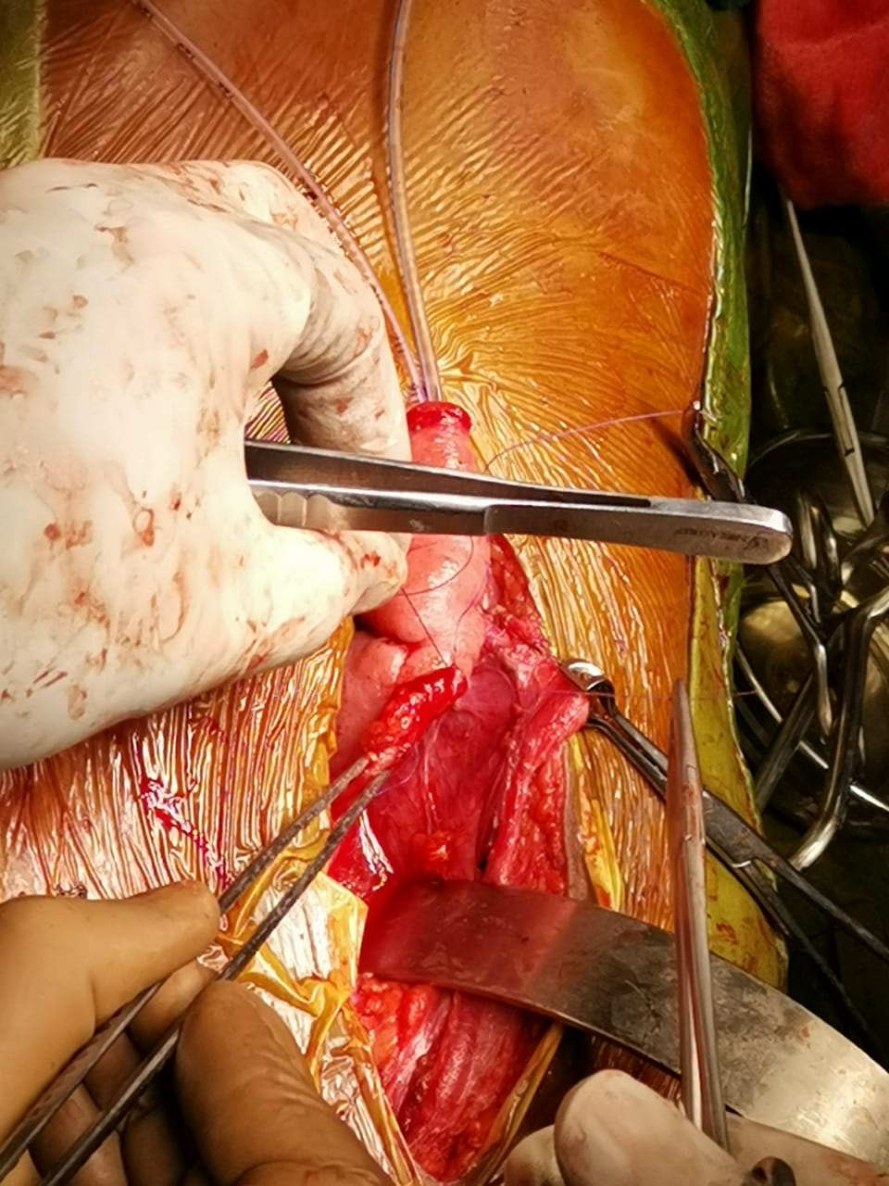
Ureter being reimplanted
Kidney

Slide 16
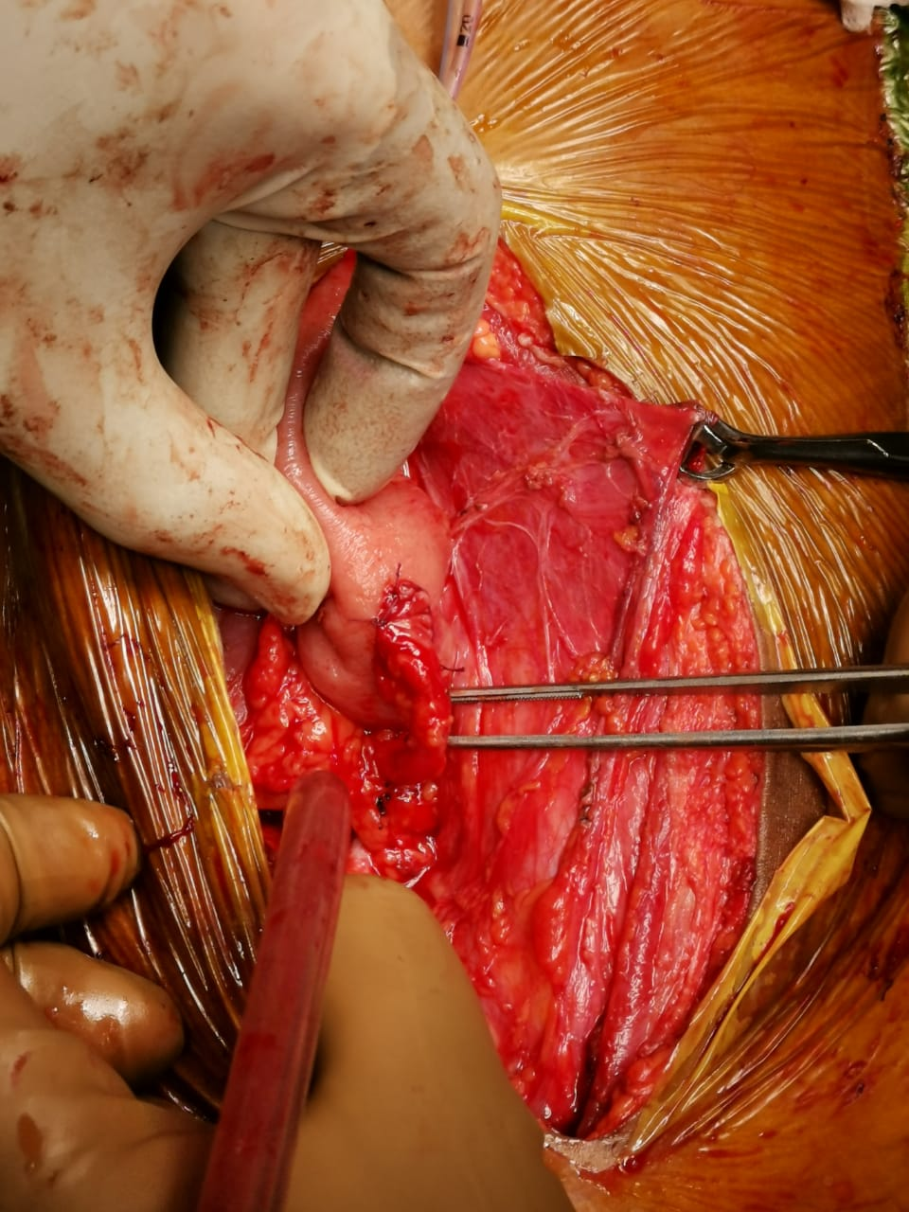

Slide 17
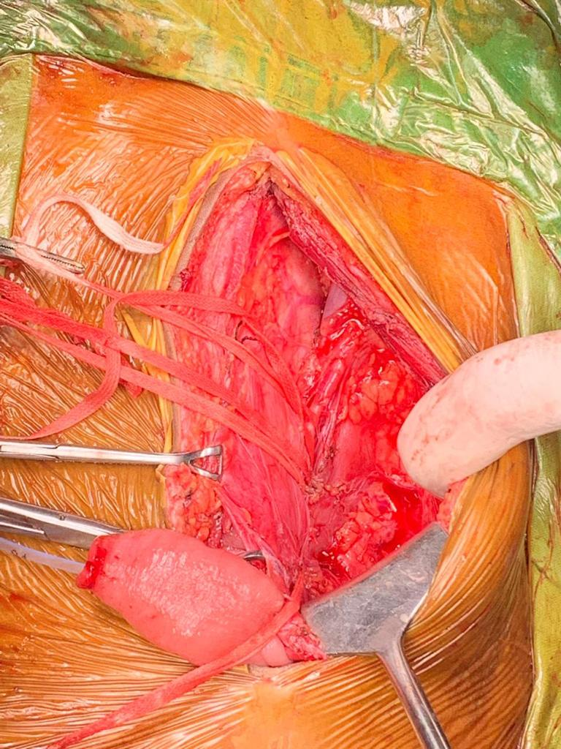
Trasnplanted kidney
Iliac vessels
conduit

Slide 18
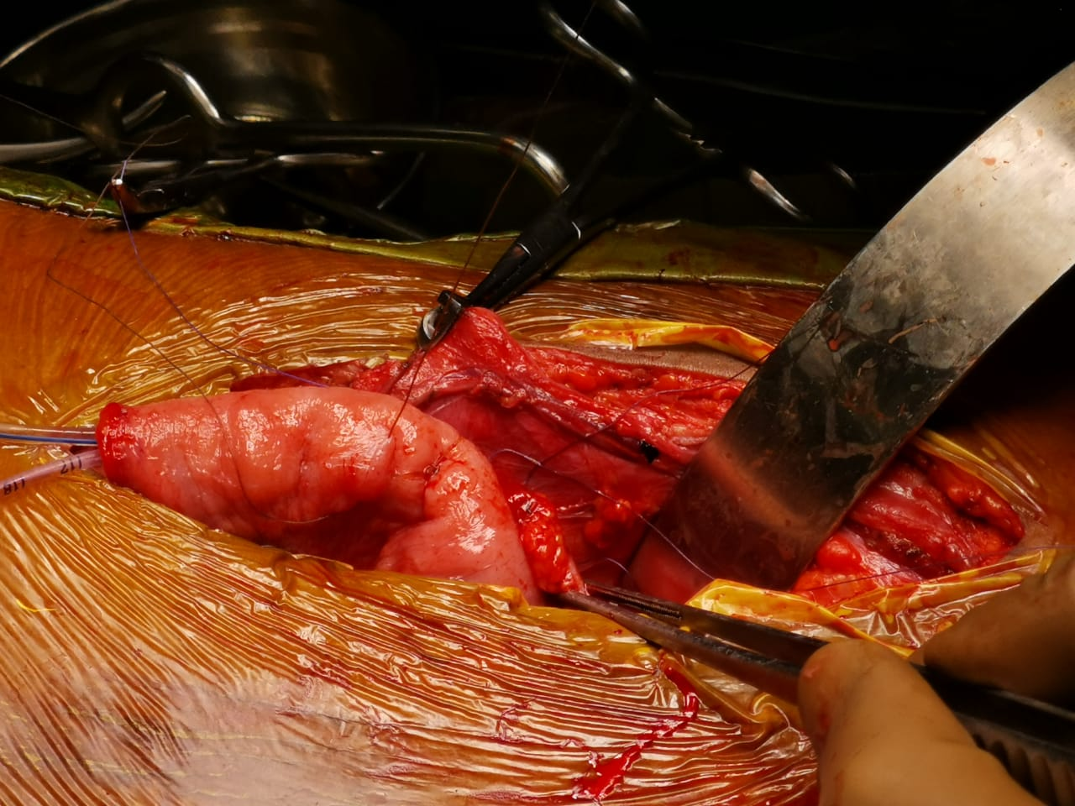
ureter
Ileal conduit


Slide 19
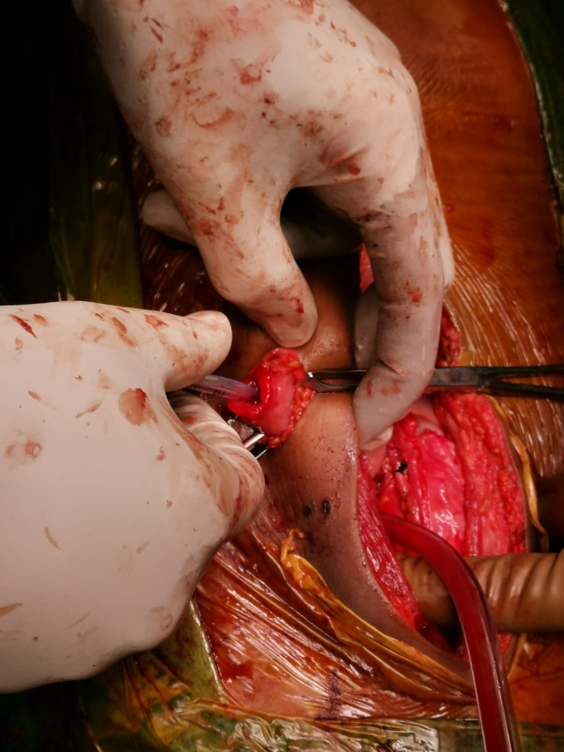
Ileostomy with IFT through stomal opening

Slide 20
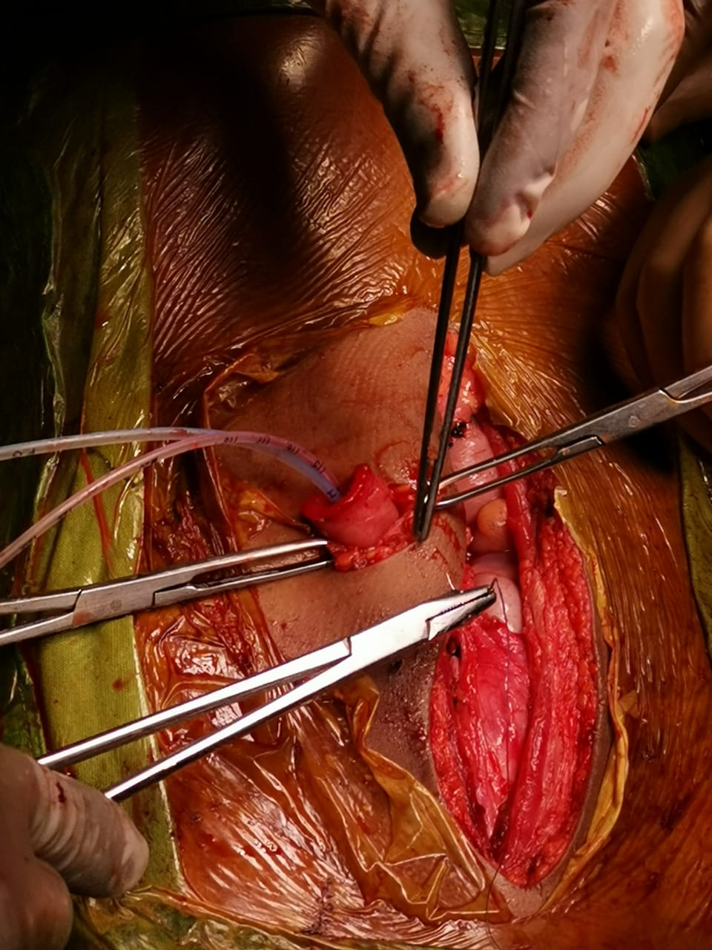
Stoma being fixed to skin and rectus

Slide 21
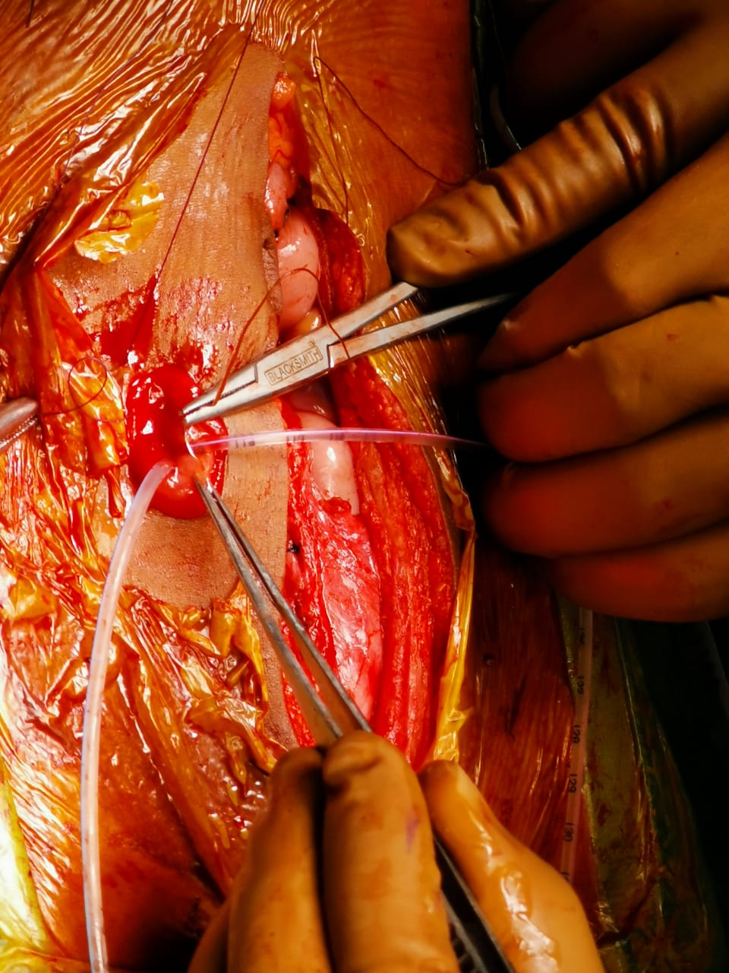
Stoma with ileostomy and IFT

Slide 22
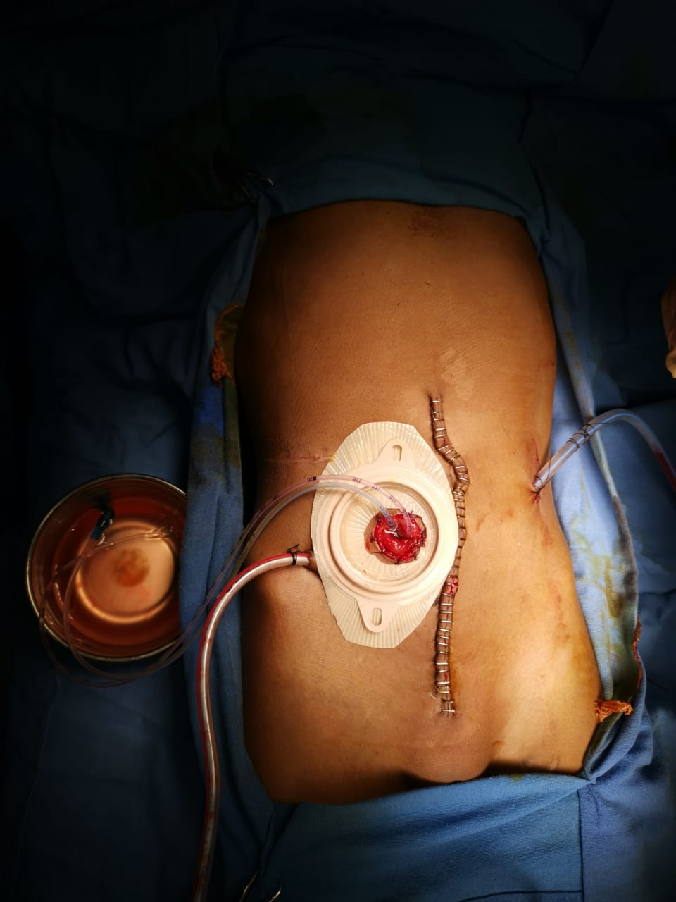
Midline incision
IFT
URINE SEEN DRAINING
Pelvic
drain
Anastamotic
Site drain
Ileostomy bag

Slide 23
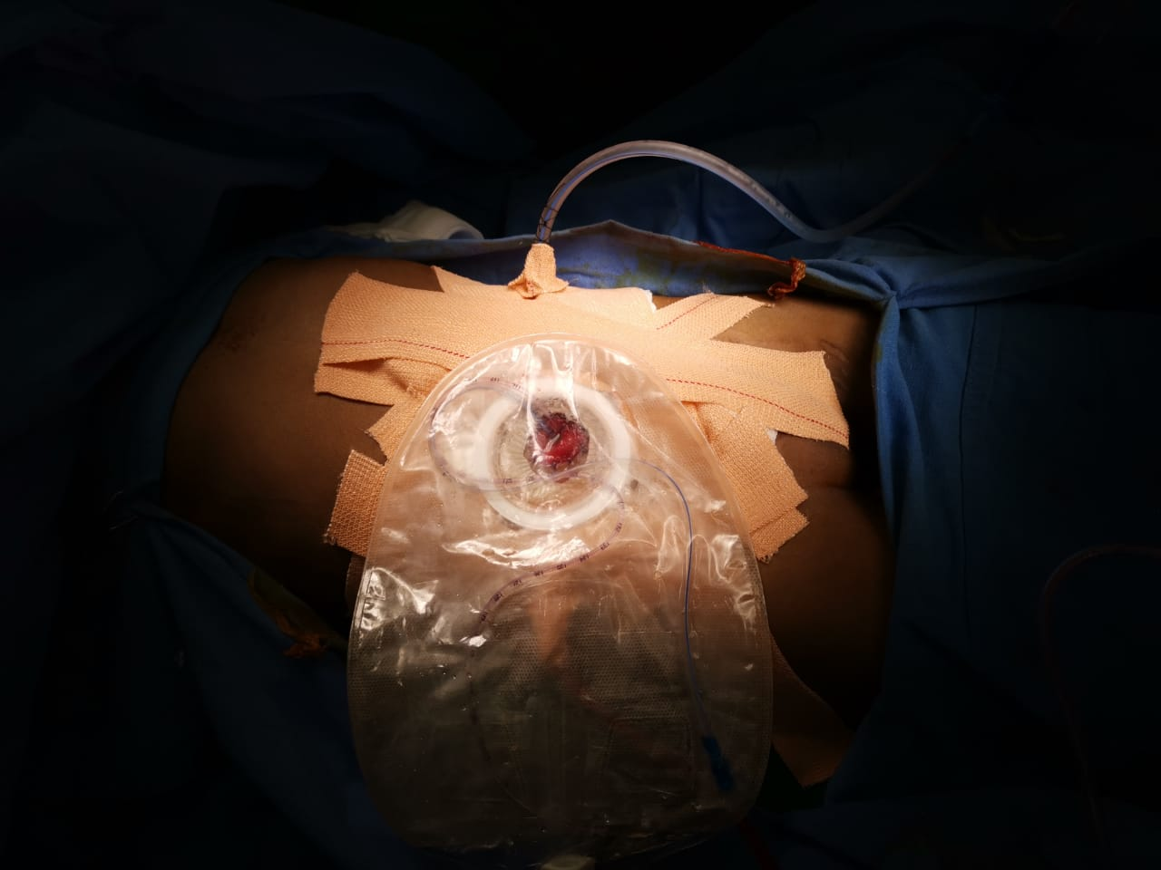
Urostomy Bag over Stoma
With IFT placed inside

Slide 24
INTRAOEPRATIVE /POSTOPERATIVE
Intraoperative period was uneventful
Post operatively patient had leak through the sides of the urostomy bag due to inability to properly fix the bag because of lack of space
Drain removal was done on POD-5
Suture removal was done on POD-10
IFT removal done on IPD basis on POD-15

Slide 25
Patient is presently doing well with no post operative complications
Stoma is healthy with no peri urostomy bag leak
Patient is on follow up for periodic change of urostomy bag

Slide 26
THANK YOU

