Slide 1
RECURRENCE AFTER TRANSPLANT: SOME HAPPY ENDINGS AND SOME NOT-SO-HAPPY ONES !
Dr. Adel Moideen
IInd Year Resident
Department of Nephrology
Dr. D Y Patil Medical College
Pune

Slide 2
CASE - 1
HISTORY
24y/ Male/ Nov 2014 - C/o giddiness, nausea and vomiting, DOE, pedal edema and decreased U.O
On presentation,
BP 160/100 mm of Hg
Urea-80mg/dl, S.Creat4.0 mg/dl;
Urine R/M- Protein-+++, RBC-2-3/ hpf, Pus cells-0-1/hpf, UPCR-2.5;
viral markers and autoimmune workup - negative;
Opthalmology & ENT evaluation-normal.

Slide 3
HISTORY (Contd…)
USG KUB s/o B/L small, shrunken kidneys ( RK 7.3 x 3.5cm & LK 8.0 x 3.7cm) with loss of CMD.
Diagnosed with CKD stage V/ ? CGN; maintained on conservative management.
Lost for F/U; Jan 2015 - dyspnea, hypervolemia, pedal edema and HTN
Urea-164mg/dl and S.Creat -9 mg/dl
Initiated on hemodialysis; thrice weekly maintenance hemodialysis/ Right IJV tunneled perm-cath as access.

Slide 4
HISTORY (Contd…)
Worked up for renal transplant; his father underwent pre-transplant work up and was found to be fit as donor.
Underwent live related renal transplant on 08/06/2015 (3/6 mismatch)
No induction (financial reasons); On Triple immunosuppresion therapy : Tacrolimus, Mycophenolate sodium, Prednisolone.
Discharged on POD-10 with baseline S.Creat of 1.1mg/dl.
Asymptomatic for next 2 years with stable S.Creat and Tac levels; but lost for F/U again for the next 7 months.

Slide 5
HISTORY (Contd…)
Feb 2018 - c/o on & off fever, decreased appetite and generalised weakness since 15 days (unreliable drug compliance).
O/E - Conscious, Oriented, afebrile
PR- 84/min, B.P.- 140/80 mm Hg, RR-20/min
No Pallor, edema, icterus
Transplanted kidney was palpable with scar mark seen in right iliac fossa.
Systemic examination- unremarkable

Slide 6
INVESTIGATIONS
Hb-12.5 gm%, TLC-10000 cells/cumm, Platelet-2.3 lakhs/cumm
Blood Urea-89 mg/dl, S.Creat- 5.8mg/dl, S.Na-142 mmol/l, S.K-4.2 mmol/l
S.Uric acid – 7.8 mg/dl, S.PO4– 5.7 mg/dl, S.Ca- 7.6 mg/dl
Urine R/M- Protein-+++, RBC-6-8/ hpf, Pus cells-2-3/hpf;
UPCR- 0.8

Slide 7
INVESTIGATIONS (Contd…)
Blood C/S – no growth
Urine C/S – no growth
CMV load – Normal
B K Virus load – Normal
Tac level-3.4ng/ml
USG of Transplanted Kidney size : 11.4 x4.3 cm, normal echogenicity & CMD maintained and normal graft vessel doppler.

Slide 8
DIFFERENTIAL DIAGNOSIS
? Chronic allograft nephropathy
? Recurrence of primary disease
? CNI toxicity

Slide 9
Patient underwent graft kidney biopsy in March 2018
Light microscopy:
11 glomeruli-
2 glomeruli - globally sclerosed
2 glomeruli - Fibrous crescents
1 glomerulus - segmental sclerosis
remaining glomerular tuft - mild mesangial matrix expansion with mesangial hypercellularity.
Diffuse acute tubular injury, moderate interstitial inflammation and interstitial edema.

Slide 10
Few interstitial blood vessels show moderate medial thickening.
No glomerulitis or chronic glomerulopathy/ No necrotizing lesion seen/ No peritubular capillaritis.
No evidence of BKV nephropathy or CNI toxixity
.

Slide 11
Immunofluorescence:
IgG: Negative
IgA: 3+ granular in mesangium
IgM: Negative
C3: Negative
C1q: Negative
Kappa: 2+ granular in mesangium
Lambda: 2+ granular in mesangium
C4d: Negative in peritubular capillaries (C4d0)
Immunohistochemistry:
SV40-Negative

Slide 12
Overall features are of IgA nephropathy (denovo/recurrent) with 18% glomerular crescents.
Diagnosis:
IgA nephropathy (denovo/recurrent) with 18% glomerular crescents.

Slide 13
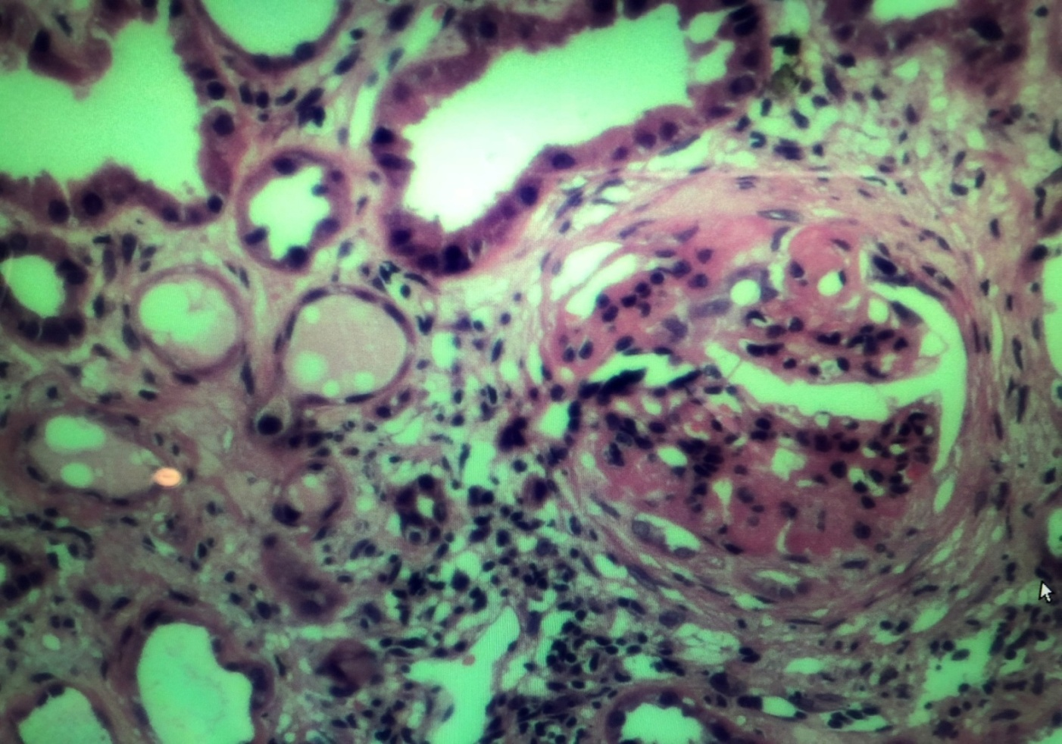
H & E Stain
Mesangial proliferation and focal matrix expansion can be seen.
Cellular crescent with partial collapse of glomerular tuft.

Slide 14
Silver Stain
Mild to moderate mesangial hypercellularity can be seen.

Slide 15
MT Stain
Mesangial proliferation and matrix expansion.

Slide 16
TREATMENT
IV Pulse therapy (methylpred 1 gm ) for 3 days, f/b oral pred 40mg/day
Triple immunosuppressants continued.
Underwent 5 cycles of Plasmapheresis and received 3 doses of IV CYC 500mg each.
Was on regular F/U and asymptomatic with S.Creat maintained (btw 2-3mg/dl x 5 months).
Again lost for F/U for 3 months and this time when he presented, he had been already initiated on maintenance HD outside since the last 1 month
Notes:
1.(tapered by 5mg/week).
5 (S.Creat told to be 7.5 at initiation).

Slide 17
CASE - 2
HISTORY (Contd…)
A 14y/ male/ normal birth and development history/ April 2018 - c/o nausea and vomiting, DOE, decreased appetite & generalised weakness, facial puffiness & pedal edema and decreased U.O
On presentation,
BP -144/96 mm of Hg.
Urea-128mg/dl, S.Creat-7.2 mg/dl
Urine R/M- Protein-+++, RBC-0-1/ hpf, Pus cells-0-1/hpf, UPCR-4.8
viral markers and autoimmune workup – negative
Opthalmology & ENT evaluation-normal.

Slide 18
HISTORY (Contd…)
USG KUB S/O bilateral small, shrunken kidneys ( RK 5.8 x 2.5cm & LK 5.5 x 3.0cm) with loss of CMD.
He was initiated on Hemodialysis; thrice weekly maintenance HD with Right IJV tunnelled permcath as access.
Diagnosed with CKD stage Vd/ ?CGN- ?FSGS
He tolerated HD well with interdialytic weight gain of 0.5-1kg.
Notes:
however, d/t persistently rising RFT and oliguria, he was put on thrice weekly maintenance HD with Right IJV tunnelled permcath as access.

Slide 19
HISTORY (Contd…)
His grandmother underwent pre-transplant work up and was found to be fit as donor.
Underwent live related renal transplant on 27/08/2018 (6/6 mismatch)
ATG induction (TOTAL-150mg) ; On Triple immunosuppresion therapy : Tacrolimus, Mycophenolate sodium, Prednisolone.
Developed fever with increasing facial puffiness, B/L lower limb swelling, scrotal swelling and decreasing U.O since POD 3 (Serum creatinine-1.1mg/dl).

Slide 20
HISTORY (Contd…)
USG of Transplanted Kidney size : 9.8 x 5.4 cm, normal echogenecity & CMD maintained with normal graft vessel and lower limb doppler.
O/E - Conscious, Oriented, afebrile
PR- 114/min, B.P.- 134/90 mm Hg, RR-24/min,
No Pallor, icterus. B/L lower limb and scrotal edema+
Transplanted kidney was palpable with scar mark seen in right iliac fossa.
Systemic examination- unremarkable

Slide 21
INVESTIGATIONS
Hb-6.9 gm%, TLC-6400 cells/cumm, Platelet-1.8 lakhs/cumm
Blood Urea-25 mg/dl, S.Creat- 0.7 (POD-2)→1.1 mg/dl (POD-3), S.Na-134 mmol/l, S.K-3.6 mmol/l
S.Alb-2.48g/dl, S.Uric acid – 6.6 mg/dl, S.PO4– 4.3 mg/dl, S.Ca- 7.6 mg/dl (corrected-8.7)
Urine R/M- Protein-++++, RBC-1-2/ hpf, Pus cells-1-2/hpf; UPCR- 10.6
Blood C/S – no growth; Urine C/S – no growth
S.TAC level-8.3ng/ml

Slide 22
DIFFERENTIAL DIAGNOSIS
? Recurrence of primary disease (?FSGS)
? Acute rejection

Slide 23
TREATMENT
It was decided to perform a graft biopsy - refused by the relatives.
Given IV Pulse therapy (methylpred 500mg) for 3 days, f/b oral pred.
Triple immunosuppressants continued.
ACEi added on.
Underwent 5 sessions of plasmapheresis on alternate days with FFP as replacement
Edema began to resolve and repeat urine protein by dipstick was 1+ with UPCR-1.3.

Slide 24
Discharged on post op day 14 with a baseline S.Creat of 0.84mg/dl and UPCR of 0.8.
At present, he is on regular F/U and asymptomatic with S.Creat of 0.7mg/dl and UPCR of 0.2 with adequate Wt and Ht gain (6cm in 8months).

Slide 25
RECURRENCE AFTER TRANSPLANT

Slide 26
GN and DM – 2 leading causes of ESRD
As per US Renal Allograft Disease Registry data, prevalence of GN recurrence :
-2.8% at 2yrs
-9.8% at5yrs
-18.5% at 8yrs of F/U after Tx
As per ANZDATA, biopsy proven recurrence causing graft loss was:
-0.5% within 1yr
-3.7% within 5yrs
-8,4% within 10yrs after Tx

Slide 27
Recurrent disease:
Requires histologic demonstration of the same disease involving both the native & transplanted kidneys.
Incidence underestimated – histologic Dx of primary kidney ds not always obtained and most Tx biopsies are done without keeping recurrent ds in mind.
Recurrent disease – 3rd most common cause of graft failure beyond 1st yr after Tx.

Slide 28
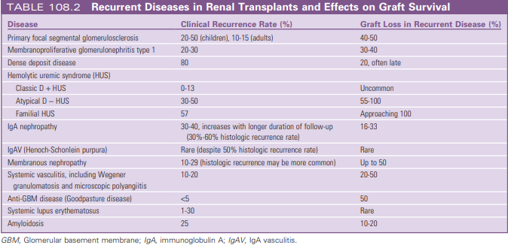

Slide 29
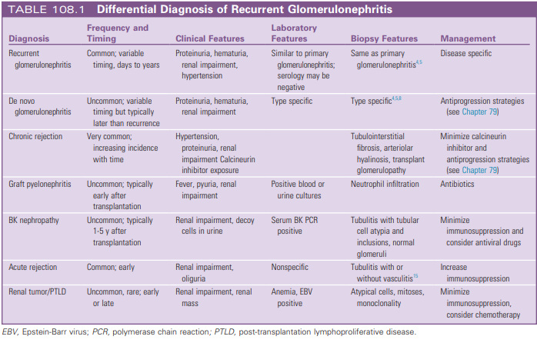

Slide 30
IgA NEPHROPATHY
M.C form of GN l/t ESRD.
Histologic recurrence – frequent and can occur +/- symptoms; Recurrence - difficult to predict.
Early stages of IgAN recurrence - no proteinuria, hematuria, or graft dysfunction.
Published recurrence (8% to 53%)- variation d/t study differences in biopsy indication (protocol or clinical) and length of post-transplant follow-up.

Slide 31
Risk factors-
younger age at transplantation
rapid progression of the native IgAN
degree of proteinuria
donor factors (presence of IgA deposits in donor kidney, HLA matching)
More recurrence in living donor grafts than deceased donors - not confirmed.
2 Australian registry studies - those with 0 mismatch kidneys have higher rates of recurrence than those with >1 HLA mismatches
ABO-incompatible transplants - lower rates of recurrence (?differences in immunosuppression regimens).

Slide 32
Graft loss within the first 3 years after transplantation-
Uncommon
can occur when IgAN in the native kidney was rapidly progressive or after previous graft loss resulting from recurrence.
Long-term graft survival is less for pts with recurrent IgAN after a decade.
Other causes of IgA deposition: liver disease, celiac disease.
Notes:
An Italian cohort study of 190 patients followed for 15 years - of the 22% of patients with recurrence, 1/3rd graft loss because of IgAN recurrence during follow-up.

Slide 33
Choice of immunosuppression after transplantation is controversial.
One large USRDS registry analysis suggested - individual drug choices did not affect the risk for graft loss attributed to recurrence.
In contrast, a retrospective analysis of ANZDATA - continuation of corticosteroids was strongly a/w protection from graft loss caused by recurrence of IgAN, although not from other types of GN.
Observational data - induction with ATG may afford relative protection

Slide 34
Treatment of recurrent IgAN and IgAV has not been systematically evaluated.
No known preventive measure.
Addition of steroid maintenance in steroid free pts with recurrence > unproven but reasonable.
Non-specific, useful measures – tight BP control, RAS blockade, and avoidance of nephrotoxins
A change to MMF, the use of fish oil, antiplatelet agents, and tonsillectomy – questionable benefit.

Slide 35
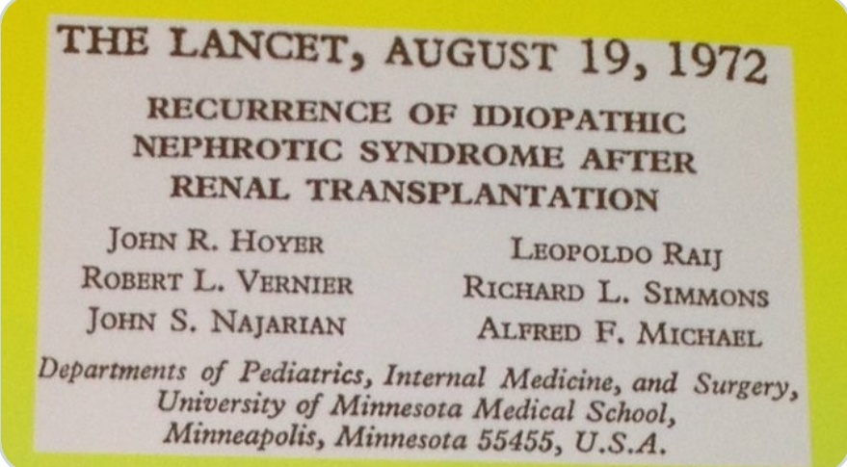
Focal Segmental Glomerulosclerosis
1500 FSGS pts undergo Tx every year with a 30-80% risk of recurrence in the new graft.
FSGS accounts for 11% of pediatric kidney transplants.

Slide 36
Low risk for recurrence –
FSGS secondary to vascular disease or reflux nephropathy
those with familial or sporadic forms a/w mutation of slit-diaphragm proteins such as podocin
(rare cases of post-transplant nephrotic syndrome d/t dev of antibodies against the “neoantigen” within the donor kidney reported).

Slide 37
High risk - pts with
primary FSGS
malignant FSGS (heavy proteinuria and renal failure within 3 years of onset)
age < 15 yrs
mesangial hypercellularity on biopsy
with recurrence in a previous graft.

Slide 38
Mophologic variants of FSGS:
FSGS NOS
FSGS, perihilar
FSGS, cellular
FSGS, collapsing
FSGS, tip

Slide 39
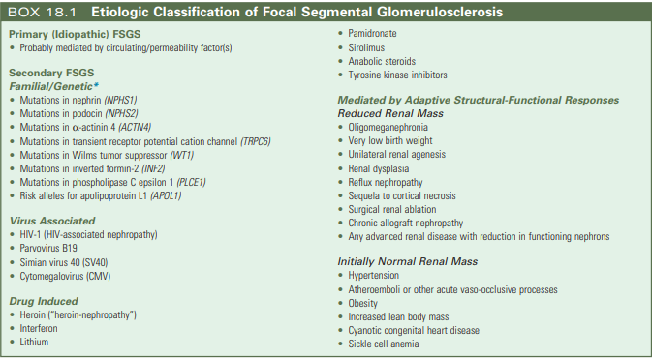

Slide 40
Rate of recurrence >75% in subsequent grafts when 1st graft was lost d/t recurrence.
Recurrence –
occurs typically within the 1st month post-transplantation
manifests initially with heavy proteinuria, f/b HTN and graft dysfunction.
more susceptible to acute rejection and AKI, as well as graft loss.
a/w early graft loss in up to 50% of patients
Plasmapheresis delays graft loss in most patients and decreases the incidence of overall graft failure.

Slide 41
Primary FSGS - caused by a circulating factor that targets podocytes (specific factor– unknown).
suPAR and the costimulatory protein B7-1 (CD80) – ?role in recurrence.
Plasma exchange / immunoadsorption with either a protein A or anti-IgG column - effective in pts with recurrent FSGS - removes the circulating permeability factor (disease remission reported in most pts receiving Rx within 2 weeks of recurrence).
So, a course of plasma exchange is warranted in all patients without contraindications.

Slide 42
Immunosuppression should include a CNI, and addition of an ACEi should be considered.
Pts with incomplete response / relapse -> require repeated / long-term plasma exchange or concurrent treatment with secondary agents such as Ritux or CYC.
For such pts - a course of rituximab 500 mg weekly for 4 weeks + existing immunosuppression and weekly plasma exchange.
Pre-transplantation plasma exchange – controversial role in preventing recurrence.
MCD – rare cause of ESRD; Recurrence after transplantation reported; difficult to be sure that the underlying disease was not FSGS.

Slide 43
Reference | No: of Patients | Era / Controls | No: of Plasmapheresis sessions | Result
Gonzales et al. 2011 | 34 pediatric pts | 1996-2007 No controls | 1-10 x 1.5 exchanges with 5% albumin replacement | Not useful
Gohh et al. 2005 | 9 adults and 1 child (only high risk pts enrolled; prior recurrence or rapid progression to FSGS) | 1999-2003 No controls | 8 x 1.0 exchanges with 5% albumin replacement | 30% recurrence which they concluded was lower than the reported 52%
Ohta et al. 2001 | 20 japanese children | 1984-1991: controls 1991-1997: cases | 1-3 x 1.5 exchanges with 5% albumin replacement | 67% recurred without PP vs 33% with PP

Slide 44
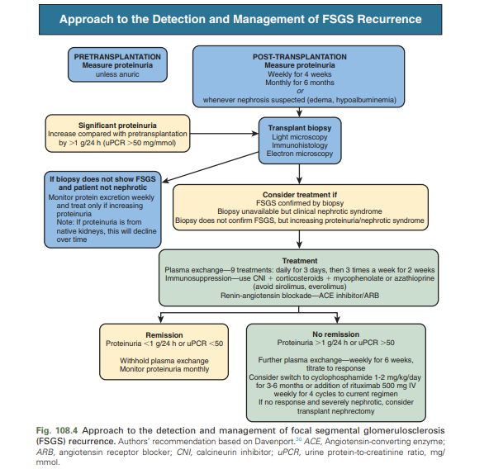

Slide 45
THANK YOU !

