Slide 1
Varied Presentations of Same Entity
Dr. John Abraham Tharayil
MD (General Medicine)
I ^{st} Year Resident in DM Nephrology
Dr. D. Y Patil Medical College, Pimpri, Pune

Slide 2
Case Vignette – 1
26 years/ Male, Driver
No known comorbidities
Presented with breathlessness, facial puffiness, swelling of feet, lethargy, decreased appetite, joint pain – 2 weeks
h/o Urine output around 1 litre/day

Slide 3
Case Vignette - 1 , history cont..
initiated 4 sessions of hemodialysis through right IJV HD catheter.
HD done on alternate days (outside Centre) ; given 3 doses of Inj. MP
h/o chills during dialysis
h/o tobacco chewing
Notes:
No h/o fever, nausea, vomiting, cough, dyspnoea, hemoptysis, abdominal distention, frothy urine, hematuria, dysuria, urgency, increased frequency of micturition, deafness, diarrhoea, NSAID’s/ alternative medication intake, altered sensorium, oral ulcers, photosensitivity, arthalgia, rashes, nocturia
No h/o smoking, ethanol consumption

Slide 4
On Examination
BMI : 24.22kg/m² ^{(Wt: 70 kg, Ht:} ^{1.7m)}
HR: 90/ min, BP: 170/120 mmHg, RR: 16/ min, Temp : 98.6 ⁰F
RS: normal breath sounds. No crepitations
CVS: S1, S2 heard normally. No pericardial rub
P/A : soft. No organomegaly. Bowel sounds present
CNS: no focal deficits, Fundus normal

Slide 5
Urine Routine

Slide 6
Provisional Clinical Diagnosis
? Rapidly progressive renal failure
? AKI
? Nephritic syndrome
? Infection
Systemic Hypertension (recent)

Slide 7
Lab investigations
UPCR | Hb | TLC | Platelet | Urea (mg/dl) | Creat (mg/dl) | Bil total (mg/dl) | SGPT/SGOT (U/L) | S.Protein (g/dl), S.Albumin (g/dl) | Sodium , Potassium
26.32 | 10.6 | 11,900 | 3.0 lakhs | 104 | 7.37 | 0.24 | 13/21 | 4.08 , 1.99 | 140, 3.9
Notes:
Egfr 10

Slide 8
Lab investigations cont..
USG Abdomen,KUB, Prostate | Kidney size,echo – wnl, CMD maintained, prostate 18 cc
p –ANCA (U/ml) | c –ANCA (U/ml) | ANA (IFA) | Anti – DSDNA (OD ratio) | ANA blot | C3 Gm/L | C4 Gm/l | ECG | CXR | 2D-Echo
7.15 | 2.33 | neg | 0.44 | neg | 0.83 | 0.22 | NSR | WNL | LVEF – 60%, normal valves, No PAH, No pericardial effusion

Slide 9
On probing history
h/o NSAID intake present for 10 days. (aceclofenac 200 mg daily)

Slide 10
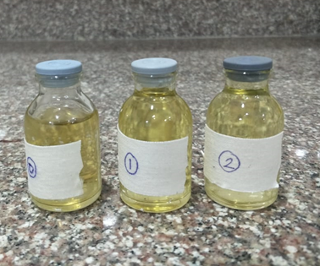
Renal Biopsy
Done under USG guidance. Uneventful.

Slide 11
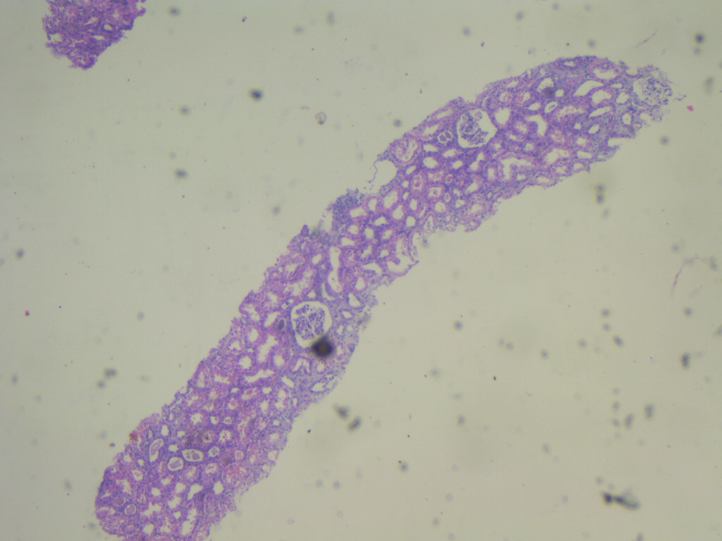
Notes:
H &e

Slide 12
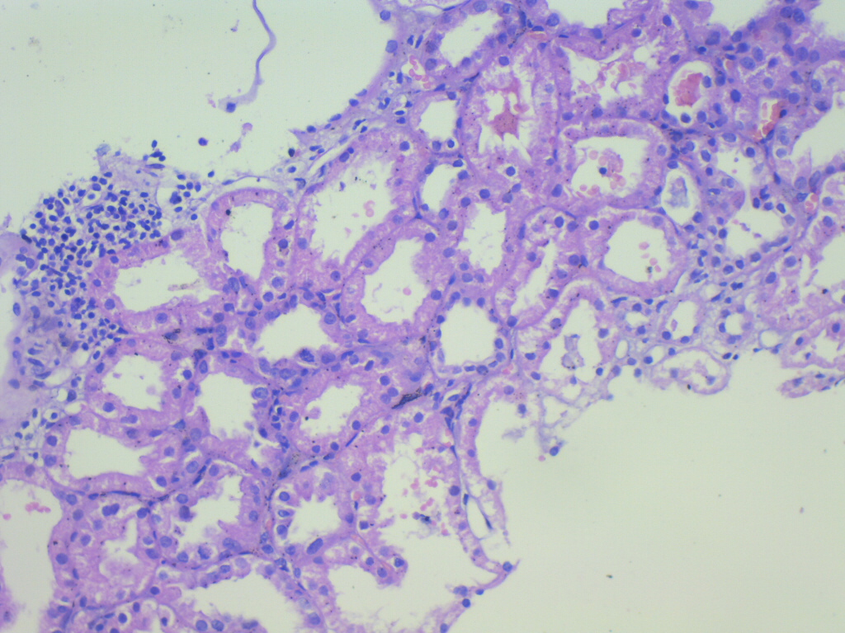
Notes:
H &e

Slide 13
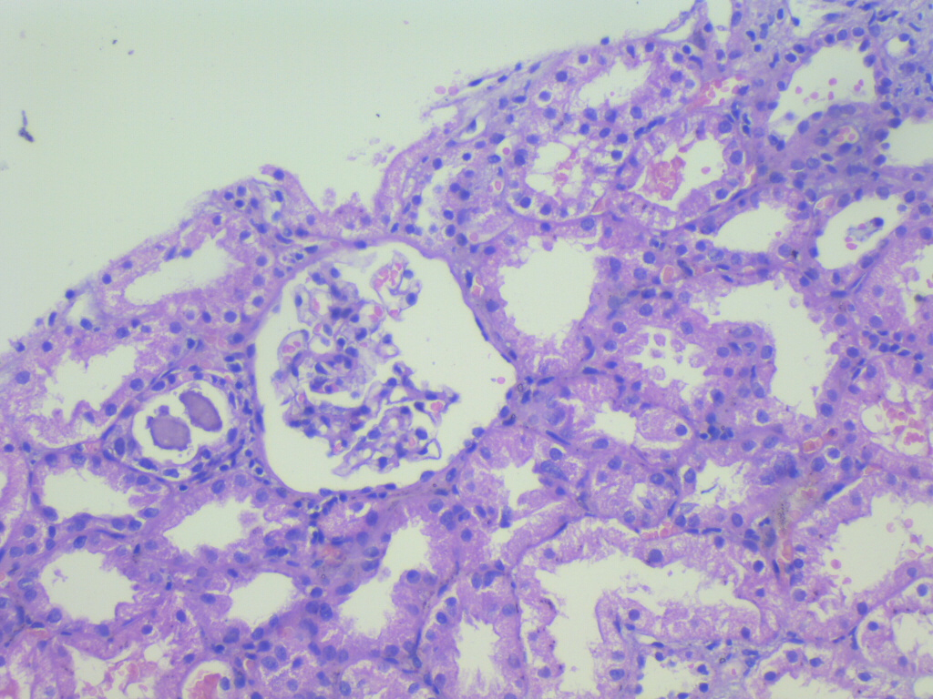
Notes:
H &e

Slide 14
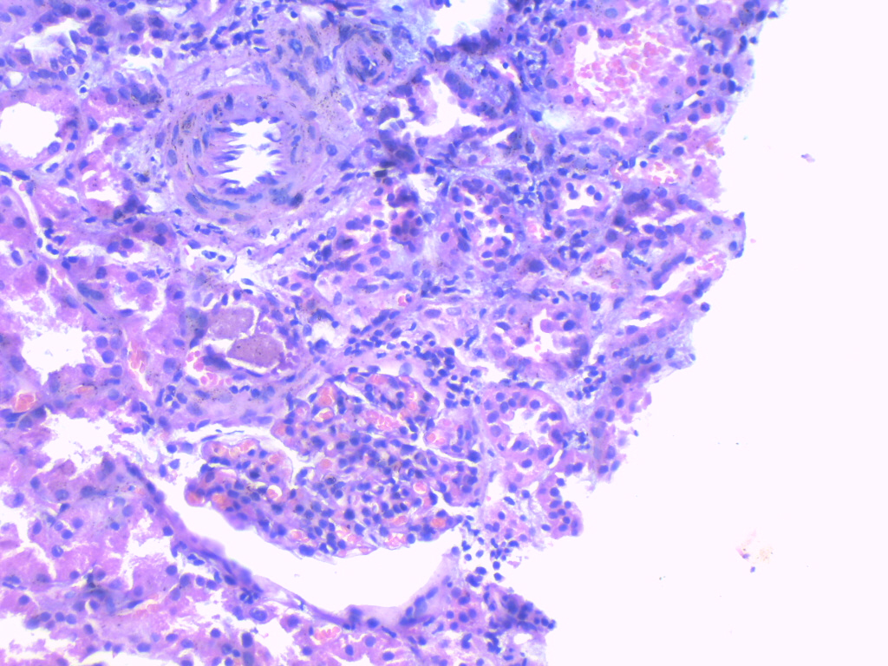
Notes:
H &e

Slide 15
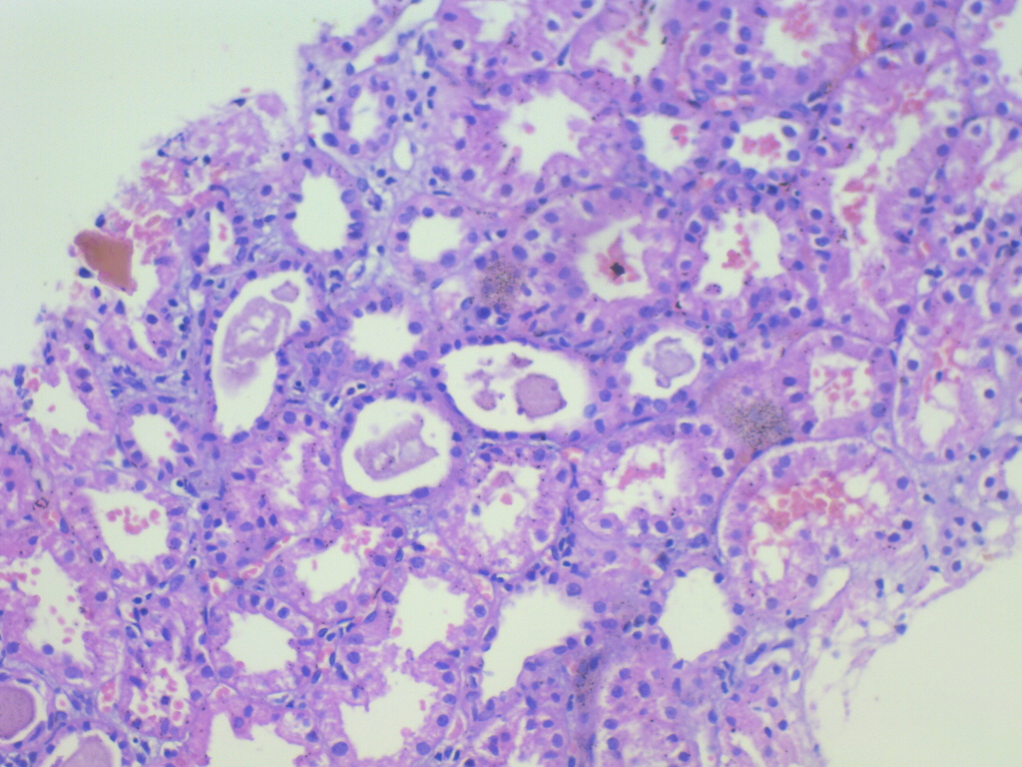
Notes:
H &e

Slide 16
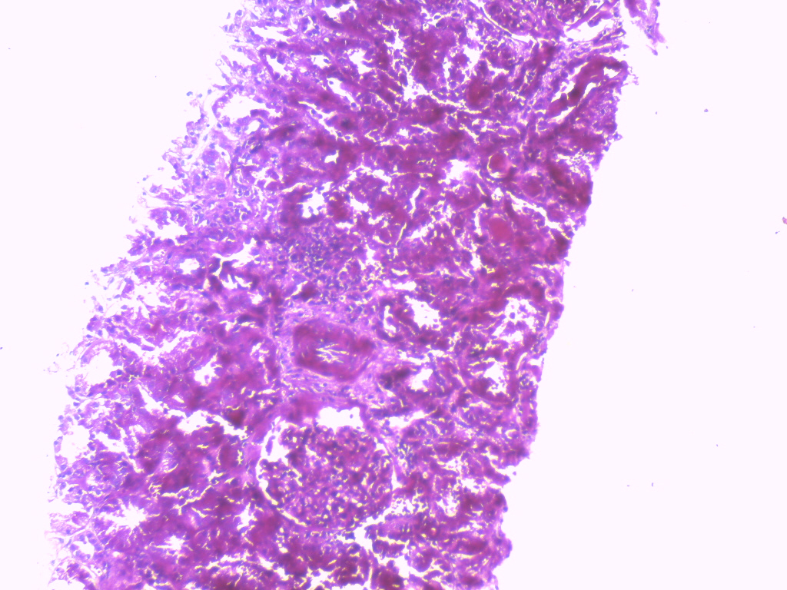
Notes:
PAS

Slide 17
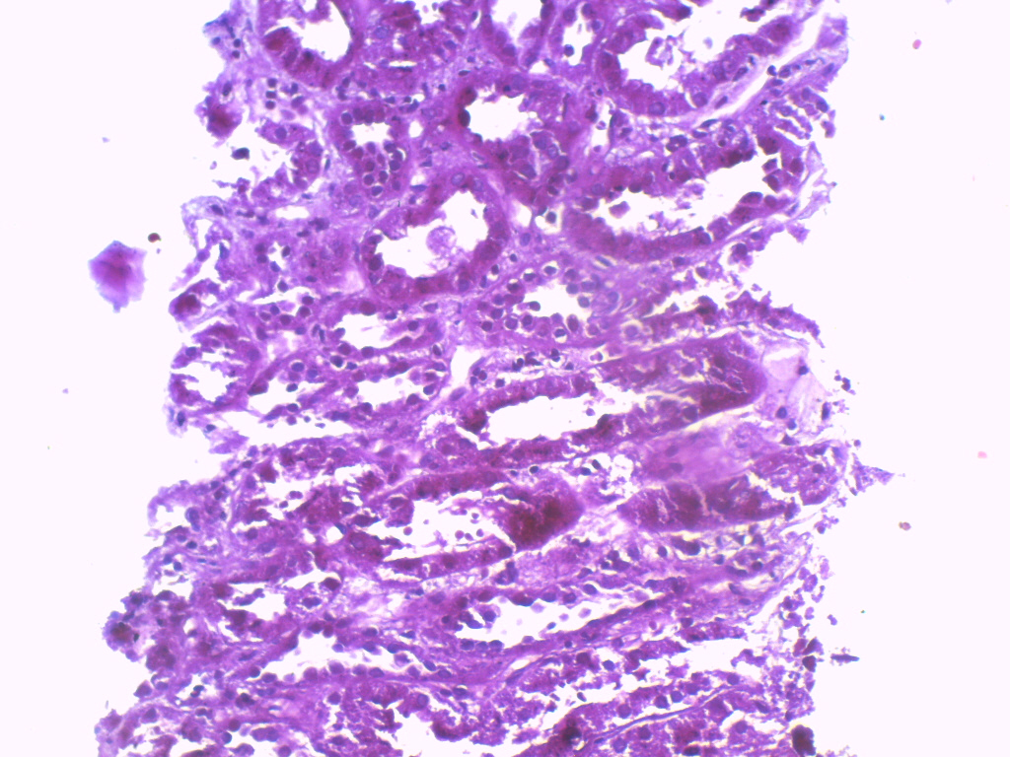
Notes:
PAS

Slide 18
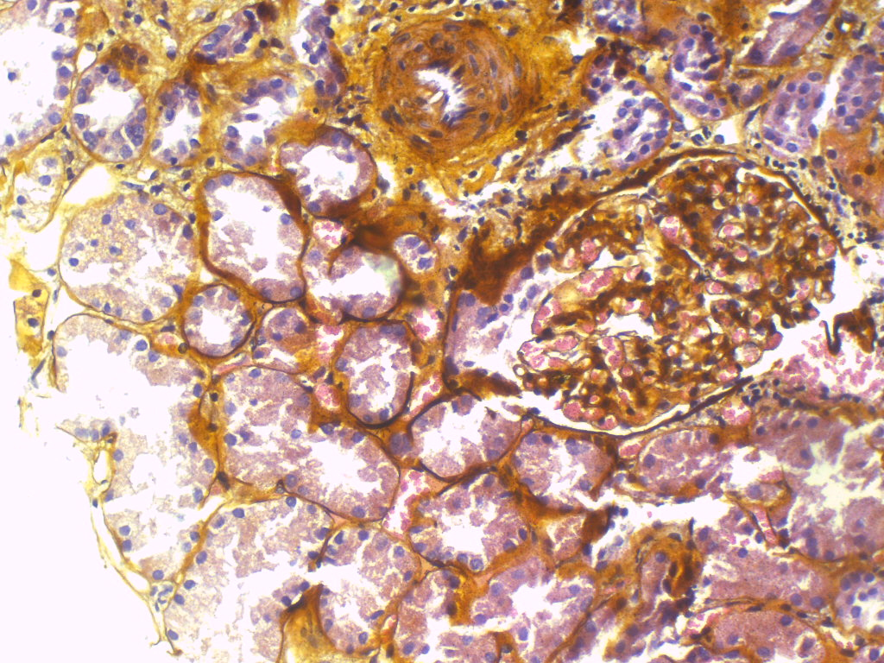
Notes:
sILVER

Slide 19
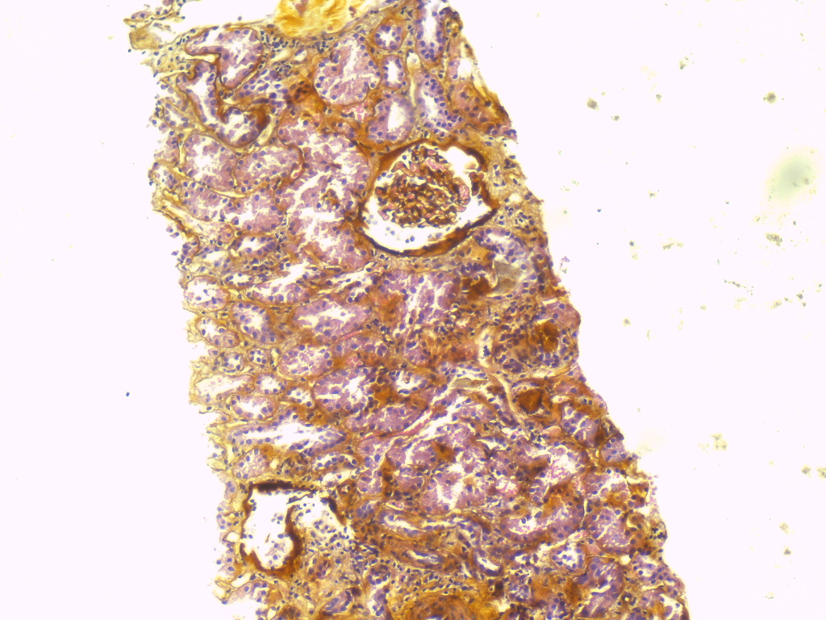
Notes:
sILVER

Slide 20
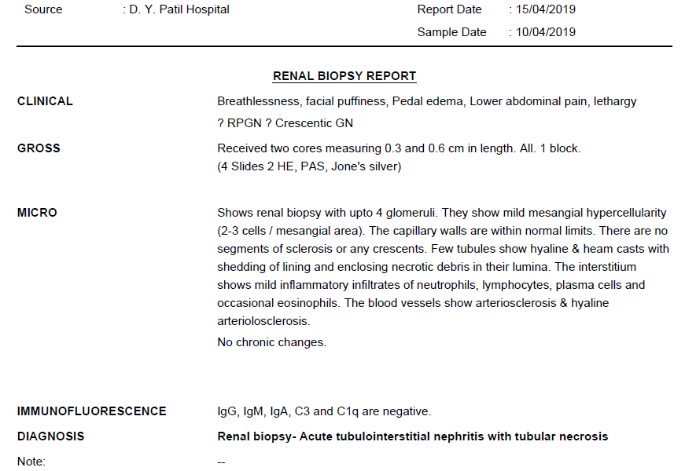

Slide 21
Treatment
Continued on oral steroids 1mg/kg
Post biopsy given single dose of cyclophosphomide 500mg (before biopsy report)
2 Antihypertensives
3 sessions of hemodialysis
Serum Creatinine 1.2 mg/dl at discharge

Slide 22
Follow up
Serum Creatinine 1.0 mg/dl after 10 days of discharge.
Serum Creatinine 0.8 mg/dl after 2 months of discharge.

Slide 23
Case Vignette – 2
75 years/ Male
Known case of Hypertension – 3 years, IHD -2 years, BPH.
Presented with breathlessness on exertion, facial puffiness, swelling of feet, decreased urine output, decreased appetite– 1 month
Urine output around 300 ml/day
Notes:
No h/o fever, nausea, vomiting, cough, dyspnoea, hemoptysis, abdominal distention, frothy urine, hematuria, dysuria, urgency, increased frequency of micturition, nocturia, deafness, diarrhoea, NSAID’s/ alternative medication intake, altered sensorium, oral ulcers, photosensitivity, arthalgia, rashes
No h/o smoking, tobacco chewing/ ethanol consumption
No h/o T2DM , DLP, Asthma, Liver disease, seizure disorder.

Slide 24
Case Vignette - 2 , history cont..
Treatment history: no h/o long term drug intake.
Allergic history: not known
Family history: no significant illnesses

Slide 25
On examination
BMI : 25.53kg/m^{2 (Wt: 67 kg, Ht:} ^{1.62} ^{m)}
HR: 80/ min, BP: 130/80 mmHg, RR: 16/ min, Temp : 98.6 ⁰F
RS: normal breath sounds. No crepitations.
CVS: S1,S2 normally heard. No pericardial rub.
P/A : Distended. No organomegaly. No shifting dullness.
CNS: no focal deficits, Fundus normal.

Slide 26
Urine Routine
Urine appearance | Urine colour | pH | Specific gravity | albumin | sugar | Pus cells | Epithelial cells | RBC’s | Casts, crystals, bacteria
clear | Pale yellow | 6.5 | 1.015 | 2+ | nil | 0-1/hpf | 0-1/hpf | 10-12/hpf | Absent

Slide 27
Provisional Clinical Diagnosis
?Rapidly progressive renal failure
?AKI
?Nephritic syndrome
Systemic Hypertension, IHD, BPH

Slide 28
Lab investigations
UPCR | Hb | TLC | Platelet | Urea (mg/dl) | Creat (mg/dl) | Bil total (mg/dl) | SGPT/SGOT (U/L) | S.Protein (g/dl), S.Albumin (g/dl) | Sodium/ Potassium
2.0 | 10.6 | 8900 | 3.5 lakhs | 27 | 6.3 | 0.62 | 9/23 | 7.0 , 3.46 | 146 / 4.2
Corrected Calcium | Phosphorus | Uric acid | S. Cholesterol | HDL | LDL | Triglycerides | HBA1c | Hco3 | Serial Serum Creatinine levels
9.3 | 2.7 | 2.5 | 200 | 32 | 135 | 214 | 5.5 | 18.2 | 6.3→1.9→ 1.3 →0.9
Notes:
Egfr 34 ml

Slide 29
Lab investigations cont..
USG Abdomen,KUB, Prostate | Kidney size, echo – wnl, CMD maintained, prostate 32 cc
p –ANCA (U/ml) | c –ANCA (U/ml) | ANA (IFA) | Anti – DSDNA (OD ratio) | ANA blot | C3 Gm/L | C4 Gm/l | ECG | CXR | 2D-Echo
neg | positive | Positive 1:100 | neg | neg | normal | normal | NSR | WNL | LVEF-60%, normal valves

Slide 30
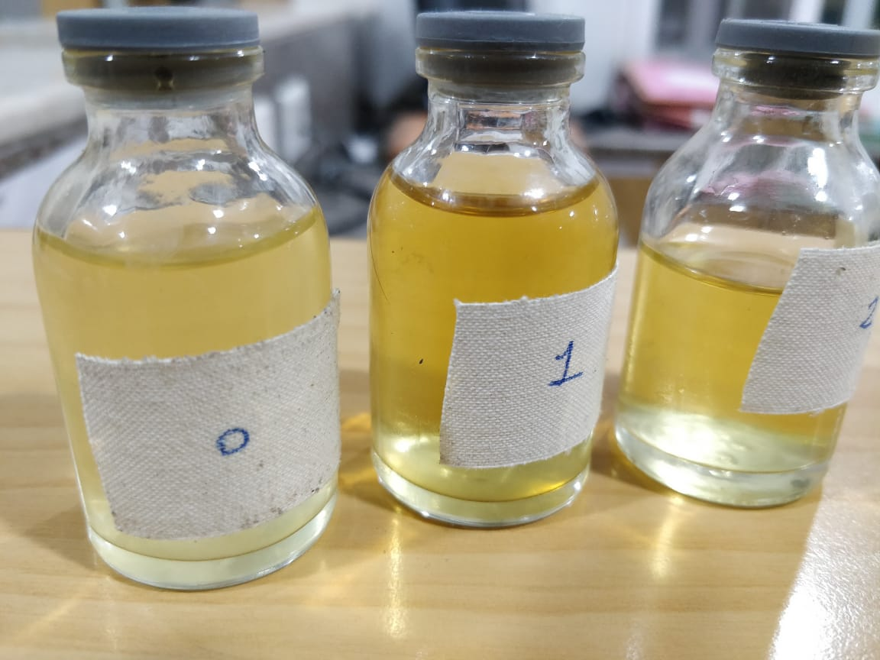
Renal Biopsy
Done under USG guidance. Uneventful.

Slide 31
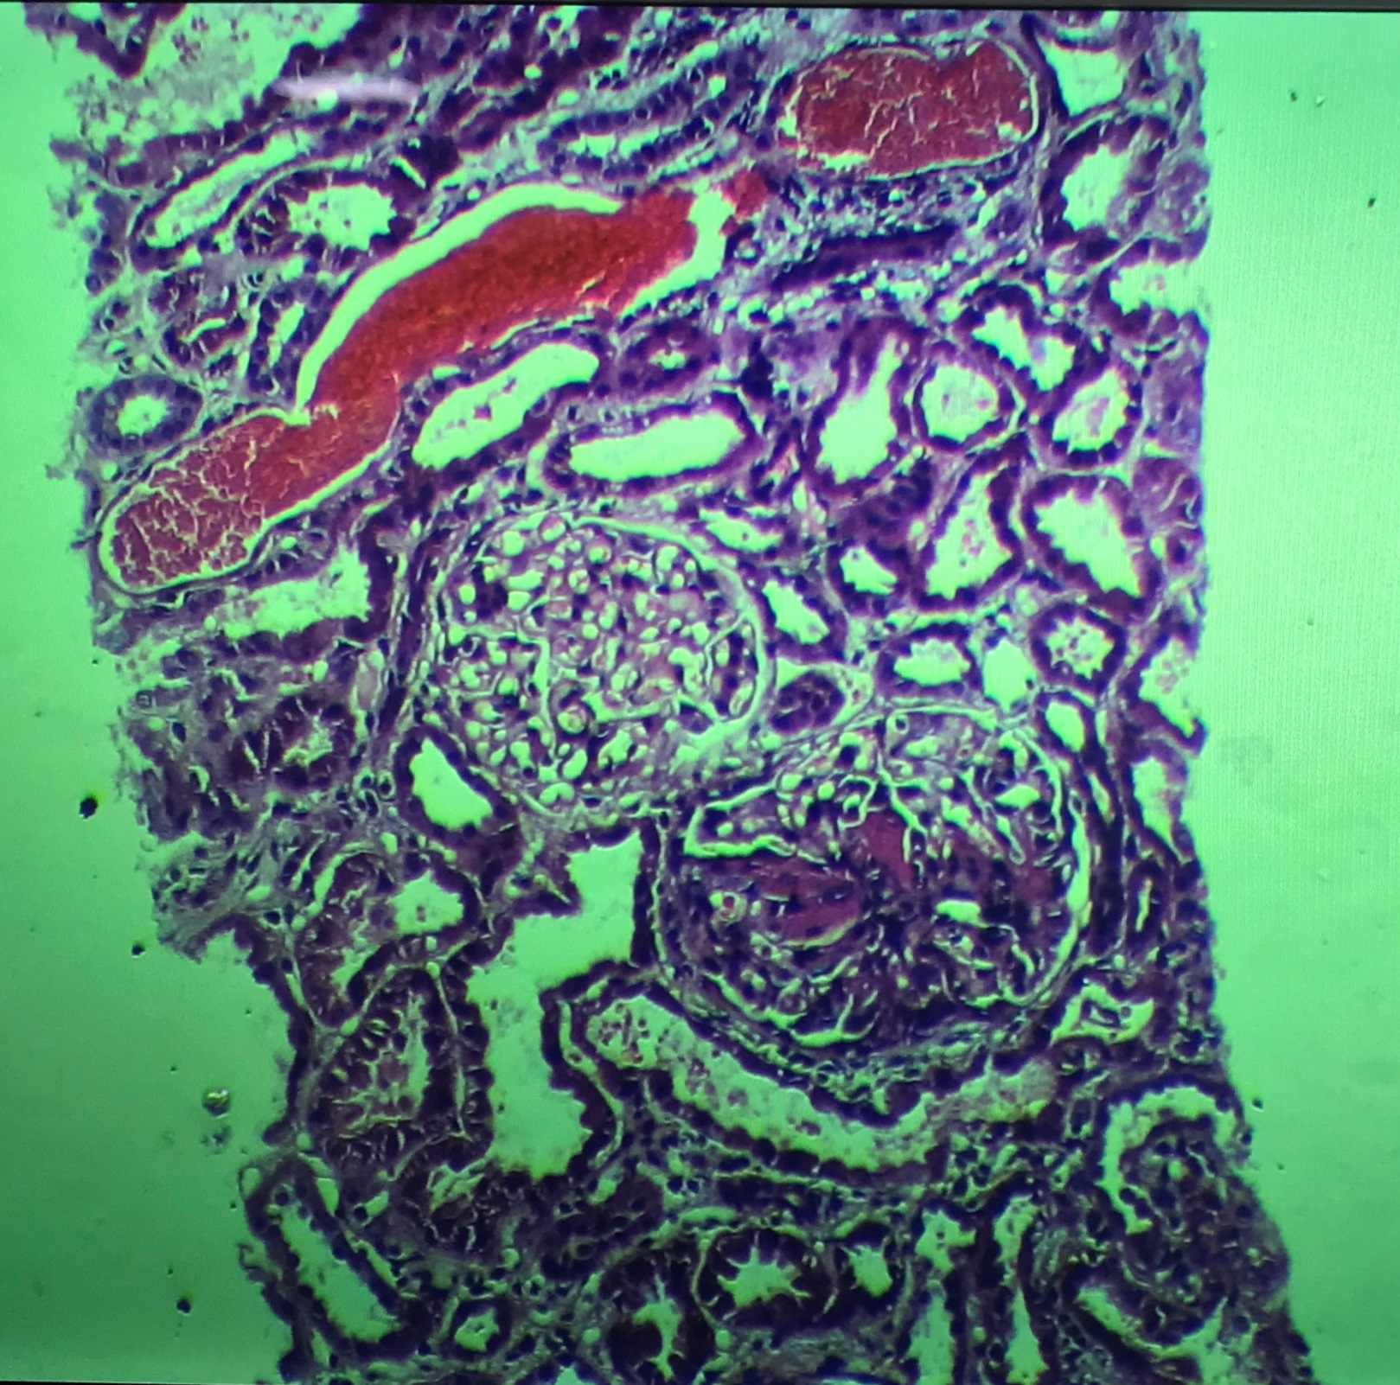
Notes:
Rbc cast, nl glomeruli, down glomeruli withmesangial hypercellularity and expansion with periglomerular fibrosis

Slide 32
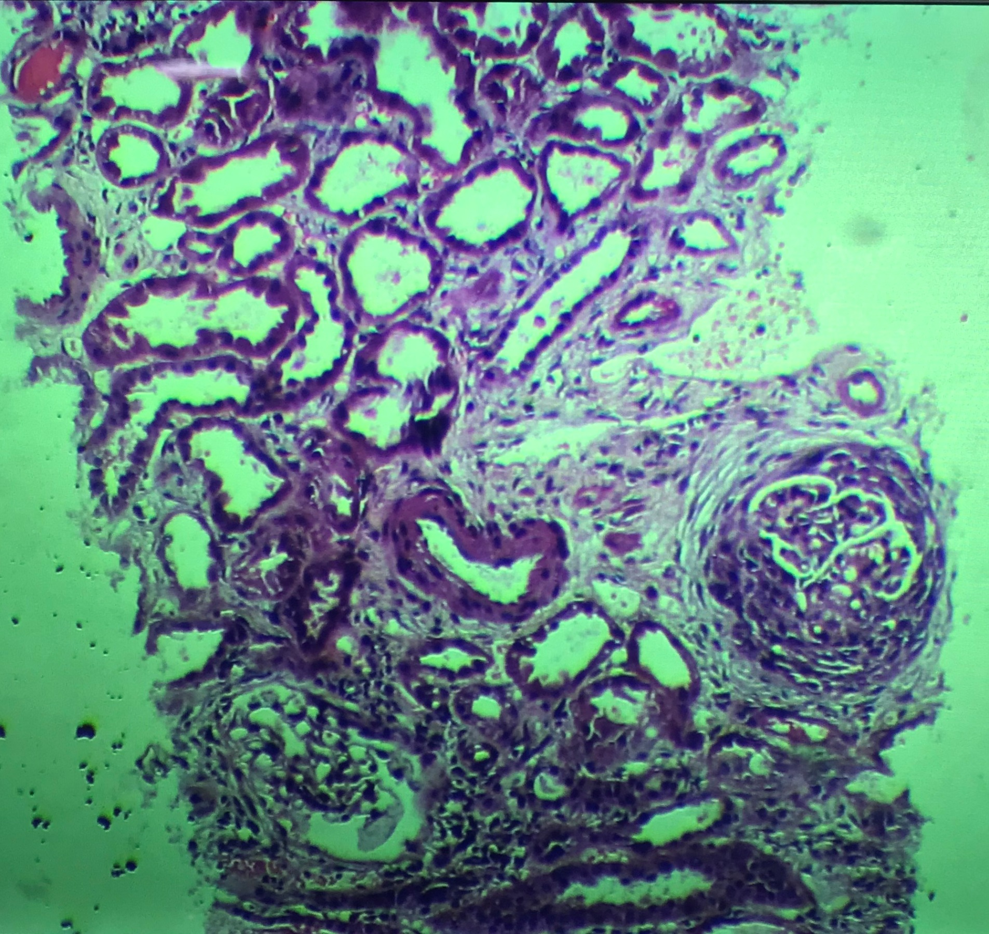
Notes:
Fc crescent, dilated tubules

Slide 33
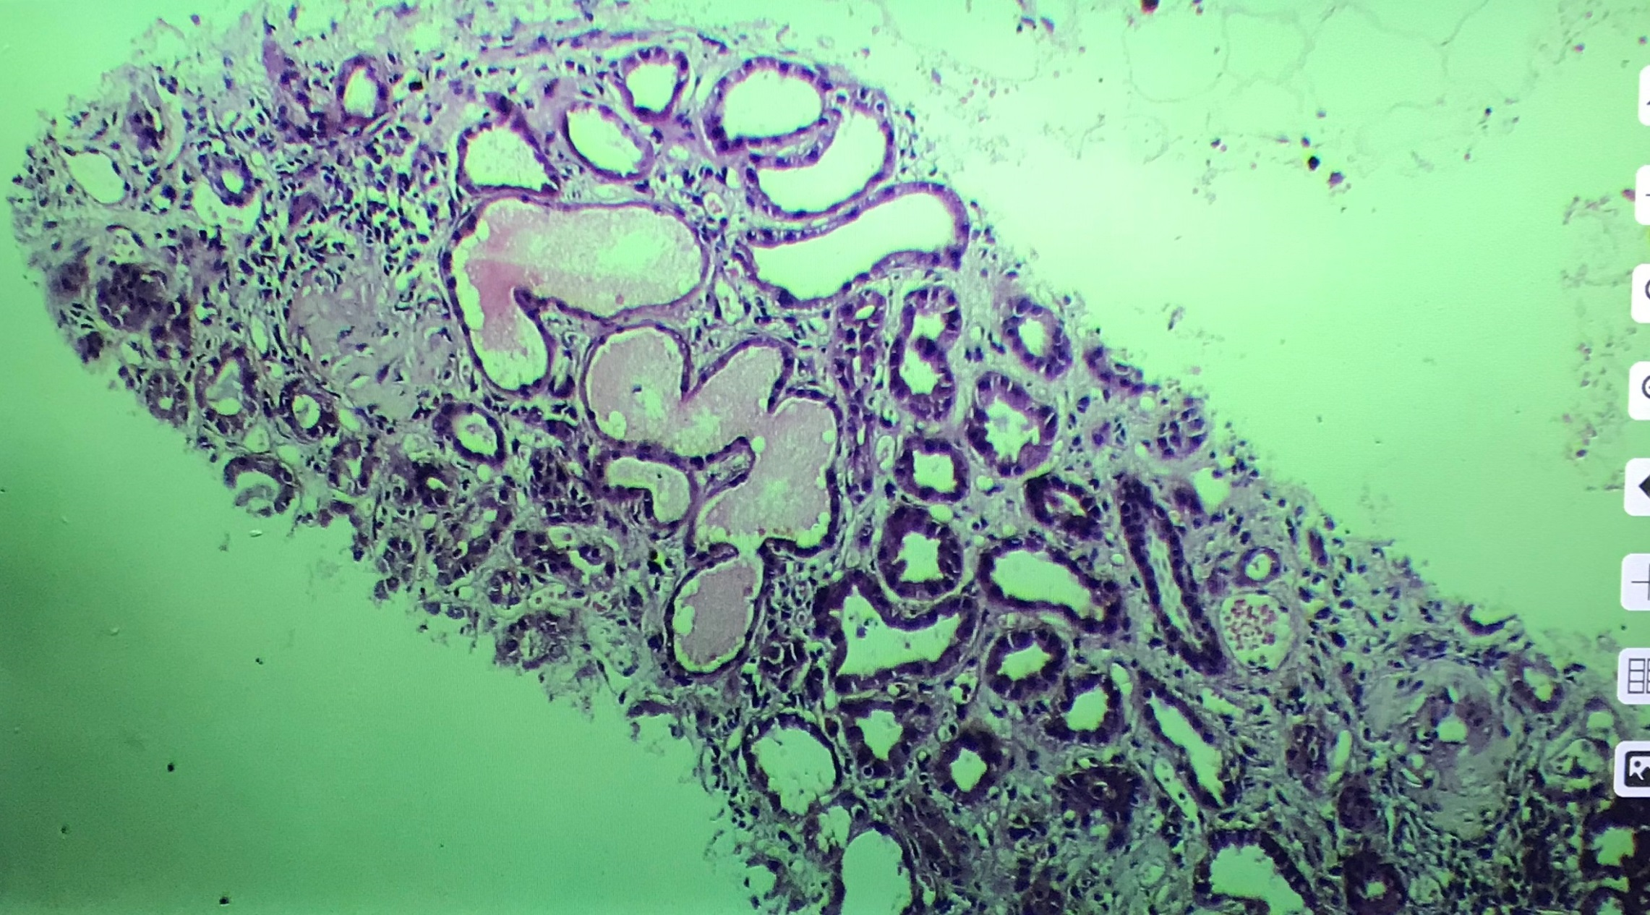
Notes:
Hyaline cast

Slide 34
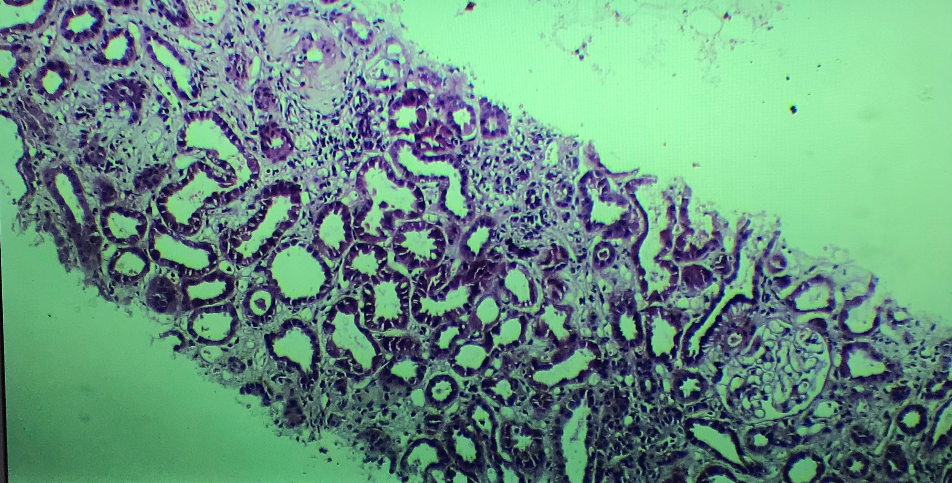
Notes:
Medial hypertrophy of artery

Slide 35
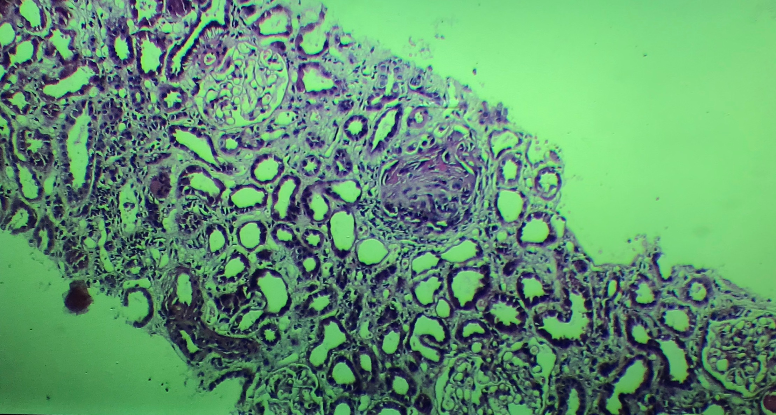
Notes:
Necrosed glomeruli

Slide 36
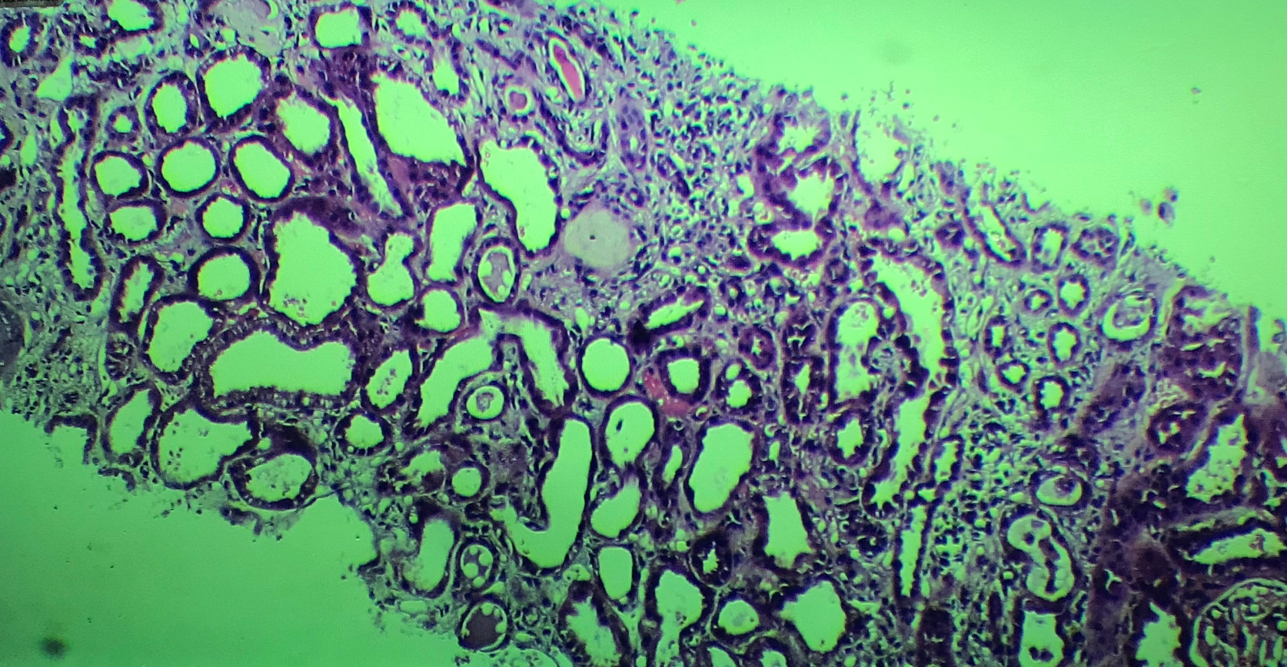

Slide 37
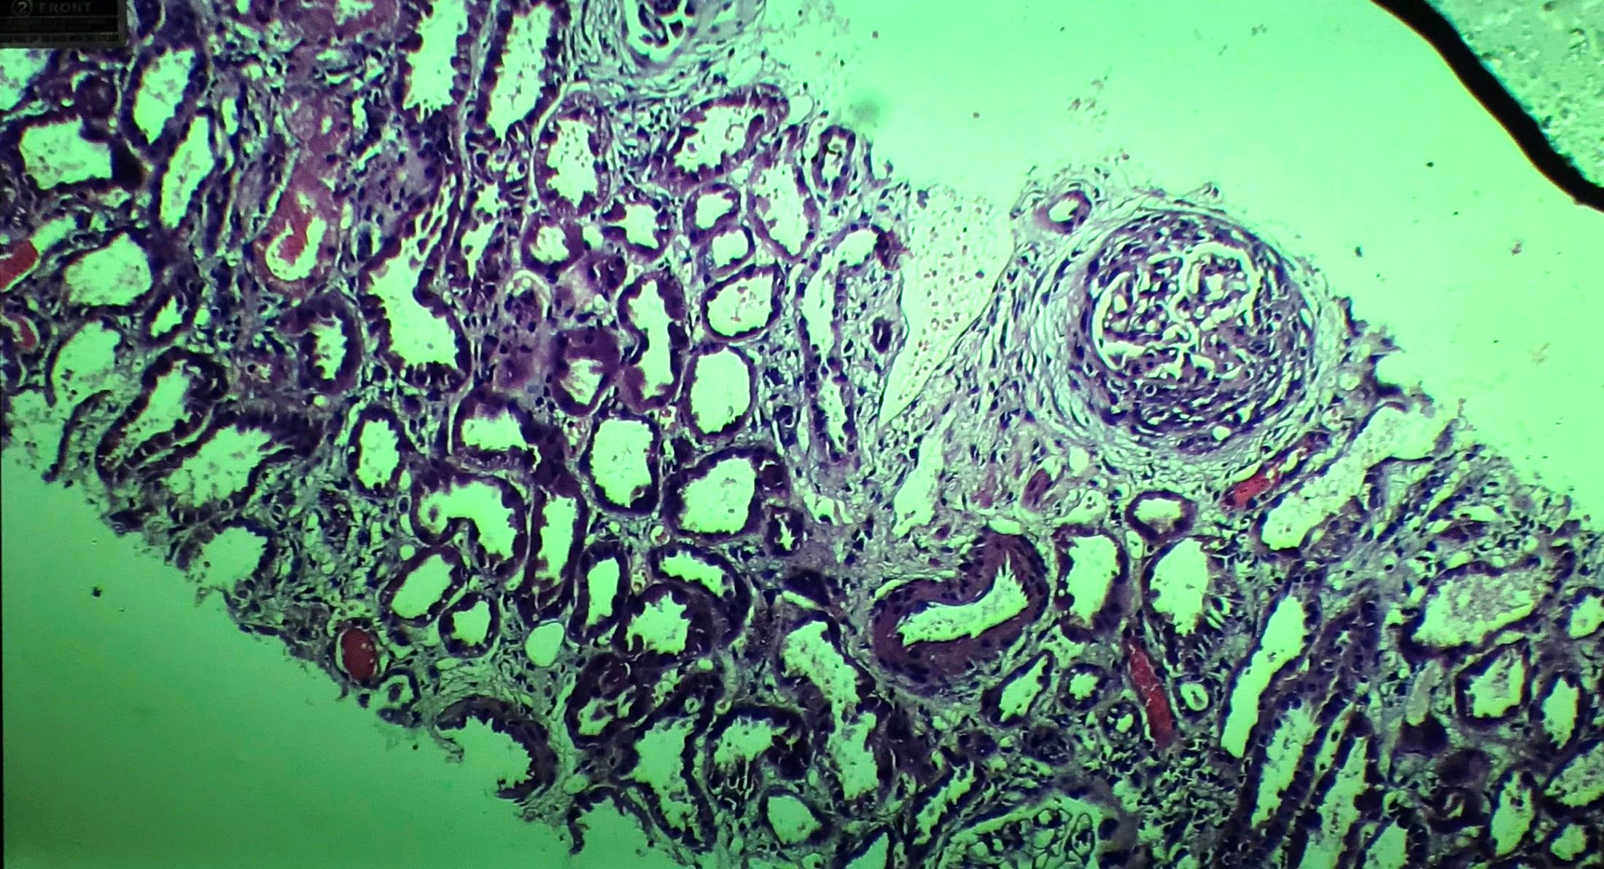
Notes:
Fc cresent

Slide 38
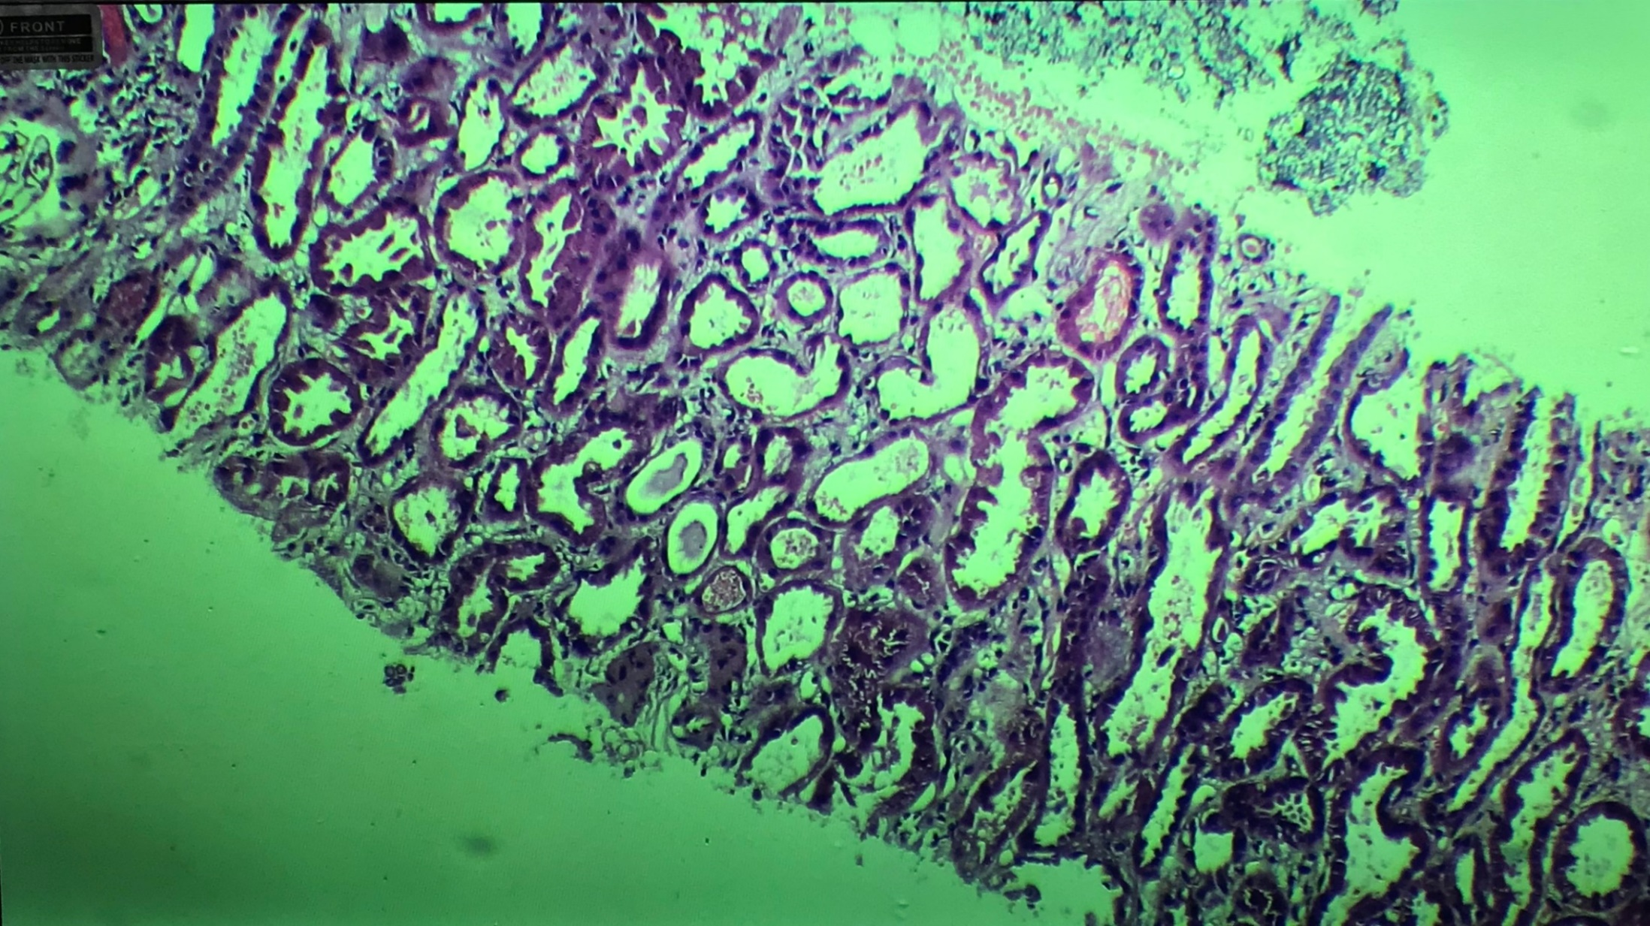

Slide 39
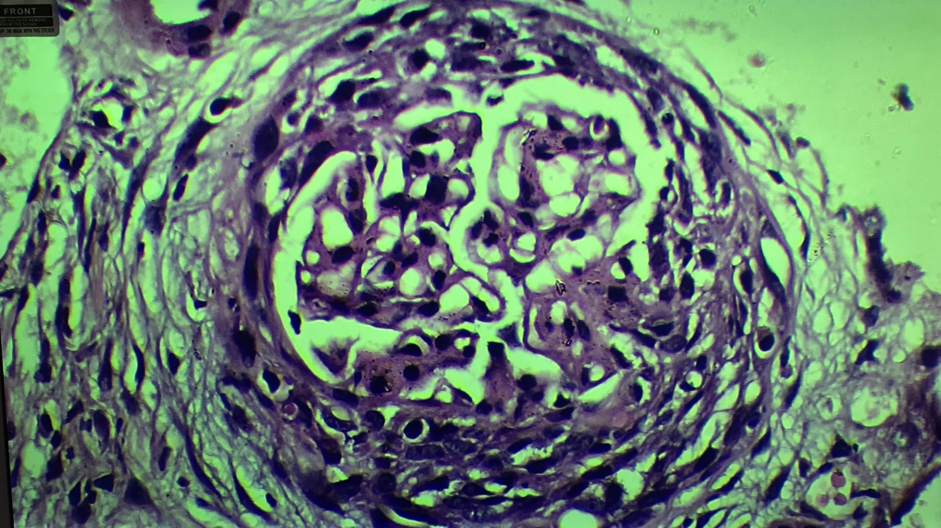

Slide 40
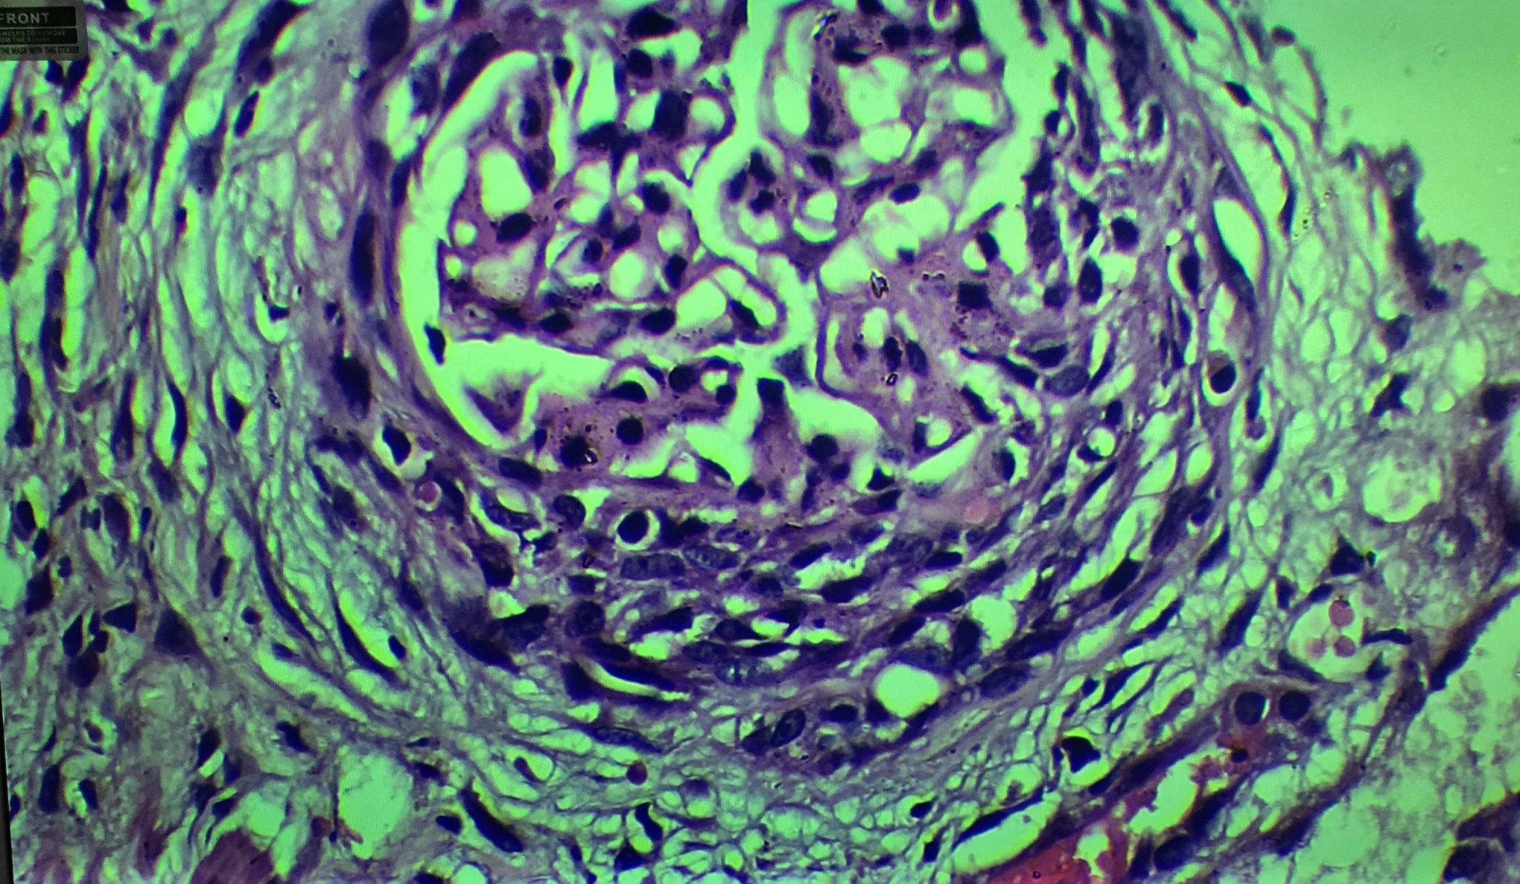

Slide 41
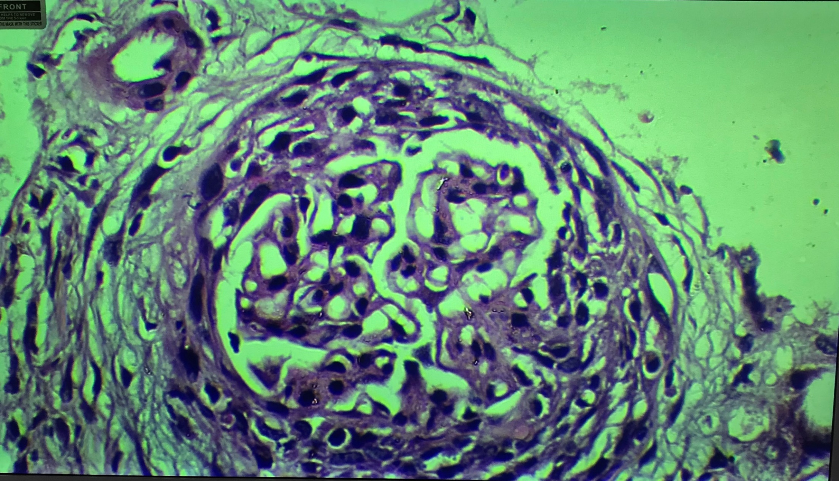

Slide 43
Treatment
Inj. Methylprednisolone pulse x 3 days → oral steroids
Post biopsy - Inj. Cyclophosphomide
Continued antihypertensive, Tamsulosin, added on sulfamethoxazole and trimethoprim and acyclovir prophylaxis.

Slide 44
Follow up
After 3 doses of cyclophosphomide: UPCR : 0.1, Serum Creatinine : 1 mg/dl
After 5 doses of cyclophosphamide: UPCR : 0.1, Serum Creatinine : 1 mg/dl
Plan: 6 th dose of Cyclophosphomide on 14.6.19

Slide 45
DISCUSSION - Rapidly Progressive Glomerulonephritis (RPGN)
2019 ICD-10-CM Diagnosis Code N01-99
RPGN - clinical syndrome manifested by features of glomerular disease in the urinalysis & by progressive loss of renal function over a comparatively short period of time
characterized morphologically by extensive crescent formation (extracapillary proliferation in Bowman's space)
Notes:
(days, weeks or months).

Slide 46
PATHOGENESIS OF CRESCENT FORMATION
crescent formation - nonspecific response to severe injury to the glomerular capillary wall
Rents are induced in the glomerular capillary wall → movement of plasma products, including fibrinogen, into Bowman's space with subsequent fibrin formation, the influx of macrophages and T cells, and the release of proinflammatory cytokines, such as IL-1 and TNF alpha and procoagulant and fibrinolytic inhibitory factors.
Notes:
Rents (focal gaps or discontinuities of the capillary wall)

Slide 47
Pathogenesis cont..
crescents may be seen with any form of severe inflammatory glomerular disease
Stage of active inflammation → followed by the development of fibrocellular & fibrous crescents.
Collagen deposition is due to fibroblast proliferation → driven by fibroblast growth factors.
fibrous crescents - not likely to respond to immunosuppressive therapy.

Slide 48
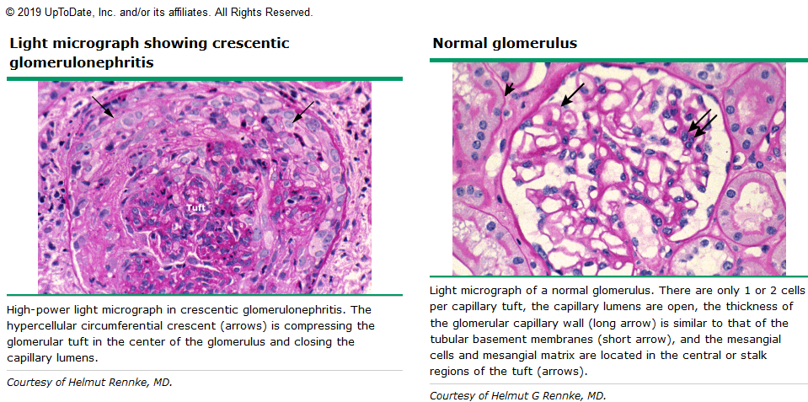

Slide 49
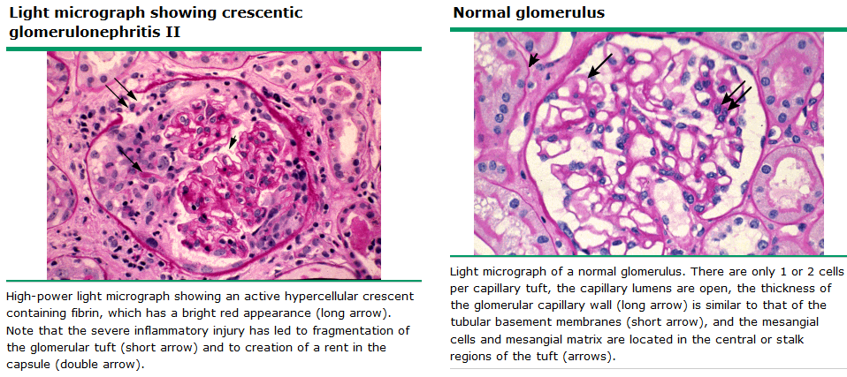

Slide 50
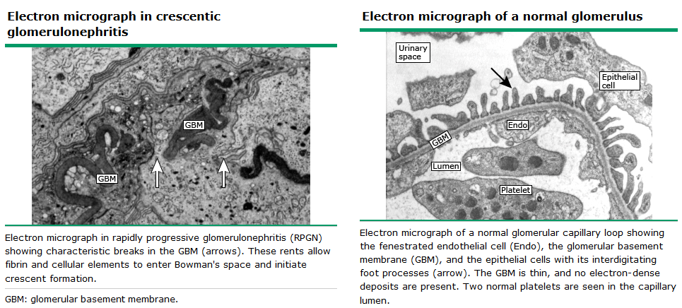

Slide 51
CLINICAL PRESENTATION
Acute onset of macroscopic hematuria, decreased urine output, hypertension, and edema.
fatigue or edema
Renal insufficiency - often exceeding 3 mg/dL
urinalysis typically - dysmorphic hematuria, red cell and other casts, variable degree of proteinuria

Slide 52
CLINICAL PRESENTATION cont..
Rarely no hematuria
Extrarenal : involvement of the lower airway, musculoskeletal system, skin, and/or nervous system

Slide 53
EVALUATION AND DIAGNOSIS
clinical findings suggestive of RPGN
Serologic tests include ANCA, anti-GBM antibodies, complement component assays, antinuclear antibodies, cryoglobulins,

Slide 54
PAUCI-IMMUNE FOCAL AND SEGMENTAL NECROTIZING GLOMERULONEPHRITIS
Small-vessel vasculitis - characterized by necrotizing inflammation of the small vessels: arterioles, capillaries, and venules.
Characterized by little or no deposition of immune complexes in the vessel wall (pauci-immune).
Medium or large vessels may occasionally be involved.
Pauci-immune small vessel vasculitides include granulomatosis with polyangitis , microscopic polyangiitis, and Churg-Strauss syndrome.

Slide 55
NCGN Cont..
characteristic kidney lesion in these conditions is pauciimmune focal and segmental necrotizing and crescentic glomerulonephritis (NCGN).
Active pauci-immune smallvessel vasculitis is typically associated with circulating ANCA
NCGN may occur without extrarenal manifestations of disease.

Slide 56
NCGN Cont..
Pauci-immune NCGN - associated with a rapidly declining GFR over days or weeks.
90% of patients with small-vessel vasculitis or pauci-immune NCGN have ANCA, directed primarily to the neutrophil granule proteins - MPO / PR3.

Slide 57
Pauci-immune NCGN cont..
Some studies : autoantibodies directed against LAMP-2 may be present in over 90 percent of ANCA-positive patients
Some patients: have scattered small immune deposits in the mesangium and glomerular capillary wall.
Notes:
lysosome-associated membrane protein 2

Slide 58
RATIONALE for Rx
Without therapy, ANCA vasculitis with GN - very poor outcomes.
high-quality evidence for treatment with corticosteroids and cyclophosphamide - improved the short- and long-term outcomes of ANCA vasculitis associated with systemic disease.
Immunosuppressive therapy may not be appropriate in patients with severe NCGN already requiring dialysis.
All patients with extrarenal manifestations of disease should receive immunosuppressive therapy regardless of the degree of kidney dysfunction.

Slide 59
Studies & Trials
Cohort studies did not detect a level of kidney function below which therapy can be deemed futile, as remission occurred in about 57% of patients with a GFR of 10 ml/min or less at presentation.
Of 69 patients who presented dialysis-dependent at the beginning of the Methylprednisolone or Plasma Exchange (MEPEX) trial, 44% were dialysis-independent at 12 months, and the point at which the chance of dying from therapy with plasmapheresis exceeded that of the chance of recovery was reached only in patients with severe tubular atrophy and injury of nearly all glomeruli.

Slide 60
Disease Activity
Active GN - progressive decline in kidney function, ongoing proteinuria with the continued presence of dysmorphic red cells in the urine and red cell casts.
Remission - absence of manifestations of vasculitis and GN disease activity. For GN, it is defined as the absence of microscopic hematuria and a stable or improved proteinuria and GFR

Slide 61
KDIGO 2012

Slide 62
Cyclophosphamide
addition of cyclophosphamide to corticosteroids in induction therapy improved the remission rate from 55% to 85%, and decreased the relapse rate three-fold.
Pulse i.v. and daily oral regimens for cyclophosphamide are associated with similar remission and relapse rates

Slide 63
Pulse Methylprednisolone
Rationale: rapid anti-inflammatory effect. rapid reduction in ANCA-producing plasma cells.
no data that 1000 mg daily for 3 days is better than 500 mg;
Notes:
this lower
dose is widely used in clinical practice, and the higher dose
may be associated with increased short- and long-term risks
of infection and other complications of steroids.

Slide 64
Rituximab
RITUXVAS trial, 44 patients with newly diagnosed ANCA vasculitis were randomized 3:1 to either rituximab (375 mg/m2 weekly4) in addition to cyclophosphamide (15 mg/kg i.v., 2 weeks apart for a total of two doses); or to cyclophosphamide (15 mg/kg i.v. every 2 weeks3, then every 3 weeks for a maximum total of 10 doses).
Both groups received the same regimen of methylprednisolone 1000 mg i.v. followed by oral corticosteroids.
Rates of remission were similar (76% with rituximab group vs. 82% with cyclophosphamide), as were rates of serious adverse events.
Notes:
Rituximab shows equivalent efficacy to cyclophosphamide
in initial therapy and the evidence does not suggest a
difference in rates of adverse effects.

Slide 65
Plasmapheresis
advanced kidney failure (S.Cr 5.66 mg/dl),
diffuse alveolar hemorrhage
PEXIVAS study

Slide 66
MMF
insufficient data to support the use of MMF for induction therapy in ANCA vasculitis

Slide 67
Maintenance therapy
goal : is to decrease the incidence and severity of relapsing vasculitis.
KDIGO recommend maintenance therapy in patients who have achieved remission. (1B)
KDIGO suggest continuing maintenance therapy for at least 18 months in patients who remain in complete remission. (2D)
KDIGO recommend no maintenance therapy in patients who are dialysis-dependent and have no extrarenal manifestations of disease. (1C)

Slide 68
Choice of agent for maintenance therapy- KDIGO
recommend azathioprine 1-2 mg/kg/d orally (1B)
suggest that MMF, up to 1 g twice daily, be used for maintenance therapy in patients who are allergic to, or intolerant of, azathioprine. (2C)
suggest trimethoprim-sulfamethoxazole as an adjunct to maintenance therapy in patients with upper respiratory tract disease. (2B)

Slide 69
Choice of agent for maintenance therapy- KDIGO cont..
suggest methotrexate (initially 0.3mg/kg/wk, maximum 25mg/wk) for maintenance therapy in patients intolerant of azathioprine and MMF, but not if GFR is < 60 ml/min per 1.73m2. (1C)
recommend not using etanercept as adjunctive therapy. (1A)

Slide 70
Treatment of Relapse
Relapse : occurrence of increased disease activity after a period of partial or complete remission.
recommend treating patients with severe relapse of ANCA vasculitis (life- or organ threatening) according to the same guidelines as for the initial therapy (1C)
suggest treating other relapses of ANCA vasculitis by reinstituting immunosuppressive therapy or increasing its intensity with agents other than cyclophosphamide, including instituting or increasing dose of corticosteroids, with or without azathioprine or MMF (2C)

Slide 71
Treatment of resistant disease
Resistance : persistence of or appearance of kidney and/or systemic manifestation of vasculitis, while receiving treatment equal in intensity to initial immunosuppressive therapy.
In ANCA GN resistant to induction therapy with cyclophosphamide and corticosteroids, recommend the addition of rituximab (1C), and suggest i.v. immunoglobulin (2C) or plasmapheresis (2D) as alternatives.

Slide 72
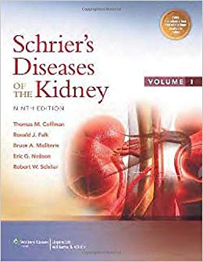
References

Slide 73
Thank You

