Slide 1
History
A 11 yrs old girl with normal birth history, vaccinated appropriately
- At the age of 5 yrs she presented with
c/o urinary incontinence
Nocturnal enuresis
difficulty in walking
In 2011 was evaluated and found to have
-occult spinal dysraphism
-tethered cord
-transitional lipoma with sacral agenesis

Slide 2
Feb 2013
- serum creat -1.47, urea 43
L2- L4 laminectomy, detethering of cord
Excision of lipoma
-started on levetiracetam post surgery (GTCS 2 episodes)
-post surgery advised CIC, however patient was not cooperative
Jan 2015
corrective surgery (post soft tissue release) for club foot

Slide 3
Dec 2018
-Detected to have HTN started on calcium channel blocker (dihydropyridine)
-Foleys catheter was inserted and continued since then(changed every 2 weeks )

Slide 4
Feb 2019
Presented to us with symptoms of nausea, loss of appetite
On examination
Weight 18 kg, height 123 cms ,BMI 11.9 kg/m2 (underweight)
-Vitals were stable
-Systemic examination NAD

Slide 5
-Serum Creat 5.7, urea 78 , Hb 7.2, Total counts 7200 , plt 1.87 lakh
-USG abd/Pelvis
Bil gross Hydronephrosis and Hydroureteronephrosis
Bil paper thin cortex due to ?VUR
Pre void 85 ml, post void 50 ml(significant)
-Urine output approximately 750 ml/day
She was initiated on maintainence hemodialysis(eGFR 8 ml/min/1.73 m2) at our centre thrice per week with access as Right IJV uncuffed HD catheter

Slide 6
Subsequently the uncuffed catheter was changed
-Left femoral uncuffed HD catheter
Later underwent Right IJV tunneled,cuffed HD catheter
She tolerated the hemodialysis well, felt better with each session with interdialytic weight gain on average of 0.5 kg
Bladder evaluation done was evaluated in view of transplant
Underwent Urodynamic study

Slide 7
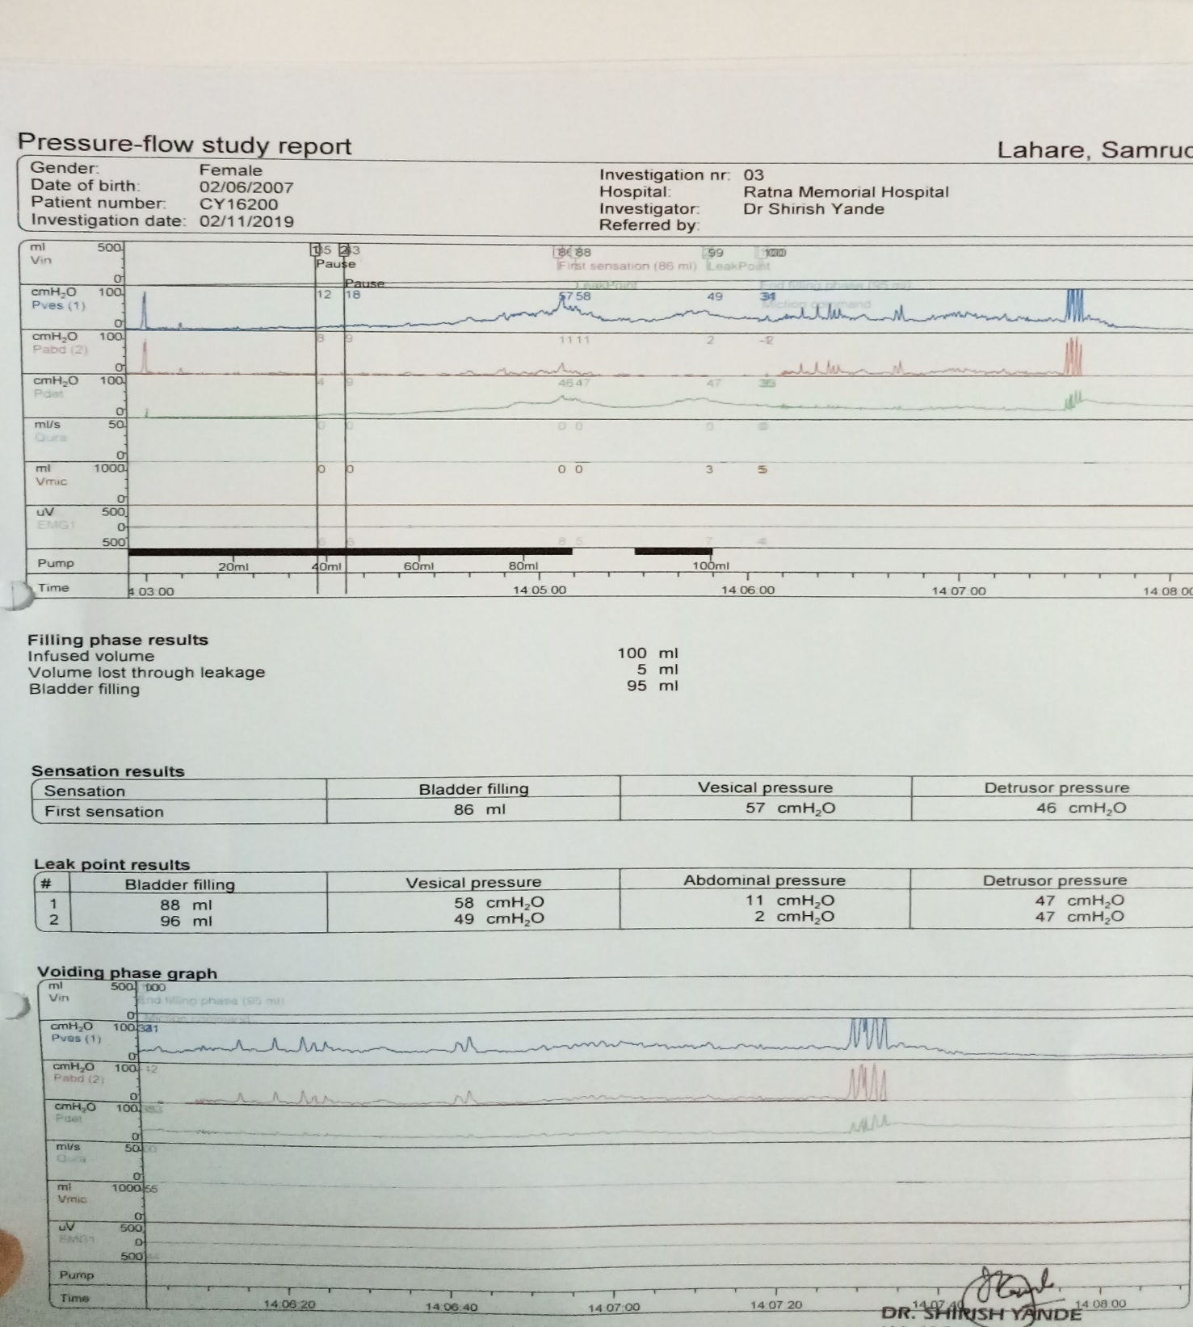

Slide 9
March 2019
-Radionuclide MCU –suggestive of Right VUR grade IV
-Conventional MCU - she was not cooperative
-cystoscopy with retrograde urography : small capacity bladder and Rt VUR
Meanwhile Paternal grandmother with similar blood group worked up as donor with HLA 5/6 mismatch
April 2019
- Right nephrectomy

Slide 10
Urology opinion : ileal conduit
Need of permanent ileostomy and post transplant CIC explained to parents and they agreed
Pretransplant
-Lymphocyte cross matching (CDC and flow cytometry ) -ve

Slide 11
Induction
Day 0
Antithymocyte globulin
Dose :100 mg (5 mg/kg)
Route: IV
Duration :4 hrs

Slide 12
Maintainence
- TMS protocol
Tab Tacrolimus 2 mg/day(0.1 mg/kg)
Tab Mycophenolate mofetil sodium 360 mg/day as per BSA
Tab Prednisone 20 mg/day
Other Medications:
Tab Valgancyclovir 450 mg -CMV prophylaxis,
Tab Cotrimoxazole(SS) - pneumocystis prophylaxis
She was discharged on day 12 post transplant in a stable condition

Slide 13
Challenges
1.Younger age of transplant
-High immunological risk
-Compliance issues
-Larger vessel size (Anastomotic issues will be dealt by urology dept.)
-Disparity in kidney size
2. Care of ileostomy bag
3. Ileal conduit
chances of infections

Slide 14
Complications to be expected further
Recurrent UTI
Stoma stenosis

Slide 15
Indications of native nephrectomy
High grade VUR
Intractable UTI
Persistent refractory Hypertension (helps in reducing need of anti hypertensive therapy)
X-Y gonadal dysgenesis and renal failure (Drash syndrome) as wilms tumor chances are high

Slide 16
Renal transplant in children

Slide 17
ESRD ETIOLOGY:
CAKUT including obstructive uropathy, hypoplasia, dysplasia
Heriditary renal diseases (polycystic renal diseases, cystinosis, hereditary nephritis, Atypical hemolytic uremic syndrome)
FSGS
Reflux nephropathy
HUS
Wilms tumour

Slide 18
NEUROGENIC BLADDER

Slide 19
Neurogenic bladder refers to dysfunction of the urinary bladder due to disease of the central nervous system or peripheral nerves involved in the control of micturition .

Slide 20
Efferent innervation | NERVE | ACTION | FUNCTION
Parasympathetic | Pelvic nerve(nervi | Detrusor muscle | Voiding
S2,3,4 | erigentes) – hypogastric | contraction
 | plexus | Internal sphincter
 |  | relaxation
Sympathetic | Hpogastric nerves | Detrusor muscle | Storage
T11-L2 | ---inferior hypogastric | relaxation
 | ganglion | Internal sphincter
 |  | Contraction
Somatic :FROM | Pudendal nerve | Voluntary innervations | Voluntary control
AHC- S-2,3,4 | (ventral rami) | initiate or inhibits
 |  | micturition through
 |  | cortical control
Afferent innervation
Parasympathetic | Pudendal nerve –enter | Sensation of pain and | Carried normal
S= 2,3,4 | through posterior rami and | distension conveyed | sensation
 | terminate in anterolateral | from bladder wall and
 | column | internal capsule
Sympathetic (T9 L2) | Hypogastric plexus:enter | Sensation of painful | Carried painful
 | through posterior rami and | distension conveyed | sensation
 | terminate in | from bladder wall
 | anteromediolateral column
 | T9-L2

Slide 21
MICTURITION(VOIDING) REFLEX
Sensation of bladder fullness via pelvic and pudendal nerves to
S 2,3,4
Frontal lobe decides social appropriateness
Periaqueductal gray matter
Medial Pontine micturition center
Detrussor center (S 2,3,4) to pelvic nerves
Onuf’s nucleus to pudendal nerves
RECIPROCAL ACTIVITY BETWEEN SPHINCTER & DETRUSSOR
Micturition

Slide 22
STORAGE REFLEXES
Passive low level phenomena mediated by a spinal reflex

Slide 23
Reflexic –Spastic /uninhibited/UMN | Areflexic - autonomous/flaccid/LMN | Sensory
Characteristics | Characteristics | Characteristics
No inhibitions influence | Bladder acts as if there | lack of sensation of need
time & place of voiding Bladder empties in response to stretching of bladder wall | were paralysis of all motor functions | to urinate
Clinical manifestations | Clinical manifestations | Clinical manifestations
-Incontinence | Fills without emptying | Poor bladder sensation ,
-Frequency | Retention | Infrequent voiding of large
-Urgency -voiding is unpredictable and incomplete | Dribbling incontinence | residual volume
Causes :- corticospinal | Causes:- Lower motor | Causes:- Damage to
tract lesion | Neuron lesion caused by | sensory limb of bladder
observed in | trauma involving S2-S4 | spinal reflex arc seen in
SCI/stroke/multiple | lesions of cauda | Multiple
sclerosis/brain tumor/brain trauma | equina/pelvic nerves | sclerosis/diabetes mellitus

Slide 24
Investigations

Slide 25
Noninvasive
1.Urine R/M
2.Urine C/S
3. RFT
4.Usg -Post void residual volume
5.Uroflowmetry : Voided volume ( >100ml)
Maximal flow, maximal and average flow rate (M > 20ml/sec F > 15ml/sec)
6.Neuro Imaging

Slide 26
Invasive
1. Voiding cystourethrogram to rule out VUR
2.Urodynamic studies for
Detrusor instability, incontinence, bladder pressure, bladder capacity , urine flow rate, sphincter activity
3.Cystoscopy

Slide 27
TREATMENT:
•
Non-invasive conservative treatment
Electrical stimulation
Drugs- anticholinergics, cholinergics, tricyclic antidepressants
Minimal invasive treatment
Clean Intermittent Catheterization
Botulinum toxin injections in the bladder
Sphincterotomy
Surgical treatment
Detrusor myectomy
Sacral rhizotomy with Sacral ant root stimulation
Sacral neuromodulation
Sphincterotomy
•
•

