Slide 1
A case of multiple discharging sinuses
Case presentation
Department of Microbiology
BY: Dr Izna

Slide 2
Case
A 35 years old Female patient (agricultural worker),came to Dermatology department with chief complaints of
Painful, raised lesions over the axilla, upper chest, B/L shoulders and over the back since 2 months
Lesions were associated with blisters having serous discharge
Initially the lesions appeared over the left neck area then back
Lesions were well defined hyperpigmented nodules , varying size papules, plaques with multiple discharging sinuses without granules.
H/O – Fever on and off with evening rise of temperature, slight weight loss
No H/O-Hypertension, Diabetes

Slide 3
0/E-
Patient was febrile
Pulse-78/min ,regular
BP-110/70mm Hg
Past history-
Mass lesions over the right side of the neck for which patient got operated one and half year back.
Again her symptoms started 2 months back so, she went to a local practitioner in Kasarwadi and was given medication .As her symptoms did not subside she discontinued the medicine and came to Dr.D.Y Patil Medical College for the same.
Personal history-
Sleep
Bowel
Bladder Normal
Appetite

Slide 4
Differential diagnosis
Tuberculosis
Pyoderma
Scrofuloderma
Hidradenitis suppurativa
Sporotrichiosis

Slide 5
Investigations
Mountoux test= Negative
USG Neck report-
Multiple Lymph node abscesses on B/L sides of neck level ,II,III,IV and intraparotid and submandibular region with largest of size 35x15mm on left side in level IV and 22x17 mm on RT side ,compressing internal jugular vein on both sides.
USG Neck-Cold abscess measuring 36x23 mm in RT lower neck with small caseating Lymph node in left posterior triangle. Multiple collapsing lymph nodes of size 1-2 cm noted in B/L submandibular region and parotoid gland.

Slide 6
USG Breast – Abscess suggestive of Tubercular etiology( size 2-4 cm) with thick wall and multiple internal echos in all quadrants many coalescing with each other
CT Neck- It also suggested the similar findings
Patient was started on Tab-Rifampicin 300 mg, Tab Clindamycin 300 mg, Tab Linezolid 600mg.

Slide 7
Multiple purulent discharging sinuses from axillary lymph node

Slide 8
Investigation
Bilateral axillary lymph node excision
USG guided aspiration was done
of breast abscess under LA (7-8 cc pus was aspirated)
Both Pus samples were received in microbiology department
Microscopy: KOH Mount: Showed filamentous septate Hyphal structures s/o of a Fungal etiology
Gram stain: Showed some Gram positive filamentous hyphae and Budding yeast cells along with Gram negative bacilli
ZN stain-No acid fast bacilli seen

Slide 9
Organism isolated from bacteriology culture were Klebsiella pneumoniae and Pseudomonas aeruginosa
Sample was also cultured on SDA and SCA
Gen-Probe and GeneXpert MTB/RIF- Negative

Slide 10
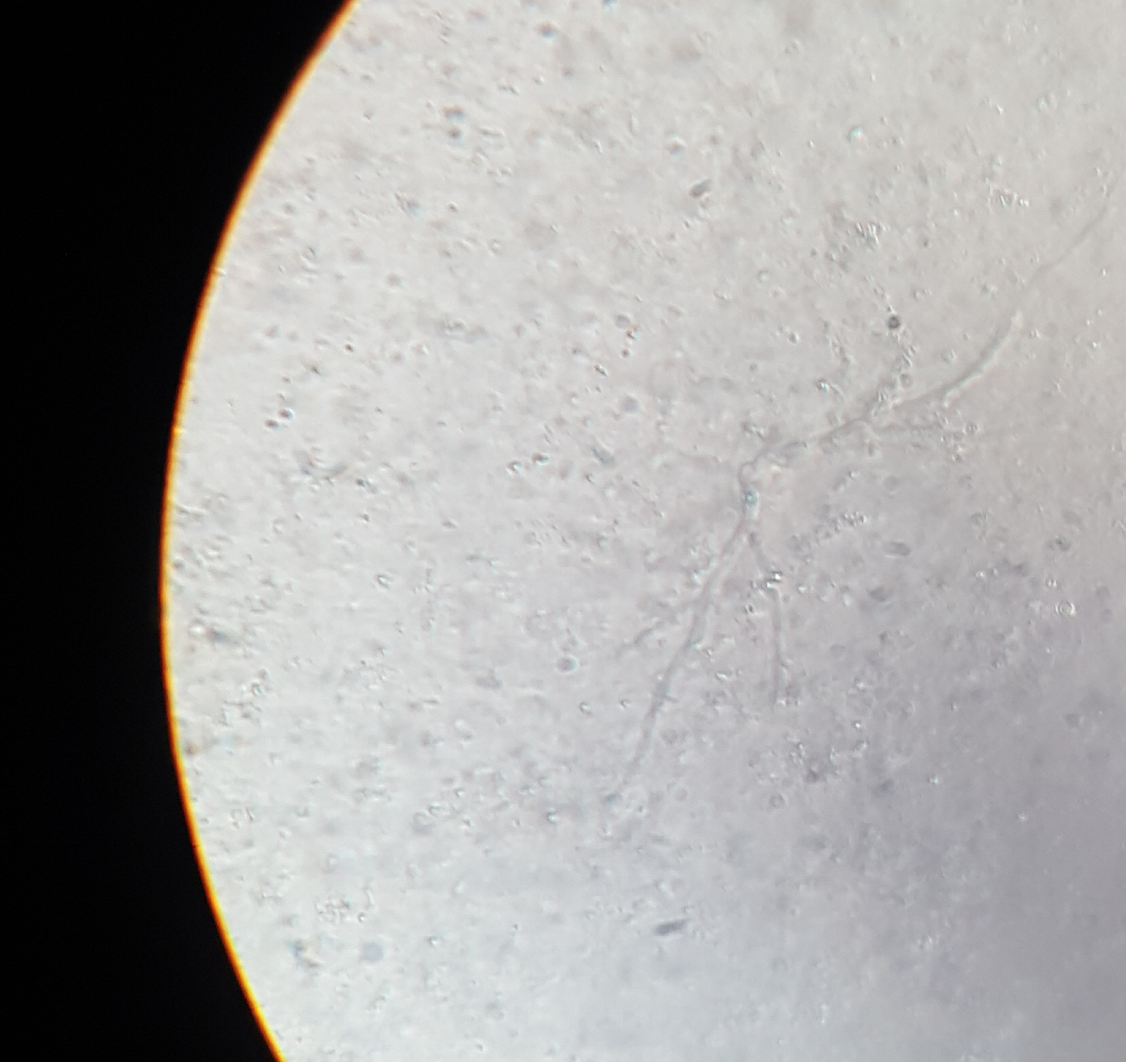
KOH Mount-showing septate fungal elements

Slide 11
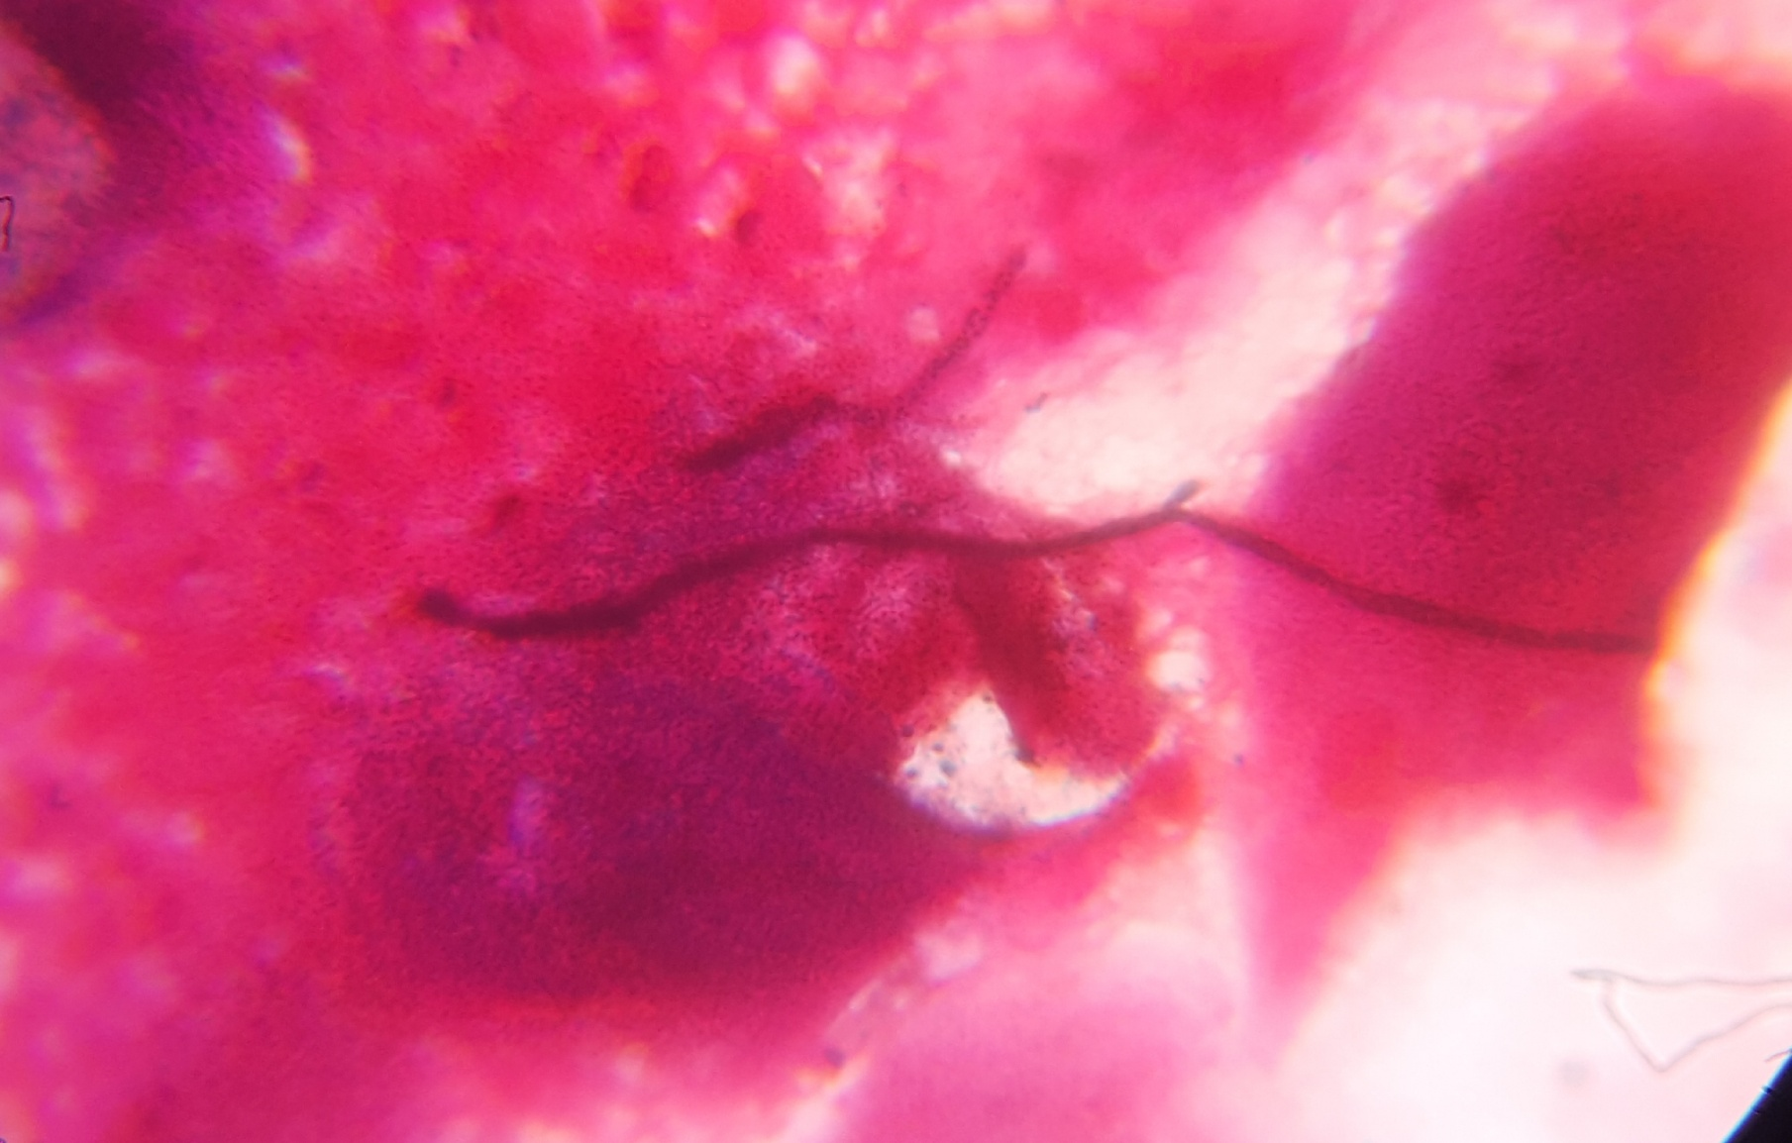
Gram positive fungal elements seen

Slide 12
ZN staining
Acid fast bacilli not seen

Slide 13
Fungal culture identification
Growth on Sabouraud dextrose agar SDA and SCA at both incubator and room temperature showed slow growing dark greenish grey coloured colonies in 12-15 days.
LPCB staining was done, septate hyphae were seen
Meanwhile, patient was started on Itraconazole on these evidences.

Slide 14
Dark Greenish grey velvety colonies
SDA AGAR

Slide 15
Further incubation was done for 7 more days, septate hyphae with annellophore was seen, a diagnosis of Exophiala spp. was made
For speciation , the slant with growth was sent to PGI Chandigarh (PGIMER) for further speciation, and Exophiala spinifera was confirmed genotypically.
Meanwhile patient was continued on Itraconazole and she had great deal of improvement in her lesions.

Slide 17
Exophiala spinifera
Exophiala species are common environmental fungi often associated with decaying wood and soil enriched with organic wastes.
Most common spp isolated among Exophiala is Exophiala jeanselmei
Fungi classified in this genus are characterized by slow growth with black or dark brown colonies, the presence of budding cells, and have conidia repetitively produced from annellides.
Exophiala spinifera infection though rare is one of the most virulent species of this group and a potential agent of disseminated, osteotropic disease.
Greenish black yeast genus Exophiala contains several species capable of producing human disease, by traumatic injury.
Notes:
Herpotrichellaceae-black yest and relatives

Slide 18
Differentiation of these species remains problematic for routine clinical laboratories. Features contributing to difficulty in identification include the pleomorphic nature of the genus, i.e., the ability of several species to form a yeast phase as well as a filamentous phase.
C/F
It causes deep cutaneous fungal infection including:-
Epidermal hyperkeratosis
Acanthosis
Pseudoepitheliomatous hyperplasia
Intraepidermal pustule formation
Chromoblastomycosis
Cutaneous phaeohyphomycosis

Slide 19
1st reported in 1954 from Amritsar, Punjab, India
Less than 50 cases reported in literature
Histology
Multinucleated giant cells are a common feature
Pigmented fungal elements can be detected often in areas of inflammation, within or adjacent to multinucleate giant cells
Other histologic descriptions have included budding yeast-like cells, thick walled chlamydospores, branched hyphae that were constricted at prominent septations, toruloid hyphal elements, and hyphae without prominent swellings.

Slide 20
Treatment
E. spinifera is highly susceptible to itraconazole but poorly responsive to amphotericin B.

Slide 21
TAKE HOME MESSAGE
Multiple discharging sinuses/granulomatous lesions can have varied differential diagnosis
A complete microbiological workup is essential to reach to a diagnosis and mode of treatment.
Holistic approach is essential when dealing with such rare cases

Slide 22
References
1.Chromoblastomycosis associated with bone and central nervous involvement system in an immunocompetent child caused by Exophiala spinifera. Indian Journal of dermatology, Volume 61,Issue: 3,324-328,13 May 2016
2.Phaeohyphomycosis is caused by Exophiala spinifera in India, Journal of Medical Mycology 41(5):437-441.February 2010
3.Subcutaneous phaeohyphomycosis due to Exophiala spinifera in an immunocompromised host. Indian Journal of Medical Microbiology,Volume:28,Issue :4,396-399, 20 October 2010
4. Exophiala spinifera and its allies: diagnostic from morphology to DNA barcoding
Medical Mycology ,Volume 46,Issue 3,1 May 2008
5.Exophiala spinifera as a cause of cutaneous phaeohyphomycosis ,Case study and review of Literature, Medical Mycology, Volume 47,Issue: 1,87-93,1February 2009

Slide 23
THANKYOU

