Slide 1
Case of Fever with Anuria
DR SONIKA REDDY
JR II
DEPARTMENT OF MEDICINE

Slide 2
History of Present illness
28 year old male, resident of Nigdi, Pune, cloth merchant by occupation, admitted with
Fever- Continuous, high grade
Loose stools - 10 to 12/day, watery ,
foul smelling, no mucous/blood
Abdominal pain – diffuse, intermittent,
spasmodic, non radiating
Vomiting – 5 to 6 times, bilious
Decreased urine output
Irrelevant talk, intermittently 1day.
12 days
2 days

Slide 3
Prior to admission, Patient received a 3 day antibiotic course from a local doctor (Tab cefuroxime 500 BD)
No h/o alcohol / drug abuse
No significant past and family history
Clinical Examination: On admission
- Conscious , was talking irrelevant intermittently
- Febrile, Temp - 102◦ F (axilla)
- Pulse – 110/min, regular
- BP – 120/80 mm Hg, right arm supine position
- RR – 26/min
- SpO₂- 96% on room air
No Pallor, icterus, cyanosis, clubbing, lymphadenopathy, edema, rash, petechiae, ecchymosis

Slide 4
Clinical Examination
Systemic Examination:
CVS : heart sounds were normal, no other significant abnormality noted.
RS : normal vesicular breath sounds heard, no added sounds.
P/A : hepatosplenomegaly. Liver span- 17 cms, tenderness over Right Hypochondrium and Umbilical region.

Slide 5
Clinical Examination:
CNS:
Higher Mental functions: conscious, oriented to time, place and person; but had episodes of irrelevant talk intermittently.
Other higher functions were normal
No other neurological deficit.
Fundus - (LE) macular edema
(RE) normal

Slide 6
Lab Investigations on the day of admission
HB gm% | 16.0
TLC /mm³ | 3000
Platelet count /mm³ | 60,000
T.BIL | 1.74
D.BIL | 0.99
ALT | 88
AST | 158
ALP | 113
PT INR | 1.0
Sr.LDH | 1332
Bl.Urea | 76
Sr.Creat | 4.1
Sr.Calcium | 8.5
Sr.Uric acid | 9.9
Sr.Phosphorus | 3.3
Sr.Magnesium | 1.67
Sr.Na | 143
Sr.K | 4.8
Sr. Amylase | 165
Sr. Lipase | 105

Slide 7
Lab Investigations:
Urine R/M
Albumin – 1+
Sugar – Trace
Pus cells – 1-2 / hpf
Epi cells – 2-3/ hpf
No RBC casts
UPCR- 1.1
Stool R/M: Ova / cysts not seen,
Occult blood positive, no pus cells.

Slide 8
Lab Investigations
Widal slide test –
S.Typhi O
S.Typhi H negative
S.Paratyphi AH
S.Paratyphi BH
Dengue IgG, IgM, NS1Ag – negative
Rapid Malaria (Ag)Test – Negative
HIV, HBsAg and Anti HCV – negative

Slide 9
Lab Investigations:
CRP – positive
Trop T – negative
CPKMB– 70 IU/L (0-24 IU/L)
CPK Total – 240 U/L (34-145 U/L)
Serum Procalcitonin – 68.8 (<0.3ng/ml)
Plasma fibrinogen – 265.0 mg/dl (180-350)
Brucella, Leptospira & Weil Felix test-Negative.
Complement 3 – 66.5 (90- 180 mg/dl)
Complement 4 – 23.0 (10- 40 mg/dl)
Sr. ANA – 2.6 U/ml (0-10U/ml)
TFT: within normal limits

Slide 10
Peripheral blood smear
Normocytic Normochromic RBCs.
Burr cells ++.
Occasional schistocytes seen. No hemoparasites seen

Slide 11
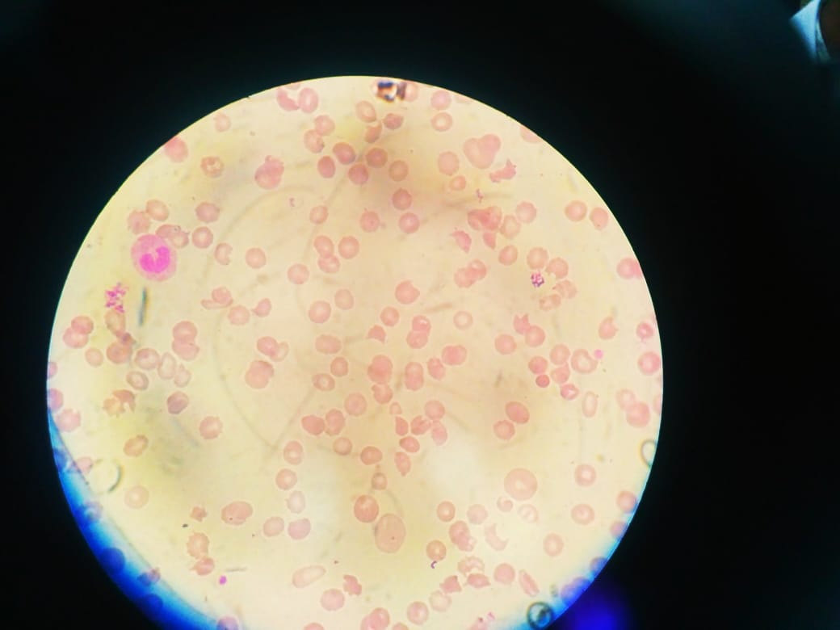

Slide 12
Radiological Investigations:
USG abdomen and pelvis –
Liver – 16.4cm
Spleen – 15 cm
2D Echo –
Mild global hypokinesia
Left Ventricular Ejection Fraction : 45-50%
 | Rt kidney | Lt kidney
Size | 14 x 6.8 mm | 14 x 7 mm
C.M.Difference | Accentuated | Accentuated

Slide 13
12 hours after admission
He was febrile, in delirium and aggressive.
Disoriented to time, place and person.
Speech was irrelevant, muttering.
No focal neurological deficit.
Urine output was 10ml over 12 hrs.
Blood pressure was maintained.

Slide 14
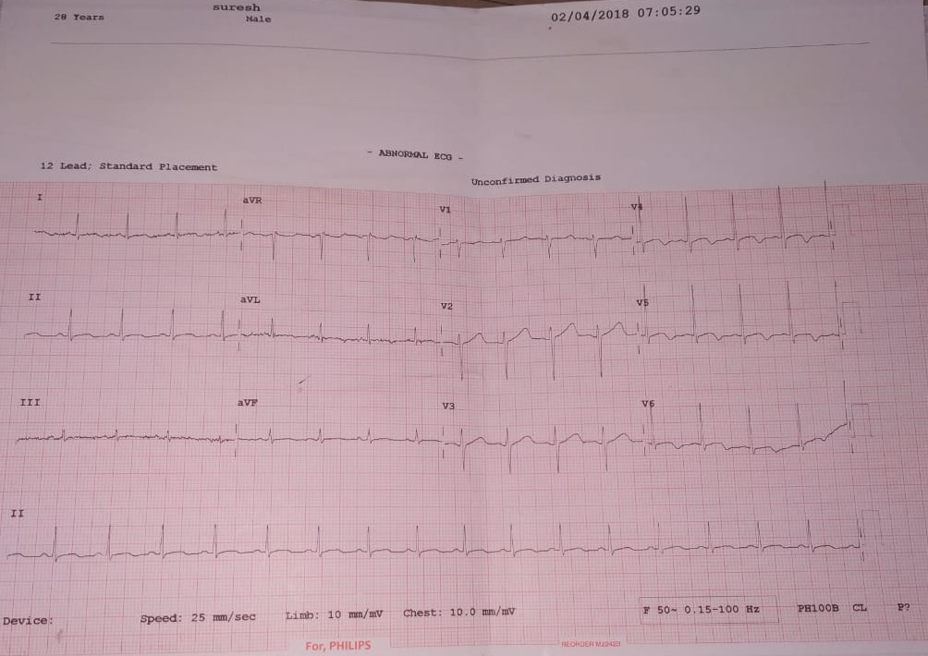
ECG
ECG showed ST elevation with convexity upwards and T wave inversion along with 2D echo evidence of mild global hypokinesia with low left ventricular ejection fraction, and raised cardiac enzymes were suggestive of myocarditits.

Slide 15
Our Differential Diagnosis on the day of admission
Gram negative sepsis due to E.coli or Salmonella species.
Connective tissue disorder with sepsis
Leptospirosis
with Acute kidney injury,
Encephalopathy, Myocarditis,
Pancreatitis and Hepatitis.

Slide 16
Lab Investigations
 | DAY 2 | DAY 4 | DAY 8
Hb g% | 13.6 | 12.8 | 8.6
TLC/mm³ | 3,600 | 5,400 | 12,800
Platelet/mm³ | 80,000 | 50,000 | 1.20lac
T. Bil | 0.79 | 0.58 | 0.56
D. Bil | 0.71 | 0.30 | 0.13
ALT | 71 | 82 | 26
AST | 206 | 244 | 53
ALP | 95 | 107 | 63
PT/INR |  | 1.4
DAY 14
8.4
11,200
4.0 lac
1.20
0.56
38
152
165
DAY 20
10.2
10800
4.20 lac
0.42
0.16
29
62
83
1
DAY 10
7.4
15,800
1.70 lac
0.27
0.09
5
31
28
2.54
This were his lab invest during the course in hospital. Hb was 13.6 on admission. It was decreasing, initially, he had leucopenia and then started raising, platelet count was low, LFTs showed raised AST, PT/INR was deranged, later normalised.

Slide 17
Lab Investigations
 | DAY 2 | DAY 5 | DAY 8 | DAY 10 | DAY 13 | DAY 20
Bl. Urea | 153 | 163 | 189 | 99 | 108 | 80
S. Creat | 8.39 | 8.2 | 4.3 | 3.5 | 3.97 | 1.42
S. Calcium | 7.2 |  | 7.9 | 4.1 | 7.5 | 8.2
S. Uric Acid | 12 | 7.7 | 5.7 | 3.1 | 2.8 | 7.8
S. Phosphorus | 5.1 |  | 7.9 | 4.0 | 5.9
S. Sodium | 139 | 154 | 146 | 148 | 139 | 150
S. Pottasium | 2.7 | 3.7 | 4.5 | 4.6 | 5 | 4.5
S. Amylase | 165 | 343 | 1678 |  | 1389 | 446
S. Lipase | 105 | 172 | 957.6 |  | 1465 | 278
This slide showed RFTs were deranged for which we had kept him on daily hemodialysis, sr.ca was low, sr ph was raised, sr amylase went upto to 1678, sr lipase was went upto to 957

Slide 18
Lab Investigation
URINE | DAY 2 | DAY 4 | DAY 13
Albumin | 1+ | 2+ | 2+
Sugar | trace | 1+ | Nil
Pus cells | 1-2 | 3-4 | 10-14
Epithelial cells | 2-3 | 2-3 | 3-4
RBC |  | >60/hpf | >50/hpf
This was the slide of U/M showed albuminuria, sugar trace, pus cells was 10-14/hpf , RBCs more than 50/hpf

Slide 19
Lab Investigations
Blood Culture – Salmonella Typhi isolated and had significant colony count.(On 7th day of admission)
Sensitive to imipenem, cefoxitin, ceftazidime, cefotaxime, ampicillin,chloramphenicol, amikacin, gentamicin, cotrimoxazole
Nephrologist opinion was taken for the Renal biopsy but as proteinuria was less then 400mg/day, it was not considered.

Slide 20
Lab Investigation
MRI brain was normal.
Lumbar puncture was done and CSF was normal
Bone marrow Aspiration: normal

Slide 21
Management
Supportive IV fluids and inj haloperidol was given for delirium.
Initially started on Inj. Ceftriaxone 1gm BD, but later Inj. Meropenem 500gm BD and Teicoplanin 200mg OD(renal dose) were started due to suspected sepsis.
Received Two Packed Red Blood Cells for anaemia.
He was on daily hemodialysis for 10 days and remained anuric for a week & then went into polyuric phase.
His general condition improved slowly after 4 to 5 days of polyuric phase.

Slide 22
LAB INVESTIGATIONS ON DISCHARGE
 | 10/04
Hg % | 12.6
TLC/mm³ | 8000
Platelets/mm³ | 3.35 lac
Blood urea | 38
Creatinine | 1.0
ALT | 30
AST | 43
ALP | 77
Sr Sodium | 140
Sr Potassium | 4.5
Sr amylase | 97
Sr lipase | 60
Sr LDH | 203

Slide 23
LAB INVESTIGATION ON DISCHARGE
URINE | 10/04
Albumin | Nil
Sugar | Nil
Pus cells | 1-2
Epithelial cells | 1-2
He is on regular follow-up and has no proteinuria at present.

Slide 24
OUR FINAL DIAGNOSIS
Gram Negative Sepsis due to Salmonella typhi with
Hemolytic Uremic Syndrome with
Salmonella induced encephalopathy,
hepatitis, myocarditis & pancreatitis.

Slide 25
DISCUSSION
COMPLICATIONS OF TYPHOID FEVER
Disseminated intravascular coagulation
Hematophagocytic syndrome
Pancreatitis
Hepatic and splenic abscesses and granulomas
Endocarditis
Pericarditis, Myocarditis
Hepatitis
Glomerulonephritis, Pyelonephritis and Hemolytic-uremic syndrome
Severe pneumonia
Arthritis, Osteomyelitis
Endophthalmitis
Parotitis.

Slide 26
HEMOLYTIC UREMIC SYNDROME
HUS is characterized by triad of
- Microangiopathic hemolytic anemia
-Thrombocytopenia
- Renal insufficiency.
A confirmed diagnosis of HUS should have onset within three weeks of acute diarrhea/dysentery (our patient presented within 2 weeks)

Slide 27
Contd.. Hemolytic Uremic Syndrome
HUS due to diarrhea is caused by
- Vero-toxin producing E.coli
- Shiga toxin of Shigella dysentriae type-1
- Rarely Salmonella species
The pathogenesis of HUS in Enteric fever is unclear, but the expression of S.typhi virulence factors and endothelial injury with oxidative & shear stresses & resultant microvascular thrombosis may be a possible explanation.
Presence of leucocytosis in typhoid fever suggests a complication and should alert one to the possibility of the haemolytic-uremic syndrome.

Slide 28
WIDAL TEST
Cases treated early with antibiotics may shows poor agglutination response & Widal test could be negative

Slide 29
Take home message
Widal test, although frequently used is not reliable test to diagnose Enteric fever.
In a patient of enteric fever if we get leukocytosis, that should also alert the complication like hemolytic uremic syndrome, which is a rare association with Salmonella typhi infection other than intestinal perforation leading to peritonitis.

Slide 30
References
Huang DB, DuPont HL. Problem pathogens: extra-intestinal complications of Salmonella enterica serotype Typhi infection. The Lancet infectious diseases. 2005 Jun 1;5(6):341-8
David A. pegues., Sameul I. Miller. Salmonellosis. Kasper, D. L., Fauci, A. S., Hauser, S. L., Longo, D. L. 1., Jameson, J. L., & Loscalzo, J. (2015). Harrison's principles of internal medicine (19th edition.). New York: McGraw Hill Education.
Chinnasami B, Prema A. Enteric Fever Presenting as Hemolytic Uremic Syndrome. IJSR,8 Aug 2013; 2(6).
George P, pawar B. A sinister presentation of typhoid fever. Indian J Nephrol 2007;17:176-7
Albaqali A, Ghuloom A, Al Arrayed A, Al Ajami A, Shome DK, Jamsheer A, et al. Hemolytic uremic syndrome in association with typhoid fever. Am J Kidney Dis2003;41:70913.
Ananthanarayan and Paniker; textbook of microbiology. 2017, 10th ed, Ch 31, Pg 304. ed Reba Kanungom Universities press, Hyderabad.

Slide 31
THANK YOU

