Slide 1
AN UNUSUAL CASE OF CHRONIC DIARRHOEA
Dr. Shivam Sharma
Dept. of General Medicine

Slide 2
Presentation
A 28 year old male presented with
Diarrhoea and weight loss of 5 Kg over a period of 6 months refractory to standard treatment
Frequent episodes of abdominal pain since 2 months.
Clinical examination was normal.
Routine hematology and biochemistry was normal.
Serology for HBV, HIV was negative.
Stool routine microscopy was normal.
Ultrasonography of abdomen & pelvis was normal.

Slide 3
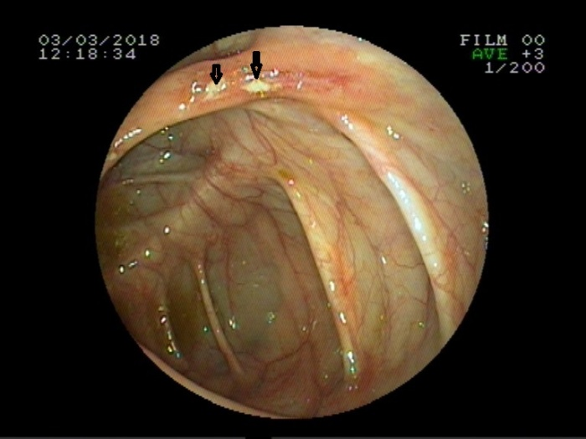
Colonoscopy
Colonoscopy showed multiple small discrete ulcers measuring less than 1 cm in the caecum with mucosal thickening at the distal portion of the ascending colon.
Multiple biopsies were taken.

Slide 4
CECT Abdomen
CECT abdomen showed asymmetrical thickening (maximum 11 mm) of the caecal wall with moderate thickening of ileo-caecal valve.
Other organs were normal.

Slide 5
Histopathology
We received multiple fragmented biopsy bits from colon
HPE revealed large bowel mucosa with ulceration and atypical nodular lymphoid cell aggregates involving the submucosa and muscularis propria.

Slide 6
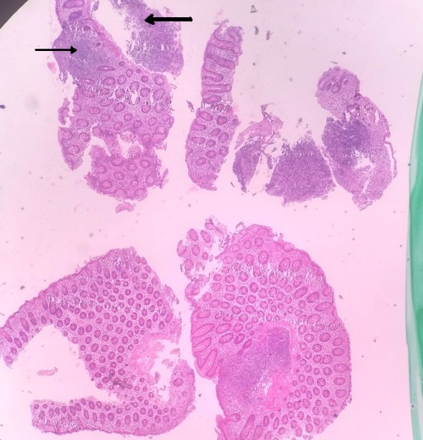
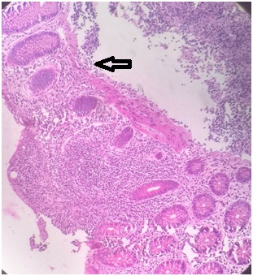
Photomicrograph of colonic biopsy fragments showing atypical nodular lymphoid cell aggregates in mucosa (thin arrow) and beneath in the muscularis mucosa (thick arrow) with mucosal ulceration in places

Slide 7
Immunohistochemistry
Immunohistochemical studies revealed positivity for CD20 and results were negative for CD 5/ CD10/ TdT/ CyclineD1 confirming the diagnosis of B cell lymphoma (NHL).
The diagnosis according to WHO classification was B cell Lymphoma, unclassified (BCLU)
CD20 is the most widely used pan–B-cell marker and is expressed from the naı̈ve B cell until the final stages of B-cell development just prior to plasmacytic differentiation.
Notes:
Terminal deoxynucleotidyl transferase

Slide 8
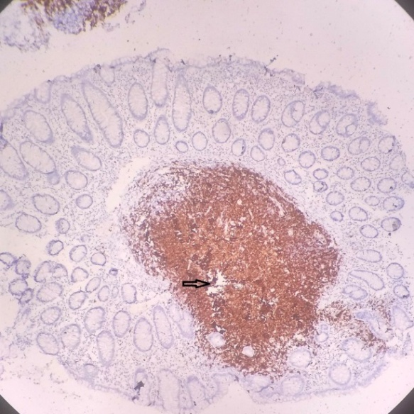
IHC photomicrograph shows lymphoid aggregates in the mucosa with a striking positivity for CD 20
Notes:
Terminal deoxy nucleo tidyl transferase

Slide 9
Diagnosis: Colonic – B Cell Hodgkin’s Lymphoma (Unclassified)

Slide 10
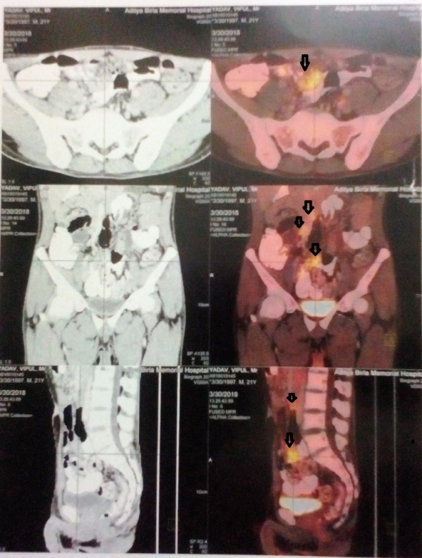
PET scan was performed with 7.5 mCi of 18 FDG, it showed circumferential thickening of caecum.
FDG uptake was seen in multiple mesenteric nodes measuring 1.5x1.2 cm, sub-centric aortocaval node, mildly enhancing mesenteric thickening along the SMV.
Notes:
Fluoro deoxyglucose

Slide 11
Diagnosis
To conclude, the patient had a metabolically active caecal wall thickening consistent with histological diagnosis of lymphoma.
The presence of metabolically active mesenteric and aortocaval lymph nodes were noted.
The staging of this case was BCLU T3N3M0B0 according to Paris Staging system which is specifically meant for primary gastrointestinal lymphomas.
Final Diagnosis - Primary B cell Lymphoma of Caecum and Colon presenting as an ulcerative lesion in a young male.

Slide 12
Treatment
Patient was advised R-CHOP regimen (Rituximab, Cyclophosphamide, Doxorubicin, Vincristine, Prednisolone) as treatment option.

Slide 13
Discussion
Non-Hodgkin lymphomas (NHLs) commonly present as lymphadenopathy.
Primary NHL accounts for 0.1%-0.5% of all colorectal malignant disease, with most common being the Diffuse Large B cell Lymphoma. ^{[1]}
The most common symptoms of colonic lymphoma are abdominal pain and weight loss, with a palpable abdominal mass^{[2]}

Slide 14
Tumour was considered to be primary because:
No palpable superficial lymphadenopathy at the first examination
No obvious enlargement of the mediastinal nodes on chest x ray
Normal TLC, DLC and normal bone marrow examination
SPECT scan showed no focal lesions in the liver, spleen, and bone marrow
No FDG uptake in liver and spleen

Slide 15
On endoscopic examination, primary B-cell lymphomas of gut usually present as exophytic lesions, which also provides specimen for histologic diagnosis.^{[3]}
Primary intestinal lymphoma is mostly seen in the ileocaecal region, probably due to presence of high lymphoid tissue.
Involvement of regional lymph nodes has a bad prognosis^{[4]}
BCLU is curable with surgery and or chemotherapy.
Hence, lymphoma should also be considered as a differential diagnosis in patients presenting with colonic ulcers even though it is an uncommon manifestation.

Slide 16
REFERENCES
1) Kumar KM, Indira V, Reddy CK, Swetha K, Vujhini SK. Diffuse Large B-Cell Lymphoma of the Caecum in a Non-HIV Patient - A Rare Occurrence: Case Report. Sch. Acad. J. Biosci., 2014; 2(9): 613-617
2) Bairey O, Ruchlemer R, Shpilberg O. Non-Hodgkin’s Lymphomas of the Colon. IMAJ 2006; 8:832–835
3) Wu PH, Chu KE, Lina YM,Huang SH ,Wu CC T-Cell Lymphomas Presenting as Colon Ulcers and EosinophiliaCase Rep Gastroenterol. 2015 May-Aug; 9(2): 246–252.
4) Jayabackthan L, Murgi SB, Graham S, Kini RG. A rare case of primary lymphoma of the caecum presenting as intussusception. J Lab Physicians 2013; 5:118-20.

