Slide 1
AN UNUSUAL CASE OF FEVER
DR. KUNAL OSTWAL
JR II
DEPARTMENT OF MEDICINE

Slide 2
CHIEF COMPLAINTS
22 year/M, resident of Pune, came with c/c of :
- Fever : 2 days
high grade
associated with chills, myalgia and arthralgia
- Loose stools (4-5epi/d) : 1 day
- Vomiting (2-3 epi/d) : 1 day
No h/o hematemesis , malena, fresh blood in stools,
pain in abdomen, breathlessness.
PAST HISTORY
No H/o DM / HTN / TB / BA

Slide 3
PERSONAL HISTORY
Sleep : Normal
Appetite : Decreased
Bladder habits : Normal
Bowel habits : Loose stools (+)
Mixed diet
No addictions
FAMILY HISTORY
Mother : K/c/o Hypothyroidism
Father : K/c/o Hypertension

Slide 4
GENERAL EXAMINATION
Pulse : 78 / minute
Blood Pressure : 120 / 80 mmHg
Respiratory Rate : 16 / minute
SpO₂ : 97 % at room air
No pallor, icterus, clubbing, cyanosis, lymphadenopathy, oedema.
No blanching rash at the time of admission.

Slide 5
SYSTEMIC EXAMINATION
CNS : Conscious, oriented. No neurological deficit.
RS : Normal vesicular breath sounds heard bilaterally
P/A. : Soft, non-tender. Mild hepatomegaly. No Spleenomegaly
CVS : S₁ , S₂ normal. No murmur.

Slide 6
LAB INVESTIGATIONS
I_{x} DOA | 19/10/18
HB (g%) | 15.4
TLC (cumm) | 3400
DLC (%) N/L/E/M | 75/15/3/7
Plt.Count (lakhs/mm³) | 1.20
HCT (%) | 40.6
Urea/Creatinine(mg/dl) | 20/1.21
TB / DB (mg/dl) | 0.45/0.07
SGPT / SGOT (IU/L) | 28/48
Na⁺ / K⁺ (mmol/L) | 134/4.1
TP/Albumin (g/dl) | 6.9/4.3
CRP | Positive

Slide 7
Amylase : 54 IU/L
Lipase : 20 IU/L
BSL (R) : 87 mg/dl
Urine R/M : Normal
Sr. Calcium : 8.5 mg/dl
CPKMB : 136 U/L
HIV / HbsAg : Negative
Anti-HCV : Negative
HAV – IgM Ab : Non Reactive (0.46)
HEV – IgM Ab : Non Reactive (0.28)
RMT : Negative
ECG : Normal
Dengue NS1 (19/10/2018) [ELISA] : Positive

Slide 8
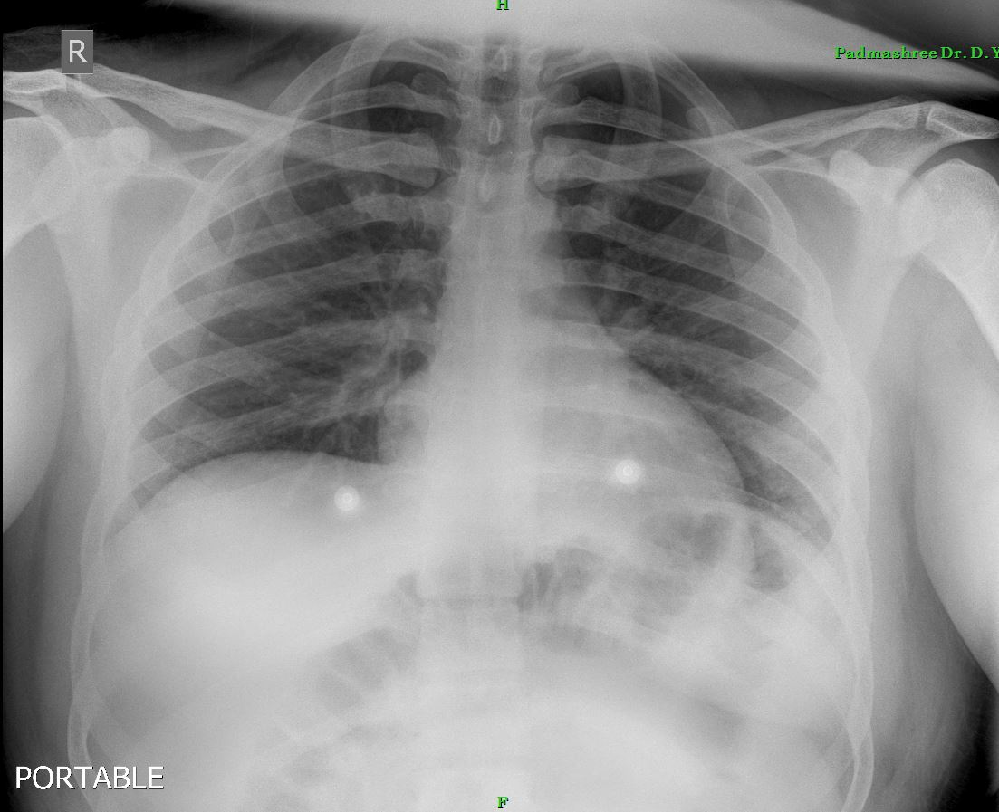
RADIOLOGICAL INVESTIGATIONS
CHEST X-RAY : Normal
ULTRASOUND (Abdomen+pelvis) :
- Splenomegaly (14cm)
Rest of the study was normal.
No e/o fluid collection.

Slide 9
TREATMENT (DAY 1)
He was treated with :
IV fluids
Inj. Ceftriaxone (1g) IV BD 4 days
Inj. Metronidazole (500mg) IV TDS 3 days
Inj. Ondensetron (4mg) IV TDS 6 days
Inj. Pantoprazole (40mg) IV OD 6 days
Tab. Paracetamol (500mg) TDS 4 days , then S.O.S

Slide 10
COURSE OF DISEASE
Patient continued to have persistent c/o :
Fever
Vomiting for 5-6 days
Loose stools
On the 8th day of illness, he developed rash on trunk, upper limb and lower limbs.
The rash increased over a period of next 3 days.

Slide 11
LAB INVESTIGATIONS
I_{x} DOA | DAY 2 | DAY 3 | DAY 4 | DAY 5 | DAY 6
HB (g%) | 15.5 | 16.4 | 16.8 | 16.0 | 15.7
TLC (cumm) | <2000 | 1600 | 2000 | 2600 | 3300
DLC (%) N/L/E/M | 79/14/1/6 | 62/26/6/6 | 60/30/4/6 | 54/30/6/10 | 51/29/8/12
Plt.Count (lakhs/mm³) | 1.50 | 1.20 | 60,000 | 38,000 | 80,000
HCT (%) |  |  |  | 49.5 | 45.1
Urea/Creatinine(mg/dl) |  |  |  | 14/0.96 | 12/0.7
TB / DB (mg/dl) |  |  | 0.67/0.37 | 0.53/0.18 | 0.42/0.18
SGPT / SGOT (IU/L) |  |  | 571/1100 | 454/710 | 224/171
Na⁺ / K⁺ (mmol/L) |  |  |  | 131/4.4 | 132/4.5
TP/Albumin (g/dl) |  |  |  | 6.91/3.83 | 6.19/3.51
PT / INR / aPTt |  |  |  | 13.2/1.0/ - | 14.6/1.1/29.2
CRP |  |  |  |  | Negative

Slide 12
IgM (23/10/2018) [ELISA} : Positive (3.98)
Serum Ferritin level : 7035 ng/ml [NR = 30-400ng/ml]
Fibrinogen : 372.0 mg/dl [NR = 200-400mg/dl]
LDH : 878
Cholesterol / TG : 116 / 346 mg/dl
HDL / LDL : 15.3 / 65 mg/dl

Slide 13
Weil-Felix test
OX19 : 1:640
OX2 : 1:80
OXK : Negative
Total CD25 : 12.0% (Negative)
[Done by flow cytometry]

Slide 14
TREATMENT
In view of continuous fever and development of fresh rashes
Inj. Dexamethasone 8mg iv TDS
Tab.Hydroxyzine 25mg BD , were added.

Slide 15
After a total period of 7-8 days, the patient showed improvement.
Hb | 15.4 g%
TLC | 9600 /cumm
DLC | 86/11/03/10
Platelet count | 1.80 lakhs/cumm
HCT | 44.8 %
Urea / Creat | 17 / 0.77 mg/dl
TB / DB | 0.35 / 0.15 mg/dl
SGPT / SGOT | 143 / 47 IU/L
Serum Ferritin | 654.3 ng/ml
Platelet count by finger prick | 1.70 lakhs/cumm

Slide 16
FINAL DIAGNOSIS : DENGUE FEVER WITH HAEMOPHAGOCYTIC LYMPHOHISTIOCYTOSIS

Slide 17
Supportive criteria for HLH in this case
Fever
Splenomegaly
Bicytopenia
Hypertriglyceridemia
Increased Ferritin levels
Elevated Transaminases
Elevated LDH

Slide 18
HAEMOPHAGOCYTIC LYMPHOHISTIOCYTOSIS
Haemophagocytic lymphohistiocytosis is a fatal hyperinflammatory condition.It may arise secondary to infectious, rheumatologic, malignant, or metabolic conditions.
It is helpful to think of HLH as the severe end of the spectrum of hyperinflammatory disorders when the immune system starts to damage host tissue.
Hence,no single clinical feature is diagnostic for HLH, and entire clinical presentation should be considered in making the diagnosis.

Slide 19
DIAGNOSTIC CRITERIA FOR HAEMOPHAGOCYTIC LYMPHOHISTIOCYTOSIS (As Per American Society of Haematology)
The diagnosis of HLH can be established if one of either 1 0r 2 is fulfilled :
1.A molecular diagnosis consistent with HLH is made.
2.Diagnostic criteria for HLH are fulfilled(5 out of 8 criteria below):
Fever
Spleenomegaly
Cytopenias (Affecting> or = 2-3 lineages in the peripheral blood)
Hypertriglyceridemia and or hypofibrinogenemia :
Fasting triglycerides>265mg/dl ; fibrinogen<1.5g/L

Slide 20
Haemophagocytosis in Bone marrow spleen or lymph nodes.
Low or absent NK-cell activity
Ferritin > 500ug/L
Soluble CD25 > 2400U/ml
Supportive criteria include neurologic symptoms,cerebrospinal fluid pleocytosis,
conjugated hyperbilirubinemia and transaminitis, hypoalbuminemia, hyponatermia ,
elevated LDH
Absence of hemophagocytosis in BM does not exclude a diagnosis of HLH.

Slide 21
TAKE HOME MESSAGE
If fever in case of dengue lasts for more than 5-6 days complication such as haemophagocytic lymphohistiocytosis should be suspected

Slide 22
REFERENCES
1. Janka G. Haemophagocytic lymphohistiocytosis: when the immune system runs amok. Klin padiatr. 2009;221:278-285
2. Gupta S, Weitzman S. Primary and secondary hemophagocytic.
3. Henter JI, Elinder G, Soder O, Ost A. Incidence in Sweden and clinical features of lymphohistiocytosis.

