Slide 1
Common presentation of a relatively Uncommon disease- An unusual case of Fever.
Dr. Shubham Malani.
Department of Medicine
Dr. D. Y. Patil Medical College.

Slide 2
A 24 year old male, student, came with c/o
Fever moderate to high grade since 1 month
Progressive breathlessness since 1 month which has worsened since 3 days
Generalized weakness and fatigability
There was no history of cough, chest pain, vomiting, bleeding manifestations or any other complaints .

Slide 3
PAST HISTORY :
Patient had history of similar episode of Anemia with jaundice and fever admitted twice in last year, details of which were unavailable.
PERSONAL HISTORY :
Appetite was reduced.
Sleep was reduced.
Vegetarian by diet.
Bladder & bowel were unaltered.
No addictions.

Slide 4
On Examination:
The patient was drowsy but oriented.
Severe pallor and icterus was present.
Febrile, Temperature – 103ºF
PR : 108/min
RR : 40 /min
BP : 110 / 70 mmhg
SPO2 was low. 76% on oxygen enriched room air.
JVP was raised upto the angle of jaw .
Clubbing grade II present.
Bilateral Pitting Pedal edema was present .

Slide 5
CNS : Drowsy but oriented. No focal neurological deficit. Plantars- Flexor.
RS : Tachypnoea with B/l basal crepitations were present.
P/A : Soft , Mild hepatosplenomegaly.
CVS : Tachycardia was present. No S3/S4/murmur.
Chest Xray showed bilateral fluffy shadows.
ECG suggestive of sinus tachycardia.
In view of above findings & as patient was unable to maintain saturation on oxygen ,he was intubated.

Slide 6
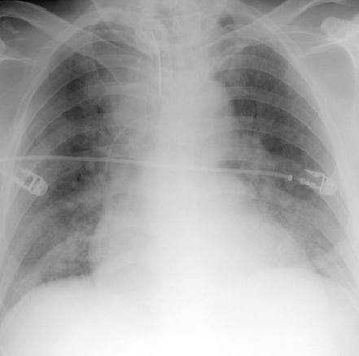
Chest Xray showing B/L Fluffy Shadows s/o Pulmonary edema.

Slide 7
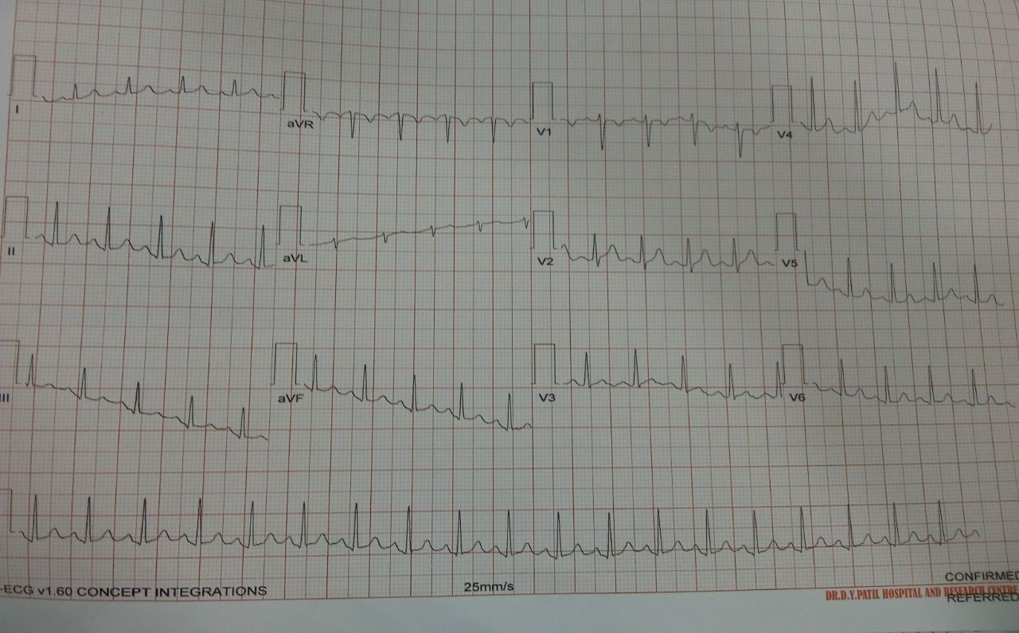
ECG showing Sinus Tachycardia.

Slide 8
Investigations
Hb | 2.2 gm% (13.3-16.2) | Urea | 55 (16-48)
TLC | 4700 | Creatinine | 0.84
PLT | 36000 (1.5L-4.5L) | Total bilirubin | 7.4 (0-1.4)
MCV | 115.5 (79-93.3) | Direct | 1.4
HCT | 6.7(38.8-46.4) | Indirect | 6.06 (0-0.9)
MCH | 37.93 | SGPT | 445 (0-40)
MCHC | 32.8 | SGOT | 729 (0-40)
LDH | 2838 (115-221) | Serum electrolytes | WNL
PBS showed Macrocytes, Microcytes, Hypochromasia.
Retic count- 1%
Urine examinations showed 20-30 RBCs/hpf.
Above investigations were suggestive of Acute hemolysis with Megaloblastic anemia.

Slide 9
WORKING DIAGNOSIS
In view of history and investigations our provisional diagnosis was-
Fever with Congestive cardiac failure with pulmonary oedema due to severe anemia and jaundice with differentials being –
Complicated Malaria.
Salmonellosis
Leptospirosis

Slide 10
Treatment (Day 1)
2 PCV were given immediately.
Inj . Furosemide 20 mg IV with BP monitoring was given.
Inj . Ceftriaxone 1 gm IV BD .
Inj . Artesunate 120 mg stat f/b 60 mg BD was started .
Tab . Paracetamol 500mg TDS.

Slide 11
Day 2-3
The patient improved post BT .
But the fever continued .
Patient was further evaluated .
Investigations :
PT-INR was raised(1.8) .
Rapid malaria test and PBS for malarial parasite was negative.
Dengue NS1,IgM, IgG (by elisa)was also negative.
Widal test & Leptospira was also negative.
Blood and urine cultures were awaited.

Slide 12
USG abdomen : Was suggestive of mild hepato-splenomegaly, mild ascites, mild pleural effusion.
With presentation of pallor, clubbing, splenomegaly and high grade fever- A possibility of Infective endocarditis was also thought of.
2D echo showed mild global hypokinesia and thin rim of pericardial effusion with EF of 60%.
Transesophageal & transthoracic echocardiography showed no vegetations
Fundoscopy – Roth’s spots, Flame shaped hemorrhages, Cotton wool spots, tortuous blood vessels suggestive of Septic systemic embolization due to Infective endocarditis.

Slide 13
Hematology reference was done :
Pancytopenia under evaluation
Adv - Direct and Indirect coombs test, ANA.
Further Investigations-
Sickling test – negative.
Direct and Indirect coombs test – negative.
ANA - negative.
Serum B12 - 97.9 pg/ml ( 191-663 pg/ml)
Folic acid - 1.4 ng/ml ( 4.6 – 34.8 ng/ml )
Further Treatment-
Inj. Hydroxycobalamin 1000 mcg OD for 6 days followed by once 3 monthly.
Tab Folic acid 5mg OD

Slide 14
The following day (Day 4-5)
Congestive cardiac failure and hematocrit was improving.
The consciousness and general condition of the patient was getting better.
Patient was weaned off the ventilator.
Further PCV and FFP was given .
Fever however continued ,thus evaluating further ….

Slide 15
OGDoscopy showed antral gastritis.
Bone marrow aspiration - Erythroid hyperplasia with dual maturation (Megaloblastic and micronormoblastic)
Urine culture showed no growth
Blood culture showed no growth
Bone marrow culture also was negative.

Slide 16
Despite of all the measures fever still continued and no cause was found.
Then on recording further history It was found that patient had history of consumption of unpasteurized raw milk and contact with cattle for more than 1 year.
Following which Brucella antibody was sent and IgM antibody was found to be strongly positive (1.35).
Brucellosis induced Acute Hemolysis with Vit. B12 and Folic acid deficiency with Infective Endocarditis.

Slide 17
Treatment
Tab. Rifampicin 600 mg OD for 6 weeks
Tab. Doxycycline 100mg BD for 6 weeks
Following this treatment Patient recovered and is now doing well and came for follow-up after 1 month with repeat antibody titre positive. He was advised to continue the same treatment . After 3 months his repeat Antibody titre is Negative.

Slide 18
Discussion.
Human brucellosis is a zoonosis usually associated with occupational or domestic exposure to infected animals or their products.
The incubation period varies from 1 week to 3 months.
According to a study 14% of patients with brucellosis can present with Pancytopenia.
Brucellosis induced acute hemolysis due to Vit. B12 and folic acid deficiency presents as Pancytopenia and is a rare presentation of Brucellosis.

Slide 19
Take home message.
As brucellosis is common in our country, and pancytopenia is a common presentation, it should be included in the differential diagnosis of all those clinical conditions presenting as Fever with Pancytopenia.

Slide 20
References
Brucellosis induced acute hemolytic anemia in a severe vitamin b12 deficient individual presenting as pancytopenia: a case report ;2018 ; Mathi Manoj Kumar R and Subramony H ; Department of General Medicine,Apollo Hospital, Chennai.
Hematological Findings in adult with brucellosis ; Aypak A, et al. Pediatr Int. 2015.

